Slide 1
Citizenship and Social Development
Theme 3: Interconnectedness and Interdependence of the Contemporary World
Topic: Public health and human health
Learning focus:
Individuals’ responsibilities in promoting public health (particularly in responding to infectious diseases)
Mar 2024
(Translated version)

Slide 2
Learning objectives
Knowledge
To learn the relationship between the individuals and public health, the legal and ethical responsibilities associated with it, and how to respond to infectious diseases
To learn the broad meaning of health
Skills
To analyse and judge the credibility of health information released by different media
To analyse the impact of different lifestyles on health and public health, and grasp the correct protective measures against infectious diseases based on credible and objective information
Values
To cultivate a scientific outlook on health, and be able to develop and practise a healthy lifestyle
To be willing to co-operate in the protection of public health and with government policies, and fulfill the sense of responsibility to fight the epidemic together

Slide 3
Lead-in
Public health
Do you know what “public health” is?
Watch the video below to get an initial understanding of the concept.
Click on the image to watch the video
Source: EDB Educational Multimedia - “Public Health”
(https://emm.edcity.hk/media/%E5%85%AC%E5%85%B1%E8%A1%9B%E7%94%9F+%28%E4%B8%AD%E6%96%87%E5%AD%97%E5%B9%95%E5%8F%AF%E4%BE%9B%E9%81%B8%E6%93%87%29/1_td5s9pq7)

Slide 4
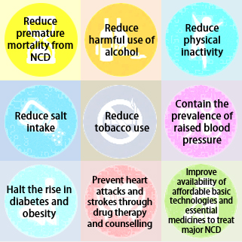
Lead-in
Public health
In May 2018, the HKSAR Government launched the Towards 2025: Strategy and Action Plan to Prevent and Control Non-communicable Diseases in Hong Kong, setting out nine targets and a series of measures to be achieved by 2025 to reduce the burden caused by non-communicable diseases (NCDs).
The Government provides the public with up-to-date information and prevention advice on infectious diseases, and produces publicity materials in multiple languages to educate the public how to prevent infectious diseases and develop a healthy lifestyle.
The Government implements health quarantine measures in accordance with the International Health Regulations and the Prevention and Control of Disease Ordinance to prevent the introduction into and the transmission from Hong Kong of any infectious diseases and other serious diseases. All control points are equipped with infrared thermal imaging cameras to monitor the temperature of inbound travellers.
Think about it
How are the health of citizens benefit from Government’s public hygiene policies and measures?
Click on the image
to learn more.
Source:
The Department of Health - Towards 2025: Strategy and Action Plan to Prevent and Control NCD in Hong Kong (https://www.change4health.gov.hk/en/saptowards2025/)

Slide 5
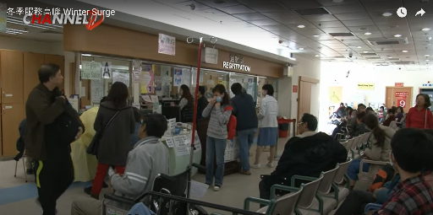
Public health
The relationship between individuals and public health are very close and the two reinforce each other.
The public health system guarantees the health of individuals. A sound public health system, sufficient public health resources and high-quality public health services can provide a strong guarantee for safeguarding personal and public health, thereby improving citizens’ quality of life, improving productivity and promoting the long-term social development.
Individual participation and support are essential to safeguarding public health. Citizens have the responsibility to maintain personal health, keep public places clean and prevent the spread of diseases so as to reduce the pressure on public health and maintain public health security.
Click on the image
to watch the video
Affected by the continuous cold weather and peak season of influenza, there has been an increase in demand for visits to hospitals and admissions to the Accident & Emergency Department of the Hospital Authority.
Source: The Hospital Authority - Winter Service Surge
(https://www.youtube.com/watch?v=-kH_jsc7eIA)

Slide 6
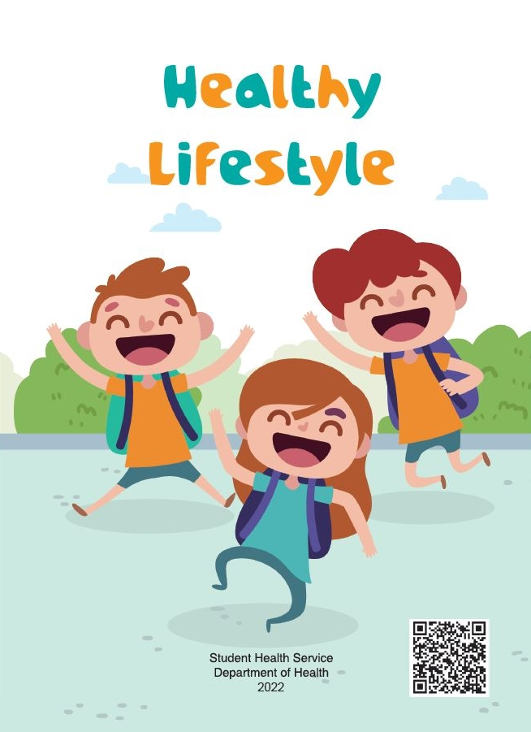
What is “staying healthy”? On what basis can we assess health?
Individuals’ responsibilities in promoting public health
Maintaining a healthy lifestyle
Good health is precious, and sought by all. It is everyone's responsibility to maintain a healthy lifestyle, reduce the causes of diseases, promote personal health, and maintain public health.
Think about it
A body without disease is healthy.
What modern society calls health is wellness.
Click on the image to learn more.
The concept of health is constantly evolving, and people of different times and cultural backgrounds have different views on “physical health” and “what is the state of healthy”. Nowadays, health has multiple definitions, involving different dimensions.
Source: Student Health Service of the Department of Health - “Healthy lifestyle” (https://www.studenthealth.gov.hk/english/resources/resources_bl/files/bl_hea_lif_sty.pdf)

Slide 7
Broad meaning of health
Reference
The World Health Organization (WHO) states that health is a state of complete physical, mental and social well-being, and not merely the absence of disease or infirmity.
Source: WHO - the Constitution of the World Health Organization
(https://www.who.int/about/accountability/governance/constitution)
The WHO views health as a holistic concept, believing that each person's different aspects of health are interdependent, that is, “holistic health”. It includes the following four dimensions:
Physical health – refers to the physical functioning of the human body, which is relatively easy to measure.
Intellectual health – refers to the ability to memorize, reason, analyze and make rational decisions. It also influences an individual's mental state.
Emotional health – refers to the ability to recognize and express emotions properly, including joy, anger, grief, fear and frustration; it also refers to the ability to cope with the stress, worries and depression in daily life.
Social health – refers to the ability to establish and maintain good relationships with others, to actively care for and respect others, to show a sense of belonging to the community and society where you belong, and to communicate effectively with others.

Slide 8
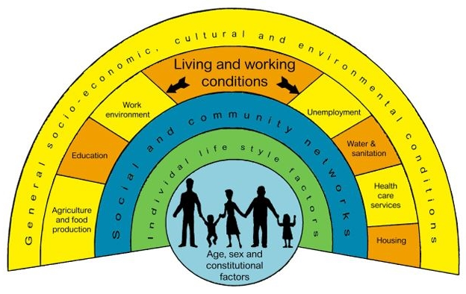
Factors affecting health
Reference
Factors affecting health mainly include lifestyle, genetics, social, economic, cultural, environmental conditions, etc.
Age, sex and genetic factors: These inborn factors plays a part in determining lifespan and likelihood of developing certain illness.
Individual lifestyle factors: These includes diet, physical exercise, smoking, drinking, sexual behavior, etc. Individuals may have more control over these factors by making choice to adopt a healthy lifestyle practice that enhance health.
Social and community networks: Greater support from families, friends and communities are linked with better health. The caring and respect occur in such social relationship help people to cope with challenges and act as a buffer against health problems.
General socio-economic, cultural and environmental conditions: These factors are multiple and interactive. Integrated and multi-level of public health interventions are crucial to shape these factors for a positive health impact.
The main determinants of health
Source:
The Department of Health - Preface of the Action Plan to Promote Healthy Diet and Physical Activity Participation in Hong Kong
https://www.change4health.gov.hk/filemanager/common/image/strategic_framework/action_plan/action_plan_e.pdf
https://www.chp.gov.hk/files/pdf/hcp_health_determinants_en.pdf

Slide 9
Individuals’ responsibilities in promoting public health
Adopting a healthy lifestyle
A healthy lifestyle refers to the adoption of healthy habits, which mainly include practising healthy eating and regular physical activities, maintaining personal hygiene, regular daily routines and mental health, and refusing tobacco, alcohol and substance abuse. Practising healthy lifestyles and behaviours can reduce the risk of catching diseases, improve the quality of life, and achieve physical and mental health. An unhealthy lifestyle not only can harm personal health, but also affect family happiness and society as a whole.
Health literacy refers, broadly, to the ability of individuals to “gain access to, understand and use information in ways which promote and maintain good health.
Source:
Student Health Service of the Department of Health - “Healthy Lifestyle”
https://www.studenthealth.gov.hk/english/health/health_hl/health_hl_ahl.html
WHO- Health Promotion
https://www.who.int/teams/health-promotion/enhanced-wellbeing/ninth-global-conference/health-literacy
Click on the image to watch the video
Source: The Department of Health - “Healthy Living Starts with You” (https://www.youtube.com/watch?v=KQwxNCyeV9U)

Slide 10
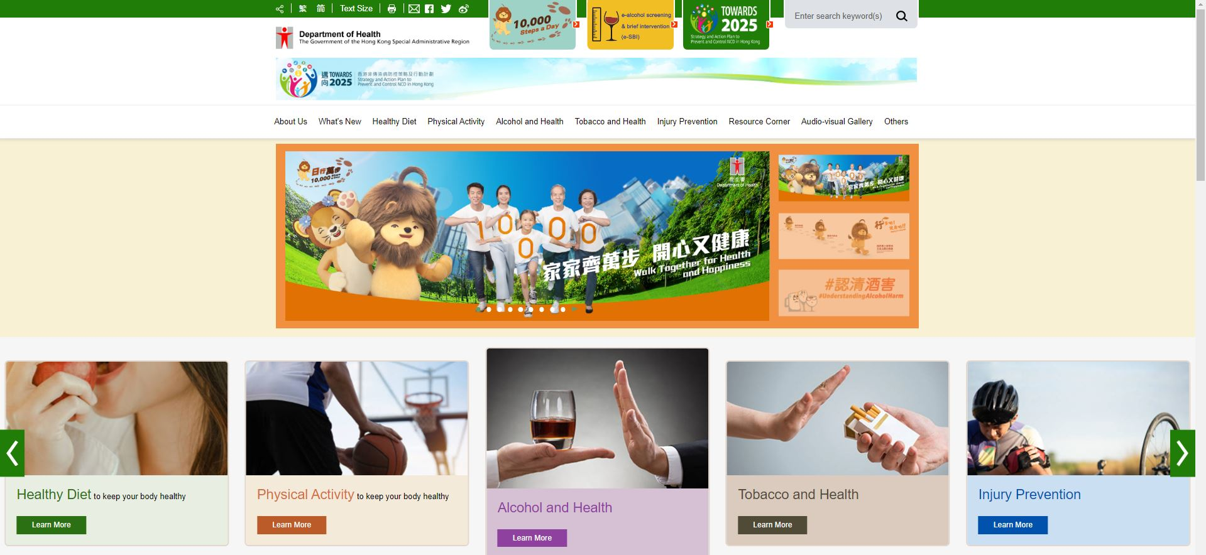
Individuals’ responsibilities in promoting public health
Reference
The Department of Health’s “Change for Health” website
The Department of Health launched the “Change for Health” website to disseminate the latest information on NCD prevention and control actions to the public and to provide appropriate knowledge and skills to help the public adopt and practise healthy lifestyle.
We can refer to the professional health advice provided by the Department of Health to reflect on our lifestyle and practise healthy living.
Click on the image to learn more.
Source: The Department of Health’s “Change for Health” website (https://www.change4health.gov.hk/en/index.html)

Slide 11
Individuals’ responsibilities in promoting public health
Healthy Eating
Healthy eating refers to the maintenance of a reasonable dietary and nutrient structure. Each kind of food provides various nutrients and should be eaten according to the proportion indicated in the “Healthy Eating Food Pyramid”; drink 6 to 8 glasses of fluids (including water and clear soup) daily to promote physical health.
Activity
Do you know the nutrients contained in the food you eat every day? Try the “Food Nutrition Finder” to understand the nutrient content of different foods.
Source:
Student Health Service of the Department of Health - “Health Information” (https://www.studenthealth.gov.hk/english/health/health_dn/health_dn_eat_hea.html)
The Centre for Food Safety - “Nutrient Information Inquiry” (https://www.cfs.gov.hk/english/nutrient/searchmenu.php)
Click on the image to learn more.

Slide 12
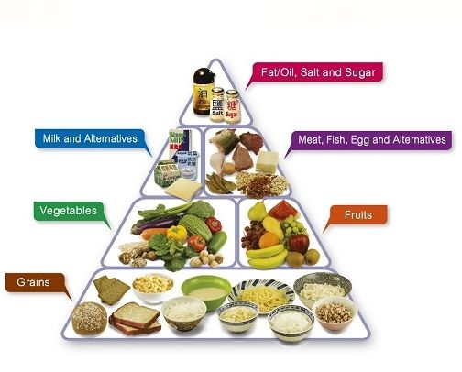
Individuals’ responsibilities in promoting public health
Healthy Eating
Check against the “Healthy Eating Food Pyramid”
Activity
Check against the “Healthy Eating Food Pyramid” and count the food intake of yourself and your family members by item yesterday.
Exchange your statistics and compare differences within your group, and discuss the relations between different food intake and health.
Source: Student Health Service of the Department of Health - “Health Information” (https://www.studenthealth.gov.hk/english/health/health_dn/health_dn_eat_hea.html)

Slide 13
Individuals’ responsibilities in promoting public health
Reference
The Department of Health’s “EatSmart Restaurant Star+” Campaign (ESR Star+ Campaign)
Since April 2008, the Department of Health has launched the “EatSmart@restaurant.hk” Campaign (ESR Campaign) whereby the public can easily savour “EatSmart Dishes”, including “More Fruit and Vegetables” dishes and “3 Less” dishes (dishes with less fat or oil, salt and sugar) when eating out.
In 2019, the Department of Health launched the ESR Star+Campaign as the enhanced version of the ESR Campaign. Under a new star-rating scheme, ESRs are classified into one-star, two-star or three-star.
Click on the image to learn more.
Source: The Department of Health’s “ESR Star+” Campaign
(https://restaurant.eatsmart.gov.hk/eng/home.aspx)

Slide 14
Individuals’ responsibilities in promoting public health
Regular physical activities
Regular physical activities mean doing regular and appropriate physical activities and sports on a persistent basis. Sports are an important element of healthy living and closely related to social, emotional, physical and mental development.
Strengthening your body immunity, reducing the chance of getting sick and enhancing work efficiency
Improving your cardiopulmonary functions and blood circulation
Burning calories to help you maintain a healthy body weight
Strengthening your muscles and reducing the risk of osteoporosis
Enhancing the mobility and flexibility of joints to lower the risk of injuries and falls
Benefits of exercise
Reducing the risk of developing cardiovascular disease, hypertension, stroke and diabetes mellitus, and preventing some types of cancer
Relieving stress, boosting confidence and improving mental health
Helping you broaden your social circle by participating more in group exercises
Source: GovHK - The Enjoyment of Sports and Sports Safety
(https://www.gov.hk/en/residents/culture/recreation/activities/benefitsport.htm)

Slide 15
Individuals’ responsibilities in promoting public health
Reference
The Education Bureau’s “Active Students, Active People” Campaign
To further engage students in developing an active and healthy lifestyle, the Education Bureau has launched the “Active Students, Active People” Campaign in the 2021/22 school year to rally the concerted efforts of schools, parents as well as other stakeholders to promote an optimised sports atmosphere in schools and in society, and encourage students to engage in regular exercise as soon as possible for the sake of maintaining good health, adopting an active and healthy lifestyle, and unleashing vitality with positive attitudes.
Click on the image to learn more
Source: The Education Bureau’s “Active Students, Active People” Campaign
(https://www.edb.gov.hk/en/curriculum-development/kla/pe/asap/index.html)

Slide 16
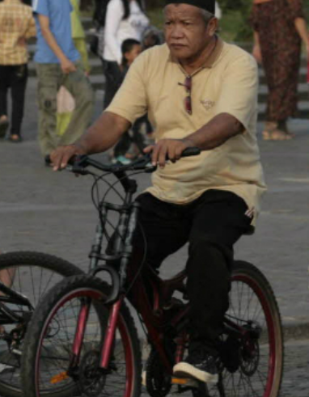
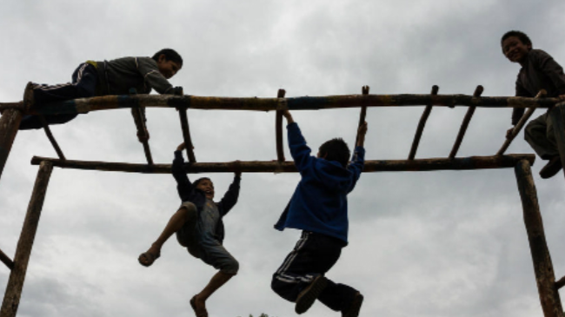
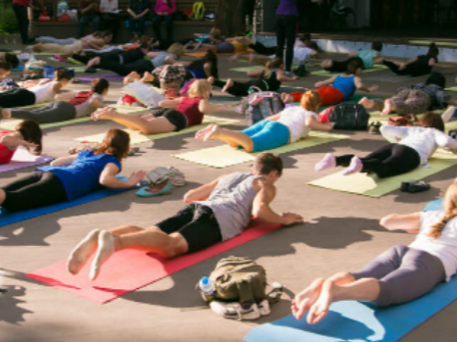
Individuals’ responsibilities in promoting public health
Reference
Ten facts about physical activity
The WHO points out that a lack of physical activity is a significant risk factor for NCDs such as stroke, diabetes, and cancer. Globally, 23% of adults and 81% school-going adolescents are not active enough. To promote health, individuals must increase physical activity, while countries and communities must also take action to provide individuals with more opportunities to be active.
Physical activity reduces the risk of disease
Regular physical activity helps to maintain a healthy body
Physical activity is not the same as sport
Moderate and vigorous physical activity bring benefits...
Click on the image to learn more about these ten facts.
Source: WHO - “ Physical Activity” (https://www.who.int/news-room/facts-in-pictures/detail/physical-activity)

Slide 17
Individuals’ responsibilities in promoting public health
Maintain reasonable daily routines
Reasonable daily routines mean upholding balanced daily routines; get enough sleep so as to cope with daily activities.
Click on the image to watch the video
Click on the image to watch the video
Different medical studies have shown that lack of sleep can cause obesity, decreased concentration, cardiovascular disease, etc.; yet surveys show that children or adults in Hong Kong sleep less than in other countries.
Good sleep is an important part of the fight against the epidemic. Psychologists share ways to sleep soundly.
Source: The Centre for Health Protection of the Department of Health - Health Talk on “Sleeping Well to Fight the Epidemic”
(https://www.youtube.com/watch?v=Hi56bga9B5A)
Source: The Radio Television Hong Kong (RTHK) - “Sleepless nights” (2016-07-17) (https://podcast.rthk.hk/podcast/item.php?pid=244&eid=76085&year=2016&display=all&lang=zh-CN)

Slide 18
Individuals’ responsibilities in promoting public health
Stay away from tobacco, alcohol and drugs (including cannabis)
Smoking, alcohol and drug abuse will not only cause a variety of diseases seriously damage one’s physical health, but also affect the health of others and social security, violate the law and ruin self prospects.
Harmful effects of smoking
Harm the respiratory tract
Cause lung cancer
Cause mental decline
Cause blood clots and strokes
Cause heart disease
Cause loss of appetite
Make gastrointestinal diseases worse
Cause oral cancer
Increase the risk of contracting cancer
...
Harmful effects of alcohol abuse
Increase fat
Affect vision
Cause osteoporosis
Damage skin
Cause liver cirrhosis
Affect digestion
Increase blood pressure
Affect muscles
Jeopardize society
...
Harmful effects of drug abuse
Contract diseases e.g. AIDS, Hepatitis B and Tetanus by sharing infected needles
Alter behaviour
Distort perception of and response to the environment, causing harm to oneself and to others
Adversely affect liver, lung, kidney and heart health
Acute intoxication and death
Problems appear in interpersonal relationships and one can lose friends and even family
School and work performance may deteriorate
Lead to poor appetite and weight loss
Become addicted
Since a lot of money is needed to buy drugs, one may commit crimes, be imprisoned and destroy his/her future
Source of data in the right column: Student Health Service of the Department of Health - “Understanding Drug Abuse” (https://www.studenthealth.gov.hk/english/health/health_sdsa/health_sdsa_usa.html)

Slide 19
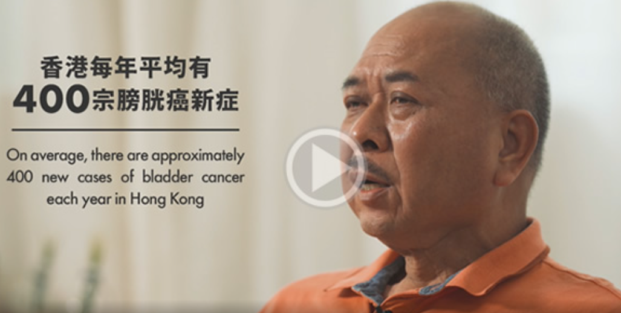
Individuals’ responsibilities in promoting public health
Reference
Stay away from tobacco, alcohol and drugs (including cannabis)
Click on the image to watch the video
Click on the image to watch the video
Click on the image to watch the video
The harm of drug abuse to the body, mind and family; Alcohol is also harmful to the human body.
Mr. Cheung started smoking in his teens, was diagnosed with bladder cancer at the age of 60 and had to undergo total cystectomy. Mr. Cheung will share his experience of and thinking on contracting the disease and quitting smoking in the short video.
Rehabilitees share the harmful effects of drug abuse; don't try it.
Source: Educational MultiMedia - “Stay away from drugs and alcohol” (https://emm.edcity.hk/media/%E9%81%A0%E9%9B%A2%E8%97%A5%E7%89%A9%E8%88%87%E9%85%92%E7%B2%BE/0_5j01kidu)
Source: Narcotics Division of the Security Bureau - “Anti-drug Community Awareness Building Programme of Wong Tai Sin District - Rehabilitee sharing“
(https://www.youtube.com/watch?v=9voosI5-jVg)
Source: Tobacco and Alcohol Control Office of the Department of Health - “Ex-smokers’ Testimonials 2 - Bladder Cancer and Smoking”
(https://www.livetobaccofree.hk/en/ex-smokers/bladder_cancer.html)

Slide 20
Individuals’ responsibilities in promoting public health
Reference
Stay away from tobacco, alcohol and drugs (including cannabis)
Both electronic and heated tobacco products are bad for health. The Smoking (Public Health) (Amendment) Ordinance 2021 came into effect on April 30, 2022, which prohibits the import, promotion, manufacture, sale or possession for commercial purposes of alternative smoking products, including electronic cigarettes, heated tobacco products and herbal cigarettes.
Click on the image to watch the video
Source: Tobacco and Alcohol Control Office of the Department of Health - Smoking (Public Health) (Amendment) Ordinance 2021 (https://www.taco.gov.hk/t/english/whatsnew/amendment_order_2021.html)
Source: The Hong Kong Council on Smoking and Health - “Feature Story: Alternative smoking products – The tobacco industry's latest scam” (https://www.youtube.com/watch?v=qfAH2OhJWiI)

Slide 21
Individuals’ responsibilities in promoting public health
Mental health
The WHO defines mental health as a state of mental well-being in which an individual realises his or her own abilities, can cope with the normal stresses of life, can work productively, and is able to make a contribution to their communities. Mental health is fundamental to maintaining personal health as well as the functioning of the communities. There is no health without mental health.
With an increasingly fast pace of life, the mounting pressure people face in study, work and life has resulted in a rise in bad moods and psychological problems, as well as in the prevalence rate of mental illnesses. So, we should pay more attention to mental health, and actively take preventive measures for early identification, timely intervention and treatment.
Source: The Advisory Committee on Mental Health - The “Shall We Talk” Initiative Background (https://www.shallwetalk.hk/en/about/background/)
“Shall We Talk” is a mental health promotion and public education initiative launched by the Advisory Committee on Mental Health since July 2020. It aimed to raise the public awareness of mental well-being.
Click on the image to watch the video
Source: The Advisory Committee on Mental Health - Appeal video for “Shall We Talk”
(https://www.shallwetalk.hk/en/resources/videos/)

Slide 22
Individuals’ responsibilities in promoting public health
Activity
Mental health
Mental health tips
Sharing
Express your gratitude or praise others
Be kind and helpful
Meet up with friends
Voice out to gain support from others
5. Get along and communicate with your family members
Mind
Be hopeful
Pay attention to yourself
Believe in yourself
Set goals in life
Be grateful
Enjoyment
Discover and develop your interests
Take notice of your surroundings
Enjoy your private space and time
Engage in physical activities
Engage in activities that can maximise your potential
Source: The Advisory Committee on Mental Health - “Shall We Talk” - Mental Well-Being > Joyful Life > Adolescents
(https://www.shallwetalk.hk/en/mental-well-being/adolescents/)
Click on the image to take a quick test to measure your level of psychological distress
Source: The Advisory Committee on Mental Health - “Shall We Talk” - Kessler Psychological Distress Scale (K10)
(https://www.shallwetalk.hk/en/mental-health-information/psychological-distress-test/)

Slide 23
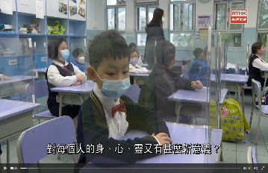
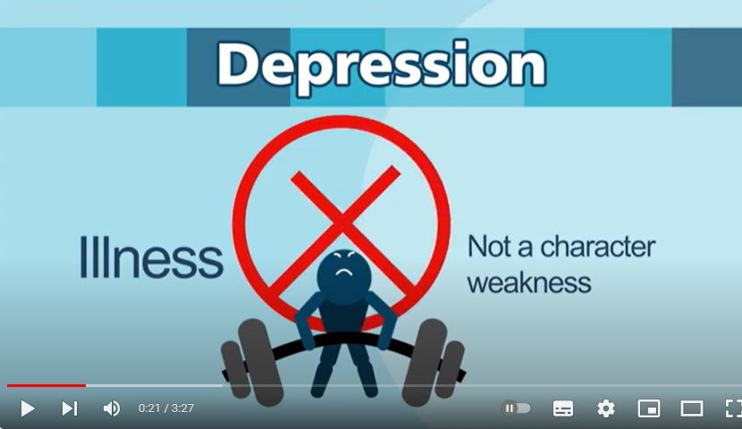
Individuals’ responsibilities in promoting public health
Mental health
Click on the image to watch the video
Click on the image to watch the video
Click on the image to watch the video
Community organisations, religious groups, primary and secondary schools have launched many mindfulness activities to help reduce stress and concentrate.
Rapid economic growth has quickened the pace of life at the expense of mental health. Faced with anxiety, depression, and even other more serious mental problems, more and more people are suffering from emotional problems.
Depression is a common mood disorder, and according to the Hong Kong Mental Morbidity Survey 2010-2013, about 3% of the local Chinese population aged 16 to 75 suffered from depression at that time.
Source: RTHK - “Hong Kong Connection – Mindfulness” (https://podcast.rthk.hk/podcast/item.php?pid=244&eid=197745&year=2022&lang=zh-CN)
Source: The Centre for Health Protection of the Department of Health - “Depression Matters - Let’s Stand Together” (https://www.youtube.com/watch?v=2q_WbHomd3g&t=69s)
Source: China Current - “The Human Stories Behind the Headlines” (https://chinacurrent.com/hk/story/20352/mental-health-china)

Slide 24
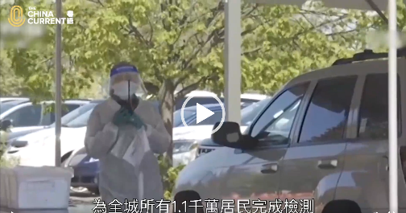
Fulfilling civic responsibilities and co-operating with
the government's policy to fight the epidemic together
Today's world is fraught with a wide variety of public health risks, as the development of communicable and noncommunicable diseases has become complicated. Responding to major public health crises will be a long-term challenge.
When an epidemic occurs, it requires the concerted efforts of the government, individuals and all sectors of society. Individuals should do their part, actively co-operate with government policies, abide by epidemic prevention laws, effectively take all-round protection measures, and fulfill their civic responsibility.
Click on the image to watch the video
Source: China Current - “11M People Just Got Tested In 5 Days” (https://chinacurrent.com/hk/story/20529/qingdao-to-test-11-million-in-five-days)

Slide 25
Fulfilling civic responsibilities and co-operating with
the government's policy to fight the epidemic together
Abiding by epidemic prevention laws
The International Health Regulations (2005) (the “IHR”) are an instrument of international law that is legally-binding on all WHO Member States, including the People's Republic of China, which extends to cover Hong Kong. The IHR define the roles of WHO and Member States in identifying and responding to public health incidents and sharing concerned information with each other, and require Member States to report to WHO on all public health emergencies of international concern, in particular smallpox, polio caused by wild strains, novel influenza and severe acute respiratory syndrome (SARS) and to undertake their own local examinations, so as to strengthen the capabilities of their public health surveillance and response systems to respond to public health emergencies of international concern, and to enable Member States' international airports, seaports and ground crossings to meet the requirements set out in the IHR.
For details of the Mainland and Hong Kong's co-operation with the WHO IHR, please refer to the PowerPoint slides for teaching on “Functions and roles of the World Health Organization in Global Public Health Matters”.
Source:
WHO - The International Health Regulations (2005): Page 1
(https://iris.who.int/bitstream/handle/10665/246107/9789241580496-eng.pdf?sequence=1)
The Department of Health (https://www.dh.gov.hk/textonly/english/useful/useful_Regulations/useful_Regulations.html)

Slide 26
Fulfilling civic responsibilities and co-operating with
the government's policy to fight the epidemic together
Reference
Abiding by epidemic prevention laws
The Prevention and Control of Disease Ordinance (Cap. 599) brings Hong Kong's legislation on disease prevention and control into line with the provisions of the IHR of WHO, which helps prevent the introduction into, the spread in and the transmission from, Hong Kong of any disease, source of disease or contamination, and plays a crucial role in strengthening the prevention and control of diseases in Hong Kong.
Source: The Prevention and Control of Disease Ordinance (Cap. 599) (https://www.elegislation.gov.hk/hk/cap599!en?INDEX_CS=N)
Activity
Think about it
In view of the COVID-19 epidemic, what regulations have been put in place pursuant to the Prevention and Control of Disease Ordinance (Cap. 599)?
Under what circumstances will a person commit an offence in respect of restrictions on group gathering?
Who can be exempted from or are not subject to the compulsory quarantine arrangement?
Click on the image to find the answer.
Source: Health Bureau- SFH's Blog (https://www.healthbureau.gov.hk/blog/en/2022/post_20220630.html)
Teachers are requested to pay attention to the latest update on epidemic prevention policies when teaching relevant topic.

Slide 27
Contravention of the compulsory quarantine order constitutes a criminal offence
Fulfilling civic responsibilities and co-operating with
the government's policy to fight the epidemic together
Reference
Contravention of the compulsory quarantine order constitutes a criminal offence punishable by a fine of up to HK$25,000 and imprisonment for six months. A spokesman for the Department of Health expressed that the sentence sends a very clear message to the public that contravening the quarantine order is a criminal offence that the Government will not tolerate, and solemnly remind the public to comply with the regulations.
As of January 3, 2022, a total of 212 persons had been convicted by the court for breaching the quarantine order and sentenced to immediate imprisonment for up to 14 weeks or a fine of up to HK$15,000. The spokesman reiterated that the Department of Health will take serious follow-up measures against any person who contravened the relevant regulations.
Source: HKSAR Government Press Release - “Man sentenced for breaching compulsory quarantine order”
(https://www.info.gov.hk/gia/general/202201/03/P2022010300447.htm)
Teachers are requested to pay attention to the latest update on epidemic prevention policies when teaching relevant topics.

Slide 28
Reference
Fulfilling civic responsibilities and co-operating with
the government's policy to fight the epidemic together
To ensure that the Government has is equipped with the core capabilities to prevent, detect, characterise and respond to the threat of novel infectious diseases in an efficient and coordinated manner, so as to reduce mortality or morbidity, the HKSAR Government promulgated the Preparedness and Response Plan of the HKSAR Government for Novel Infectious Disease of Public Health Significance (2020) in 2020. The Plan defines three response levels, which respectively represent the graded risk of novel infectious diseases affecting Hong Kong and its health impact on society, and sets out each response level as well as the corresponding command structure for each of them.
Emergency response level
The Emergency response level shows a high risk of serious human infections caused by the novel infectious agent in Hong Kong, and serious infections may be widespread.
Serious response level
The Serious response level indicates a situation when there is limited spread of the disease in local population e.g. sporadic or small cluster(s) of infection.
Alert response level
The Alert response level refers to a situation where the immediate health impact caused by the novel infection on local population is low but there is risk of potential spread locally through human to human transmission or through vector/animal once the disease is introduced to Hong Kong.
Response levels of the HKSAR Government
Teachers are requested to pay attention to the latest update on epidemic prevention policies when teaching relevant topics.
Source: The Preparedness and Response Plan of the HKSAR Government for Novel Infectious Disease of Public Health Significance (2020) - Pages 1, 3-5 (https://www.chp.gov.hk/files/pdf/govt_preparedness_and_response_plan_for_novel_infectious_disease_of_public_health_significance_eng.pdf)

Slide 29
Co-operation with epidemic prevention management
Fulfilling civic responsibilities and co-operating with
the government's policy to fight the epidemic together
Take COVID-19 for example, in order to control the epidemic, the HKSAR Government has adopted a prevention and control strategy “preventing the importation of cases and the spreading of the virus in the community”. On the one hand, the Government strictly implements epidemic control measures at various boundary control points, including testing and quarantine for inbound tourists, to suppress any opportunity for the virus to enter the community; on the other hand, the Government continues to implement various epidemic prevention and control measures in accordance with the principle of “early identification, early isolation and early treatment of the infected”, including monitoring and surveillance, targeted group testing, social distancing measures, etc., to prevent the spread of the virus in communities, all of which requires the support and co-operation of individuals and the general public.
Source: HKSAR Government Press Release - “LCQ3: Coping with the Coronavirus Disease” 2019 (https://www.info.gov.hk/gia/general/202011/11/P2020111100439.htm?fontSize=1)
Teachers are requested to pay attention to the latest update on epidemic prevention policies when teaching relevant topics.

Slide 30
Co-operation with epidemic prevention management
Fulfilling civic responsibilities and co-operating with
the government's policy to fight the epidemic together
How to co-operate with government’s policies and management
To grasp accurate information and try all means to get the facts. To collect epidemic prevention information from reliable sources such as government websites or professional groups, judge the actual risks, take appropriate preventive measures, and make sure not to spread, believe in or start rumors.
To comply with social distancing measures and effectively take personal protective measures. To adhere to wearing protective equipment, develop the habit of recording trips, comply with code scanning and registration requirements, and make sure not to touch or spread any virus.
To comply with tests and quarantines and obey quarantine management. To co-operate with professionals and follow stay-at-home and quarantine rules; seek prompt medical treatment and report your condition in time; achieve early identification, early quarantine and early treatment.
To comply with preventive measures and get vaccinated in a timely manner. To co-operate with the government's epidemic prevention strategy and measures, learn about the benefits and protective effects of vaccines on a scientific basis, understand the safety and effectiveness of vaccines, respond to the vaccination schemes implemented by the Government, and get vaccinated as soon as possible.

Slide 31
Fulfilling civic responsibilities and co-operating with
the government's policy to fight the epidemic together
How to co-operate with government’s policies and management (e.g. in responding to COVID-19)
Grasp accurate information and try all means to get the facts:
To collect epidemic prevention information from reliable sources such as government websites or professional groups, judge the actual risks, take appropriate preventive measures, and make sure not to spread, believe in or start rumors.
Q1: Where did you get information related to COVID-19?
Mobile messaging software (e.g. WhatsApp, WeChat)
Online communication tools (e.g. Facebook, Twitter)
Official websites (e.g. the website of WHO, news.gov.hk, the Centre for Health Protection)
Newspapers and magazines (both online and in print)
Online forums
Others
Q2: Have you ever forwarded any epidemic-related SMS to others?
Yes
No
Q3: What is the content of (epidemic-related) SMS you forwarded (take the latest forwarded SMS for example)?
Q4: Why did you forward this (epidemic-related) SMS?
Q5: Before forwarding this SMS, have you verified its source? If so, please introduce the verification method.
Q6: Why didn't you forward them?
Q7: Under what circumstances will you forward the received messages?

Slide 32
Check out COVID-19 information from reliable websites (examples)
Fulfilling civic responsibilities and co-operating with
the government's policy to fight the epidemic together
Reference
Co-operation with epidemic prevention management
WHO
(https://www.who.int/)
The Chinese Center for Disease Control and Prevention
(https://www.chinacdc.cn/)
HKSAR Government (COVID-19 dedicated website)
(https://www.coronavirus.gov.hk/eng/index.html)
Click on the image to learn more
During the epidemic, false information may circulate online, and citizens should make rational judgments.
Source: Centre for Health Protection
(https://www.chp.gov.hk/en/)
Click on the image to learn more

Slide 33
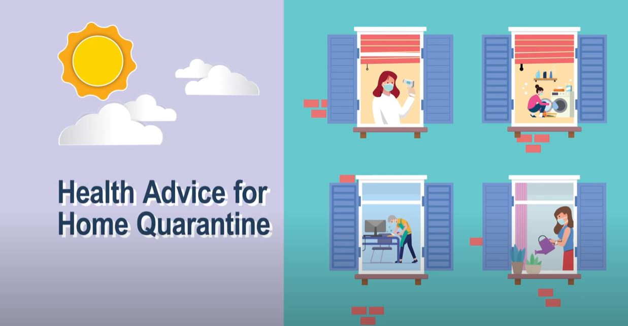
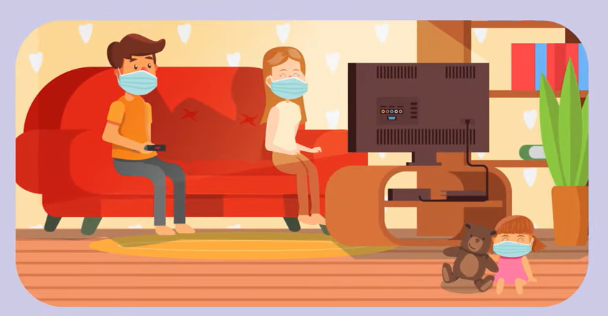
Fulfilling civic responsibilities and co-operating with
the government's policy to fight the epidemic together
Co-operation with epidemic prevention management
How to co-operate with government policies and management (e.g. in responding to COVID-19)
To comply with tests and quarantines and obey quarantine management. To co-operate with professionals and follow stay-at-home and quarantine rules. To seek prompt medical treatment and report your condition in time; achieve early identification, early quarantine and early treatment.
Click on the image to watch the video
Source: The Information Services Department - “Together, We Fight the Virus: Home quarantine health advice” (11.2.2022)
(https://www.youtube.com/watch?v=BOmX2dc7hI4)
Teachers are requested to pay attention to the latest update on epidemic prevention policies when teaching relevant topics.

Slide 34
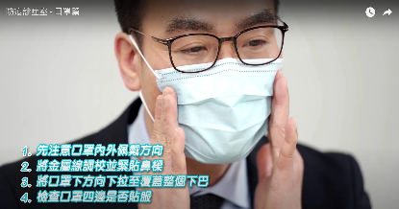
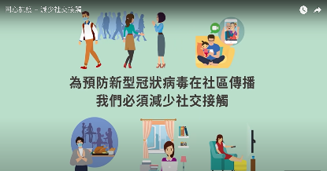
Fulfilling civic responsibilities and co-operating with
the government's policy to fight the epidemic together
Co-operation with epidemic prevention management
How to co-operate with government policies and management (e.g. in responding to COVID-19)
To comply with anti-epidemic measures and effectively take personal protective measures. To adhere to wearing protective equipment, and scan the QR code of venues using the “LeaveHomeSafe” mobile app.
Click on the image to watch the video
Click on the image to watch the video
Click on the image to watch the video
Source: The Centre for Health Protection of the Department of Health
- “LeaveHomeSafe” mobile app (https://www.youtube.com/watch?v=UAJW7-Ett_c&t=3s)
Source: The Centre for Health Protection of the Department of Health - “Epidemic Prevention Clinic - Surgical Mask” (https://www.youtube.com/watch?v=yobJIvRUzs4)
Source: The Centre for Health Protection of the Department of Health - “Together, We Fight the Virus - Reduce social contact” (https://www.youtube.com/watch?v=HZlLItWqLPQ)
Teachers are requested to pay attention to the latest update on epidemic prevention policies when teaching relevant topics.

Slide 35
Fulfilling civic responsibilities and co-operating with
the government's policy to fight the epidemic together
Co-operation with epidemic prevention management
How to co-operate with government policies and management (e.g. in responding to COVID-19)
To take effective personal protective measures
To avoid areas where the disease is endemic.
To reduce activities in public places with dense crowds and poor ventilation, such as shopping malls, transport stations, airports, docks, fitness rooms, etc.
To cover your mouth and nose when sneezing or coughing.
Do not spit; mouth and nose secretions should be wrapped properly and disposed of in covered bins.
To pay attention to nutrition and do regular exercise.
To maintain hygiene at home
To keep your home clean and open windows frequently for good ventilation.
Family members do not share towels, keep your furniture and tableware clean, and dry clothes and quilts frequently.
To take the initiative to effectively monitor the health of yourself and your family members, measure body temperature when you have a fever, and seek medical treatment in time.
To prepare common supplies, such as household thermometers, disposable masks, household disinfectants, etc.
Click on the image to watch the video
Source: The Centre for Health Protection of the Department of Health - “Clean Your Hands Prevent Infection”
(https://www.youtube.com/watch?v=-5Iq2k6O3AY)

Slide 36
Fulfilling civic responsibilities and co-operating with
the government's policy to fight the epidemic together
Co-operation with epidemic prevention management
How to co-operate with government policies and management (e.g. in responding to COVID-19)
To comply with preventive measures and get vaccinated in a timely manner. To comply with the government's epidemic prevention strategy and measures, learn about the benefits and protective effects of vaccines on a scientific basis, understand the safety and effectiveness of vaccines, respond to the vaccination schemes implemented by the Government, and get vaccinated as soon as possible.
Why should we get vaccinated?
Teachers are requested to pay attention to the latest update on epidemic prevention policies when teaching relevant topics.

Slide 37
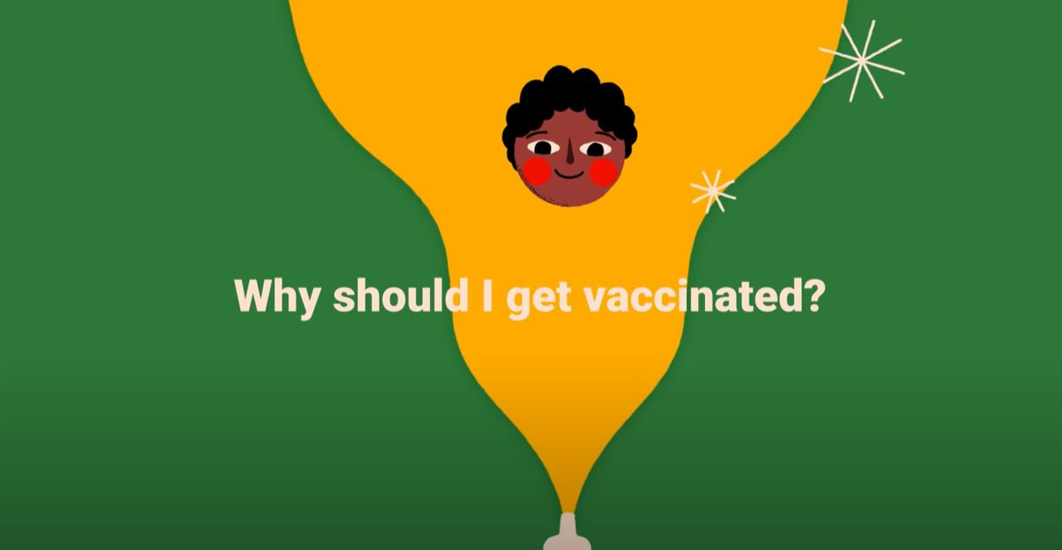
Fulfilling civic responsibilities and co-operating with
the government's policy to fight the epidemic together
Co-operation with epidemic prevention management
How to co-operate with government policies and management (e.g. in responding to COVID-19)
Vaccination reduces the chance of us contracting infectious diseases by producing antibodies in our body to fight the invasion of diseases. If the majority of people are vaccinated and become immune, the chance of infectious diseases spreading in the community can be reduced, and the health and life of individuals and the whole community can be protected. Vaccines are available against at least 20 diseases, including diphtheria, tetanus, pertussis, influenza and measles.
Source:
The Department of Health (https://www.fhb.gov.hk/pho/files/child_care_tips_booklet.pdf)
The Food and Health Bureau (https://www.healthbureau.gov.hk/blog/en/2020/post_20201220.html)
Teachers are requested to pay attention to the latest update on epidemic prevention policies when teaching relevant topics.
Click on the image to watch the video
Click on the image to learn more.
Source: WHO - “Why should I get vaccinated?”
https://www.youtube.com/watch?v=9nadnOxvE74
Source: The Centre for Health Protection of the Department of Health (Vaccination Schemes)
(https://www.chp.gov.hk/en/features/17980.html)

Slide 38
Fulfilling civic responsibilities and co-operating with
the government's policy to fight the epidemic together
Co-operation with epidemic prevention management
How to co-operate with government policies and management (e.g. in responding to COVID-19)
Activity
Please visit the COVID-19 dedicated website to search for some promotional videos of the Government appealing to citizens to co-operate with epidemic prevention measures and health advice, and share them with your classmates.
Click on the image to learn more
Teachers are requested to pay attention to the latest update on epidemic prevention policies when teaching relevant topics.
Source: HKSAR Government - COVID-19 dedicated website
(https://www.coronavirus.gov.hk/eng/index.html#Health_Tips)

Slide 39
Fulfilling civic responsibilities and co-operating with
the government's policy to fight the epidemic together
Reference
Co-operation with epidemic prevention management
Don't hesitate! Get vaccinated
Vaccination is part of an overall public health policy in response to COVID-19. Vaccination accompanied by non-pharmacological interventions, such as social distancing, good hand hygiene, and wearing masks in public places, provides the best protection against the virus.
Source: The Centre for Health Protection of the Department of Health - Health Topics: Coronavirus Disease 2019 (COVID-19) (https://www.chp.gov.hk/en/healthtopics/content/24/102466.html)
Teachers are requested to pay attention to the latest update on epidemic prevention policies when teaching relevant topics.
Click on the image to learn more
Source: The Centre for Health Protection of the Department of Health (COVID-2019 vaccination programme)
(https://www.chp.gov.hk/en/features/106934.html)

Slide 40
Conclusion
Maintaining public health is both the responsibility of the government and society, as well as the responsibility of individuals, and requires the joint co-operation of the government, public and private institutions, communities, families and individuals.
We should enhance health literacy, maintain healthy lifestyle, promote physical and mental health, actively respond to infectious diseases, co-operate with government policies and actions, protect ourselves and others, and assume personal responsibility for maintaining public health.

Slide 41
Websites for extended references
The Centre for Health Protection of the Department of Health Resources (https://www.chp.gov.hk/en/index.html)
Student Health Service of the Department of Health - Student Zone (https://www.studenthealth.gov.hk/english/hot_topics/student_zone.html)
The Advisory Committee on Mental Health - The “Shall We Talk” Initiative (https://www.shallwetalk.hk/en/)
The Tobacco and Alcohol Control Office of the Department of Health (https://www.taco.gov.hk/main/english/index.html)
The Education Bureau's “Active Students, Active People” Campaign - Learning and Teaching Resources (https://www.edb.gov.hk/en/curriculum-development/kla/pe/asap/index.html)
RTHK - “Hong Kong Connection - Children have put on some weight” (2021-11-21) (https://podcast.rthk.hk/podcast/item.php?pid=244&eid=191315&year=2021&lang=zh-CN)

Slide 42
User Guide
The primary users of this resource are teachers. It aims to provide teachers with content knowledge relevant to the topic to enable teachers to have a deeper understanding of teaching content when preparing for their lessons.
All data, videos, photos, pictures, questions and suggested answers can be used for multiple purposes, such as teachers’ teaching materials, references for curriculum planning and learning and teaching, and student assignments, etc. To align with Citizenship and Social Development Curriculum and Assessment Guide (Secondary 4-6) (2021) (C&A Guide), this resource should be adapted to cater for students’ learning diversity and the needs of classroom teaching, etc.
Teachers may provide appropriate supplementary notes/ explanations to enrich this resource in order to enhance students’ understanding of the topic and information provided.
In accordance with the curriculum rationale and aims, teachers may select other learning and teaching resources which are correct, reliable, objective and impartial to help students build up a solid knowledge base, develop positive values and attitudes as well as enhance critical thinking and problem solving skills, and various generic skills.
If some information cannot be provided in this resource due to copyright issue, teachers may visit relevant websites provided.
Some information may have been updated when being used by teachers, teachers may visit the corresponding websites to obtain the up-to-date information.
Please also refer to the C&A Guide to understand the requirements and arrangements of the learning and teaching of the curriculum. Teachers are welcome to point out the areas need improvement, and welcome to provide updated information to enrich the content for all teachers’ reference.

Slide 43
Notice and Disclaimer
Some sources were not translated into English as the official English version is not available.
In case of any discrepancy between the Chinese and English versions, the Chinese version shall prevail.

