Slide 1
Citizenship and Social Development:
Theme 2: Our Country since Reform and Opening-up
Topic: Change in people’s life and overall national strength
Learning focus:
Changes and enhancement of people’s quality of life (income, mode of consumption, educational level, standard of medical care, life expectancy, poverty eradication, etc.)
Translated version
May 2022

Slide 2
Learning objectives
Knowledge
To understand the change and improvement of people's quality of life in terms of income, poverty eradication, consumption patterns, educational level, standard of medical care and life expectancy per capita since the reform and opening-up.
Skills
Based on objective evidence, analyse in the context of the country the impacts of objective conditions, such as its vast area on the development to the country from multiple perspectives so as to enhance critical thinking skills.
Values
To care about the nation’s development, challenges and opportunities with an objective and unbiased attitude and empathy.
To recognise national identity and foster pride in being a Chinese citizen. To enhance the sense of responsibility and commitment to serving the country and society.

Slide 3
Watch video for
lesson preparation
Looking at China with Big Data: Forty Years in One Minute
Click on the image to watch the video
Source: Xinhua Net. (http://big5.xinhuanet.com/gate/big5/www.xinhuanet.com/video/sjxw/2018-12/11/c_1210013223.htm)

Slide 4
Increase in income
Gross domestic product (GDP) refers to the total value of production activities of all resident units in a country within a certain period of time. Over the past 40 years of reform and opening-up, the GDP of China has increased from RMB 367.87 billion in 1978 to RMB 101,598.62 billion in 2020, laying the foundation for improving the people’s living standard.
Economic growth is the basis for the rise in people’s income. Regarding per capita GDP, it increased substantially from RMB 385 in 1978 to RMB 72,000 in 2020.
Source: National Bureau of Statistics. China Statistical Yearbook 2021, Chapter 3, Section 1: Gross National Product. http://www.stats.gov.cn/tjsj/ndsj/2021/indexch.htm

Slide 5
Changes in disposable income
With the rapid increase in the income of China’s urban and rural residents, the standard of living has been continuously improving. In 1978, the national per capita disposable income was RMB 171. In 2020, it reached RMB 32,189.
Source: National Bureau of Statistics. China Statistical Yearbook 2021, Chapter 6, Section 16: Per capita disposable income and index. (http://www.stats.gov.cn/tjsj/ndsj/2021/indexch.htm)
Note: Per capita disposable income refers to "the sum of residents' final consumption expenditure and savings, that is, residents' discretionary income. It includes both cash income and income in kind. According to the source of income, disposable income includes four categories: wage, net operating income, net property income and net transferable income.”.
Source: National Bureau of Statistics. China Statistical Yearbook 2021, Chapter 6: Explanation of main statistical indicators (http://www.stats.gov.cn/tjsj/ndsj/2021/indexch.htm)

Slide 6
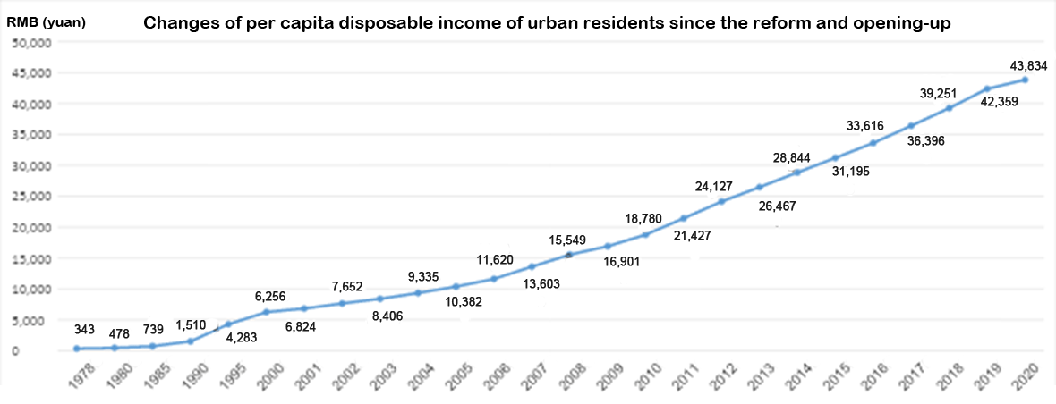
Growth in urban disposable income
From 1978 to 2020, the per capita disposable income of urban residents alone rose from RMB 343 to RMB 43,834. There was an increase of about 128 times.
Source: National Bureau of Statistics. China Statistical Yearbook 2021, Chapter 6, Section 16: Per capita disposable income and index. (http://www.stats.gov.cn/tjsj/ndsj/2021/indexch.htm)

Slide 7
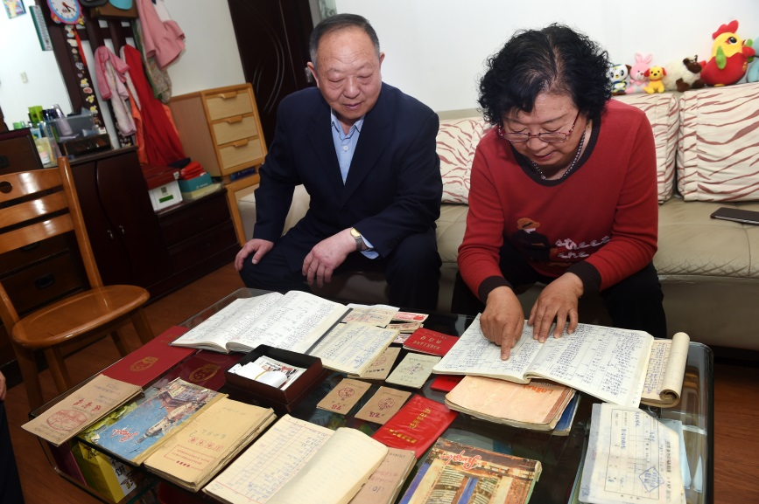
Reference
Sign of the Times - 40 Years of a Qingdao Family’s Accounts
Reference
In 1978, the monthly salary of Ma Lianfa and his wife Wang Lulong was RMB 36 and RMB 32 respectively. After spending on basic living expenses and giving both sets of parents RMB 5 each, there was not much left.
In 1983, they spent RMB 194.9 on a bicycle, which was the first pricey item they purchased. It took them five years to save enough money for that. From 1978 to 1989, they purchased only a handful of pricey items: two bicycles, a sewing machine, a recorder, an accordion, a watch, a clock and a refrigerator.
After paying RMB 3,999 for the refrigerator in 1989, the family bought more high-end consumer goods. For example, in 1995, they spent RMB 2,400 installing a telephone. Then they spent RMB 1,800 on a leather jacket in 1997, RMB530,000 on a new house in 2007, RMB 80,000 on their first car in 2010, and RMB 33,600 on a piano in 2011. In 2018, they “upgraded” their car to one that cost RMB 230,000.
In 2018, Ma Lianfa's monthly pension was as much as RMB 6,649 and Wang Lulong's also reached RMB 2,956.
Ma Lianfa and his wife have been keeping household accounts since 1978, more than 40 years. The financial books recorded the drastic changes in their family’s life, which reflects the changes in the lives of people since the reform and opening-up.
Source: Xinhua Net
(http://www.xinhuanet.com/politics/2018-04/20/c_1122712749.htm)

Slide 8
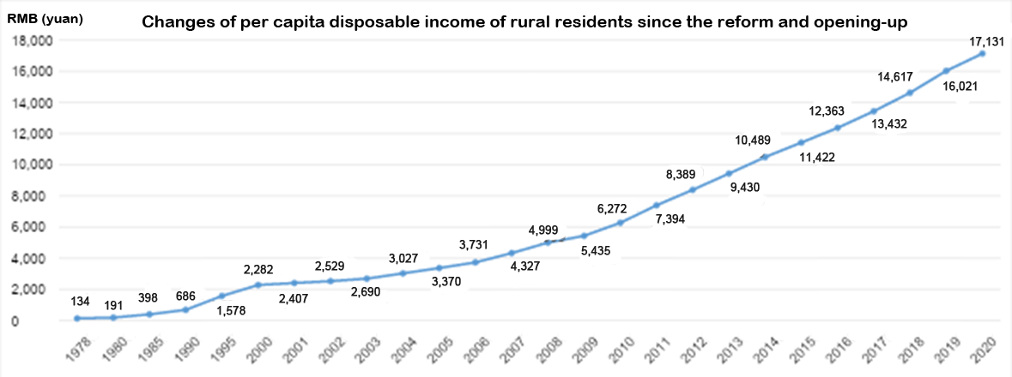
Growth in per capita disposable income of rural residents
In 1978, the per capita disposable income of rural residents alone was RMB 134. By 2020 it increased to RMB 17,131, which increased for about 128 times.
Source: National Bureau of Statistics. China Statistical Yearbook 2021, Chapter 6, Section 16: Per capita rural disposable income and index. (http://www.stats.gov.cn/tjsj/ndsj/2021/indexch.htm)

Slide 9
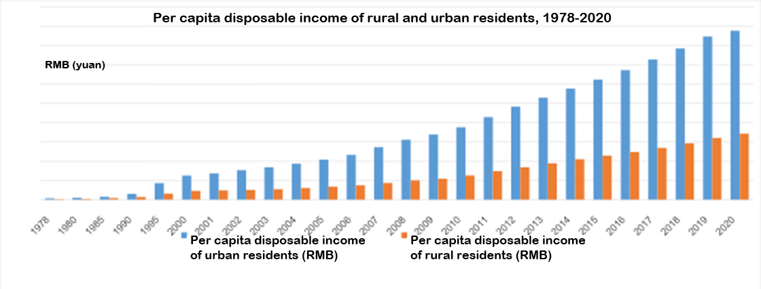
Question
The gap between per capita disposable incomes
in rural and urban areas
Question: Why can't we draw the conclusion that urban life is better by comparing the urban and rural per capita disposable income?
Suggested Answer: Different factors in the living conditions, such as prices and consumption patterns, infrastructure and services of rural and urban areas, should be considered together.
Source: National Bureau of Statistics. China Statistical Yearbook 2021, Chapter 6, Section 16. (http://www.stats.gov.cn/tjsj/ndsj/2021/indexch.htm)

Slide 10
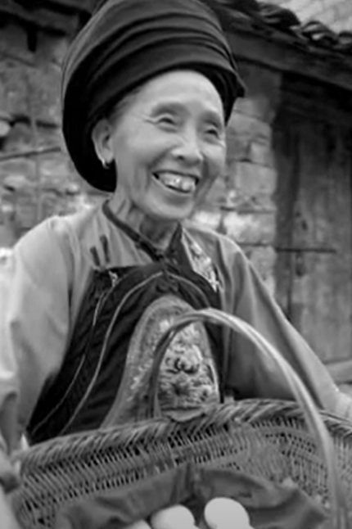
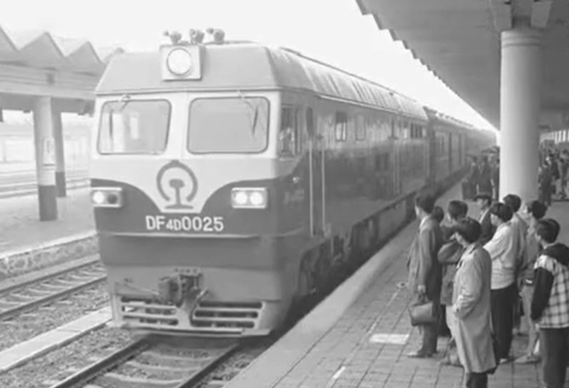
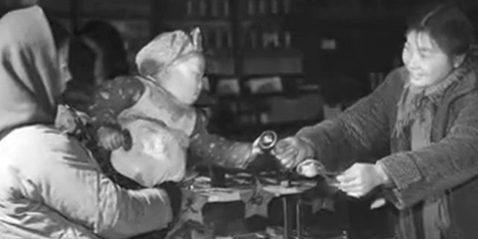
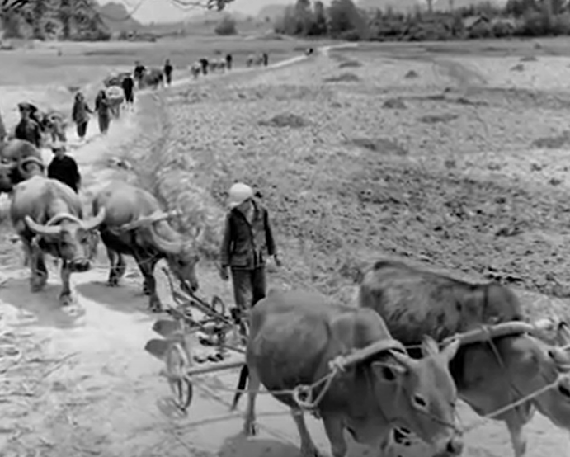
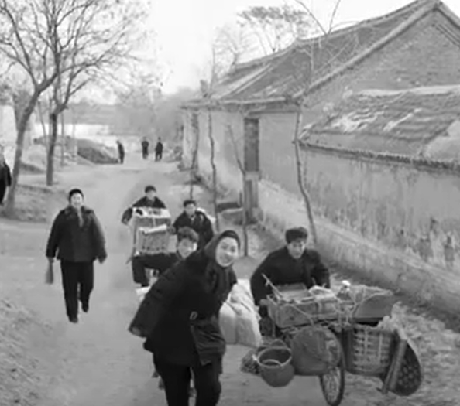
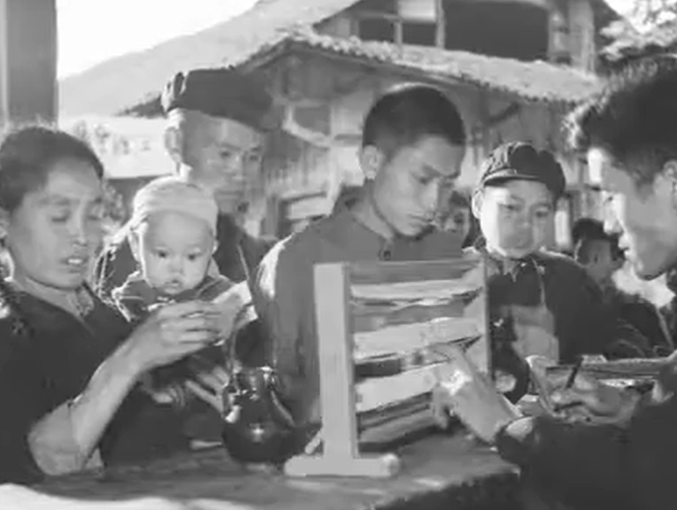
Click on the pictures to watch the videos
Watch the documentary, National Album
Watch “Episode 93 – Buying and Selling in Rural Areas” to find out the change of people's lives.
Source: Xinhua News Agency. (http://www.xinhuanet.com/video/gjxc/index.htm#review)

Slide 11
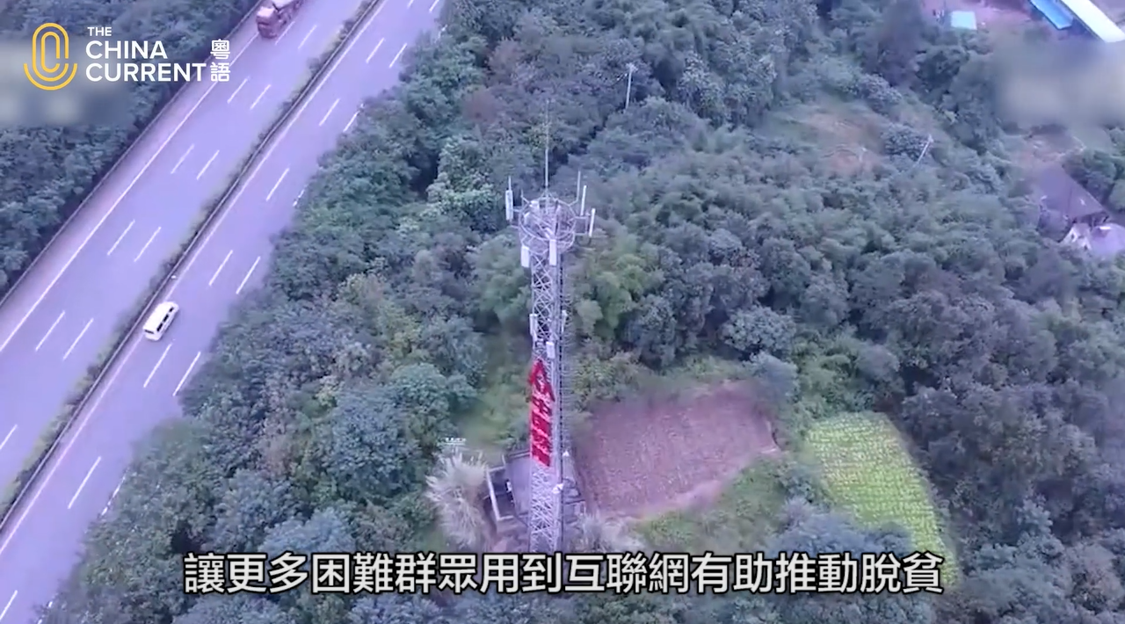
Narrowing down the relative income gap between urban and rural residents
Overall, the living standards in both urban and rural China are continuously improving, and people’s incomes are steadily increasing. In recent years, the gap between urban and rural development and living standards has been narrowed. At present, the problem of unequal urban-rural development still exists. It is necessary to boost rural development by means of increasing capital investment and using information technology, etc.
Click on the image to watch the video
Video source: The China Current. The "digital divide" between urban and rural areas.
(https://chinacurrent.com/story/21219/closing-digital-divide-rural-and-urban-areas)

Slide 12
Achievements in poverty eradication
For the definition of "poverty" and the standard of national poverty eradication, please refer to:
Theme 1: Hong Kong under "One Country, Two Systems" > Topic: Situation of the country and sense of national identity > L&T Resource: ”Achievements of the country in different areas in recent years (new high-end technologies, medical care and public health, culture education, infrastructures, poverty eradication)".
Source of the PowerPoint presentation: Citizenship and Social Development/Liberal Studies. Web-based Resource Platform. The Education Bureau.
(https://cs.edb.hkedcity.net/en/index.php#)

Slide 13
The progress of poverty eradication in China
In 1978, there were about 770 million rural impoverished population in China. The rural poverty rate reached 97.5%.
Through years of effort, China, which accounts for nearly one-fifth of the world's population, eradicated absolute poverty in 2020. This goal of ending poverty as stated in the United Nations 2030 Agenda for Sustainable Development was achieved ten years ahead of schedule.
Source: The State Council Information Office of the People’s Republic of China. (http://www.scio.gov.cn/zfbps/ndhf/44691/Document/1701664/1701664.htm)
Source: National Bureau of Statistics. China Statistical Yearbook 2021, Chapter 6, Section 36. (http://www.stats.gov.cn/tjsj/ndsj/2021/indexch.htm)

Slide 14
Rise in the income level of the impoverished population
The per capita disposable income of rural residents in poor areas continues to increase. From RMB 6,079 in 2013 it has risen to RMB 12,588 in 2020, with an average annual growth rate of 11.6%. The growth rate continues to be 2.3% faster than that of Chinese rural areas in general.
Significant achievements have been made in poverty eradication among ethnic minorities and ethnic areas. From 2016 to 2020, there was a decrease of a total of 15.6 million impoverished population in Inner Mongolia Autonomous Region, Guangxi Zhuang Autonomous Region, Tibet Autonomous Region, Ningxia Hui Autonomous Region, Xinjiang Uygur Autonomous Region and the provinces of Guizhou, Yunnan and Qinghai. All 28 smaller ethnic groups have been lifted out of poverty.
Annual Per Capita Disposable Incomes for the Rural Impoverished (2013-2020)
Source: The State Council Information Office of the People’s Republic of China. Poverty Alleviation: China‘s Experience and Contribution – White Paper. (http://english.scio.gov.cn/whitepapers/2021-04/06/content_77380652.htm)

Slide 15
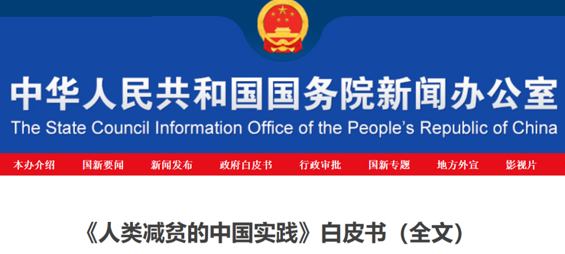
Basic strategy for poverty eradication in China
In 2015, the central government proposed the basic strategy of targeted poverty alleviation from five dimensions, namely, “boosting the economy to provide more job opportunities”, “relocating poor people from inhospitable areas”, “compensating for economic losses associated with reducing ecological damage”, “improving education in impoverished areas” and “providing subsistence allowances for those unable to shake off poverty through their own efforts alone”.
compensating for economic losses associated with reducing ecological damage
Poverty Alleviation: China‘s Experience and Contribution – White Paper
C
relocating poor people from inhospitable areas
B
improving education in impoverished areas
D
boosting the economy to provide more job opportunities
A
E
providing subsistence allowances for those unable to shake off poverty through their own efforts alone
Click on the image for details
5 dimensions of poverty alleviation
Note: The State Council Information Office of the People’s Republic of China. Poverty Alleviation: China‘s Experience and Contribution – White Paper. http://english.scio.gov.cn/whitepapers/2021-04/06/content_77380652.htm)

Slide 16
Basic strategy for poverty eradication in China
In 2015, the central government proposed the “targeted efforts in six areas " as the basic strategy for poverty alleviation:
"Identify the poor accurately": The work of accurately identifying targets to be supported, mobilising grassroots officials to enter villages and households, and creating poverty files;
"Arrange targeted programs": The implementation of suitable poverty alleviation measures according to different situations;
“Utilize capital efficiently": Making sure funds provided are used efficiently;
“Take household-based measures": Making sure the implementation of poverty alleviation measures can truly help the poor;
“Dispatch first Party secretaries based on village conditions": The establishment of poverty alleviation system in villages and strengthening the supervision;
“Achieve the set goals": The evaluation of poverty alleviation effectiveness and setting up a five-year transitional period immediately after poverty eradication for monitoring and prevention of return to poverty
Targeted efforts in six areas
Identify the poor accurately
Arrange targeted programs
Utilize capital efficiently
Take household-based measures
Dispatch first Party secretaries based on village conditions
Achieve the set goals
Source: The State Council Information Office of the People’s Republic of China. Poverty Alleviation: China‘s Experience and Contribution – White Paper. (http://english.scio.gov.cn/whitepapers/2021-04/06/content_77380652.htm)

Slide 17
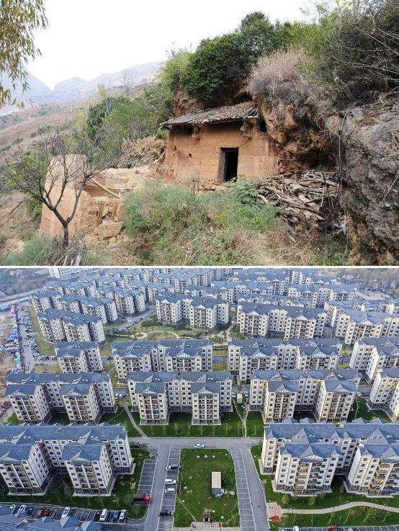
Example of Poverty Eradication Measure:
relocating poor people from inhospitable areas
Based on the principle of voluntary participation, the country lifted the poor out of poverty through relocation.
Wumen Mountains
The pictures show an old house where villagers in Haiping Village (Weining Yi, Hui and Miao Autonomous County in Bijie City) once lived and the relocation project in Chaoyang New Town, where the villagers now live.
Source: Xinhua News Agency. Report on China's Anti-poverty Battle in Bijie. (http://www.xinhuanet.com/politics/2021-01/23/c_1127016313.htm)
Click on the image for more details

Slide 18
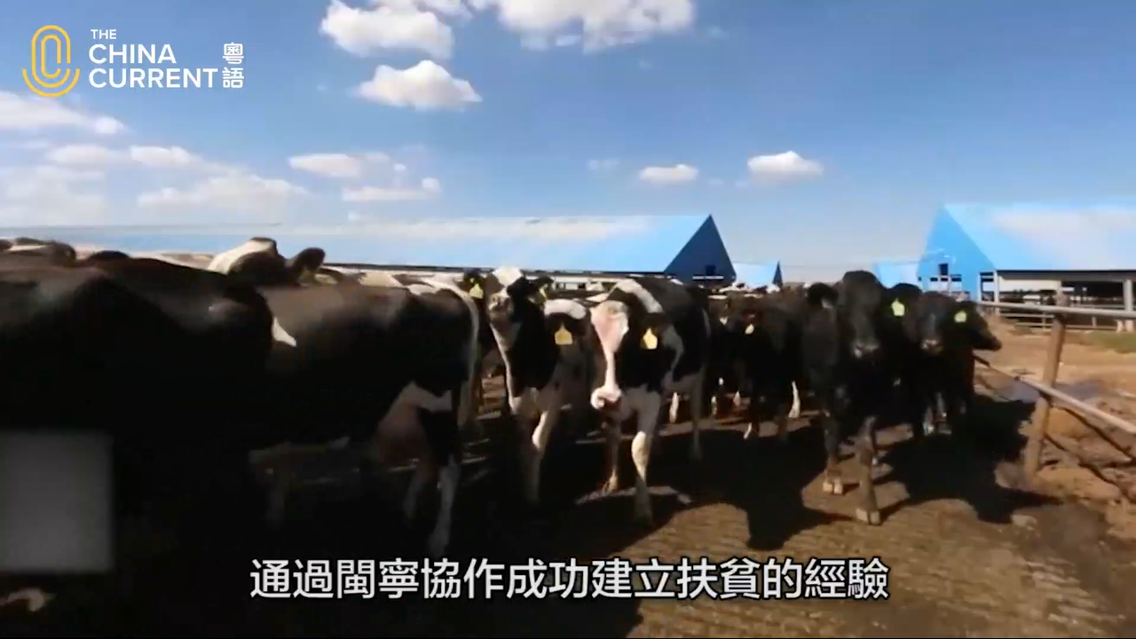
Example of poverty eradication measure:
social poverty alleviation (counterpart support)
In October, 1996, in “關於儘快解決農村貧困人口溫飽問題的決定”, the central government decided on a counterpart assistance policy. This policy required nine eastern coastal provinces and cities such as Beijing, Shanghai, Guangzhou and Shenzhen and four other cities to provide counterpart assistance to ten poverty-stricken provinces and regions in the west, such as Inner Mongolia, Yunnan, Guangxi and Guizhou. The two sides carried out all-round co-operation, economic and technological co-operation and talent exchange, so as to achieve mutual development.
Click on the image to watch the video
Fujian and Ningxia are far apart. In 1996, the Chinese Government began the poverty alleviation program in the two places. After more than 20 years of effort, 左閩寧鎮 was founded, as a result of Fujian’s counterpart support for the poor Ningxia.
Source: Website of the Chinese Government. The Information Office’s press conference on the guiding opinions to further strengthen the co-operation between the east and the west to alleviate poverty. (http://www.gov.cn/xinwen/2016-12/08/content_5145111.htm)
Source: The China Current
(https://chinacurrent.com/hk/story/20976/fujian-ningxia-poverty-alleviation)

Slide 19
Example of poverty eradication measure:
improve the infrastructure to enhance the development capacity of poor areas
Difficulties in transportation, water supplies and communication have hindered China’s effort in lifting the poor areas out of poverty for a long time. Improvement in infrastructure can effectively promote rapid economic and social development in poor areas.
Source: The State Council Information Office of the People’s Republic of China. Poverty Alleviation: China‘s Experience and Contribution – White Paper. (http://english.scio.gov.cn/whitepapers/2021-04/06/content_77380652.htm)
Improve basic infrastructure
Click on the images to watch the videos
Build, improve, protect and
manage roads in rural areas
Improve water infrastructure
Strengthen the construction of communication facilities
in poor areas
The construction of highways, bridges and railways in Guizhou opened up its external traffic links, thus facilitating the economic development of Guizhou.
Gansu used to be a province with serious water shortage for agricultural irrigation. It now has a large scale artesian irrigation area.
Internet network has been set up in the rural areas of Yunnan to promote livestream selling of agricultural products to increase sales and income.
Source: The China Current
(https://chinacurrent.com/hk/story/20672/guizhous-war-on-poverty)
Source: The China Current (https://chinacurrent.com/story/22401/smart-drip-irrigation-system)
Source: The China Current (https://chinacurrent.com/hk/story/20353/taobao-live-village)

Slide 20
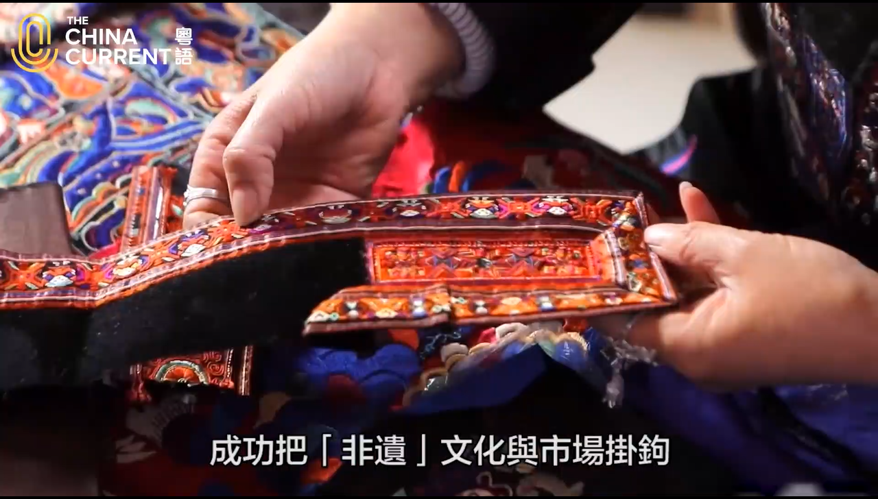
Example of poverty eradication measure: industrial development
Agriculture
Tourism
Earnings from poverty alleviation funds and assets
E-commerce
Technology
”Poverty alleviation through intangible cultural heritage" is a collaborative project between the Chinese government and local regions to support intangible cultural heritage relating to traditional crafts. Employment workshops are set up to provide local job opportunities so that people do not have to leave their hometown for work. People can also have a higher income by selling the cultural products.
Industrial development projects to alleviate poverty
Click on the image above to watch the video
Source: The 13th Five-Year Plan for Poverty Alleviation.
(http://big5.www.gov.cn/gate/big5/www.gov.cn/gongbao/content/2016/content_5148746.htm)
Source of video: The China Current. ”Poverty alleviation through intangible cultural heritage" (https://chinacurrent.com/hk/story/20409/traditions-that-reduce-poverty)

Slide 21
Example of poverty eradication measure:
a successful combination of agriculture and tourism
Based on its natural environment, Lingqiu, Datong(大同市靈丘縣) , Shanxi Province has developed agriculture and rural tourism.
Beekeeping
Guided tours
Click on the image for more details
Source: The State Council, PRC. Lingqiu (靈丘), Shanxi: "Agriculture+Tourism" induce the transformation of the countryside
(http://www.gov.cn/xinwen/2021-09/27/content_5639632.htm#allContent)
Livestreaming to introduce apple orchard
Organic farming

Slide 22
Example of poverty eradication measure: E-commerce
This measure uses e-commerce to sell products from poor areas. It especially targets the sales of agricultural products, the building of brands and infrastructure, and the cultivation of talents. It uses the Internet to increase farmers' income, facilitate the transformation and upgrade of agriculture.
From 2015 to 2020, the retail sales of China’s rural network increased by more than five times.
Source: People.cn. Sell good products and live a good life.(賣出好產品 過上好日子)”.
(http://hb.people.com.cn/BIG5/n2/2021/0414/c194063-34674057.html)

Slide 23
Example of poverty eradication measure: E-commerce
Click on the image for more details
Click on the image for more details
In recent years, China has been striving to revitalise the rural economy. Apart from investment, new technologies are being used to improve agricultural techniques and productivity. 5G technology is used to boost e-commerce activities and digitalisation. Among these, livestream selling is the key to enhancing the effectiveness of the rural economy and contemporary Chinese economy.
In 2018, a veteran and several fellow villagers began selling mangoes online. More than 6,000 boxes were sold that year with sales reaching RMB 500,000.
Source: Our Hong Kong Foundation. Our China Story: “Rural Poverty Alleviation with 5G E-commerce. Live-Streaming to Boost China's Economy (農村扶貧結合5G電商 直播帶貨推動中國經濟). “
(https://www.ourchinastory.com/zh/2 )
Source: People.cn. (http://hb.people.com.cn/BIG5/n2/2021/0414/c194063-34674057.html)

Slide 24
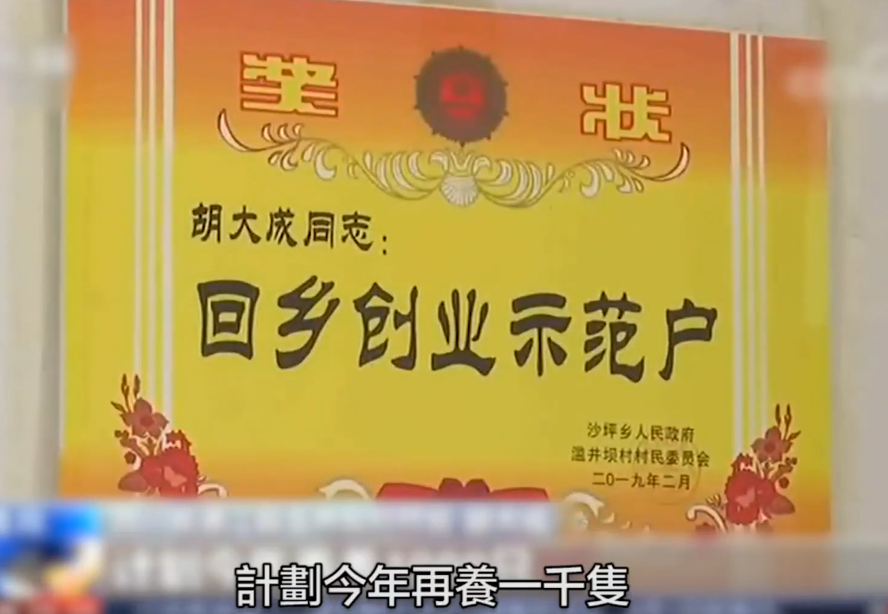
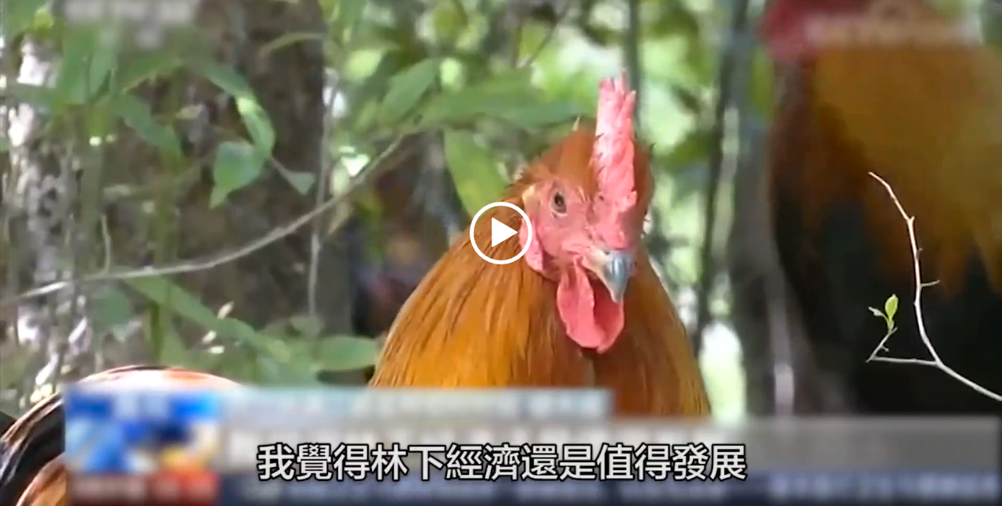
Example of poverty eradication measure:
eco-environmental conservation
In order to alleviate poverty and improve the quality of life in remote areas, China’s National Forestry and Grassland Administration has introduced an ecological poverty alleviation plan. This plan involves hiring people from poor households as forest rangers. It helps the poor and preserves the local environment at the same time.
Click on the images to watch the videos
Source: The China Current
(https://chinacurrent.com/hk/story/20460/ecological-poverty-eradication)

Slide 25
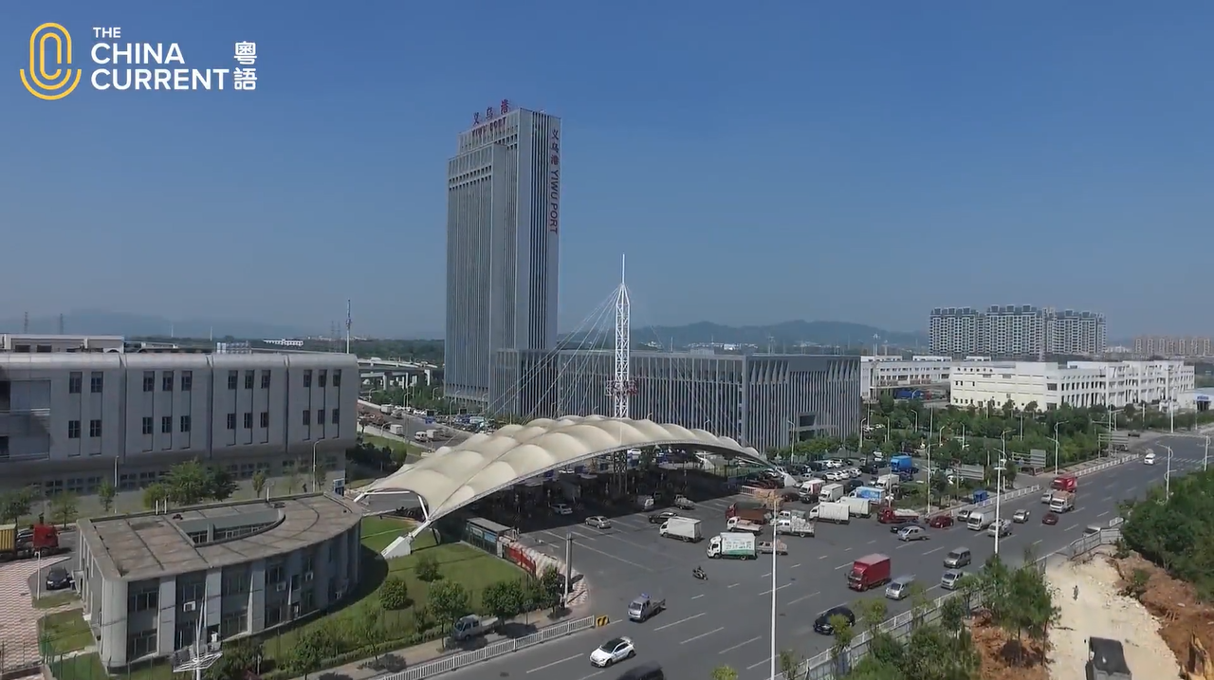
Future Development: The "Common Prosperity” policy
In March, 2021, the National People‘s Congress of PRC adopted the “Outline of the 14th Five-Year Plan for the National Economic and Social Development and the Long-Range Objectives Through the Year 2035” the 14th Five-Year Plan) and formulated an action plan for promoting common prosperity. It means that after building a moderately prosperous (xiaokang) society, China will promote common prosperity, which has become an extremely important long-term policy of China.
Click on the image to watch the video
Source: “Outline of the 14th Five-Year Plan for the National Economic and Social Development and the Long-Range Objectives Through the Year 2035” (http://big5.www.gov.cn/gate/big5/www.gov.cn/xinwen/2021-03/13/content_5592681.htm)
Source: The China Current
(https://chinacurrent.com/education/article/2021/08/22429.html)
For more details about the "14th Five-Year Plan", please refer to the presentation slides on the learning focus "Highlights and related policies of the recent five-year development plan, and the highlights and policies and the promotion of the development of China and Hong Kong".

Slide 26
Achievements in poverty eradication
For more information about China’s achievements in poverty eradication, please refer to:
Theme 1: Hong Kong under "One Country, Two Systems" > Topic: Situation of the country and sense of national identity > Resource: ”Achievements of the country in different areas in recent years (new high-end technologies, medical care and public health, culture education, infrastructures, poverty eradication)".
Source of the PowerPoint presentation: Citizenship and Social Development/Liberal Studies. Web-based Resource Platform. The Education Bureau.
(https://cs.edb.hkedcity.net/en/index.php#)

Slide 27
Changes in consumption pattern and
increase in household consumption expenditure
The quality of urban and rural lives have continuously improved. Once the basic need for food and other daily necessities has been satisfied, people want a better life, including better clothing, food, housing, and travel facilities. Household appliances are in full supply, and the consumption of services such as catering, healthcare, education, tourism, culture and entertainment has continued to increase.
Source: China’s Epic Journey from Poverty to Prosperity: White Paper.
(http://english.scio.gov.cn/whitepapers/2021-09/28/content_77779569_4.htm)
The household consumption expenditure
Source: National Bureau of Statistics. China Statistical Yearbook 2021, Chapter 3, Section 13. The household consumption expenditure http://www.stats.gov.cn/tjsj/ndsj/2021/indexeh.htm)

Slide 28
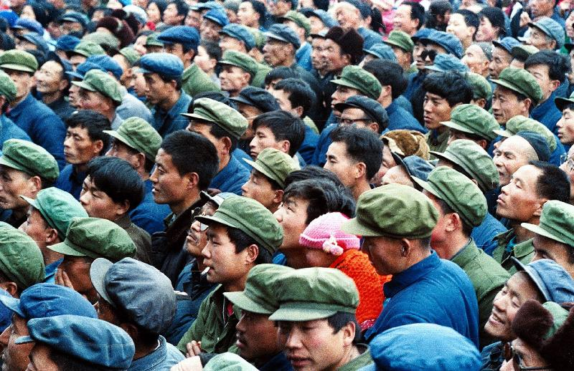
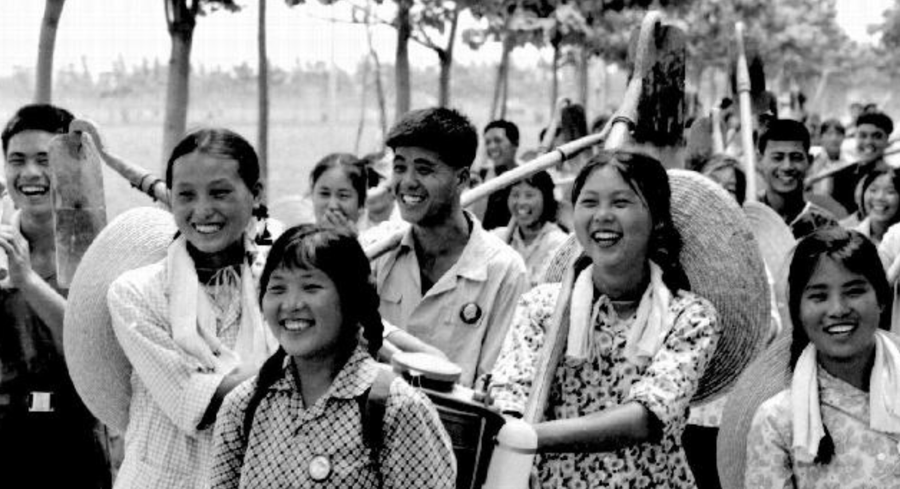
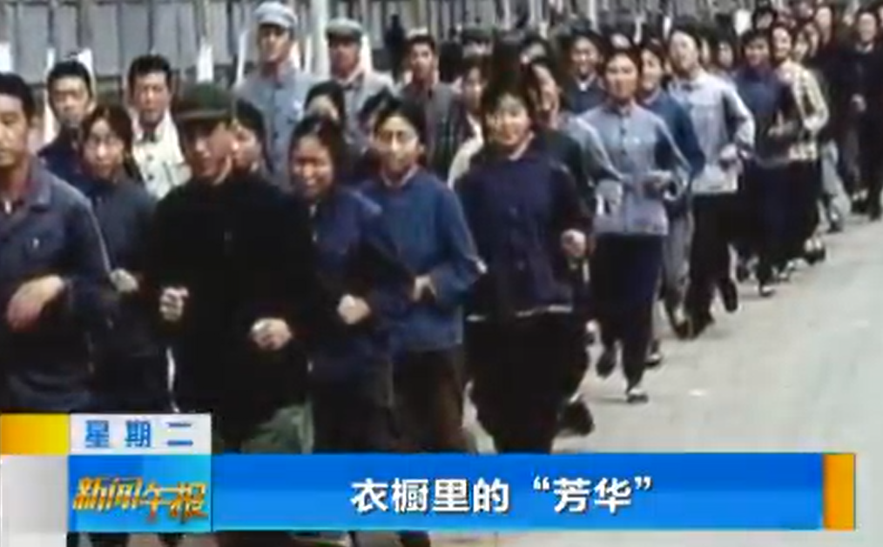
Clothing – changes in style
At the beginning of the reform and opening-up, people’s need for clothing was quite basic. They wanted clothes mainly for keeping warm. The clothes were meant to be suitable for different seasons, whether homemade or tailor-made. The colours were mostly blue, green or grey.
Nowadays, people care more about the materials, styles and colours.
Source: Hong Kong Government Press Release. Everyday items illustrating changes in Chinese daily life. (民生用品細說中國老百姓生活故事). (https://www.info.gov.hk/gia/general/201107/05/P201107050128.htm)
Click on the image for more details
Source:【Picture of Forty Years】 Beauty in Wardrobe (衣櫥裡的芳華). CCTV. http://news.cctv.com/2018/12/18/VIDE5m7hppPDcZue7yg11bUH181218.shtml)

Slide 29
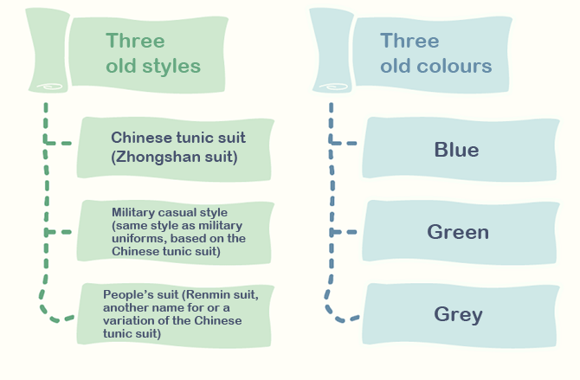
Reference
Clothing style from 1960s-70s
Click on the image for more details
Source: Academy of Chinese Studies. 70 years of style and memories. (「穿」越七十載的服裝記憶) （https://chiculture.org.hk/tc/china-today/1856）

Slide 30
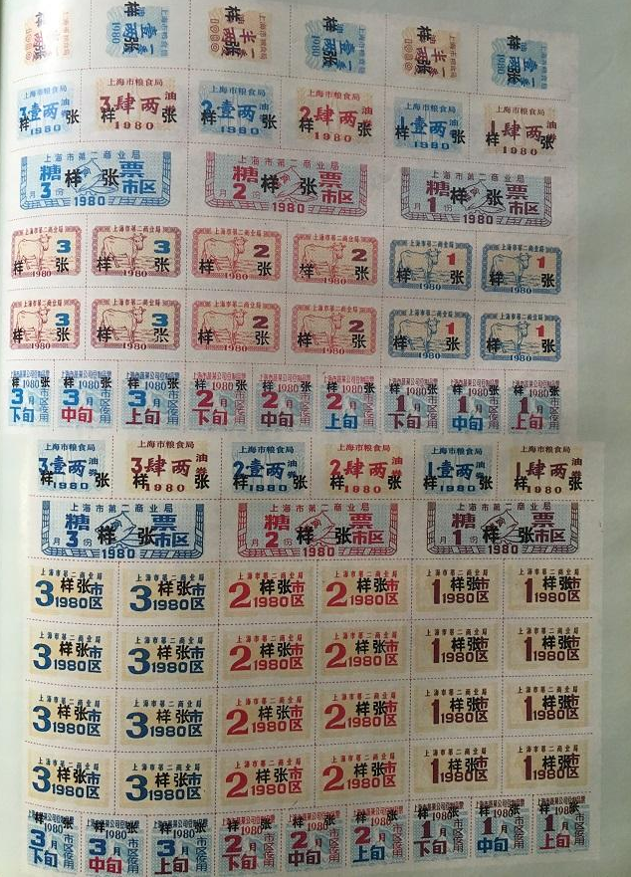
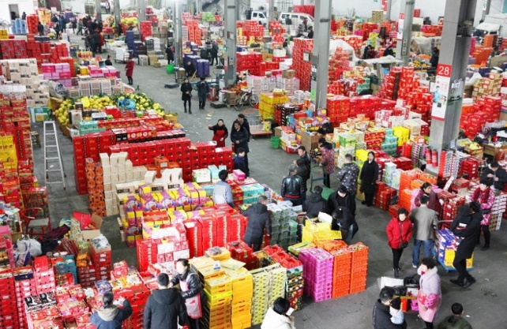
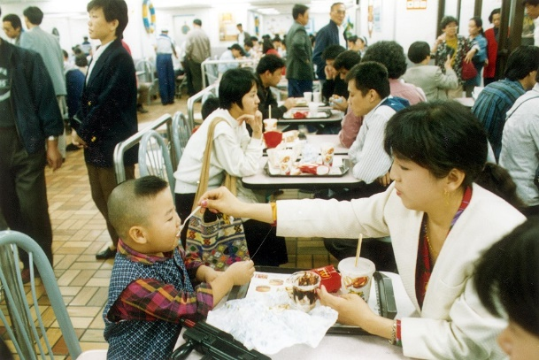
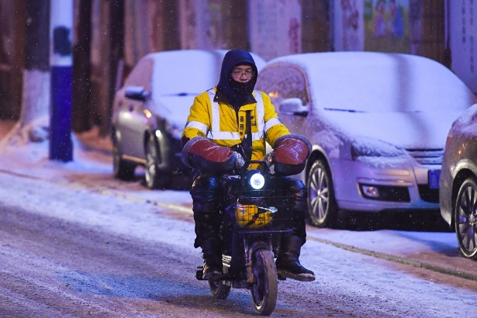
Food – from filling the stomach to quality
Early 80’s
Late 80’s
Late 90’s
Nowadays
To cope with the demand, the Ministry of Agriculture implemented the "Vegetable Basket Project" in 1988 to make sure that people could access to more fruit, vegetables, meat, eggs, milk, etc.
As the economy developed, people increasingly valued the quality of food and dined out more often.
Ordering take-outs has become the “new normal” of urban life. Consumers are willing to pay more for good quality food.
In the early days of the reform and opening-up, people bought food using ration coupons, living at subsistence level.
Source: Academy of Chinese Studies
(https://chiculture.org.hk/tc/china-today/2899)
Source: Academy of Chinese Studies
（https://chiculture.org.hk/tc/china-today/3165）
Source: Academy of Chinese Studies
(https://chiculture.org.hk/tc/china-today/3192)
Click on the image for more details
Source: Xinhua News Agency
（http://www.xinhuanet.com/2017-01/28/c_1120390702.htm）
Activity: Asking students to share their hometown delicacies.

Slide 31
Housing – Better living conditions
Since the founding of the People's Republic of China, housing conditions have been continuously improved. Families live better and better.
In 2019, the per capita living space in urban areas reached 39.8 m2 (about 428 sq. ft.). There was an increase of 33.1 m2 (about 356 sq. ft.) compared to 1978. In 2019, the per capita living space in rural areas reached 48.9 m2 (about 526 sq. ft.). There was an increase of 40.8 m2 (about 439 sq. ft.) compared to 1978.
As living area increased, the living environment has also undergone tremendous changes. Separate houses and low-rise buildings have been gradually developed into modern residential areas.
Click on the image to watch the video
Source of the video and description: Xinhua News Agency. “[Count, hundred years] We live more and more brightly. (【數·百年】這些年，我們住得越來越敞亮”.
(http://www.xinhuanet.com/video/sjxw/2021-01/06/c_1210968418.htm)

Slide 32
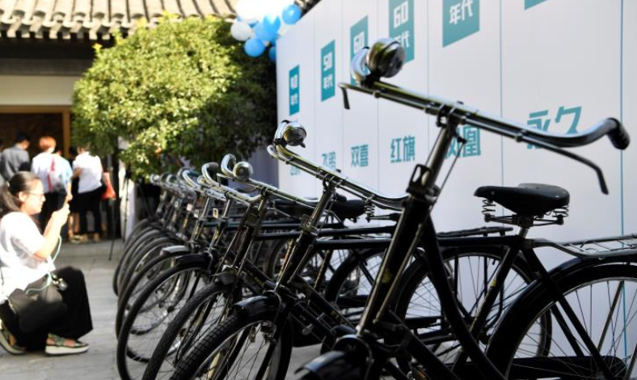
Travel facilities –Faster and more convenient transportation
At the beginning of the reform and opening-up, bicycles were considered as luxury goods. A bicycle was one of the three “big items” for young people to purchase when they got married. ”Fenghuang (Phoenix)", ”Yongjiu (Forever)" and ”Feige (Flying Pigeon)" were some of the well-known brands.
In October 2003, China's first high-speed railway "Qinhuangdao–Shenyang passenger railway" was opened. Since then, the high-speed railway network has been extending in the country.
Click on the image to watch the video
Source: Xinhua News Agency. “An old man’s memory of bicycle (一位老者的自行車記憶)”. (http://www.xinhuanet.com/politics/2021-06/03/c_1127526734.htm)
Source: The China Current. “High-speed rail economic belt (高鐵經濟帶)."
(https://chinacurrent.com/hk/story/22694/high-speed-rail-economic-zone)

Slide 33
Reference
Development of transportation:
tunnels, bridges and highways
There were no highways in China in 1987. In 2020, the length of all highways in China reached 160,000km. If all these highways were connected end to end, they would circle the Earth nearly four times.
Click on the image to watch the video
Source: Our China Story
(https://www.ourchinastory.com/zh/1374)

Slide 34
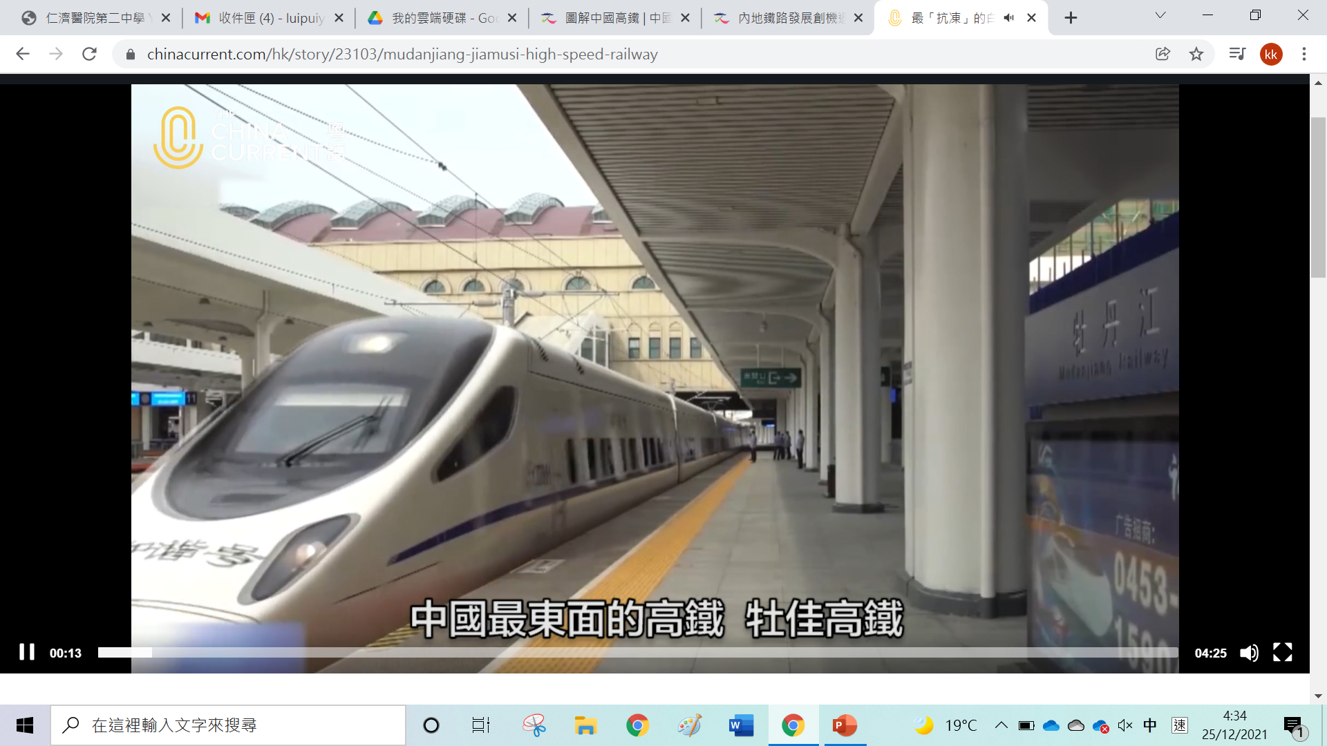
Reference
The application of new technology
in transportation
Click on the image to watch the video
The Mudanjiang–Jiamusi high-speed railway located in the east of Heilongjiang is "frost-resistant”, as it needs to run in high latitude and cold regions.
The electric emission-free Autonomous Rail Rapid Transit can be considered a crossover between a bus and a tram. It is currently operating in areas scuh as Zhuzhou (Hunan, Yongxiu (Jiangxi) and Yibin (Sichuan).
China’s first 5G-based bus line was opened in Huangpu District, Guangzhou. Empowered by 5G, the electric buses are equipped with an early warning system that improves safety. Multiple cameras are installed inside and outside the bus to ensure that it does not deviate from the designated route. The system can also monitor the driver in real time, providing extra safety.
Source: The China Current
(https://chinacurrent.com/hk/story/23103/mudanjiang-jiamusi-high-speed-railway)
Source: The China Current
(https://chinacurrent.com/hk/story/22731/autonomous-rail-rapid-transit）
Source: The China Current
(https://chinacurrent.com/hk/story/22708/5g-in-Guangzhou)

Slide 35
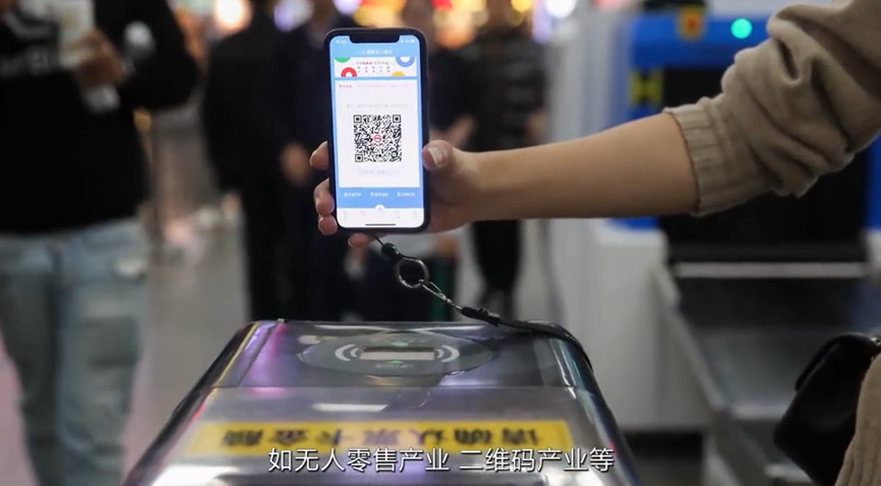
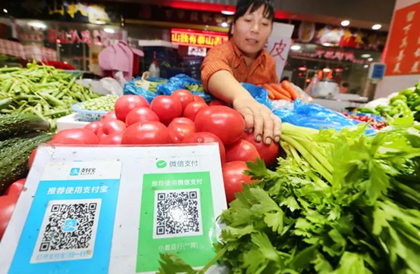
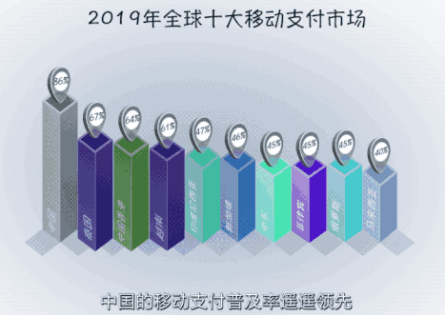
More convenient payment method – electronic payment
At the beginning of the reform and opening-up, people had to pay with physical means, whether they used ration coupons or cash. In recent years, with the rise and popularity of the Internet, electronic payment has become available for shopping.
Click on the images to watch the videos
Source: Cyberspace Administration of China. “Mobile payment first in the world, why China can? (移動支付世界第一，中國為甚麼能？)”. (http://www.cac.gov.cn/2019-09/22/c_1570684197212789.htm)

Slide 36
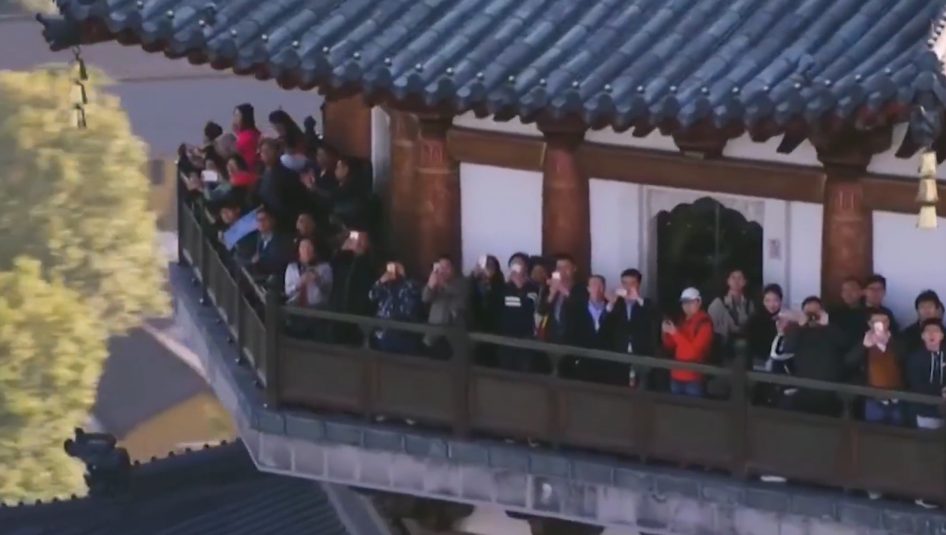
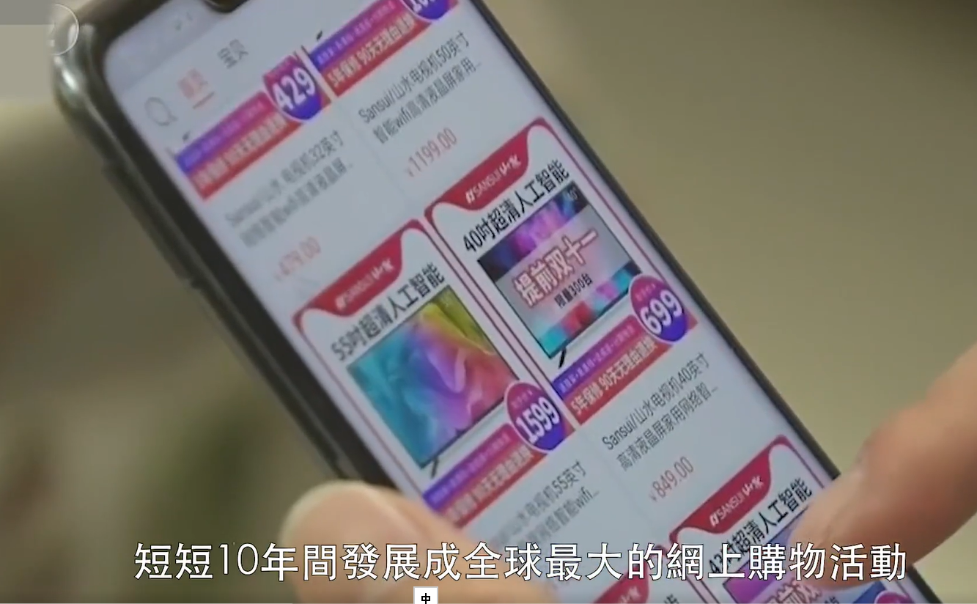
Online shopping and consumption
As the Internet became ubiquitous, online shopping through smartphones and computers grew rapidly.
The online shopping market in the Mainland is gigantic. For example, since 2009, major e-commerce sites in the Mainland have organised the "Double 11" shopping festival to celebrate 11 November. They offer large discounts and promotions to boost their sales.
Traditional industries are moving online. In the wake of the pandemic, face-to-face face industries such as education, medical care, catering, and fitness have moved online.
Source: CAICT. “Report on the development trend of information consumption in China 2020 (中國資訊消費發展態勢報告（2020年）”. http://www.caict.ac.cn/kxyj/qwfb/bps/202012/P020201204391940595835.pdf
Click on the images to watch the videos
Source: The China Current (https://chinacurrent.com/hk/story/20340/eshopping-double-11)
"Double 11" shopping activity has become more and more popular, boosting domestic consumption

Slide 37
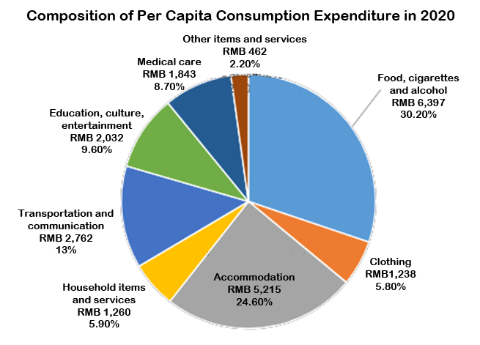
Change in consumption pattern
Before the reform and opening-up, Chinese people mainly consumed basic necessities. However, people pursue quality nowadays. The proportion of retail sales of consumer goods that are basic necessities has dropped significantly in total retail sales. People are spending more on catering, culture and entertainment, leisure and tourism, education and training, health and well-being, etc.
Source: National Bureau of Statistics. The 11th series of reports on the achievements of economic and social development in the 70th anniversary of the founding of the People's Republic of China: increasingly powerful consumer market, innovative development of circulation mode.
(http://www.stats.gov.cn/tjsj/zxfb/201908/t20190802_1688781.html)
Source: National Bureau of Statistics. China Statistical Yearbook 2021, Chapter 6, Section 21. (http://www.stats.gov.cn/tjsj/ndsj/2021/indexeh.htm

Slide 38
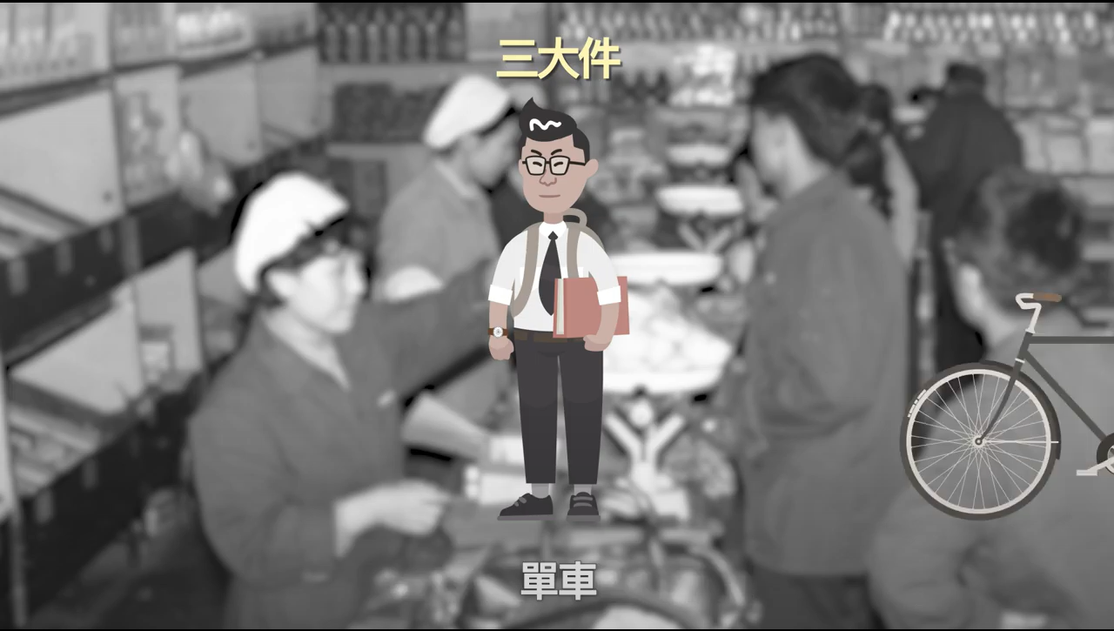
Rise in consumption level –
the changes in “Three Big Items”
80’s
Refrigerator, black-and-white TV, washing machine
90’s
Air-conditioner, motorcycle, computer
00’s
House, car, savings
70’s
Bicycle, watch, sewing machine
The changes of the "three big items" illustrate the changes brought about in people's lives by the reform and opening-up.
Click on the image to watch the video
Source: Academy of Chinese Studies
（https://ls.chiculture.org.hk/tc/video-china/262）

Slide 39
The changes in consumption pattern from the perspective of social development
1979
For every 100 households
1989
For every 100 households
2020
For every 100 households
Urban dwellers
Urban dwellers
Urban dwellers
204 watches
113 bicycles
54.3 sewing machines
36.5 Refrigerators
76.2 washing machines
55.7 black-and-white TVs
51.5 coloured TVs
248.7 mobile phones
72.9 computers
44.9 family cars
Rural dwellers
Rural dwellers
Rural dwellers
27.8 watches
36.2 bicycles
22.6 sewing machines
0.9 Refrigerators
8.2 washing machines
33.9 black-and-white TVs
3.6 coloured TVs
260.9 mobile phones
28.3 computers
26.4 family cars
Source: National Bureau of Statistics. China Statistical Yearbook 2021, Chapter 6.
(http://www.stats.gov.cn/tjsj/ndsj/2021/indexeh.htm)

Slide 40
Increase in the proportion of
cultural education consumption
Cultural education consumption has become more and more important in China. In recent years, more and more people are willing to spend on knowledge. Based on their own characteristics, advantages and product positioning, the paid knowledge platforms have created different business models like content reward, paid community, paid lectures, paid reading.
Source: People.cn. (http://finance.people.com.cn/BIG5/n1/2021/0715/c1004-32159220.html)
Examples of paid knowledge platforms in China
Image: Iimedia. (https://www.iimedia.cn/c400/76060.html)

Slide 41
Increase in spending on healthcare
The living standards in China is constantly on the rise. The people’s concept of life is gradually changing. Their awareness of disease prevention and medical treatment has increased. More and more people are taking preventative measures against health problems instead of getting treatment when problems emerge. They are willing to invest in their health and spending on healthcare is rising rapidly.
Currently, consumers mainly buy three types of health food: nutritional supplements, sleep aids and traditional nourishment. Consumer behaviour has changed. Health food are no longer high-end consumer goods, but necessities. This has led to the expansion of China's health food market.
Source: Hong Kong Trade Development Council - Research. (https://research.hktdc.com/en/article/MzA4NzQ3NzUw)

Slide 42
Increase in number of tourists and tourism expenditure
The number of outbound tourists increased from 5 million in 1995 to 143 million in 2017. This represents an average annual increase of 17%.
National outbound tourism expenditure is increasing. As people’s living standards rose, China's outbound tourism expenditure also increased substantially to USD 257.7 billion in 2017. This represents an increase of USD 254 billion which is 68.6 times when compared to the USD 3.7 billion in 1995.
Source: Ministry of Culture and Tourism of the People’s Republic of China. (https://www.mct.gov.cn/whzx/whyw/201909/t20190904_846087.htm)

Slide 43
Universal Education
Since the reform and opening-up, the education level of Chinese people has been continuously increasing. Education at all levels has become widespread, reaching or exceeding the average level of middle- and high-income countries. In 2019, the proportion of new labour force with higher education reached 50.9%, and the average length of education was 13.7 years.
Source: Website of the Central People’s Government of People’s Republic of China. (http://www.gov.cn/xinwen/2020-12/01/content_5566304.htm)
Click on the image to watch the video
China’s Education Modernisation Plan 2035
In February 2019, China announced "China's Education Modernisation Plan 2035” with the goal of building ”a modern education system that encourages lifelong learning for all, promotes quality pre-school education, realises quality and balanced compulsory education, universalises high school education, significantly improves service capabilities for vocational training, greatly improves the competitiveness of higher education, provides appropriate education for disabled children and adolescents, forming a new landscape of education governance with the participation of the whole society.
Source: Website of the Central People’s Government of People’s Republic of China. (http://english.www.gov.cn/policies/latest_releases/2019/02/23/content_281476535024192.htm)

Slide 44
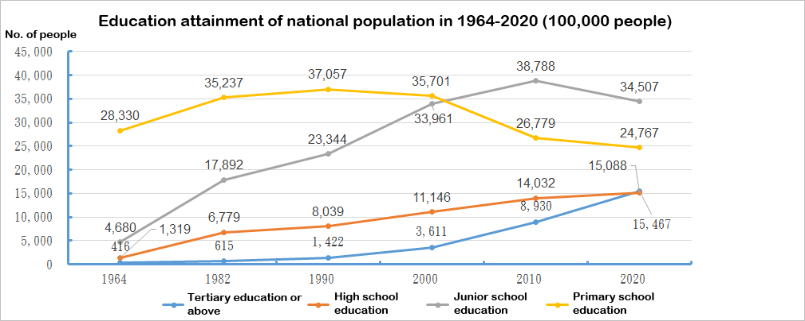
Rising education levels
According to the results of the 2020 Seventh National Population Census, compared with the 2010 Sixth National Census, the number of people with university (post-secondary or above) education per 100,000 people increased from 8,930 to 15,467. The number of people with high school education rose from 14,032 to 15,088 per 100,000 people.
Source: National Bureau of Statistics. Result of Census.
(https://data.stats.gov.cn/easyquery.htm?cn=C01)

Slide 45
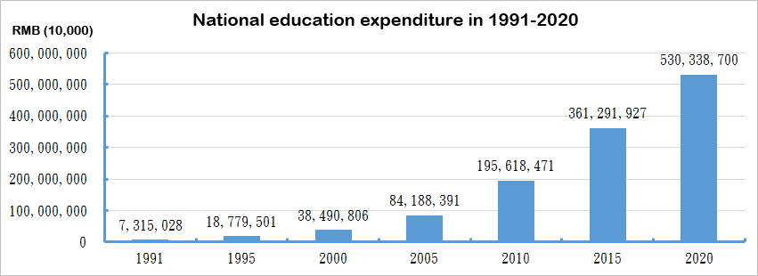
Increase in education expenditure
China attaches importance on education. From 1991 to 2020, the national education expenditure increased by 72 times.
Read relevant news report: National commitment of free compulsory education
Source: People.cn.
(http://sn.people.com.cn/BIG5/n2/2021/0621/c393584-34785641.html)
Source: National Bureau of Statistics. National education expenditure.
(https://data.stats.gov.cn/easyquery.htm?cn=C01)

Slide 46
More education pathways
Regular education
Studying abroad
Adult education
Vocational education
Source: Ministry of Education. Outline of the National Medium- and Long-Term Programme for Education Reform and Development, 2010-2020年
(http://www.gov.cn/jrzg/2010-07/29/content_1667143.htm)

Slide 47
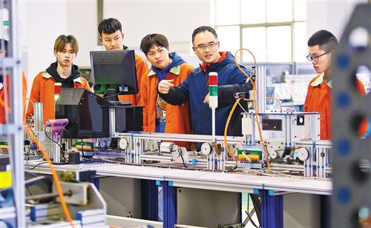
Vocational education – skills training
After 40 years of reform and opening-up, China has established an enormous vocational education system, providing skills training for diversified talents and promoting employment and entrepreneurship.
Source: People.cn. (http://edu.people.com.cn/BIG5/n1/2021/0419/c1006-32081372.html)
The Story of “Skills changes Life”
Case study
Targeted training to fulfil the needs of enterprises
Zhaxi Zhuma, who lives in Liangshan Yi Autonomous Prefecture, is a nurse at the First People's Hospital of Chengdu. She said, "The free vocational education programme has changed my life. Not only was the tuition fee exempted, but there was also a monthly allowance of RMB 300. The transportation cost could also be reimbursed.”
Fengrun Comprehensive Vocational and Technical School in Tangshan, Hebei, is a key vocational school in China. It provides training in aircraft maintenance, auto repair, nursing and other specialties. It has agreements made with more than 40 enterprises across the country.
Source: People.cn. (http://cpc.people.com.cn/BIG5/n1/2021/0412/c64387-32075236.html)
Source: People.cn.
(http://m.people.cn/n4/2021/0111/c655-14678152.html)

Slide 48
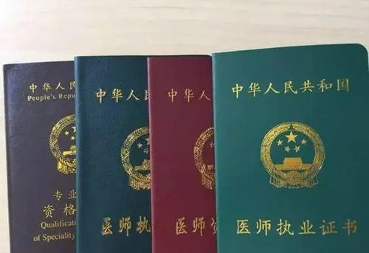
Building a lifelong learning system that serves everyone
China's Education Modernisation Plan 2035 aims to build a lifelong learning system that serves everyone. It proposes to strengthen continuing education and vocational training provided by vocational schools and higher education institutions. This includes developing various types of continuing education programmes, expanding provision of resources for community education, accelerating the development of education for the elderly in urban and rural areas, and promoting the establishment of various educational organisations.
Source: Website of the Central People’s Government of People’s Republic of China. (http://www.gov.cn/zhengce/2019-02/23/content_5367987.htm)
The Chinese Government attaches importance to adult education and provides different types of courses at all levels, such as on-the-job training, self-study higher education, qualification certificates and community education. There is no age limit for the courses, and flexible teaching approaches are adopted to enrich the learners’ knowledge, develop their capabilities, enhance their skills and improve their professional qualifications.
Qualification certificates issued by the state

Slide 49
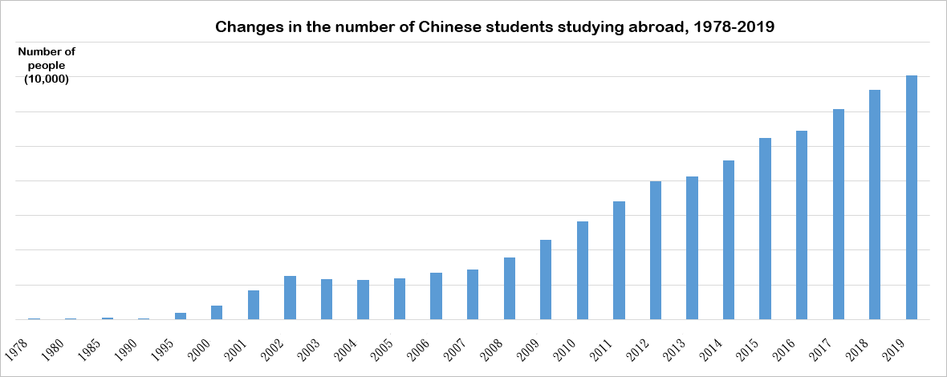
Studying abroad
From 1978 to 2019, the number of different types of students studying abroad continued to rise, with an increase of over 780 times.
Source: National Bureau of Statistics – Students who study abroad.
(https://data.stats.gov.cn/easyquery.htm?cn=C01)

Slide 50
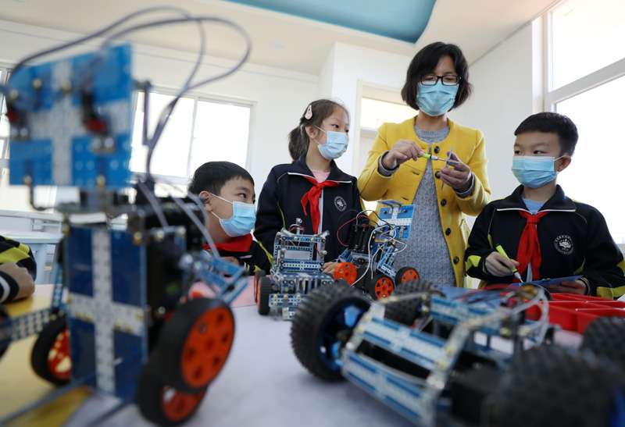
Ever enriching forms of education
As technology advances, Internet technology is integrated into education, forming “Internet+Education.”
Smart classroom is a smart and efficient classroom integrating the "Internet+" way of thinking and the new generation of information technologies such as big data and cloud computing. Through the analysis of dynamic learning data and application of "cloud, network and terminal", the smart classroom realises data-based decision-making of teaching and immediate evaluation and feedback.. It also provides three-dimensional communication and interaction, intelligent transferral of resources, which facilitates individualised learning and intellectual development of students.
Source: People.cn. “’Double Reduction. Happiness Remains” (助力「雙減」快樂不減)”. (http://edu.people.com.cn/BIG5/n1/2021/1023/c1006-32261925-3.html)

Slide 51
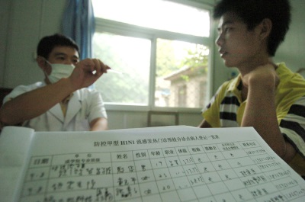
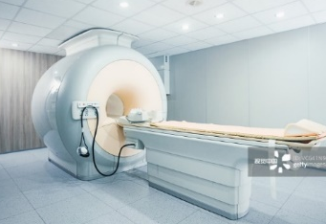
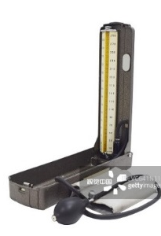
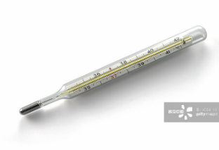
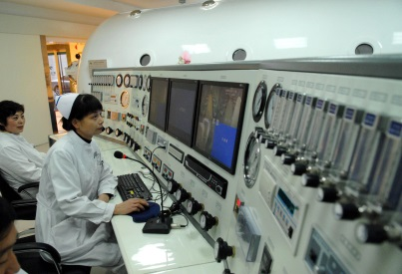
Improvement of medical standard
Medical equipment is becoming more and more advanced. In the past, stethoscopes, sphygmomanometers and thermometers were used. Nowadays, the use of MRI, hyperbaric oxygen chamber and CT scanning is becoming more and more widespread.
Medical practices have been improving. New technologies, new drugs and new diagnosis and treatment models are used.
In the future, China will focus on supporting traditional Chinese medicine medical centers, traditional Chinese medicine inheritance and innovation centres, and flagship hospitals that combine traditional Chinese and Western medicine. This will promote traditional Chinese medicine services integrating preventive health care and disease treatment and rehabilitation, as well as to promote the inheritance and innovation of traditional Chinese medicine.
Source: Plan for the Construction of High-quality and Efficient Medical and Health Service System in the 14th Five-year Plan. P.14. (https://www.ndrc.gov.cn/xxgk/zcfb/tz/202107/P020210701531053450491.pdf)
VS

Slide 52
Increase in medical and health resources
China continuously increases its medical expenditure and medical resources to meet the rising demand for medical services.
In 2020, China’s per capita health expenditure was RMB 5,146.4 with 6.46 hospital beds per 1,000 people. For every 10,000 people, there were 6.56 public sector healthcare professionals.
Source: Statistical Bulletin of China's Health Care Development in 2020. (http://www.nhc.gov.cn/guihuaxxs/s10743/202107/af8a9c98453c4d9593e07895ae0493c8.shtml)
Source: National Bureau of Statistics. Total expenditure on healthcare. (https://data.stats.gov.cn/easyquery.htm?cn=C01)

Slide 53
Healthcare Security System
The healthcare security system is continuously improving. In the future, China will strengthen the triple-layered security system, which provides basic medical insurance, serious illness insurance and medical assistance, and make them as complementary as possible. Protection against serious illness will be stepped up and the development of private health insurance to meet different medical needs.
Supplementary
Source: Website of the Central People’s Government of People’s Republic of China. (http://www.gov.cn/zhengce/2020-03/05/content_5487407.htm)
Supplementary medical insurance
(Adds on to the basic medical insurance, with higher upper limit and wider coverage)
Multi-layered healthcare security system
Core
Basic medical insurance
(Provides basic medical financial aid)
Ultimate
Medical assistance
(Mainly provides medical assistance to the poor with serious illness as the third type of protection after basic medical insurance and serious illness insurance)
Source: People.cn.
(http://politics.people.com.cn/BIG5/n1/2016/0908/c1001-28699189.html)

Slide 54
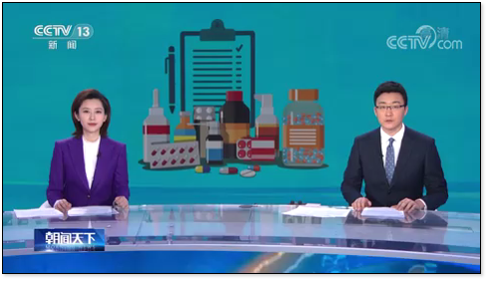
National Essential Drugs system
Between 2018 and the end of 2021, the National Healthcare Security Administration was continuously updating the national medical insurance catalogue. There are currently more than 2,800 drugs on the list. The adjustment regulations and indicator systems have been continuously improved.
With reference to the affordability of the medical insurance, people’s basic medical needs and clinical outcomes, etc., the National Healthcare Security Administration adjusts and optimises the national medical insurance catalogue, and sets restrictions on pricing to reduce people’s medical financial burden.
Source: The latest edition of the national list of insured medication added 74 new drugs into the medical insurance plan.
(http://big5.www.gov.cn/gate/big5/www.gov.cn/xinwen/2021-12/03/content_5655663.htm)
Video
"The new medical insurance catalogue implemented. 2,800 kinds of medication are included. Realising full coverage. (新版醫保目錄正式執行 藥品達2800種 基本實現治療領域全覆蓋)
Source: CCTV. 1 March 2021. (https://tv.cctv.com/2021/03/01/VIDEupLij78Nuyuix19JuMp5210301.shtml)
Click on the image to watch the video

Slide 55
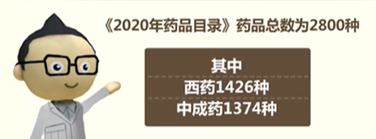
National Essential Drugs system
Questions
What are the features of the updated national medical insurance catalogue?
Analyse the impact of the updated medical insurance catalogue.
Source: CCTV. 1 March 2021. (https://tv.cctv.com/2021/03/01/VIDEupLij78Nuyuix19JuMp5210301.shtml)
Suggested answers
Features: 1. more varieties of medications; 2. Lower price; 3. Wider coverage of medications; 4. Better coverage of cancer medications; 5. All COVID-19 medications
Impact: More medications can be reimbursed, so medicine is cheaper.

Slide 56
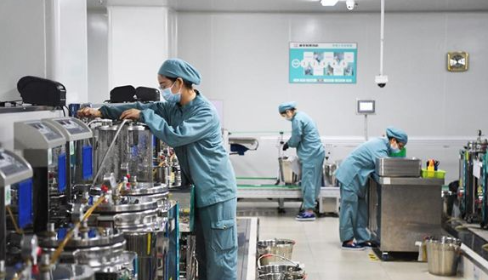
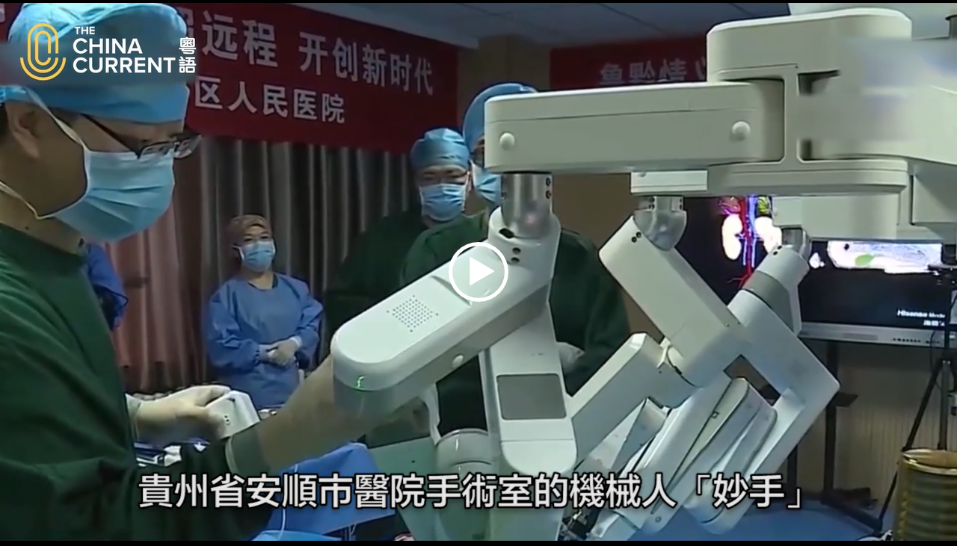
More convenient medical treatment
With "Internet+", China is constantly optimising the process of medical treatment and create smart hospitals so as to provide patients with better medical experience.
E-medical record
online booking
Full-scenario smart hospital
management platform
Electronic medical record management system
The medicine-decoction staff are working in the "Smart Pharmacy"
Robotic assistance in future hospitals
Shared medical resources for remote diagnosis and treatment
The era of robotic surgery has begun. Robots are used in orthopedic surgeries and neurosurgery.
Click on the image to watch the video
Seeking expert opinions via the Internet
Source: The China Current (https://chinacurrent.com/hk/story/23042/surgical-robotic-technology)

Slide 57
Application of medical technology
In recent years, China has been actively developing online medical services to strengthen the application of artificial intelligence in medical treatment. Applications include prescribing medication online for common diseases and chronic illnesses, and accelerating the sharing of medical and health information. As such, the level of medical care is further improved.
Source: Opinions of the General Office of the State Council on Promoting the Development of "Internet+ Health Care” (http://www.gov.cn/zhengce/content/2018-04/28/content_5286645.htm)
With an e-medical insurance code, patients can use the app on their mobile phone to inquire about the details of their medical insurance, make hospital appointments, pay and collect medication, etc. This not only saves time, but also allows patients to consult doctors online and have the medication delivered to their homes.
National development of 5G network for remote surgery
Click on the image for more details
Click on the image to watch the video
Source: Academy of Chinese Studies. “E-medical security code. One code to know your health (電子醫保碼 一碼知健康？).
(https://ls.chiculture.org.hk/tc/hot-topics/550)
Source: The China Current
(https://chinacurrent.com/hk/story/20424/new-tech-in-healthcare)

Slide 58
Reference
Integrated medical and health service system-
Medical and health care with better quality and higher efficiency
In 2020, the National Health Commission of the PRC proposed to accelerate the setting up of an integrated medical and health service system and implemented it in various parts of China gradually.
The integrated medical and health service system consolidates the medical and health resources in the area. Led by level 3 public hospitals, several other hospitals, primary health care institutions and public health institutions in the area work together to provide local residents with comprehensive medical and health services such as disease prevention, diagnosis, treatment, rehabilitation and nursing. A rational medical treatment order is formed featuring “primary treatment at the community level, serious illness at the hospital, and recovery back at the community level.
Level 3 hospitals (difficult-to-treat diseases) (intractable diseases)
Level 2 hospitals (minor or common diseases)
Community hospital (chronic diseases and convalescence)
Integrated health care system
Integrated medical and health service system
Resource allocation
Information sharing
Two-way transfer treatment
Source: Bureau of Medical Administration. (http://www.nhc.gov.cn/yzygj/s3594r/202007/0f58f93e3f5a4a26ab9079f78bf2dca5.shtml)

Slide 59
“Family doctor” - Personalised healthcare service
Forty years ago, the level of health care services in villages and towns was generally low. They mostly relied on “barefoot doctors”.
With the implementation of specialist areas and diagnosis and treatment systems, people can now go to major hospitals for treatment. In addition, they can also sign up for "family doctors" to set up personalised health care services.
"Family doctor" contracted services are mainly provided by various primary medical and health institutions. The family doctor team can select team members according to the health needs of residents and the coverage of the contracted services. The selected doctors may include specialists, physicians, pharmacists, health managers, traditional Chinese medicine health care therapists, psychotherapists, and so on. The contracted residents must perform the obligations stated in the service agreement and pay accordingly.
Click on the image to watch the video
Source: CCTV. Brilliant China: Family Doctors
(輝煌中國：家庭醫生)
(http://m.news.cntv.cn/2017/09/24/VIDEENTkDsCulkW8obD6lyfY170924.shtml)
National Administration of Traditional Chinese Medicine. Guiding Opinions on Regulating Family Doctors‘ Contract Service. (http://yzs.satcm.gov.cn/zhengcewenjian/2018-10-10/8052.html)

Slide 60
Increase in average life expectancy
According to the “Statistical Bulletin of Health Care Development in China, 2019” issued by the National Health Commission, by that time (2019), the average life expectancy in China had risen to 77.3 years. The maternal mortality ratio had dropped to 17.8 per 100,000 live births, and the infant mortality rate had dropped to 5.6 per 1,000 live births.
Source: Statistical Bulletin on the Health Care Development in China, 2019. (http://www.nhc.gov.cn/guihuaxxs/s10748/202006/ebfe31f24cc145b198dd730603ec4442.shtml)
77.3
71.4
Source: Xinhua News Agency. (http://www.xinhuanet.com/politics/2020-06/07/c_1126082950.htm)

Slide 61
Increase in average life expectancy
Source: National Bureau of Statistics. China Statistical Yearbook 2021, Chapter 22, Section 18. Monitoring regional children and maternal mortality rate. (http://www.stats.gov.cn/tjsj/ndsj/2021/indexch.htm)

Slide 62
Increase in average life expectancy
Death rate of children, infants and pregnant women
 | United Nations’ 2030 Agenda – Sustainable Development Goals | China (2020)
Maternal mortality ratio (per 100,000 live births) | Below 70 | 16.9
Infants mortality rate (per 1,000 live births) | 12 | 3.4
Death rate of children under 5 (per 1,000 children) | 25 | 7.5
Sources：
United Nations’ 2030 Agenda – Sustainable Development Goals (https://www.un.org/sustainabledevelopment/zh/health/)
Source: National Bureau of Statistics. China Statistical Yearbook 2021, Chapter 22, Section 18.(http://www.stats.gov.cn/tjsj/ndsj/2021/indexch.htm)

Slide 63
The End

Slide 64
User guide
The primary users of this resource are teachers. It aims to provide teachers with content knowledge relevant to the topic to enable teachers to have a deeper understanding of teaching content when preparing for their lessons.
All data, videos, photos, pictures, questions and suggested answers can be used for multiple purposes, such as teachers’ teaching materials, references for curriculum planning and learning and teaching, and student assignments, etc. To align with Citizenship and Social Development Curriculum and Assessment Guide (Secondary 4-6) (2021) (C&A Guide), this resource should be adapted to cater for students’ learning diversity and the needs of classroom teaching, etc.
Teachers may provide appropriate supplementary notes/ explanations to enrich this resource in order to enhance students’ understanding of the topic and information provided.
In accordance with the curriculum rationale and aims, teachers may select other learning and teaching resources which are correct, reliable, objective and impartial to help students build up a solid knowledge base, develop positive values and attitudes as well as enhance critical thinking and problem solving skills, and various generic skills.
If some information cannot be provided in this resource due to copyright issue, teachers may visit relevant websites provided.
Some information may have been updated when being used by teachers, teachers may visit the corresponding websites to obtain the up-to-date information.
Please also refer to the C&A Guide to understand the requirements and arrangements of the learning and teaching of the curriculum. Teachers are welcome to point out the areas need improvement, and welcome to provide updated information to enrich the content for all teachers’ reference.

Slide 65
Notice and Disclaimer
Some sources were not translated into English as the official English version is not available.
In case of any discrepancy between the Chinese and English versions, the Chinese version shall prevail.

