Slide 1
Learning focus: Factors shaping the characteristics of cultural diversity with Chinese culture as the mainstay in Hong Kong society: brief introduction to the development of Hong Kong, and the impact of Chinese traditional culture integrating with different cultures on Hong Kong society
Citizenship and Social Development:
Theme 1: Hong Kong under “One Country, Two Systems”
Topic: Characteristics of cultural diversity of Hong Kong Society
Translated version
August 2021

Slide 2
Learning Objectives
Knowledge:
Characteristics, causes and impact of cultural diversity with Chinese culture as the mainstay in Hong Kong society.
Skills:
To analyse and explore the cultural features of Hong Kong society and the impact of the integration of traditional Chinese culture and other cultures on Hong Kong society, with a view to enhancing the ability to observe from multiple perspectives and analyse in a rational manner.
Values:
To recognise and respect Chinese culture, understand and embrace cultural diversity, and uphold open-minded and inclusive attitudes, with a view to strengthening cultural self-confidence.

Slide 3
Roots in Chinese culture
The culture of Hong Kong society is rooted in Chinese culture, which has always been the mainstay. Besides, Hong Kong is also regarded as a multicultural city, bearing influences from other cultures.

Slide 4
Chinese culture
Chinese culture is extremely rich in contents and is manifested in various fields, such as history, education, thoughts, ethics, literature and arts, science and technology.
Chinese culture is featured by its uniqueness, continuity, diversity and inclusiveness.
China is an ancient civilisation of the world. Chinese culture has never been interrupted and continues to this day.

Slide 5
Reference
Archeological sites in Hong Kong are mainly located in areas such as Hong Kong Island, Tuen Mun, Lamma Island, Sai Kung and Lantau Island.
The excavated artefacts in Hong Kong reveal that the ancestors of the Hong Kong region lived and produced on this land around 7,000 years ago.
According to archaeological discoveries, the remains of human skeletons found in the burial ground at Tung Wan Tsai North on Ma Wan Island were confirmed as being closely related to the Neolithic ancestors of the Pearl River Valley after examination.
Click on the image to acquire more archeological knowledge about Hong Kong
https://www.amo.gov.hk/en/archaeology/recent-archaeology/index.html

Slide 6
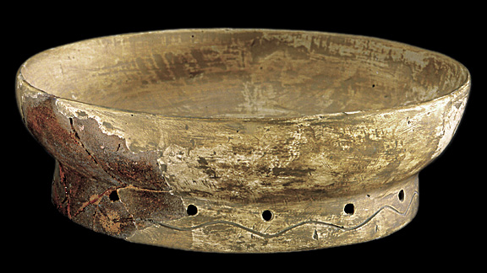
Reference
The archaeological discoveries in historical sites of the Neolithic period, including the painted pottery and stone tools found in Hong Kong, are closely related to those found at the sites and burial grounds in Guangdong and elsewhere. The ancient cultures of the Hong Kong region and the Lingnan region are very closely linked.
Archaeologists have unearthed a Neolithic period Tai Wan-style painted pottery dish at the Tai Wan site on Lamma Island. It is closely linked to the Gaomiao and Daxi cultures of the middle reaches of the Yangtze River.

Slide 7
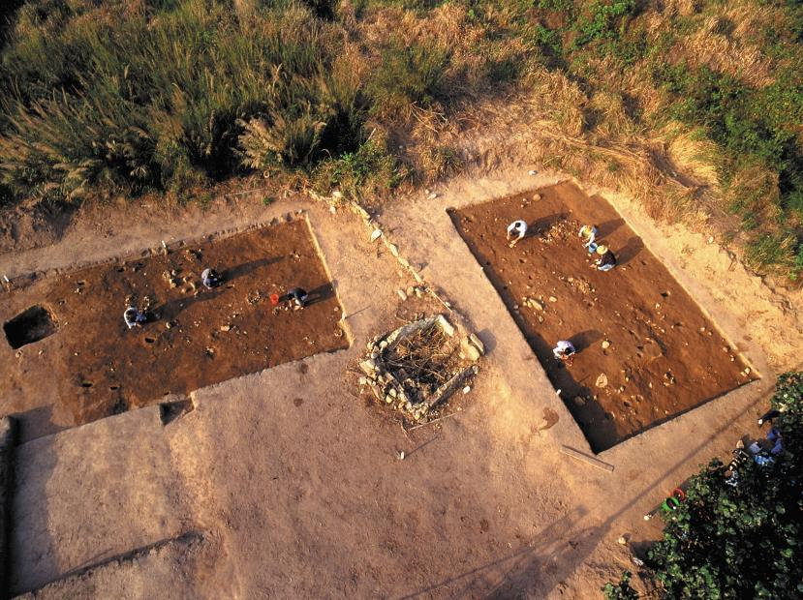
Reference
Archaeologists found that the burial sites at the Tai Wan site on Lamma Island belonged to the Shang Dynasty. It was considered to be a manifestation of the southward extension of the ritual material civilisation of Northern China during the Shang Dynasty.
The excavated artefacts in Hong Kong reflect the prehistoric Hong Kong had the same identity as Lingnan and even certain ancient cultures in the Yangtze and Yellow River valleys.
Remains of a 6,000-year-old housing settlement discovered in Tai Wan, Lamma Island, Hong Kong.
Source: Hong Kong Chronicles (https://www.hkchronicles.org.hk/node/127), Page18-19.
Click on the image to learn more about the historical background
of the development of Hong Kong.

Slide 8
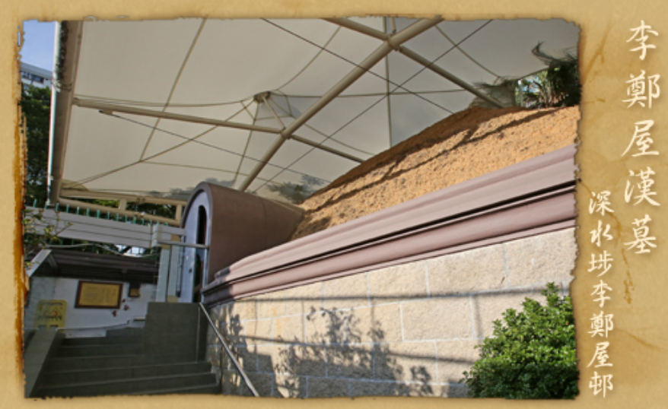
Reference
During the Qin and Han dynasties, Yue, Chu and Han cultures were already present in the Hong Kong area.
In the Han tomb at Lei Cheng Uk, discovered in 1955, a tomb brick inscribed with the words “Daji Panyu” was found. This discovery is still the most important archaeological discoveries of the Han Dynasty in Hong Kong. It has testified the inseparable relationship between Hong Kong and Guangdong as early as in the Han Dynasty for more than 2,000 years ago.
The Lei Cheng Uk Han Tomb, excavated in 1955 at Lei Cheng Uk Estate, Sham Shui Po, is the most famous cultural site of Han Dynasty in Hong Kong. The structure, construction materials and excavated artefacts of Han tomb are similar to those found in many ancient tombs of the Eastern Han Dynasty in Guangdong, indicating the cultural affinity between Hong Kong and Southern China to a considerable extent.
The Han Tomb at Lei Cheng Uk
(Lei Cheng Uk Estate, Sham Shui Po)
Source: Antiques and Monuments Office (https://www.amo.gov.hk/en/historic-buildings/monuments/kowloon/monuments_35/index.html)

Slide 9
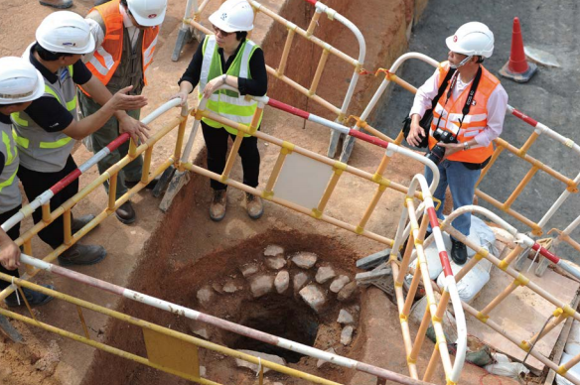
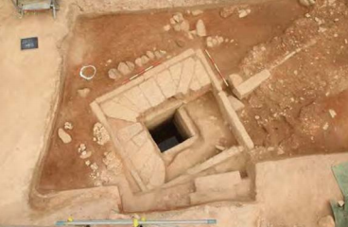
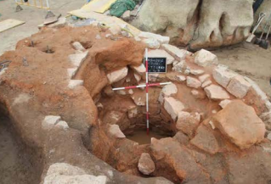
Reference
There are also many archaeological discoveries from the Tang, Song, Yuan, Ming and Qing Dynasties in Hong Kong. The coins, artefacts and tombs unearthed from the excavations all show the cultural links between Hong Kong and Southern China.
The remains of an ancient well from the Song Dynasty unearthed at the construction sites of Shatin to Central Link of MTR in recent years further testify the relationship between Hong Kong and the coastal cities along the Maritime Silk Road in the Song Dynasty.
An earthen well that may be from Song or Yuan Dynasty, as speculated by archeologists from Sun Yat-sen University, Chinese University of Hong Kong, and the Antiques and Monuments Office
Photo of Well No.5 viewed from the top
Photo of Well No.4 viewed from the top
Source: Antiques and Monuments Office (https://www.amo.gov.hk/en/archaeology/recent-archaeology/scl/scl-reports/index.html)

Slide 10
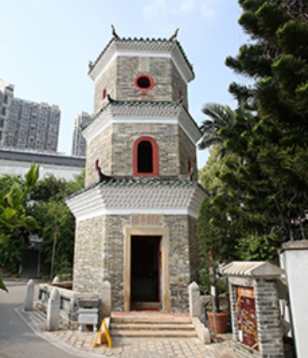
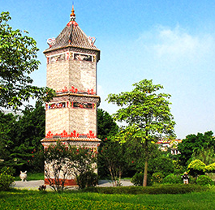
Reference
The cultural landscape of Hong Kong is similar to that of other parts of Southern China. The large number of Chinese-style historic buildings preserved in Hong Kong are very similar in architectural style and structure to the historic buildings in Southern China.
Tsui Sing Lau Pagoda at Ping Shan, Yuen Long, Hong Kong
Source: Antiques and Monuments Office
(https://www.amo.gov.hk/en/historic-buildings/monuments/new-territories/monuments_75/index.html)
Shenjingwen Tower at Guangzhou
Source: People’s Government of Huangpu District, Guangzhou http://www.hp.gov.cn/zjhp/hpjd/content/post_3612368.html
Click on the images for more information

Slide 11
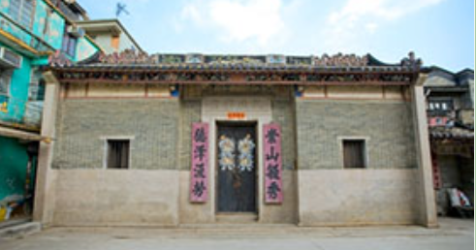
Reference
Ancient study halls in Hong Kong
In the 8th year during the Xining reign (1075), Northern Song Dynasty, Tang Fu (who styled himself as Yuanxie) founded Li Ying Study Hall, also known as Li Ying College. Hong Kong historian Wong Chai Lok pointed out that Tang Fu made a tremendous effort in promoting learning, which made Kam Tin prosper in culture and became the centre of local culture and education.
Colleges and study halls in ancient Hong Kong were mostly built in New Territories today. Those preserved till today or found as historical sites include Chou Wong Yi Kung Study Hall and Yi Tai Study Hall at Shui Tau Tsuen in Kam Tin, Kun Ting Study Hall at Hang Mei Tsuen in Ping Shan, Sin Shut Study Hall in Fanling, Sin Hing Study Hall at Tai Hang Tsuen in Tai Po.
Kun Ting Study Hall founded by the Ping Shan Tang Clan in the Qing Dynasty, with a typical architectural style of Southern China.
Source of image:
Antiques and Monuments Office
(https://www.amo.gov.hk/en/heritage-trails/ping-shan-heritage-trail/kun-ting-study-hall/index.html)

Slide 12
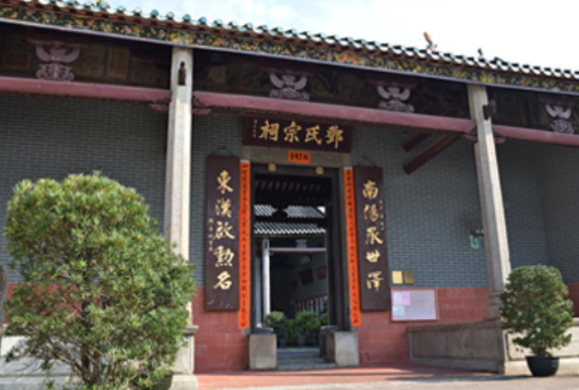
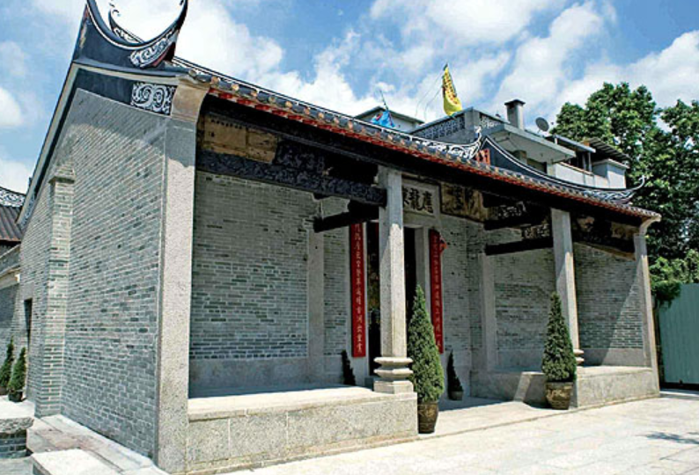
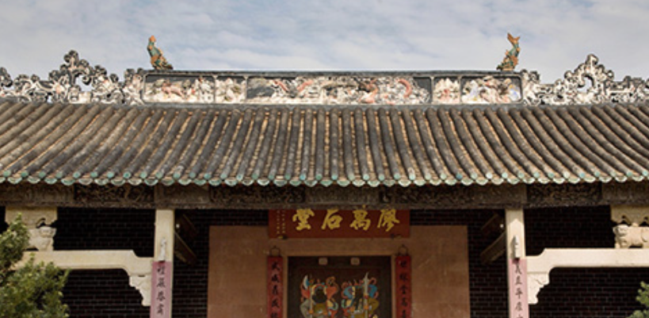
Reference
Ancestral Halls, used for home schooling, include the Man Lun Fung Ancestral Hall in San Tin, the Leung Ancestral Hall and the Kwok Ancestral Hall in Pat Heung, the Tang Ancestral Hall at Ha Tsuen in Yuen Long, the Liu Man Shek Tong Ancestral Hall, Liu Ying Lung Study Hall, Liu Ying Fung Study Hall in Sheung Shui, etc..
Tang Ancestral Hall
Source: Antiques and Monuments Office (https://www.amo.gov.hk/en/historic-buildings/monuments/new-territories/monuments_83/index.html)
Liu Man Shek Tong Ancestral Hall
Source: Antiques and Monuments Office (https://www.amo.gov.hk/en/historic-buildings/monuments/new-territories/monuments_30/index.html)
Liu Ying Lung Study Hall
Source: Press Releases of the Government of the HKSAR (https://www.info.gov.hk/gia/general/200612/05/P200612040212.htm)

Slide 13
Development background for shaping the Chinese culture as the mainstay in Hong Kong society
During the Northern Song and Yuan Dynasties, the Jin and the Mongols moved to the South and disturbed the locals as intruders, so the clans in central-north China moved southward one after another.
Many clans migrated from regions such as Jiangxi, Fujian and Guangdong to Hong Kong, and became the earliest residents to establish themselves in the Hong Kong. The five great clans of Tang, Pang, Hau, Man and Liu have a long history in Hong Kong and they are known as the locals.
The Hakka people of Hong Kong are also immigrants from the Central Plateau who moved to the South and are scattered in different parts of all over Hong Kong. They are also an important group in Hong Kong.
Hong Kong is surrounded by the sea on three sides. Many boat dwellers who made a living by the waters of Southern China have also lived in Hong Kong for a long time.

Slide 14
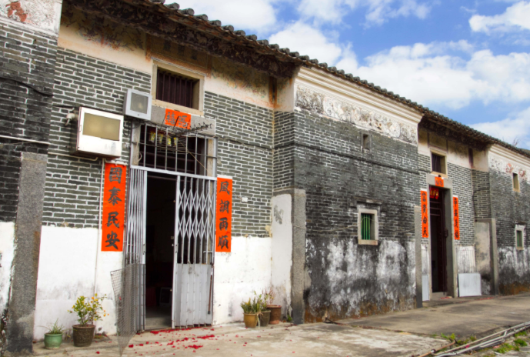
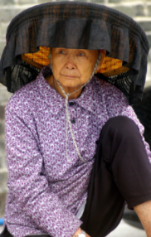
The Hakka people
The Hakka people belonged to the Han Chinese in the Central Plateau and migrated southward for several times since the Western Jin Dynasty, and settled in regions such as Fujian, Jiangxi and Anhui. Later, they moved southward to the Northern and Southern regions of Guangdong. During the Song Dynasty, Hakka people moved to Hong Kong.
After the relocation of the borders in the early years of the Qing Dynasty, the government encouraged the Hakka people to move from Northern Guangdong, Fujian and Jiangxi to Hong Kong to establish their villages and businesses. A large number of the Hakka people from neighbouring areas moved to Hong Kong.
The Hakka people were hardworking. After their arrival in Hong Kong, they cultivated wasteland and settled in villages.
Ta Kwu Ling is one of the oldest Hakka villages in Hong Kong.
A woman wearing a traditional Hakka hat
Click on the image to learn more about the history of the Hakka people in Hong Kong

Slide 15
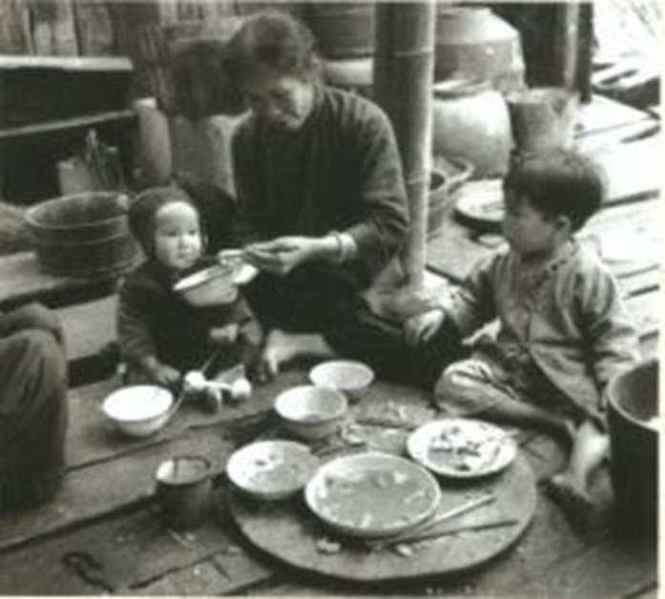
The Tanka people and the Hoklo people
Reference
The Tanka people are also called “boat dwellers” because they live on boats.
During the Tang and Song Dynasties, most of the Tanka people lived in the coastal area of Fujian and Guangdong.
Some of them moved to the coastal harbours of Hong Kong. Most of them moved to Deep Bay, Tai Po Hoi, Sai Kung and the Outlying Islands.
The ancestors of the Hoklo people came from Fujian Province and moved southward during the Tang Dynasty to avoid disasters, settling around Chaozhou-Shantou, Haifeng and Lufeng in Eastern Guangdong. During the Song Dynasty, they migrated to Hong Kong due to war and barren land.
The Hoklo people became another group of “boat dwellers” who made their living by fishing.

Slide 16
Mainland immigrants in Hong Kong
Since the mid-19th century, due to the political turmoil in the Mainland, a large number of people from the Mainland moved to Hong Kong.
For example, the outbreak of the War of Resistance against Japan and the subsequent Chinese Civil War led to a large number of people moving to Hong Kong. Most of them were farmers and workers from Guangdong. In addition, many entrepreneurs (especially industrialists from Jiangsu and Zhejiang) also moved to Hong Kong, bringing along capital and technology with them, which promoted the industrial development in Hong Kong at a later stage.

Slide 17
Chinese customs and traditions
in Hong Kong
Many people of the Mainland who migrated to Hong Kong in the modern era came from Chaozhou, Fujian, Jiangsu and Zhejiang, and they had their own traditional customs and practices. After migrating to Hong Kong, many of them followed the customs and practices of their original places of residence. For example, the Hakka people still follow Hakka customs, and many of the customs and practices of the boat dwellers are still preserved.
Traditional Chinese culture is a key element in shaping the culture of Hong Kong society in terms of folk customs, habits, values, language, etc.

Slide 18
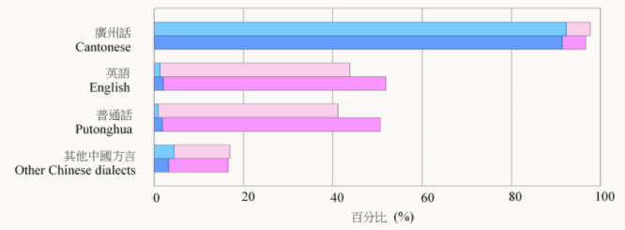
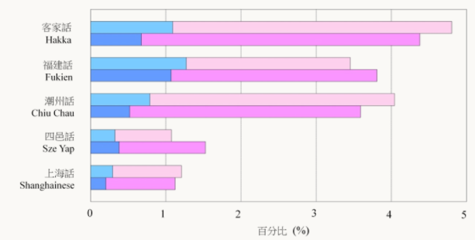
A Chinese-oriented Hong Kong society
Hong Kong society is predominantly Chinese, and Hong Kong people mainly use Cantonese as their common language of communication.
2016 By-census
(Please refer to the latest population census)
Other than Cantonese and Putonghua, the three most common Chinese dialects spoken by the Hong Kong population are Hakka, Fukien and Chiu Chau.
Proportion of population aged 5 years and over being able to speak selected languages/ dialects, 2006 and 2016
Source: 2016 Population By-census (https://www.bycensus2016.gov.hk/en/Snapshot-08.html)

Slide 19
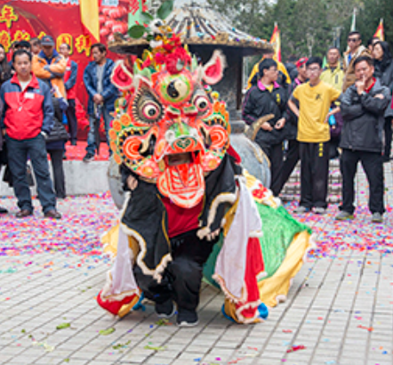
Reference
Hakka Unicorn Dance in Hang Hau, Sai Kung
The activity has been practised for more than 200 years. The Hakka people believe the Chinese unicorn, the qilin, is an auspicious animal that can ward off evil and bring good luck. So, on all celebratory occasions such as Chinese New Year, weddings, birthday parties, the inauguration of an ancestral hall, moving into a new home, welcoming guests, the jiao festivals and birthdays of deities, there would invariably be a unicorn dance.
Since the Hakka people brought the unicorn dance to Hong Kong, fusing local traditional music and martial arts, the unicorn dance has developed its own styles and sequence of movements. Hang Hau Hakka unicorn dance was inscribed onto the fourth national list of Intangible Cultural Heritage in 2014.
Source: Intangible Cultural Heritage Office
(https://www.lcsd.gov.hk/CE/Museum/ICHO/en_US/web/icho/representative_list_unicorn.html)

Slide 20
The Chinese culture has never been interrupted in Hong Kong
During the British occupation of Hong Kong, even though foreign cultures had a great influence on Hong Kong, the inheritance of Chinese culture has never been interrupted in Hong Kong.
Click on the image to learn more about.the intangible cultural heritage of Hong Kong that passes on Chinese culture
Leisure and Cultural Service Department
Intangible Cultural Heritage Office

Slide 21
Reference
Searching for the roots of Chinese culture
The University of Hong Kong was founded in 1912 and its motto ‘Sapientia et Virtus’ (wisdom and virtue);「明德格物」) originated from a well-known sentence quoted from the Confucian classic The Great Learning (《大學》) in the Four Books (「四書」). In 1927, the Chinese Section of the University of Hong Kong was founded.
The Chinese University of Hong Kong was founded in 1963. Its motto ‘Through learning and temperance to virtue’ (「博文約禮」) comes from On Mean in the Analects of Confucius (《論語．雍也》).
In 1995, the City University of Hong Kong was inaugurated and its motto is ‘Officium et Civitas’ (sense of duty and union of citizens);「敬業樂群」), which comes from Record on the Subject of Education in the Book of Rites (《禮記．學記》).
Activity: With the help of the guiding questions below, search for the roots of Chinese culture in your daily life:
What are the meaning and origins of the mottos of your schools?
Where do we come from? to trace our ancestries based on our “native place”: what traditional customs and practices are there in the local area? What are the cultural characteristics? What historical sites are there?

Slide 22
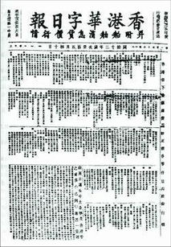
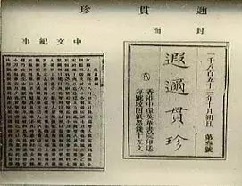
Reference
Chinese newspapers in the early days of Hong Kong
In 1853, Chinese Serial was established. It published a large number of articles which introduced social sciences and natural science in the West. It was one of the earliest Chinese periodicals in modern China.
In 1872, The Chinese Mail was established. It was the first Chinese newspaper run by Hong Kong people.

Slide 23
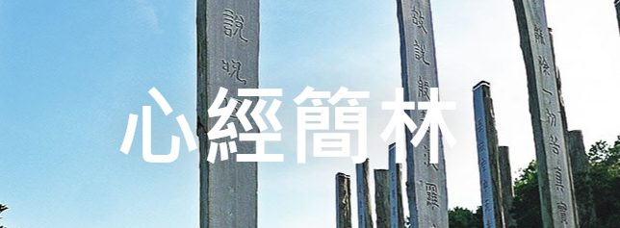
Reference
Chinese studies in Hong Kong
In the 1940s, Professor Tschen Yin Koh, a master of Chinese studies, taught at the University of Hong Kong for two years. He was the first person to teach the history of Tang Dynasty in Hong Kong.
To learn more about the development of the School of Chinese, the University of Hong Kong, please refer to: http://web.chinese.hku.hk/main/school-history/
In 1949, Dr Ch’ien Mu, discussed Chinese and Western cultures based on his own philosophical and cultural ideas, as well as organised and promoted Chinese traditional culture. He established New Asia College with a group of scholars coming from the Mainland. New Asia College is the predecessor of the Chinese University of Hong Kong, and it nurtured several generations of experts in Chinese studies for Hong Kong.
Source: website of the Chinese University of Hong Kong (https://www.cuhk.edu.hk/ugallery/en/story/chien_mu.html)
Professor Jao Tsung-I was born in Chaozhou, Guangdong. He developed his studies in Hong Kong and was internationally well-known. He advocated “amalgamation of academia and arts”, and practised this principle throughout his life with outstanding achievements in both arts and academia.
Source: Jao Tsung-I Academy (https://www.jtia.hk/en/art-exhibition/)
Click on the image to learn more about calligraphy of Professor Jao Tsung-I, a master of Chinese Studies

Slide 24
Relationship between Hong Kong and the Mainland from late Qing Dynasty to early 20th century (I)
Under the British rule, Hong Kong still maintained close ties with the Mainland with frequent interaction, especially in terms of business and population movement.
Taking the Revolution of 1911 as an example, Hong Kong also played a role in overthrowing the Manchurian Qing Government.
Whenever large-scale natural disaster occurs in the Mainland, Hong Kong residents would make generous donations to help the Mainland compatriots to overcome difficulties.

Slide 25
Relationship between Hong Kong and the Mainland from late Qing Dynasty to early 20th century (II)
During the Japanese invasion of China, Hong Kong residents spent money and efforts in helping the Mainland to fight against Japanese troops. After Hong Kong was occupied, guerillas formed by Hong Kong residents kept fighting against the Japanese and made contributions to the victory of Hong Kong in the War of Resistance against Japanese Aggression.
After the war, the Nationalist Government planned to recover Hong Kong. Unfortunately, due to the joint forces of UK and the USA, Hong Kong was occupied by Britain again.
Activity
Many civil anti-Japanese organisations emerged in Guangdong, among which the Dongjiang (East River) Column led by the Communist Party of China, and the Hong Kong Independent Battalion formed by Hong Kong civil forces were the most well known. These organisations made indelible contributions to the victory of China in the War of Resistance against Japanese Aggression.
Collect relevant information to learn more about the history and achievements of the above-mentioned anti-Japanese forces, from which we can understand the perseverant and indomitable spirit of our elder generations to defend our country.

Slide 26
Hong Kong in the Anti-Japanese National Salvation Movement
Reference
During the War of Resistance against Japanese Aggression, Hong Kong became one of the major centres of the Anti-Japanese Salvation Movement. In January 1938, the Hong Kong Office of the Eighth Route Army, led by Liao Chengzhi and Pan Hannian, was established in Hong Kong. On 14 June 1938, the Chinese Defence League was founded in Hong Kong.
In 1938, Hong Kong launched the 813 National Salvation Donation Campaign, and obtained millions of donation.
Another form that Hong Kong people supported the motherland in fighting against Japanese aggression was to organise ambulance teams, homecoming service corps, etc. During the War of Resistance against Japanese Aggression, many well-known scholars such as Zou Taofen, Mao Dun, Xia Yan, Fan Changjiang and Zhang Tiesheng went to Hong Kong and facilitated the organisation of anti-Japanese cultural propaganda activities.
Source: Xinhuanet (http://www.xinhuanet.com/mil/2020-07/05/c_1210688041.htm)

Slide 27
Reference
Examples of major anti-Japanese events in Hong Kong
On 7 December1941, the Pacific War broke out. On the following day, the Japanese Army crossed Shenzhen River and attacked the New Territories. The British Army defended for 18 days before they declared their surrender.
In 1942, anti-Japanese guerilla force organised the ‘Secret Rescue’, sending around 800 politicians, cultural figures and their family members stranded in Hong Kong back to the Mainland.
After Hong Kong was occupied, the anti-Japanese guerilla force, the Hong Kong Independent Battalion led by the Communist Party of China, never ceased to organise anti-Japanese activities in Hong Kong.

Slide 28
Relationship between Hong Kong and the Mainland after the war
After 1949, the Korean War and the embargo imposed by the United Nations on China provided opportunities for the development of the shipping industry in Hong Kong. Hong Kong merchants and shipowners traded with China through different means. Hong Kong acted as China’s window towards the outside world, and the Mainland provided Hong Kong with drinking water, food, and raw materials, which supported the stable development of Hong Kong society.
After the reform and opening-up, the relationship between Hong Kong and the Mainland has become closer.
Regarding the embargo and the development of industrialisation, please refer to the sources below:
Source: Marine Department (https://www.mardep.gov.hk/theme/port_hk/en/p1ch6_1.html)

Slide 29
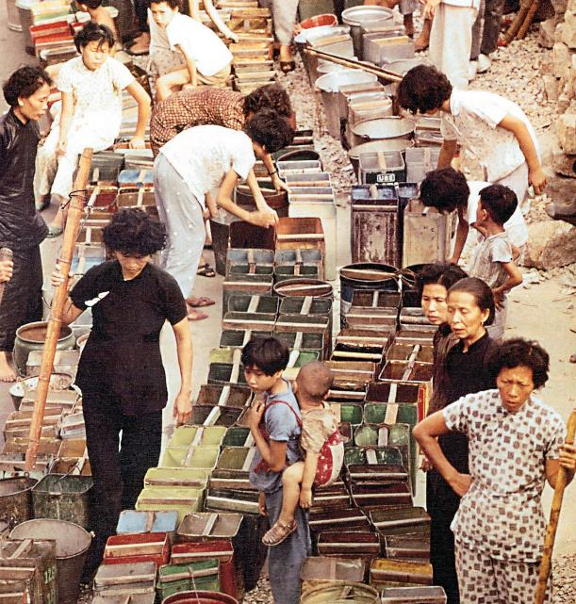
Dongjiang Water Supply to Hong Kong
Reference
Hong Kong lacks fresh water resources. With the rapid growth of population and the development of industry and commerce, this problem became more serious.
In 1963, Hong Kong was hit by the most serious water shortage in recent 60 years. The Hong Kong Government announced the imposition of water rationing, and water was only supplied once every four days and for four hours each time.
Hong Kong residents queuing for water in 1963

Slide 30
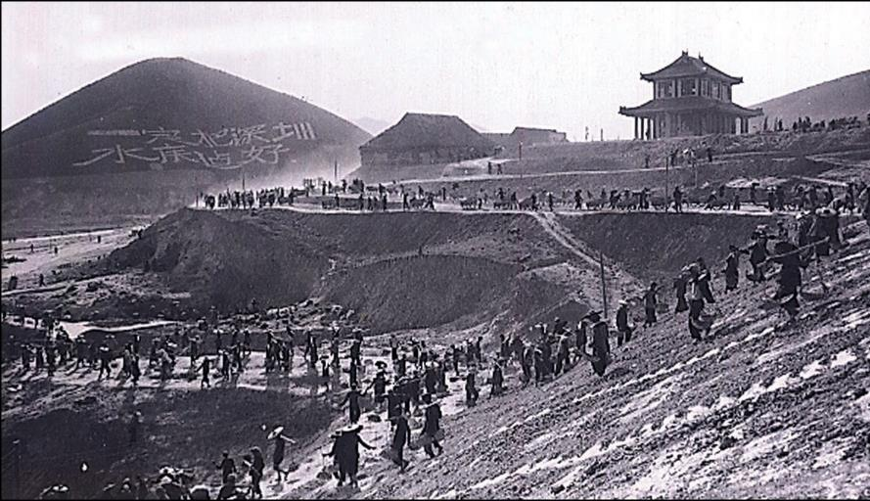
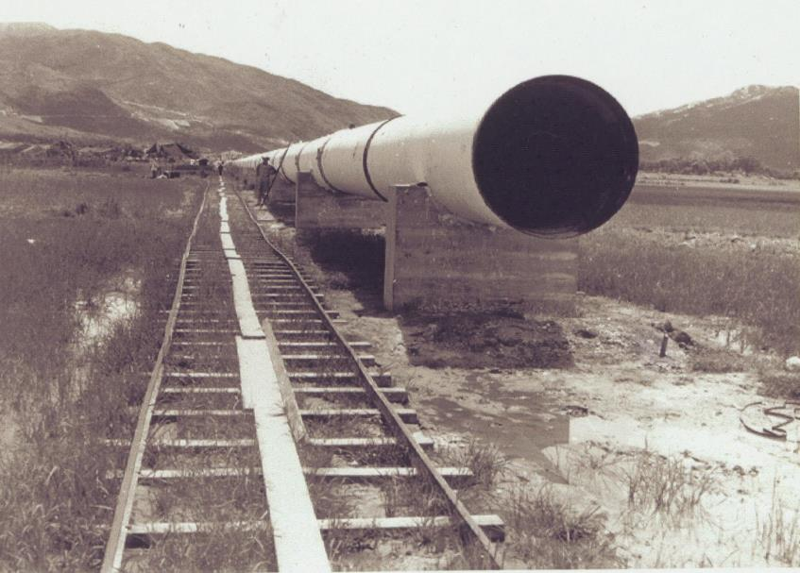
Dongjiang Water Supply to Hong Kong
Reference
The Chinese General Chamber of Commerce in Hong Kong and the Hong Kong Federation of Trade Unions repeatedly reported to Guangdong Province several times concerning the serious situation of water shortage in Hong Kong. In order to solve the problem of inadequate supply of drinking water in Hong Kong in the long run, the then Premier of the PRC, Zhou Enlai, ordered to launch the Dongjiang-Shenzhen Water Supply Scheme.
The country allocated RMB 35.84 million from foreign aid fund to ensure the smooth completion of the project.
In 1963, in order to solve the water shortage in Hong Kong, with the consent of Guangdong Provincial Government, Hong Kong used oil tankers to fetch fresh water from the Pearl River.
Since the 1970s, Dongjiang-Shenzhen Water Supply Scheme has been expanded for three times, which cost over RMB 2 billion in total.
Shenzhen Reservoir was an important source of water supply for Hong Kong. The photo shows the construction of Shenzhen Reservoir in 1959.
In order to hold the water transported from Shenzhen Reservoir, Hong Kong laid large water pipes in 1960.

Slide 31
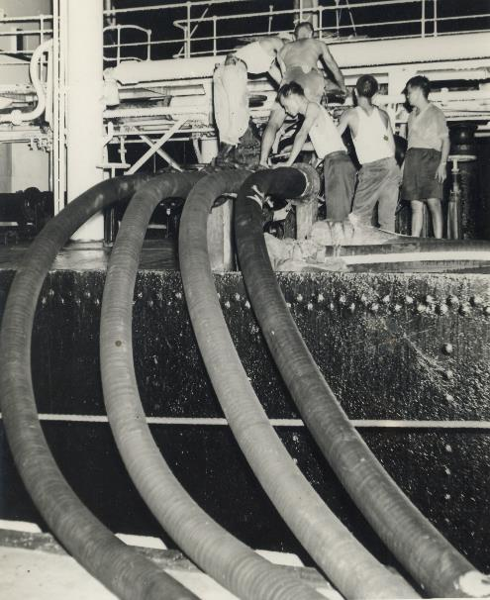
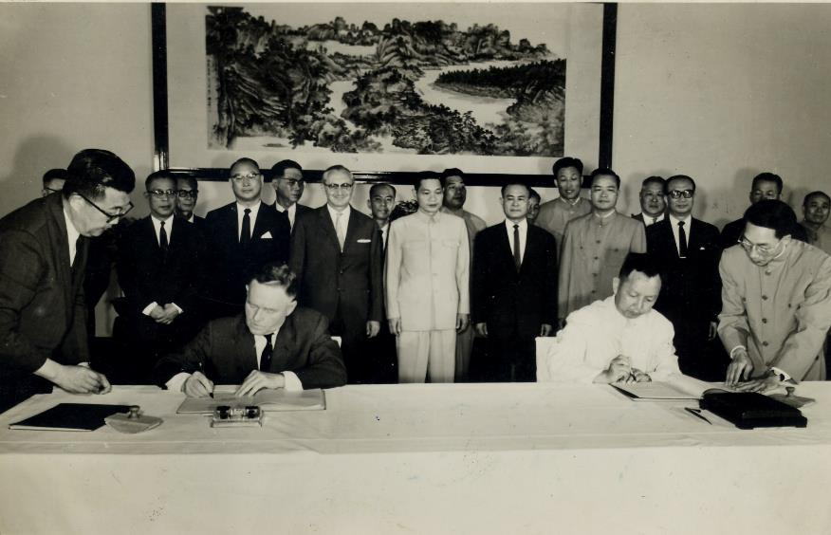
Reference
Dongjiang Water Supply to Hong Kong
On 22 April 1964, the signing ceremony of Agreement on Supplying Dongjiang Water to Hong Kong and Kowloon was held in Guangzhou.
The photo shows that Head of the Guangdong Province Water Conservancy and Hydro-electric Bureau, Liu Zhaolun (right), and, Deputy Director of Public Works cum Head of the Waterworks Office, T.O. Morgan (left), signed the agreement. The agreement stipulates that water supply is 68.2 million cubic meters per year, and water price is RMB 0.1 per cubic meter.
After ton tanker “lanthe” shipped freshwater to Hong Kong, workers used tubes to connect to the water distribution system in Hong Kong.

Slide 32
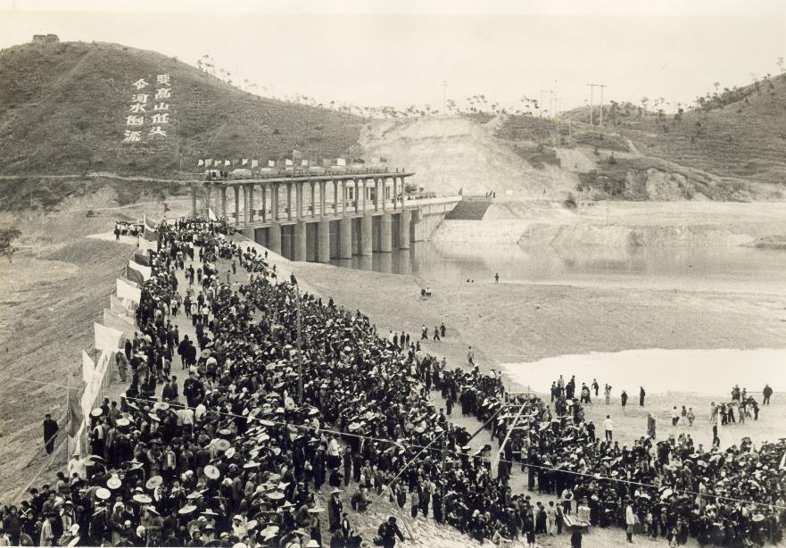
Relationship: From the example of water supply from the Mainland to Hong Kong, we can see that our country tried every possible means to solve problems for Hong Kong when Hong Kong residents encountered difficulties in their lives. Among these, our country spent a lot of human and material resources to provide assistance. This shows that our country is very concerned about the needs of Hong Kong residents. Relevant example: Take the fight against COVID-19 as an example. As requested by the Government of the HKSAR, the Central Government arranged laboratory testing personnel to Hong Kong to assist in the testing of COVID-19.
Reference
Dongjiang Water Supply to Hong Kong
When drinking water, one should not forget where it comes from. From this example, what do you think is the relationship between the Mainland and Hong Kong?
Can you name other examples showing the close relationship between the Mainland and Hong Kong?
On 27 February 1965, the completion ceremony of the first construction phase of Dongjiang-Shenzhen Water Supply Scheme was held at Tangtouxia, Shenzhen. This construction supplied 60 million cubic meters of water to Hong Kong in that year, which accounted for 1/3 of Hong Kong’s annual water consumption at that time.

Slide 33
Material support to Hong Kong
Reference
Our country is an important source of food, industrial raw materials and fuels for Hong Kong.
In order to solve transportation difficulties in supplying fresh produce to Hong Kong and Macao, our country has arranged three “express trains to deliver frozen produce to Hong Kong and Macao” since 1962. Every day, these trains transport goods from Shanghai, Zhengzhou, and Wuhan (or Changsha) to Hong Kong via Shenzhen. Except Lunar New Year’s Day, these trains run 364 days a year, and they are called “three express trains” in history.
In the early days after the founding of the PRC, the Mainland supported Hong Kong economy and people’s livelihood, which was one of the important factors for the success of industrialization in Hong Kong. Due to the stable and balanced supply of products from the Mainland, the inflation rate and labour cost in Hong Kong were lower than those of Western industrialised countries, which enhanced the Hong Kong’s competitiveness in the international market.

Slide 34
1. Illustrate how Chinese and Western cultures integrate in Hong Kong with concrete examples. Hong Kong people communicate in Cantonese and English, and write in Chinese and English in daily lives. According to the Official Languages Ordinance, both Chinese and English are official languages in communication between the government or officials and the public, and in court proceedings. 2. What do you think is the impact of cultural diversity integrating Chinese and Western cultures on the development of Hong Kong? Cultural diversity integrating Chinese and Western cultures makes Hong Kong society more colourful. In addition to inheriting Chinese culture, cultures of different regions are integrated in different aspects of life, such as festivals, food, and clothing. Hong Kong people understand and appreciate cultures of different regions, which enhance their global perspectives and competitiveness.
The features of cultural diversity based on Chinese culture

Slide 35
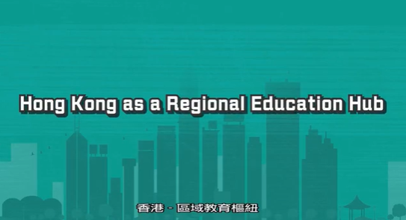
Internationalisation of education
Internationalisation is the goal that many universities in Hong Kong pursue, and the proportion of overseas employees of higher education institutions in Hong Kong is very high. The elements of internationalisation includes teachers from different countries and regions, internationally recognised degrees, promotion of bi-literacy and trilingualism in the medium of instructions, and frequent international academic exchanges.
For more information, please click on the image and watch the video.
Source: Education Bureau
(https://www.youtube.com/watch?v=kaO9EENkb6A&t=48s)

Slide 36
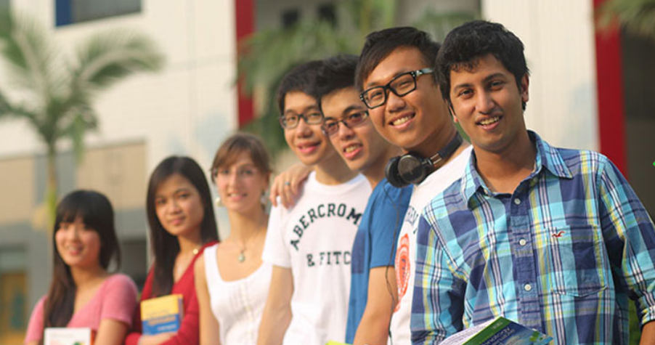
Internationalisation of education
Internationalisation and openness of the universities in Hong Kong enable Hong Kong academia to be well-informed of the development and trends of world academia. They can also recruit, attract, and accommodate world-class talents. These not only widen their horizons and promote academic development, but also improve teaching and research levels of universities.
Picture from Education Bureau (https://www.studyinhongkong.edu.hk/en/)

Slide 37
Promotion of Putonghua
Due to frequent cultural exchanges between Hong Kong and the Mainland, Putonghua has gradually become the language in daily life and work for Hong Kong people. Since primary and secondary schools offer Putonghua in the curriculum, students are generally able to communicate in Putonghua.
The Civil Service Training and Development Institute of Hong Kong (renamed as the Civil Service College in December 2021) offers various Putonghua courses. Promotion of Putonghua facilitates cultural exchanges between Hong Kong and the Mainland, and improves Hong Kong’s status as a centre of cultural exchanges.

Slide 38
Question
At the end of 1950s of the 20th century, the proportion of exports of manufactured products accounted for 70% of the total export values of Hong Kong, indicating that Hong Kong had transformed to an industrialised city. In the 1970s, Hong Kong implemented policies for promoting economic diversification. In particular, after the reform and opening-up of the Mainland, Hong Kong’s economy stepped into a stage of rapid development, and gradually formed several pillar industries, such as finance, foreign trade, manufacturing industry, shipping, tourism, and information technology, and has developed into an international financial, trade and transportation centre.
Along with industrialisation and rapid economic growth, new trends have emerged in Hong Kong culture. The development of the international market economy, together with corresponding political and legal systems, facilitate diversified development of Hong Kong culture.
Based on the above information, what are the factors that shape the cultural characteristics of Hong Kong?
Hints:
The inclusiveness of Chinese culture; the integration of customs and immigrants; the impact of economic development; and the government policies …

Slide 39
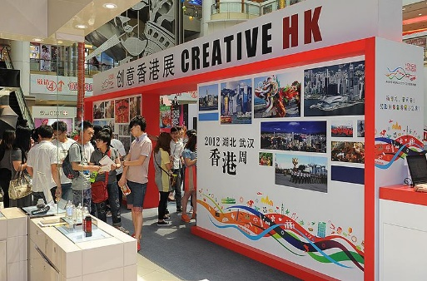
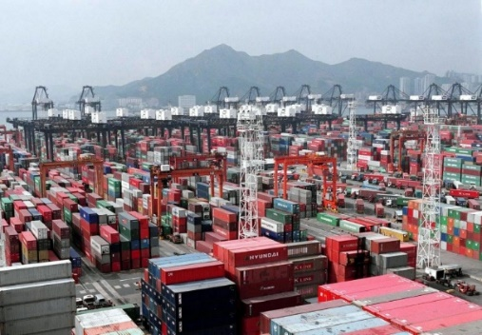
Influence on Hong Kong’s economic development
Hong Kong is a modernised city of the country, which preserves the tradition of Chinese culture at the same time. Cultural diversity in Hong Kong, which is rooted in Chinese tradition, has a significant impact on social development in Hong Kong. Economic development in free trade reflects Hong Kong people’s spirit that values credit and contract, flexibility and creativity, and perseverance and diligence inherited from Chinese culture. These promote economic development and enable Hong Kong to develop from an entrepot into an international trade, financial and transportation centre. Furthermore, The Outline of the Fourteenth Five-Year Plan for the National Economic and Social Development and the Long-Range Objectives Through the Year supports Hong Kong to become an international innovation and technology hub.
Promoting the creative industry in Hong Kong
Source: InvestHK (https://www.investhk.gov.hk/en/industries/creative-industries.html)
Shipping docks in Hong Kong
Source: Hong Kong Maritime and Port Board (https://www.hkmpb.gov.hk/en/port.html)

Slide 40
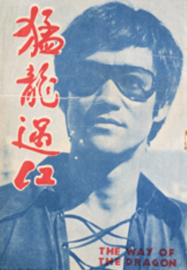
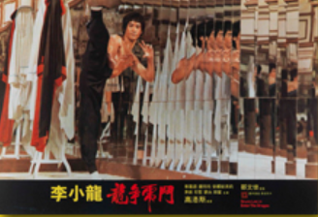
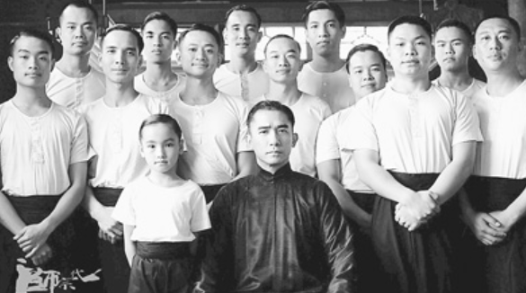
Rapid development of cultural and creative industries (I)
Creative industries are important driving forces for the economic development in Hong Kong, strengthening the innovation capacity of the economy and driving its economic growth in the future. Hong Kong has a leading edge in key creative sectors such as film, television, music, design, architecture, advertisement, comics and animation, games and digital entertainment, printing and publication. The creative industries of Hong Kong have been striving for excellence and receiving international awards from time to time.
Source: Website of Hong Kong Economic, Trade and Cultural Office (https://www.hketco.hk/en/culture/creative.html)
The film The Grandmaster inherits wisdom and grace of traditional Chinese culture
The film The Way of the Dragon
The film Enter the Dragon
Source:
Hong Kong Heritage Museum: https://www.heritagemuseum.gov.hk/en_US/web/hm/exhibitions/data/exid209.html
People’s Daily Online: http://theory.people.com.cn/BIG5/n/2013/0110/c40531-20153215.html

Slide 41
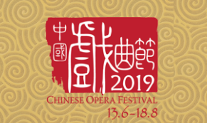
Rapid development of cultural and creative industries (II)
According to the statistics, there are a total of around 39,200 cultural and creative industry-related enterprises in Hong Kong, with about 200,000 practitioners. Cultural and creative industries represent around 5% of Hong Kong’s Gross Domestic Product.
Source: Website of Hong Kong Economic, Trade and Cultural Office (https://www.hketco.hk/en/culture/creative.html)
Please click on the images to get more information.

Slide 42
Activity for enquiry (I)
Various arts and cultural activities are held frequently in Hong Kong. Arts and culture as well as creative industries in Hong Kong are well known for their diversity as well as integration of Chinese and Western cultures. These activities are wide-ranging with high quality and quantity.
Please learn more about the programmes of Hong Kong Arts Festival, and classify the performances according to their types, forms, and cultural background, etc. Then, select a topic, design a display board, and share your findings with others.
Source: Website of Hong Kong Arts Festival
(https://www.hk.artsfestival.org/en)

Slide 43
Activity for enquiry (II): cultural and creative industries
From drama to dance, and from pop music to Chinese opera, Hong Kong is the centre of Eastern and Western performing arts.
Hong Kong has been promoting the development of creative industries, with a view to building itself as Asia's creative capital. ‘Create Hong Kong’, established in June 2009, is a dedicated agency for promoting the development of creative industries in Hong Kong and providing one-stop services and better support for the industries.
Source: Website of Hong Kong Economic, Trade and Cultural Office (https://www.hketco.hk/en/culture/creative.html)
Including M+, Xiqu Centre, Hong Kong Palace Museum, etc.
Please refer to the suggestions of the images and explore the latest news of arts, cultural and creative industries in Hong Kong, and use examples to explain the integration of Chinese and foreign cultures and the co-existence of diverse cultures in Hong Kong.
Please click on the images to get more information

Slide 44
The End

Slide 45
User Guide
The primary users of this resource are teachers. It aims to provide teachers with content knowledge relevant to the topic to enable teachers to have a deeper understanding of teaching content when preparing for their lessons.
All data, videos, photos, pictures, questions and suggested answers can be used for multiple purposes, such as teachers’ teaching materials, references for curriculum planning and learning and teaching, and student assignments, etc. To align with Citizenship and Social Development Curriculum and Assessment Guide (Secondary 4-6) (2021) (C&A Guide), this resource should be adapted to cater for students’ learning diversity and the needs of classroom teaching, etc.
Teachers may provide appropriate supplementary notes/ explanations to enrich this resource in order to enhance students’ understanding of the topic and information provided.
In accordance with the curriculum rationale and aims, teachers may select other learning and teaching resources which are correct, reliable, objective and impartial to help students build up a solid knowledge base, develop positive values and attitudes as well as enhance critical thinking and problem solving skills, and various generic skills.
If some information cannot be provided in this resource due to copyright issue, teachers may visit relevant websites provided.
Some information may have been updated when being used by teachers, teachers may visit the corresponding websites to obtain the up-to-date information.
Please also refer to the C&A Guide to understand the requirements and arrangements of the learning and teaching of the curriculum.

