Slide 1
Learning focus:
Benefits and contributions of the HKSAR’s participation in national affairs:
Benefits: the country’s policies supporting the development of Hong Kong; enabling Hong Kong to have the advantage of “one country, two systems”
Contributions: Hong Kong promoting the development of and exchange with the Mainland in different areas; donations for natural disasters and supporting the needs of the developing regions of the Mainland
Citizenship and Social Development:
Theme 1: Hong Kong under “One Country, Two Systems”
Topic: Situation of the country and sense of national identity
Translated version
July 2021

Slide 2
Learning Objectives
Knowledge
To understand that the country’s key policies supporting the development of the HKSAR provide significant foundation for the prosperity and stability of Hong Kong; to understand the key contributions of Hong Kong’s participation in national affairs
To explain that Hong Kong would be even better when our country is doing well and the advantage of “one country, two systems”. Hong Kong is not only a beneficiary but also a contributor in the course of the development of our country
Skills
To be able to build on objective evidence to analyse the benefits and contributions of Hong Kong’s participation in national affairs from multiple perspectives
Values
To understand that the motherland provides significant foundation for the prosperity and stability of Hong Kong, and Hong Kong would be even better when our country is doing well; to be willing to care about our country and participate in national affairs, and make contributions to Hong Kong and our country

Slide 3
Supporting the HKSAR in response to the Asian financial crisis
In 1997, the outbreak of the Asian financial crisis spread rapidly. During the Asian financial crisis, Hong Kong dollar came under heavy attack by international speculators which seriously threatened the stability of the monetary and financial system of Hong Kong. The HKSAR government took decisive actions and finally warded off the speculators, and led Hong Kong through the serious crisis.
In this incident, the central government clearly stated its stance in supporting the HKSAR government and it would provide assistance when needed. The former Chief Executive of the Hong Kong Monetary Authority (HKMA), Mr Norman Chan, once wrote in his blog post on the HKMA’s webpage, quoting the speech of the former Premier of the State Council of the People’s Republic of China (PRC), Mr Zhu Rongji, and indicated, “The Central People’s Government’s pledge, offered during such a critical period, was undoubtedly a powerful boost to our confidence and morale.”
References:
Blog posts of two former Chief Executives of HKMA: Blog post of Mr Joseph Yam (URL), blog post of Mr Norman Chan (URL)
Speech of the former Premier of the State Council of the PRC, Mr Zhu Rongji (Chinese only) (URL (29”17 – 29”50))

Slide 4
Reference
Supporting Hong Kong in response to the international financial crisis
The international financial crisis in 2008 was a result of the subprime mortgage crisis originated from the United States, which hammered Hong Kong’s economy: the export growth slowed down markedly, the domestic demand shrank, the unemployment rate rose, and small and medium enterprises had difficulties in financing and struggled in operation.
Our country was highly concerned about the impact of the crisis on Hong Kong. In December 2008, our country put forward 14 policy measures to support the financial stability and steady economic development of Hong Kong. In January 2009, our country launched a series of policies and measures including the currency swap agreement up to RMB200 billion signed by the People’s Bank of China and the Hong Kong Monetary Authority. Later, the central government announced various policy measures to support the economic development of Hong Kong, improve people’s livelihood, and strengthen exchanges and cooperation with the Mainland.
4

Slide 5
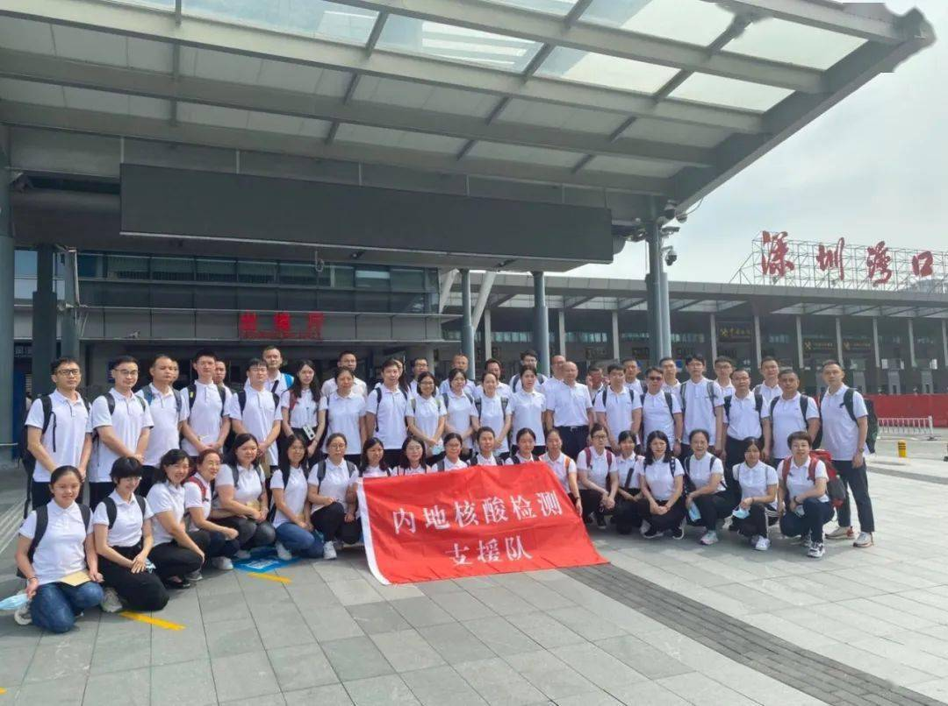
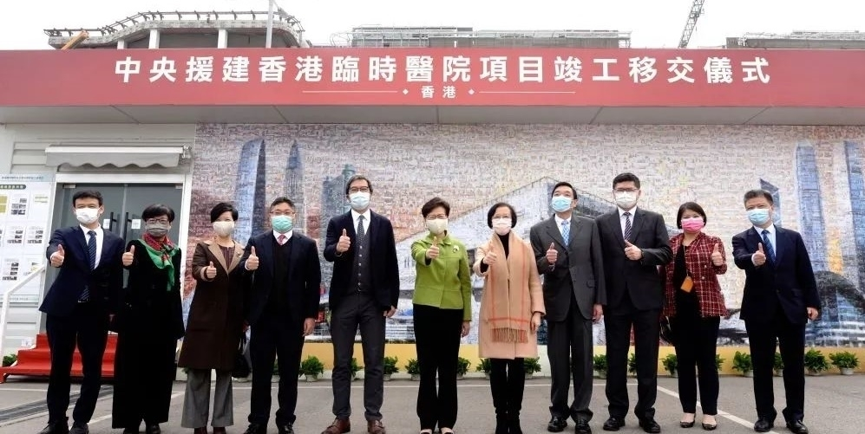
Supporting Hong Kong to fight against the COVID-19 epidemic
In 2020, the central government was deeply concerned about the epidemic situation of COVID-19 in Hong Kong. As requested by the HKSAR government, the central government arranged the Mainland testing support team to assist in large-scale nucleic acid testing and speeding up the construction of temporary quarantine and treatment centres.
In early July 2020, Hong Kong experienced its third wave of COVID-19 outbreak. As requested by the HKSAR government, the National Health Commission quickly established the Mainland support team to support nucleic acid testing and anti-epidemic measures in Hong Kong.
On 20 January 2021, Mrs Carrie Lam officiated the completion and handover ceremony of the temporary hospital construction project.

Slide 6
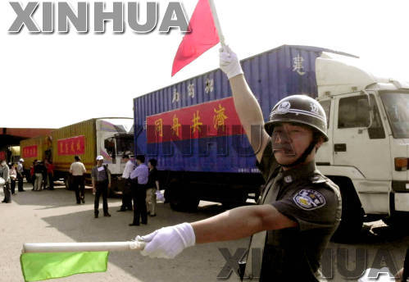
Supporting Hong Kong to fight against SARS
During the first half of 2003, Hong Kong was still in the aftershock of the Asian financial crisis. To compound its woes, the outbreak of SARS threatened the health of Hong Kong people and further stunted local economic growth. Deflation was resulted; the market was depressed; unemployment rate surged. The Mainland, despite its pressing needs for anti-epidemic medical supplies, provided large quantities of anti-epidemic medicine and equipment to Hong Kong for free.
On 29 June 2003, the Mainland and Hong Kong Closer Economic Partnership Arrangement (CEPA) was signed between the Mainland of China and Hong Kong. It put forward the liberalisation measures and implementation objectives in trade in goods, trade in services, and trade and investment facilitation between the Mainland and Hong Kong, which helped Hong Kong move out of the doldrums of SARS and restore its economic growth.
In May 2003, the first batch of medical supplies for fighting against SARS was received from the central government and delivered through the Shenzhen port to Hong Kong.

Slide 7
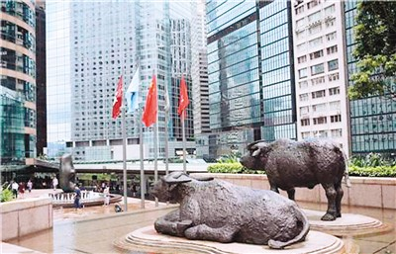
Supporting the HKSAR to consolidate and enhance its competitive edge
After years of development, Hong Kong has developed its distinctive competitive edge in various aspects. The central government has also launched a series of policies to consolidate and enhance its position as international centres for financial services, transportation and trade, and an international aviation hub.
Examples related to the country’s support for the development of Hong Kong as an international financial centre:
To encourage the Mainland enterprises to list in Hong Kong
To launch “Shanghai-Hong Kong Stock Connect”, “Shenzhen-Hong Kong Stock Connect” and “Bond Connect”
……
Entrance of Hong Kong Exchanges and Clearing Limited (HKEX)
7

Slide 8


Supporting and strengthening Hong Kong as a global offshore RMB business hub
Reference
In November 2003, the People’s Bank of China (PBC) announced that it agreed clearing arrangements would be provided for banks in Hong Kong which handled personal renminbi (RMB) services in four areas (including deposits, exchange, remittances and RMB cards).
In February 2004, banks in Hong Kong officially launched their RMB business.
In June 2007, PBC allowed financial institutions of the Mainland to issue RMB bonds in Hong Kong.
In September 2009, the Ministry of Finance issued RMB government bonds in Hong Kong for the first time.
In June 2009, PBC allowed enterprises in Hong Kong and those in cities like Shanghai and Guangzhou to use RMB as the settlement currency for trade transactions.

Slide 9
Reference
Measures for the Administration of Pilot RMB Settlement in Cross-border Trade
According to the Measures for the Administration of Pilot RMB Settlement in Cross-border Trade announced by the People’s Bank of China (PBC) etc. in 2009:
Article 6 states that “the cross-border clearing and settlement in RMB of import and export trade between a pilot enterprise and an overseas enterprise can be done either through the clearing banks for RMB business in Hong Kong, Macao or through a domestic commercial bank that acts as an agent for an overseas commercial bank.”
Article 7 states that “the commercial banks that are approved by the PBC and Hong Kong Monetary Authority or by the PBC and the Monetary Authority of Macao that are members of the PBC’s Large Value Payment System and are providing RMB clearing service in Hong Kong or Macao may serve as clearing banks for RMB business in Hong Kong or Macao to provide cross-border RMB clearing and settlement service.”
9

Slide 10
Reference
Supporting the interconnection between the stock and bond markets of the Mainland and Hong Kong
Launched
“Shanghai-Hong Kong Stock Connect”
Launched “Shenzhen-Hong Kong Stock Connect”
Launched “Bond Connect”
In 2014, stock markets of Shanghai and Hong Kong achieved interconnection and mutual access.
In 2016, stock markets of Shenzhen and Hong Kong achieved interconnection and mutual access.
In 2017, investors could buy Mainland bonds in Hong Kong.
10

Slide 11
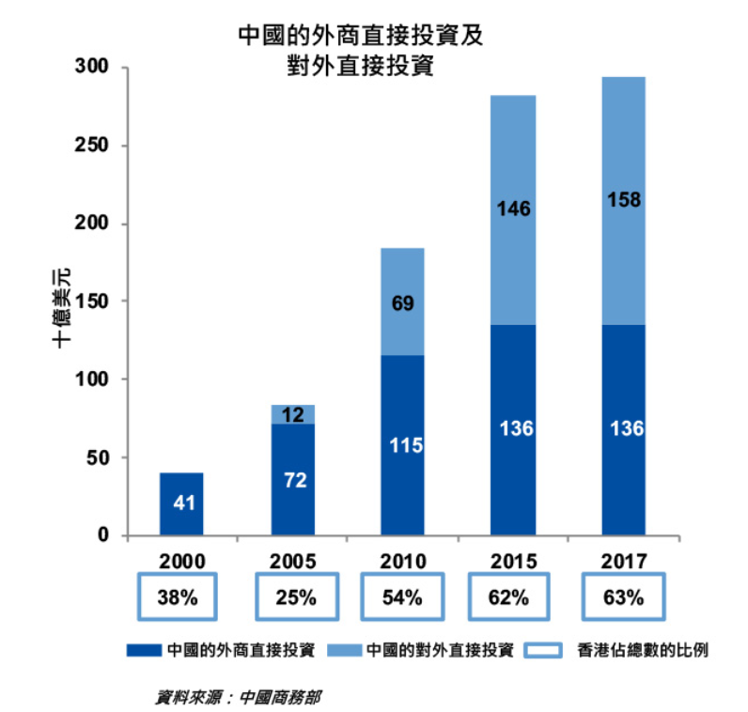
Reference
With its strengths as an international financial centre and unique advantage of having close links with the Mainland, Hong Kong has been the dominant gateway to the Mainland. In 2017, about two-thirds of China’s inward foreign direct investment and outward direct investment was made through Hong Kong.
Source: Website of Hong Kong Monetary Authority (URL)
As of the end of 2019, Hong Kong had 1,241 Mainland enterprises listed on its stock market, 114 of which were listed in 2019, raising more than $250 billion in equity funds.
Source: Hong Kong Yearbook 2019 (URL)
11

Slide 12
Reference
… Nowadays, the financial and capital markets of the Mainland are drastically different from those of the international markets, which create difficulties for markets to be integrated. With the measures of interconnection and mutual access, Hong Kong market paves ways for overseas capital to enter the Mainland market while channelling the capital of the Mainland to the stock market of Hong Kong based on international rules. This large-scale dynamic exchanges will definitely be conducive for optimising the capacity of the Mainland market and promoting its internationalisation… This new function is built on the advantages of “one country, two systems” and the mechanism of interconnection and mutual access, which has formed a series of institutional arrangements at the lowest costs, such as local custody, net settlement, closed-loop fund and mutual supervision assistance. It has achieved effective conversion of capital in the markets of the Mainland and Hong Kong, enabled the free flow of capital into and out of China in accordance with the international practice and market principles, and prevented vast influx or outflux of capital.
In the process of creating value for our country, Hong Kong contributes to and benefits from the development, and has transformed from a regional stock market to one of the international financial centres. This success is brought by the successful implementation of “one country, two systems”.
Source: Translated from the blog post written by the former Chief Executive of the Hong Kong Exchanges and Clearing Limited, Mr Charles Li (2020) (URL)
12

Slide 13
Hong Kong is not only an international financial centre, but also an international trade and transportation centre. In the future, it would also become an international innovation and technology centre. What policies has the country launched to strengthen Hong Kong as international trade and transportation centres and support Hong Kong to be an international innovation and technology centre?
International financial centre
International trade centre
International transportation centre
International innovation and technology centre
Policy support
13

Slide 14

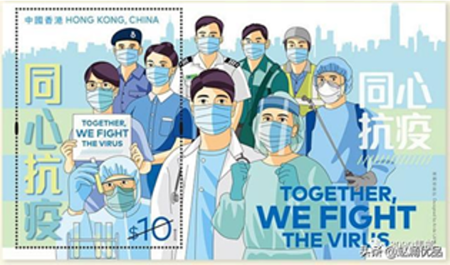
Supporting the development of Hong Kong as an international trade centre
After the signing of the Mainland and Hong Kong Closer Economic Partnership Arrangement (CEPA) in June 2003, several Supplements to CEPA were signed between the Mainland and Hong Kong and implemented subsequently. The Mainland applies zero tariff to all products originating from Hong Kong.
View the video clip on CEPA (April 2019)
https://www.tid.gov.hk/english/cepa/webcast/cepa_201904.html
14

Slide 15
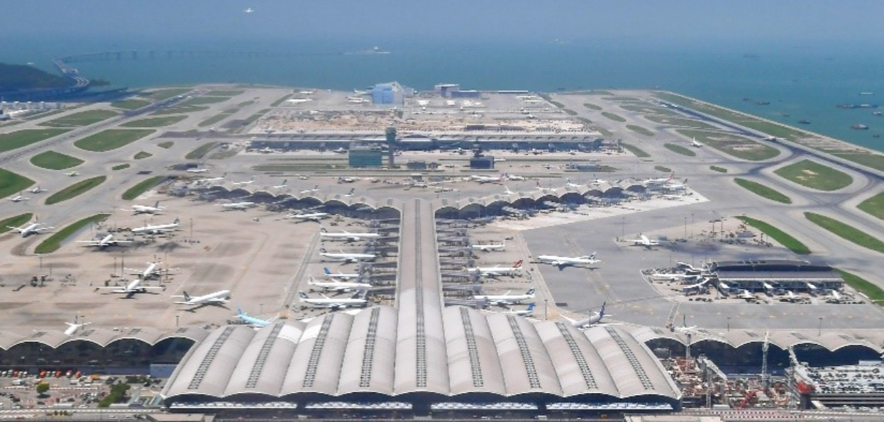
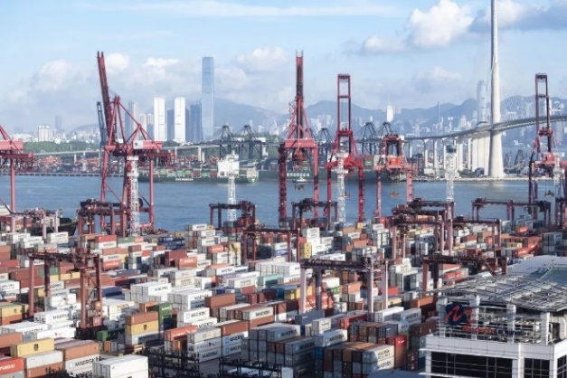
Supporting the development of Hong Kong as an international transportation centre
The “National Plan for the Layout of Coastal Ports” and the “12th Five-Year Plan for the Comprehensive Development of Transportation Systems” both consider the need for strengthening and developing Hong Kong as an international transportation centre.
As proposed in the “Outline Development Plan for the Guangdong-Hong Kong-Macao Greater Bay Area”, Hong Kong’s status as an international transportation centre has to be strengthened and enhanced.
As mentioned in the “Outline of the Fourteenth Five-Year Plan for the National Economic and Social Development and the Long-Range Objectives Through the Year 2035”, our country continues to support Hong Kong to enhance its status as international financial, transportation and trade centres and an international aviation hub.
Hong Kong International Airport
Click the image above for a report on Hong Kong being the aviation hub of the Greater Bay Area
The Kwai Chung Container Port situated along the Rambler Channel is the major container processing logistics centre of Hong Kong.

Slide 16
Reference
According to the World Trade Organization, Hong Kong was the world’s eighth largest trading entity in 2019. It operates one of the world’s busiest airports in terms of the number of international passengers and volume of international air cargo handled, as well as one of the busiest container ports by the container throughput.
Source: Hong Kong Yearbook https://www.yearbook.gov.hk/2019/en/pdf/E03.pdf
16

Slide 17
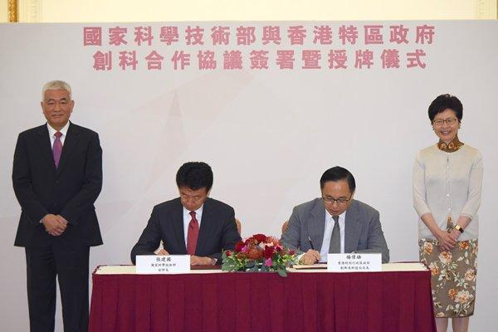
Supporting Hong Kong to build
an international innovation and technology centre
On 20 September 2018, the HKSAR Government and the Ministry of Science and Technology (MOST) signed the “Arrangement on Enhancing Innovation and Technology Cooperation between the Mainland and Hong Kong” and “Agreement on Commencing Jointly Funded Projects between the MOST and the Innovation and Technology Bureau of the HKSAR Government”.
Signing of agreements on innovation and technology cooperation between the Mainland and Hong Kong

Slide 18
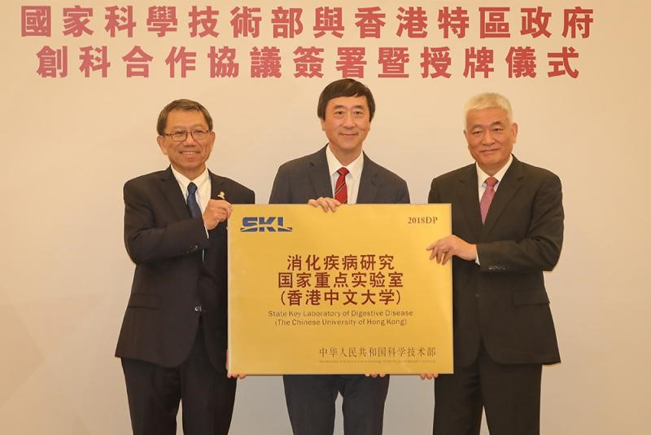
Reference
16 key laboratories in Hong Kong are listed as state key laboratories and included in the national scientific research and innovation system. This will help the scientific research projects in Hong Kong to gain support from the country.
No. | Supporting institution | Name of Laboratory
1 | HKU | State Key Laboratory of Liver Research
2 | HKU | State Key Laboratory of Brain and Cognitive Sciences
3 | HKU | State Key Laboratory for Emerging Infectious Diseases
4 | HKU | State Key Laboratory of Synthetic Chemistry
5 | HKU | State Key Laboratory of Synthetic Chemistry
6 | CUHK | State Key Laboratory of Oncology in South China
7 | CUHK | State Key Laboratory of Agrobiotechnology
8 | CUHK | State Key Laboratory of Phytochemistry and Plant Resources in West China
9 | CUHK | State Key Laboratory of Digestive Disease
10 | CityU | State Key Laboratory of Millimeter Waves
11 | CityU | State Key Laboratory of Marine Pollution
12 | PolyU | State Key Laboratory of Ultra-precision Machining Technology
13 | PolyU | State Key Laboratory of Chiroscience
14 | HKUST | State Key Laboratory of Molecular Neuroscience
15 | HKUST | State Key Laboratory of Advanced Displays and Optoelectronics Technologies
16 | HKBU | State Key Laboratory of Environmental and Biological Analysis
The State Key Laboratory of Digestive Disease of the Chinese University of Hong Kong was awarded the signboard.

Slide 19
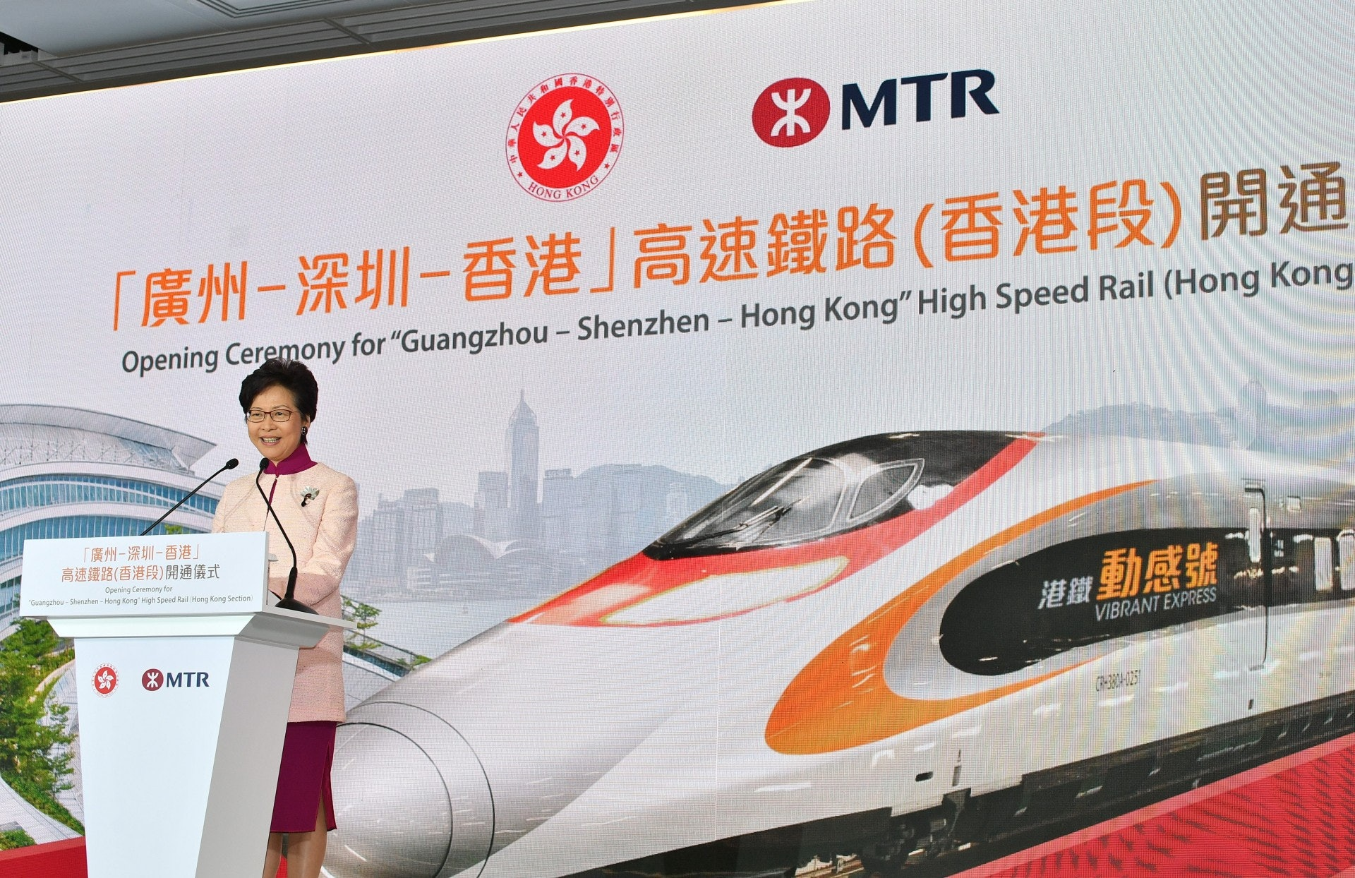
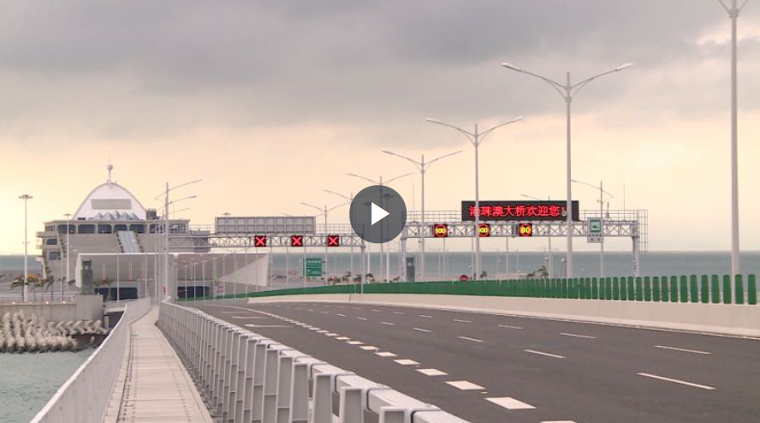
Strengthening exchanges and cooperation between the HKSAR and the Mainland
Supporting the connectivity of infrastructure
In July 2007, the Shenzhen Bay Bridge was completed and opened to traffic, becoming the fourth channel connecting the Mainland and Hong Kong over the land.
On 22 September 2018, the Hong Kong Section of the Guangzhou-Shenzhen-Hong Kong Express Rail Link was officially commissioned marking the beginning of the “high-speed railway era” of Hong Kong.
In September 2018, the Hong Kong Section of the Guangzhou-Shenzhen-Hong Kong Express Rail Link was completed and commissioned, connecting Hong Kong to the national high-speed rail network.
In October 2018, the Hong Kong-Zhuhai-Macao Bridge was officially commissioned, connecting Hong Kong and Macao to the national expressway network.
On 24 October 2018, the Hong Kong-Zhuhai-Macao Bridge was officially commissioned to connect Hong Kong and Macao to the national expressway network.
Sources:
https://www.info.gov.hk/gia/general/201809/22/P2018092200392.htm
https://www.news.gov.hk/eng/2018/10/20181019/20181019_201647_654.html?type=category&name=infrastructure
Click to watch the opening of the Hong Kong-Zhuhai-Macao Bridge.
19

Slide 20
Supporting Hong Kong to deepen economic and trade cooperation with the Mainland
The implementation of CEPA and various agreements have effectively removed institutional barriers in trade and investment between Hong Kong and the Mainland. It also provides more opportunities for financial service institutions and professionals to flexibly integrate with the market, making Hong Kong more attractive to market users. This strengthens Hong Kong’s competitive edge as an international financial centre and the preferred financing centre for enterprises of the Mainland.
Source: Mainland and Hong Kong Closer Economic Partnership Arrangement (CEPA)
https://www.tid.gov.hk/english/cepa/index.html

Slide 21
Supporting Hong Kong to deepen economic and trade cooperation with the Mainland
June 2003: The Mainland and Hong Kong Closer Economic Partnership Arrangement (CEPA) was signed
January 2016: CEPA Agreement on Trade in Services was implemented
June 2017: CEPA Agreement on Economic and Technical Cooperation was implemented
January 2018: CEPA Investment Agreement was implemented
January 2019: CEPA Agreement on Trade in Goods was implemented
21

Slide 22
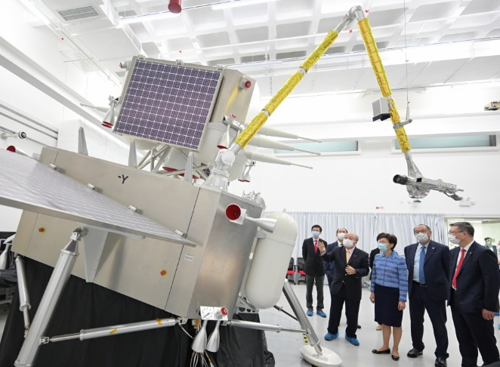
Supporting Hong Kong to strengthen education exchange and cooperation with the Mainland
Our country not only improves construction of infrastructure, but also implements various measures to strengthen and foster exchange between Hong Kong and the Mainland.
Supporting Hong Kong and the Mainland higher education institutions to recruit students across regions; supporting Hong Kong and the Mainland higher education institutions to cooperate in running schools; supporting exchange between teachers and students in Hong Kong and the Mainland
Supporting Hong Kong higher education institutions to set up research institutes in the Mainland; supporting workers in the field of science and technology in Hong Kong to apply for national science and technology R&D projects; supporting the opening of major national science and technology projects to Hong Kong
The Chief Executive Mrs Carrie Lam visited the Hong Kong Polytechnic University and the Research Centre for Deep Space Explorations. https://www.ceo.gov.hk/eng/gallery/gallery.html?date=20210723
22

Slide 23

Reference
Scheme for Admission of Hong Kong Students to Mainland Higher Education Institutions (the Scheme)
At present, higher education institutions in the Mainland mainly open their undergraduate and postgraduate programmes to Hong Kong students. As of 30 June 2020, there are 2,740 higher education institutions in the Mainland. In which, 1,272 are undergraduate schools while 1,468 are vocational schools. Among those undergraduate schools, 127 institutions can recruit Hong Kong senior secondary students through the Scheme in 2021/22 academic year; around 300 institutions can recruit Hong Kong students through the National Education Exams Authority, People’s Republic of China Joint Entrance Exam For Universities in PRC (JEE, PRC); six institutions are authorised by the Ministry of Education of the PRC to recruit students directly in Hong Kong.
Source:
https://www.edb.gov.hk/attachment/tc/edu-system/postsecondary/policy-doc/pilot-scheme/scheme_2021/booklet_2021.pdf
23

Slide 24
Reference
Scheme for Admission of Hong Kong Students to Mainland Higher Education Institutions (the Scheme)
According to the statistics of China Education Exchange (Hong Kong) Centre in June 2020, the number of students enrolled in higher education institutions of the Mainland under the Scheme increased by nearly 14% as compared to the same period in the previous year. Statistics showed that as of 1 June 2020, 10,778 Hong Kong secondary school graduates had applied for admission to higher education institutions of the Mainland via different channels, 3,993 of which were enrolled under the Scheme.
Source: The website of the Central People’s Government of the People’s Republic of China
http://www.gov.cn/xinwen/2020-06/16/content_5519826.htm
24

Slide 25

Supporting Hong Kong to strengthen cultural exchange and cooperation with the Mainland
In 2005, the Mainland and Hong Kong signed an Agreement on Closer Cultural Partnership Arrangement to promote a full range of cooperation in cultural conservation, industrial development and exchange, etc.
Supporting Hong Kong, Macao and Guangdong Province’s joint application and Yueju (Cantonese opera) was successfully inscribed onto UNESCO Representative List of the Intangible Cultural Heritage of Humanity*
Supporting Hong Kong to successfully list the Hong Kong National Geopark in Sai Kung as a global geopark
Supporting the co-production of films between Hong Kong and the Mainland;
Supporting the construction of the Hong Kong Palace Museum …
Hexagonal rock columns at the High Island Reservoir, UNESCO Global Geopark, Hong Kong
*For related content, please refer to: https://www.lcsd.gov.hk/CE/Museum/ICHO/en_US/web/icho/the_first_intangible_cultural_heritage_inventory_of_hong_kong.html

Slide 26
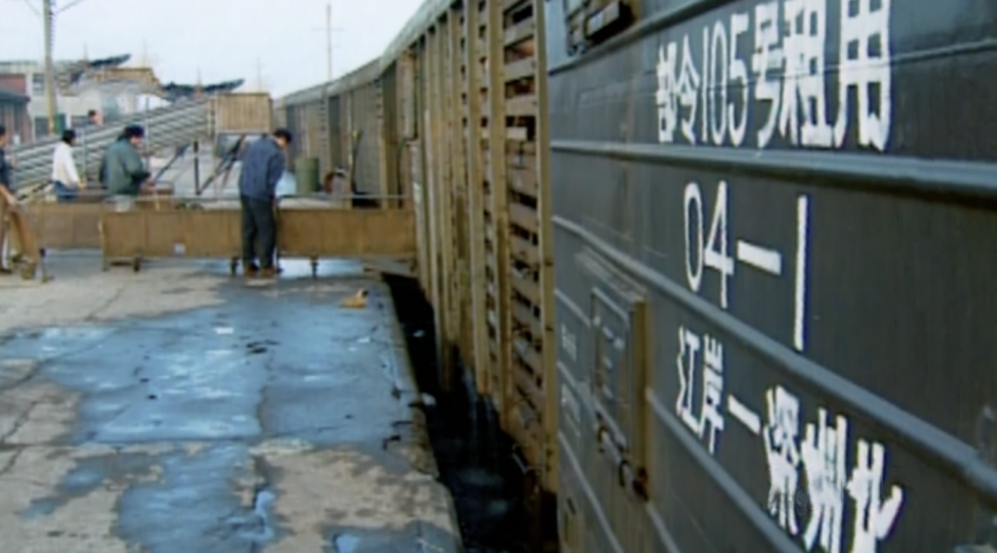
Securing the supply of food and agricultural by-products to Hong Kong
At present, around 85% of live poultry, 90% of vegetables and 60% of aquatic products in Hong Kong market are supplied by the Mainland. Over 60,000 hectare of plantation bases from more than ten provinces across the nation supply agricultural products to Hong Kong.
In the early days, live and fresh products were transported to Hong Kong as ordinary goods. The long transportation hours and unfixed transportation routes led to significant losses. To overcome the transportation difficulties in the supply of live and fresh products to Hong Kong, Premier Zhou Enlai, ordered to form a freight system containing three express trains which supplied live and fresh products to Hong Kong and Macao by the end of 1962. The trains departed from Shanghai, Zhengzhou, and Wuhan (or Changsha) to Hong Kong via Shenzhen every day.
A train departing from Jiang’an (Wuhan) to North Shenzhen
Sources:
http://jinan.customs.gov.cn/customs/xwfb34/mtjj35/3248105/index.html
https://www.hkcd.com/content/2020-03/20/content_1184367.html

Slide 27
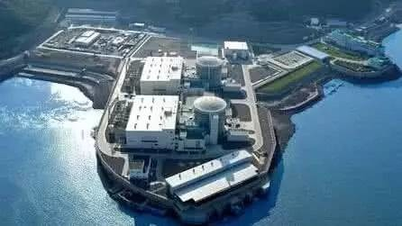
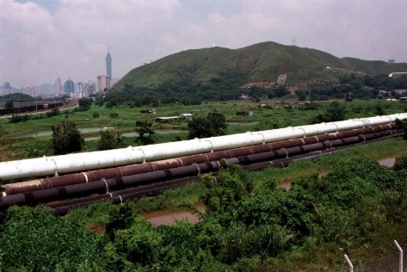
Securing the supply of water, electricity and natural gas to Hong Kong
Daya Bay Nuclear Power Plant
Dongjiang-Shenzhen Water Supply Project
Since 1994, the Daya Bay Nuclear Power Plant has been supplying electricity to Hong Kong with the annual supply accounting for a quarter of Hong Kong’s total electricity consumption. By the end of 2016, the Daya Bay Nuclear Power Plant had transmitted 33.7 billion kWh of electricity to Hong Kong in total, accounting for around a quarter of its total electricity consumption, and reduced carbon dioxide emission by about 27 million tons.
Hong Kong suffered from severe drought in 1963. Millions of Hong Kong residents encountered difficulties in accessing drinking water. To tackle the problem of water shortage, the construction work under the Dongjiang-Shenzhen Water Supply Project commenced as requested by Hong Kong. The project overcame the difficulties regarding unfavourable factors like construction constraints and natural disasters, and constructed an 83km water pipeline within a year. In 1965, the project was officially launched, with water supply of 68.2 million cubic meters to Hong Kong every year. This quickly helped Hong Kong to get rid of the problem of water shortage.
Daya Bay Nuclear Power Plant provides clean energy
Pipeline dedicated to transferring water from Dongjiang to Hong Kong
27

Slide 28
Securing the supply of water, electricity and natural gas to Hong Kong
In 2019, our country announced the “Outline Development Plan for the Guangdong-Hong Kong-Macao Greater Bay Area” which proposed to optimise the energy structure and layout of the Guangdong-Hong Kong-Macao Greater Bay Area and to build a clean, low-carbon, safe and efficient energy supply system with a view to guaranteeing the safe and stable supply of energy to Hong Kong and Macao.
Source: http://www.gov.cn/gongbao/content/2019/content_5370836.htm

Slide 29
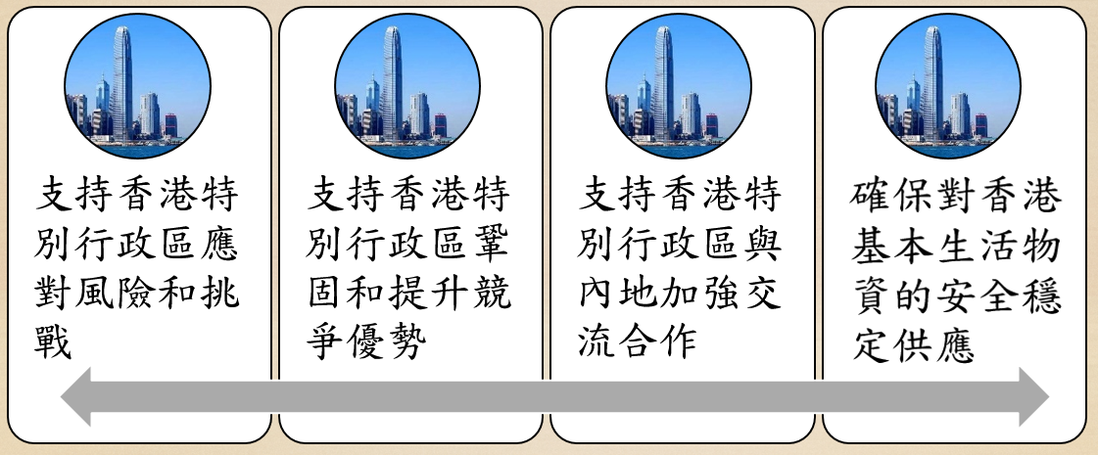
With reference to the information below, discuss how our country’s support enables Hong Kong to have the advantage of “one country, two systems”.
Enabling Hong Kong to have the advantage of “one country, two systems”
Support Hong Kong to respond to risks and challenges
Support Hong Kong to strengthen and enhance competitive advantage
Support Hong Kong to strengthen exchanges and cooperation with the Mainland
Ensure safe and stable supply of basic necessities to Hong Kong

Slide 30
Reference
Hong Kong integrates into the overall national development
Since the returning to the Motherland, the central government has made “maintaining Hong Kong’s prosperity and stability” a priority of the country's overall development strategy.
Content supporting the development of Hong Kong in the Five-Year Plans for the National Economic and Social Development of the People's Republic of China
Examples:
12th Five-Year Plan (2011-2015)
13th Five-Year Plan (2016-2020)
14th Five-Year Plan (2021-2025)
30

Slide 31
Hong Kong integrates into the
overall national development (1)
12th Five-Year Plan (2011-2015)
The plan, for the first time, put the content related to Hong Kong and Macao as a separate chapter and further clearly stated the strategic position of Hong Kong in national development, emphasising that our country supported Hong Kong to strengthen and enhance its competitiveness, to nurture emerging industries and to deepen economic cooperation between the Mainland and Hong Kong. Our country also supported Hong Kong to develop into an offshore RMB business centre and international asset management centre.
13th Five-Year Plan (2016-2020)
The Dedicated Chapter on Hong Kong and Macao highlighted that our country supported Hong Kong to strengthen and enhance its status as an international financial centre and a global offshore RMB business hub, and to fortify its functions as an international asset management centre. Besides, the development of financing, commerce, logistics and professional service industries were driven to a higher end and become more value-added.
31

Slide 32
Hong Kong integrates into the
overall national development (2)
14th Five-Year Plan (2021-2025)
Our country supports Hong Kong to enhance its status as international financial, transportation and trade centres and an international aviation hub, to strengthen Hong Kong’s functions as a global offshore RMB business hub, an international asset management centre and a risk management centre, and to build an international innovation and technology centre, an international legal and dispute resolution service centre in the Asia-Pacific region, and a regional intellectual property trading centre. Our country also supports Hong Kong’s service industry to shift to a higher end and become more value-added and supports Hong Kong to develop into an East-meets-West centre for international cultural and arts exchange.
32

Slide 33
Reference
Guangdong-Hong Kong-Macao Greater Bay Area (GBA) and Hong Kong integrates into the overall national development
The development of the Greater Bay Area is accorded the status of key strategic planning in the country's development blueprint, having great significance in the country's implementation of innovation-driven development and commitment to reform and opening-up. The objectives are to further deepen cooperation amongst Guangdong, Hong Kong and Macao, fully leverage the composite advantages of the three places, facilitate in-depth integration within the region, and promote coordinated regional economic development, with a view to developing an international first-class bay area ideal for living, working and travelling.
Being the most open and international city in the Greater Bay Area, Hong Kong is known for its status as international financial, transportation, trade centres and aviation hub as well as its renowned professional services. Enjoying the dual advantages of "one country, two systems", Hong Kong plays an important role in the Greater Bay Area Development. On the one hand, Hong Kong will facilitate and support the economic development of the region, with a view to enhancing the role and functions of the Greater Bay Area in the country’s two-way opening up; on the other hand, we will facilitate the development of industries in which Hong Kong’s strengths lie in the Greater Bay Area, capitalising on Hong Kong’s strengths to serve the country's needs.
Source: https://www.bayarea.gov.hk/en/about/overview.html
33

Slide 34
Reference
“A range of measures has been implemented to facilitate the flow of people, goods, capital and information between the Hong Kong and the Mainland cities in the GBA. But much more needs to be done with a clear pathway in mind. The GBA study has certainly given us much food for thought,” said Mrs Carrie Lam.
Source: https://www.info.gov.hk/gia/general/202105/11/P2021051100844.htm
Hong Kong proactively integrates into the overall national development. What new opportunities would this move bring to different sectors of society, particularly to young people?
34

Slide 35
Judicial assistance in civil and commercial matters between the Mainland and Hong Kong
The two regions are from different law traditions which are distinctive in terms of legal systems, judicial concepts, legislative techniques and language styles. However, legal personnel of the two regions, from procedural assistance to substantive mutual trust, work to figure out new ways for judicial assistance within “one country” which then become conducive sources of reference for the state to roll out international judicial assistance and strengthen the construction of foreign-related legal systems.
Since the returning of Hong Kong, the Mainland and Hong Kong have signed eight judicial assistance arrangements in civil and commercial matters by January 2021. Among them, the signing of service arrangements and evidence collection arrangements strengthen the connection of trial procedures of the two regions and reduce procedural difficulties of cross-border civil and commercial cases.
The Report on the Practice of Judicial Assistance in Civil and Commercial Matters between the Mainland and the Hong Kong Special Administrative Region
https://www.court.gov.cn/zixun-xiangqing-285241.html

Slide 36
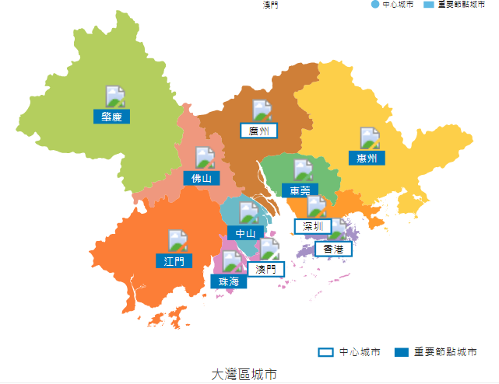
Supporting Hong Kong to capitalise on its strengths and play its role in GBA development
The “Outline Development Plan for the Guangdong-Hong Kong-Macao Greater Bay Area” formulated by the country in 2019 aligns with the basic policy of “one country, two systems” to fully leverage the composite advantages of the three places, deepen the cooperation amongst the Mainland, Hong Kong and Macao, support Hong Kong and Macao in integrating into the overall development of the country, and maintain long-term prosperity and stability of Hong Kong and Macao.
Source: https://www.bayarea.gov.hk/en/home/index.html

Slide 37
The development of the Greater Bay Area (GBA) is to fully leverage the composite advantages of Guangdong Province, Hong Kong and Macao under the framework of “one country, two systems” and the Basic Law. GBA is built against the backdrop of one country, two systems, three customs zones and three currencies. There is no international precedent.
The central and local governments have launched various preferential policies that favour the development of Hong Kong and Macao in the GBA. For instance:
Supporting the open recruitment of Hong Kong and Macao residents by government agencies and related units in the GBA;
Encouraging innovation and entrepreneurship of young people of Hong Kong and Macao in the nine Mainland cities of the GBA;
Allowing Hong Kong and Macao residents to enjoy the same treatment as local residents when purchasing properties in the Mainland;
Optimising the policies that allow children of Hong Kong and Macao residents to access to education in Guangdong Province …

Slide 38
Proactively investing and starting businesses
At the beginning of the country’s reform and opening-up, businessmen of Hong Kong took the lead to invest and start businesses in the Mainland. In addition to channelling capital to support economic development in the Mainland and introducing advanced manufacturing equipment, technology and management practice to the Mainland, Hong Kong businessmen also brought international capital to the Mainland market. Hong Kong has long been the principal source of investment of the Mainland.

Slide 39
Example
First joint venture in the Mainland
On 1 May 1980, Beijing Air Catering Co., Ltd., the first joint venture, was established. The two investors, Civil Aviation Administration of China and China Air Catering Limited from Hong Kong, accounted for 51% and 49% of the shares respectively. Since then, countless Hong Kong businessmen have invested and started their businesses in the Mainland.

Slide 40
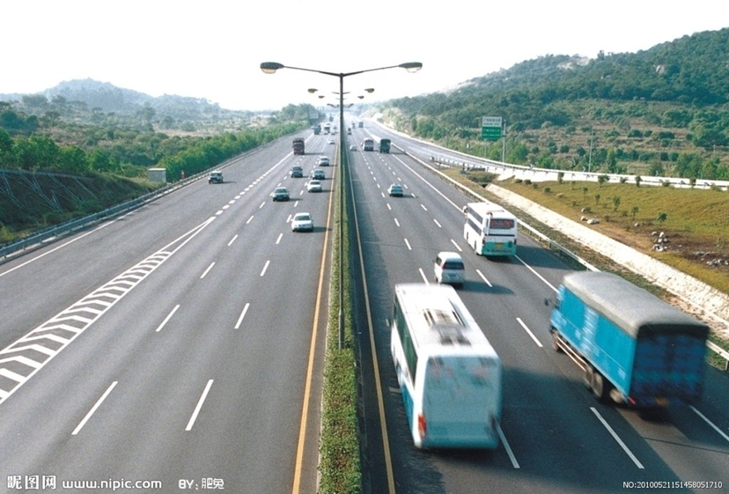
Example
Joint venture expressway
On 1 July 1997, the Guangshen Expressway was officially launched. This 122.8 km expressway, the first of its kind jointly built by Guangdong Province and Hong Kong, has become an important passage connecting Guangzhou, Shenzhen, Dongguan and Hong Kong. Until now, it is still one of the busiest expressways in China being crowned as the “Golden Corridor of the Pearl River Delta”.
The Guangshen Expressway

Slide 41
Example
First branch of Hong Kong-funded bank in the Mainland
In January 1982, Nanyang Commercial Bank opened its branch in Shenzhen which became the first branch of a Hong Kong-funded bank in the Mainland since the reform and opening-up.
Other banks from Hong Kong like Hang Seng Bank, Bank of East Asia and Standard Chartered Bank gradually set up their branches in the Mainland. The financial ties between Hong Kong and the Mainland have become increasingly close.

Slide 42
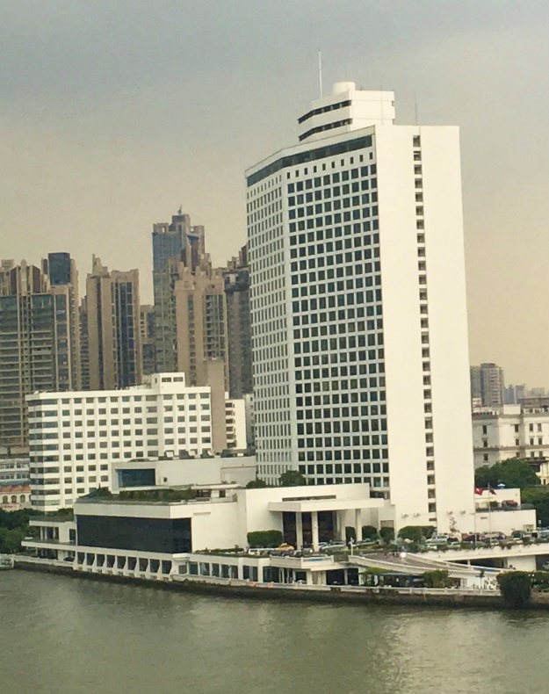
Example
Jointly built hotel
The White Swan Hotel was jointly invested by Mr Henry Fok and the Guangdong Provincial People’s Government. It was opened in 1983 as the first jointly built five-star hotel in China.
White Swan Hotel in Guangzhou
The photo was taken by the resource developer.

Slide 43
Boosting market economy
The economic reform of our country started in Shenzhen and the Zhujiang Delta which are adjacent to Hong Kong. At the initial stage of the reform and opening-up, many Hong Kong professionals, who were knowledgeable about the international market and rules, provided advice and suggestions on the reform of market economy in the Mainland. Hong Kong has thus become a key example for the Mainland to experience market economy, to learn about it, and to put it into practice in a convenient and effective manner.

Slide 44
Example
Boosting market economy
In 1978, Mr Leung Chun-ying conducted free lectures on the management system of western land economy in cities like Shenzhen and Shanghai. In 1987, he participated in the compilation of a bilingual bidding document in a land auction. The document was the first of its kind in Shenzhen and even in China.
Mr Anthony Neoh, the former Chairman of Securities and Futures Commission of Hong Kong (SFC), was invited by the then Premier, Zhu Rongji, to be the principal consultant of the China Securities Regulatory Commission (CSRC) in 1999. He took the initiative to promote and provide advice on various milestones of China’s security market such as the combination of AB shares, the setup of open-end fund, the introduction of QFII and the set up of the Growth Enterprise Market.
Mrs Laura Cha often makes suggestions on regulating securities in the Mainland. She served in the SFC from 1991 to 2000, and served as the Deputy Chairman of the SFC in 1998. In 2001, she served as the Deputy Chairman of the CSRC .
…
44

Slide 45
Fulfilling the function of early and pilot implementation
During the reform and opening-up of our country, some policies were piloted in Hong Kong to gain practical experience before being applied gradually and extensively. This facilitates the country to open up and allows effective risk management while providing Hong Kong with the first-mover advantage.
e.g.
Opening-up of service industry in the Mainland was taken forward with the implementation experience gained from the liberalisation of trade in services between Guangdong, Hong Kong and Macao under the CEPA framework.
e.g.
The internationalisation of RMB started in Hong Kong.
45

Slide 46

Demonstration of urban management
Hong Kong is more experienced in the areas such as urban construction and management as well as the provision of public services. The Mainland made reference to the advanced practice of Hong Kong to improve its urban construction and management.
The construction and management of subways in many Mainland cities originated from the Mass Transit Railway of Hong Kong. Constructing and operating urban railways needs ample capital. With reference to the Mass Transit Railway of Hong Kong, Guangzhou has been passing all proceeds from property development along the subway line to the subway company for subway construction. *
* Click on the image to browse their website and learn more.

Slide 47
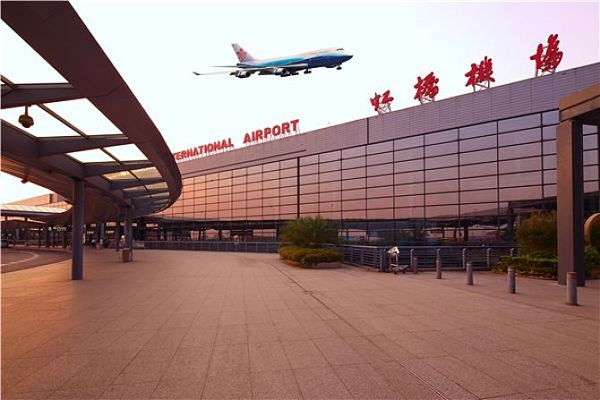
Shanghai Hongqiao International Airport
The Shanghai Airport Authority and the Airport Authority Hong Kong jointly set up the Shanghai Hong Kong Airport Management Co. in 2009. Advanced management concepts and experience of the Hong Kong International Airport were introduced to facilitate service innovation and service quality upgrade of Shanghai Hongqiao International Airport (SHIA). SHIA then came first in the “World's Most Improved Airport award” by Skytrax in the “World Airport Awards 2011”.
Shanghai Hongqiao International Airport

Slide 48
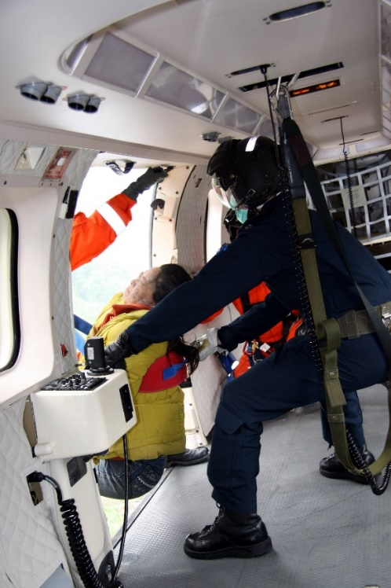
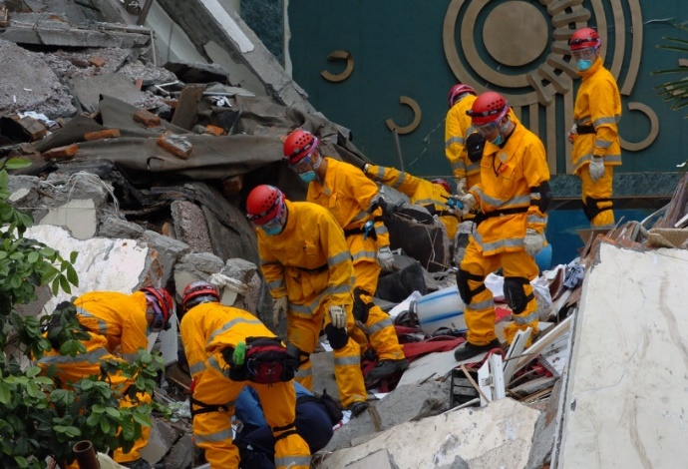
Supporting disaster relief and post-disaster reconstruction in the Mainland
Whenever the Mainland encounters major natural disasters, Hong Kong always takes the initiative to provide support without hesitation. Hong Kong citizens make generous donations, which demonstrates the inseparable bond and mutual help among the compatriots in the Mainland and Hong Kong.
On 1 June 2008, Hong Kong Government Flying Service rescued two victims who had been trapped for 21 days.
In May 2008, a disruptive earthquake hit Wenchuan, Sichuan. Hong Kong arranged a number of search and rescue teams, medical teams and anti-epidemic teams to participate in the rescue.
The Hong Kong search and rescue team worked in Hanwang Town, Mianzhu City.

Slide 49
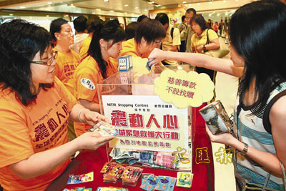
A total of HK$10 billion donation from the HKSAR government (HK$9 billion) and Hong Kong Jockey Club (HK$1 billion) was contributed to support Sichuan’s post-disaster reconstruction work. The funded projects were related to education, medical care and health, social welfare, construction of highways and infrastructure, Wolong National Nature Reserve, etc.
People from all walks of life took the initiative to make donations. Various social organisations and entertainers organised disaster relief activities like charity performance. Many Hong Kong journalists went to the disaster-stricken areas to conduct live reports.
Doing good is the greatest source of happiness. Hong Kong citizens took the initiative to make donation.
49

Slide 50

Contributions to the Mainland’s industries on education, technology, culture, medical and healthcare, and sports
Education
Hong Kong people are enthusiastic and passionate in supporting the national development on education, technology, culture, medical and healthcare, and sports. Some of them are renowned entrepreneurs, while some others are ordinary citizens. All of them contribute to charity work of our country.
Sports
Technology
Medical and healthcare
Culture

Slide 51
Examples of contributing to the Mainland’s industries on education, technology, culture, medical and healthcare, and sports (1)
Sir Run Run Shaw continuously made large donations to run schools in the Mainland. In 2008, he was awarded the “Lifetime Achievement Award for Philanthropy” by the Ministry of Civil Affairs of the PRC.
Source: http://www.chinanews.com/ga/kjww/news/2008/04-15/1220655.shtml
Mr Henry Fok talked about his donations to the Mainland, and said, “All I wish for is the prosperity of our country. I always remember that I am a Chinese. I would like to do my best to contribute practically to the prosperity of our country.”
Source: http://theory.people.com.cn/BIG5/n1/2020/0728/c40531-31799898.html
51

Slide 52
Examples of contributing to the Mainland’s industries on education, technology, culture, medical and healthcare, and sports (2)
Tin Ka Ping Foundation was founded in 1982 by Dr Tin Ka Ping. The Foundation is devoted to its charitable causes and aspires to improving the quality of education as its contribution to China’s advancement. “The Foundation has funded 93 tertiary institutions, 163 Tin Ka Ping secondary schools, 42 Tin Ka Ping primary schools, 20 Tin Ka Ping colleges and kindergartens and over 1800 rural libraries” across the country. All Tin Ka Ping schools in the Mainland are state-owned; the Foundation does not involve in any daily management. Besides, it has also set up scholarships in three overseas tertiary institutions for Chinese students. Apart from education, the Foundation has funded 29 hospitals, about 130 bridges and roads, over 200 entertainment and social projects and countless units. Source: http://www.tinkaping.org/history/
Apart from the above examples, please find out other people who have made donation to support our country’s development and their stories.

Slide 53
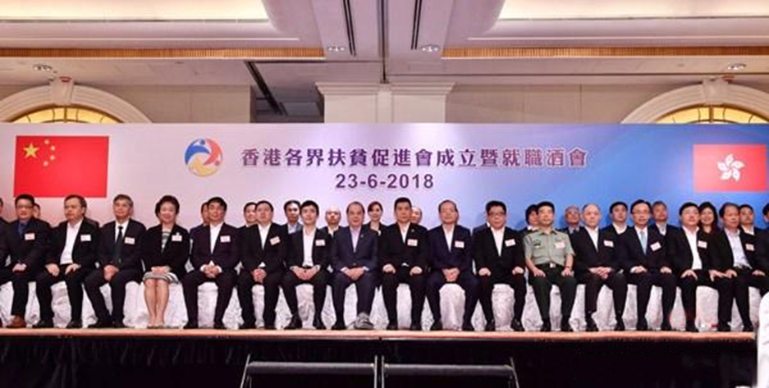
Supporting poverty alleviation
in poverty-stricken areas in the Mainland
The Hong Kong Poverty Alleviation Association Limited identified Nanjiang County of Sichuan Province as its starting point and rolled out poverty alleviation work with a view to improving the development of Nanjiang County in the areas of industrial development, education, medical care, etc. In 2013, the impoverished population of Nanjiang County was around 70,000 to 80,000, and all the impoverished population were lifted out of poverty in 2019. Hong Kong citizens were one of the contributors to this accomplishment.
The Hong Kong Poverty Alleviation Association Limited was established in June 2018.
Sources:
http://www.gov.cn/xinwen/2020-03/12/content_5490339.htm
https://www.hkpaa.com.hk/

Slide 54
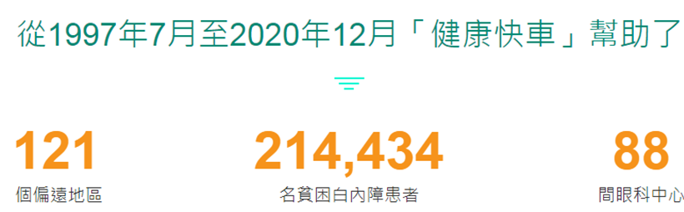

Reference
Lifeline Express Hong Kong Foundation is a registered charitable organisation in Hong Kong dedicated to fund-raising in support of the eye care medical services of Lifeline Express in the Mainland.
The “Lifeline Express” started in 1997 to raise funds for eye care medical treatment in the Mainland. The “Lifeline Express” is a specially designed hospital eye-train which consists of four compartments including an examination room, two operating theatres, a patient ward and a multi-function conference room with a living quarter for the medical team. It aims to provide free surgery for underprivileged cataract patients in the Mainland, hoping that they could enjoy a new life with restored vision.
From July 1997 to December 2020, the “Lifeline Express” helped
Remote areas
Underprivileged cataract patients
Eye care centres
Source: https://lifelineexpress.org.hk/en/home

Slide 55
Hong Kong volunteer “Ah Fuk”
Wong Fuk Wing, a Hong Kong resident, started his volunteer life in 2002. He participated in the rescue work of the Yushu earthquake in Qinghai. On 14 April 2010, though he managed to pull through the earthquake, he returned to an orphanage to save three orphans and a teacher, and sacrificed his life during the aftershock. In recognition of Mr Wong’s voluntary contribution to the earthquake-stricken areas, Mr Wong was posthumously awarded the Medal for Bravery (Gold) by the HKSAR government.

Slide 56
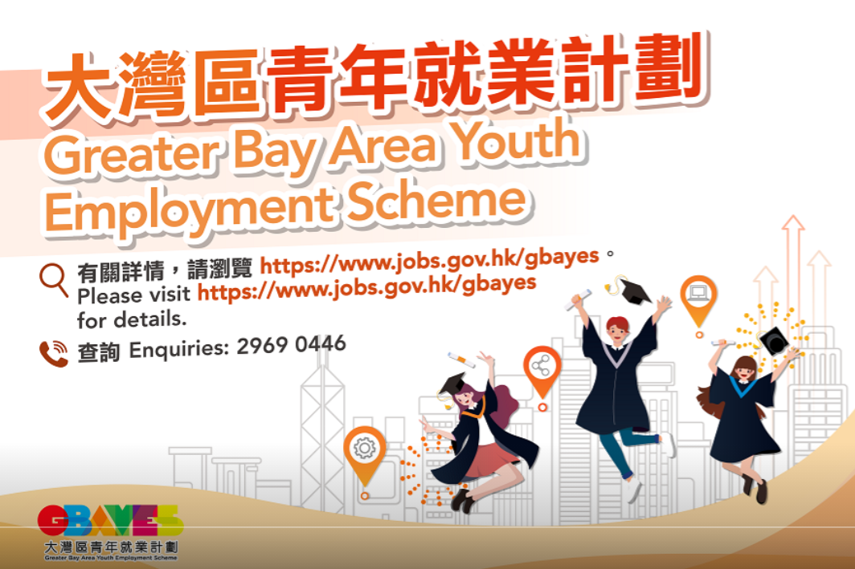
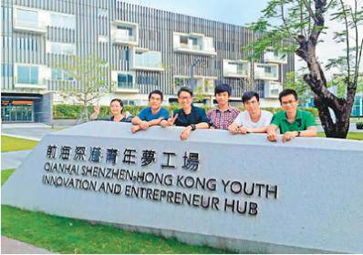
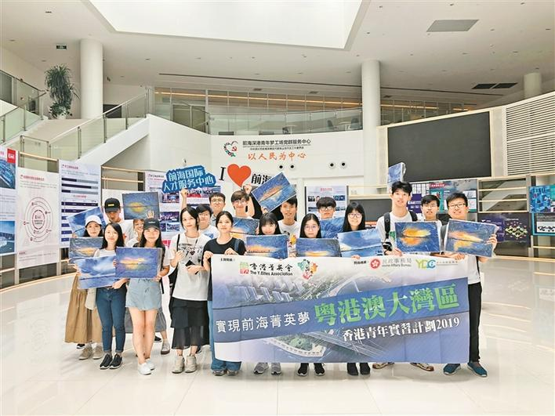

Entering the GBA
Examples of experiential activities
Youth from Hong Kong took part in the GBA development
Hong Kong youth visited the Qianhai Shenzhen Hong Kong Youth Innovation and Entrepreneur Hub
Click on the image for more information

Slide 57
After learning this topic’s content, to understand the national development and review personal development goals, please formulate a topic for the Mainland study tour.

Slide 58
The End
58

Slide 59
User Guide
The primary users of this resource are teachers. It aims to provide teachers with content knowledge relevant to the topic to enable teachers to have a deeper understanding of teaching content when preparing for their lessons.
All data, videos, photos, pictures, questions and suggested answers can be used for multiple purposes, such as teachers’ teaching materials, references for curriculum planning and learning and teaching, and student assignments, etc. To align with Citizenship and Social Development Curriculum and Assessment Guide (Secondary 4-6) (2021) (C&A Guide), this resource should be adapted to cater for students’ learning diversity and the needs of classroom teaching, etc.
Teachers may provide appropriate supplementary notes/ explanations to enrich this resource in order to enhance students’ understanding of the topic and information provided.
In accordance with the curriculum rationale and aims, teachers may select other learning and teaching resources which are correct, reliable, objective and impartial to help students build up a solid knowledge base, develop positive values and attitudes as well as enhance critical thinking and problem solving skills, and various generic skills.
If some information cannot be provided in this resource due to copyright issue, teachers may visit relevant websites provided.
Some information may have been updated when being used by teachers, teachers may visit the corresponding websites to obtain the up-to-date information.
Please also refer to the C&A Guide to understand the requirements and arrangements of the learning and teaching of the curriculum. Teachers are welcome to point out the areas need improvement, and welcome to provide updated information to enrich the content for all teachers’ reference.

Slide 60
Notice and Disclaimer
Some sources were not translated into English as the official English version is not available.
In case of any discrepancy between the Chinese and English versions, the Chinese version shall prevail.

