Slide 1
Citizenship and Social Development:
Theme 1: Hong Kong under “One Country, Two Systems”
Topic: Situation of the country and sense of national identity
Learning focus:
Achievements of the country in different areas in recent years (new high-end technologies, medical care and public health, culture and education, infrastructures, poverty eradication)
Translated version
August 2021

Slide 2
Learning Objectives
Knowledge
To understand the achievements, efforts and influence of our country in different areas in recent years
Skills
To acquire generic skills such as communication, collaboration, critical thinking, and synthesis and analytical skills
Values
To cultivate students’ patriotism, enhance their sense of pride as Chinese and national identity

Slide 3
Achievements of our country in different areas in recent years
1. New high-end technologies
2. Medical care and public health
3. Culture and education
4. Infrastructure
5. Poverty eradication

Slide 4
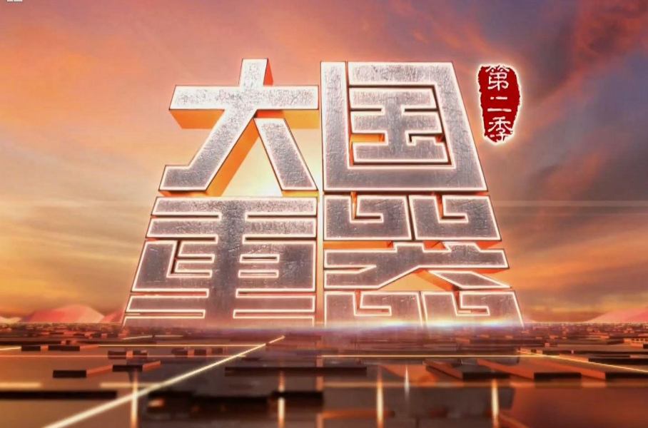
Lead-in
Play a video clip from Season 2 of The Pillars of a Great Power (00:00-03:00)
https://tv.cctv.com/2018/03/07/VIDEh0Ln01tPZZJu3GX52GEV180307.shtml?spm=C55953877151.PHXsiQANZko2.0.0
According to the first 3-min of the video clip, what are the current achievements of China?
Reference answer :
In 2020, China made great progress in innovative technologies, smart manufacturing, the Internet, etc. Besides, 115 Chinese enterprises were on Fortune Global 500 list...The achievements are remarkable.
Click on the image for the video clip

Slide 5



As far as you know, what other achievements has China made in recent years?
The BeiDou Navigation Satellite System (BDS) has been launched, providing all-weather, real-time, and accurate services for the world.
By the end of 2020, our country has eradicated absolute poverty under current standards.
Do you know what achievements our country has made?

Slide 6
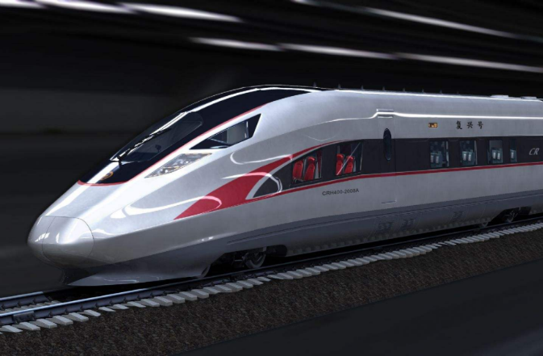
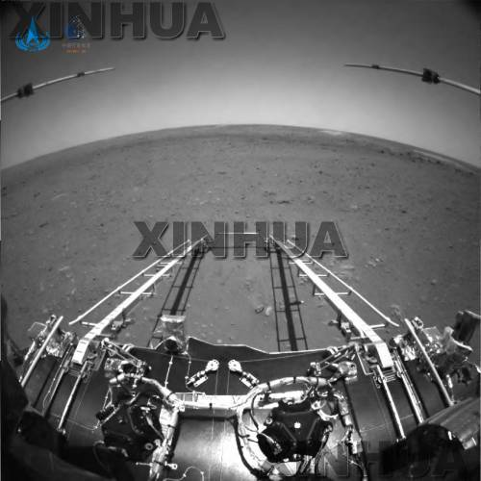
1. Achievements in new high-end technologies
China has made huge leaps in scientific and technological innovations in recent years, enabling China to have a place in many domains of the field of technology.
The world’s fastest commercial electric multiple unit (EMU) trains: Fuxing
The deep-sea manned submersible: Fendouzhe
Landing of the Tianwen-1 spacecraft on Mars, with images taken by Rover Zhurong

Slide 7
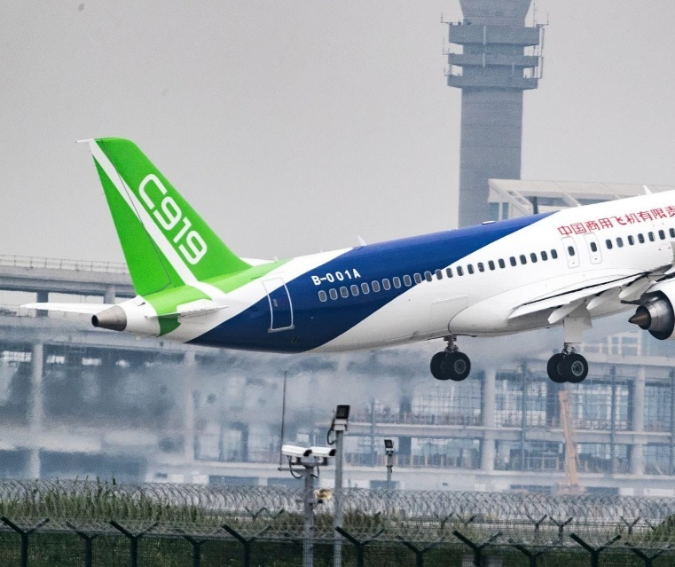
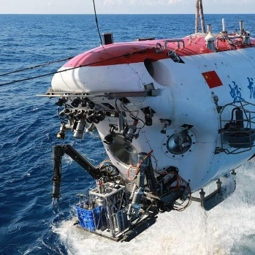

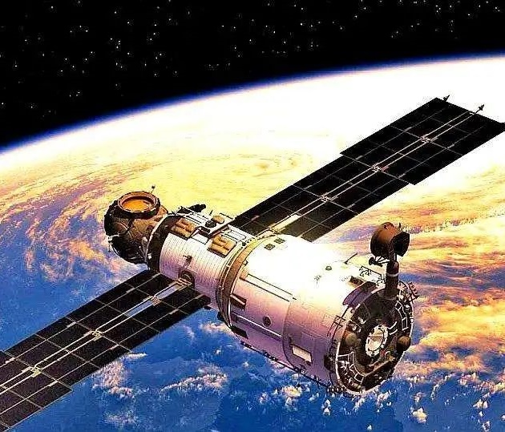
Major scientific and technological achievements in recent years
Projects (examples) | Achievements
“BeiDou Navigation Satellite System” of China covering the whole world | The fourth country in the world with a global navigation satellite system, right after the U.S., Russia and Europe
The manned submersible Jiaolong (7,062 metres) and the unmanned submersible Haidou (10,907 metres) | New records of deep-sea dive set

Slide 8

Major scientific and technological achievements in recent years
Projects (examples) | Achievements
The third-generation nuclear reactor: “Hualong One” | The latest safety standards of the International Atomic Energy Agency met.
High-speed rail | The largest high-speed railway network in the world; export of technologies overseas
New energy vehicles | Possesses core technologies of power batteries, such as motors, electronic control, etc.; leading technology of power battery in the world
8

Slide 9

World-class scientific research infrastructure
Our country has been vigorously developing technology to provide policy and systematic support for exploring the unknown world, discovering the laws of nature, and bringing about technological changes; to make breakthroughs in scientific research and promote economic and social development; and to ensure the science and technology security of the country.
Our country has built a number of major scientific and technological infrastructure, key national laboratories and national technological innovation centres, gradually improving the basic conditions for scientific research.

Slide 10
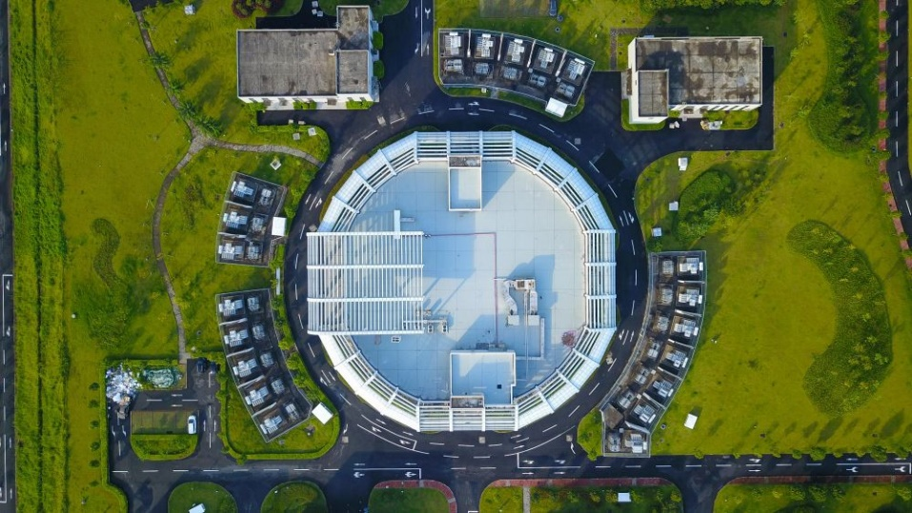
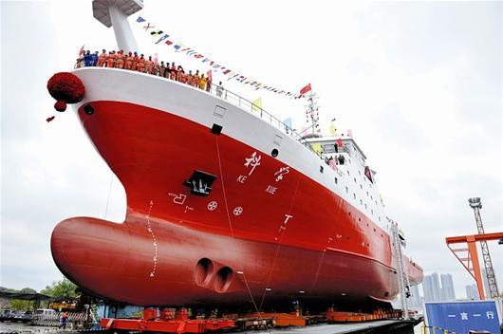
Reference
China Spallation Neutron Source is the fourth pulsed facility of its kind in the world, right after the U.K., the U.S. and Japan. It is a scientific research device for studying the properties of neutrons and detecting the microstructure and motion of matters, leading to advances in scientific the development.
For details, please refer to the webpage of the Institute of High Energy Physics of the Chinese Academy of Sciences: http://csns.ihep.cas.cn/
The marine research vessel “Kexue” is equipped with advanced devices, such as the remote operated vehicle (ROV), deep-sea towing detection systems, gravity piston samplers, rock drilling rig, and 10,000-metre conductivity temperature depth (CTD), making China a global leader in marine scientific expeditions and research.
For details, please refer to the webpage of the Bulletin of Chinese Academy of Sciences: http://www.bulletin.cas.cn/publish_article/2019/Z2/2019Z220.htm

Slide 11
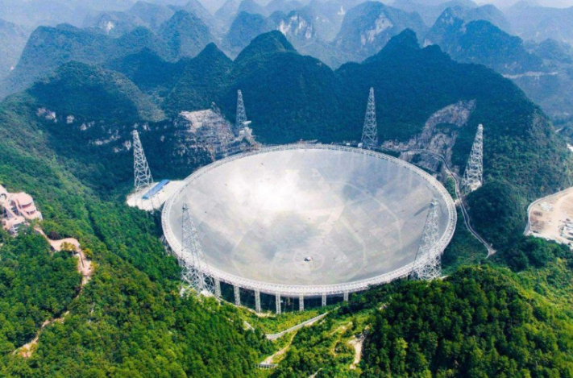
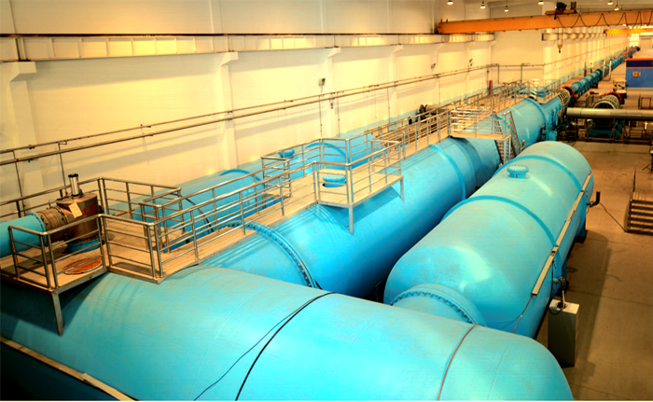
Reference
The Five-hundred-meter Aperture Spherical Telescope (FAST, nicknamed “Tianyan”, or Heaven’s Eye): This is a large astronomical instrument located in Pingtang County, Guizhou Province, China. It can detect radio waves emitted from deep space and even receive signals from beyond our Galaxy, allowing scientists to explore space.
(For details, please refer to the webpage of the Chinese Academy of Sciences: http://www.cas.cn/zt/kjzt/fast/)
JF12 shock wave wind tunnel: This large equipment is used to test the aerodynamic characteristics of various transportation tools (such as high-speed rail, automobiles), aerospace ships and missiles and help improve their design (such as how to reduce wind resistance and increase its stability).
(For details, please refer to the webpage of the Chinese Academy of Sciences: http://cxcj.cas.cn/ccg/gjzdkjjcss/jf12jbfd/201705/t20170509_4527979.html)

Slide 12

Major scientific and technological achievements
“Mozi” is China’s first quantum satellite for scientific experiments, which is used to test long-distance quantum communications with a distance as far as 1,400 kilometres. Its transmission efficiency of quantum communication is even higher than that of optical fibre.
Significant breakthroughs have been made in basic research field such as quantum science, iron-based superconductivity, dark matter particle detection satellite, CIPS stem cells.
Global networking completed for China’s BeiDou Navigation Satellite System; deep-diving records set by the manned submersible Jiaolong and the unmanned submersible Haidou; and other significant achievements such as large aircrafts manufactured in China, high-speed rail, third-generation nuclear reactor, and new energy vehicles

Slide 13
Reference
Iron-based superconductivity: Superconductors are materials that can conduct electricity with zero resistance at low temperature. Superconductors can be used in communications, energy storage, transportation, etc. China has successfully developed iron-based superconductors, which are more efficient than the other types.
Source: Xinhuanet (http://www.xinhuanet.com/tech/2021-02/25/c_1127136652.htm)
Dark matter particle detection satellite: This is China’s first space astronomy satellite, which helps detect the origin of cosmic rays and carry out research on gamma-ray astronomy.
Source: Xinhuanet (http://www.xinhuanet.com/science/2021-05/20/c_139957943.htm)
CIPS stem cells: Stem cells are cells with the potential to develop into many different types of cells in the body. CIPS refers to the conversion of general cells into stem cells by chemical methods. Stem cell research can help explore treatments for some serious diseases (such as dementia).
Source: National Natural Science Foundation of China (http://www.nsfc.gov.cn/publish/portal0/tab440/info56114.htm)

Slide 14


Reference
The BeiDou Navigation Satellite System (BDS) is a global satellite navigation system developed and operated by China with the aim to safeguarding national security and socio-economic development of the country. As a major temporal-spatial infrastructure of the country, the BDS provides all-weather, real-time and accurate positioning, navigation and timing services for global users.
The BDS has been widely used in areas such as transportation, agriculture, forestry, fisheries, hydrological monitoring, meteorological forecasting, power dispatching, disaster relief, public safety, and has been serving as a major infrastructures of the country, thereby resulting in remarkable economic and social benefits.
The BDS-based navigation services have been widely adopted by many businesses, such as e-commerce companies, intelligent mobile terminal manufacturers and location-based service providers, which have extensively entered into the fields of mass consumption, shared economies, and people’s livelihood.
Click on the image to learn more.
Source: Webpage of BeiDou Navigation Satellite System (http://www.beidou.gov.cn/)

Slide 15

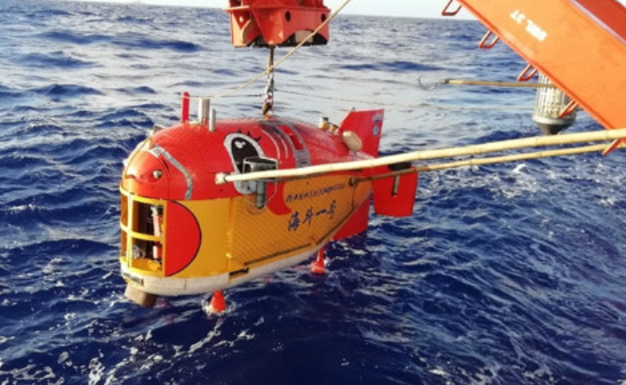
Reference
Click on the image to learn more
Manned submersible Jiaolong: Independently developed by China, it can descend as deep as 7,000+ metres underwater for scientists to conduct research, including observation and sampling. This is the manned submersible with the deepest dive in the world (as of November 2018).
Sources:
Gov.cn: http://www.gov.cn/xinwen/2018-11/30/content_5344610.htm
Webpage of China Central Television: http://news.cntv.cn/special/jiaolong/shouye/index.shtml
Unmanned submersible Haidou: Haidou-1 completed the first 10,000-metre sea trial and experimental application task making its deepest dive of 10,907 metres, setting a deep-sea diving record for Chinese submersibles.
Sources:
Gov.cn: http://www.gov.cn/xinwen/2020-06/08/content_5518069.htm
Xinhuanet: http://big5.xinhuanet.com/gate/big5/m.xinhuanet.com/2020-06/08/c_1126089162.htm

Slide 16
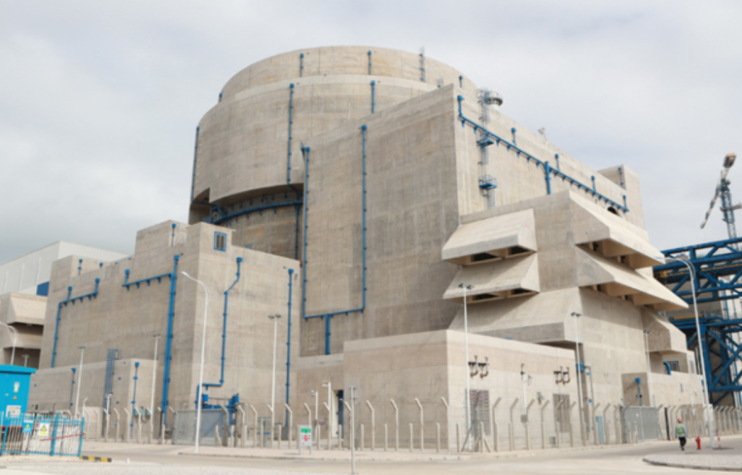
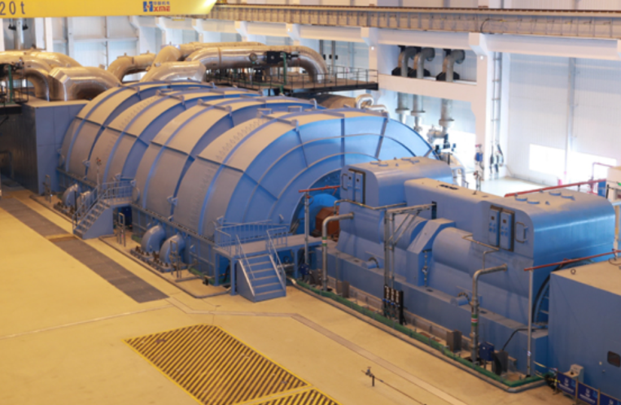
Reference
Third-generation nuclear reactor: Hualong One is the third-generation nuclear technology of China. With a design life of 60 years, the Hualong One reactor adopts a 177-core design that replenishes the fuel every 18 months, with a utilisation rate of 90 percent. It innovatively uses a combination of "passive and active" safety systems with double containment and other technologies, which meets the highest international safety standards. Hualong One technology is the world’s first nuclear reactor used in grid connection of power systems. It considerably enhances the competitiveness of China’s nuclear power industry and has great significance for optimising the energy structure and promoting green and low-carbon development.
Sources:
http://www.gov.cn/xinwen/2020-11/27/content_5565321.htm
http://www.gov.cn/xinwen/2020-11/27/content_5565354.htm#allContent

Slide 17
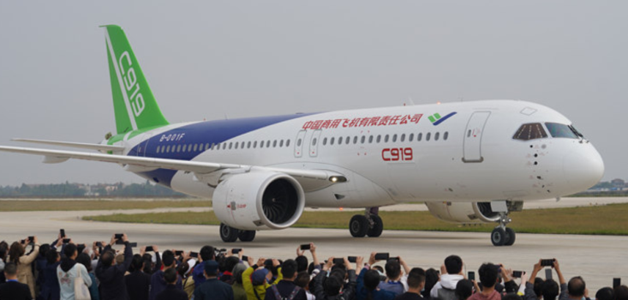

Reference
Large aircraft manufactured in China: The C919 is a large civil jetliner with property rights owned by China. It was put into commercial operation in early 2021. The first large aircraft production and flight test centre designed and built by China was established in April 2021. It marked the formation of a relatively complete industrial chain from scientific research and design, production and flight test to delivery and operation of the large aircraft industry in China.
Picture: Li Keqiang inspects the development and production of new energy vehicles
New energy vehicles: They generally include battery electric vehicles (BEVs) and hybrid electric vehicles (HEVs). China is the world’s largest new energy vehicle market, accounting for 58% of the global sales. In 2020, the State Council adopted the “Development Plan for the New Energy Vehicle Industry” which emphasised the government’s role in aspects such as the formulation of standards and regulations, and quality and safety supervision.
Sources:
http://www.gov.cn/xinwen/2020-10/31/content_5556399.htm#allContent
http://www.gov.cn/xinwen/2021-04/24/content_5601901.htm
Sources:
http://www.gov.cn/xinwen/2020-10/11/content_5550282.htm
http://www.gov.cn/xinwen/2016-02/24/content_5045809.htm
http://auto.people.com.cn/n1/2020/0111/c1005-31544253.html

Slide 18
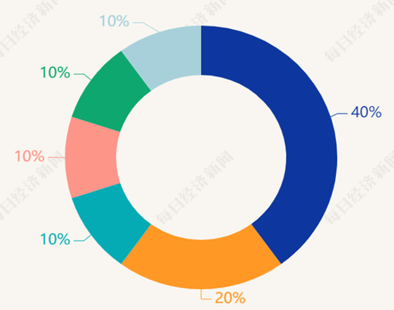
Progress in intellectual property output
According to the World Intellectual Property Indicators 2020 report released by the World Intellectual Property Organization (WIPO), China National Intellectual Property Administration received 1.4 million patent applications in 2019. It has been ranked first for nine consecutive years, with the number of applications more than twice of that received by the country ranked next. China ranked second worldwide in terms of citations of scientific papers.
Source: China National Intellectual Property Administration (https://www.cnipa.gov.cn/art/2020/12/18/art_55_155689.html)
In 2020, Chinese applicants filed 69,000 PCT international patent applications through the Patent Cooperation Treaty (PCT), ranking first in the world.
The proportion of the top ten companies in PCT patent applications in 2019
Germany
Sweden
US
China
Japan
Korea
Unit: item

Slide 19


Supporting the industrial chain upgrade
With the support of science and technology, “Made in China” is being upgraded to “Smart Manufacturing in China”.
With the continuous development of “Internet Plus”, big data and cloud computing, China’s new generation of information technology featured by 5G is becoming practical. New products based on mobile Internet and industrial Internet of Things, new business forms, models have been booming. It has become a new driving force for economic development.
According to 5G standard patent data and technical contribution data, China ranks first in the world.
Visitors at the Mobile World Congress held in Barcelona, ​​Spain, are impressed by the flexible OLED screen, an “Smart Manufacturing in China” product.

Slide 20


5G
5thGeneration cellular communication technology (5th generation mobile networks, or 5th generation wireless systems, or 5th-Generation) is the latest generation of cellular communication technology and an extension of the 4G system.
The performance goals of 5G include high data rates, reduced latency, energy saving, reduced costs, increased system capacity and large-scale device connectivity.

Slide 21

Development of 5G in China
According to the “China Internet Development Report (2021)”, China’s Internet industry made rapid development in 2020, with the number of netizens growing steadily. At the end of 2020, China had more than 160 million 5G network users, accounting for approximately 89% of the global total.
China has built the world’s largest optical fibre network, as well as standalone 4G and 5G networks. There are currently 916,000 5G base stations, accounting for 70% of the world total. Next, China will increase its support and investment in basic core technologies, including 5G, big data, basic software, industrial software and artificial intelligence, so as to advance basic industries and modernise industrial chains.
Source: Gov.cn (http://www.gov.cn/xinwen/2021-07/14/content_5624950.htm)
Click on the image to learn more about the information and figures about the development of 5G in our country. Please keep in view of the latest development of 5G.

Slide 22


What are the new products and new operational modes with stronger global competitiveness resulting from the commercial use of 5G in China?
Smart home
Smart wear
Smart city
Smart security
Others?
Mobile phones
AR/VR
Driverless cars
Smart transportation network
Industrial Internet of Things

Slide 23
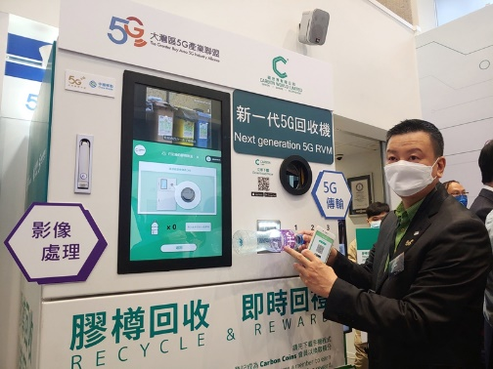
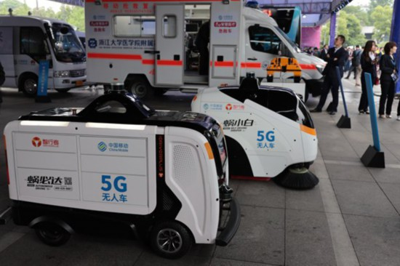
Application of 5G - Examples
Smart city - the new generation of 5G recycling machine
A smart plastic bottle recycling machine using 5G technology is introduced by the “Greater Bay Area 5G Industry Alliance”. It can recognise the shapes of plastic bottles and sort them automatically to make recycling easier and more efficient.
Source: Gov.cn (http://www.gov.cn/xinwen/2021-04/28/content_5603660.htm)
Driverless vehicles
5G technology is used in driverless sweeping and logistics vehicles. This 5G driverless sweeping vehicle Woxiaobai is installed with sensors like LiDAR. Combined with a cloud platform management system with 360° full-time monitoring and real-time information interaction, and regular cleaning time settings, the driverless vehicles bring about smart sanitation.
Source: People's Daily Online (http://media.people.com.cn/BIG5/n1/2019/0429/c14677-31057927.html)

Slide 24
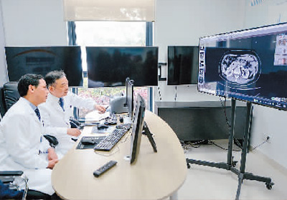
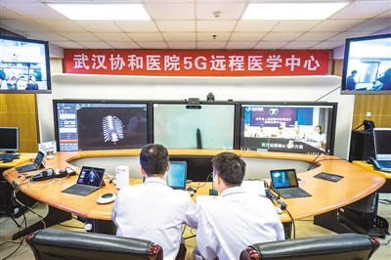
Application of 5G - Examples
5G + medical care
At the international remote consultation held at the Changxing branch of the Second Affiliated Hospital Zhejiang University School of Medicine, the oncologists from the University of California, Los Angeles are. a patient’s pathological imaging data
Experts of Wuhan Union Hospital in Hubei Province are providing guidance on a thoracic spine surgery for another hospital in Xianfeng County 500 kilometres away via 5G network.
Source: Xinhuanet (http://www.xinhuanet.com/tech/2019-10/08/c_1125076638.htm)

Slide 25
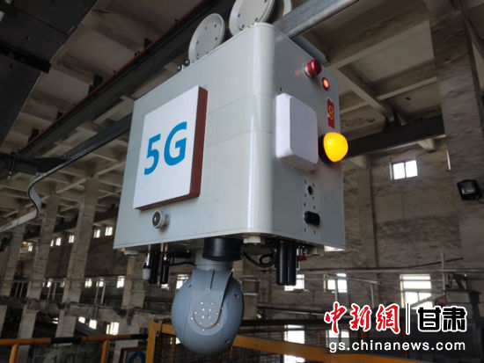
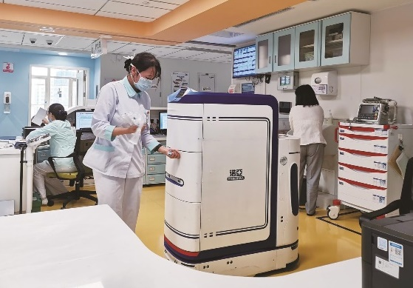
Application of 5G - Examples
5G production / security inspection robots
5G intelligent inspection robots effectively solve the problems of long distance and difficulty encountered by human inspectors, helpings achieve the goals of “unmanned operation” for fixed positions and “manpower saving” for mobile positions.
Source: http://www.gs.chinanews.com/news/2021/06-28/341119.shtml
5G logistics robots
Intelligent logistics robots can distribute medicines, disinfectant supplies, and surgical equipment.
Source: People's Government of Hubei Province (http://www.hubei.gov.cn/zhuanti/2020/2020jxt/202011/t20201120_3040434.shtml)

Slide 26

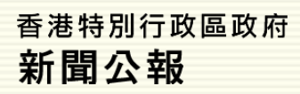
Reference
LegCo Q21(2021):
The fifth generation mobile communications services
Communications Authority-- 5G
Click on the image to learn more about the development of 5G. Please keep in view of the latest development of 5G.

Slide 27
Reference
According to the “Global Innovation Index 2020” released by the World Intellectual Property Organisation (WIPO), China ranked 14th in terms of comprehensive innovation capability. It was the only middle-income economy that ranked among the top 30 in the Global Innovation Index.
Source: Gov.cn
(www.gov.cn/xinwen/2020-12/18/content_5570481.htm)
Every time I go to China, I can feel the tremendous progress in technological innovation. The high-tech companies in China are transforming into global innovation leaders, and China’s innovation capability constantly improving.
—— Luigi Gambardella, President of ChinaEU
Source: People's Daily Online
(http://it.people.com.cn/BIG5/n1/2020/0410/c1009-31668507.html)

Slide 28
2. Achievements in medical care and public health
1. Continuous improvement in residents’ health
2. Establishment of a basic medical insurance system
3. Contributions to the improvement of the world’s medical and health services

Slide 29
Achievements of the country
in medical care and public health
The national medical and healthcare system covering urban and rural areas have been basically established. There has also been continuous enhancement of the capabilities of disease prevention and control, the expansion of medical insurance coverage, enhanced level of medical science and technology, and remarkable improvement in people’s health.
Our country has made significant contributions to the world’s medical and health services. It plays an important role in international health care and medical assistance and cooperation, and is actively engaged in the promotion of human health and hygiene.

Slide 30


Public health and medical services
Social public health service
Medical services
Health promotion services
Relevant management, security, monitoring systems, etc.
Reference
Public health involves medial and healthcare services……
As there are 1.4 billion people in China, medical care and public health is a major livelihood issue concerning the well-being of the population.
In China, the medical and health care services focus on the rural areas . Disease prevention, with the use of both traditional Chinese medicine and Western medicine, and supported by science, technology and education, with engagement of all members in the society.

Slide 31
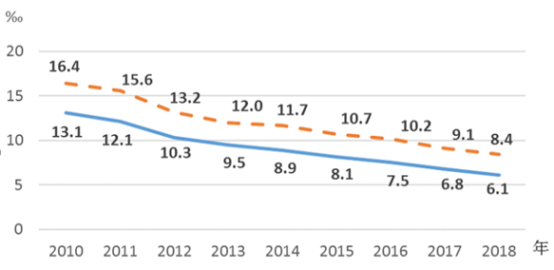
Chinese people’s health condition high up among developing countries
In recent years, both the infant mortality rate and the under-five mortality rate have continued to decline (see the graph on the right), achieving the United Nations (UN) Millennium Development Goal ahead of schedule.
Goal 4 of UN Millennium Development Goals is to reduce child mortality. The under-five morality rate was expected to reduce by two thirds, between 1990 and 2015.
Source: Webpage of the United Nations (https://www.un.org/millenniumgoals/)
—— Infant morality rate
- - - - Under-five mortality rate
Infant mortality rate and the under-five mortality rate during 2010-2018
Source: National Bureau of Statistics of China
(http://www.stats.gov.cn/tjsj/zxfb/201912/t20191206_1715751.html)

Slide 32


Establishing a large-scale basic medical and healthcare security system
Do you know who are covered by China’s basic medical security system?
I know! It benefits the employed and unemployed population in urban areas, rural population as well as the urban and rural population with economic difficulties.

Slide 33
Basic medical insurance for urban residents
Basic medical insurance for urban employees
New rural cooperative medical system
The medical insurance system covers more than 1.3 billion people, accounting for 96.8% of the population.
Our country has established a large-scale medical insurance system with universal coverage. Medical treatments are basically free of charge for urban and rural residents.
Medicines and treatments are free of charge for patients of infectious diseases, such as AIDS, tuberculosis, snail fever, hydatid disease and leprosy.
Source:
National Health Commission of the People’s Republic of China. Statistical Report on the Sixth National Health Service Survey (January 2021)
(http://www.nhc.gov.cn/mohwsbwstjxxzx/s2908/202101/0838723e3f3a4adb835d970abd551665.shtml)

Slide 34
Reference
During an interview with China.com.cn in December 2018, Dr Gauden Galea, the World Health Organisation (WHO) Representative in China, said that China has made significant achievements in medical and healthcare services in the 40 years of reform and opening-up, and China’s achievements would determine the realisation of the global sustainable development goals.
Source: China Internet Information Center (http://guoqing.china.com.cn/2018-12/29/content_74324894.htm)
On 17 November 2016, the International Social Security Association (ISSA) awarded the “Social Security Outstanding Achievement Award (2014 – 2016)” to the Government of the People’s Republic of China, in recognition of our country’s outstanding achievements in expanding the coverage of social security in recent years.
Source: Ministry of Human Resources and Social Security of the PRC
(http://www.mohrss.gov.cn/SYrlzyhshbzb/dongtaixinwen/buneiyaowen/201611/t20161118_259793.html)

Slide 35
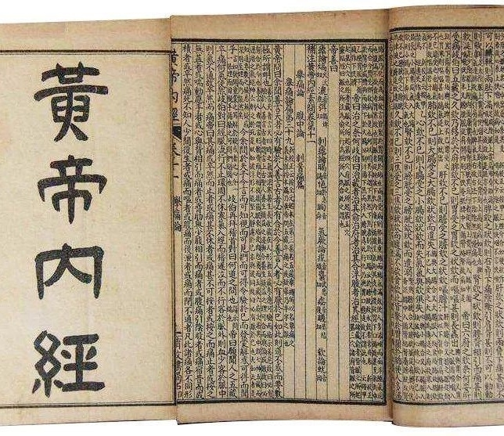
Contributions to the world’s medical and healthcare services
At present, there has been an ongoing expansion of traditional Chinese medicine in medical care, education and technological cooperation, spreading the practices to more than 160 countries and regions.
The International Standardization Organization (ISO) has set up a Traditional Chinese Medicine Technical Committee with its secretariat in China.
Acupuncture and moxibustion of traditional Chinese medicine is inscribed on the Representative List of the Intangible Cultural Heritage of Humanity. Pharmacopoeias such as the Huangdi Neijing (Inner Canon of the Yellow Emperor), Bencao Gangmu (Compendium of Materia Medica) were inscribed on the Memory of the World Register.

Slide 36


Tu Youyou: The first Chinese Nobel laureate in physiology or medicine
Tu Youyou is a pharmacist and the Chief Scientist of China Academy of Traditional Chinese Medicine. Devoted herself to the research and practice of traditional Chinese medicine for more than six decades, she led her team in the discovery of artemisinin, which proves to be an effective treatment of malaria. She has made tremendous contributions to the technological innovation of traditional Chinese medicine and human health. She was awarded the Nobel Prize in Physiology or Medicine in 2015.
Source: Webpage of The Nobel Prize (https://www.nobelprize.org/prizes/medicine/2015/summary/)
UN Women posted a photo of the Chinese scientist Tu Youyou, and captioned “She found a drug to treat malaria from traditional Chinese medicine, tested it on herself & and saved millions of lives. On International Women’s Day, let’s congratulate the courageous women who, like Tu Youyou, have devoted themselves to science!”
Source: National Administration of Traditional Chinese Medicine of the PRC: http://www.satcm.gov.cn/xinxifabu/gedidongtai/2019-03-11/9301.html
Screenshot of UN Women on Twitter
Watch the CCTV programme,
“The Medal of the Republic Goes to: Tu Youyou”
Source: Webpage of CCTV, retrieved from http://news.cctv.com/2019/09/25/ARTIgyhEsFfTs8OWYJSFtEnY190925.shtml

Slide 37

China arranging medical aid teams to Africa
Reference
China has been providing assistance for Africa’s medical and healthcare services since the 1960s. As of June 2020, China has delegated medical aid teams to nearly 50 countries in Africa, treating more than 200 million African patients. China has also assisted in building a large number of anti-malarial centres in the countries in Africa and carried out medical cooperation projects such as “Brightness Journey”, which has overall improved the medical capabilities of many African countries.
Source: China Social Sciences Network.
(http://m.cssn.cn/zx/zx_bwyc/202006/t20200623_5146478.htm)
A 73-year-old Maldivian elderly at Hulhumale Hospital near the capital of Maldives, Malé, expressed gratitude to Chinese Ophthalmic Medical Team.

Slide 38

The Chinese Naval Hospital Ship - Peace Ark
Reference
The Chinese Naval Hospital Ship, Peace Ark, is a large professional hospital ship specifically built for maritime medical rescue.
As of the end of 2019, the Peace Ark hospital ship has been in service for 11 years, sailed abroad for 9 times and more than 240,000 nautical miles in total. It has visited 43 countries and regions, providing medical services for more than 230,000 people and over 1,400 surgeries. It is indeed a ship of life, peace, friendship, and culture.
The Chinese Naval Hospital Ship - Peace Ark
Source: Xinhuanet (http://www.xinhuanet.com/politics/2019-12/11/c_1125335738.htm)

Slide 39
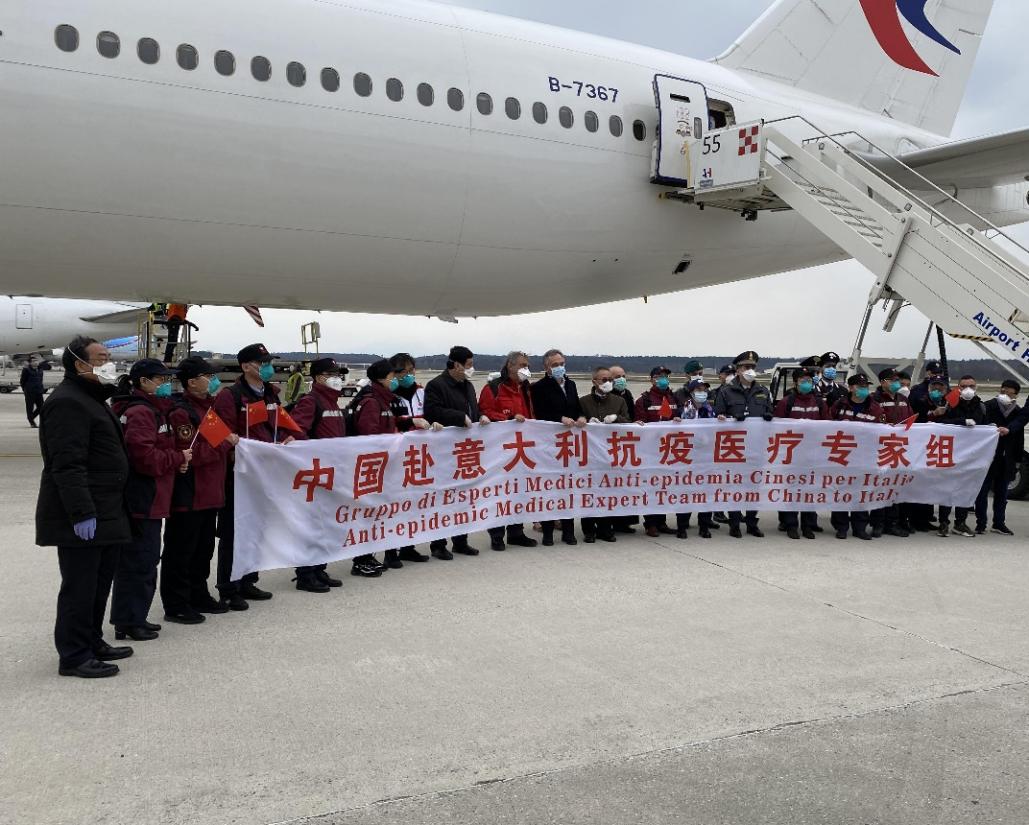
Reference
After the outbreak of COVID-19, China has not only endeavoured to prevent and fight against the virus, but also actively helped other countries. China has arranged medical expert teams to share its experience in preventing and fighting against the virus, provided material assistance, and joined the COVID-19 Vaccines Global Access (COVAX), which demonstrate the commitment of our country to the world.
The third anti-epidemic medical expert team from China arrived in Milan, Italy

Slide 40
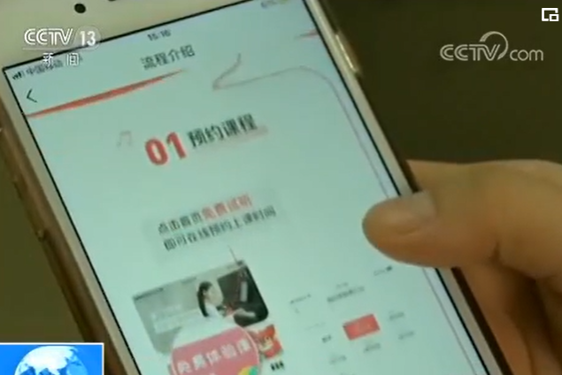

3. Achievements in culture and education
Greater cultural influence 2. Rapid development of education
In recent years, our country’s investment in cultural industries and education has been continuously increasing, and the public cultural services and facilities have been improving. Education has become more accessible, and cultural industries have been developing rapidly. Chinese culture has continued to spread to other parts of the world with greater influence. Watch the video clip to learn about the development in the production and broadcasting of programmes and cinematic works in China.
Video
Source: CCTV (https://tv.cctv.com/2019/07/26/VIDEqNwNBCwxmPULTRGrvlz7190726.shtml)
Question: Watch the video and briefly describe our country’s development in broadcasting and cinematography in recent years.

Slide 41
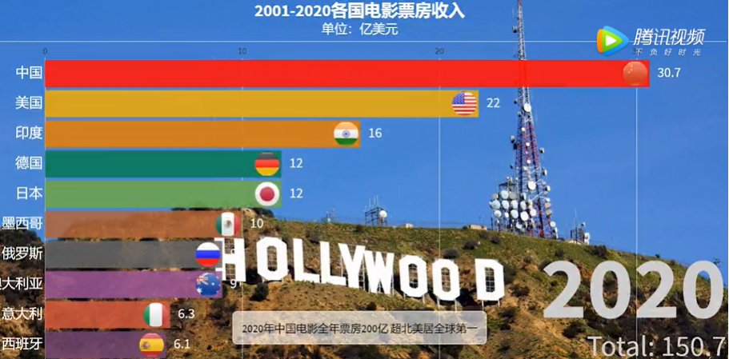
Greater cultural influence
Booming of China’s film market
In 2020, China produced 531 drama movies and 119 science education movies, documentaries, animation and special movies.
Source: Statistical Communiqué of the People’s Republic of China on the 2020 National Economic and Social Development, retrieved from http://www.stats.gov.cn/english/PressRelease/202102/t20210228_1814177.html
In 2020, the total box office revenue of Chinese films amounted to 17,093 million yuan, accounting for 83.72% of China’s total box office revenue of 20,417 million yuan.
Source: China Film Administration (http://www.chinafilm.gov.cn/)
Video: Witness the Development of Chinese Film Market.
Source: Tencent (https://new.qq.com/rain/a/20210318V0EGDS00)
Click on the image to watch the video

Slide 42
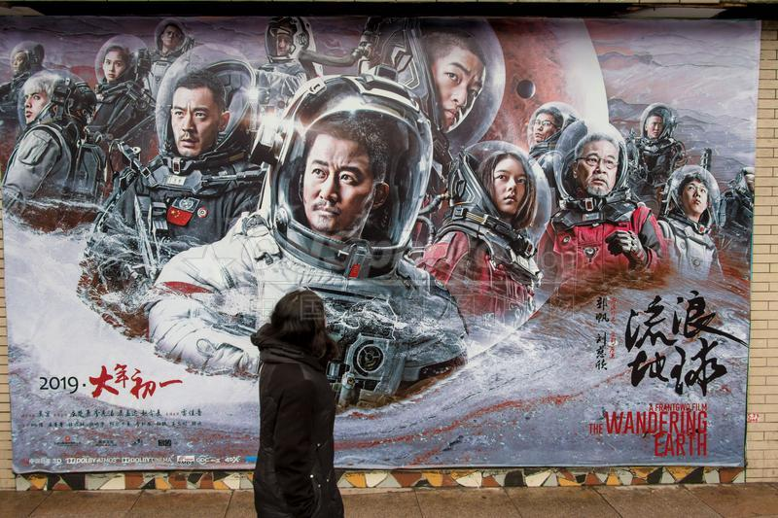
Reference
Examples of blockbusters in the Mainland
The Wandering Earth is a milestone in Chinese science fiction movies. As of 20 February 2019, the domestic box office exceeded 4 billion yuan, with more than 85 million viewers. The overseas box office exceeded US$5 million, making the best overseas record for Chinese films in the past five years.
The poster of The Wandering Earth
Source: People’s Daily Online ( http://media.people.com.cn/BIG5/n1/2019/0221/c40606-30851052.html/)

Slide 43

Reference
Significant improvements of film and television production and broadcasting
Story of Yanxi Palace has become popular worldwide. TV stations around the world, including TVB in Hong Kong, GTV in Taiwan, NBC in Japan, Asian N in Korea, and the US satellite television, have purchased it. It has been broadcast in more than 70 countries and regions.
Poster of Story of Yanxi Palace

Slide 44

Reference
Watch the video
The documentary A Bite of China takes a closer look at the beauty of food and traces the cultural origins of Chinese cuisine, so as to explore more meaningful and fascinating Chinese stories by means of food.
Source: CCTV.COM (http://jishi.cctv.com/special/shejian3PC/shouye/)
Screenshot of the documentary A Bite of China
Click on the image to learn more.

Slide 45
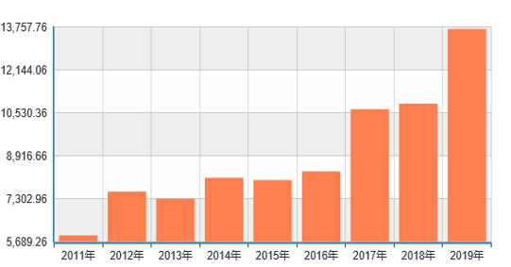
Flourishment of press and publication
In 2020, a total of 27.7 billion copies of newspapers and 2 billion copies of magazines were issued, and 10.1 billion copies of books were published.
Source: Statistical Communiqué of the People’s Republic of China on the 2020 National Economic and Social Development (http://www.stats.gov.cn/tjsj/zxfb/202102/t20210227_1814154.html)
China’s exchanges with other countries on publication has been developing rapidly. There were 1,314 book copyrights exported in 2004 and 10,873 in 2018, with an increase of 727% and an average annual growth of 15%, reflecting that its influence is growing.
Source: People’s Daily Online. (http://media.people.com.cn/n1/2019/0930/c40606-31381950.html)
The total number of China’s book copyright exports between 2011 and 2019
Source: National Bureau of Statistics of China

Slide 46
Flourishment of game development in China
Report released by the 2019 GameDaily Connect
In 2019, China’s game exports exceeded US$11 billion, with an increase of about 100 times over the past decade.
Source: People’s Daily Online.
(http://finance.people.com.cn/n1/2019/1209/c1004-31495522.html)
Question: Do you know any online games developed by China?

Slide 47
Reference
Rapid growth of cultural trade
There has been a steady growth of the total imports and exports of cultural products.
• In 2018, China’s total values of imports and exports of cultural products were US$102.38 billion, 5.5 times that of 2005 and an increase of 15.4% over 2012. During the period of 2013 – 2018, the average annual growth was 2.4%.
• In 2018, the US, HKSAR, the Netherlands, UK and Japan were the top five export markets for Chinese cultural products, accounting for 59.6% of the total exports.
Source: Gov.cn (http://www.gov.cn/xinwen/2019-07/25/content_5415076.htm)

Slide 48
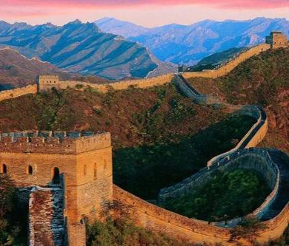



Significant achievements in
cultural heritage protection
As of October 2019, there were a total of 5,058 national key protected cultural relics units.
A total of 55 sites of “China’s world heritage” have been inscribed onto the World Heritage List.
To date a total of 42 items in China have been inscribed onto the UNESCO’s List of Intangible Cultural Heritage.
The Great Wall
Art of Dunhuang
Active cultural exchanges with other countries
Sources:
Gov.cn
http://www.gov.cn/xinwen/2019-
10/10/content_5437939.htm
Xinhuanet: http://www.xinhuanet.com/politics/2020-12/17/c_1126874696.htm
UNESCO:
http://whc.unesco.org/en/list/
"Happy Chinese New Year" performance in Johannesburg, South Africa
A dance with Chinese opera elements in Helsinki, Finland
kunqu opera

Slide 49



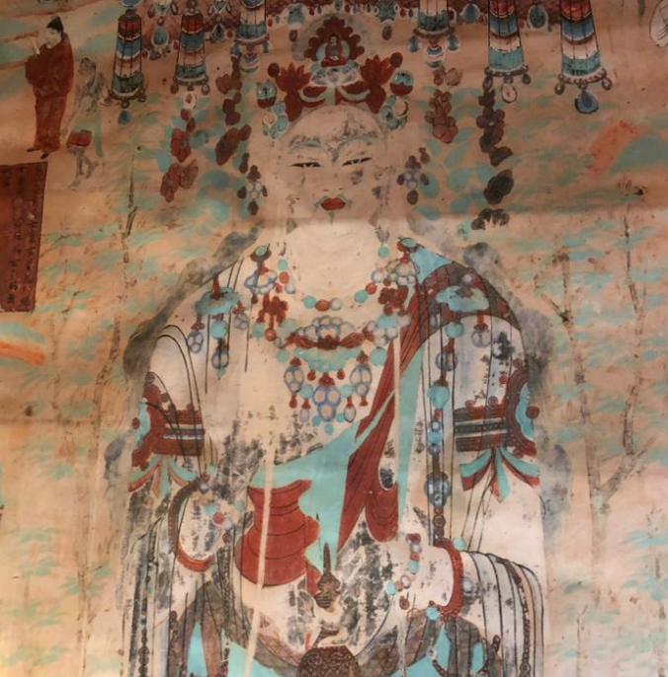
Reference
Significant achievements in cultural heritage protection
The Mogao Caves in Dunhuang are world-famous for their statues and murals, which span thousands of years of Buddhist art. The Mogao Caves were declared as one of the national key protected cultural relic units by the State Council as early as in 1961, They were inscribed onto the World Heritage List by UNESCO in 1987.
The picture was taken by the developer of this resource
The picture was taken by the resource developer

Slide 50

Reference
Intangible Cultural Heritage in Hong Kong
In 2017, the Leisure and Cultural Services Department announced the first Representative List of the Intangible Cultural Heritage of Hong Kong, which comprises 20 items. The Representative List provides the Government with a basis for prioritising resources allocation and introducing measures for protecting intangible cultural heritage (ICH) items.
Source: www.info.gov.hk/gia/general/201708/14/P2017081400655.htm
Activity: Enter the following webpage to understand the intangible cultural heritage in Hong Kong, and the relationship between the heritage and Chinese traditional culture. (Please keep in view of the latest development.)
Source: Intangible Cultural Heritage Office (https://www.lcsd.gov.hk/CE/Museum/ICHO/en_US/web/icho/the_representative_list_of_hkich.html)
Click on the image to learn more.

Slide 51
Cultural Heritage
According to the Convention Concerning the Protection of World Cultural and Natural Heritage, “cultural heritage” includes:
• Monuments: architectural works, works of monumental sculpture and painting, inscriptions, cave dwellings and combinations;
• Groups of buildings: groups of separate or connected buildings; and
• Sites: works of man or the combined works of nature and man, and areas including archaeological sites.
In Hong Kong, the Antiquities and Monuments Ordinance was enforced in 1976 to ensure that the best examples of Hong Kong’s heritage are protected appropriately. In the same year, the Antiquities Advisory Board (AAB) and the Antiquities and Monuments Office (AMO) were established. The AMO, which provides secretarial and executive support to AAB in conserving places of historical and archaeological interest, is the executive arm of the Antiquities Authority.
Sources:
UNESCO. World Heritage. https://whc.unesco.org/en/about/
Antiquities and Monuments Office. https://www.amo.gov.hk/en/home/index.html
Convention Concerning the Protection of the World Cultural and Natural Heritage. https://whc.unesco.org/archive/convention-en.pdf

Slide 52
Intangible Cultural Heritage (1)
According to the UNESCO’s Convention for the Safeguarding of the Intangible Cultural Heritage (the “Convention”), “intangible cultural heritage” means the practices, representations, expressions, knowledge, skills – as well as the instruments, objects, artefacts and cultural spaces associated therewith – that communities, groups and, in some cases, individuals recognise as part of their cultural heritage.
Source: Intangible Cultural Heritage Office (https://www.lcsd.gov.hk/CE/Museum/ICHO/en_US/web/icho/what_is_intangible_cultural_heritage.html)

Slide 53
Intangible Cultural Heritage (2)
China ratified the Convention in 2004. The Government of Hong Kong Special Administrative Region (HKSAR Government) agreed that the Convention should apply to Hong Kong with effect from December 2004. With the enforcement of the Convention in April 2006, an Intangible Cultural Heritage Unit was set up in the same year under the establishment of the Hong Kong Heritage Museum of the Leisure and Cultural Services Department (LCSD) to undertake necessary work in compliance with the Convention. In May 2015, the LCSD upgraded Intangible Cultural Heritage Unit to the Intangible Cultural Heritage Office (ICHO) to heighten its endeavours on the identification, documentation, research, preservation, promotion and transmission of intangible cultural heritage.
Sources:
UNESCO. World Heritage. What is Intangible Cultural Heritage? https://ich.unesco.org/en/what-is-intangible-heritage-00003
Antiquities and Monuments Office. https://www.lcsd.gov.hk/CE/Museum/ICHO/en_US/web/icho/what_is_intangible_cultural_heritage.html
Convention Concerning the Protection of the World Cultural and Natural Heritage. https://ich.unesco.org/en/convention

Slide 54


4. Rapid development of education
Reference: International Education Quality Monitoring Index
The Education for All Development Index (EDI) proposed in the UNESCO “Education for All Global Monitoring Report” is an indicator to measure the development level of education for all. The index mainly monitors universal primary education, adult literacy, gender equality and education quality.
Sources: Translated, extracted and rewritten from the sources below
UNESCO (Education for All Development Index) http://www.unesco.org/new/en/archives/education/themes/leading-the-international-agenda/efareport/statistics/efa-development-index/
UNESCO (2012) (Education for All Global Monitoring Report 2012) http://www.unesco.org/new/fileadmin/MULTIMEDIA/HQ/ED/pdf/gmr2012-report-edi.pdf

Slide 55
Rapid development of education
The overall development level of China’s education has gone up to above average in the world, establishing a large-scale education system.
537,100 educational institutions of different types at all levels
In 2020
289 million students in educational institutions of different types at all levels
17,921,800 full-time teachers
Source: Webpage of Ministry of Education of the People’s Republic of China ( http://www.moe.gov.cn/jyb_xwfb/s5147/202103/t20210302_516416.html)

Slide 56
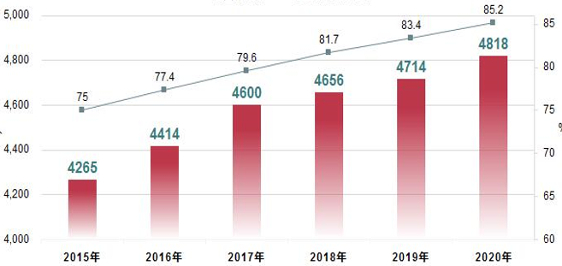
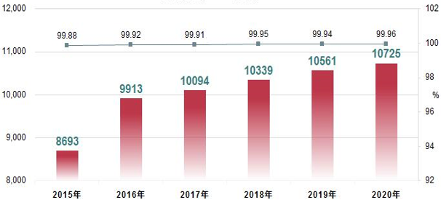
Popularisation of pre-school education, compulsory education, senior secondary school education and higher education
The number of children in kindergartens and gross enrolment rate of preschools in China
The number of students in primary schools and net enrolment rate in China
10,000 Gross enrolment rate of preschools %
Number of children in kindergartens
10,000 Net enrolment rate % Number of students in primary schools
Source: Webpage of Ministry of Education of the People’s Republic of China http://www.moe.gov.cn/jyb_xwfb/gzdt_gzdt/s5987/202103/t20210301_516062.html

Slide 57



Activity
To learn more
Gross Enrolment Ratio (GER) or Gross Enrolment Index (GEI) refers to the total number of students enrolled at a specific level of education regardless of age, as a percentage of the population in the nationally defined age group for that level of education. The GER may exceed 100% due to the inclusion of non-school age groups (under- or over-age) students.
What is gross enrollment ratio? Enter the following website for answer.
Click on the image to learn more
Source:
https://www.un.org/chinese/millenniumgoals/unsystem/indicator6.htm
http://uis.unesco.org/en/glossary-term/gross-enrolment-ratio

Slide 58
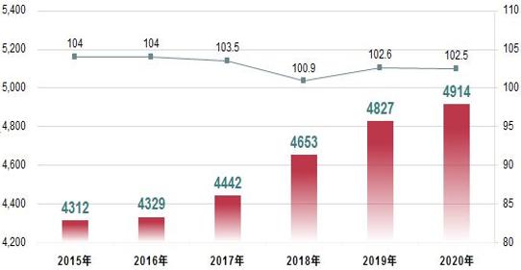
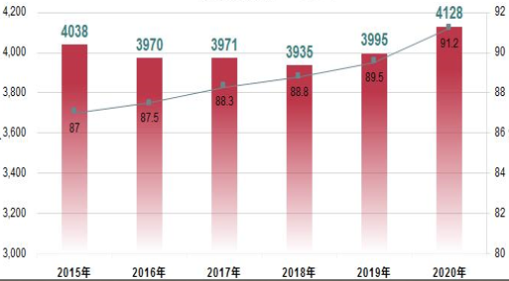
The number of students in junior and senior secondary schools and gross enrolment rates in China
The number of students at junior secondary levels and gross enrolment rates in China
The number of students at senior secondary levels and gross enrolment rates in China
10,000 Gross enrolment rates %
Number of students at junior secondary levels
10,000 Gross enrolment rates %
Number of children at senior secondary level
Source: Webpage of Ministry of Education of the People’s Republic of China (http://www.moe.gov.cn/jyb_xwfb/gzdt_gzdt/s5987/202103/t20210301_516062.html)

Slide 59
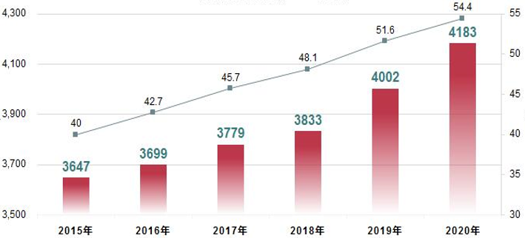
The number of students in higher education and
gross enrolment rates in China
In 2020, there were 2,738 ordinary higher education institutions (HEIs). 41,830,000 students were involved in different types of higher education. The gross enrolment rate was 54.4%.
Source: People’s Daily Online (http://sh.people.com.cn/BIG5/n2/2021/0301/c176739-34599352.html)
10,000 Gross enrolment rate %
Number of students in higher education
Source: Webpage of Ministry of Education of the People’s Republic of China (http://www.moe.gov.cn/jyb_xwfb/gzdt_gzdt/s5987/202103/t20210301_516062.html)

Slide 60
Reference
According to the latest Times Higher Education World University Rankings in 2021, Tsinghua University and Peking University ranked 20th and 23rd in the world respectively. They have become world-renowned institutions.
Source: Times Higher Education World University Rankings
https://www.timeshighereducation.com/student/best-universities/best-universities-world
https://www.timeshighereducation.com/world-university-rankings/2021/regional-ranking#!/page/0/length/25/sort_by/rank/sort_order/asc/cols/stats

Slide 61
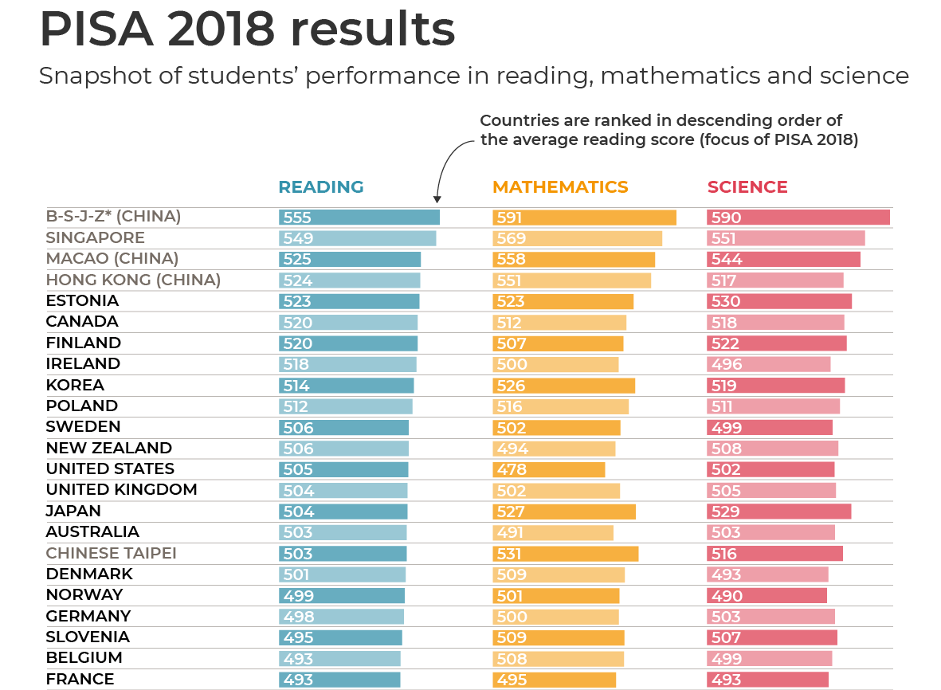
Quality of education is gradually improving
In 2018, four Mainland provinces and municipalities (Beijing, Shanghai, Jiangsu, and Zhejiang, collectively as “B-S-J-Z”) participated in the Programme for International Student Assessment (PISA2018) test. In the sample test of 15-year-old students from all the 79 participating countries / regions, the B-S-J-Z students ranked first in all the three tested spectrums, namely reading, mathematics and science, with an average score of 555, 591 and 590 respectively, outperforming the other participating countries / regions.
Source: OECD Programme for International Student Assessment (PISA)
https://www.oecd.org/pisa/PISA-results_ENGLISH.png

Slide 62
Reference
Introduced by the Organization for Economic Co-operation and Development (OECD) in 2000, PISA is a cross-cultural evaluation programme on basic education in different countries (regions). It assesses 15-year-old students’ ability in reading, mathematics and science, and using knowledge and skills to solve real-life problems, reflecting students’ ability to overcome real-life challenges in future.

Slide 63
Greater equity has been achieved in educational services
Achievements of education reforms during the “13th Five-Year Plan” period:
The gap between urban and rural education was narrowing gradually.
Special assistance and policies were provided for students in the impoverished areas.
According to the Ministry of Education of the country, effective measures were taken during the “13th Five-Year Plan” period to foster the work on preventing student dropouts. As of the end of 2019, the national nine-year compulsory education retention rate reached 94.8%, an increase of 1.8% as compared to 2015. By 2020, almost all the 200,000 impoverished drop-out students have been convinced to return to school. Key HEIs have enrolled up to 525,000 students from rural and impoverished areas. Funding of 773.9 billion yuan has been given to 391 million impoverished students. More than 37 million students have benefit from a government-funded nutrition improvement plan.
Sources:
Gov.cn (http://www.gov.cn/xinwen/2020-12/10/content_5568725.htm)
CCTV.COM (https://news.cctv.com/2020/09/23/ARTIVPWzIrjJFStphGvIV4x7200923.shtml)

Slide 64
“Two exemptions and one subsidy” policy
The “two exemptions” under the compulsory education policy refers to the exemption of tuition and miscellaneous fees for students in rural and urban areas. Textbooks are provided for students for free. “One subsidy”, on the other hand, is a subsidy for living expenses for students of families with financial difficulties.
Thanks to the efforts by the central and local governments over the years, China fully achieved nine-year compulsory education free of charge for all in 2008. The fund required for exemption of tuition and miscellaneous fees in the stage of implementing compulsory education in rural areas, as well as the exemption of miscellaneous fees in the stage of implementing compulsory education in urban areas were entirely covered by guarantee mechanism for compulsory education.
Source: Webpage of Ministry of Education of the People’s Republic of China
http://www.moe.gov.cn/jyb_zwfw/zwfw_fwzt/fwzt_zzzcwd/zzzcwd_ywjy/201608/t20160817_275473.html
http://www.moe.gov.cn/jyb_xwfb/s5147/202012/t20201221_506637.html

Slide 65
More and more foreign students are attracted to study in China
According to statistics, in 2018, a total of 492,185 international students from 196 countries and regions studied in 1,004 Higher Education Institutions located in 31 provinces (regions and municipalities) across China, an increase of 3,013 people or 0.62% over 2017 (Hong Kong, Macao and Taiwan were excluded).
Among these international students, 295,043 were from Asia, 81,562 from Africa, 73,618 from Europe, 35,733 from Americas, and 6,229 from Oceania.
The top 15 countries where the students came from were: Korea, Thailand, Pakistan, India, the US, Russia, Indonesia, Laos, Japan, Kazakhstan, Vietnam, Bangladesh, France, Mongolia, and Malaysia.
Source: Webpage of Ministry of Education of the People’s Republic of China
(http://www.moe.gov.cn/jyb_xwfb/gzdt_gzdt/s5987/201904/t20190412_377692.html)

Slide 66
4. Achievements in infrastructures
1. Development of transportation system
2. Development of postal system
3. Development of network system
4. Development of energy system

Slide 67
What impact does infrastructure have on social development and people’s lives?
Infrastructure includes transportation, post and telecommunications, water and power supply, commercial services, scientific research and technical services, landscaping, environmental protection, culture and education, hygiene, as well as other facilities of municipal public works and public services.

Slide 68

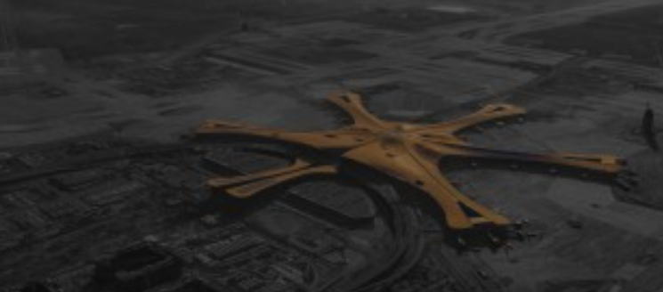
Projects in China
Examples of China’s large-scale infrastructure projects
Hong Kong-Zhuhai-Macao Bridge
Beijing Daxing International Airport
Source: Webpage of Transport and Housing Bureau of the HKSAR Government
https://www.hzmb.gov.hk/tc/info/photo-main-bridge.html
Source: Webpage of Beijing Daxing International Airport
https://daxing-pkx-airport.com/zh-hans/

Slide 69
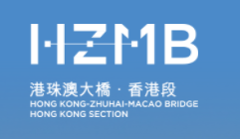

Reference
The Hong Kong-Zhuhai-Macao Bridge (1)
The Hong Kong-Zhuhai-Macao Bridge is the first mega seacrossing jointly built by Guangdong, Hong Kong and Macao. The bridge is 55 kilometres long, and costs RMB120 billion. The bridge is expected to be used for 120 years. The enabling works of the bridge started in August 2003, and construction commenced in December 2009. The bridge was formally opened in October 2018. The Hong Kong-Zhuhai-Macao Bridge is the longest sea-crossing bridge in the world with the world’s longest submarine immersed tunnel It is one of the most challenging mega projects in the world.
Click on the image to learn more
Source: Webpage of Transport and Housing Bureau of the HKSAR Government
https://www.hzmb.gov.hk/en/index.html

Slide 70
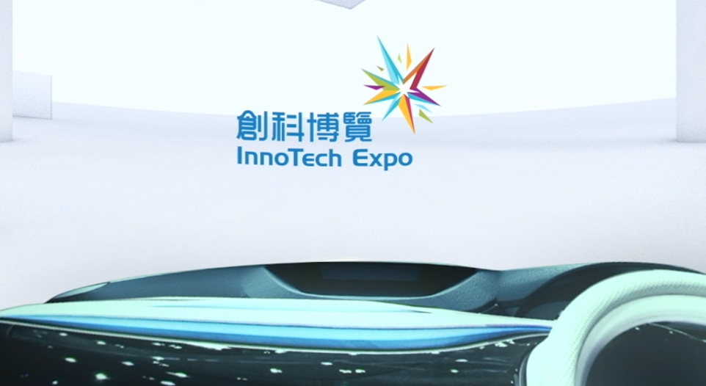
Reference
The Hong Kong-Zhuhai-Macao Bridge (2)
The most difficult and technically complex part of the entire project was the submarine immersed tunnel. While the former record for the longest submarine tunnel in the world was only 3 kilometres, that of the Hong Kong-Zhuhai-Macao Bridge is 6.7 kilometres long. It is a world-class problem to connect immersed tubes at a depth of more than 40 metres under the water pressure of tens of thousands of tonnes. The engineering team used 33 immersed tubes, of each weighed more than 80,000 tonnes and as heavy as an aircraft carrier, to build a 6.7-kilometre-long tunnel.
Click on the image to experience the Hong Kong-Zhuhai-Macao Bridge in 360 degrees.
Source: Our Hong Kong Foundation https://www.youtube.com/watch?v=87xcU3mRnfQ

Slide 71

Watch the video clip
The Hong Kong-Zhuhai-Macao Bridge achieved the goal of “a one-hour living circle”
With the official opening of the bridge, Hong Kong is included in the national expressway network. It takes only about 40 minutes to drive from Hong Kong to Zhuhai or Macao. The distance by land transport to Guangzhou, Foshan and other places concerned has also been greatly reduced. The goal of a one-hour economic circle for cities in the Greater Bay Area has been basically achieved.
Click on the image to watch the video
Source: Information Services Department, the HKSAR Government
https://www.isd.gov.hk/eng/tvapi/18_td56.html

Slide 72

Reference
Beijing Daxing International Airport
Beijing Daxing International Airport is currently the world’s largest newly constructed airport. The project has been the most difficult in the world in terms of construction, operation preparation, and comprehensive management and control. Its terminal building is the largest shock-absorbing and isolation construction in the world, with the world’s largest single concrete slab built.
The terminal building is the first in the world with double-deck departure and arrival platforms, and a high-speed rail underneath. It is also the first airport in China with the design of “omnidirectional” runways. For air traffic control, the world’s largest automation system with leading comprehensive capabilities is used. Daxing is also the airport with the highest renewable energy utilisation rate in China with 100% use of New Energy Vehicles (NEVs) on the airport premises as well as the undertaking of the world’s largest project of coupling shallow geothermal energy utilisation.
Source: Gov.cn (http://www.gov.cn/xinwen/2019-09/26/content_5433241.htm)
Click on the image to learn more
Source: Beijing Daxing International Airport
(https://daxing-pkx-airport.com/)

Slide 73
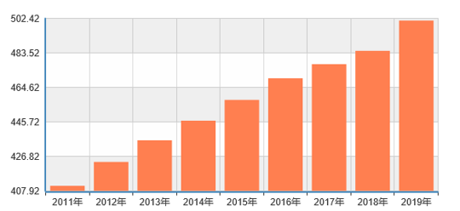
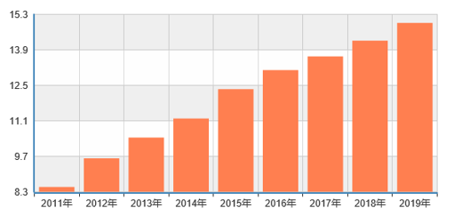
Development of transportation system
Highways
As at the end of 2019, China had 5.013 million kilometres of highways, including 150,000 kilometres of expressways, ranking first in the world.
Highway mileage (in 10,000 km)
Highway mileage of expressway (in 10,000 km)
Source: National Bureau of Statistics of China (http://www.stats.gov.cn/tjsj/)

Slide 74

The Duge Beipanjiang Bridge
Reference
Spanning across Shuicheng County, Liupanshui City of Guizhou Province and Puli Town, Xuanwei City of Yunnan Province, Beipanjiang First Bridge starts from Duge Town in the North, crosses Nizhu River and reaches Lalong Village in the South. The bridge is 1,341.4 metres long and 565.4 metres above the water. It adopts the standard of a four-lane two-way expressway, with a design speed of 80 kilometres per hour. The total investment of the project is 1.028 billion yuan.
As at December 2018, Beipanjiang First Bridge was the world’s largest span cable-stayed bridge with steel truss and girder. It won the Gustav Lindenthal Medal, dubbed the “Nobel Prize of Bridges”, at the 35th International Bridge Conference.
Beipanjiang First Bridge
Source: Phoenix Satellite Television (http://v.ifeng.com/c/v/v001HtobVQJx7z36P82GhknmgeADSYf70Oy61FCcoEjv9NcOPjKQlCWjgCxSLmd)

Slide 75
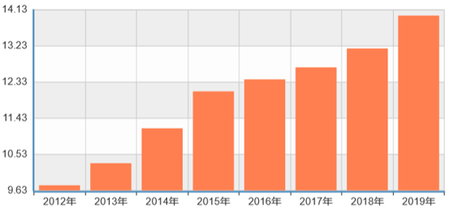
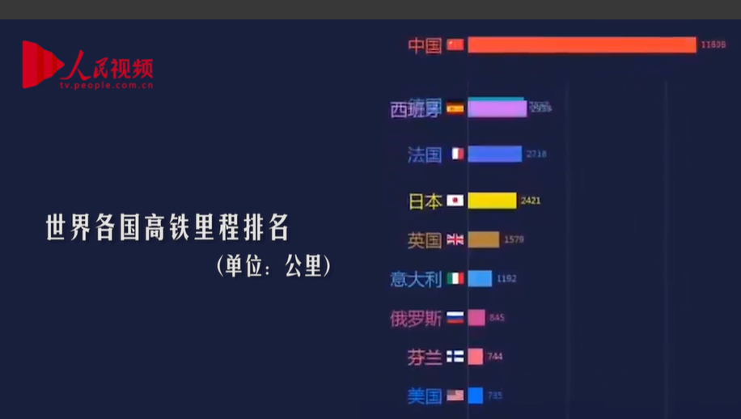

High-speed rail
China’s high-speed railway network with the “Four Verticals and Four Horizontals” has taken shape. The mileage of operating railways increased from 96,300 kilometres in 2012 to 141,300 kilometres in 2019 of which the high-speed rail mileage was 38,000 kilometres. It ranked first in the world, accounting for 60% of the world’s total high-speed rail mileage.
Rail mileage (in 10,000 km)
Click on the image to watch the video
Rail mileage from 2012 to 2019
Watch video: Ranking of high-speed rail mileage in the world
Source: National Bureau of Statistics of China
(http://www.stats.gov.cn/tjsj/)
Source:
(http://tv.people.com.cn/n1/2018/1204/c413792-30442603.html)

Slide 76
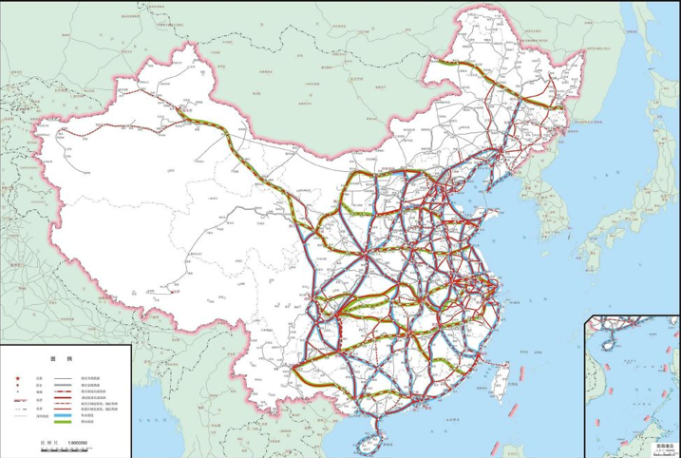
“Eight Verticals and Eight Horizontals”
High-speed railway network
Medium- and Long-term Railway Network Plan
According to the “Medium- and Long-term Railway Network Plan” issued by the National Railway Administration in 2016, China was to enhance its high-speed railway from “Four Verticals and Four Horizontals” to “Eight Verticals and Eight Horizontals” network to connect coastal with inland regions, and link southern and northern parts, as supported by the cross-region and inter-city railway lines.
Source: National Railway Administration of the PRC (http://www.nra.gov.cn/jglz/fgzd/gfwj/201607/t20160721_308872.shtml )

Slide 77
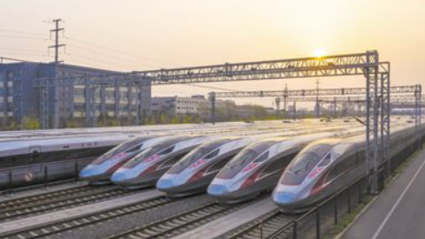
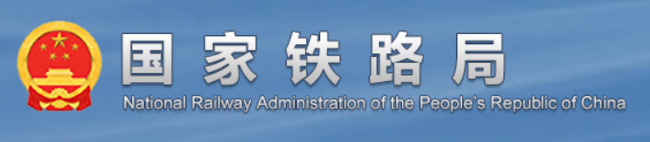
Activity
The goal of “one-hour living circle” has been realised with Hong Kong joining the national high-speed railway network. Now we can enjoy yum cha in Hong Kong in the morning and arrive at a Mainland city in the afternoon. Our concept of time and space has changed, and the economic landscape has also been reconstructed. Our lives have been changed unknowingly by the development of infrastructure.
EMU train Fuxing
List some Mainland cities that can be reached within a short time by the Guangzhou-Shenzhen-Hong Kong Express Rail Link.
List the locations covered by the “Eight Verticals and Eight Horizontals” high-speed railway network .
Explain how the development of the high-speed railway network can promote the development of our country.
Explain the significance of Hong Kong joining the country’s high-speed railway network.
Sources:
National Railway Administration of the PRC (http://www.nra.gov.cn/xxgkml/xxgk/xxgkml/201908/t20190830_87801.shtml)
People’s Daily Online (http://finance.people.com.cn/BIG5/n1/2021/0623/c1004-32137870.html)
Click on the image to learn more

Slide 78
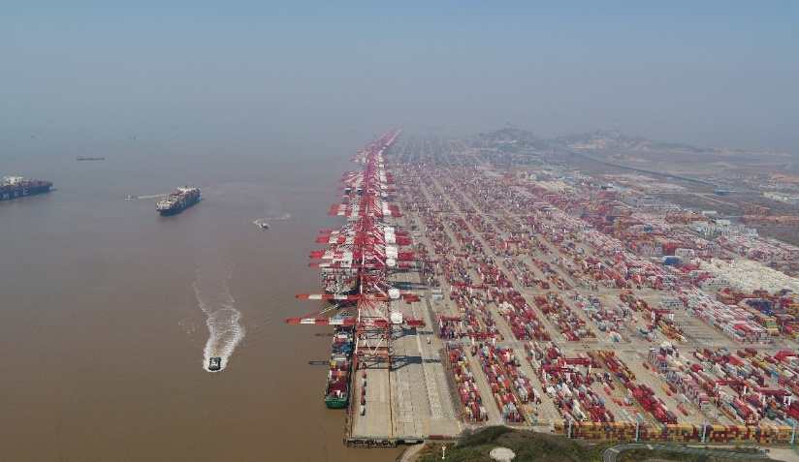


Ports
Top ports in the world include Shanghai, Singapore, Shenzhen, Ningbo-Zhoushan, Hong Kong, Busan, Qingdao, Guangzhou, Rotterdam and Tianjin. Most of them are the ports in China.
Yangshan Port in Shanghai
Click on the image to learn more
Source: Informa
(https://lloydslist.maritimeintelligence.informa.com/one-hundred-container-ports-2020/Port-Data)

Slide 79
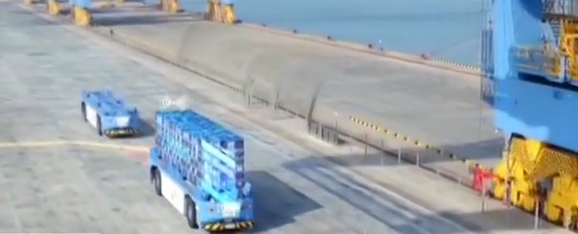
Watch video: Fully-automated container terminal at Qingdao Port
Click on the image to watch the video
Question: After watching the video, explain the features of the fully-automated container terminal at Qingdao Port.
Source: http://tv.people.com.cn/BIG5/n1/2017/0512/c39805-29270574.html

Slide 80
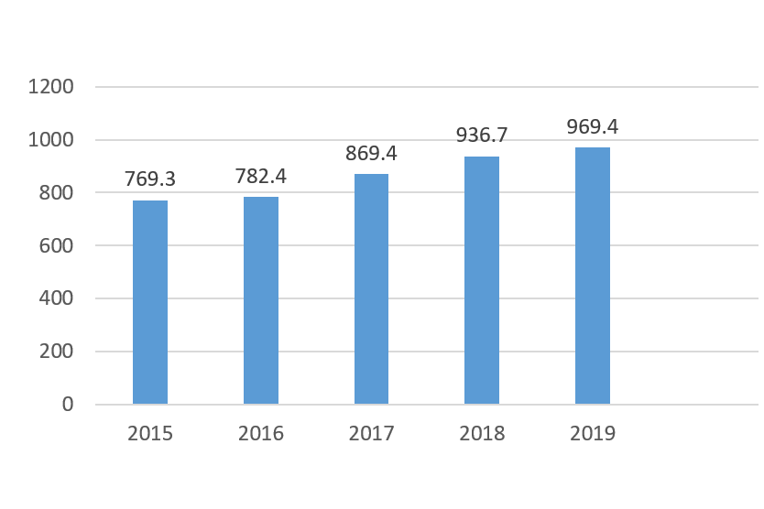
Airport
In 2019, the total fixed-asset investment in civil aviation was 181.99 billion yuan, of which 96.94 billion yuan was invested in civil aviation infrastructure and technological upgrading.
According to the statistics by Cirium, a global travel data and analytics company, on the total number of passenger flights operated by various countries in 2020, the United States, China and Japan ranked the top three.
100 million dollars
Civil Aviation Infrastructure and Technological Transformation Investment in 2015-2019
Source: Civil Aviation Administration of China. Statistical Bulletin on the Development of the Civil Aviation Industry in 2019.
http://www.gov.cn/xinwen/2020-06/13/content_5519220.htm
Related news report:
Overview of the development of national airports in 2020
Source: Webpage of China Aviation News (http://www.cannews.com.cn/2021/01/25/99319555.html)
Sources:
Webpage of China Aviation News: http://www.cannews.com.cn/2021/01/25/99319555.html
People’s Daily Online: http://sc.people.com.cn/BIG5/n2/2021/0106/c345167-34512925.html
Please keep in view of the latest development.

Slide 81

Development of Postal System
China has basically formed a modern country-wide postal network. Comprehensive use of multiple forms of transportation by air, railway, and road is involved to connects urban and rural areas across the country, and the world. Its capabilities of receiving, sending and delivering mails have been greatly improved.
Online shopping has become part of people’s daily lives. Logistics and courier services and the Internet have developed rapidly to meet the needs of the general public.
Picture: Smart lockers for picking up parcels (Photo taken by resource developer)
81

Slide 82


As at 2019, there were more than 310,000 postal business outlets nationwide, with a total length of more than 12.22 million kilometres of postal routes. In 2020, the number of letters, parcels, newspapers and magazines were 1,420 million, 20.306 million, 16,560 million and 720 million respectively.
Source: Performance of the Postal Industry in 2020, by the State Post Bureau
The express industry in China has been growing rapidly with a steady increase of market size, ongoing optimisation of market structure, continuous enhancement of quality and efficiency, significant strengthening of service capabilities. Empowered by the utilisation of science and technology, the industry is heading for high-quality development.
Changes in volume of the express industry from 2010 to 2019 (Unit: in 100 million pieces)
Source: Performance of the Postal Industry in 2020, by the State Post Bureau
Changes in revenue of the express industry from 2010 to 2019 (Unit: in 100 million yuan)

Slide 83

Watch the video clip
Automated sorting of express parcels by robots
Click on the image to watch the video
Source: CCTV.COM (http://tv.cctv.com/2017/11/11/VIDEOsOi5Qxd5v1ltrOzdnD7171111.shtml)

Slide 84
Development of network System
In recent years, China has been speeding up the construction of optical fibre networks and 4G base stations in rural areas, so that broadband access and speed available in both rural and urban areas are the same. The “digital gap” between urban and rural areas has been significantly reduced.
With access to the Internet, rural residents can have instant access to the latest information and new technologies, and thus enjoy the convenience brought by information technology like their urban counterparts. As e-commerce and live sales are booming in the rural areas, agricultural products can now be sold through more channels. With the help of the telemedicine system, the service capabilities of primary medical institutions have been effectively improved. All primary and secondary schools across the country have been provided with broadband access, making high-quality education available in rural areas as well.
Source: Gov.cn (http://www.gov.cn/xinwen/2021-04/19/content_5600635.htm)

Slide 85
China has built the largest 5G network in the world
The 5G network has covered cities above the prefecture level* and key counties and cities across the country. As of the end of March 2021, there were 819,000 5G base stations in China.
Sources:
Gov.cn: http://www.gov.cn/xinwen/2021-01/26/content_5582523.htm；
Economic performance of the communications industry in the first quarter of 2021: https://www.miit.gov.cn/gxsj/tjfx/txy/art/2021/art_a2624764516d40989d2db2548bf9c95d.html
In 2020
Related news reports
The 2020 World 5G Conference was held in Guangzhou. The Governor of Guangdong Province, Ma Xingrui, stated at the opening ceremony that the province expressed that more than 1,600 5G-related companies, accounting for about one third of the country’s total. Huawei and ZTE have more than a total of 5,000 essential 5G patents, accounting for about one third of the world’s total. There are more than 110,000 5G base stations in Guangdong, becoming the largest 5G industry cluster in the world.
Source: Wenweipo (https://www.wenweipo.com/a/202011/26/AP5fbf30c4e4b0844413642175.html)
*A prefecture-level city is one of China's administrative divisions, and its administrative status is the same as that of a region, autonomous prefecture, and league. The prefecture-level administrative region is under the jurisdiction of the province and autonomous region.

Slide 86

Activity
In 2021, the Internet broadband services were widely promoted with a steady growth. Visit the following webpage for the latest development. Please keep in view of the latest data released.
Click on the image to enter the webpage
Possible direction of the research includes:
Income growth
Development of different major regions (such as Eastern, Central, Western, Northeastern China), etc.
Source: Performance of the Communications Industry from January to February 2021 by Ministry of Industry and Information Technology of the People’s Republic of China (2021) (https://www.miit.gov.cn/gxsj/tjfx/txy/art/2021/art_82f101e1d078447fac75443a50348b7c.html)

Slide 87



Achievements in public transportation
Achievement 1
Achievement 2
As of the end of 2020, there were 233 urban rail transit lines operated in 44 Mainland cities, with a total operating route length of 7,545.5 kilometres. Throughout the year, 39 new urban rail transit lines were built, adding 1,240.3 kilometres to the total operating route length, with an increase of 20.1% over the previous year.
In 2018, the total operating route length of China’s subway ranked first in the world, accounting for 35.26% of the world’s total.
Related reports:
Beijing Subway Goes “Fully Automated”
Total Operating Route Length of Beijing Subway Reaches 636.8 kilometres
Click on the image to enter the webpage
Sources:
Academy of Chinese Studies. Towards the future-the story of China's subway.
https://chiculture.org.hk/tc/china-today/2856)
http://www.gov.cn/xinwen/2021-01/06/content_5577537.htm

Slide 88

Development of Energy System
The generation capacities of hydropower, wind power, solar energy and nuclear power in China have continued to grow, with a gradually increasing proportion of clean energy supply such as natural gas. The energy supply system has been optimised with enhanced energy supply capacity.
The Baihetan Hydropower Station, located at the junction of Qiaojia County in Yunnan Province and Ningnan County in Sichuan Province, is currently the largest hydropower station in the world.
Source: Statistical Report of the People's Republic of China on the 2020 National Economic and Social Development (http://www.stats.gov.cn/tjsj/zxfb/202102/t20210227_1814154.html)

Slide 89

The Three Gorges Project
The Three Gorges Project is a key backbone project for the treatment, development and protection of the Yangtze River. It is the largest water conservancy and hydropower project in the world so far, alleviating the pressure on flood control in the middle and lower reaches of the Yangtze River. In 2020, the Three Gorges Power Station generated 111.8 billion kilowatt-hours of electricity, setting a world record for annual power generation.
Sources:
Gov.cn (http://www.gov.cn/xinwen/2019-06/23/content_5402601.htm#1)
People’s Daily Online (http://finance.people.com.cn/BIG5/n1/2021/0105/c1004-31988899.html)
https://www.chinanews.com/gn/2021/01-01/9376426.shtml
The Three Gorges Dam discharges floodwater

Slide 90

Solar power generation in China (Photovoltaic power generation)
In 2011, the generation capacity of China’s installed solar power was only 60% of that of Japan and the United States, and 6% of that of the EU. The country has stepped up the efforts to conserve energy and reduce emission since 2013, and the photovoltaic (PV) industry has also been developing rapidly. In 2017, China’s generation capacity exceeded that of the EU.
The PV industrial chain continues to be enhanced and upgraded. In each of the four major parts of PV panel production, China’s output volume accounts for around 70% to almost 100% of the global total. China also surpassed Japan and made the most patent applications in 2013.
Click on the image to watch the video
According to institutions such as the Energy Research Institute (ERI) of the National Development and Reform Commission (NDRC), it is estimated that nearly 40% of electricity consumption will be generated by PV by 2050.
Watch the video clip:
Source: CCTV.COM
(http://tv.cctv.com/2021/04/24/VIDEqrU1lweGosRPepwFMJOe210424.shtml)
Source: News Centre of China Central Television

Slide 91



New Infrastructure
In December 2018, the Central Economic Work Conference proposed accelerating the pace of 5G commercialisation and strengthening the construction of new infrastructure such as artificial intelligence, industrial Internet, and Internet of Things.
Leading examples of telecommunications infrastructure include 5G, Internet of Things, industrial Internet, and satellite Internet. New technology infrastructure is represented by artificial intelligence, cloud computing, blockchains, and computing power infrastructure is represented by data centres and intelligent computing centres.
Converged infrastructure mainly refers to the technologies such as in-depth application of the Internet, big data, artificial intelligence to support the transformation and upgrading of traditional infrastructure as part of the converged infrastructure. Examples include intelligent transportation infrastructure and smart energy infrastructure.
Innovation infrastructure mainly refers to infrastructure that supports scientific research, technology development, and product development, which can benefit the public. Examples include major scientific and technological infrastructure, science and education infrastructure, and industrial technology innovation infrastructure.

Slide 92

Achievements in
poverty eradication
What is poverty?
Since 2011, the extreme poverty line of US$1.9 per person per day adopted by the World Bank is also the absolute poverty line in monetary measures. It is calculated through the purchasing power parity (PPP) exchange rates, based on an individual’s minimum food consumption.
Under this standard, more than 11% of the world’s population were living in extreme poverty in 2019. Based on varying development levels of different countries, the World Bank introduced two new thresholds in 2018: the poverty line for lower middle income countries is US$3.2 per person per day, and the poverty line for lower middle income countries is US$5.5 per person per day.
Source:
Center for International Knowledge on Development（2020） (http://www.cikd.org/chinese/detail?leafId=216&docId=1554)

Slide 93

The United Nations Sustainable Development Goals: Eradication of absolute poverty by 2030
The United Nations Sustainable Development Goals, also known as Global Goals, strive to eradicate poverty, fight inequality and injustice, provide clean energy, and address climate change, between 2015 and 2030.
Source: Webpage of the UN Sustainable Development Goals (https://sdgs.un.org/goals)

Slide 94
Adjustments of standards
for poverty alleviation in our country
Our country has been implementing large-scale planned and organised poverty alleviation programmes. Poverty alleviation standard is formulated according to its social and economic development and the basic living needs of impoverished population.
In 1986, China set the poverty alleviation standard for the first time, at RMB 206 yuan and the corresponding number of impoverished population was 125 million. It is mainly designed to provide adequate food and clothing. In 2001, when formulating the Outline of Development-driven Poverty Alleviation in Rural Areas (2001-2010), China raised the standard to RMB 865 yuan and the corresponding number of impoverished population was 94.228 million. In 2011, when formulating the Outline of Development-driven Poverty Alleviation in Rural Areas (2011-2020), the standard was further adjusted to RMB 2,300 yuan (based on the 2010 price index) and the corresponding number of impoverished population was 122 million.
Source: “人類減貧的中國實踐”, The State Council Information Office of the People’s Republic of China.
(http://www.mod.gov.cn/big5/regulatory/2021-04/06/content_4882650_7.htm)

Slide 95
Adjustments of standards for
poverty alleviation in our country
Impoverished population in our country are identified and discounted by household. The main criteria are, namely, “One Income”, “Two Assurances” and “Three Guarantees”. “One Income” considers whether the annual per capita income of the household exceeds the current poverty line. “Two Assurances” refer to the access to adequate food and clothing, and “Three Guarantees” refer to the provision of compulsory education, basic medical services, and safe housing.
Source: “人類減貧的中國實踐”, The State Council Information Office of the People’s Republic of China.
http://www.mod.gov.cn/big5/regulatory/2021-04/06/content_4882650_7.htm)

Slide 96

Adjustments of standards for
poverty alleviation in our country
In 2010, the PRC Government set a new poverty line at a per-capita annual income of RMB2,300, which is equivalent to US$2.3 in terms of PPP per person a day.
From 2012 to 2020, China’s official poverty line was raised from a per-capita annual income of RMB2,625 to RMB4,000, and nearly 100 million rural people were lifted out of poverty.
Click on the image to read the reports and watch the videos
Source: Xinhuanet (http://www.xinhuanet.com/politics/2021-02/23/c_1211035555.htm)

Slide 97
Progress of poverty eradication
China has attached great importance to poverty eradication since 2012 and proposed “Winning the Battle Against Poverty” in 2015.
In 2020, the 98.99 million people in rural areas who were living below the current poverty threshold got rid of poverty. All the 128,000 impoverished villages and 832 poor counties got rid of poverty. The problem of regional poverty was solved and the enormous task of eradicating absolute poverty accomplished.
Source: People’s Daily Online ( http://opinion.people.com.cn/BIG5/n1/2021/0531/c1003-32117364.html)

Slide 98


Reference
Hantianling is a village located in the remotest mountainous Xihaigu area of Hexi Town, Tongxin County, Wuzhong City, Ningxia Autonomous Region. It is an arid land with a vulnerable ecological environment, challenging living conditions and highly dense impoverished population. Since 2013, measures such as collective relocation and resettlement have been implemented to solve problems, such as poor living conditions, inconvenient transportation and limited access to drinking water that had plagued local people for generations.
The old site of Hantianling
The new site of Hantianling
Please refer to the webpage of the State Council of the PRC:
http://www.gov.cn/xinwen/2019-05/22/content_5393734.htm#allContent

Slide 99



Watch the video clips and information,
and then share your feeling.
Source: Wenweipo https://www.wenweipo.com/a/202102/25/AP6037bc3de4b04e1918c85cf6.html
Source: CCTV.COM
http://tv.cctv.com/yskd/special/xycgs/index.shtml
中國減貧學
Click on the image to watch the video
Source: Xinhua News Agency National High-end Think Tank
http://www.xinhuanet.com/politics/2021jpxbg.pdf

Slide 100
Contributions to global poverty eradication
According to the World Bank’s international poverty standard, people lifted out of poverty in China accounted for more than 70% of the global total over the same period. China, being home to nearly one fifth of the world’s population, has eradicated absolute poverty in the country, achieving the first goal of the UN 2030 Agenda for Sustainable Development, 10 years ahead of schedule. This is not only a milestone in history of the Chinese nation, but also a major event in the history of poverty eradication as well as human development, making important contributions to global poverty eradication and human development.

Slide 101
The End

Slide 102
User Guide
The primary users of this resource are teachers. It aims to provide teachers with content knowledge relevant to the topic to enable teachers to have a deeper understanding of teaching content when preparing for their lessons.
All data, videos, photos, pictures, questions and suggested answers can be used for multiple purposes, such as teachers’ teaching materials, references for curriculum planning and learning and teaching, and student assignments, etc. To align with Citizenship and Social Development Curriculum and Assessment Guide (Secondary 4-6) (2021) (C&A Guide), this resource should be adapted to cater for students’ learning diversity and the needs of classroom teaching, etc.
Teachers may provide appropriate supplementary notes/ explanations to enrich this resource in order to enhance students’ understanding of the topic and information provided.
In accordance with the curriculum rationale and aims, teachers may select other learning and teaching resources which are correct, reliable, objective and impartial to help students build up a solid knowledge base, develop positive values and attitudes as well as enhance critical thinking and problem solving skills, and various generic skills.
If some information cannot be provided in this resource due to copyright issue, teachers may visit relevant websites provided.
Some information may have been updated when being used by teachers, teachers may visit the corresponding websites to obtain the up-to-date information.
Please also refer to the C&A Guide to understand the requirements and arrangements of the learning and teaching of the curriculum.

Slide 103
Notice and Disclaimer
Some sources were not translated into English as the official English version is not available.
In case of any discrepancy between the Chinese and English versions, the Chinese version shall prevail.

