Slide 1
Citizenship and Social Development:
Theme 1: Hong Kong under “One Country, Two Systems”
Topic: Situation of the country and sense of national identity
Learning focus:
The national symbols (national flag, national emblem, national anthem) and stipulations as stated in Annex III to the Basic Law
The national flag, national emblem, and national anthem are the national symbols
To preserve the dignity of the national flag, national emblem, and national anthem
Translated version
July 2021

Slide 2
Learning Objectives
  Knowledge
  To understand that the national flag, national anthem, and national emblem are the symbols and signs of a nation
  To understand that preserving the dignity of the national flag, national anthem, and national emblem is the statutory obligation of Hong Kong residents
Skills
  To be able to identify and explain accurately the spirit and meaning of the national flag, national anthem, and national emblem
Values
  To enhance the sense of national identity, and the self-awareness of respecting and preserving the dignity of the national flag, national anthem, and national emblem, and to cultivate patriotic sentiments.

Slide 3
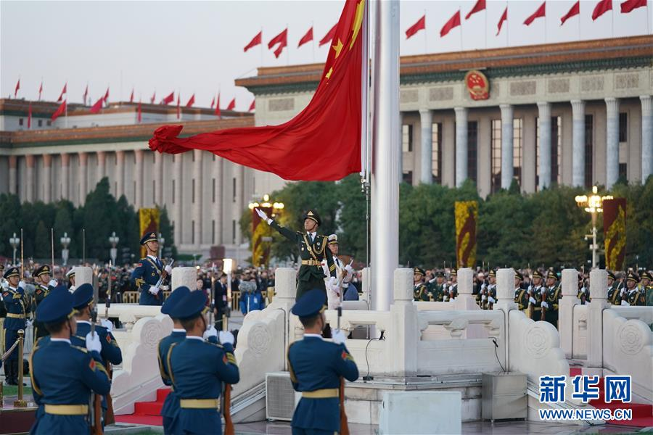
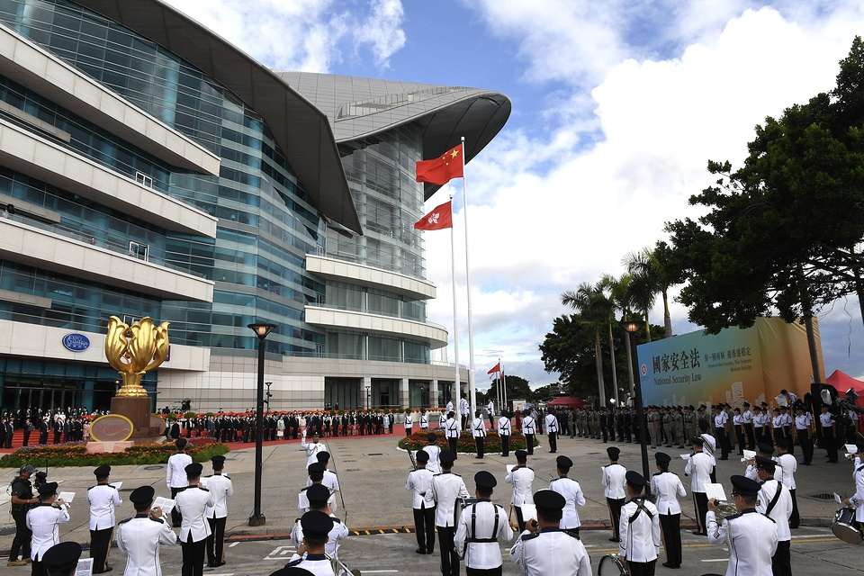
Please watch the following videos
Video 1:
CCTV (2019) Flag-raising Ceremony at Tiananmen Square on New Year’s Day of 2019
https://youtu.be/4QkW_IAK_KU
Video 2:
Flag-raising Ceremony marking the 23rd Anniversary of the establishment of the Hong Kong Special Administrative Region, 1 July 2020. Retrieved from news.gov.hk
https://www.news.gov.hk/eng/2020/07/20200701/20200701_080028_323.html
Photo credit: Xinhuanet
Photo credit: the official website of the Government of the HKSAR

Slide 4
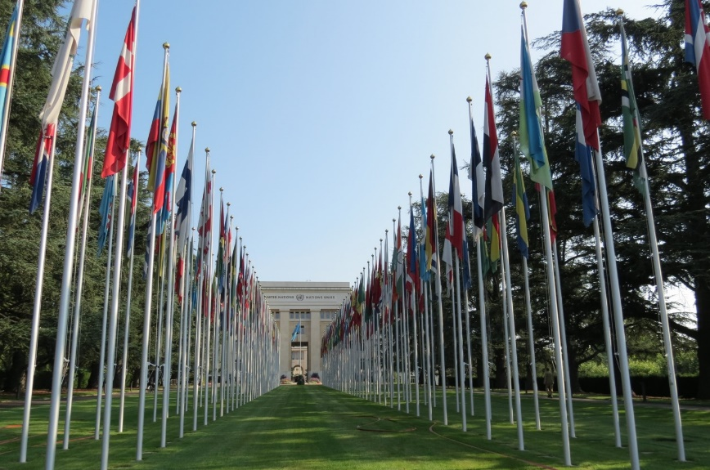
What are national symbols?
National symbols, also known as the signs of a nation, are usually stipulated in the Constitution and other laws, representing the symbols and signs of a nation’s sovereignty, independence, and dignity. National symbols in general include the national flag, national emblem, national anthem, etc.
National flags of Member States of the United Nations, Headquarters of the United Nations, Geneva
All nations have their own national symbols, as signs of identifying the nation in international communication and exchanges.
Photo taken by the resources developer

Slide 5
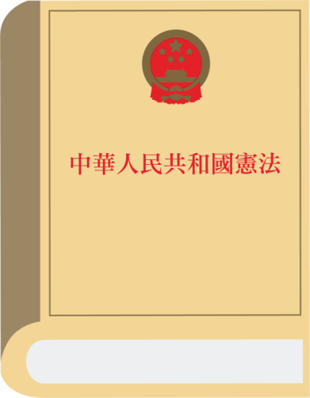
According to the stipulations of the Constitution of the People’s Republic of China (The Constitution), the national symbols of our country include the national flag, national anthem, national emblem, and the capital.
Chapter IV of the Constitution - The National Flag, National Anthem, National Emblem and the Capital
Article 141: The national flag of the People’s Republic of China is a red flag with five stars. The national anthem of the People’s Republic of China is the March of the Volunteers.
Article 142: The national emblem of the People’s Republic of China consists of an image of Tiananmen Gate in the center illuminated by five stars and encircled by spikes of grain and a cogwheel.
Article 143: The capital of the People’s Republic of China is Beijing.

Slide 6
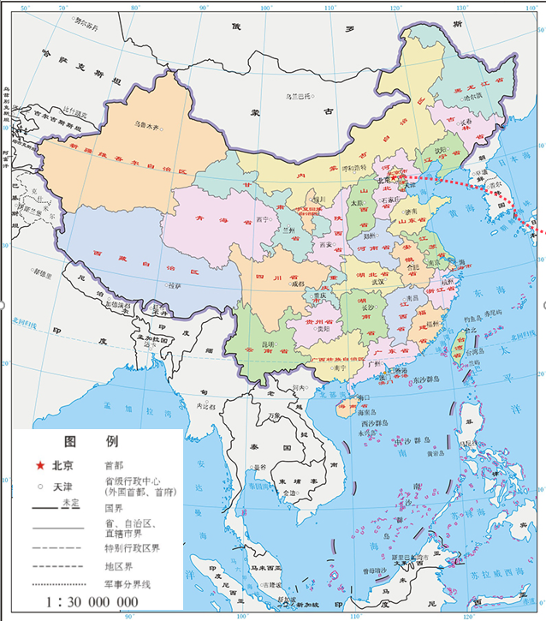
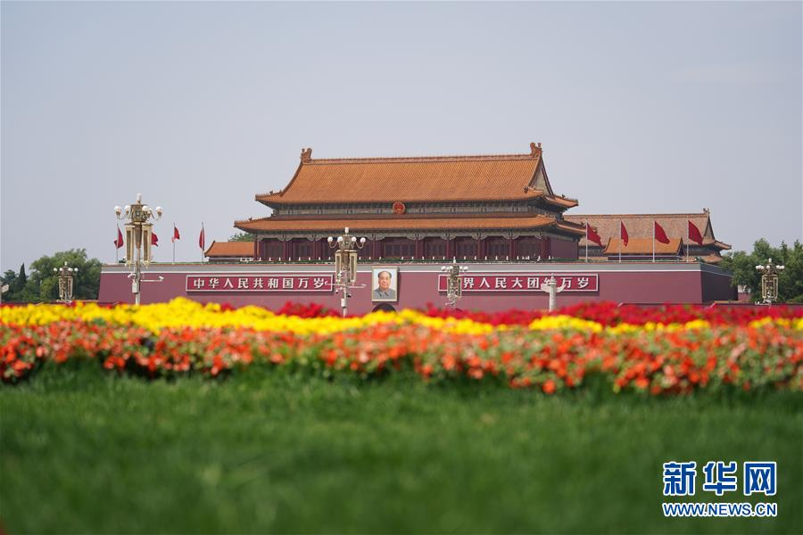
The People’s Republic of China
，
Tiananmen Gate, Beijing
Photo credit: Xinhuanet
Source: Map of the PRC
(supervised by the Ministry of Natural Resources)
http://bzdt.ch.mnr.gov.cn/

Slide 7
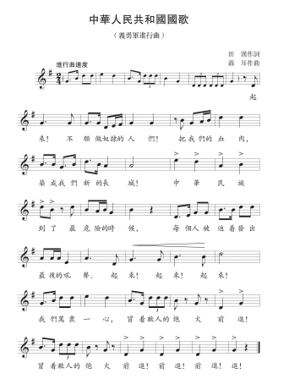


The national flag
The national emblem
The national anthem
Source: the Central People’s Government of the People’s Republic of China http://www.gov.cn/guoqing/index.htm

Slide 8
National laws on the national symbols and their implementation
On 1 September 2017, the Law of the People’s Republic of China on the National Anthem was passed after voting in the 29th Session of the Standing Committee of the 12th National People’s Congress (NPC), and came into force on 1 October 2017.
On 17 October 2020, the amended versions of the Law of the People’s Republic of China on the National Flag and the Law of the People’s Republic of China on the National Emblem were passed after voting in the 22nd Session of the Standing Committee of the 13th NPC, and came into force on 1 January 2021.

Slide 9
Local legislation on the national symbols and their implementation in Hong Kong
The National Flag and National Emblem Ordinance enacted by the Government of the HKSAR came into effect on 1 July 1997. In 2020, the Standing Committee of the NPC amended the laws on the national flag and national emblem, stating that the Government of the HKSAR would amend the National Flag and National Emblem Ordinance accordingly in order to fulfill its constitutional responsibility.
On 11 June 2020, the Chief Executive of the HKSAR, Mrs Carrie Lam Cheng Yuet-ngor, signed the National Anthem Ordinance passed by the Legislative Council in accordance with Article 48(3) of the Basic Law. The National Anthem Ordinance was gazetted and came into effect on 12 June 2020.

Slide 10
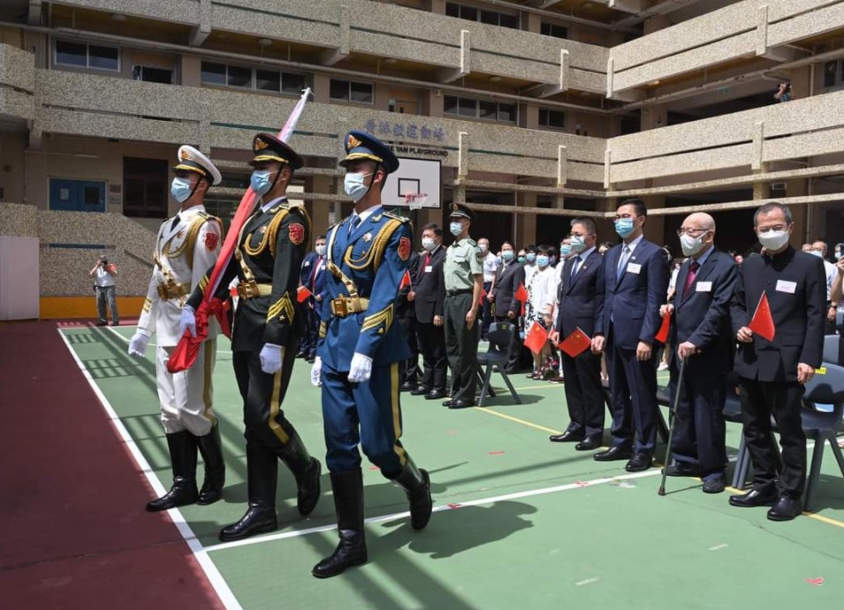
Implementation of the national laws listed in Annex III to the Basic Law in the HKSAR
According to Article 18(2) of the Basic Law, the national laws listed in Annex III to the Basic Law shall be applied locally by way of promulgation or legislation by the HKSAR.

Slide 11
Examples of implementing the national laws listed in Annex III to the Basic Law in the HKSAR
On 4 November 2017, in accordance with Article 18 of the Basic Law, the Standing Committee of the NPC added the Law of the People’s Republic of China on the National Anthem in Annex III to the Basic Law, and the Government of the HKSAR legislated the National Anthem Ordinance. This is a case of applying the national law in Hong Kong by way of local legislation by the HKSAR.
On 30 June 2020, in accordance with Article 18 of the Basic Law and relevant decisions of the NPC, the Standing Committee of the NPC added the Law of the People’s Republic of China on Safeguarding National Security in the Hong Kong Special Administrative Region in Annex III to the Basic Law. The Government of the HKSAR applied the law locally by way of promulgation and it came into immediate effect upon gazettal.

Slide 12
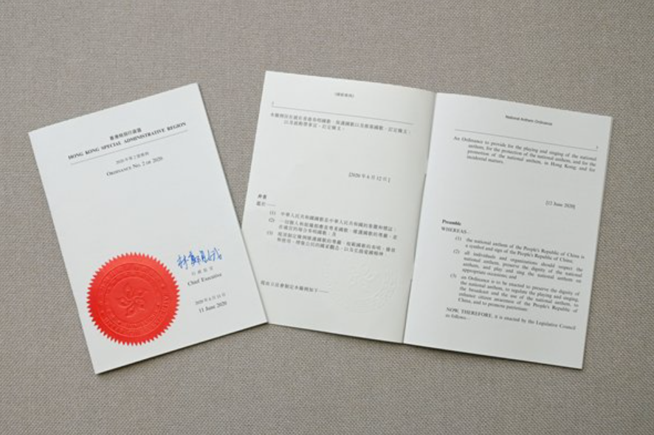
The National Anthem Ordinance enacted by the Government of the HKSAR
Having regard to the common law system and actual circumstances in Hong Kong, the Government of the HKSAR decided to implement the Law of the People’s Republic of China on the National Anthem in the HKSAR by local legislation. The National Anthem Bill was introduced into the Legislative Council for the first and second readings in January 2019, and was passed by the Legislative Council at the third reading on 4 June 2020.
On 11 June 2020, the Chief Executive of the HKSAR, Mrs Carrie Lam Cheng Yuet-ngor, signed the National Anthem Ordinance passed by the Legislative Council in accordance with Article 48(3) of the Basic Law. The ordinance came into immediate effect after it was gazetted on 12 June 2020.
Source: https://www.news.gov.hk/eng/2020/06/20200611/20200611_200601_164.html

Slide 13
The National Anthem Ordinance enacted by the Government of the HKSAR
Like the national flag and the national emblem, the national anthem is a symbol and sign of a nation. As an inalienable part of the People’s Republic of China, the Hong Kong Special Administrative Region is duty-bound to preserve the dignity of the national anthem through legislation. The national anthem is the March of the Volunteers, i.e. the national anthem of the People’s Republic of China under the Constitution.
The HKSAR Government implemented the Law of the People’s Republic of China on the National Anthem (passed in the 29th Session of the Standing Committee of the 12th NPC on 1 September 2017) in the HKSAR by local legislation. The National Anthem Ordinance was gazetted and came into effect, signifying the fulfillment of the constitutional responsibility of the HKSAR, and reflecting the spirit of “one country, two systems”.
Sources:
https://www.elegislation.gov.hk/hk/A405
https://www.news.gov.hk/eng/2020/06/20200611/20200611_200601_164.html

Slide 14
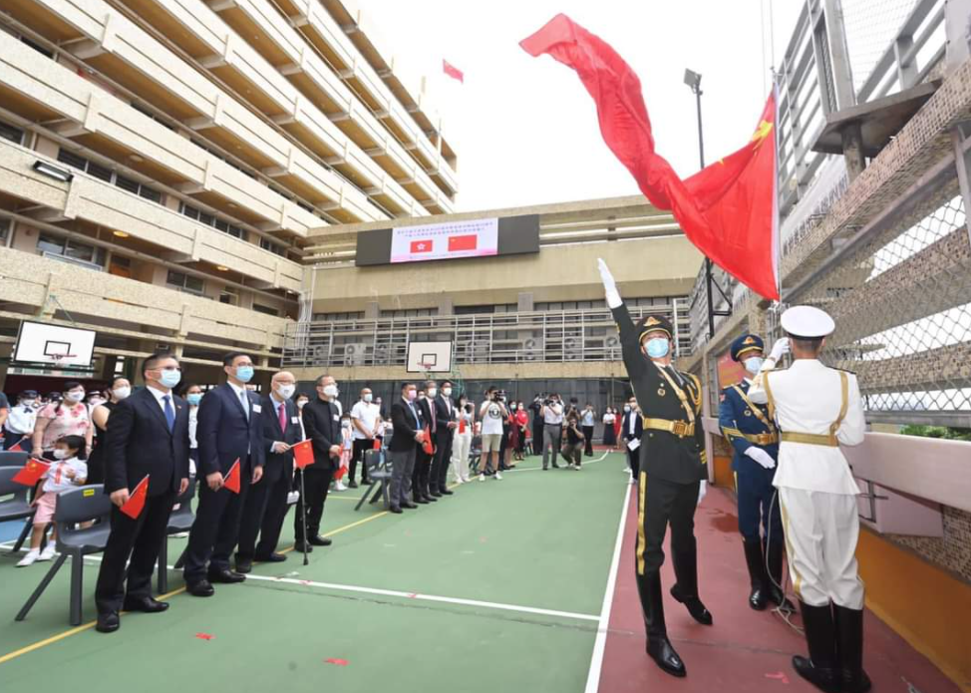
The National Anthem Ordinance of the HKSAR
According to the National Anthem Ordinance
(1) The national anthem of the People’s Republic of China is a symbol and sign of the People’s Republic of China;
(2) All individuals and organizations should respect the national anthem, preserve the dignity of the national anthem, and play and sing the national anthem on appropriate occasions; and
(3) An Ordinance is to be enacted to preserve the dignity of the national anthem, to regulate the playing and singing, the broadcast and the use of the national anthem, to enhance citizen awareness of the People’s Republic of China, and to promote patriotism.

Slide 15
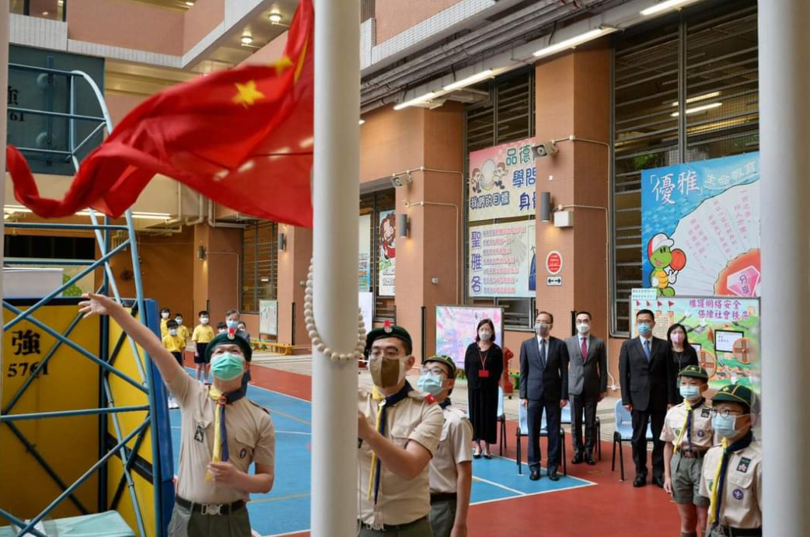
The National Anthem Ordinance of the HKSAR
Inclusion of the national anthem in primary and secondary education in accordance with the National Anthem Ordinance
(1) The Secretary for Education must give directions for the inclusion of the national anthem in primary education and in secondary education —
(a) to enable the students to learn to sing the national anthem; and
(b) to educate the students—
(i) on the history and spirit of the national anthem; and
(ii) on the etiquette for playing and singing the national
anthem.

Slide 16

1. The National Flag
The face of the flag shall be red and rectangular; the proportions of its length and height shall be 3 to 2. The upper left of the face of the flag shall be studded with five yellow five-pointed stars. One of the stars shall be bigger than the others, and shall be placed in the left; the four other stars shall be smaller, with their circumcircle’s diameter being 1/10th of the height of the flag, encircling the big star on its right in the shape of an arc.
The red colour of the national flag symbolises revolution. The five five-pointed stars and their relationship represent the unity of Chinese people under the leadership of the Communist Party of China.
The national flag of the People’s Republic of China (PRC) is a red flag with five stars
Source: http://www.gov.cn/guoqing/guoqi/index.htm

Slide 17
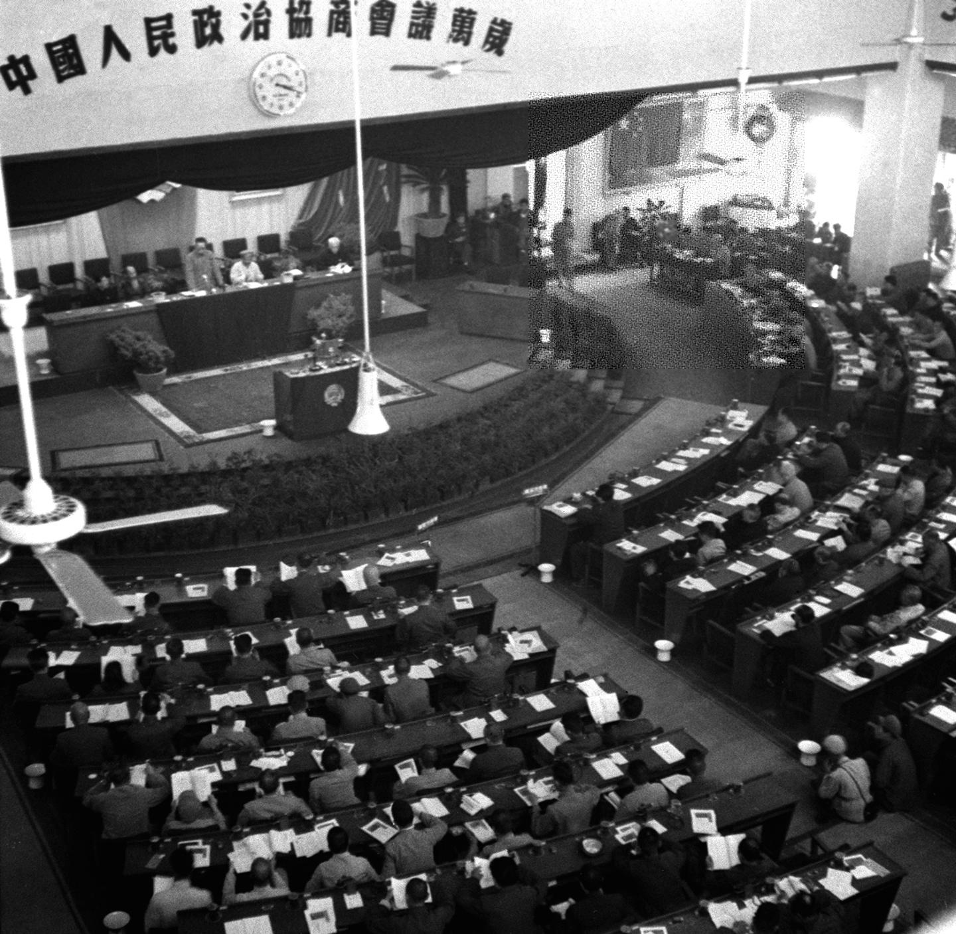
Birth of the national flag
On 27 September 1949, the 1st Plenary Session of the Chinese People’s Political Consultative Conference passed a resolution adopting the “red flag with five stars” as the national flag.
Video: ‘Birth of the National Flag of the PRC’ in National Memory
https://youtu.be/3BQnITu-EUA

Slide 18
Regulation of using the national flag in the Mainland (I)
The national flag shall be raised and displayed daily in the following places or premises of institutions:
(1) Tiananmen Square and Xinhuamen in Beijing;
(2) The Central Committee of the Communist Party of China, the Standing Committee of the National People’s Congress, the State Council, the Central Military Commission, the Central Commission for Discipline Inspection of the Communist Party of China, the National Commission of Supervision, the Supreme People’s Court, the Supreme People’s Procuratorate, the National Committee of the Chinese People’s Political Consultative Conference;
(3) The Ministry of Foreign Affairs; or
(4) Airports, harbours and railway stations of entry or exit and other frontier ports, frontier stations and coastal defence stations.

Slide 19
Regulation of using the national flag in the Mainland (II)
The national flag shall be raised and displayed on working days at the following premises of institutions:
(1) All central departments and local committees at all levels of the Communist Party of China;
(2) All departments of the State Council;
(3) The standing committees of the local people’s congresses at all levels;
(4) Local people’s governments at all levels;
(5) Local commissions for discipline inspection of the Communist Party of China at all levels and local commissions of supervision at all levels;
(6) Local people’s courts at all levels and special people’s courts;
(7) Local people’s procuratorates at all levels and special people’s procuratorates;
(8) Local committees of the Chinese People’s Political Consultative Conference at all levels;

Slide 20
Regulation of using the national flag in the Mainland (III)
The national flag shall be raised and displayed on working days at the following premises of institutions:
(9) All democratic parties and social organizations;
(10) Relevant offices set up by the Central People's Government in the Hong Kong Special Administrative Region and relevant offices set up by the Central People's Government in the Macao Special Administrative Region.
Schools shall raise and display the national flag daily, except during winter vacations, summer vacations and rest days. Kindergartens, when conditions permit, shall raise and display the national flag with reference to school rules.
Libraries, museums, cultural centers, art galleries, science and technology museums, memorial halls, exhibition halls, gymnasiums, youth centers and other public cultural and sports facilities shall raise and display the national flag on open days.
Source: http://www.gov.cn/guoqing/guoqi/index.htm

Slide 21
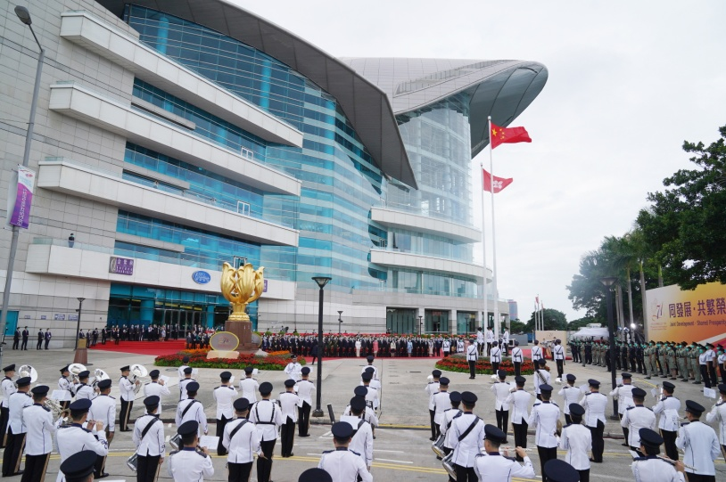
Regulation of using the national flag in Hong Kong
Priority of the national flag
What is priority of the national flag?
When the national flag is displayed, it shall be placed in a prominent position.
When the national flag is raised or carried in a procession with another flag or flags, it shall be in front of the other flag or flags.
When the national flag is displayed with another flag or flags, it shall be either at the centre, above the other flag or flags, or in a position of prominence.
When the national flag and regional flag are displayed at the same time or displayed side by side, the regional flag shall be smaller than the national flag, with the national flag on the right and the regional flag on the left.
When the national flags of two or more nations are displayed in foreign affairs activities, relevant provisions of the Ministry of Foreign Affairs or the international practice shall be followed.
On 1 October 2020, the Government of the HKSAR held a flag-raising ceremony to celebrate the 71st anniversary of the Founding of the PRC at Golden Bauhinia Square
Source: https://www.protocol.gov.hk/en/show/show.html

Slide 22
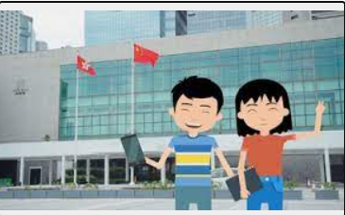
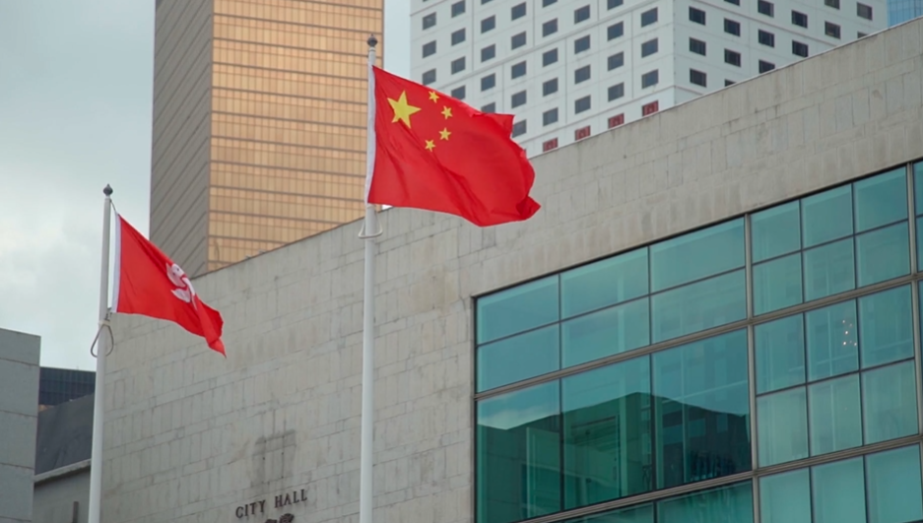
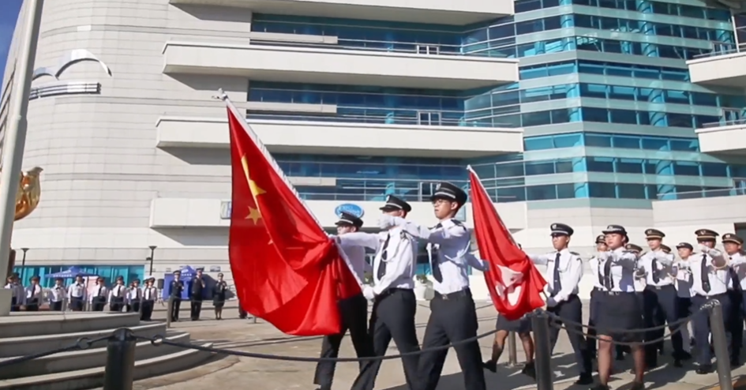
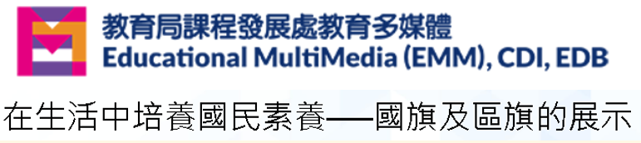
Watch the video: Display of the national flag and the regional flag
Click on the above images and watch the videos

Slide 23
Learn more: Regulation of using the national flag in foreign affairs activities
In accordance with the international practice, when the national flags of two nations are displayed, the one on the right is superior to that on the left. When two national flags are displayed side by side, in the direction that the flags face, the national flag of the guest nation is displayed on the right, and the national flag of the host nation is displayed on the left.
As for the host nation, in principle, the use of national flag in foreign affairs activities is not based on the country where the event is held, but based on the host of the event.
For details, please refer to the website of the Ministry of Foreign Affairs of the PRC:
https://www.fmprc.gov.cn/web/ziliao_674904/lbzs_674975/200705/t20070524_7949246.shtml

Slide 24
Respect for the national flag
A national flag which is damaged, defiled, faded or substandard must not be raised or used. A national flag must not be displayed upside down, and must not be raised or used in any other ways that undermine the dignity of the national flag.
A national flag must not be discarded at will. The damaged, defiled, faded or substandard national flag shall be recovered or disposed of in the manner stipulated in relevant provisions issued by the State. After a large-scale public event, the event organizer shall recover or properly dispose of the national flag used on the site of the event.
Source: http://www.gov.cn/xinwen/2020-12/24/content_5572913.htm

Slide 25
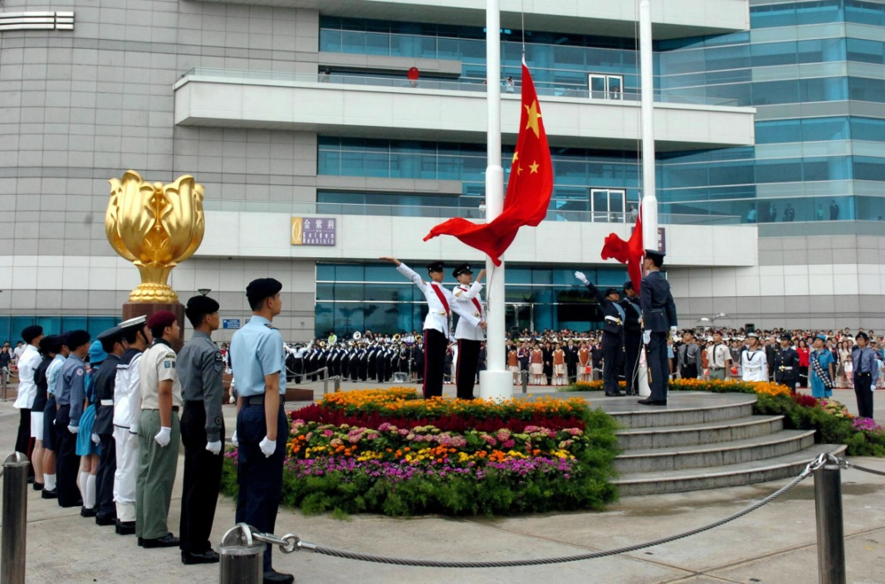
Etiquette for raising the national flag
When the national flag is raised and displayed, a flag-raising ceremony may be held.
The national anthem shall be played and sung during the flag-raising ceremony.
While the national flag is being raised, people present shall stand solemnly facing the national flag, look at the national flag with respectful attention or to salute it as required, and shall not behave in a way that undermines the dignity of the national flag.
The flag-raising ceremony held at Golden Bauhinia Square, Hong Kong

Slide 26
Display of the national flag, and playing and singing the national anthem at schools in Hong Kong
Primary and secondary schools must conduct a national flag raising ceremony weekly. The national anthem should be played and sung in a national flag raising ceremony. Schools are also required to conduct a national flag raising ceremony on the New Year’s Day, the HKSAR Establishment Day and the National Day, or on the preceding/ following school day of the above days. Schools are strongly advised to conduct a national flag raising ceremony on important days and special occasions, such as the first day of a school year, open day, and graduation ceremony.
—— Extracted from Education Bureau Circular No. 11/2021 - National Flag, National Emblem, National Anthem and Regional Flag, https://applications.edb.gov.hk/circular/upload/EDBC/EDBC21011E.pdf
Remarks: Relevant content should be updated properly in accordance with the amendment to the Law of the People's Republic of China on the National Flag.

Slide 27
2. The National Anthem
“Arise! We who refuse to be slaves!” Whenever we listen to the national anthem, we should stand solemnly.
Access to the webpage and listen to the national anthem:
http://www.gov.cn/guoqing/guoge/index.htm
Stave notation of the national anthem

Slide 28
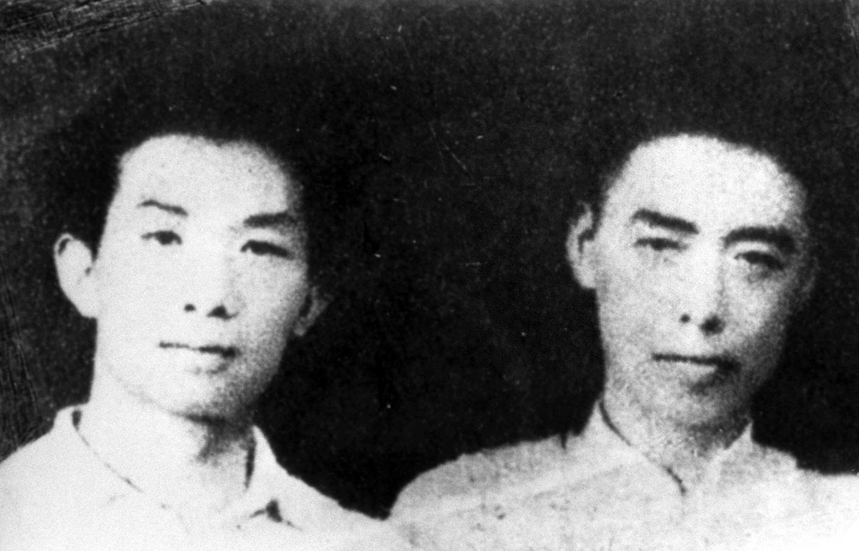
History of the national anthem
March of the Volunteers was the theme song of the movie in the 1930s, i.e. Sons and Daughters in a Time of Storm, and the song was widely circulated during the war of resistance against Japanese aggression. March of the Volunteers was adopted as the national anthem at the 1st Plenary Session of the Chinese People’s Political Consultative Conference in 1949, and was added to the Constitution in 2004.
The lyrics and music of March of the Volunteers were written by Tian Han (right) and composed by Nie Er (left) respectively.
Video: History of the National Anthem of the PRC from National Memory
https://youtu.be/_53e8MzvLTk

Slide 29
Occasions on which the national anthem is played and sung
The national anthem shall be played and sung on the following occasions:
1. Opening and closing ceremonies of sessions of the National People's Congress and local people's congresses at all levels; and opening and closing ceremonies of sessions of the National Committee and local committees at all levels of the Chinese People's Political Consultative Conference ;
2. Congresses at all levels of all political parties and people's organizations;
3. Constitutional oath-taking ceremonies;
4. Flag-raising ceremonies;

Slide 30
Occasions on which the national anthem is played and sung
The national anthem shall be played and sung on the following occasions: (cont’d)
5. Major celebrations, award ceremonies, commemorative ceremonies, etc., which are organized by all levels of state organ;
6. National memorial ceremonies;
7. Major diplomatic activities;
8. Major sporting events;
9. Other occasions on which the national anthem shall be played and sung.
Source: http://www.gov.cn/guoqing/guoge/index.htm

Slide 31
Occasions on which the national anthem is played and sung
The national anthem must not be used, or covertly used, in a trademarks or commercial advertisements, must not be used at private funeral events or on other inappropriate occasions, and must not be used as background music in public places.
Source: http://www.gov.cn/guoqing/guoge/index.htm

Slide 32
Etiquette for playing and singing the national anthem
Playing and singing of the national anthem shall follow the lyrics and score in the Attachment to the Law of the People’s Republic of China on the National Anthem, and it must not be played or sung in any form that undermines the dignity of the national anthem.
When the national anthem is being played and sung, the people present shall stand solemnly and deport themselves with dignity, and should not behave in a way disrespectful to the national anthem.

Slide 33
Occasions on which the national anthem must be played and sung
under the National Anthem Ordinance of the HKSAR (I)
According to the National Anthem Ordinance, occasions on which the national anthem must be played and sung :
1. Oath-taking Ceremony——
(a) for taking the Oath of the Chief Executive under Section 16A of the Oaths and Declarations Ordinance (Cap. 11);
(b) for taking the Oath of the Principal Officials under Section 16B of that Ordinance;
(c) for taking the Judicial Oath under Section 17 of that Ordinance;
(d) for taking the Oath of Fidelity and the Executive Council Oath under Section 18 of that Ordinance;
(e) for taking the Legislative Council Oath under Section 19 of that Ordinance;
(f) for taking the District Council Oath under Section 19A of that Ordinance.
Source: https://www.elegislation.gov.hk/hk/A405

Slide 34
Occasions on which the national anthem must be played and sung
under the National Anthem Ordinance of the HKSAR (II)
According to the National Anthem Ordinance, occasions on which the national anthem must be played and sung :
2. A national flag raising ceremony, including ——
(a) Flag Raising Ceremony held by the HKSAR Government at Golden Bauhinia Square;
(b) Flag Raising Ceremony held by the HKSAR Government to celebrate the Anniversary of the Founding of the People’s Republic of China; and
(c) Flag Raising Ceremony held by the HKSAR Government to celebrate the Anniversary of the Establishment of the Hong Kong Special Administrative Region of the People’s Republic of China.
Source: https://www.elegislation.gov.hk/hk/A405

Slide 35
Occasions on which the national anthem must be played and sung
under the National Anthem Ordinance of the HKSAR (III)
3. National Day Reception held by the HKSAR Government to celebrate the Anniversary of the Founding of the People’s Republic of China
4. Reception held by the HKSAR Government to celebrate the Anniversary of the Establishment of the Hong Kong Special Administrative Region of the People’s Republic of China
5. Ceremony held by the HKSAR Government to commemorate the victory day of Chinese people’s war of resistance against Japanese aggression
6. Ceremony held by the HKSAR Government to commemorate those who died in the defence of Hong Kong
7. Ceremony held by the HKSAR Government on Nanjing Massacre National Memorial Day
8. A major sporting event held by the HKSAR Government
9. Ceremonial Opening of the Legal Year
Source: https://www.elegislation.gov.hk/hk/A405

Slide 36
Etiquette for playing and singing the national anthem
under the National Anthem Ordinance of the HKSAR
According to Section 4 of Part 2 of the National Anthem Ordinance
While the national anthem is being played and sung, the etiquette to be followed by the persons who take part in or attend the occasion is—
(a) to stand solemnly and deport themselves with dignity; and
(b) to not behave in a way disrespectful to the national anthem.
Source: https://www.elegislation.gov.hk/hk/A405

Slide 37

3. The National Emblem
Two bunches of wheat and rice form a round ring. A cogwheel is placed where the wheat and rice stems cross at the base. Red ribbon forms a knot in the centre of the cogwheel. The red ribbon coils up the wheat and rice on the left and right of the cogwheel and hangs down, dividing the cogwheel into an upper and a lower part.
The national emblem of the PRC consists of an image of Tiananmen Gate in the center illuminated by five stars and encircled by spikes of grain and a cogwheel.
Source: http://www.gov.cn/guoqing/guohui/index.htm

Slide 38
Birth of the national emblem
On 28 June 1950, the Design and Description of the National Emblem of the People’s Republic of China recommended by the 2nd Session of the 1st National Committee of the Chinese People’s Political Consultative Conference was adopted.
Video: National Memory - Birth of the National Emblem of the PRC
https://youtu.be/9bbQjGfbF8I

Slide 39
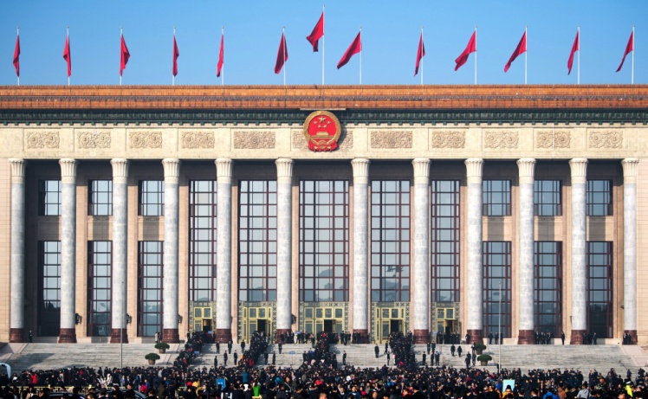
Regulation of using the national emblem
The following organs shall hang the national emblem:
(1) The standing committees of the people’s congresses at all levels;
(2) The people’s governments at all levels;
(3) The Central Military Commission;
(4) The commissions of supervision at all levels;
(5) The people’s courts at all levels and other special people’s courts;
The Great Hall of the People

Slide 40
Regulation of using the national emblem
The following organs shall hang the national emblem: (cont’d)
(6) The people’s procuratorates at all levels and other special people’s procuratorates;
(7) The Ministry of Foreign Affairs;
(8) The country’s embassies, consulates and other diplomatic missions stationed in other countries;
(9) The resident organs of the Central People’s Government in the Hong Kong Special Administrative Region and the resident organs of the Central People’s Government in the Macao Special Administrative Region.
The national emblem shall be hung right in the middle on top of the front gate of the organs concerned.
Source: http://www.gov.cn/guoqing/guohui/index.htm

Slide 41
Regulation of using the national emblem
The national emblem and its design must not be used for:
Trademarks, designs for which patent rights are granted, and commercial advertisements;
Products in everyday life and furnishings or ornaments in everyday life;
Private activities of celebration or condolence;
Other circumstances where the national emblem and the design thereof may not be used as prescribed by the General Office of the State Council.
Source: http://www.gov.cn/xinwen/2020-12/24/content_5572912.htm

Slide 42


Preserving the dignity of the national flag, national anthem, and national emblem is the statutory obligation of every citizen
Article 23 of the Law of the People’s Republic of China on the National Flag and Section 7 of the National Flag and National Emblem Ordinance of the HKSAR
The Law of the People’s Republic of China on the National Flag: http://www.gov.cn/xinwen/2020-12/24/content_5572913.htm
The National Flag and National Emblem Ordinance of the HKSAR: https://www.elegislation.gov.hk/hk/A401
Article 15 of the Law of the People’s Republic of China on the National Anthem and Section 7 of the National Anthem Ordinance of the HKSAR
The Law of the People’s Republic of China on the National Anthem: http://www.gov.cn/guoqing/2017-09/04/content_5222515.htm
The National Anthem Ordinance of the HKSAR: https://www.elegislation.gov.hk/hk/A405
Article 13 of the Law of the People’s Republic of China on the National Emblem and Section 7 of the National Flag and National Emblem Ordinance of the HKSAR
The Law of the People’s Republic of China on the National Emblem: http://www.gov.cn/xinwen/2020-12/24/content_5572912.htm
The National Flag and National Emblem Ordinance of the HKSAR: https://www.elegislation.gov.hk/hk/A401

Slide 43
Misconduct/ improper behaviours may contravene the law
The national flag or national emblem of the PRC must not be desecrated by intentionally burning, damaging, defacing, defiling or trampling upon it or in any other way in public.
The national anthem of the PRC must not be publicly and intentionally insulted by altering the lyrics or score, playing and singing it in a distorted or disrespectful way or in any other way.
The national anthem must not be used, or covertly used, in a trademark or commercial advertisement, on inappropriate occasions such as a private funeral event, or as background music in a public place, etc.

Slide 44
Misconduct / improper behaviours may contravene the law
Prohibition on certain uses of national flag and national emblem
The national flag or its design must not be displayed or used in —— (a) trademarks or advertisements; (b) private funeral activities; or (c) other occasions on which or places at which the display or use of the national flag or its design is restricted or prohibited under a stipulation made by the Chief Executive.
The national emblem or its design must not be displayed or used in —— (a) trademarks or advertisements; (b) furnishings or ornaments in everyday life; (c) private activities of celebration or condolence; or (d) other occasions on which or places at which the display or use of the national emblem or its design is restricted or prohibited under a stipulation made by the Chief Executive.

Slide 45
Penalties for desecrating the national flag, national anthem, and national emblem under related ordinances of the HKSAR:
Section 6(3) and Section 7 of the National Flag and National Emblem Ordinance stipulate:
A person who without lawful authority or reasonable excuse displays or uses the national flag, national emblem or the design of the national flag or of the national emblem contrary to subsection (1) or (2)* commits an offence.
A person commits an offence if the person publicly and intentionally desecrates the national flag or national emblem by burning, mutilating, scrawling on, defiling or trampling on it or in any other way, and is liable on conviction to a fine at level 5 and to imprisonment for 3 years.
*Please refer to relevant sections of the National Flag and National Emblem Ordinance:
https://www.elegislation.gov.hk/hk/A401

Slide 46
Penalties for desecrating the national flag, national anthem, and national emblem under related ordinances of the HKSAR:
Section 7 of the National Anthem Ordinance stipulates:
A person who commits an offence of insulting the national anthem is liable on conviction to a fine at level 5 and to imprisonment for 3 years. *
*Please refer to relevant sections of the National Anthem Ordinance:
https://www.elegislation.gov.hk/hk/A405

Slide 47
Offences of insulting behaviour towards
the national anthem under the National Anthem Ordinance
(1) A person commits an offence if, with intent to insult the national anthem, the person publicly and intentionally ——
(a) alters the lyrics or score of the national anthem; or
(b) plays or sings the national anthem in a distorted or disrespectful way.
(2) A person commits an offence if the person publicly and intentionally insults the national anthem in any way.
(3) A person commits an offence if, with intent to insult the national anthem, the person intentionally publishes ——
(a) altered lyrics or an altered score of the national anthem; or
(b) the national anthem played or sung in a distorted or disrespectful way.
(4) A person commits an offence if, with intent to insult the national anthem, the person intentionally publishes the insulting in any way of the national anthem.
For details, please refer to relevant sections of the National Anthem Ordinance: https://www.elegislation.gov.hk/hk/A405

Slide 48
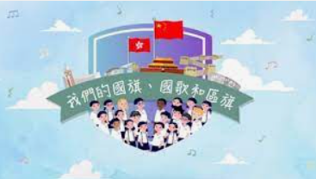
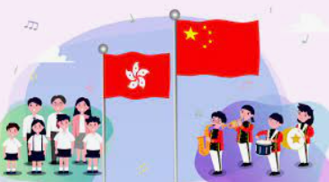
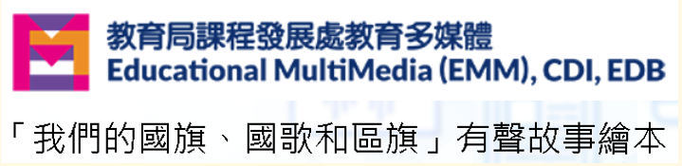
Videos: “Our National Flag, National Anthem and Regional Flag”
“Our National Flag, National Anthem and Regional Flag” (an audio picture book)
Click on the above images and watch the videos

Slide 49

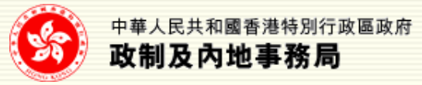


Relevant learning and teaching resources
https://www.protocol.gov.hk/en/show/show.html
https://www.cmab.gov.hk/en/issues/national_anthem_introduction.htm
https://www.edb.gov.hk/en/curriculum-development/4-key-tasks/moral-civic/newwebsite/flagraising.html
https://emm.edcity.hk/

Slide 50
The End

Slide 51
User guide
The primary users of this resource are teachers. It aims to provide teachers with content knowledge relevant to the topic to enable teachers to have a deeper understanding of teaching content when preparing for their lessons.
All data, videos, photos, pictures, questions and suggested answers can be used for multiple purposes, such as teachers’ teaching materials, references for curriculum planning and learning and teaching, and student assignments, etc. To align with Citizenship and Social Development Curriculum and Assessment Guide (Secondary 4-6) (2021) (C&A Guide), this resource should be adapted to cater for students’ learning diversity and the needs of classroom teaching, etc.
Teachers may provide appropriate supplementary notes/ explanations to enrich this resource in order to enhance students’ understanding of the topic and information provided.
In accordance with the curriculum rationale and aims, teachers may select other learning and teaching resources which are correct, reliable, objective and impartial to help students build up a solid knowledge base, develop positive values and attitudes as well as enhance critical thinking and problem solving skills, and various generic skills.
If some information cannot be provided in this resource due to copyright issue, teachers may visit relevant websites provided.
Some information may have been updated when being used by teachers, teachers may visit the corresponding websites to obtain the up-to-date information.
Please also refer to the C&A Guide to understand the requirements and arrangements of the learning and teaching of the curriculum.

Slide 52
Notice and Disclaimer
Some sources were not translated into English as the official English version is not available.
In case of any discrepancy between the Chinese and English versions, the Chinese version shall prevail.

