Slide 1
Constitutional relationship between the country and the Hong Kong Special Administrative Region (HKSAR) (China has indisputable sovereignty and jurisdiction over Hong Kong), legal basis of “one country, two systems” and the Basic Law
Citizenship and Social Development
Theme 1: Hong Kong under “One Country, Two Systems”
Topic: The meaning and implementation of “one country, two systems”
Learning Focus:
Translated version
June 2021

Slide 2
Constitutional relationship between the country and the HKSAR
Knowledge
To understand the constitutional relationship between the country and the HKSAR
To understand that Hong Kong’s high degree of autonomy originates from the delegation of power from the Central Authorities
Skills
To acquire generic skills, including communication, collaboration and critical thinking skills
Values
To consciously safeguard “one country, two systems”
To develop patriotism among students

Slide 3
Have you read the news below?
Source A:
Five young Hong Kong public officers have been recommended by the Central People’s Government to work at the United Nations …
https://www.news.gov.hk/eng/2019/12/20191223/20191223_172812_902.html
Source B:
The Secretary for Food and Health of the HKSAR Government will attend the World Health Assembly as a member of the China delegation
What concepts about the constitutional relationship between the Central Authorities and the HKSAR are reflected in the two sources?
Answers: One Country, subordination
https://www.fhb.gov.hk/en/press_and_publications/press/2012/press120516.htm

Slide 4
Features of the constitutional structure of the country
The country has only one constitution, and only one central administrative system
All administrative or self-governing organs are subject to the unified leadership of the central authorities; the powers of the local authorities are delegated by the central authorities; the local governments shall abide by the leadership and subject to the supervision of the central authorities. The local authorities do not have the power to be independent of the central authorities.
For external relations, only the country can be the subject of international law.

Slide 5
Only one constitution and one central administrative system in the country
Preamble
The People's Republic of China is a unified multiethnic state founded by the Chinese people of all ethnic groups.
Article 3
The division of functions and powers between the central and local state institutions shall honor the principle of giving full play to the initiative and motivation of local authorities under the unified leadership of the central authorities.
For contents of the Constitution and the Basic Law (Junior Secondary), please refer to:
https://www.edb.gov.hk/tc/curriculum-development/kla/pshe/basic-law-education/constitution-basiclaw/index.html
Excerpted from the Constitution of the People’s Republic of China
5

Slide 6
All administrative or self-governing organs are subject to the unified leadership of the central authorities; the powers of the local authorities are delegated by the central authorities; the local governments shall abide by the leadership and subject to the supervision of the central authorities. The local authorities do not have the power to be independent of the central authorities.
Article 4
All ethnic groups of the People’s Republic of China are equal. All areas inhabited by ethnic minorities shall practice regional autonomy, establish autonomous organs, and exercise the power to self govern. All ethnic autonomous areas are inseparable parts of the People’s Republic of China.
Article 31
The state may establish special administrative regions when necessary. The systems instituted in special administrative regions shall, in light of specific circumstances, be prescribed by laws enacted by the National People’s Congress.
For contents of the Constitution and the Basic Law (Junior Secondary), please refer to:
https://www.edb.gov.hk/tc/curriculum-development/kla/pshe/basic-law-education/constitution-basiclaw/index.html
Excerpted from the Constitution of the People’s Republic of China
6

Slide 7
Reference: sovereignty and jurisdiction
Sovereignty is the unified, persistent and inseparable highest power of a country for independently and autonomously handling its internal and external affairs.
Jurisdiction is the exercise of sovereignty, the specific powers to govern a country, and an inseparable part of sovereignty.
7

Slide 8
The relationship between the central and local authorities defined by the Constitution of the PRC
The relationship between the central and local authorities is authorising and being authorised.
Powers of local authorities are authorised by the Central Authorities.
8

Slide 9
Reference
China is a country with a unitary institution: its sovereignty is vested in its 1.3 billion people, and exercised by the National People’s Congress, the organ of the highest state power. Local authorities do not have steady powers; their powers are authorised by the Central Authorities. Under the law of authorisation, the prerequisite for authorisation is that the Central Authorities must have overall jurisdiction; and once the authorisation has been made, the authorising organ has the power of supervision over the one being authorised. If the authorised does not acknowledge the powers of the authorising organ, it cannot get the authorised power. Since Hong Kong has never had its own sovereignty, it has no residual powers. The high degree of autonomy of the special administrative region is entirely granted by the Central Authorities. The special administrative region has no power on its own. Therefore, in the provisions of the Basic Law, some articles contain several general principles for national governance as the embodiment of powers of the Central Authorities.
Source: Footsteps in Time: Twenty Years of Basic Law in Hong Kong, by Elsie Leung Oisie, City University of Hong Kong Press, 2017, pp. 6-7.
9

Slide 10
Questions
Some argue that the power of the Central Authorities over the HKSAR is confined to those relating to national defense and foreign affairs, and the HKSAR enjoys all other powers which fall within the scope of a “high degree of autonomy”. This view is wrong.
Please read the Basic Law, and find out how the provisions stipulate the relationship between the Central Authorities and the HKSAR. Why does the HKSAR have no residual power?
10

Slide 11
Answers
The Basic Law prescribes the relationship between the Central Authorities and the HKSAR. It also stipulates the Central Authorities’ delegation of authority to the HKSAR.
The Basic Law prescribes the extensive powers of the Central Authorities over the jurisdiction of the HKSAR, such as the powers to appoint the Chief Executive and principal government officials, to interpret and amend the Basic Law, the ultimate power to lead and determine the constitutional development, and the power to review the reporting of local legislation of Hong Kong for record.
The Central Authorities authorises the HKSAR to exercise a high degree of autonomy. There is no residual power vested in the HKSAR.
For the relationship between the country and the HKSAR, please refer to: https://www.basiclaw.gov.hk/en/basiclaw/index.html
11

Slide 12
“One country, two systems”
The HKSAR is an inalienable part of the country.
Article 1 of the Basic Law
‘The Hong Kong Special Administrative Region is an inalienable part of the People’s Republic of China.’
Article 12 of the Basic Law
‘The Hong Kong Special Administrative Region shall be a local administrative region of the People’s Republic of China, which shall enjoy a high degree of autonomy and come directly under the Central People’s Government.’

Slide 13
Questions
1. What is the status of Articles 1 and 12 in the Basic Law?
2. If people do not abide by Articles 1 and 12 of the Basic Law, what will be the consequences?

Slide 14
Suggested Answers
1. The two articles are the fundamental provisions in the Basic Law. If they were undermined, the “one country, two systems” would no longer exist.
2. If people do not abide by Articles 1 and 12 of the Basic Law, it will lead to disrespectful behaviours towards the Central Authorities, or even advocacy of Hong Kong independence, and undermine the practice of “one country, two systems”.

Slide 15
“One country, two systems”
The HKSAR is a local administrative region directly under the Central People’s Government. It is on the same level as provinces, autonomous regions, and municipalities.
The Central People’s Government
23 provinces
5 autonomous regions
4 municipalities
2 special administrative regions
15

Slide 16
“One country, two systems”
The overall jurisdiction of the Central Authorities
The system of the special administrative region, as prescribed in the Constitution of the People's Republic of China and the Basic Law of the HKSAR, is a special administrative system developed by the state for certain regions. Under this system, the Central Authorities exercises overall jurisdiction over the HKSAR, including both the powers directly exercised by the Central Authorities, and the powers authorised to the HKSAR by the Central Authorities to enable it to exercise a high degree of autonomy in accordance with the law. The Central Authorities has the power of oversight over the exercise of a high degree of autonomy in the HKSAR.
Source: White Paper on The Practice of the “One Country, Two Systems” Policy in the Hong Kong Special Administrative Region (10 June 2014)
http://english.www.gov.cn/archive/white_paper/2014/08/23/content_281474982986578.htm
16

Slide 17
The Central Authorities exercise overall jurisdiction over the HKSAR according to the Constitution and the Basic Law
1. The decision to establish the HKSAR is based on the Constitution.
2. The Basic Law, which is formulated in accordance with the Constitution, prescribes the system to be practised in HKSAR.
3. Based on the Constitution and the Basic Law, the Central Authorities exercise the power of direct jurisdiction over the HKSAR.
4. According to laws, the HKSAR is authorised to enjoy a high degree of autonomy and is subject to supervision.
17

Slide 18
What powers can the Central Authorities directly exercise over the HKSAR?
Learning Activity
Read the following contents on the types of powers directly exercised by the Central Authorities over the HKSAR, and draw a mind map.
18

Slide 19
Powers directly exercised by the Central Authorities over the HKSAR
The power to prescribe the establishment of the HKSAR and its systems
Refer to Article 31 of the Constitution
“The state may establish special administrative regions when necessary. The systems instituted in special administrative regions shall, in light of specific circumstances, be prescribed by laws enacted by the National People’s Congress.”
Refer to Article 62 (14) of the Constitution
The National People’s Congress shall exercise the function and power of “deciding on the establishment of special administrative regions and the systems to be instituted there”.
19

Slide 20
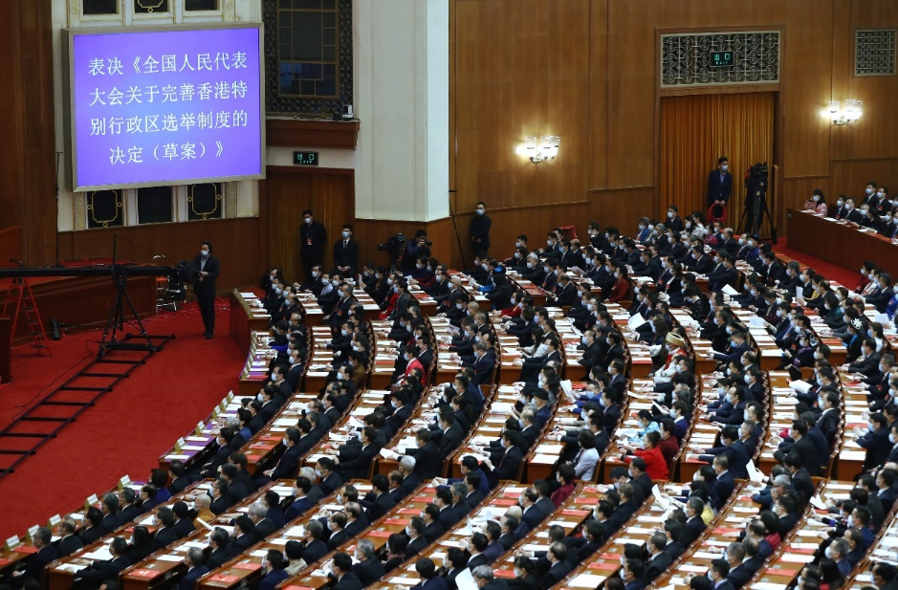
The power to form the organs of political powers in the HKSAR
According to the Constitution and the Basic Law, the power to form the organs of political powers in the HKSAR is vested in the National People’s Congress. The Central Government has the power to appoint the Chief Executive and principal government officials.
For the latest developments of the political system of the HKSAR, please refer to:
https://www.cmab.gov.hk/en/issues/index.htm
The Draft Decision on Improving the Electoral System of the HKSAR was voted at the Fourth Session of the 13th National People’s Congress
20

Slide 21
Supplementary information: The Chief Executive Sworn in
Since the first term HKSAR Government, the swearing-in ceremony of every Chief Executive has been overseen by leaders of the Central Authorities, who shall attend the ceremony for the change of term of the Chief Executive and the HKSAR Government.

Slide 22
Support and guide the Chief Executive and the HKSAR Government to administer according to the law
The Chief Executive reports his/her work to the Central Authorities every year.
State leaders supervise the Chief Executive on major matters relating to the implementation of the Basic Law.
CE reports to state leaders on work
Source: https://www.info.gov.hk/gia/general/202101/27/P2021012700891.htm
22

Slide 23
Responsible for the foreign affairs relating to the HKSAR
Foreign affairs involve national sovereignty and are important responsibilities of the Central Government.
The Central People’s Government shall be responsible for the management of foreign affairs relating to the HKSAR. (Refer to Article 13 (1) of the Basic Law)
The Ministry of Foreign Affairs of the People’s Republic of China shall establish an office in Hong Kong to deal with foreign affairs. (Refer to Article 13 (2) of the Basic Law)
23

Slide 24
Responsible for the defence of the HKSAR
Article 14 of the Basic Law prescribes that the Central People’s Government is responsible for the defence of the HKSAR.
The People’s Liberation Army Hong Kong Garrison started entering Hong Kong at the midnight of 30 June 1997, and took over the defence of Hong Kong at the midnight of 1 July 1997.
On 29 September 2020, the HKSAR Government transferred the military port of Central District to the People’s Liberation Army Hong Kong Garrison. A photo of the military port of Central District is shown on the left.
24

Slide 25
Power of amendment of the Basic Law
According to Article 159 of the Basic Law,
The power of amendment of the Basic Law shall be vested in the National People’s Congress;
The power to propose bills for amendments to the Basic Law shall be vested in the Standing Committee of the National People’s Congress, the State Council, and the HKSAR;
Before a bill for amendment to the Basic Law is put on the agenda of the National People’s Congress, the Committee for the Basic Law of the Hong Kong Special Administrative Region shall study it and submit its views;
No amendment to the Basic Law shall contravene the established basic policies of the People’s Republic of China regarding Hong Kong.
25

Slide 26
Power of interpretation of the Basic Law
According to Article 158 of the Basic Law,
The power of interpretation of this Law shall be vested in the Standing Committee of the National People’s Congress;
The Standing Committee of the National People’s Congress shall authorize the courts of the Hong Kong Special Administrative Region to interpret on their own, in adjudicating cases, the provisions of this Law which are within the limits of the autonomy of the Region.
26

Slide 27
Power of interpretation of the Basic Law (continued)
The courts of the Hong Kong Special Administrative Region may also interpret other provisions of this Law in adjudicating cases. However, if the courts of the Region, in adjudicating cases, need to interpret the provisions of this Law concerning affairs which are the responsibility of the Central People’s Government, or concerning the relationship between the Central Authorities and the Region, and if such interpretation will affect the judgments on the cases, the courts of the Region shall, before making their final judgments which are not appealable, seek an interpretation of the relevant provisions from the Standing Committee of the National People’s Congress through the Court of Final Appeal of the Region. When the Standing Committee makes an interpretation of the provisions concerned, the courts of the Region, in applying those provisions, shall follow the interpretation of the Standing Committee. However, judgments previously rendered shall not be affected.
The Standing Committee of the National People’s Congress shall consult its Committee for the Basic Law of the Hong Kong Special Administrative Region before giving an interpretation of this Law.
27

Slide 28
Power to decide on the declaration of a state of war or emergency
Article 18 (4) of the Basic Law prescribes: “In the event that the Standing Committee of the National People’s Congress decides to declare a state of war or, by reason of turmoil within the Hong Kong Special Administrative Region which endangers national unity or security and is beyond the control of the government of the Region, decides that the Region is in a state of emergency, the Central People’s Government may issue an order applying the relevant national laws in the Region.”
28

Slide 29
Other powers
According to the provisions of the Constitution and the Basic Law, apart from the above powers, the Central Authorities shall exercise other powers regarding national sovereignty.
For instance: the power to give instructions to the Chief Executive of the HKSAR, and the power to review the reporting for record of the laws enacted by the legislature of Hong Kong, etc.
For the power to review the reporting for record, refer to Article 17 of the Basic Law
https://www.basiclaw.gov.hk/en/basiclaw/chapter2.html
29

Slide 30
What powers are authorised to the Hong Kong Special Administrative Region by the Central Authorities ?
A high degree of autonomy
The Central Authorities exercising overall sovereignty and jurisdiction over the country is the prerequisite for the delegation of authority to the HKSAR. The HKSAR is authorised by the Central Authorities to enjoy a high degree of autonomy.

Slide 31
The National People’s Congress authorises the Hong Kong Special Administrative Region to exercise a high degree of autonomy
High degree of autonomy
Executive power
Legislative power
Independent judicial power, including that of final adjudication
31

Slide 32
Executive power
Article 16 of the Basic Law prescribes: “the Hong Kong Special Administrative Region shall be vested with executive power. It shall, on its own, conduct the administrative affairs of the Region in accordance with the relevant provisions of this Law.”
Supplementary information
Executive power refers to the authority of the HKSAR Government to manage social affairs regarding economy, culture, municipal services, security and social welfares, as well as daily governance.
Learning activity: The scope of administrative affairs is very broad and covers almost all aspects of social life. In your daily life, what government departments do you have contact with?

Slide 33
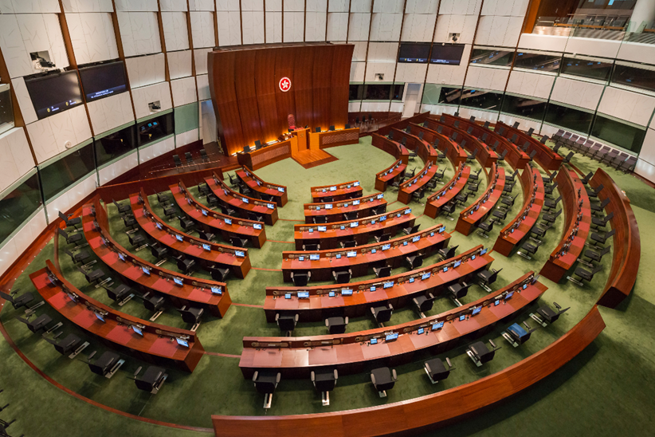
Legislative power
The National People’s Congress authorises the HKSAR to enjoy legislative power.
The Legislative Council of the HKSAR shall be the legislature of the HKSAR that has very extensive legislative power.
33

Slide 34
Supplementary information
Do you know about “Reporting for record”? The laws enacted by the Legislative Council of the HKSAR must be reported to the Standing Committee of the National People’s Congress for record.
If the Standing Committee of the National People’s Congress… considers that any law enacted by the legislature of the Region is not in conformity with the provisions of this Law regarding affairs within the responsibility of the Central Authorities or regarding the relationship between the Central Authorities and the Region, the Standing Committee may return the law in question but shall not amend it.
Any law returned by the Standing Committee of the National People’s Congress shall immediately be invalidated. This invalidation shall not have retroactive effect, unless otherwise provided for in the laws of the Region.
— Refer to Article 17 of the Basic Law

Slide 35
Independent judicial power and power of final adjudication
Article 19 (1) of the Basic Law prescribes that the Hong Kong Special Administrative Region shall be vested with independent judicial power, including that of final adjudication.
Article 80 of the Basic Law prescribes that the courts of the Hong Kong Special Administrative Region at all levels shall be the judiciary of the Region, exercising the judicial power of the Region.
35

Slide 36
In the final verdict of NG Ka-ling versus the Director of Immigration (FACV14.15.16/1998) in 1999, the Court of Final Appeal held:
The judicial power of the courts of the HKSAR comes from the Basic Law. It is unquestionable that High Court accepts the authority exercised by the National People’s Congress and the Standing Committee in accordance with the provisions of the Basic Law and the procedures prescribed in this law (including the power of interpretation of the Basic Law). It is based on the legal interpretation of the Standing Committee of the National People’s Congress.
36

Slide 37
Supplementary information
The scope for exercising independent judicial power in the HKSAR
The independent judicial power of the HKSAR is authorised by the Central Authorities in accordance with the Basic Law. Its authority is not unlimited. The Basic Law also prescribes the limitations on the exercise of judicial power:
The restrictions on jurisdiction imposed by the legal system and principles previously in force in Hong Kong (Refer to Article 19 (2) of the Basic Law);
The courts of the HKSAR shall have no jurisdiction over acts of state such as defense and foreign affairs (Refer to Article 19 (3) of the Basic Law) ;
In certain circumstances, the courts of the Region shall seek an interpretation of the relevant provisions of the Basic Law from the Standing Committee of the National People’s Congress as prescribed in the Basic Law (Refer to Article 158 (3) of the Basic Law).
37

Slide 38
The power authorised by the Central Authorities to conduct relevant external affairs on its own
Article 13 (3) of the Basic Law prescribes:
“The Central People’s Government authorises the Hong Kong Special Administrative Region to conduct relevant external affairs on its own in accordance with this Law.”
38

Slide 39
Since Hong Kong’s return to China in 1997, the HKSAR, as a member of delegation of the People’s Republic of China, has participated in a number of international intergovernmental organisations with countries as the unit, such as International Telecommunication Union (ITU), Group of Twenty (G-20), World Health Organization (WHO), Organization for the Prohibition of Chemical Weapons (OPCW), ASEAN+3 Finance Ministers' Process.
Using the name “Hong Kong, China”, the HKSAR participated in those international intergovernmental organisations that are not confined to countries as the unit, such as Asia/Pacific Group on Money Laundering (APG), Advisory Centre on WTO Law, Study Group on Asian Tax Administration and Research (SGATAR), International Association of National Public Health Institutes (IANPHI).
Source: International Organisations and Conferences, the official website of the Office of the Commissioner of the Ministry of Foreign Affairs of the People’s Republic of China in the Hong Kong Special Administrative Region (http://www.fmcoprc.gov.hk/eng/syzx/gjhy//)
39

Slide 40
Since Hong Kong’s return to China in 1997, there have been 257 multilateral agreements applicable to the Hong Kong Special Administrative Region. (Source: Department of Justice, up to 9 September 2020).
Currently, 168 countries and territories have granted visa-free access or visa-on-arrival to the Hong Kong Special Administrative Region (HKSAR) passport holders. (Source: Immigration Department, up to May 2021)
Sources:
Official website of the Department of Justice: https://www.doj.gov.hk/en/external/treaties.html#interlawTbl
Official website of Immigration Department: https://www.immd.gov.hk/eng/service/travel_document/visa_free_access.html
Hong Kong also hosted international events such as the Six Ministerial Conference of the World Trade Organization in 2005, the Equestrian Competitions at the 2008 Summer Olympics, the 2009 East Asian Games, the Hong Kong Sevens, the Hong Kong Tennis Open, the Hong Kong Open, Hong Kong Masters, Art Basel, etc.
40

Slide 41
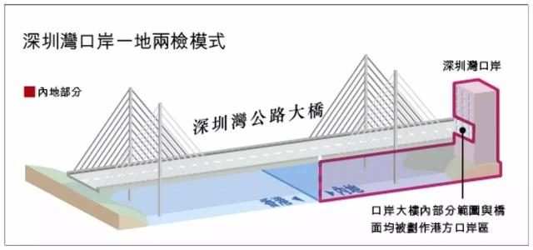
Other powers granted by the Central Authorities
The Hong Kong Special Administrative Region also enjoys other powers granted by the Central Authorities as prescribed in Article 20 of the Basic Law.
For instance, on 31 October 2006, the Standing Committee of the National People’s Congress adopted the Decision on Empowering the Hong Kong Special Administrative Region to Exercise Jurisdiction over the Hong Kong Port Area of the Shenzhen Bay Port .
Co-location arrangement at Shenzhen Bay Port
Shenzhen Bay Port
The mainland location
Shenzhen Bay Bridge
Certain areas in the port building and on the bridge are defined as Hong Kong Port Area
41

Slide 42
Implementation of the constitutional order prescribed by the Constitution and the Basic Law
「在落實憲法和基本法確定的憲制秩序時，要把中央依法行使權力和特別行政區履行主體責任有機結合起來。」
Source: Xi Jinping’s speech at meeting marking the 20th anniversary of Hong Kong’s return to the motherland and the inaugural ceremony of the fifth-term government of the Hong Kong Special Administrative Region (1 July 2017)
Source: Excerpted and translated from http://cpc.people.com.cn/BIG5/n1/2017/0701/c64094-29376639.html
The Basic Law is an “authorisation law”. The high degree of autonomy enjoyed by the HKSAR is conferred by the Central Authorities. Therefore, powers that are unauthorised shall be vested in the Central People’s Government, not in the HKSAR.
42

Slide 43
Constitutional responsibility of the HKSAR
01
02
03
04
Safeguard national sovereignty, security and development interests
Safeguard the constitutional order of the HKSAR as prescribed by the Constitution and the Basic Law
Maintain the prosperity and stability of the HKSAR
Actively integrate into the overall development of the country
43

Slide 44
The Constitution firmly upholds the “one country, two systems” policy
The meaning of “one country, two systems”
“One country, two systems” is a holistic concept.
“One country” means that within the PRC, the HKSAR is an inalienable part of the country and a local administrative region directly under the Central People’s Government. “Two systems” means that, within “one country”, the main body of the country practices socialism, while Hong Kong and some other regions practice capitalism.
“One country” is the premise and basis of the “two systems”, and the “two systems” is subordinate to and derived from “one country” and are unified within “one country”.
Source: White paper on The Practice of the “One Country, Two Systems” Policy in the Hong Kong Special Administrative Region (10 June 2014)
44

Slide 45
Questions
“One country” is like the root of a tree. Only deep roots can make the leaves flourish.
The Central Government will firmly uphold two points in implementing the “one country, two systems” principle. First, unswervingly implementing the policy without change; second, ensuring that the implementation of the “one country, two systems” policy in Hong Kong is not distorted and advancing towards the right direction.
The above statements may enhance our understanding of the relationship between “one country” and “two systems”. Please share your thoughts on this.
Source: https://www.news.gov.hk/en/categories/admin/html/2015/12/20151223_170439.shtml
45

Slide 46
Answers
“One country, two systems” is a holistic concept and cannot be separated or opposed to one another. “One country” refers to the People’s Republic of China (PRC). “One country” is the prerequisite for and foundation of the “two systems”, while the “two systems” are subordinate to and derived from “one country”.
Upholding the principle of “one country” should be integrated with the respect for the differences of the “two systems”. We should adhere to the foundation of “one country” and realise the “two systems” in harmony and reinforce each other. We should not only ensure the success of development on the mainland where the socialist system is practised, but also the success of development in Hong Kong where the capitalist system is practised.
46

Slide 47
The Constitution provides the legal basis for implementation of “one country, two systems”
Article 31 of the Constitution stipulates: “The state may establish special administrative regions when necessary. The systems instituted in special administrative regions shall, in light of specific circumstances, be prescribed by laws enacted by the National People’s Congress.”
Article 31 is a special clause in the Constitution
It states that the system practised in a special administrative region will be different from that of the mainland.
47

Slide 48
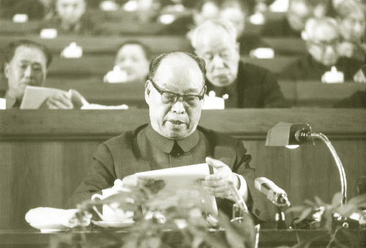
Supplementary information:
Report on the Draft Amendment to the Constitution of the PRC explains the intention of drafting Article 31
Report on the Draft Amendment to the Constitution of the PRC clearly states: “Taiwan may become a special administrative region and enjoy a high degree of autonomy. Such autonomy includes that Taiwan’s current social and economic systems as well as its way of life will remain unchanged. Taking into account the needs of this special situation, draft amendment to Article 31 of the Constitution stipulates… this is our basic position on handling matters as such.” This statement obviously applies to Hong Kong and Macau as well.
On 26 November 1982, Peng Zhen, Deputy-Director of the Constitutional Amendment Committee, presented the Report on the Draft Amendment to the Constitution of the PRC to the Fifth Session of the Fifth National People’s Congress

Slide 49
The Constitution establishes “one country, two systems”
The Constitution provides the constitutional basis for the legalisation and institutionalisation of “one country, two systems” principle and makes it the most authoritative provision.
The Constitution safeguards that the principle of “one country, two systems” would not be changed or shaken, and ensures its implementation without being distorted.
01
02
“One country, two systems” not only is the best solution to the questions of Hong Kong and Macau left over from history, but also the best institutional arrangement for their long-term prosperity and stability after their return to the motherland.
“One country, two systems” offers a new proposal for the international community to resolve similar issues, which is the contribution of China to world peace and development.
03
04
49

Slide 50
The Constitution provides legislative backing for the Basic Law
The Constitution is the fundamental law of the State and it has the highest legal effect. It provides the legislative backing for the enactment of all the laws.
50

Slide 51
Learning Activity: To understand the relationship among the Constitution, the Basic Law and the principle of “one country, two systems”, please fill in the blanks based on the information below and your own knowledge.
Article 31 of the Constitution of the PRC
“The state may establish special administrative regions when necessary. The systems instituted in special administrative regions shall, in light of special circumstances, be prescribed by laws enacted by the National People’s Congress.”
Article 57 of the Constitution of the PRC
“The National People’s Congress of the People’s Republic of China is the highest state organ of power. Its permanent organ is the National People’s Congress Standing Committee.”
Article 58 of the Constitution of the PRC
“The National People’s Congress and the National People’s Congress Standing Committee exercise the legislative power of the state.”
51

Slide 52
Preamble, Paragraph 3, of the Basic Law
“In accordance with the Constitution of People’s Republic of China, the National People’s Congress hereby enacts the Basic Law of the Hong Kong Special Administrative Region of the People’s Republic of China, prescribing the systems to be practised in the Hong Kong Special Administrative Region, in order to ensure the implementation of the basic policies of the People’s Republic of China regarding Hong Kong.”
Article 11 of the Basic Law
“In accordance with Article 31 of the Constitution of the People’s Republic of China, the systems and policies practised in the Hong Kong Special Administrative Region, including the social and economic systems, the system for safeguarding the fundamental rights and freedoms of its residents, the executive, legislative and judicial systems, and the relevant policies, shall be based on the provisions of this Law.”
No law enacted by the legislature of the Hong Kong Special Administrative Region shall contravene this Law.
52

Slide 53
Learning Activity: To understand the relationship among the Constitution, the Basic Law and the principle of “one country, two systems”, please fill in the blanks based on the information below and your own knowledge.
guarantees
The __________of the People’s Republic of China
grants
The National People’s Congress: the highest __________________
_________ system
_____
formulates and passes
_____________
decides
_________system
The______,_______, _______ systems in Hong Kong
53

Slide 54
Answers
guarantees
The Constitution of the People’s Republic of China
grants
The National People’s Congress: the highest state organ of power
Socialist system
“One Country”
formulates and passes
The Basic Law
decides
Capitalist system
The executive, legislative and judicial systems in Hong Kong
54

Slide 55
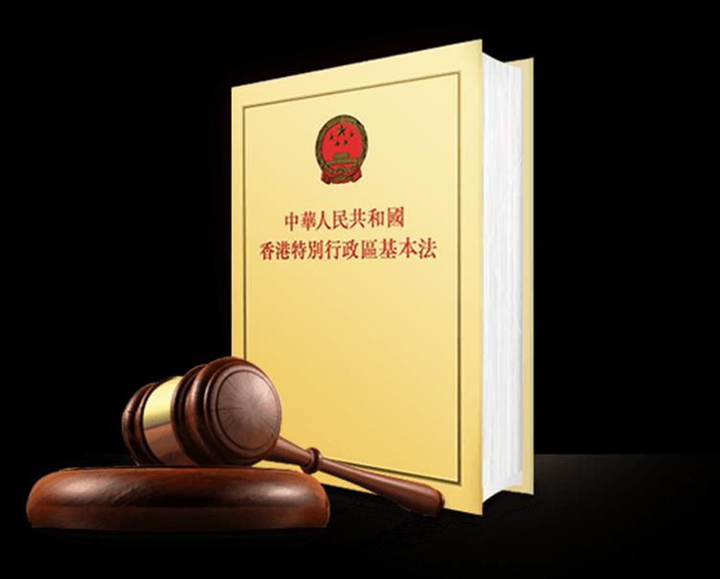
Learning activity
1.
Legislative backing
Some people think that the legislative backing for the Basic Law is merely Article 31 of the Constitution, but not the entire Constitution. Is this statement correct?
55

Slide 56
Answers
The Basic Law is a basic law of the country that embodies the principle of “one country, two systems”. In addition to Article 31 of the Constitution, other provisions as prescribed in the Constitution also set out guidelines and stipulations for the implementation of “one country, two systems” policy.
According to the Preamble of the Basic Law, the Basic Law is enacted in accordance with the Constitution. Decision on the Basic Law of Hong Kong passed by the National People’s Congress stated that the Basic Law was enacted in accordance with the Constitution and with regards to the specific conditions in Hong Kong. It is in compliance with the Constitution.
56

Slide 57
Features of the Basic Law
The Basic law is a national law, as well as the constitutional law of the Hong Kong Special Administrative Region (HKSAR).
All the systems and policies practised in the special administrative region shall be based on the provisions of the Basic Law. No law enacted by the legislature of the HKSAR shall contravene the Basic Law.
57

Slide 58
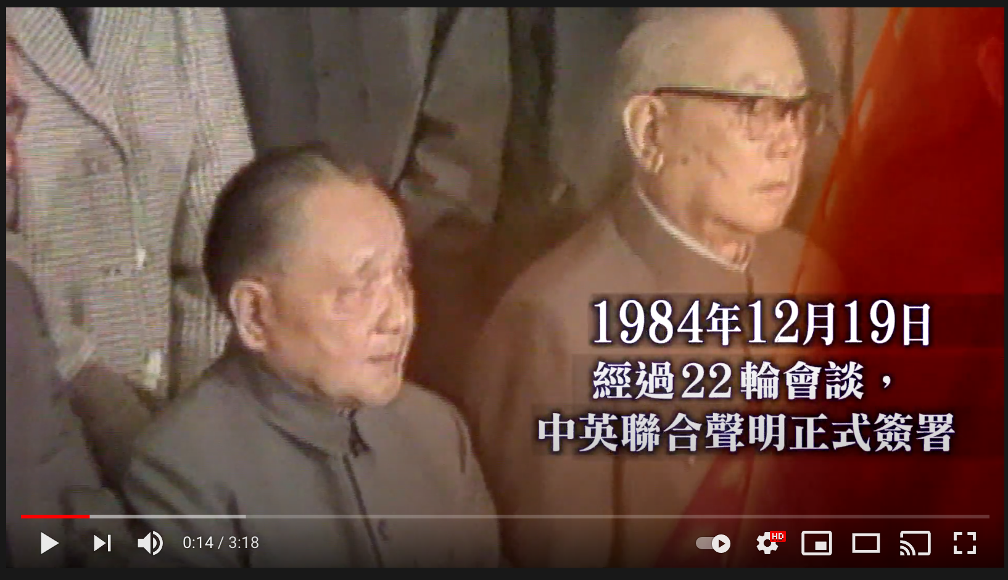
Watch the video from the Constitutional and Mainland Affairs Bureau
https://youtu.be/R9p4buqcLdk
On 19 December 1984, after 22 rounds of talks, the Sino-British Joint Declaration was formally signed.
58

Slide 59
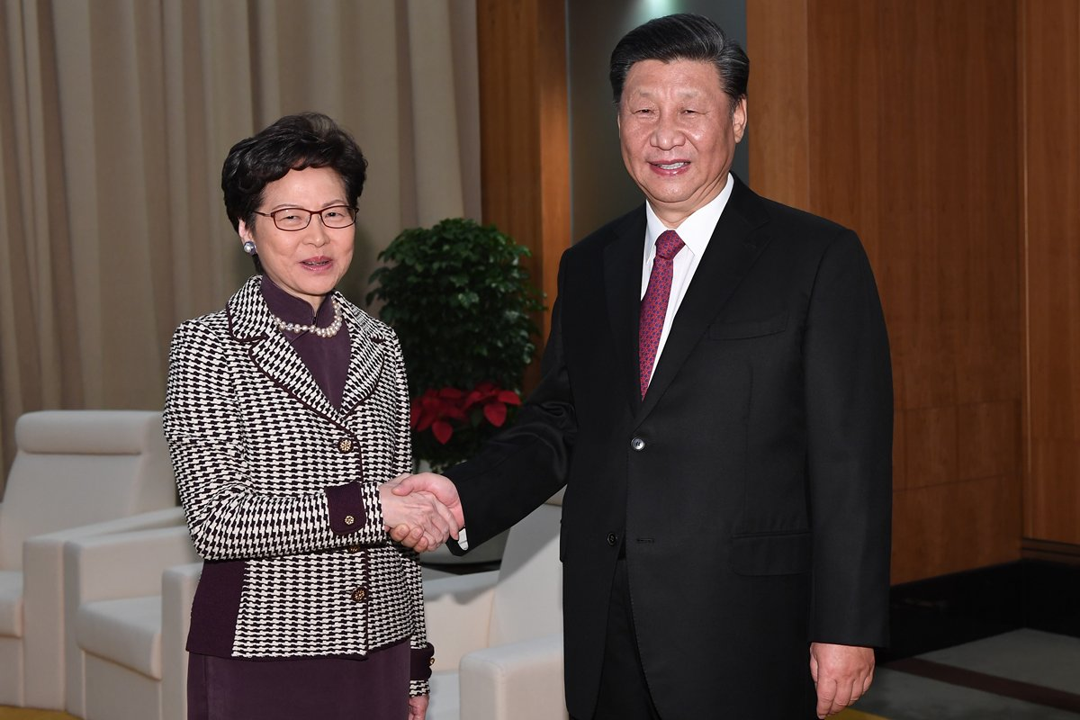
The aims of “one country, two systems”
The fundamental aims of “one country, two systems” are to safeguard the country’s sovereignty, security and development interests, as well as maintain the long-term stability and prosperity of Hong Kong. These two aspects are consistent, interactive and closely related.
The core requirement of implementing the Basic Law is to develop a sense of national awareness and adhere to the principle of “one country”. Nothing would be possible without this basic premise.
59

Slide 60
The Constitution establishes the policy of “one country, two systems”. The Basic Law is enacted in accordance with the Constitution to realise the institutionalisation and legalisation of the policy.
The steadfast and successful implementation of “one country, two systems” can only be achieved by safeguarding the constitutional order comprised by the Constitution and the Basic Law.
60

Slide 61
Education Bureau’s learning and teaching resources on the Constitution and the Basic Law
Teaching resources on the Constitution of the People’s Republic of China 【Junior Secondary Curriculum of the Personal, Social and Humanities Education Key Learning Area】
The Constitution and the Basic Law Education Wall-chart Resources
Basic Law Online Courses for Secondary School Students’ Self-directed Learning
Learning and Teaching Resources on “The Constitution and the Basic Law”
Website:
https://www.edb.gov.hk/en/curriculum-development/kla/pshe/basic-law-education.html
61

Slide 62
The End
62

Slide 63
User guide
The primary users of this resource are teachers. It aims to provide teachers with content knowledge relevant to the topic to enable teachers to have a deeper understanding of teaching content when preparing for their lessons.
All data, videos, photos, pictures, questions and suggested answers can be used for multiple purposes, such as teachers’ teaching materials, references for curriculum planning and learning and teaching, and student assignments, etc. To align with Citizenship and Social Development Curriculum and Assessment Guide (Secondary 4-6) (2021) (C&A Guide), this resource should be adapted to cater for students’ learning diversity and the needs of classroom teaching, etc.
Teachers may provide appropriate supplementary notes/ explanations to enrich this resource in order to enhance students’ understanding of the topic and information provided.
In accordance with the curriculum rationale and aims, teachers may select other learning and teaching resources which are correct, reliable, objective and impartial to help students build up a solid knowledge base, develop positive values and attitudes as well as enhance critical thinking and problem solving skills, and various generic skills.
If some information cannot be provided in this resource due to copyright issue, teachers may visit relevant websites provided.
Some information may have been updated when being used by teachers, teachers may visit the corresponding websites to obtain the up-to-date information.
Please also refer to the C&A Guide to understand the requirements and arrangements of the learning and teaching of the curriculum.

