Slide 1
Citizenship and Social Development
Theme 3: Interconnectedness and Interdependence of the Contemporary World
Topic: Public Health and Human Health
Learning Focus:
Contributions of the State and Hong Kong to Global Public Health (Particularly in Preventing and Controlling Infectious Diseases)
April 2023
(Translated version)

Slide 2
Learning Objectives
Knowledge
To understand the contributions of the State and Hong Kong to global public health and their achievements in preventing and controlling infectious diseases
Skills
To be able to summarise and analyse the contributions of the State and Hong Kong to global public health based on data, facts and evidence;
To identify the accurate channels of health information dissemination, solve daily healthcare issues, nurture critical thinking and lifelong learning skills
Values
To respect advices from medical professionals, develop health awareness of “prevention is better than cure” and put emphasis on personal hygiene
To care about public health at individual, social and global levels, possess the sense of national identity and international perspective in contributing to the protection of public health

Slide 3
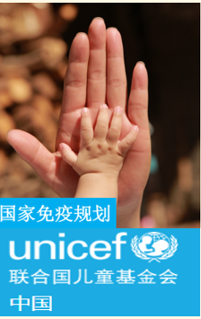
Contributions of our Country to Global Public Health
Lead-in
Since its establishment, and in particular after its reform and opening up, the State has been committed to enhancing people’s health and public health in developing a robust national healthcare services system to continuously improve people’s physique and wellness and contributed to global public health.
Reference
To improve hygiene, the State has implemented at full swing, a series of policies since 1950s, including the elimination of pesticides, prevention of diseases and enhancement of environmental hygiene. The quality of national hygiene and health has been significantly improved and has received worldwide recognition.
Source: the Chinese Government’s website (http://www.gov.cn/xinwen/2017-07/05/content_5208242.htm)
Since 1978, the State has been promoting the Expanded Programme on Immunization to boost vaccination and improve people’s health, with an aim of preventing and controlling the occurrence and prevalence of certain infectious diseases. The Programme has been praised as a highly successful and cost-effective public health intervention which protects many children from vaccine-preventable diseases.
Please click on the image to see the reference information on the success of the Programme above: unicef (China) (https://www.unicef.cn/sites/unicef.org.china/files/2019-06/04CN-%E5%9B%BD%E5%AE%B6%E5%85%8D%E7%96%AB%E8%A7%84%E5%88%92%20Atlas%202018.pdf)

Slide 4
Contributions of our Country to Global Public Health
Addressing Domestic Public Health Problems
Attaching importance to people’s wellness, the State strives to promote healthy lifestyle, improve health services, optimise health protection, build healthy environment, advance the construction of a “Healthy China” with a focus on the development of Health industry. In 2016, the State published the outline of “Healthy China 2030” Plan to advocate “universal health through joint collaboration and shared benefits”. It also proposed a blueprint, such as the Healthy China Initiative (2019-2030) published in 2019.
Outline of “Healthy China 2030” Plan
The core message of “共建共享 、 全民健康” is “以人民健康為中心，以基層為重點，以改革創新為動力，預防為主，中西醫並重把健康融入所有政策” while highlighting “政府主導與調動，社會、個人的積極配合，落實預防為主，推行健康生活方式，減少疾病發生，強化早診斷 、早治療 、早康復實現全民健康.
Please refer to the following materials to gain a full understanding of the goals and agenda mentioned in the Outlines of “Healthy China 2030” Plan and read the key indicators proposed in the Healthy China Initiative (2019-2030) for achieving the relevant goals and agenda.
Source: the Chinese Government’s website
http://big5.www.gov.cn/gate/big5/www.gov.cn/gongbao/content/2016/content_5133024.htm
http://www.gov.cn/xinwen/2019-07/15/content_5409694.htm

Slide 5

Contributions of our Country to Global Public Health
Elimination and Control of Infectious Diseases
Our country has been committed to the elimination and control of infectious diseases over the years and has achieved a profound effect, such as a Class A infectious diseases being managed from severe to under effective control and finally being eliminated; a Class B infectious diseases from pandemic to an epidemic at a lower level and near elimination; and from the mass outbreak of Class C infectious diseases to an epidemic at a lower level.
Click on the image to learn about Class A, Class B and Class C infectious diseases.
Source: https://www.chinacdc.cn/jkzt/crb/
Examples of Important Milestones throughout the State’s Elimination and Control of Diseases
A poliomyelitis-free status was achieved.
The influenza A H1N1 epidemic was effectively controlled
Blinding trachoma was eliminated
Infection rate of hepatitis B virus for children under five years of age was reduced to less than 1%.
2000
2009
2014
2020
1960
2007
2012
2019
2021
Smallpox was basically eliminated
Certified by the WHO as the first filariasis-free country in the world
Tetanus concerning pregnant women and newborns was eliminated
The reported occurrence of measles reached a historical low
Officially awarded a malaria-free certification
The Chinese Government’s website (http://www.gov.cn/gongbao/content/2003/content_62505.htm); (http://www.gov.cn/zhengce/content/2009-09/11/content_6153.htm); (http://www.gov.cn/xinwen/2020-07/28/content_5530817.htm)
Bureau of Medical Administration, National Health Commission (http://www.nhc.gov.cn/xcs/wsjksy/201909/ec95e9865e39452ab20683ab70499fb3.shtml) ; (http://www.nhc.gov.cn/wsb/pwsyw/200811/38281.shtml); (http://www.nhc.gov.cn/yzygj/s7652/201506/898dc6013aad4e4aa8a4bbef974853e2.shtml); (http://www.nhc.gov.cn/xcs/s7847/201904/c3e7050d4e5c4021ac1cb1681c702a67.shtml)
The World Health Organization (WHO) (https://www.who.int/zh/news/item/30-06-2021-from-30-million-cases-to-zero-china-is-certified-malaria-free-by-who)

Slide 6
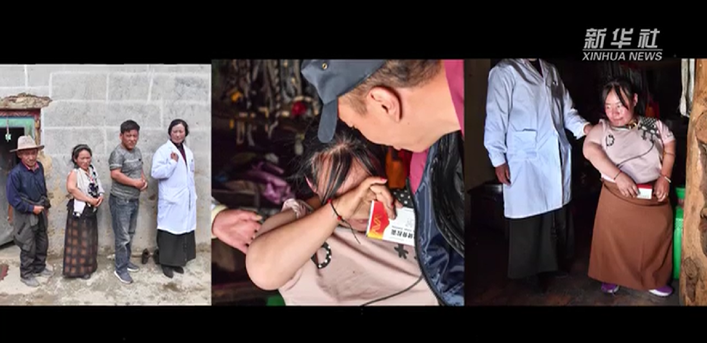
Contributions of our Country to Global Public Health
Reference
Elimination and Control of Endemic Diseases
Highly restricted to a certain locality, endemic diseases are caused by biological factors, environmental factors, lifestyle, etc., with critical cases basically distributed across poor and remote rural areas. Generally, the poor the area is, the more critical the situation, hence the striking phenomenon of “poverty-related disease and illness-induced poverty”. China was stricken by endemic diseases characterised by critical situations, grave dangers and wide distribution, with 31 provinces affected in various degrees. Over the years, the State has simultaneously achieved the prevention and control of endemic diseases as well as poverty alleviation through dedicated deployment, personnel and protection. Endemic diseases in most regions are now effectively controlled and eliminated.
Kashin-Beck disease, a multiple, deforming and endemic osteochondropathy, long plagued populations in different regions of the State, such as Tibet, Qinghai, Sichuan, Inner Mongolia and Shaanxi. In 2018, 10 departments, including National Health Commission, joined hands to carry out escalated operations related to key prevention and control measures, as well as other missions. Through persistent efforts, Kashin-Beck disease and other critical endemic diseases have been basically eliminated from the State.
Click on the image to watch the video and learn about the symptoms of Kashin-Beck disease and the national prevention and treatment.
Source: Xinhuanet (http://www.xinhuanet.com/politics/2018-12/06/c_1123813513.htm); (http://m.xinhuanet.com/xz/2021-05/26/c_139970960.htm)

Slide 7
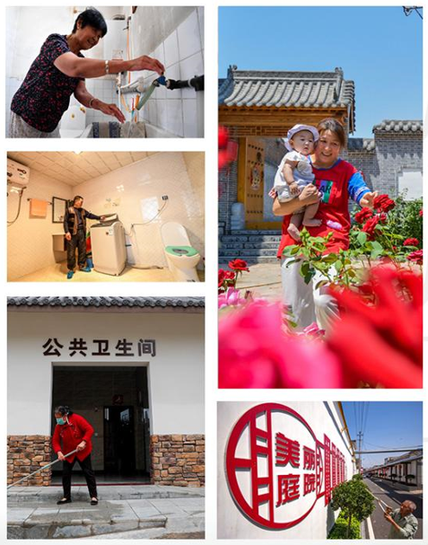
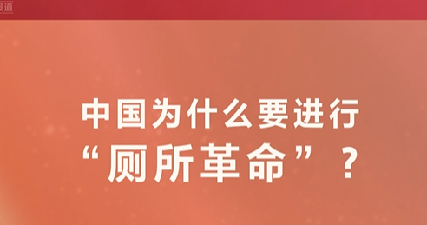
Contributions of our Country to Global Public Health
Reference
“Toilet Revolution”
The toilets in rural environment are generally in unsatisfactory hygiene conditions, making it very difficult to carry out disease prevention and control. Gastroenteritis that seriously affects our health, such as dysentery and typhoid, has high incidence rate. The infection rate of ascariasis among children is more than 70%. To improve the situation, the State has begun a “Toilet Revolution” to enhance the hygiene conditions of toilets, thereby protecting people’s health and promoting tourism.
Click on the image to watch the video
Why did China carry out the “Toilet Revolution”?
Source:
Ministry of Culture and Tourism of the People’s Republic of China (http://zwgk.mct.gov.cn/zfxxgkml/ggfw/202012/t20201213_919285.html)
people.cn (http://politics.people.com.cn/BIG5/n1/2019/0919/c429373-31362516.html)
Xinhuanet (http://www.xinhuanet.com/politics/2021-07/25/c_1127692726.htm)

Slide 8
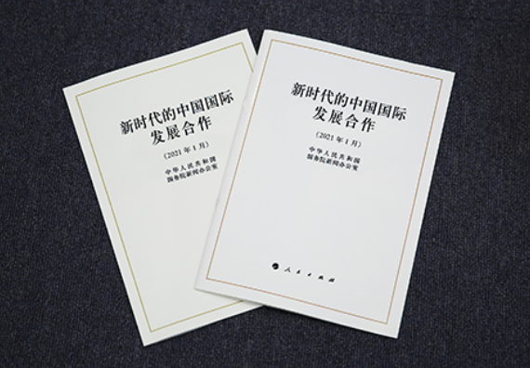
Contributions of our Country to Global Public Health
Foreign Health Assistance in Response to Public Health Emergencies
The State’s active provision of foreign health assistance represents its efforts in promoting a global community of shared future and China’s international development co-operation in the new era.
As the white paper, titled “China's International Development Cooperation in the New Era”, points out, “The unprecedented level of interconnection and interdependence among countries binds them into a global community of shared future. Guided by this vision, China’s international development co-operation in the new era has a more profound philosophical basis and clearer goals, which lead to more concrete actions.”
Click on the image to read the white paper
V. Responding to Global Humanitarian Challenges Together
(2) Responding to Public Health Emergencies

Slide 9
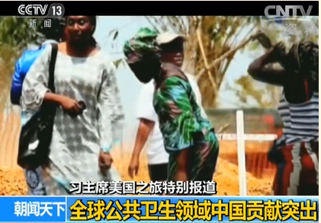
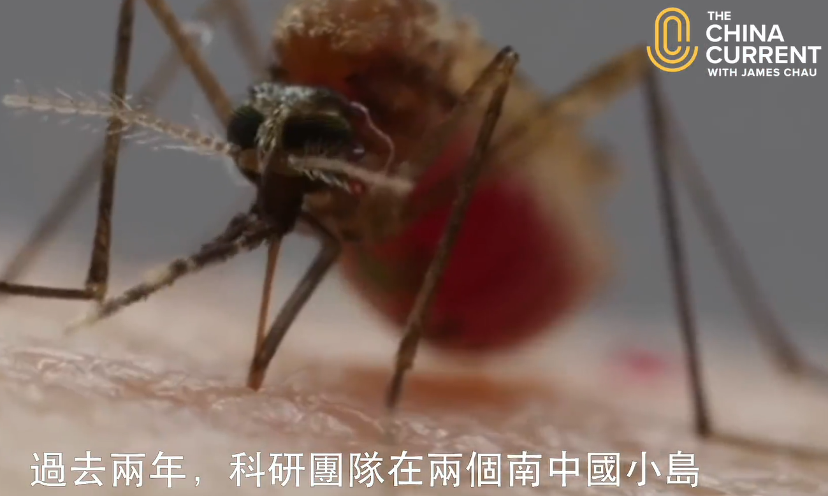
Contributions of our Country to Global Public Health
Participation in Global Prevention and Control of Infectious Diseases
As a WHO member state, our country proactively participates in global prevention and control of infectious diseases, and supports the WHO in responding to various challenges.* Meanwhile, through construction of hospitals, provision of medical supplies and equipment, deployment of medical teams, training medical personnel, and exchange and co-operation on prevention and control of diseases with developing countries, our country facilitates the improvement of health conditions in recipient countries, promotes diseases prevention and control, and enhances the development of public health capabilities.
Click on the images to watch the videos and
understand the contributions of the State to global public health
Video: Outstanding Contributions of China to Global Public Health
Source: CCTV (https://tv.cctv.com/2015/09/27/VIDE1443312115223350.shtml?spm=C53156045404.P4HrRJ64VBfu.0.0)
Video: New Solution for Containing Spread of Diseases
By piloting “Fighting Mosquitoes with Mosquitoes”, a new disease prevention measure, the research team from Sun Yat-Sen University has successfully addressed the mosquitoes issues on two islands and eliminated the source linked to various tropical diseases, such as Zika virus and dengue.
Source: The China Current (https://chinacurrent.com/hk/story/20321/mosquito-control)
* the State provides proactive support to and establishes partnership with the WHO. For example, the State has signed various international ordinances, conventions and collaboration agreements with the WHO. Please refer to relevant examples mentioned in the presentation slides for teaching of “Functions and Roles of the World Health Organization in Global Public Health Matters”.

Slide 10
Contributions of our Country to Global Public Health
Contributions to Global COVID-19 Prevention and Control
Timely Report of Epidemic Information to Facilitate Analysis and Assessment of the Epidemic
When the COVID-19 epidemic broke out, the State reported immediately information to the WHO, relevant countries and regional organisations, and immediately published information, such as COVID-19 genome sequence to the world through the WHO platforms to sound the alarm for global anti-epidemic efforts.
Timely reported epidemic information and supported the WHO and the international community in assessing the situation and risks
On 28 February 2020, the WHO published the Report of the WHO-China Joint Mission on Coronavirus Disease 2019 (COVID-19), which served as a reference about adoption of COVID-19 control measures for every country, and commended China again for its ambitious, agile and aggressive disease containment effort in the face of a previously unknown virus.
For the anti-epidemic efforts of the State, please refer to the white paper titled “Fighting COVID-19: China in Action”. http://www.gov.cn/zhengce/2020-06/07/content_5517737.htm

Slide 11
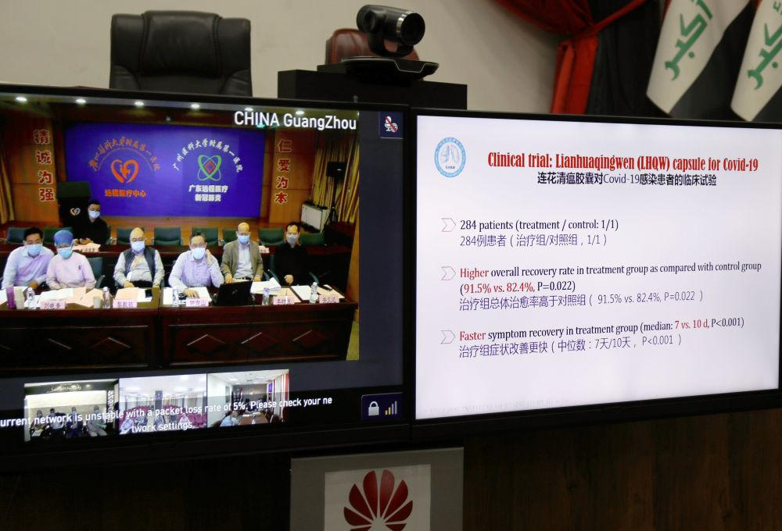
Contributions of our Country to Global Public Health
Contributions to Global COVID-19 Prevention and Control
Proactive Sharing of China’s Experience and Provision of Medical Assistance
Immediate announcement of treatment, prevention and control plans, and commencement of exchange activities on epidemic prevention and control with many countries, international and regional organisations.
Continuous updates on prevention, treatment and control guidelines, accumulation of experience about prevention, control and treatment, effective prevention and control of the domestic epidemic and mitigation of the spread of the virus.
Setting up of information websites for pandemic prevention and control, provision of medical assistance to relevant countries, unreserved sharing of anti- epidemic experience with the international community, offering technical advice on global anti-epidemic efforts.
Deployment of medical teams to various countries to provide on-site anti-epidemic support.
On 23 April 2020, Professor Zhong Nanshan and other experts shared China’s strategy on COVID-19 prevention and control through the China-Iraq Video Conference on Anti-epidemic Experience Exchange.

Slide 12
Contributions of our Country to Global Public Health
Reference
Contributions to Global COVID-19 Prevention and Control
Sharing of China’s Anti-epidemic Experience by Professor Zhong Nanshan*
On 23 April 2020, Professor Zhong Nanshan and other experts shared China’s strategy on COVID-19 prevention and control through the China-Iraq Video Conference on Anti-epidemic Experience Exchange. The Red Cross Society of China and the First Affiliated Hospital of Guangzhou Medical University were connected to the video conference. Professor Zhong Nanshan and his team members shared China’s experience on combating COVID-19 and results of recent research, and discussed about deepening anti-epidemic co-operation between China and Iraq. Professor Zhong Nanshan introduced four strong control measures, including lockdowns; national announcement of the number of confirmed and suspected cases on a daily basis to ensure openness and transparency; extension of the joint prevention and control mechanism to cover the grassroots, and real-time quantitative nucleic acid testing for all close contacts. Moreover, Professor Zhong Nanshan also shared the definition of asymptomatic Covid-19 patients, as well as the latest clinical trials of prevention, control and treatment methods.
*Professor Zhong Nanshan is an academician of the Chinese Academy of Engineering and a renowned respiratory specialist. He is committed to the study, prevention and treatment of severe respiratory tract infection and chronic respiratory diseases, bagging a number of honours in recognition of his significant contributions, the Outstanding Academic Contribution Award for Respiratory Diseases by the Chinese Medical Association (2004), Reform Pioneer (An Important Promotor of the Construction of China's Public Health Event Emergency System, 2018), Medal of the Republic (2020), etc.
Source: CCTV.com (http://news.cnr.cn/native/gd/20200424/t20200424_525067028.shtml)

Slide 13
Contributions of our Country to Global Public Health
Contributions to Global COVID-19 Prevention and Control
Providing Anti-epidemic Protection Supplies for the World
Our country has taken active actions to meet the national demand for medical supplies, while proactively providing much needed anti-epidemic resources to countries and international organisations through various forms, including free aid, government-facilitated procurement and commercial procurement.
As the largest global provider of anti-epidemic supplies, our country actively participated in international co-operation against the epidemic by providing and exporting anti-epidemic supplies to over 200 countries and regions around the world. From March 2020 to the end of the year, major epidemic prevention and control supplies inspected and cleared by national customs reached a total of RMB438.5 billion, showcasing the image of China as a responsible country.
Source: the Chinese Government’s website (http://www.gov.cn/xinwen/2021-01/14/content_5579875.htm)
Our country has actively supported and participated in the global supply chain operation co-ordinated by the WHO for the COVID-19 epidemic, establishing a global humanitarian response hub and making significant contribution to the global anti-epidemic efforts.
The global humanitarian response hub is chiefly responsible for the procurement and consolidation of inventories of anti- epidemic supplies, in addition to the transportation of humanitarian supplies to epidemic-stricken countries, aviation services and delivery of humanitarian activities.
Source: Xinhuanet (http://big5.news.cn/gate/big5/www.xinhuanet.com/world/2020-04/23/c_1125893676.htm)

Slide 14
Contributions of our Country to Global Public Health
Contributions to Global COVID-19 Prevention and Control
Initiating Research and Development (R&D) and Promoting Equitable Distribution of Vaccines
Our country is one of the big countries that can develop and manufacture COVID-19 vaccines independently. At the onset of the COVID-19 epidemic, vaccines research and development on technology, such as inactivated vaccine was commenced, while co-operation on clinical trials with the UAE, Brazil and other countries was carried out. As of May 2021, seven vaccines were in use across the country. Meanwhile, our country took part in a WHO-led programme COVAX, to promote equitable distribution of vaccine around the world.
Chinese Vaccines: Accessible and Affordable
Taking practical actions to help developing countries
Promising that the world would be provided with COVID-19 vaccines as global public goods at a fair and reasonable price
Getting involved with the global COVID-19 vaccines programme under COVAX
Doing its best to achieve a fair and accessible distribution of vaccines

Slide 15
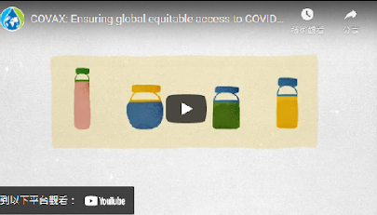
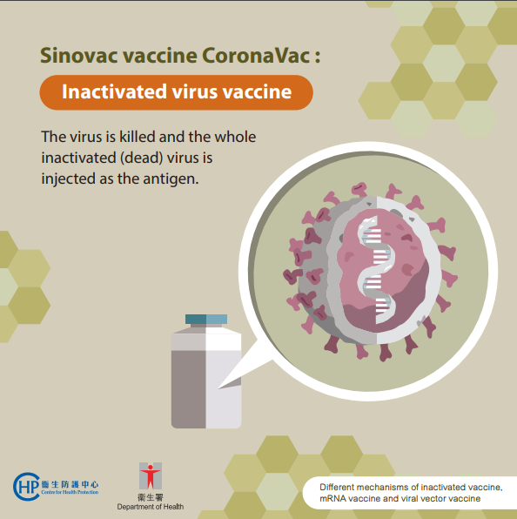
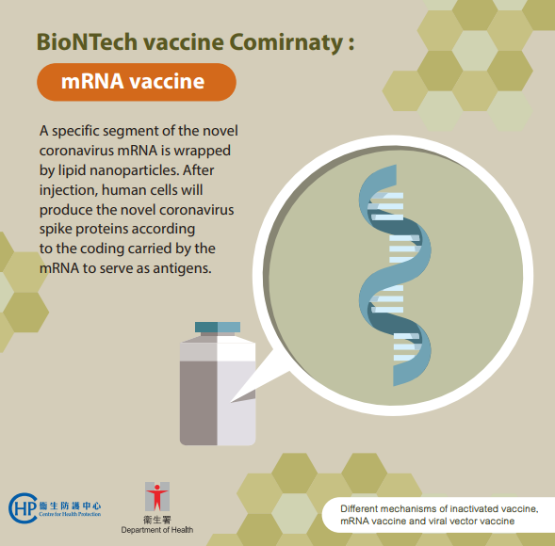
Contributions of our Country to Global Public Health
Reference
COVID-19 Vaccines Global Access
COVID-19 Vaccines Global Access (COVAX) is co-led by the WHO, Gavi, the Vaccine Alliance and the Coalition for Epidemic Preparedness Innovations, with an aim to accelerate the development and manufacture of COVID-19 vaccines and to guarantee fair and equitable access for every country in the world. To learn about this programme, please click on the image and watch the video.
Source of the information and video: WHO (https://www.who.int/zh/initiatives/act-accelerator/covax)
Types of COVID-19 Vaccines
For detailed introduction of the vaccines, please refer to the reference information.
Source: Centre for Health Protection (https://www.chp.gov.hk/files/pdf/dh_covid19_vaccine_fb_c_basicknowledge_eng.pdf)

Slide 16
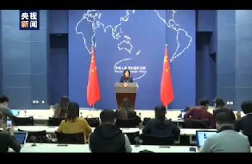
Contributions of our Country to Global Public Health
Contributions to Global COVID-19 Prevention and Control
China’s Vaccine Assistance
Participation in the WHO’s COVAX with a clear commitment to provide the first batch of 10 million doses of vaccines to meet the urgent demand from developing countries
As of March 2021, our country has provided vaccine assistance to 80 countries and three international organisations, while exporting vaccines to over 40 countries and joining hands with more than 10 countries in the R&D and manufacture of vaccines
Donation of vaccines to peacekeeping forces of various countries in response to the call of the United Nations
Source of the information and video: CCTV.com http://m.news.cctv.com/2021/03/30/ARTIOmCzQXs8b9grjEwJhwhC210330.shtml

Slide 17
Contributions of our Country to Global Public Health
Contributions to Global COVID-19 Prevention and Control
Strengthening the Global Anti-epidemic Capability with Funding
Donations of US$30 million on top of US$20 million to the WHO to carry out international co-operation against COVID-19 epidemic, and in particular to help developing countries with weak public health systems respond outbreaks effectively.
After setting up a special funding of RMB2 billion for anti-epidemic co-operation, our country announced on the 73rd World Health Assembly that it would provide an international assistance of US$2 billion over two years to help with the fight against COVID-19 and economic and social development for affected countries, especially developing countries.
On the Global Health Summit 2021, China pledged another international assistance of US$3 billion over the next three years to support COVID-19 response and economic and social development of development countries.
Source:
Xinhuanet (http://www.xinhuanet.com/world/2020-04/23/c_1125896253.htm)
the Chinese Government’s website (http://www.gov.cn/xinwen/2020-05/18/content_5512733.htm)
people.cn (http://politics.people.com.cn/BIG5/n1/2021/0521/c1024-32110237.html)

Slide 18
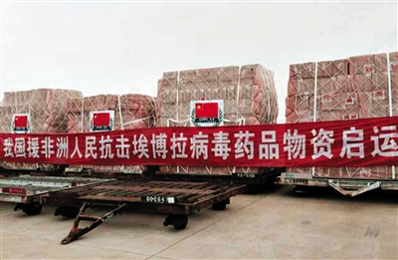
Contributions of our Country to Global Public Health
Contributions to Prevention and Control of West Africa Ebola epidemic
Ebola epidemic broke out in West Africa in 2014. Our country was among the first to provide early special assistance to the region by sending out experts and medical teams, providing guidance and directly participating in frontline treatment, despatching medical supplies and protection equipment on chartered flights. As one of the countries that offered the most numbered of assistance and medical supplies to Africa accumulatively, our country played an important role in the prevention and control of Ebola outbreak.
On 10 August 2014, antivirals were despatched as the State’s assistance to West African countries experiencing Ebola outbreak.
Source: the Chinese Government’s website (http://www.gov.cn/xinwen/2014-08/10/content_2733173.htm)

Slide 19
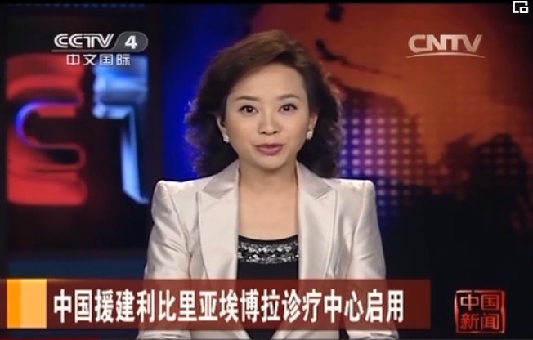
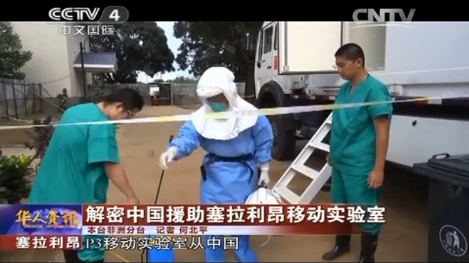
Contributions of our Country to Global Public Health
Contributions to Prevention and Control of West Africa Ebola epidemic
Construction of Ebola Diagnostic and Treatment Center
in Liberia
Construction of Mobile P3 Laboratory
to Help Sierra Leone Fight against Epidemic
In 2014, our country constructed a modern infectious diseases hospital with 100 beds in Liberia within one month. Most of the supplies were delivered from China to fully reflect the “Chinese speed”, “Chinese Standard” and “Chinese Spirit”.
Source:
CCTV.com (http://tv.cctv.com/2014/10/15/VIDE1413351844859416.shtml)
Click on the image to watch the video
Note: P3 Lab is the abbreviation of biosafety protection level 3 laboratory which is completely sealed and under negative pressure, so as to prevent air inside the laboratory from leaking and causing pollution.
Source: Xinhuanet (http://www.xinhuanet.com/politics/2020-03/22/c_1125748972.htm)
Click on the image to watch the video
Source: CCTV.com (https://tv.cctv.com/2014/11/26/VIDE1416998520453359.shtml?spm=C52507945305.P1Tyk9aHorGZ.0.0)

Slide 20
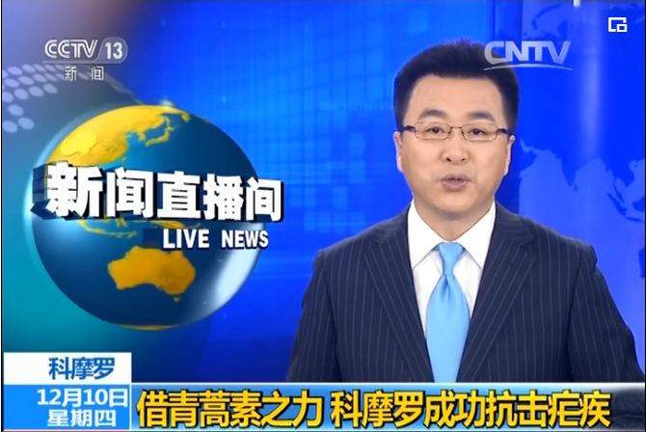
Contributions of our Country to Global Public Health
the State’s Contribution to Prevention and Control of Other Infectious Diseases
Our country has established 30 Malaria Prevention and Treatment Centers for African countries and provided $190 million worth of anti-malaria medicine containing artemisinin; sent out experts on disease control and offered strong support to Africa in emergency command and disease control during various epidemics. For prevention and control of malaria, schistosomiasis and other diseases, a series of disease prevention and control as well as universal health improvement projects have been implemented:
Offering technical assistance for prevention and control of schistosomiasis in Zanzibar, Tanzania, facilitating the formulation of regulations on prevention and control and reducing the local infection rate of schistosomiasis.
Implementing rapid elimination of malaria with compound artemisinin in Comoros, achieving zero malaria-related death and reducing incidence by 98%.
Click on the image to watch the video
Source: CCTV.com (https://tv.cctv.com/2015/12/10/VIDE1449717848751181.shtml)
Source:
the Chinese Government’s website (http://big5.www.gov.cn/gate/big5/www.gov.cn/xinwen/2017-09/29/content_5228551.htm#1)

Slide 21
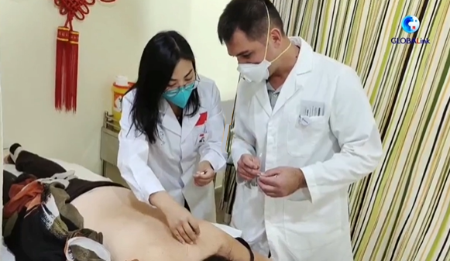
Contributions of our Country to Global Public Health
Driving Development of Global Public Health
Foreign Health Assistance
Through constructing hospitals, providing medicines and medical equipment, deploying medical teams, training medical personnel, conducting exchange and co-operation with developing countries on disease prevention and treatment together and other means, our country supports recipient countries in further improving health conditions, raising the standard of disease prevention and control, and stepping up the development of public health capabilities.
Establishing Foreign Aid Medical Teams
Click on the image above to view the video and website, and learn about the contributions of foreign aid medical teams to the world.
Our country continuously carries out foreign medical aids by sending out medical teams to countries and regions concerned to provide various forms of medical assistance. The foreign aid medical teams serve local patients with heart, creating an image for China as a responsible country.
Source: Xinhuanet (http://www.xinhuanet.com/world/2021-08/19/c_1211337026.htm)
Source:
people.cn (http://cpc.people.com.cn/BIG5/n/2014/0711/c83083-25268601.html)
China International Development Cooperation Agency (http://fasc.cidca.gov.cn/)

Slide 22
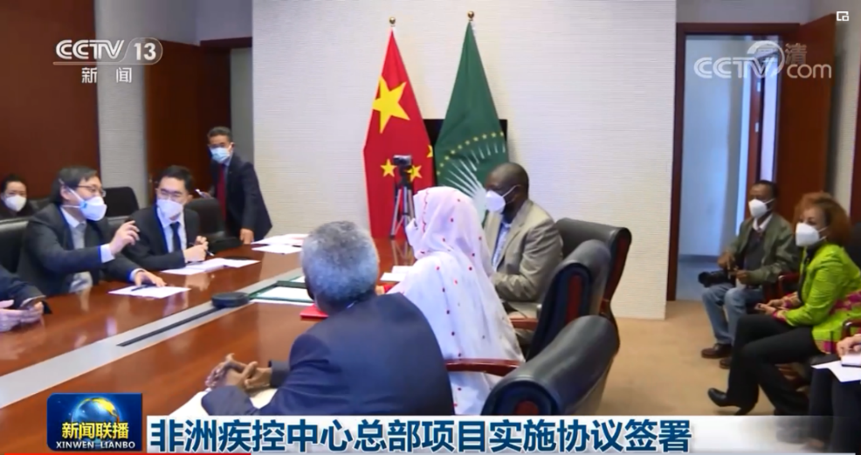
Contributions of our Country to Global Public Health
Aided the Construction of Africa Centres for Disease Control and Prevention
Our country strongly supported the construction of Centres for Disease Control and Prevention (CDC) by providing technical support, staff training, funding, etc. The construction project of the headquarters of Africa CDC will improve Africa’s response to public health challenges, and represents the China-Africa friendship and friendly collaboration, as well as China’s further participation in global public health affairs.
To know more
Africa CDC was officially launched on 31 January 2017 to strengthen the capacity of public health institutions of Member States to respond to disease threats, with five regional centres across the African continent. During the Johannesburg Summit of the Forum on China-Africa Cooperation in 2015, the State proposed the China-Africa Public Health Cooperation and announced China’s participation in the development of the public health system and capability building, such as Africa CDC.
Click on the image to watch the video
Source:
Chinese Center for Disease Control and Prevention (http://www.chinacdc.cn/yw_9324/201808/t20180820_189845.html)
the Chinese Government’s website (http://www.gov.cn/xinwen/2015-07/22/content_2900758.htm)
CCTV.com (https://tv.cctv.com/2020/07/28/VIDEq8xlCUCnJO1Pf7iLPfwV200728.shtml)

Slide 23

Contributions of our Country to Global Public Health
Other Examples of Foreign Health Assistance
Between 2013 and 2018, our country has provided emergency humanitarian assistance, including supplies and equipment, deployment of international rescue team and medical experts, and repair of damaged facilities, to 60 countries.
In 2020, initiatives of significant health assistance were provided to developing countries, including 100 hospitals and clinics and 100 “Maternal and Child Health Care Projects”.
100 healthcare and rehabilitation projects, among others, were implemented for South-South Cooperation Assistance Fund.
The Red Cross Society of China provided 44 countries with anti-epidemic supplies, and continuous medical services to people living in northeast Syria by supporting large multi-functional mobile medical units in the area. Between April and December 2019, X-ray services were provided to 350 people, trauma treatment to 1 650 people, and testing services to 700 people, benefiting over 2 000 people in total.
Source:
the Chinese Government’s website (http://www.gov.cn/xinwen/2021-01/10/content_5578617.htm)
Red Cross Society of China (https://www.redcross.org.cn/html/2019-11/63082.html)

Slide 24
Conclusion
The contributions of our country to global public health have, on the one hand, addressed significant domestic public health issues by way of improving basic public health measures and services, such as environmental hygiene and vaccination, eliminating or effectively controlling major infectious diseases with a safe mechanism, to promote people’s health. On the other hand, through its active participation in global public health affairs, rendering foreign health assistance, supporting the WHO in responding to various challenges, promoting the development of global public health, demonstrated to the world its vision of a global community of shared future embodying interconnection and interdependence that involve everyone.

Slide 25


Contributions of Hong Kong to Global Public Health
Lead-in
Healthcare in Hong Kong
The healthcare system in Hong Kong has won global recognition as it protects the health of its citizens:
Hong Kong people enjoy a very long life expectancy. In 2022, the expectancy of life at birth for men and women was 81 years and 87 years respectively, representing an increase of some six years respectively when compared to 30 years ago. The expectations of life at birth for both sexes in Hong Kong are among the longest in developed economies.
The infant mortality rate has decreased from 9.7 per 1000 live births in 1981 to 1.6 in 2022, which reflects that the health indices in Hong Kong ranks among the best in the world.
Source:
Census and Statistics Department (https://www.censtatd.gov.hk/en/page_235.html)
Department of Health (https://www.chp.gov.hk/en/statistics/data/10/27/113.html)
Health Bureau (https://www.healthbureau.gov.hk/statistics/en/dha/dha_summary_report.htm)

Slide 26


Introduction
Contributions of Hong Kong to Global Public Health
Healthcare in Hong Kong
Hong Kong’s public and private healthcare sectors provide comprehensive healthcare services, including a low‑cost public healthcare safety net that ensures no one in Hong Kong is denied medical care due to lack of means.
Hong Kong has an excellent healthcare system supported by a highly professional team of workers. The infant mortality rate in 2020 was among the lowest in the world. Male and female life expectancy at birth was among the world’s highest in 2021.
The Government’s recurrent funding for health has risen by about 63% over the past five years, from $58.7 billion in 2016 to $95.9 billion in 2021. Year-on-year, the recurrent funding for health grew more than 10% from $87.1 billion in 2020.
The recurrent expenditure for health accounted for 19% of the Government’s recurrent expenditure in 2021.
Source: Hong Kong Yearbook 2021 (https://www.yearbook.gov.hk/2021/tc/pdf/C09.pdf)
Please click on the image to learn more about the statistics on healthcare in Hong Kong.

Slide 27
Contributions of Hong Kong to Global Public Health
Large Pool of Professional Talents in Public Health
There is a comprehensive system in Hong Kong for developing public health talents while the world-class medical schools and institutions in town have nurtured many medical professionals, all contributing to the talent pool for local, national and international disease prevention and control organisations, health administration departments, medical institutions, schools and international organisations.
Healthcare R&D is outstanding in Hong Kong. For example, the Hong Kong Science and Technology Park provides a wide range of facilities and services to support the R&D of healthcare and biotechnology. Relevant facilities include the Biomedical Technology Support Centre, the Healthcare Devices Innovation Hub, etc.
With a strong research capability, Hong Kong has attracted many top‑notch universities and scientific research institutions from around the world. To give a few examples, the Dr Li Dak-sum Research Centre, a collaboration between the University of Hong Kong (HKU) and an overseas institution, provides a cutting‑edge research environment for research on stem cell and regenerative medicine in Hong Kong. In 2019, the Hong Kong University of Science and Technology signed an agreement with several first-class overseas medical schools to facilitate advanced translational neuroscience research. The partnership intends to set up the Center for Neurodegenerative Diseases in Hong Kong.
Source:
the Hong Kong Trade Development Council (https://research.hktdc.com/en/article/MzEzOTQ1MjMz)

Slide 28

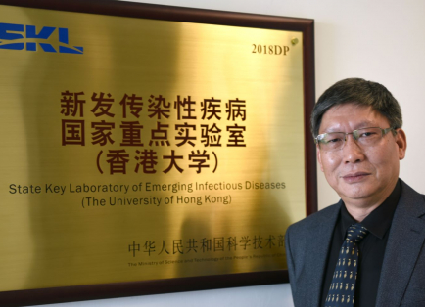
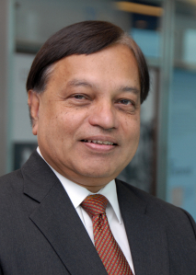
Contributions of Hong Kong to Global Public Health
Large Pool of Professional Talents in Public Health (Examples)
In 2003, Dr Margaret Chan joined the WHO as Director of the Department for Protection of the Human Environment. In June 2005, she was appointed Director, Communicable Diseases Surveillance and Response as well as Representative of the Director-General for Pandemic Influenza. In September 2005, she was named Assistant Director-General for Communicable Diseases.
Between 2007 and 2017, Dr Chan served two terms as Director-General of the WHO, which managed various public health crisis under her leadership, including the Influenza A (H1N1) pandemic in 2009, the Middle East Respiratory Syndrome (MERS) in 2012, the Ebola outbreak in 2014 and Zika epidemics in 2016.
Source: WHO (https://www.who.int/director-general/former-directors-general)
Margaret Chan
Two distinguished scholars of the HKU LKS Faculty of Medicine, Professor Guan Yi and Professor Joseph Sriyal Malik Peiris, were awarded the 2021 John Dirks Canada Gairdner Global Health Award for their significant contributions to understanding the origins and options for control of newly emerging infectious disease outbreaks in Asia, notably zoonotic influenza and severe acute respiratory syndrome (SARS).
Professor Guan Yi
Professor Joseph Sriyal Malik Peiris
Source: HKU (https://www.med.hku.hk/en/news/press/20210407-john-dirks-canada-gairdner-global-health-award)

Slide 29
Contributions of Hong Kong to Global Public Health
Contributions to Global Prevention and Control of Infectious Diseases
Given the dense population of Hong Kong, as an international hub with frequent movements of people and goods, the public health, as well as the prevention and control of infectious diseases in Hong Kong are faced with huge challenges. In the past, novel infectious diseases, such as SARS, brought severe challenges to the public health of the city. However, the concerted efforts of the HKSAR Government, citizens, and medical and research personnel have created an effective prevention and control mechanism for infectious diseases, contributing to the global public health.
Timely Amendment to Anti-epidemic Law
In line with the newly amended International Health Regulations (2005) of the WHO, Hong Kong made amendments to its Prevention and Control of Disease Ordinance* to enhance epidemic control capabilities. This provides monitoring data for global prevention and control of infectious diseases, strengthens international co-operation, supports the global pandemic prevention and control, in order to address potential future pandemics across the world together.
Source: Hong Kong Department of Health (https://www.dh.gov.hk/english/useful/useful_Regulations/useful_Regulations.html)
Please refer to relevant examples in the presentation slides for teaching titled “Functions and Roles of the World Health Organization in Global Public Health Matters” for illustration.

Slide 30
Contributions of Hong Kong to Global Public Health
A: Prevention and Control of Avian Influenza *
There have been several outbreaks involving poultry infected with highly pathogenic avian influenza (H5N1) since 1997. Since 1998, the HKSAR Government has implemented various measures at all levels, including reducing the risk of introduction of highly pathogenic avian influenza viruses into the poultry populations along our supply chain, preventing the establishment of a foothold of avian influenza viruses in our markets by, for example, introducing a vaccination programme for all local chicken farms. The Government has also secured the Mainland’s agreement and co-operation to vaccinate all chickens for export to Hong Kong. These efforts are significant contributions to the global prevention and control of avian influenza by effectively controlling the worldwide spread of avian influenza virus.
In 2005, the Mainland, Hong Kong and Macao signed the "Co-operation Agreement on Response Mechanism for Public Health Emergencies" to join the international co-operation on the global prevention and treatment of avian influenza, which was highly praised by the WHO and international community.
*Avian influenza is caused by those influenza viruses that mainly affect birds and poultry, such as chickens or ducks. Human cases infected with avian influenza A (e.g. H5N1, H5N6, H6N1, H7N4, H7N9, H9N2 and H10N8) viruses have been identified in recent years.
Source:
Government Press Releases (https://www.info.gov.hk/gia/general/200510/21/P200510210105.htm);
Legislative Council Papers (https://www.legco.gov.hk/yr03-04/english/panels/fseh/papers/fseh0402-avian-e-scan.pdf)
Centre for Health Protection (https://www.chp.gov.hk/en/healthtopics/content/24/13.html)

Slide 31
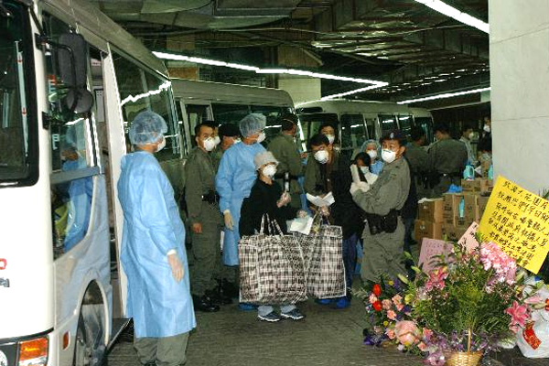
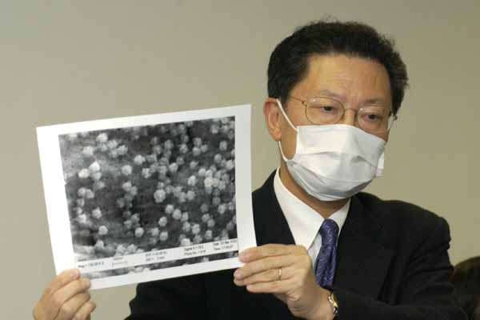
Contributions of Hong Kong to Global Public Health
B: Severe Acute Respiratory Syndrome (SARS)
To fight against SARS in 2003, the HKSAR Government formulated a series of anti-epidemic measures, including the delineation of infected areas, massive anti-epidemic campaigns and quarantine measures, to curb the spread of the disease. To control the epidemic and save patients, a medical co-operation mechanism with the Mainland was also established during the SARS outbreak with great success.
Residents affected by the epidemic are being moved to isolation centres
The committed efforts of medical and academic institutions in Hong Kong to fight against SARS met with great success. For example, Department of Microbiology, Faculty of Medicine, the HKU said they had identified the SARS virus that attacked Hong Kong and the world as “coronavirus” and named the disease as “coronavirus pneumonia”. The HKU also announced that they developed a quick diagnostic test that was believed to help cure and contain the disease, and promoted Hong Kong’s international reputation.
Lam Shiu-kum, Dean of the Medicine Faculty of the University of Hong Kong shows a picture of the SARS coronavirus
Source: Government Press Release https://www.news.gov.hk/isd/ebulletin/tc/category/healthandcommunity/030401/html/030401tc05008.htm#
https://www.news.gov.hk/isd/ebulletin/tc/category/healthandcommunity/030327/html/030327tc05003.htm#

Slide 32
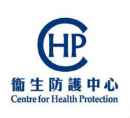
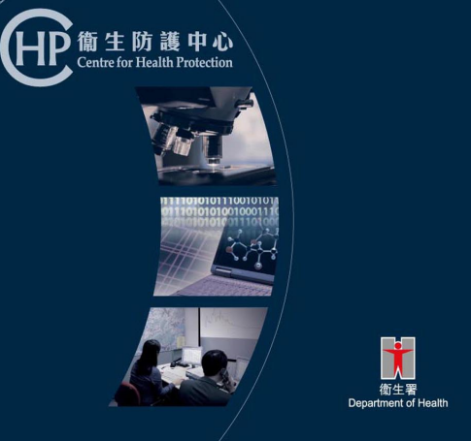
Contributions of Hong Kong to Global Public Health
B: Severe Acute Respiratory Syndrome (SARS)
The Centre for Health Protection (CHP), established by the HKSAR Government in 2004 to address the systemic issues identified by the SARS Expert Committee, is a public health agency under the Department of Health. The CHP strives to achieve effective prevention and control of diseases in collaboration with local and international partners, protect the health of the community, promote healthy living in the community, and partners with stakeholders.
In fighting communicable diseases, the CHP places emphasis on real-time surveillance, rapid intervention and responsive risk communication, and will continue to strengthen the surveillance system, infection control and laboratory diagnostic capacity; implement vaccination programmes; draw up emergency response plans; conduct risk communication and health promotion activities; and develop applied research and training programmes.
Source:
Centre for Health Protection (https://www.chp.gov.hk/files/pdf/chp_20050316.pdf) (https://www.chp.gov.hk/en/index.html)
Department of Health (https://www.dh.gov.hk/english/press/2004/041027.html)
Click on the image for details

Slide 33
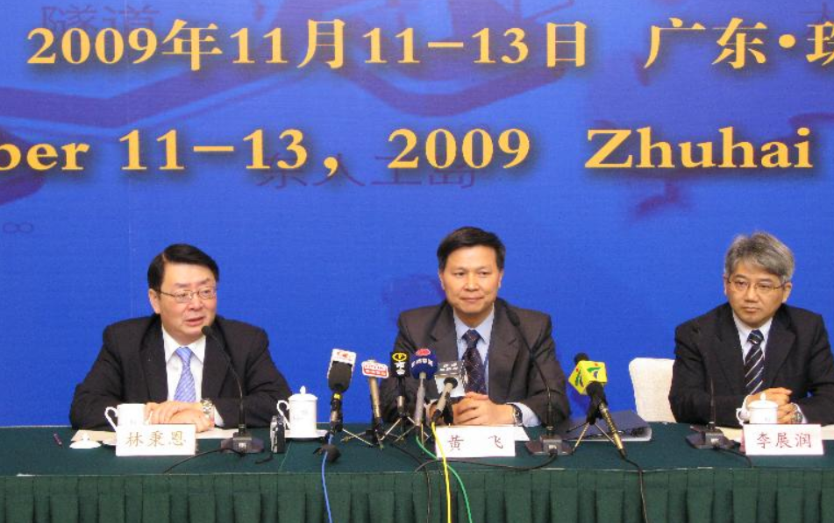
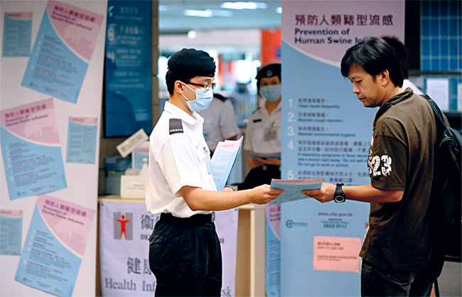
Contributions of Hong Kong to Global Public Health
C: Prevention and Control of Influenza A (H1N1) Pandemic
On 1 May 2009, the HKSAR Government confirmed that a Mexican traveller who travelled from Mexico to Hong Kong via Shanghai was infected with influenza A (H1N1) (human swine influenza (HSI)), and became the first confirmed case in Hong Kong and in Asia.
The Director of Health took prompt action, including isolation of the hotel on 1 May 2009 where the index patient had stayed, tracing of other persons who had been in close contact with the index patient, and measures taken at boundary control points.
Guangdong, Macao and Hong Kong agreed to step up co-operation and exchange in terms of prevention and control of infectious diseases, to refine the notification system, and to tackle the spread of infectious diseases among the three places. They also signed a memorandum of understanding on co-operation on HSI prevention to constitute a co-operation mechanism for prevention and control of HIS.
Hong Kong, Guangdong and Macao and Hong Kong agreed to step up co-operation and exchange in terms of prevention and control of infectious diseases, to refine the notification system, and to tackle the spread of infectious diseases among the three places.
Source:
Centre for Health Protection (https://www.chp.gov.hk/en/features/16785.html) (https://www.chp.gov.hk/en/features/19262.html)
Hong Kong Yearbook 2009 (https://www.yearbook.gov.hk/2009/photogallery/en/flu_popup_10.html)
Legislative Council Papers (https://www.legco.gov.hk/yr08-09/english/panels/hs/papers/hs0511cb2-1505-1-e.pdf)
Government Press Release (https://www.info.gov.hk/gia/general/200911/13/P200911130201.htm)
Information leaflets about the virus and preventive measures were widely distributed in several languages at traveller checkpoints.

Slide 34
Contributions of Hong Kong to Global Public Health
D. Prevention and Control of COVID-19 Epidemic
Since the outbreak of the COVID-19 epidemic, the Department of Health and the Centre for Health Protection in Hong Kong have tackled the matter according to past experience on prevention and control of infectious diseases and formulated the Preparedness and Response Plan for Novel Infectious Disease of Public Health Significance (2020). They have also adopted a series of preventive measures and the WHO’s recommendations, proactively scaled up the testing of the virus and tracing of the source of infection, enhanced health surveillance measures at boundary control points by requiring inbound travellers to have their body temperature screened, and continued to assess the epidemic situation under the assistance of various experts, in order to take actions to break the transmission chain.
Moreover, apart from the Chief Executive and other officials who made policy-related responses at media sessions, the CHP and the Hospital Authority conducted daily briefings covering the number of cases and epidemic situation. Comprehensive information in respect of the epidemic was consolidated and distributed through the website (coronavirus.gov.hk), while promotional campaigns were implemented to disseminate information on personal hygiene in various ethnic minority languages in addition to Chinese and English through online and offline media.
Source:
Government website (https://www.coronavirus.gov.hk/eng/)
Department of Health’s Preparedness and Response Plan for Novel Infectious Disease of Public Health Significance (2020) https://www.chp.gov.hk/files/pdf/govt_preparedness_and_response_plan_for_novel_infectious_disease_of_public_health_significance_eng.pdf
Chronology of Events in relation to the Outbreak of Novel Coronavirus Infection, Education Bureau (https://www.edb.gov.hk/attachment/en/curriculum-development/resource-support/learning-teaching-resource-list/COVID-19/Chronology%20of%20Events-COVID19-as%20at%205%20May%202020.pdf)

Slide 35

Contributions of Hong Kong to Global Public Health
D. Prevention and Control of COVID-19 Epidemic
The national medical team provided support and medical supplies to Hong Kong for fighting the epidemic. For example, at the request of the HKSAR Government, a Mainland medical support team of 75 people arranged by the Guangdong Province arrived at Hong Kong on 14 March 2022 to facilitate the SAR Government in the treatment of patients. Apart from six hospital experts on infection prevention and control, and four Chinese medicine practitioners, the Mainland medical support team comprised 36 doctors and 39 nurses who came from 14 Grade 3A hospitals in Guangzhou, Shenzhen, Foshan and Zhuhai, and worked in divisions that are closely related to treatment for elderly patients, including respiratory medicine, nephrology, and cardiology.
Source:
the Chinese Government’s website (http://www.gov.cn/xinwen/2022-03/14/content_5678967.htm)
Hong Kong Government Press Release (https://www.info.gov.hk/gia/general/202205/06/P2022050600651.htm?fontSize=1)
Reference
The "COVID-19 Thematic Website" (https://www.coronavirus.gov.hk/eng/index.html) serves as a one-stop platform for broadcasting the latest updates, such as figures relating to the epidemic, measures and clarifications made by bureaux and departments, public health education information on the prevention of COVID-19, as well as practical information related to inbound travellers, school arrangements, public transport, public services, etc. Click on the image for details.

Slide 36
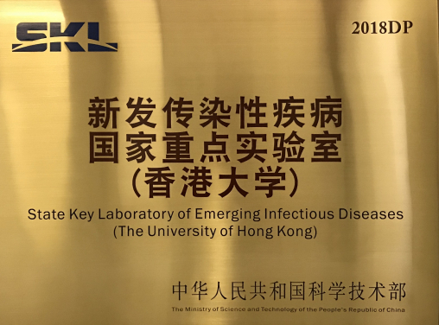
Contributions of Hong Kong to Global Public Health
Influences and Contributions of R&D
State Key Laboratory of Emerging Infectious Diseases
Established by the HKU in 2004, the State Key Laboratory of Emerging Infectious Diseases is the first state-approved key laboratory in Hong Kong with a focus on studying and monitoring emerging infectious diseases. The four major research directions of the State Key Laboratory of Emerging Infectious Diseases are: ecology and evolution of avian influenza viruses, pathogenesis of influenza and SARS viruses, emerging viral pathogens and new vaccine technology.
Source:
Office of the Commissioner of the Ministry of Foreign Affairs of the People's Republic of China in the Hong Kong Special Administrative Region (http://hk.ocmfa.gov.cn/chn/jb/zt/ndhk/200411/t20041112_6753520.htm)
HKU (https://www.hku.hk/press/press-releases/detail/22538.html)
State Key Laboratory of Emerging Infectious Diseases (The University of Hong Kong)
Reference
The State Key Laboratory (SKL) scheme is one of the major national science and technology development schemes managed by the Ministry of Science and Technology (MOST). High-quality research teams and good research equipment are prerequisites for becoming SKLs. Meanwhile, scientific research institutes approved by the MOST as Chinese National Engineering Research Centres (CNERCs) serve as major impetus in providing engineering research and consultancy support to the industries. They need to possess strong research and development (R&D) capabilities and enjoy leading positions in their areas of expertise both on the Mainland and internationally. As of 2022, there were 16 SKLs and six Hong Kong Branches of CNERCs in Hong Kong.
Source
Innovation and Technology Commission (https://www.itc.gov.hk/en/collaboration/skl_and_hkbcnercs.html)
Refer to the source for more information on SKLs in Hong Kong.

Slide 37
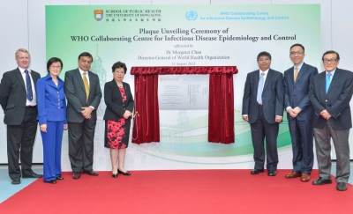
Contributions of Hong Kong to Global Public Health
Influences and Contributions of R&D
WHO Collaborating Centre for
Infectious Disease Epidemiology and Control
In collaboration with the WHO, HKU School of Public Health carries out further infection prevention and control, strengthens the capabilities of monitoring antimicrobial resistance and emergency response to unforeseen incidents of novel microbes, and strives to promote global public health and the control and prevention of infectious diseases. In 2014, HKU School of Public Health has been designated as a WHO Collaborating Centre, which is the culmination of the important partnership between HKU and the Food and Health Bureau* for the protection of the public’s health in Hong Kong and across the region.
* the Food and Health Bureau has been revamped as the Health Bureau since 1 July 2022
Plaque Unveiling Ceremony of WHO Collaborating Centre for Infectious Disease Epidemiology and Control
Source: HKU (https://sph.hku.hk/en/About-Us/School-Structure/Research-Centres-and-Units/WHO-Collaborating-Centre-for-Infectious-Disease-Epidemiology-and-Control/News-and-Events/2015/Press-Releases-2015-08-16)

Slide 38
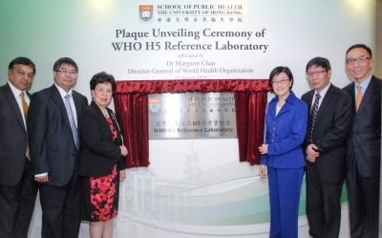
Contributions of Hong Kong to Global Public Health
Influences and Contributions of R&D
WHO H5 Reference Laboratory
The Centre of Influenza Research of the HKU is one of 13 laboratories worldwide designated as a WHO H5 (hemagglutinin-5 of influenza A viruses) reference laboratory.
The laboratory’s mandate is to provide international reference laboratory services and training on H5 and other animal influenza viruses with zoonotic or pandemic potential, and provides WHO with data and risk assessment relevant to such threats and advice on selection for relevant viruses for pre-pandemic vaccine development.
Plaque Unveiling Ceremony of WHO H5 Reference Laboratory
Source:
HKU (https://sph.hku.hk/en/About-Us/School-Structure/Research-Centres-and-Units/WHO-Collaborating-Centre-for-Infectious-Disease-Epidemiology-and-Control/News-and-Events/2015/Press-Releases-2015-08-16 )

Slide 39
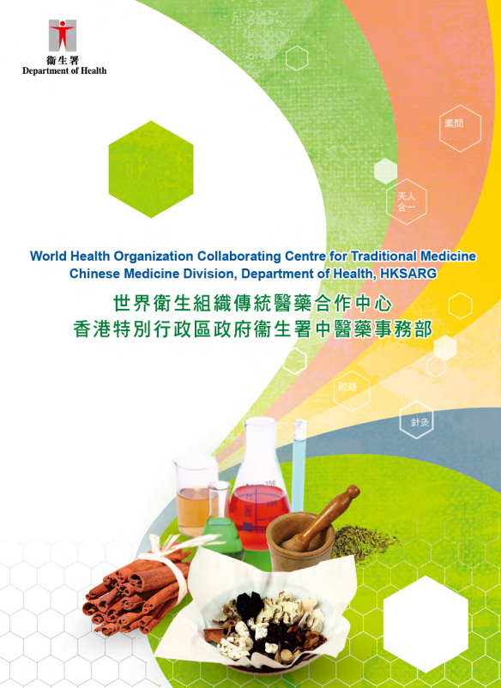
Contributions of Hong Kong to Global Public Health
Influences and Contributions of R&D
Chinese Medicine Regulatory Office*
The Chinese Medicine Regulatory Office (CMRO) of the Department of Health was designated as the WHO Collaborating Centre for Traditional Medicine (the Collaborating Centre) in 2012. Hong Kong is a pluralistic urbanised city preserving many traditions of China, making it an ideal place to develop traditional medicine. Its designation as a WHO collaborating centre manifests and signifies this characteristic of Hong Kong.
The Collaborating Centre is tasked with multiple functions, including regulation, health promotion, development of Chinese medicine standards and international liaison. Apart from safeguarding public health, it also promotes traditional Chinese medicine in both the local community and the international arena, while striving for excellence in assuming a bridging role to promote traditional medicine both regionally and internationally. The designation of the CMRO as the Collaborating Centre is certainly a recognition of Hong Kong’s hard work in this field.
Click on the image for details.
*Formerly known as “Chinese Medicine Division”, and renamed to “Chinese Medicine Regulatory Office” in September 2019.
Source: Department of Health (https://www.cmro.gov.hk/html/eng/useful_information/who_cc/index.html)

Slide 40
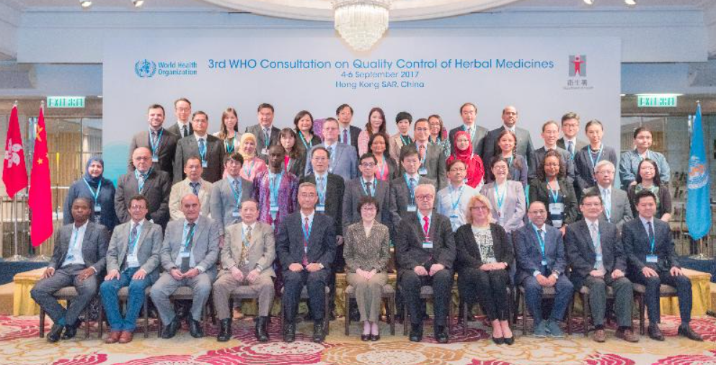
Contributions of Hong Kong to Global Public Health
Influences and Contributions of R&D
The Collaborating Centre is tasked with promoting the integration of traditional medicine into the national health system, contributing and supporting WHO’s global networking activities in traditional medicine, and supporting and nurturing professional expertise development on traditional medicine. Its terms of reference include:
At WHO's request, providing technical support to WHO on the development of WHO’s International Herbal Pharmacopoeia
Under WHO's leadership, providing technical inputs to WHO and its Member States on testing of Chinese Medicine
At WHO's request, supporting WHO in implementation of WHO Traditional Medicine Strategy 2014-2023
The crew of the Collaborating Centre comprises public health specialists, pharmacists, Chinese medicine practitioners, and experts in identification of Chinese medicines. The Collaborating Centre has maintained close networks with local and international regulators, healthcare professionals, academics, and organisations of traditional medicine, demonstrating Hong Kong’s contributions in promoting Chinese Medicine to the world.
The WHO commenced a meeting in Hong Kong to discuss and develop the WHO guidelines on quality control of herbal medicines.
Source
Department of Health (https://www.cmro.gov.hk/html/eng/useful_information/who_cc/introduction.html)
Government Press Release (https://www.info.gov.hk/gia/general/201709/04/P2017090400703.htm?fontSize=1)

Slide 41
Contributions of Hong Kong to Global Public Health
Foreign Health Assistance
Hong Kong has organised and participated in foreign health assistance, including the following:
The Hong Kong Red Cross carries out international relief and preparedness projects through its global network to provide much needed assistance to people affected by natural and man-made disasters, to enhance the capacity of vulnerable communities to cope with disasters, and to promote the global public health. For example, in response to the Ebola outbreak, Hong Kong Red Cross has mobilised a total of HK$400,000 to support International Red Cross on the anti-epidemic operation in the Democratic Republic of Congo, Rwanda, Uganda, South Sudan and Burundi.
Medecins Sans Frontieres (Hong Kong) has organised and participated in a series of projects, some of which were in response to the aftermath of major natural disasters; addressing hepatitis C, HIV, and tuberculosis; on sexual reproductive healthcare and others, with an aim of promoting global public health.
Source:
Hong Kong Red Cross (https://www.redcross.org.hk/en/disasterrelief_prepard/Africa_Ebola_Virus_Disease_Outbreak%202018.html)
Medecins Sans Frontieres (https://msf.hk/en/projects-region)

Slide 42
Conclusion
To ensure public health, the international community can play a greater role by stepping up communication, assistance, exchange and mutual support with respect to health.
The State attaches importance to protecting citizen’s health, improving people’s well-being and extensive collaboration with international institutions, such as WHO. It also proactively participates in global health management, contributing its wisdom and strengths to human health.
The State seeks active participation in global health management, explores the experience for effective health management and shares the results with other countries. Meanwhile, it continues to offer health assistance to other developing countries and supports Hong Kong in fighting against epidemic. Hong Kong has also made myriad contributions to the State and overseas counterparts on several fronts, including prevention and control of infectious diseases, sharing of professional medical research and nurturing public health talents.

Slide 43
User Guide
The primary users of this resource are teachers. It aims to provide teachers with content knowledge relevant to the topic to enable teachers to have a deeper understanding of teaching content when preparing for their lessons.
All data, videos, photos, pictures, questions and suggested answers can be used for multiple purposes, such as teachers’ teaching materials, references for curriculum planning and learning and teaching, and student assignments, etc. To align with Citizenship and Social Development Curriculum and Assessment Guide (Secondary 4-6) (2021) (C&A Guide), this resource should be adapted to cater for students’ learning diversity and the needs of classroom teaching, etc.
Teachers may provide appropriate supplementary notes/ explanations to enrich this resource in order to enhance students’ understanding of the topic and information provided.
In accordance with the curriculum rationale and aims, teachers may select other learning and teaching resources which are correct, reliable, objective and impartial to help students build up a solid knowledge base, develop positive values and attitudes as well as enhance critical thinking and problem solving skills, and various generic skills.
If some information cannot be provided in this resource due to copyright issue, teachers may visit relevant websites provided.
Some information may have been updated when being used by teachers, teachers may visit the corresponding websites to obtain the up-to-date information.
Please also refer to the C&A Guide to understand the requirements and arrangements of the learning and teaching of the curriculum. Teachers are welcome to point out the areas need improvement, and welcome to provide updated information to enrich the content for all teachers’ reference.

Slide 44
Notice and Disclaimer
Some sources were not translated into English as the official English version is not available.
In case of any discrepancy between the Chinese and English versions, the Chinese version shall prevail.

