Slide 1
Citizenship and Social Development
Theme 3 Interconnectedness and Interdependence of the Contemporary World
Topic: Public health and human health
Learning focus:
Functions and Roles of the World Health Organization in Global Public Health Matters
April 2023
(Translated version)

Slide 2
Learning Objectives
Knowledge
To understand public health, as well as the functions and roles of the World Health Organization in promoting and implementing global public health matters
Skills
To be able to generalise and summarise the roles and functions of the World Health Organization in addressing global public health problems, based on the analysis of data, facts and evidence
To identify channels for disseminating accurate health information to address health-related issues in life, and to develop the ability of critical thinking and lifelong learning
Values
To value professional medical advice and to develop an awareness of prevention is better than cure and personal hygiene
To care about personal, social and global public health, to have an international perspective and to be willing to contribute to the protection of public health

Slide 3
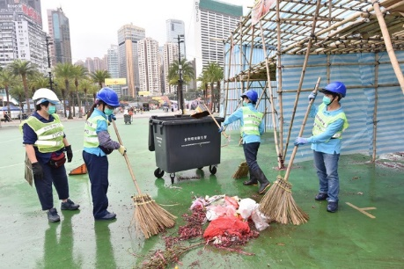
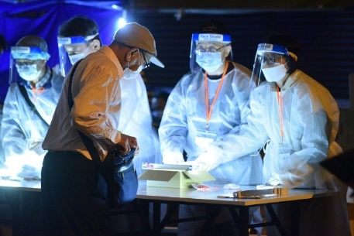
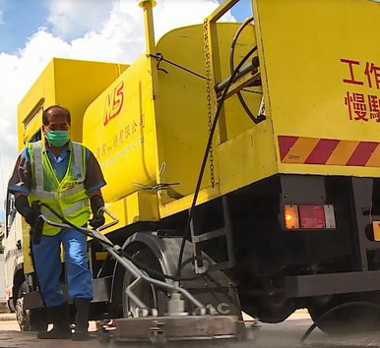
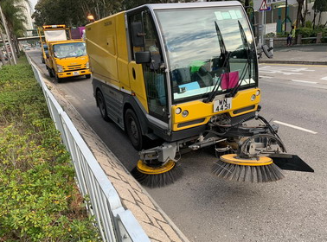
Think about it
Public Health
What is public health?
Maintaining environmental hygiene, where everyone concerns about cleanliness
Provision of medical services by government departments
Health education and prevention of disease
Control of infectious diseases
Including all of the above
Not limited to the above
Workers of the Food and Environmental Hygiene Department (FEHD) start cleaning up the venue after the LNY Fair ended in the Victoria Park
Government staff taking registration of people in restricted areas for COVID-19 tests during the epidemic
Answer: F
Public health involves a wide range of areas and requires the co-operation of international organisations, countries, communities and individuals. In addition, maintaining personal hygiene is important in promoting public health.
FEHD workers cleaning the streets
Photo credit: Hong Kong Government Press Releases
https://www.news.gov.hk/web/common/pictureStory/chi/2020/01/20200125/pstory_20200125_224922_150/20200125232517016.jpg
https://www.news.gov.hk/web/common/photoGalleryEvent/chi/2021/01/20210127/event_20210127_142028_964/20210208163104046.jpg
https://www.fehd.gov.hk/tc_chi/events/keep_clean2020-2021/enhance_cleansing.html (Chinese only)

Slide 4

Public Health
What is public health?
According to the World Health Organization (WHO), public health is an organized activity of society to promote, protect, improve, and – when necessary – restore the health of individuals, specified groups, or the entire population. It is a combination of sciences, skills and values that function through collective societal activities and involve programmes, services and institutions aimed at protecting and improving the health of all people. WHO emphasises the right of people to live healthy lives, to be healthy and to live long.
Therefore, public health covers a wide range of areas, such as improving environmental hygiene, preventing disease, prolonging life expectancy, controlling infectious diseases, providing and improving health infrastructures, training and organising health care professionals to provide early diagnosis and preventive treatment, working to reduce health care costs, reducing the burden on public health care facilities, implementing education and research programmes, and developing and implementing relevant health care policies (providing medical support and subsidies).
Reference source: WTO, Health Promotion Glossary of Terms 2021 (https://www.who.int/publications/i/item/9789240038349)

Slide 5
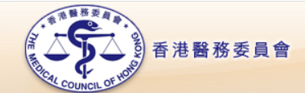
Public Health System
The public health system is a collective term for the laws, regulations, policies, institutions and specific measures involved in the maintenance and promotion of public health and hygiene, including disease prevention and control, health surveillance, and the medical response system for public health emergencies. It is the collective body of public, private and voluntary organisations providing essential public health services within the limits of the law.
To know more: For example, any person wishing to practise medicine, surgery or midwifery in Hong Kong is required to apply for registration with the Medical Council in accordance with the provisions of the Medical Registration Ordinance.
Source: The Medical Council of Hong Kong (https://www.mchk.org.hk/english/registration/registration_requirement.html)

Slide 6

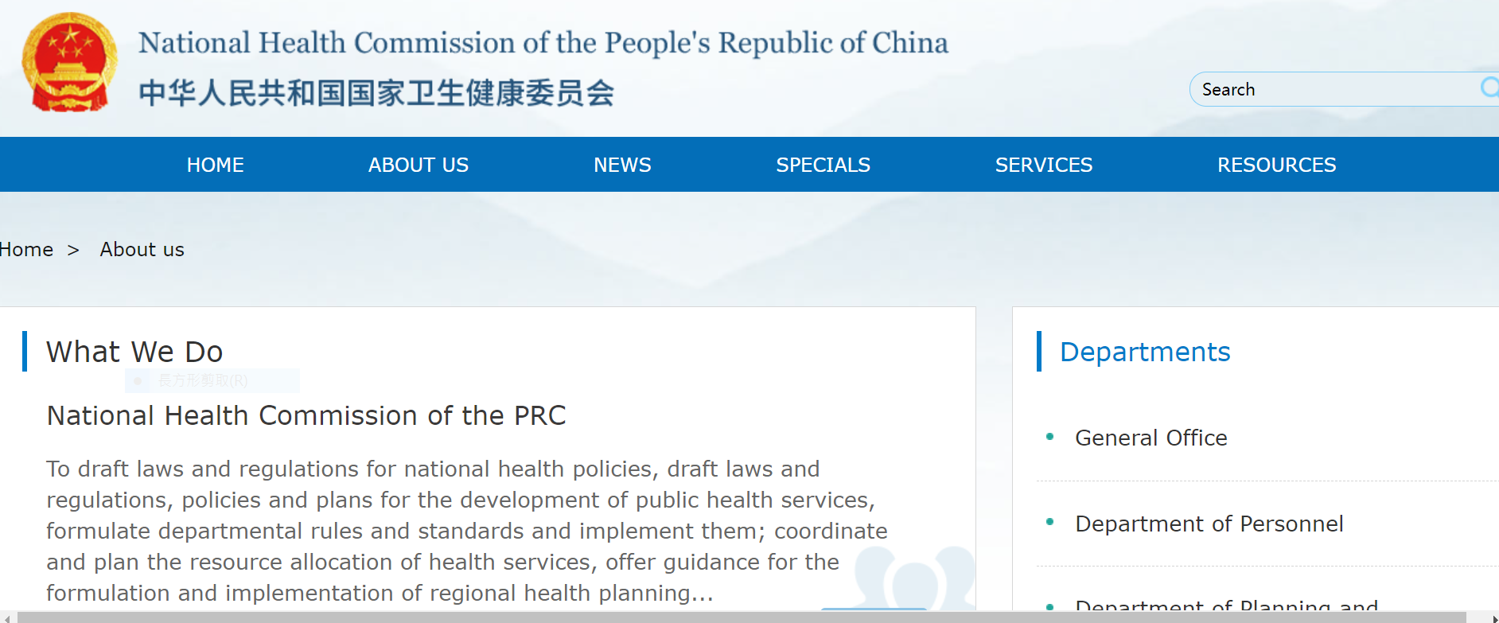
Reference
Public Health System
Public health authorities of our country
The National Health Commission (NHC) is a department of the State Council. Its main responsibilities include drafting laws and regulations for national health policies, co-ordinating and deepening the reform of medical and health system, making and implementing the plans of disease prevention and control, and organising and co-ordinating the formulation and implementation of policies and measures to cope with the ageing population problem.
Under the NHC, there are various agencies responsible for the prevention and control of various diseases, disabilities and unintentional injuries; promoting the health of the people, such as the National Bureau of Disease Prevention and Control, and the Chinese Center for Disease Control and Prevention.
Local health commissions are also set up to guide local health work, supervising and manage local medical institutions, among others.
For more information on the functions of the NHC, please refer to:
http://en.nhc.gov.cn/2018-09/22/c_74499.htm
Sources:
Chinese Government Website (http://www.gov.cn/fuwu/bm/wsjkw/index.htm, Chinese only)
National Health Commission
http://en.nhc.gov.cn/
http://www.nhc.gov.cn/wjw/dfzfwz/list.shtml (Chinese only)

Slide 7
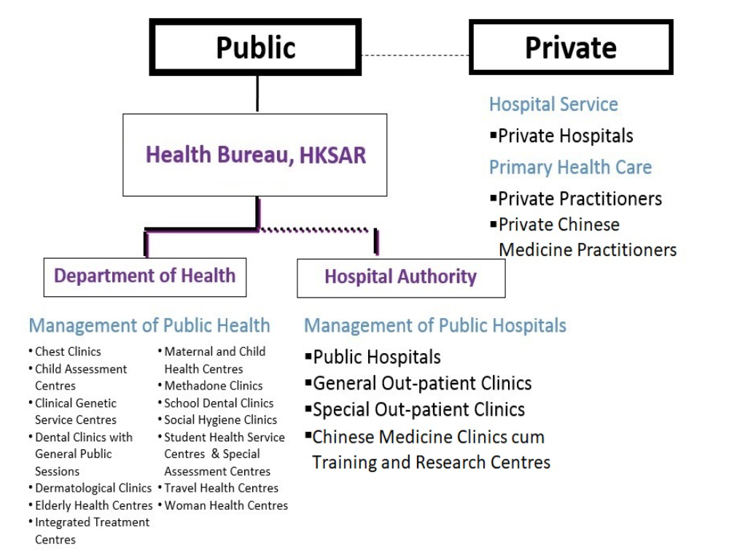

Public Health System
Reference
Public health system of HKSAR
It is responsible for forming policies and allocating resources for the running of health services
To provide lifelong holistic health care to every citizen, and ensure that no one is denied adequate medical treatment due to lack of means
It is the Government’s health adviser and agency to execute healthcare policies and statutory functions
To safeguard the community’s health through a range of promotional, preventive, curative and rehabilitative services.
To provide subsidised healthcare services through its centres and health clinics to citizens of Hong Kong
It is a statutory body providing public hospitals and related services to the citizens of Hong Kong
To offer medical treatment and rehabilitation services to patients through hospitals, day hospitals, specialist clinics, general out-patient clinics, Chinese Medicine service and community outreach services that are organised into seven clusters.
Source: GovHK, https://www.gov.hk/en/residents/health/hosp/overview.htm

Slide 8
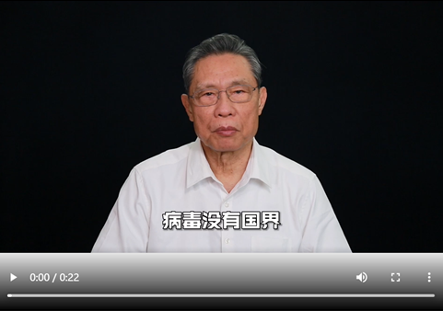



Introduction
Watch the video to learn the insights that “viruses know no borders” has offered to the promotion of global public health.
Faced with the challenge of COVID-19, WHO makes a call for world solidarity,
“A global pandemic requires no less than a world effort to end it. None of us will be safe until everyone is safe. Global access to coronavirus vaccines, tests and treatments for everyone who needs them, anywhere, is the only way out.”
Viruses know no borders and they don't care your ethnicity. In the face of a common crisis for all humanity, no country can remain insulated. The international community, organisations, individuals and others need to work together.
Click on the image to hear what Professor Zhong Nanshan* says in the video
*Professor Zhong Nanshan is an Academician of Chinese Academy of Engineering and a renowned expert in respiratory diseases. He is dedicated to the research in the, prevention and treatment of major respiratory infectious diseases and chronic respiratory diseases and has made many contributions. He has received many honours, including the Outstanding Academic Contribution Award for Respiratory Diseases by the Chinese Medical Association (2004), Reform Pioneer (An Important Promotor of the Construction of China's Public Health Event Emergency System, 2018), and the Medal of the Republic (2020).
Sources:
World Health Organization (https://www.who.int/news-room/commentaries/detail/a-global-pandemic-requires-a-world-effort-to-end-it-none-of-us-will-be-safe-until-everyone-is-safe)
People's Daily Online (http://it.people.com.cn/n1/2020/1123/c1009-31941449.html, Chinese only)
State Key Laboratory of Respiratory Disease (http://www.sklrd.cn/show.php?id=678, Chinese only)

Slide 9

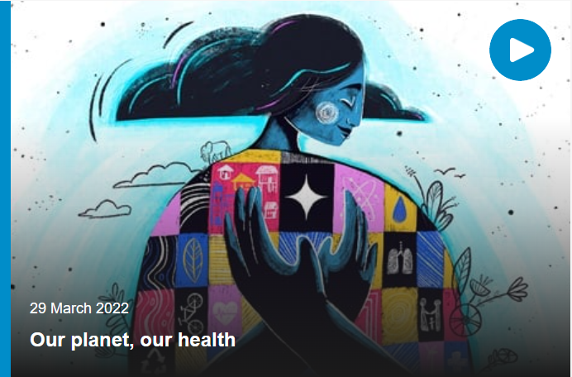
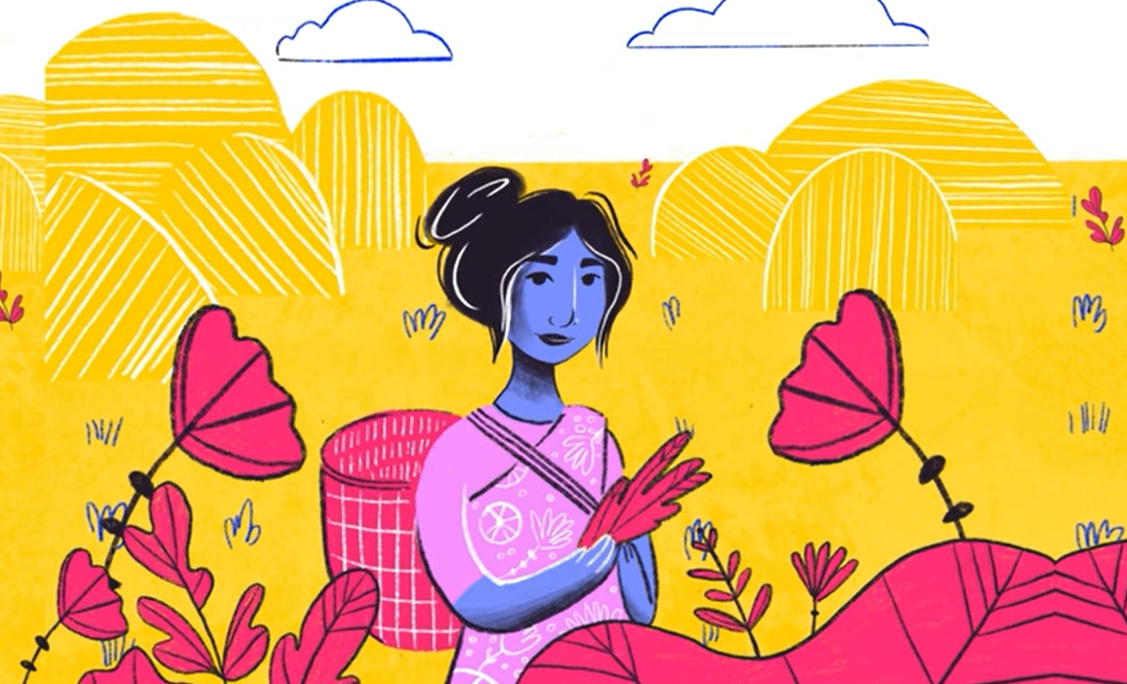
Learning about WHO
Watch the video and answer the following questions.
Which organisation mark the World Health Day?
What was the theme of World Health Day 2022 and what was it about?
Source: WHO
https://www.who.int/campaigns/world-health-day/2022
The World Health Organization (WHO) marked 7 April each year as the World Health Day.
The theme of the World Health Day 2022 was "Our planet, our health". In the midst of a pandemic, a polluted planet, increasing diseases like cancer, asthma, heart disease, the World Health Day drew global attention on keeping humans and the planet healthy and fostering a movement to create societies focused on well-being.
Source: WHO (https://www.who.int/campaigns/world-health-day/2022#)

Slide 10
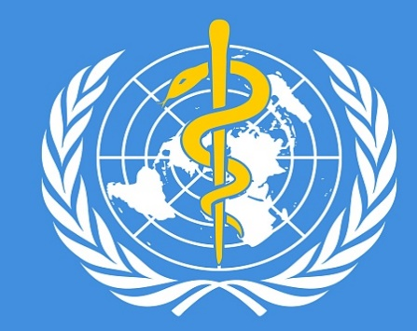
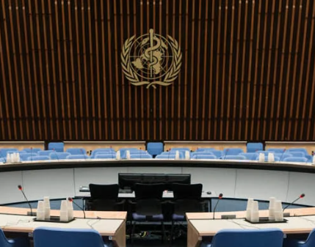
Learning about WHO
Overview of WHO
Established on 7 April 1948, WHO is the directing and co-ordinating authority on international health within the United Nations system. Headquartered in Geneva, Switzerland, WHO consists of 6 regional offices, 150 country offices and other offices around the world. It currently has more than 8,000 staff and 194 Member States.
WHO gets its funding mainly from assessed contributions and voluntary contributions. Assessed contributions are countries’ membership dues paid by Member States. Voluntary contributions are largely from Member States as well as from other United Nations organizations, intergovernmental organizations, philanthropic foundations, the private sector, and other sources.
Logo of WHO
Click on the image to read about the WHO Constitution
The Constitution of the World Health Organization (the Constitution) was adopted by the International Health Conference in 1946 and entered into force in 1948. The preamble to the Constitution sets out the principles upheld by WHO.
Click on the image to learn about WHO Member States
Sources: WHO
https://www.who.int/about/governance/constitution
https://www.who.int/countries/
https://www.who.int/about/funding

Slide 11
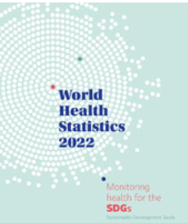
Learning about WHO
Objectives
Click on the image
to read the report.
WHO is the directing and co-ordinating authority on international health matters, with the vision of realising "a world in which all peoples attain the highest possible level of health". WHO works worldwide to promote health, keep the world safe, and serve the vulnerable. It co-ordinates the world’s response to health emergencies, promotes well-being, prevents disease and expands access to health care. Its goal is to ensure that a billion more people have universal health coverage, to protect a billion more people from health emergencies, and provide a further billion people with better health and well-being. WHO also works closely with other UN agencies and organisations, government agencies, NGOs and research centres around the world.
Directing international health matters
Having the highest authority and wide influence
The largest intergovernmental
health body in the world
The World Health Statistics report is WHO's annual overview of the state of health in the world. It is a main reference in that regard. WHO provides the annual report to countries/regions for reference.
Source: WHO (https://www.who.int/about/who-we-are)

Slide 12





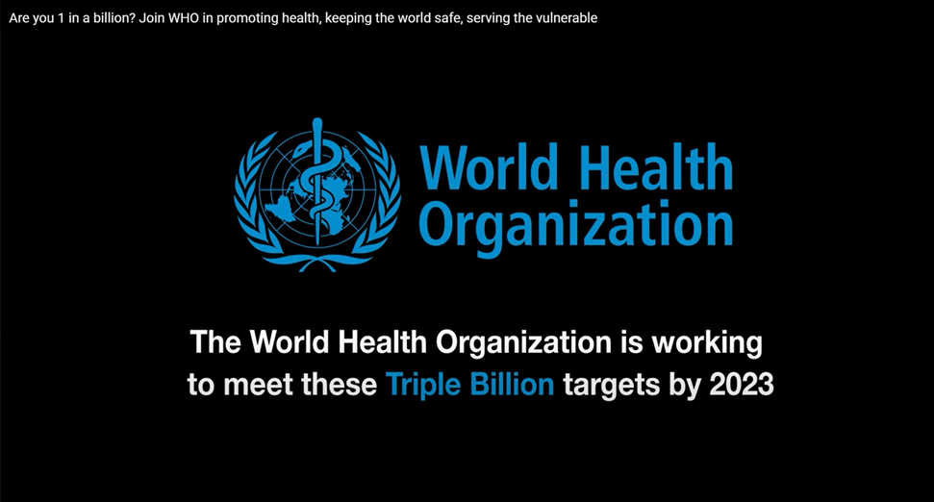
Learning about WHO
Values that WHO cherishes
Trusted to serve public health at all times
Professionals committed to excellence in health
Persons of integrity
Collaborative colleagues and partners
People caring about people
These values are inspired by the vision of a world in which all peoples attain the highest possible level of health, and the mission to promote health, keep the world safe and serve the vulnerable, with measurable impact for people at country level.
Watch the video and talk about your understanding of WHO's specific functions and WHO's influence on personal health.
Source of video: WHO (https://www.who.int/about/what-we-do)
Source: WHO
(https://www.who.int/about/who-we-are/our-values)

Slide 13
Learning about WHO
Constitution of WHO
With related principles set out in the preamble, the Constitution is an important document for understanding the values promoted by WHO as well as its roles and functions, including:
Health is a state of complete physical, mental and social well-being and not merely the absence of disease or infirmity.
The enjoyment of the highest attainable standard of health is one of the fundamental rights of every human being without distinction of race, religion, political belief, economic or social condition.
The health of all peoples is fundamental to the attainment of peace and security and is dependent on the fullest co-operation of individuals and States.
The achievement of any State in the promotion and protection of health is of value to all.
Unequal development in different countries in the promotion of health and control of diseases, especially communicable disease, is a common danger.
Healthy development of the child is of basic importance; the ability to live harmoniously in a changing total environment is essential to such development.
Continued on next page

Slide 14
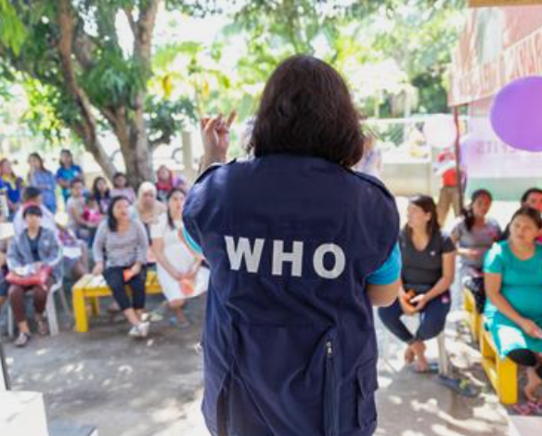
Learning about WHO
Continued from previous page
Constitution of WHO
The extension to all peoples of the benefits of medical, psychological and related knowledge is essential to the fullest attainment of health.
Informed opinion and active co-operation on the part of the public are of the utmost importance in the improvement of the health of the people.
Governments have a responsibility for the health of their peoples which can be fulfilled only by the provision of adequate health and social measures.
Mental Well-being
According to the first paragraph of the preamble of the WHO Constitution, "Health is a state of complete physical, mental and social well-being and not merely the absence of disease or infirmity." It emphasises the importance of mental health to people's well-being.
WHO works with Member States and partners to advance the mental well-being of the public, including advancing mental health, preventing mental illness, and promoting mental health activities and programmes for all, so as to provide high quality and affordable care for mental health patients.
For more information on WHO's work on mental well-being, please refer to the source webpage.
Source: WHO (https://www.who.int/about/governance/constitution)

Slide 15
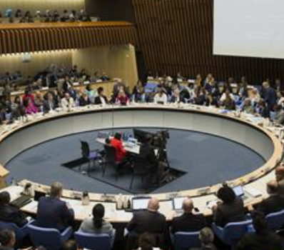
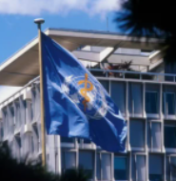
Reference
Learning about WHO
Organisational Structure of WHO
World Health Assembly: The decision-making body of WHO. It is attended by delegations from all WHO Member States. Its main functions are to determine the policies of WHO, appoint the Director-General, supervise financial policies, and review and approve the proposed programme budget. The Assembly is held annually in Geneva, Switzerland.
Executive Board: Composed of members technically qualified in the field of health. Its main functions are to implement the decisions and policies of the Health Assembly, to advise it and generally to facilitate its work.
Director-General: WHO's chief technical and administrative officer and oversees the policy for the Organization's international health work.
WHO has six regional offices in Africa, the Americas, Europe, the Eastern Mediterranean, South-East Asia and the Western Pacific, as well as representative offices in over 150 countries.
For the biographies of WHO's current and former Directors-Generals, please refer to the relevant source webpages.
Sources: WHO
https://www.who.int/about/governance
https://www.who.int/director-general/biography
https://www.who.int/director-general/former-directors-general

Slide 16
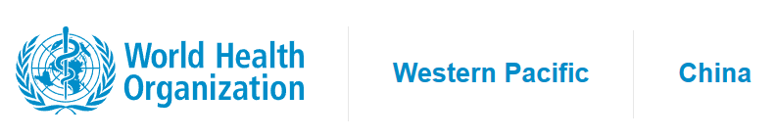
Learning about WHO
Reference
Organisational structure - Country offices
Depending on individual country’s situation, the country offices work closely with partners, engage in policy dialogue, and provide technical assistance, and support.
For example, China is in the WHO Western Pacific Region, which has more than 600 WHO staff, located in 15 country offices and the Regional Office in Manila, Philippines. The WHO China Representative Office is the official representation of the World Health Organization in China, working with the People's Republic of China in achieving good health for China’s citizens.
Source: WHO - World Health Organization Representative Office in China
https://www.who.int/china/about-us

Slide 17
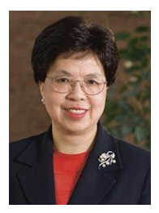
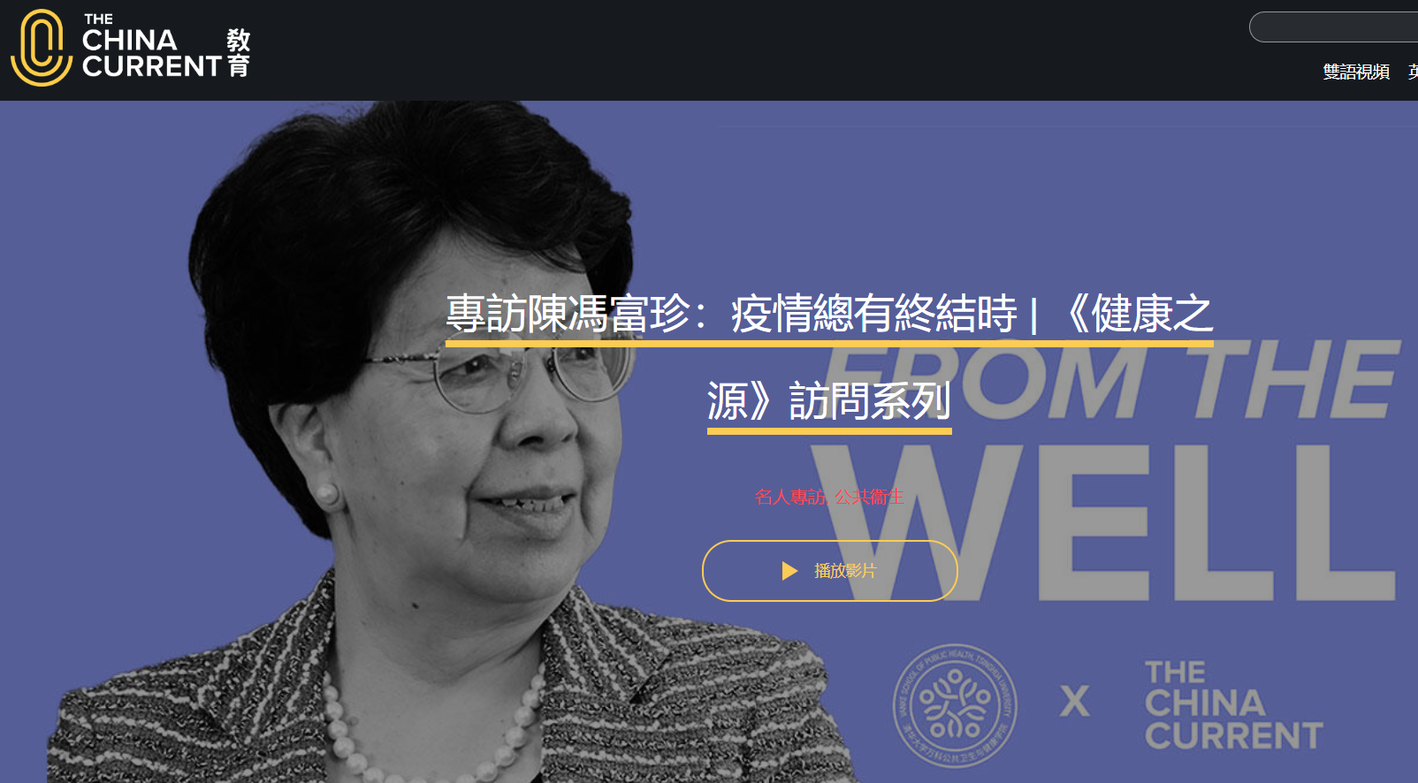


Reference
Learning about WHO
Biography of Dr Margaret Chan,
former Director-General of WHO
Dr Margaret Chan joined the Hong Kong Department of Health in 1978 and was appointed Director of Health in 1994. During her tenure, she launched new services to prevent the spread of disease and promote better health. She also introduced new initiatives to improve communicable disease surveillance and response, enhance training for public health professionals, and establish better local and international collaboration. She effectively managed outbreaks of avian influenza and of severe acute respiratory syndrome (SARS).
In 2003, she joined WHO as Director of the Department for Protection of the Human Environment. In June 2005, she was appointed Director, Communicable Diseases Surveillance and Response as well as Representative of the Director-General for Pandemic Influenza. In September 2005, she was named Assistant Director-General for Communicable Diseases.
Dr Chan was elected to the post of Director-General on 9 November 2006, being the first Chinese national to lead the Organization. She was re-elected in May 2012 and served until 30 June 2017.
Since April 2020, she has been serving as the Founding Dean of Vanke School of Public Health, Tsinghua University.
Sources:
WHO (https://www.who.int/director-general/former-directors-general)
People's Daily Online (http://hm.people.com.cn/n1/2019/0916/c42272-31355706.html, Chinese only)
The China Current (https://chinacurrent.com/education/article/2021/09/22587.html)

Slide 18
Roles and Functions of WHO in Global Public Health Matters
Read the following source and learn about WHO's work in global infectious disease control.
On 8 May 1980, the 33rd World Health Assembly officially declared, "The world and all its peoples have won freedom from smallpox". The declaration marked the end of a disease that had plagued humanity for at least 3,000 years, killing 300 million people in the 20th century alone. It was ended, thanks to a 10-year global effort, spearheaded by the World Health Organization, that involved thousands of health workers around the world to administer half a billion vaccinations to stamp out smallpox. The US$ 300m price-tag to eradicate smallpox saves the world well over US$ 1 billion every year since 1980.
Source: WHO (https://www.who.int/news/item/08-05-2020-commemorating-smallpox-eradication-a-legacy-of-hope-for-covid-19-and-other-diseases)

Slide 19


Roles and Functions of WHO in Global Public Health Matters
The source above describes WHO's major work in global infectious disease control.
The control of infectious diseases is only one of the main areas of work of WHO, which promotes global public health at different levels and scales. In terms of global infectious disease control, WHO plays a leading role in facilitating international co-operation and promoting the development and application of vaccines. For example, WHO launched and implemented the smallpox eradication campaign. Apart from facilitating equitable vaccine distribution around the world, it promoted vaccines and strengthened smallpox surveillance and control.
For an overview of WHO's achievements in global public health, refer to:
Source: United Nations (https://www.un.org/en/global-issues/health)

Slide 20
Roles and Functions of WHO in Global Public Health Matters
WHO's functions fall into six main categories:
Leading and co-ordinating international health affairs, managing and controlling the international spread of disease, helping Member States to prevent and treat disease, and monitoring Member states' implementation of Conventions.
Providing leadership
Fundamental functions
Facilitating research
Bringing together the world's health experts to produce international reference materials and to make recommendations, and facilitating research, development, sharing and dissemination of relevant information and knowledge.
Setting norms
Developing international standards, regulations, conventions, etc. for reference and adoption by Member States.
Promoting awareness
Promoting public awareness of public health issues.
Providing support
Providing technical support to Member States to facilitate change and helping them strengthen their capacity to manage risks in emergencies.
Monitoring trends
Collecting and analysing data for monitoring and assessing trends and risks, in order to prevent and respond to public health crises.
Sources: WHO
https://www.who.int/about/what-we-do/who-brochure
https://www.who.int/about/what-we-do

Slide 21
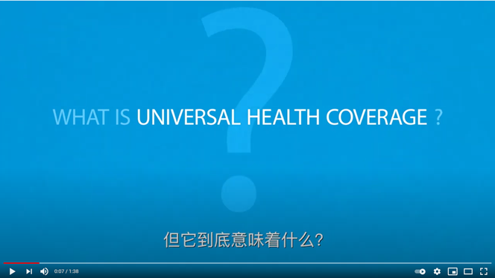
Roles and Functions of WHO in Global Public Health Matters
Promoting UHC - Leadership, awareness, support
The United Nations promotes Universal Health Coverage (UHC), which means that all people have access to the full range of quality health services they need, when and where they need them. It covers the full continuum of essential health services, from health promotion to prevention, treatment, rehabilitation, and palliative care. The goal is to achieve universal health coverage by 2030.
WHO provides technical assistance, policy development and strategies to improve the effectiveness in accordance with each country's situation and needs. In addition to assisting countries in developing their own health systems and monitoring progress, WHO also works with many different partners in different situations and for different purposes to advance UHC around the world.
Achieving UHC is one of the targets the nations of the world set when they adopted the Sustainable Development Goals (SDGs) in 2015. Countries reaffirmed this commitment at the United Nations General Assembly High Level Meeting on UHC in 2019.
Watch the video to learn about universal health coverage.
https://www.youtube.com/watch?v=pZHiIGFLN8Y
Sources: WHO
https://www.who.int/news-room/fact-sheets/detail/universal-health-coverage-(uhc)
https://www.un.org/en/observances/universal-health-coverage-day
https://www.youtube.com/watch?v=pZHiIGFLN8Y

Slide 22
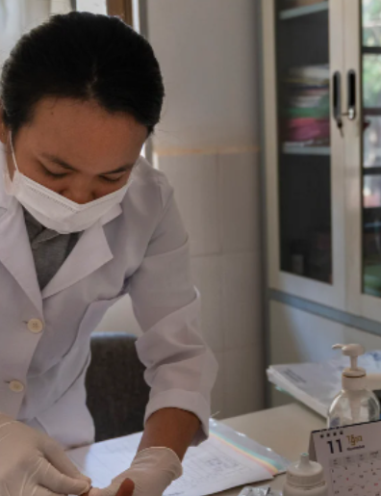

Roles and Functions of WHO in Global Public Health Matters
Promoting UHC - Norms, research and trends
International indicators
WHO provides standardised indexes which are internationally recognised, in order to assess and follow up on the progress towards UHC.
- Proportion of a population that can access essential quality health services (the higher the better)
- Proportion of the population that spends a large amount of household income on health (the lower the better)
WHO and the World Bank have jointly developed a monitoring framework to track progress, using four categories of essential health services as indicators of the extent and equity of UHC in a country:
- Reproductive, maternal, newborn and child health
- Infectious diseases
- Non-communicable diseases
- Service capacity and access
Click to view the global data assessment of UHC
Sources: WHO
https://www.who.int/news-room/fact-sheets/detail/universal-health-coverage-(uhc)
https://www.who.int/data/gho/data/major-themes/universal-health-coverage-major

Slide 23

Roles and Functions of WHO in Global Public Health Matters
Collecting, analysing and sharing data and information
WHO is a provider, guardian and sharer of global health information, monitoring community, regional and global health status and trends and compiling information on disease and health. Reliable and up-to-date health information is important to public health decision-making, resource allocation, monitoring and evaluation, and it contributes to good health and hygiene planning policies in countries. WHO has therefore developed a data-based surveillance system and, through the analysis of such data, has made available quality knowledge resources to share with countries and help them set long-term health goals and strategies.
Examples of WHO's use of data to set long-term global health goals can be found on the following page and the webpages below: https://www.who.int/data
Sources: WHO
https://www.who.int/about/what-we-do/who-brochure
https://www.who.int/data

Slide 24
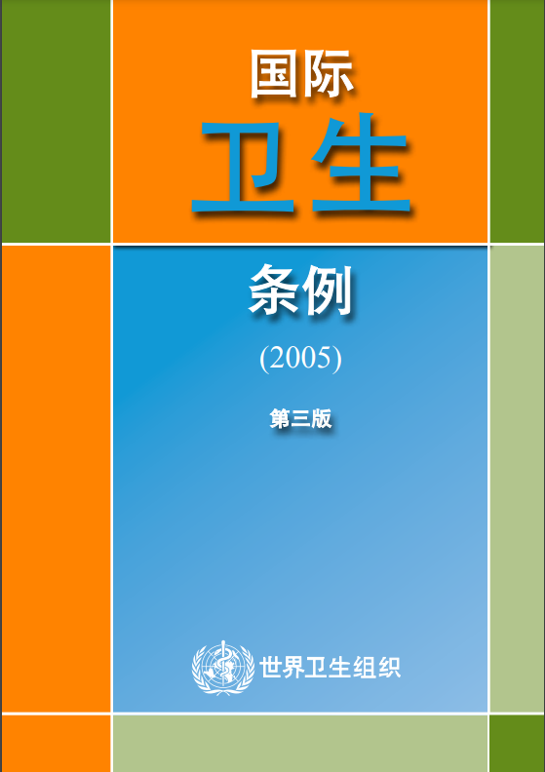
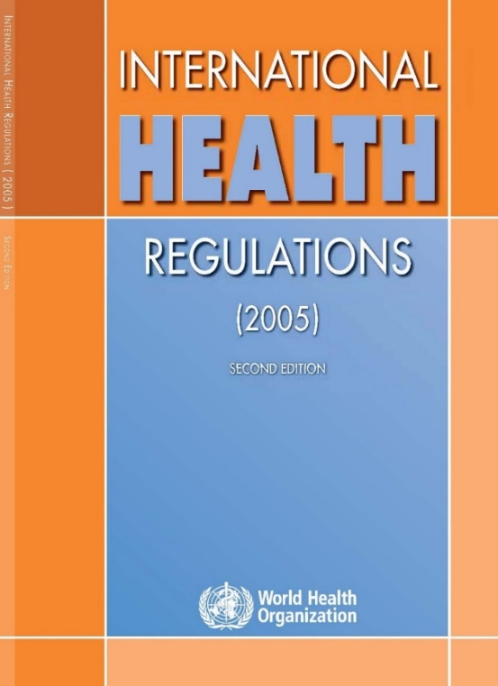
Roles and Functions of WHO in Global Public Health Matters
Setting global health standards
The International Health Regulations (2005)
The International Health Regulations (IHR) were adopted by the World Health Assembly on 23 May 2005 and came into force on 15 June 2007.
The purpose and scope of the IHR are “to prevent, protect against, control and provide a public health response to the international spread of disease in ways that are commensurate with and restricted to public health risks, and which avoid unnecessary interference with international traffic and trade”, thereby enhancing global public health security.
Sources: WHO
https://apps.who.int/iris/bitstream/handle/10665/246107/9789241580496-eng.pdf
https://www.who.int/health-topics/international-health-regulations#tab=tab_1

Slide 25
Roles and Functions of WHO in Global Public Health Matters
Setting global health standards - International Health Regulations (2005)
Highlights of the IHR
The IHR defined "public health emergency of international concern" as an extraordinary event which is determined:
- to constitute a public health risk to other States through the international spread of disease; and
- to potentially require a co-ordinated international response.
Each State Party shall notify WHO, by the most efficient means of communication available, and within 24 hours of assessment of public health information, of all events which may constitute a public health emergency of international concern within its territory, as well as any health measure implemented in response to those events.
Sources: WHO
https://apps.who.int/iris/bitstream/handle/10665/246107/9789241580496-eng.pdf
https://www.who.int/health-topics/international-health-regulations#tab=tab_1

Slide 26
Roles and Functions of WHO in Global Public Health Matters
Setting global health standards - “International Health Regulations (2005)” (IHR 2005)
Highlights of the IHR
The IHR also set out the core capacity requirements for surveillance and response regarding public health emergencies. States Parties shall utilize existing national structures and resources to meet their core capacity requirements under these Regulations, including with regard to:
1. their surveillance, reporting, notification, verification, response and collaboration activities; and
2. their activities concerning designated airports, ports and ground crossings.
The Regulations specify the core capacity requirements for airports, ports and ground crossings in accordance with international regulations, in terms of the capacities to provide prompt assessment and care, provide access to equipment and personnel, and to provide appropriate public health emergency response.
For details of the core capacity requirements for ports, please refer to Annex I of the IHR, "CORE CAPACITY REQUIREMENTS FOR SURVEILLANCE AND RESPONSE".
Sources: WHO
https://apps.who.int/iris/bitstream/handle/10665/246107/9789241580496-eng.pdf
https://www.who.int/health-topics/international-health-regulations#tab=tab_1

Slide 27

Reference
Roles and Functions of WHO in Global Public Health Matters
Examples of State policies to complement and implement the IHR (2005)
The State government decides that the IHR applies to the entire territory of the People's Republic of China, including the Hong Kong Special Administrative Region, the Macao Special Administrative Region and the Taiwan Province. It has incorporated the development, enhancement and maintenance of the core capability-building for rapid and effective response to public health emergencies into its program of establishing a national health emergency response system during the 11th Five-year Plan for National Economic and Social Development.
It has formulated the technical standards for the surveillance, reporting, assessment, determination and notification of public health emergencies of international concern. It has established an inter-agency information-sharing and co-ordination mechanism for implementing the IHR.
The State government officially launched amendments to the “Frontier Health and Quarantine Law” in 2009. In line with the Law, as well as the IHR (2005) on core capacity requirements for points of entry, the General Administration of Customs of China (GACC) put forward the principles of “政府主導、企業主責、海關主管、部門聯動 ", establishing a dynamic management mechanism for the core capacities for ports.
For details of the Frontier Health and Quarantine Law of the People's Republic of China (2018),
please read: http://www.customs.gov.cn/customs/302249/302266/302267/2369512/index.html
Reference:
China Government Website (http://www.gov.cn/jrzg/2007-05/14/content_614312.htm, Chinese only)
National Public Service Platform for Standards Information (http://std.samr.gov.cn/gb/search/gbDetailed?id=9A5A3FE83F5AAEA5E05397BE0A0ABA5B, Chinese only)

Slide 28

Roles and Functions of WHO in Global Public Health Matters
Reference
Examples of State policies to complement and implement the IHR (2005)
In 2016, the Central Committee of the Communist Party of China (CPC) and the State Council issued the “Outline of the Healthy China 2030 Plan” ("the Outline"), which sets out the specific objectives of establishing a more comprehensive national wide emergency medical network by 2030, with the country’s capabilities in emergency health response and emergency medical aid reaching the level of developed countries.
The Outline stipulates that all regions and departments should incorporate the construction of a healthy China into their important agenda, improving the leadership system and the working mechanism. The construction of a healthy China should be included into economic and social development plans, and main health indicators will be included in the performance appraisal of CPC committees and governments at all levels. Efforts should also be made to improve the performance appraisal mechanism and accountability system, with relevant tasks to be duly implemented.
Source: China Government Website (http://www.nhc.gov.cn/xcs/s7847/201907/704b1ca3555e47c6a677e384a462bd7c.shtml, bilingual)

Slide 29
Roles and Functions of WHO in Global Public Health Matters
Reference
Examples of State policies to complement and implement the IHR (2005)
In the 14th Five-Year Plan, the State government re-emphasises the need to build a robust public health system, with the following highlights:
Health care reform aims to improve disease prevention and control and strengthen, in particular, a system for health monitoring and early warning, risk assessment, epidemiological investigation, inspection and detection, and emergency response.
To strengthen the public health emergency monitoring, early warning, and response mechanisms, including measures to build a robust laboratory testing network, and improve patient care, technological support, and logistics support.
A tired, multi-level and referral-based infectious disease, treatment network will be built, so will a unified national system of reserves of essential supplies for public health emergencies. Modifications to large public buildings are underway to better accommodate the needs for epidemic control. Infectious disease screening at ports of entry has been stepped up.
Reference: https://www.fujian.gov.cn/english/news/202108/t20210809_5665713.htm)

Slide 30


Roles and Functions of WHO in Global Public Health Matters
Reference
Examples of Hong Kong's policies to complement and implement the IHR (2005)
The IHR (2005) came into effect on 15 June 2007. They are international legal instrument that is binding on all WHO Member States, including the People’s Republic of China, which extends to cover Hong Kong.
To bring the local legal provisions in line with the requirements of the IHR (2005) and to update the local legal framework for the prevention and control of disease, the Prevention and Control of Disease Ordinance (Cap. 599 has entered into force in July 2008 in Hong Kong. The Cap. 599 is an Ordinance to provide for the control and prevention of disease among human beings; to prevent the introduction into, the spread in and the transmission from, Hong Kong of any disease, source of disease or contamination; and to apply relevant measures of the IHR promulgated by the WHO.
Sources:
Hong Kong Government Press Release (https://www.info.gov.hk/gia/general/200712/19/P200712190173.htm, Chinese only)
Department of Health (https://www.dh.gov.hk/english/useful/useful_Regulations/useful_Regulations.html)

Slide 31


Roles and Functions of WHO in Global Public Health Matters
Reference
Examples of Hong Kong's policies to complement and implement the IHR (2005)
The Centre for Health Protection (CHP) of the Department of Health (DH) is responsible for the prevention and control of infectious diseases and other public health hazards.
In formulating strategies for responding to public health emergencies and their prevention and control measures, CHP adopts six principles to reduce the risk of infectious diseases to public health, including (a) reducing the risk of human infection; (b) early detection; (c) prompt response; (d) emergency preparedness; (e) risk communication; and (f) facilitating collaboration with Mainland and international health authorities.
In preparing for major public health events, CHP has developed preparedness and response plans for infectious diseases with pandemic characteristics and public health emergencies. These plans include a three-tier response level is adopted, namely (a) Alert; (b) Serious; and (c) Emergency. (Note: For a detailed description of the tiers, please refer to the following sources.)
Sources:
Hong Kong Government Press Releases:
https://www.news.gov.hk/chi/2018/04/20180415/20180415_172739_406.html (Chinese only)
https://www.info.gov.hk/gia/general/202001/04/P2020010400179.htm?fontSize=1
Centre for Health Protection:
https://www.chp.gov.hk/files/pdf/govt_preparedness_and_response_plan_for_novel_infectious_disease_of_public_health_significance_eng.pdf

Slide 32

Roles and Functions of WHO in Global Public Health Matters
Reference
Examples of Hong Kong's policies to complement and implement the IHR (2005)
On 7 February 2020, the Government published in the Gazette the “Compulsory Quarantine of Certain Persons Arriving at Hong Kong Regulation and the Prevention and Control of Disease (Disclosure of Information) Regulation” (the Regulations) to combat the spread of novel coronavirus infection and to reduce cross-boundary people flow.
The Regulations are made in accordance with the Prevention and Control of Disease Ordinance (Cap. 599). Section 8 of the Ordinance empowers the Chief Executive in Council to make public health emergency regulation for the purposes of preventing, combating or alleviating the effects of a public health emergency and protecting public health.
The Government had published in the Gazette on 8 January 2020 to include "Severe Respiratory Disease associated with a Novel Infectious Agent" as a statutorily notifiable infectious disease under the Prevention and Control of Disease Ordinance (Cap. 599).
Source: Hong Kong Government Press Release (https://www.info.gov.hk/gia/general/202002/07/P2020020700674.htm?fontSize=1)

Slide 33
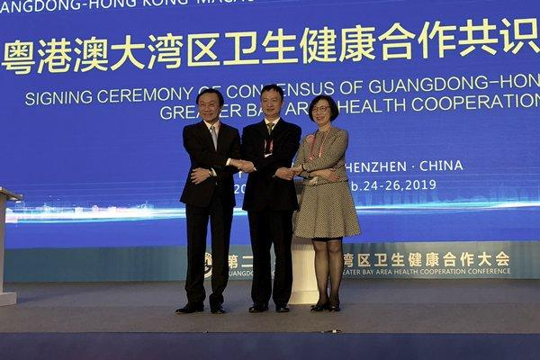

Roles and Functions of WHO in Global Public Health Matters
Reference
Examples of cooperation between Hong Kong and the Mainland to implement relevant public health policies
“The Outline Development Plan for the Guangdong-Hong Kong-Macao Greater Bay Area” also emphasises the principles of co-operation in medical and healthcare services in the region. For example, it is proposed to improve the linkage mechanism for emergency medical rescue services, so as to shape a healthy Bay Area. To foster co-operation in social security and social governance, so as to improve the mechanism for contingency management. It is also proposed to set up a Greater Bay Area coordination platform for contingency response, jointly formulate emergency response plans for major contingencies such as accidents and disasters, natural disasters, public health incidents, and public security incidents.
The three places have also signed the Framework Agreement on Hygiene and Health Co-operation of Guangdong-Hong Kong-Macao Bay Area (2018) and the Consensus of Guangdong-Hong Kong-Macao Greater Bay Area Health Cooperation (2019), in order to strengthen cooperation in the development of quality health care services, emergency response in relation to public health issues and the training of health care professionals.
Sources:
Outline Development Plan for the Guangdong-Hong Kong-Macao Greater Bay Area (https://www.bayarea.gov.hk/en/outline/plan.html)
Government Press Release (https://www.news.gov.hk/chi/2019/02/20190225/20190225_141628_557.html, Chinese only)

Slide 34
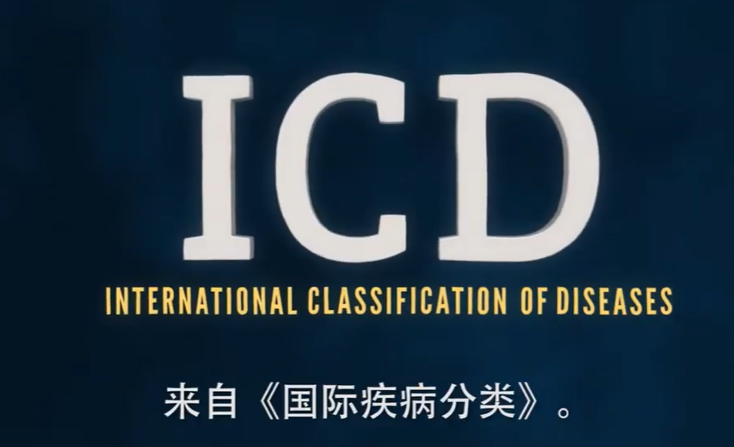

Roles and Functions of WHO in Global Public Health Matters
Setting global health standards - International Classification of Disease (ICD)
The International Classification of Diseases (ICD) is compiled by WHO to classify diseases and code diagnoses.
The ICD provides a common vocabulary for recording, reporting and monitoring health problems. The ICD provides standardized and consistent data for each country or region’s reference on classifications. Standardization is the key that unlocks global health data analysis.
These statistics form the basis for almost every decision made in health care, such as understanding what people get sick from, and what eventually kills them, which is at the core of mapping disease trends and epidemics. Governments of different countries can refer to them and decide how to programme health services, allocate health care spending, and invest in R&D. These statistics assist countries in developing resource allocation policies.
Click on the image to view the WHO's explanation
https://www.youtube.com/watch?v=7nbOQ0FS__k
Source: WHO
(https://www.who.int/news-room/spotlight/international-classification-of-diseases)

Slide 35
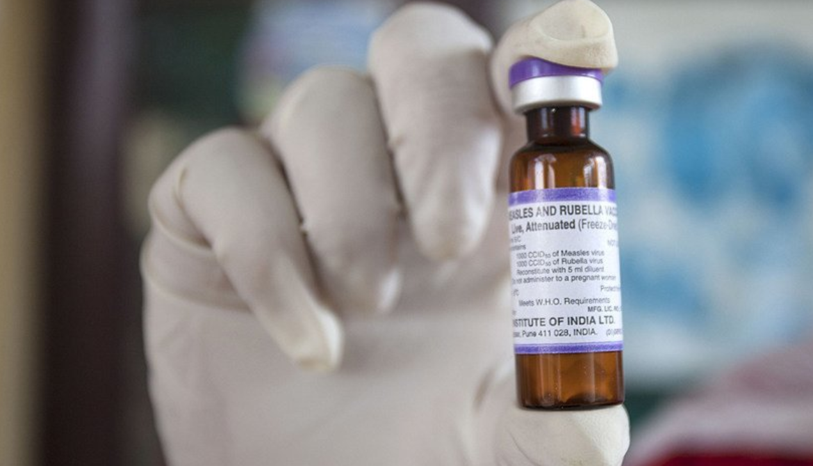
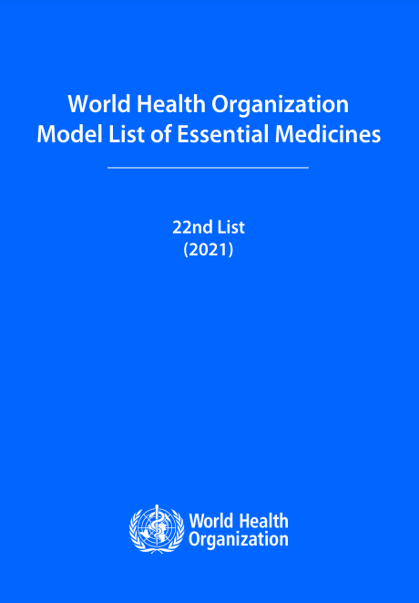
Roles and Functions of WHO in Global Public Health Matters
Setting global health standards
Essential Medicines List (EML)
The EML, updated every two years, provides countries with every medicine listed that has been vetted for efficacy and safety and delivers value for money for the health outcomes they produce. Many countries/regions develop their own EMLs based on the WHO's version.
The EML revised in 2021, for example, includes new treatments for various cancers, insulin analogues and new oral medicines for diabetes, new medicines to assist people who want to stop smoking, and new antimicrobials to treat serious bacterial and fungal infections, which should be available and affordable for all.
Source:
https://www.who.int/news/item/01-10-2021-who-prioritizes-access-to-diabetes-and-cancer-treatments-in-new-essential-medicines-lists
Click on the image to learn more

Slide 36
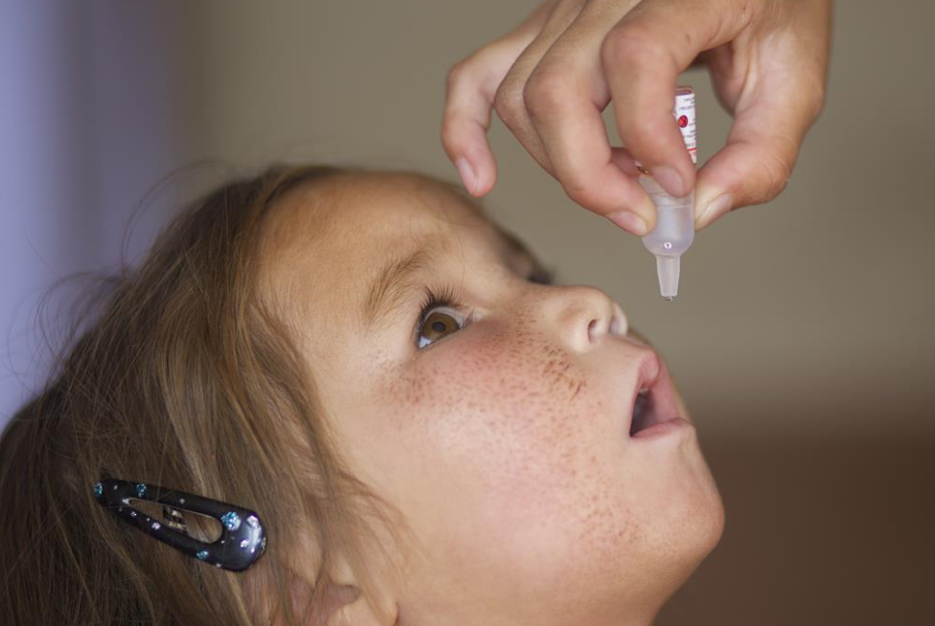

Roles and Functions of WHO in Global Public Health Matters
Controlling and eliminating diseases
WHO is committed to, and works with Member States to strengthen and maintain, the prevention, treatment and care of communicable and non-communicable diseases, such as AIDS, tuberculosis, malaria and neglected tropical diseases. Besides, WHO strives to reduce diseases through vaccination. WHO also works on the prevention and treatment of non-communicable diseases, which pose a serious public health problem, such as heart disease, stroke, cancer, diabetes, chronic lung disease and mental disorders.
Examples of WHO actions
Developing targets, strategies and programmes for controlling communicable disease control, so as to reduce morbidity and mortality
Responding to public health emergencies of international concern
Developing the Immunization Agenda 2030
Studying and preventing Neglected Tropical Diseases (NTDs)
Developing the WHO Framework Convention on Tobacco Control
Source: WHO (https://www.who.int/about/what-we-do )

Slide 37
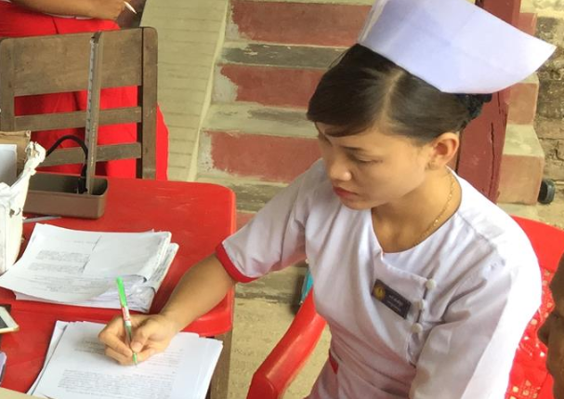

Roles and Functions of WHO in Global Public Health Matters
Reference
Examples of disease control targets
The WHO “End TB Strategy” aims for a 90 per cent reduction in tuberculosis deaths by 2030 and an 80 per cent reduction in the TB incidence rate.
WHO points out that there are a growing number of countries that are approaching, and achieving, zero cases of malaria. It has launched a new initiative to halt transmission of the disease in more countries by 2025.
In May 2016, the World Health Assembly adopted the first “Global health sector strategy on viral hepatitis, 2016-2021”. The goal is to achieve a 90% reduction in new chronic infections and a 65% reduction in mortality by 2030.
Sources: WHO
https://www.who.int/news/item/14-10-2020-who-global-tb-progress-at-risk
https://www.who.int/news/item/21-04-2021-world-malaria-day-who-launches-effort-to-stamp-out-malaria-in-25-more-countries-by-2025
https://www.who.int/news-room/fact-sheets/detail/hepatitis-c

Slide 38
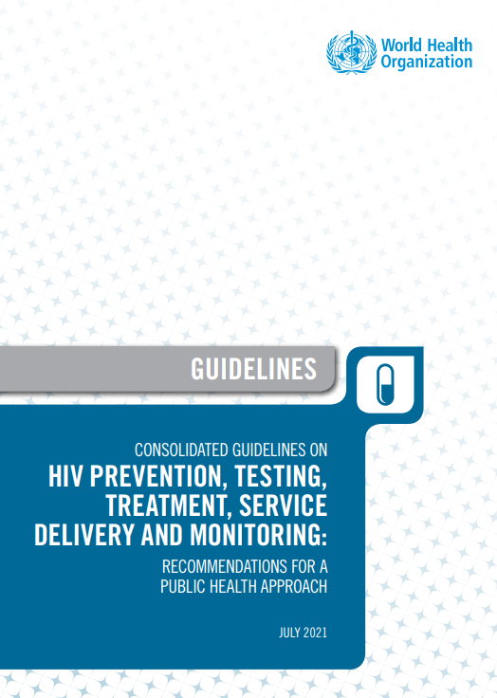
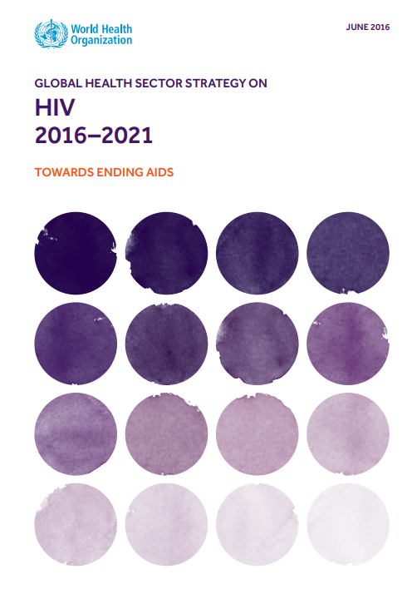
Roles and Functions of WHO in Global Public Health Matters
Reference
Examples of disease control targets
Consolidated guidelines on HIV prevention, testing, treatment, service delivery and monitoring: recommendations for a public health approach
GLOBAL HEALTH SECTOR STRATEGY ON HIV 2016-2021
WHO proposes ending the Acquired Immune Deficiency Syndrome (AIDS) epidemic as a public health threat by 2030.
AIDS remains one of the world's most significant public health challenges. In 2021, 25.4 million people received antiretroviral therapy (ART). WHO has released a set of normative guidelines and provides support to countries in formulating and implementing policies and programmes to improve and scale up HIV prevention, testing, treatment, monitoring, care and support services for all people in need.
Click on the images to learn more
Sources
https://www.who.int/news-room/facts-in-pictures/detail/hiv-aids
https://www.who.int/news-room/fact-sheets/detail/hiv-aids
https://apps.who.int/iris/bitstream/handle/10665/246178/WHO-HIV-2016.05-eng.pdf

Slide 39
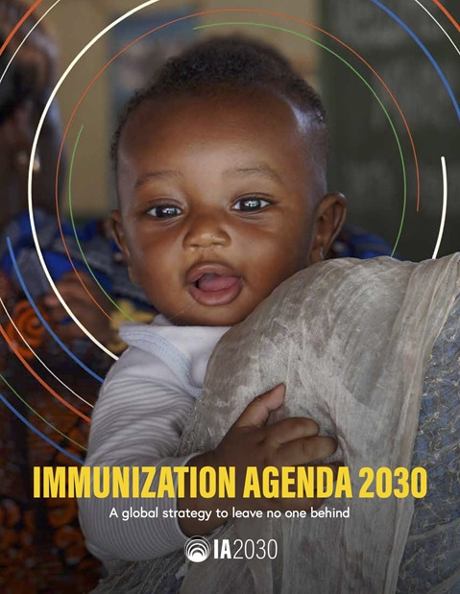
Roles and Functions of WHO in Global Public Health Matters
Reference
Controlling and eliminating diseases - Advancing action to expand global immunization programmes
“The Immunization Agenda 2030” (IA2030) sets an overarching global vision and strategy for vaccines and immunization for the decade 2021–2030, so as to realise "a world where everyone, everywhere, at every age, fully benefits from vaccines, for good health and well-being."
IA2030 aims to reduce mortality and morbidity from vaccine-preventable diseases for everyone throughout the life course, increase equitable access and use of new and existing vaccines, and well as to ensure good health and well-being for everyone by strengthening immunisation within primary health care and contributing to universal health coverage and sustainable development.
Click on the image for details
Source: WHO (https://www.who.int/publications/m/item/immunization-agenda-2030-a-global-strategy-to-leave-no-one-behind)

Slide 40
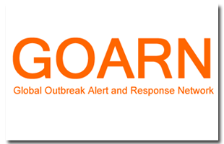

Roles and Functions of WHO in Global Public Health Matters
Establishing global response networks to prevent and control infectious diseases
WHO has established and is responsible for co-ordinating various global response networks. It utilises the technical collaboration mechanisms of existing institutions and networks to pool human and technical resources for rapidly identifying, confirming, monitoring and responding to epidemics and outbreaks of international importance. It also provides information on the outbreak to prevent and control the international spread of diseases.
Global Outbreak Alert and Response Network
A WHO network that respond to acute public health events with the deployment of staff and resources to affected countries and provide relevant training
Global Influenza Surveillance and Response System
Global mechanism of surveillance, preparedness and response for seasonal, pandemic and zoonotic influenza;
Global platform for monitoring influenza epidemiology and disease; and
Global alert for novel influenza viruses and other respiratory pathogens.
Source: WHO (https://www.who.int/initiatives/global-influenza-surveillance-and-response-system)
Source: WHO (https://extranet.who.int/goarn/)

Slide 41

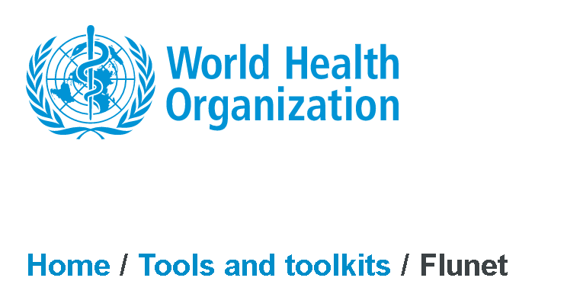
Roles and Functions of WHO in Global Public Health Matters
Reference
FluNet
FluNet is a global web-based tool for influenza virological surveillance first launched in 1997. The virological data entered into FluNet are critical for tracking the movement of viruses globally and interpreting the epidemiological data. The data at country level are publically available and updated weekly. The results are presented in various formats including tables, maps and graphs.
The data are provided remotely by National Influenza Centres (NICs) of the Global Influenza Surveillance and Response System (GISRS) and other national influenza reference laboratories collaborating actively with GISRS, or are uploaded from WHO regional databases.
Click on the image to learn more
Source: WHO (https://www.who.int/tools/flunet)

Slide 42
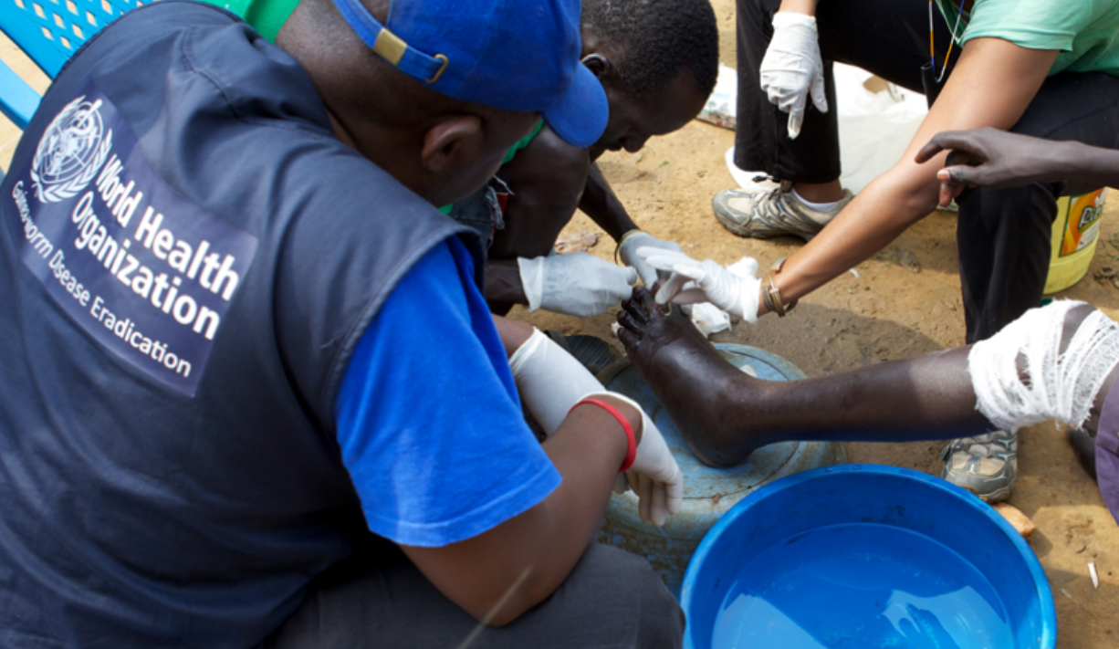
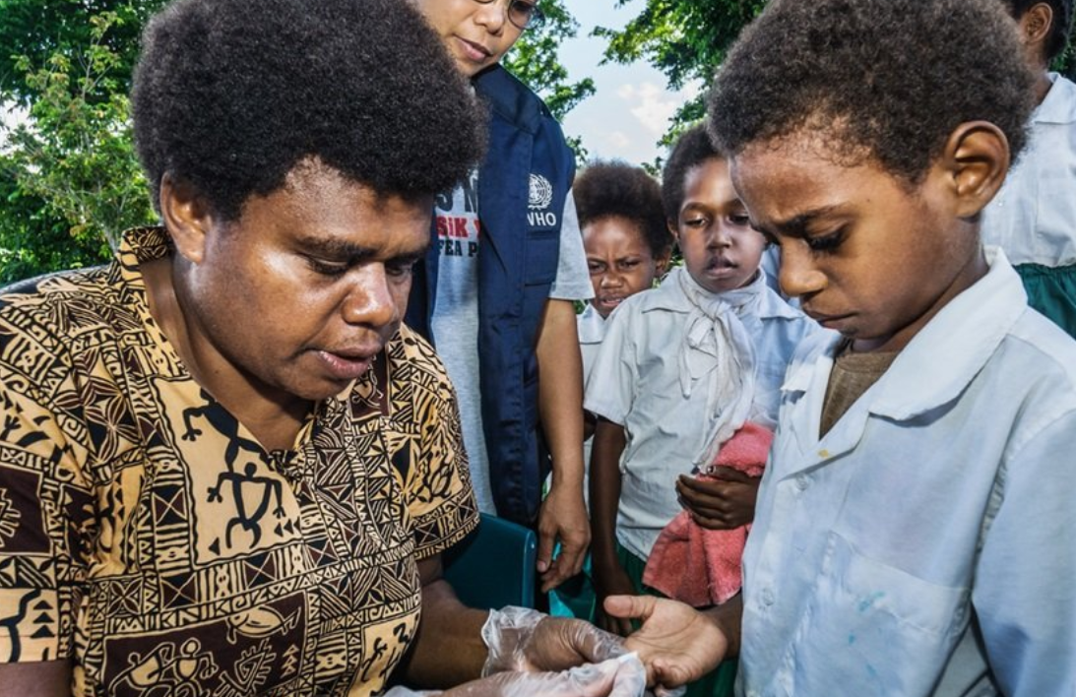

Roles and Functions of WHO in Global Public Health Matters
Controlling and eliminating diseases
Neglected tropical diseases (NTDs) are a diverse set of 20 diseases and disease groups that disproportionately affect populations living in poverty, predominantly in tropical and subtropical areas. They impose a devastating human, social and economic burden on the world. In 2021, WHO released its latest roadmap for action against NTDs, proposing the elimination of 20 tropical diseases that currently affect more than one billion people worldwide, with the following targets.
Targets
To reduce by 90% the number of people requiring interventions against NTDs
At least 100 countries to have eliminated at least one NTD
To eradicate Dracunculiasis and Yaws
75% reduction in disability-adjusted life years related to NTDs; and
To reduce 75% in the number of deaths from vector-borne related to NTD
To collect data on NTD to promote improved environmental and personal hygiene for prevention and control
Click on the image to learn about Dracunculiasis and Yaws
Sources:
UN News (https://news.un.org/en/story/2021/01/1083202)
WHO (https://apps.who.int/gb/ebwha/pdf_files/WHA73/A73_8-en.pdf)

Slide 43
Roles and Functions of WHO in Global Public Health Matters
Controlling non-communicable diseases and others
A comprehensive global action plan covering a wide range of areas, from non-communicable diseases such as cardiovascular diseases, cancers, chronic respiratory diseases and diabetes, to mental health, geriatric health, maternal and child health, maternal health, new born, child and adolescent health. It also covers developing a list of essential minimum medicines for a basic health-care system and the WHO Framework Convention on Tobacco Control.
Examples of actions
The 2030 Agenda for Sustainable Development recognises non-communicable diseases (NCDs) as a major challenge to sustainable development (SDG Target 3.4). WHO plays a key leadership role in the co-ordination and promotion of the global fight against NCDs. It has developed the "Global action plan for the prevention and control of NCDs 2013–2020".
WHO also promotes a healthy diet to address the public health risks of overweight and obesity, with a number of strategies, activities and programmes to raise public awareness and attention.
Sources: WHO
https://www.who.int/news-room/fact-sheets/detail/noncommunicable-diseases
https://www.who.int/news-room/fact-sheets/detail/obesity-and-overweight

Slide 44
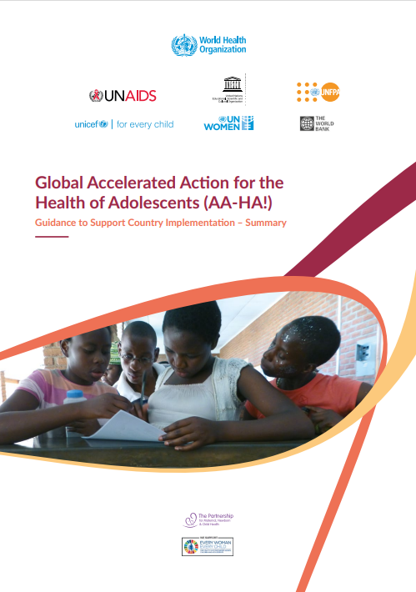

Roles and Functions of WHO in Global Public Health Matters
Reference
Promoting youth health
To know more
According to the WHO, unintentional injuries, violence, depression, alcohol and drug use, tobacco use, communicable diseases cause main health issues, with cannabis use among one of the causes of adolescent health problems.
The United Nations Office on Drugs and Crime (UNODC) states that despite the fact that evidence shows cannabis is associated with various health problems and other damages; the percentage of adolescents who perceive cannabis as harmful has dropped. It calls for educating our youths about drug addiction in order to to protect public health.
Click on the image to learn about relevant WHO programmes
In promoting youth health, WHO provides guidance to help governments plan, implement, monitor and evaluate adolescent health programmes.
The Student Health Service of the Department of Health in Hong Kong provides young people with knowledge, advice and activities on healthy living to promote physical and mental health and a good social life.
Sources:
WHO (https://www.who.int/news-room/fact-sheets/detail/adolescents-health-risks-and-solutions)
United Nations (https://news.un.org/en/story/2021/06/1094672)
Hong Kong Department of Health (https://www.studenthealth.gov.hk/english/health/health_hl/health_hl_ahl.html)
Click on the image for relevant information on healthy living

Slide 45

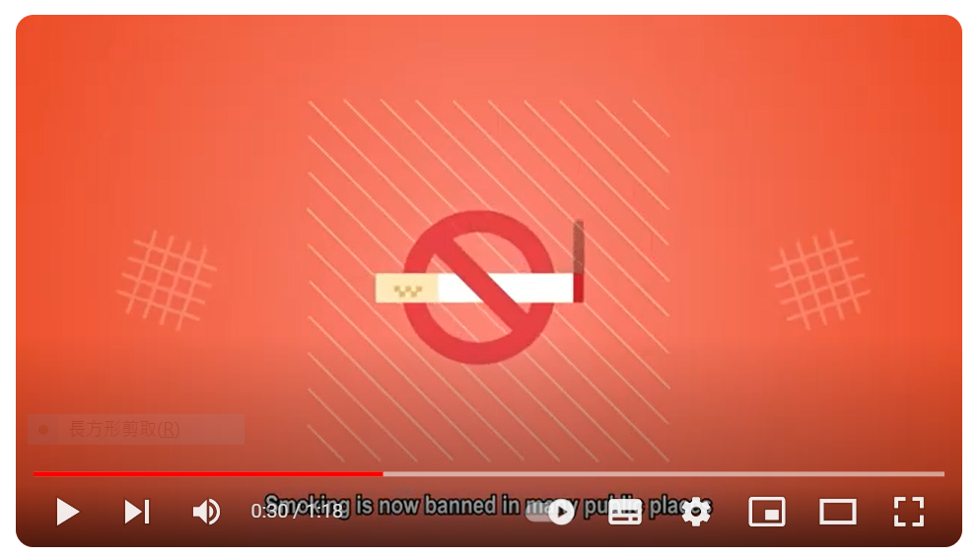
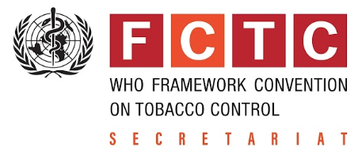
Roles and Functions of WHO in Global Public Health Matters
Examples of non-communicable disease control –
“WHO Framework Convention on Tobacco Control”
In 2003, the WHO Framework Convention on Tobacco Control (WHO FCTC) was adopted. In force since 2005, it had 182 Parties by April 2022, covering more than 90% of the world’s population, which committed to controlling tobacco use.
Watch the video to learn more about WHO's work on tobacco control
Sources: WHO
https://www.youtube.com/watch?v=kY76mxo1ZhM https://www.who.int/news-room/fact-sheets/detail/tobacco

Slide 46


Roles and Functions of WHO in Global Public Health Matters
Examples of non-communicable disease control – WHO Framework Convention on Tobacco Control
Taking a WHO report released in 2021 as an example, sixty countries are now on track to achieving the voluntary global target of a 30% reduction in tobacco use between 2010 and 2025. Article 20 of the WHO FCTC underlines the importance of running surveys to obtain evidence of the tobacco epidemic. 190 countries had run at least one national survey by 2021. They continue to collect relevant data through surveys e.g. Global Tobacco Surveillance System surveys for research, monitoring and evaluation.
WHO has adopted the following strategies to promote reduction in tobacco use in line with the requirements of the WHO FCTC, including:
Monitor tobacco use and prevention policies
Protect people from exposure to tobacco smoke
Offer help to quit tobacco use
Warn people about the dangers of tobacco
Enforce bans on tobacco advertising, promotion and sponsorship
Raise taxes on tobacco
Sources: WHO
https://www.who.int/news/item/16-11-2021-tobacco-use-falling-who-urges-countries-to-invest-in-helping-more-people-to-quit-tobacco
https://www.who.int/initiatives/mpower

Slide 47
Roles and Functions of WHO in Global Public Health Matters
Reference
Examples of non-communicable disease control – the Protocol to Eliminate Illicit Trade in Tobacco Products
To eliminate all forms of illegal trade in tobacco products in accordance to Article 15 of the WHO FCTC, the Protocol to Eliminate Illegal Trade in Tobacco Products (the Protocol) was adopted by WHO in November 2012 and entered into force on 25 September 2018. By 2022, 54 Parties have signed the Protocol to implement a series of measures to combat illicit trade, which includes three areas: preventing illicit trade, facilitating law enforcement and boosting international co-operation.
According to the Protocol, with a view to enabling effective tracking and tracing, each Party shall require that unique, secure and non-removable identification markings e.g. codes or stamps are affixed to any outside packaging of cigarettes within a period of five years and other tobacco products within a period of ten years of entry into force of this Protocol for that Party. The Protocol provides the Parties with the international legal basis to implement measures at the national and international levels to ultimately eliminate the illicit trade in tobacco products.
Source: United Nations (https://news.un.org/en/story/2018/07/1014882)

Slide 48
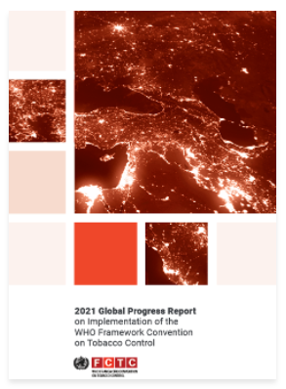

Roles and Functions of WHO in Global Public Health Matters
Reference
Examples of non-communicable disease control - WHO Framework Convention on Tobacco Control (WHO FCTC)
The WHO FCTC Secretariat prepares biennial global progress reports on the implementation of the WHO FCTC. According to the 2021 progress report, the number of countries implementing the tobacco control measures below is shown as follows (excerpt):
Measures implemented in tobacco control | Number of implementing countries
Total taxes of at least 75% or above of the retail price | 38
Complete smoking bans in all public settings | 58
To ban misleading descriptors and to ensure that the tobacco products carry prominent health warnings | 98
All forms of tobacco advertising, promotion and sponsorship banned | 14
Click to follow the latest tobacco control around the world and the global progress report on the FCTC.
Sources:
WHO (https://fctc.who.int/who-fctc/reporting/global-progress-reports)
WHO Framework Convention on Tobacco Control (https://untobaccocontrol.org/impldb/)
Source: WHO (https://fctc.who.int/publications/i/item/9789240041769)

Slide 49

Roles and Functions of WHO in Global Public Health Matters
Reference
Examples of the State policies to complement and implement the WHO FCTC
The State has always been committed to promoting anti-smoking to protect people's health and ratified the WHO FCTC on 27 August 2005 to further implement relevant anti-smoking measures, mainly including:
Tobacco control is included as one of the 15 special campaigns in the "Healthy China Initiative (2019-2030)".
Efforts are made to promote local tobacco control legislation and enforcement, as well to study and promote legislation at the national level. China's tobacco control legislation started with local legislation and by March 2022, all the four municipalities directly under the Central Government (Beijing, Shanghai, Tianjin and Chongqing) have introduced local regulations on tobacco control. Twenty-two provincial capitals have introduced specific local regulations or rules on tobacco control.
The Ministry of Transport has promulgated the “城市公共汽車和電車客運管理規定 " and the "Measures for Administration of the Operation of Urban Rail Transportation", which stipulate that passengers are not allowed to smoke in stations, public buses, trams or trains.
Source: National Health Commission
http://www.nhc.gov.cn/wjw/jiany/202102/3424c809e16b4b14930d0b3a82c62f4a.shtml (Chinese only)

Slide 50

Roles and Functions of WHO in Global Public Health Matters
Reference
Examples of Hong Kong's policies to complement and implement the WHO FCTC
The State signed the WHO FCTC in 2003. In accordance with Article 153 of the Basic Law, it was decided that the Convention should apply also to Hong Kong.
The HKSAR Government has always been discouraging smoking, containing the proliferation of tobacco use and minimising the impact of passive smoking on the public through a multi-pronged approach, including legislation, enforcement, publicity, education, smoking cessation services, and increasing tobacco duty from time to time.
Measures have been taken to gradually extend no-smoking areas and minimise the effect of second-hand smoke on the public, with a full indoor smoking ban introduced in 2007, and 11 bus interchanges across the territory being designated no-smoking areas by phases from 2016 onwards.
Sources: Hong Kong Government Press Releases
https://www.fhb.gov.hk/blog/cn/2019/post_20190530.html (Chinese only)
https://www.news.gov.hk/chi/2021/10/20211031/20211031_115735_023.html (Chinese only)

Slide 51
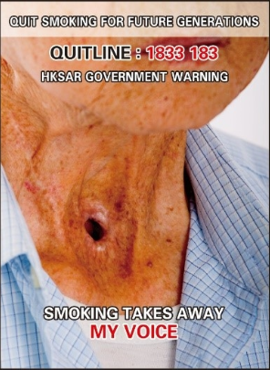
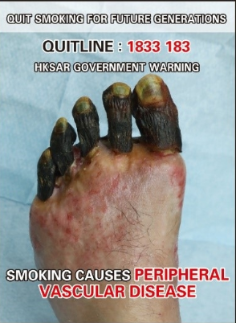
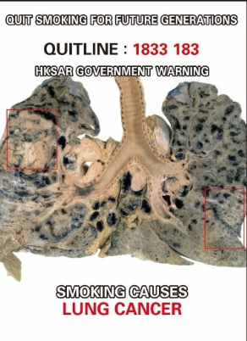
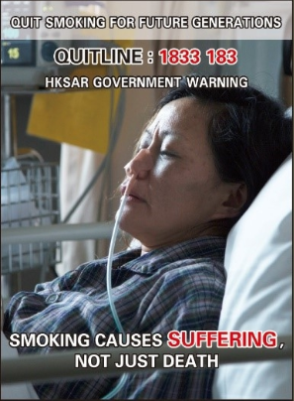

Roles and Functions of WHO in Global Public Health Matters
Reference
Examples of Hong Kong's policies to complement and implement the WHO FCTC
Pictorial health warnings (PHWs) are a tobacco control measure laid out by the Article 11 of the WHO FCTC to warn the public about the harm of smoking. WHO recommends PHWs with large, visible, clear and legible messages on at least 50% of principal areas of tobacco packs. As at February 2021, at least 126 countries and jurisdictions have implemented or approved PHWs.
Hong Kong introduced textual health warnings on tobacco packages in 1983 and gradually enhanced to PHWs in 2007. Updates were made in 2018, with the number of PHWs increased from six to 12, and increased the size of PHWs from 50% to 85% of the two largest surfaces. It is also mandated to display a health warning message (“Quit smoking for future generations) and the quitline number (1833183).
Examples of pictorial health warnings and plain packaging
Source: Hong Kong Council on Smoking and Health (https://www.smokefree.hk/page.php?id=94&lang=en)

Slide 52

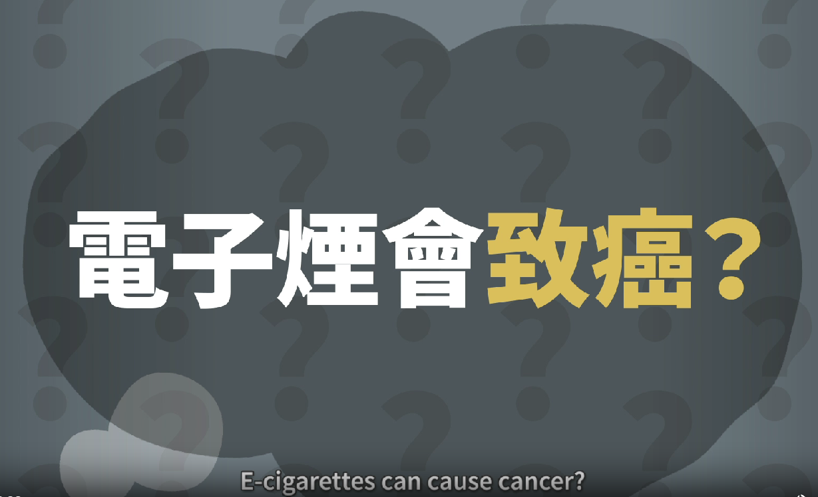
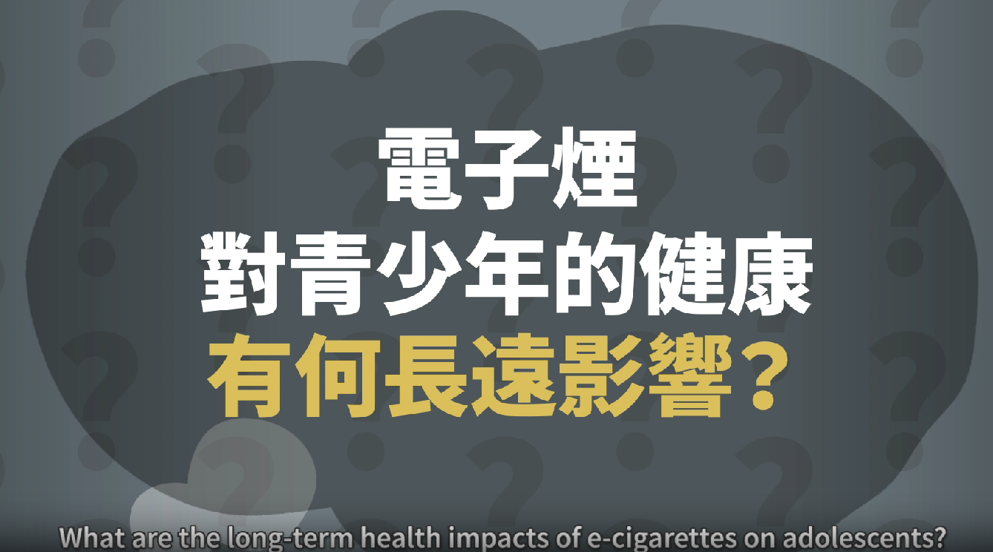
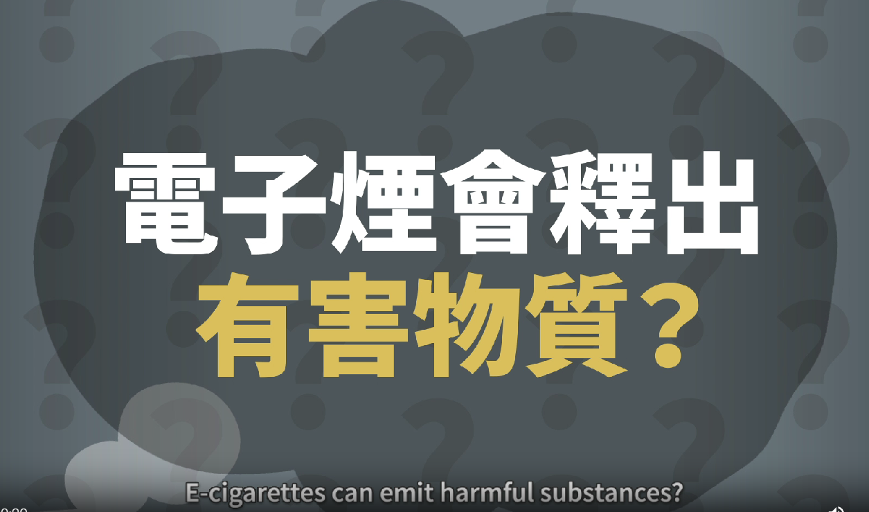
Roles and Functions of WHO in Global Public Health Matters
Reference
Control of e-cigarettes and Heated Tobacco Products (HTPs)
WHO also provides guidelines for the control of e-cigarettes and heated tobacco products (HTPs), stating that:
HTPs are, like all other tobacco products, inherently toxic and contain carcinogens. E-cigarettes and herbal tobacco are also harmful to health. E-cigarettes are particularly risky when used by children and adolescents.
They should be treated like any other tobacco product when it comes to setting policies. And it is recommended to regulate HTPs and e-cigarettes.
Source: WHO (https://www.who.int/news-room/fact-sheets/detail/tobacco)
Smoking (Public Health) (Amendment) Ordinance 2021 of Hong Kong
Smoking (Public Health) (Amendment) Ordinance 2021 was published in the Gazette on 29 October 2021. From 30 April 2022, no person may import, promote, manufacture, sell or possess for commercial purposes alternative smoking products, including electronic cigarette products, heated tobacco products and herbal cigarettes.
Click on the images to watch videos, produced by the TCO of the Department of Health,
on the harmful effects of e-cigarettes.
Sources: Tobacco Control Office, Department of Health
https://www.taco.gov.hk/t/english/whatsnew/amendment_order_2021.html
https://www.livetobaccofree.hk/videos/01_en.mp4
https://www.livetobaccofree.hk/videos/02_en.mp4
https://www.livetobaccofree.hk/videos/03_en.mp4

Slide 53
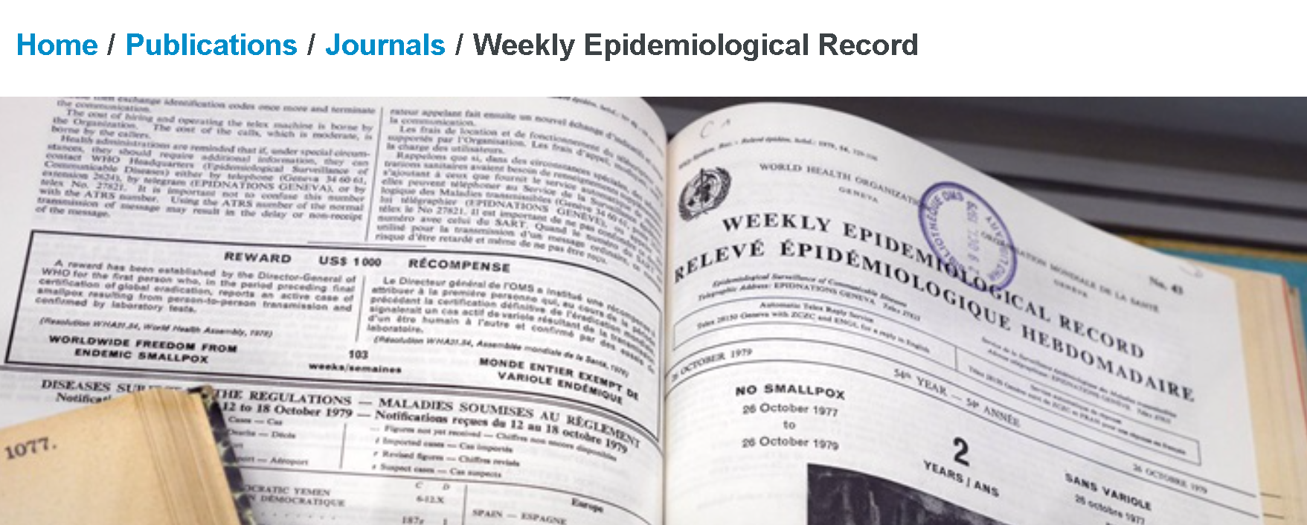
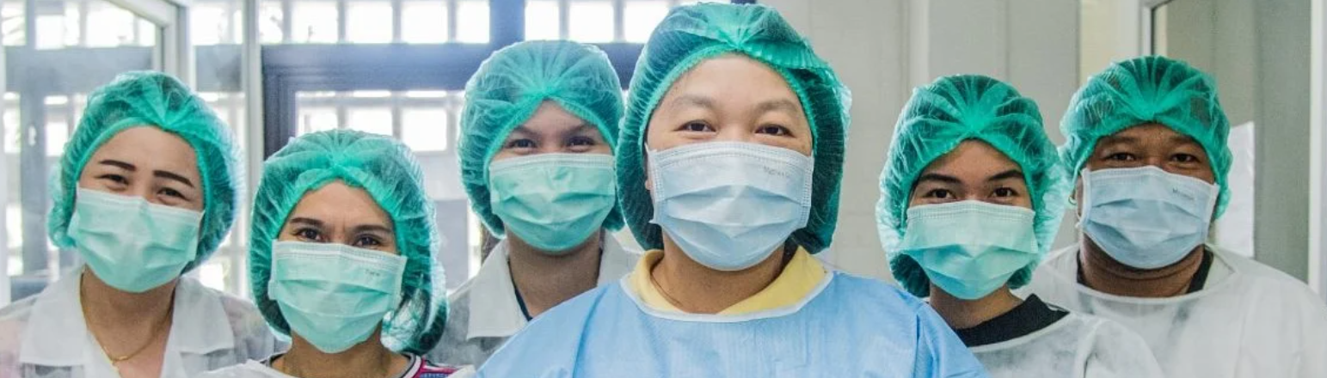
Roles and Functions of WHO in Global Public Health Matters
Leading and co-ordinating the response to health emergencies
WHO leads and co-ordinates health responses in emergencies, providing support to countries. It conducts risk assessments, identifies priorities and develops strategies. It also provides technical guidance, supplies and funding, and monitors health status. WHO assists Member States in strengthening their capacity to manage emergency risks, so as to prevent, protect against and respond to any health threatening emergencies. It also assists in recovery efforts after an emergency.
Click on the images below for WHO press releases on the latest disease outbreaks, confirmed public health emergencies, potential events of concern and others.
Sources: WHO
https://www.who.int/emergencies/situations
https://www.who.int/about/what-we-do

Slide 54
Roles and Functions of WHO in Global Public Health Matters
Reference
Establishing a response mechanism for PHEICs
WHO defines a public health emergency of international concern (PHEIC) in accordance with the IHR (2005) (see previous slides) and establishes a mechanism to facilitate prompt response to public health emergencies.
The Emergency Committee is made up of international experts who provide advice to the WHO Director-General in the context of a PHEIC. The Committee provides views on whether the event constitutes a PHEIC, as well as on the Temporary Recommendations that should be taken by the country experiencing an emergency of international concern, or by other countries, to prevent or reduce the international spread of disease and avoid unnecessary interference with international trade and travel. Members of an IHR Emergency Committee are drawn from the IHR Experts Roster, and, where appropriate, from other WHO expert advisory panels.
The WHO Director-General makes the final determination based on advice from the Emergency Committee, information provided by the State Parties, scientific experts and an assessment of risk to human health, risk of international spread of disease and of risk of interference with international travel. Related recommendations are temporary and need to be reviewed every three months.
Source: WHO
(https://www.who.int/news-room/questions-and-answers/item/what-are-the-international-health-regulations-and-emergency-committees)

Slide 55

Roles and Functions of WHO in Global Public Health Matters
Reference
Six PHEICs
Since the IHR (2005), six PHEICs have been declared by WHO up to 2022.
2009
2014
2016
2018
2020
2009 H1N1 Influenza
Polio
Ebola Virus Disease
Zika Virus Disease
Ebola Virus Disease
COVID-19
Do you know the communicable diseases in the above PHEICs?
Click on the images to see information on the symptoms, transmission routes, management and prevention of these communicable diseases. You can also learn about other communicable diseases on this webpage.
Sources: WHO
https://www.who.int/groups/h1n1-ihr-emergency-committee
https://www.who.int/news/item/03-08-2014-who-statement-on-the-second-meeting-of-the-international-health-regulations-emergency-committee-concerning-the-international-spread-of-wild-poliovirus
https://www.who.int/news/item/08-08-2014-statement-on-the-1st-meeting-of-the-ihr-emergency-committee-on-the-2014-ebola-outbreak-in-west-africa
https://www.who.int/news/item/01-02-2016-who-director-general-summarizes-the-outcome-of-the-emergency-committee-regarding-clusters-of-microcephaly-and-guillain-barr%c3%a9-syndrome
https://www.who.int/news/item/17-07-2019-ebola-outbreak-in-the-democratic-republic-of-the-congo-declared-a-public-health-emergency-of-international-concern
https://www.who.int/publications/m/item/covid-19-public-health-emergency-of-international-concern-(pheic)-global-research-and-innovation-forum

Slide 56


Roles and Functions of WHO in Global Public Health Matters
Reference
Responding to Ebola virus disease
In 2014, an outbreak of Ebola virus disease (EVD) occurred in West Africa. EVD is a serious and deadly infectious disease that is transmitted from wild animals to humans and spreads from person to person. It has an average mortality rate of about 50%. The epidemic spread rapidly in West Africa and in August of the same year, WHO declared the EVD outbreak in West Africa a PHEIC and co-ordinated the response of different countries and organisations.
In August and December, WHO made detailed recommendations on the control and prevention of EVD. It provided support to West African countries in the terms of disease detection, contact tracing, vaccination, laboratory services, infection control, etc.
Source: WHO (https://www.who.int/news-room/fact-sheets/detail/ebola-virus-disease)

Slide 57


Roles and Functions of WHO in Global Public Health Matters
Responding to COVID-19*
Since the outbreak of COVID-19, WHO has played a guiding and co-ordinating role in assisting countries to respond to the pandemic. It set up a professional multilateral platform for countries, which makes important contributions to international co-operation in the fight against COVID-19 and provides daily updates.
Click on the following pictures for information released by WHO on the pandemic.
Source: WHO, https://www.who.int/emergencies/diseases/novel-coronavirus-2019
*"Coronavirus disease 2019 (COVID-19)" is the disease caused by a new coronavirus called "SARS-CoV-2". Detailed references:
WHO (https://www.who.int/emergencies/diseases/novel-coronavirus-2019/question-and-answers-hub)
Hong Kong Government Website (https://www.chp.gov.hk/en/healthtopics/content/24/102466.html)

Slide 58

Roles and Functions of WHO in Global Public Health Matters
Leading and co-ordinating international response to COVID-19
1 Keeping track of epidemic trend and prepare international communities for the pandemic
WHO developed response guidelines for reference by governments worldwide, including community surveillance, case investigation, points of entry, infection prevention and control, case management, etc. WHO also provided updates on strategy against the latest development of a COVID-19, which includes encouraging countries to mobilise all sectors and communities to help prevent the spreading of the disease; reduce mortality rate and develop safe and effective vaccines and therapeutics to control the epidemic.
Source: WHO,
https://www.who.int/docs/default-source/coronaviruse/covid-19-sprp-operational-planning-guidelines-to-support-country-preparedness-and-response-(22may20).pdf
Click on the image to learn more

Slide 59


Roles and Functions of WHO in Global Public Health Matters
Leading and co-ordinating international response to COVID-19
2 Promoting active participation for international collaboration on research, production and distribution of vaccines
The Access to COVID-19 Tools (ACT) Accelerator, is a WHO global collaboration to accelerate development, production, and equitable access to COVID-19 tests, treatments, and vaccines. The initiative brings together governments, scientists, businesses, civil society, and philanthropists and global health organisations to achieve the above-mentioned goals.
Source: WHO (https://www.who.int/initiatives/act-accelerator/about)

Slide 60
Roles and Functions of WHO in Global Public Health Matters
Leading and co-ordinating international response to COVID-19
3 Publishing norms and guidelines for pandemic response
WHO has published a number of guidance documents on COVID-19, providing advice to Member States and the public on pandemic preparedness, outbreak management, infection prevention, travel advice, clinical management and post-COVID reopening.
WHO has published guidance on the considerations in adjusting public health and social measures for workplaces, schools and mass gatherings, as well as the public health criteria to adjust these measures, so that Member States could respond to different transmission scenarios.
WHO has updated guidance on the use of masks for control of COVID-19, based on the latest information and research.
Sources: WHO
https://www.who.int/news-room/feature-stories/detail/a-guide-to-who-s-guidance
https://www.who.int/emergencies/diseases/novel-coronavirus-2019
https://apps.who.int/iris/bitstream/handle/10665/332073/WHO-2019-nCoV-Adjusting_PH_measures-Criteria-2020.1-eng.pdf
https://www.who.int/publications/i/item/advice-on-the-use-of-masks-in-the-community-during-home-care-and-in-healthcare-settings-in-the-context-of-the-novel-coronavirus-(2019-ncov)-outbreak

Slide 61

Roles and Functions of WHO in Global Public Health Matters
Leading and coordinating international response to COVID-19
4 Providing medical expertise and technical support to countries concerned
WHO continuously monitors, directs and co-ordinates national and international responses to the pandemic through the co-ordination of emergency medical teams worldwide and global focal points. For example, WHO informs Global Outbreak Alert and Response Network (GOARN) partners about a cluster of related cases. GOARN partners include major public health agencies, laboratories, sister UN agencies, international organisations and NGOs.
Source: WHO https://www.who.int/news/item/29-06-2020-covidtimeline

Slide 62
Roles and Functions of WHO in Global Public Health Matters
Leading and coordinating international response to COVID-19
5 Providing financial and material support to countries
WHO mobilises its global stockpile of personal protective equipment (PPE) to support disaster preparedness in priority countries. It supports countries with weak health systems to prepare for and respond to the pandemic. It calls on countries to work with commodity producers to increase production to ensure the free movement of essential health products; and to ensure equitable distribution.
WHO also delivers protective gear to countries that need them most and works intensively with several partners to massively increase access to life-saving products, including PPE, medical oxygen and ventilators.
Source: WHO (https://www.who.int/news/item/29-06-2020-covidtimeline)

Slide 63



Roles and Functions of WHO in Global Public Health Matters
Reference
Leading and co-ordinating international response to COVID-19
WHO produced multimedia information to educate the public on how to respond to the pandemic.
Click on the images below to watch WHO videos on COVID-19.
Check out the WHO Q&A on COVID-19 and related health topics to learn more.
Click on the image to learn more
Sources: WHO
https://www.who.int/emergencies/diseases/novel-coronavirus-2019/advice-for-public/videos
https://www.who.int/emergencies/diseases/novel-coronavirus-2019/question-and-answers-hub

Slide 64



Roles and Functions of WHO in Global Public Health Matters
Reference
We are all being exposed to a huge amount of COVID-19 information on a daily basis. But not all of it is reliable. There is even misleading or false information. WHO also provides strategies to improve the information literacy of the public and to provide the public with accurate information.
Click on the image to learn more
Source: WHO (https://www.who.int/news-room/spotlight/let-s-flatten-the-infodemic-curve)

Slide 65


Conclusion
The world needs to work together to tackle epidemics and prevent their global spread. WHO implements a number of health objectives and sets international standards. It provides multifaceted health development assistance to countries around the world, and carries out research and assessment of health risks. All those efforts contribute to the co-operation in global health protection.
In fact, the promotion of public health, like the promotion of sustainable development and addressing international issues, such as energy, food and water resources, is not only the responsibility of intergovernmental organisations, such as WHO. It also requires the collaboration and efforts of countries, communities, organisations and individuals. Individuals should support health policies and act in accordance with world health standards for the sake of public health. We should fulfil our civic responsibility and take action to deal with viruses beyond borders and jointly safeguard public health.

Slide 66
Extended References
WHO, World Health Day 2023 (https://www.who.int/campaigns/75-years-of-improving-public-health)
WHO, Health Promotion Glossary of Terms 2021 (https://www.who.int/publications/i/item/9789240038349)
WHO, GLOBAL HEALTH SECTOR STRATEGY ON HIV 2016-2021, (https://apps.who.int/iris/bitstream/handle/10665/246178/WHO-HIV-2016.05-eng.pdf)
WHO, Neglected tropical diseases (https://www.who.int/news-room/questions-and-answers/item/neglected-tropical-diseases)
WHO, Urban Health (https://www.who.int/news-room/fact-sheets/detail/urban-health)
WHO, Air pollution (https://www.who.int/health-topics/air-pollution#tab=tab_1)
WHO, #HealthyAtHome (https://www.who.int/campaigns/connecting-the-world-to-combat-coronavirus/healthyathome)
Outline of the Healthy China 2030 Plan, 2016 (http://big5.www.gov.cn/gate/big5/www.gov.cn/gongbao/content/2016/content_5133024.htm, Chinese only)

Slide 67
Extended References
Healthy China Initiative (2019-2030)
(http://www.gov.cn/xinwen/2019-07/15/content_5409694.htm, Chinese only)
National Services for COVID-19 Prevention and Control (https://www.gov.cn/fuwu/zt/yqfwzq/yqfkblt.htm, Chinese only)
National Health Commission - Briefings on COVID-19 (http://www.nhc.gov.cn/xcs/yqtb/list_gzbd.shtml, Chinese only)
Department of Health, COVID-19 Thematic Website "Together, We Fight the Virus" (https://www.coronavirus.gov.hk/eng/)
Centre for Health Protection of the Department of Health (https://www.chp.gov.hk/en/)
Registration of Medicines in Hong Kong (https://www.dh.gov.hk/english/useful/useful_registration/useful_registration.html)
Hong Kong Drug Formulary Management (https://www.ha.org.hk/hadf/en-us/Drug-Formulary-Management.html)
Knowledge on Medicines, by the Drug Office of the Department of Health (https://www.drugoffice.gov.hk/eps/do/en/consumer/news_informations/knowledge.html)

Slide 68
Extended References
Universal Health Coverage in Our Country
In the "Outline of the Healthy China 2030 Plan" (2016), the State proposes several plans, including the followings, to achieve universal health coverage:
Strengthen public health services. By 2030, chronic disease care management will cover the life cycle of whole population and the overall five-year survival rate of cancer patients will increase by 15%. The Expanded National Immunisation Programme (ENIP) will continue to be implemented with the vaccination rate for eligible children maintained at a relatively high level.
Promote equal access to essential public health services. The essential public health care service package and major public health service package will continue to be implemented and optimised. Enhance the research on the economic burden of diseases will be conducted to make appropriate adjustments to the funding of healthcare packages. Efforts will be made to enrich and expand health care services and improve service quality to ensure equal access for both urban and rural residents, as well as for the registered and the floating population, to primary public health care services, including family planning.
China Government Website (http://big5.www.gov.cn/gate/big5/www.gov.cn/gongbao/content/2016/content_5133024.htm, Chinese only)

Slide 69

Extended Reference
Universal Health Coverage in Hong Kong
Hong Kong tops the world in longevity. This is to a certain extent attributable to our high-quality, reliable, accessible and comprehensive public healthcare services heavily subsidised by the Government.
The concept of “universal health coverage” has long been incorporated into the SAR Government’s healthcare policy. Public healthcare services provide a safety net and comprehensive lifelong medical health care for every citizen. Through our highly subsidised public healthcare system, we ensure access to affordable services for those in need and that no one will be deprived of appropriate treatment because of lack of means. That is what “universal health coverage” should be. The Government has launched the Chronic Disease Co-Care Pilot Scheme to engage more private healthcare services in the management of chronic disease.
Sources: Hong Kong Government Website
https://www.cso.gov.hk/eng/blog/blog20180401.htm
https://www.info.gov.hk/gia/general/202201/26/P2022012600579.htm (Chinese only)
https://www.info.gov.hk/gia/general/202311/06/P2023110600222.htm?fontSize=1

Slide 70


Extended Reference
National Essential Medicines List (2018)
Source: National Health Commission (http://www.nhc.gov.cn/wjw/jbywml/201810/600865149f4740eb8ebe729c426fb5d7.shtml, Chinese only)
In Hong Kong, ICD-9 (the 9th Revision of ICD) and ICD-10 (the 10th Revision of ICD) are commonly used to code malignant cancer cases. For the sake of consistency, those primarily based on ICD-9 are converted to grouped ICD-10 codes.
With increasing emphases on unifying the cancer grouping and terminology, HKCaR has revised a new cancer grouping with the collaboration of the Government Department of Health. The purpose of the table is to group the sites that are treated as a single site / group when disseminating cancer statistics to the public in most circumstances.
Refer to the following HA webpage for more details:
https://www3.ha.org.hk/cancereg/icd10.html

Slide 71
User Guide
The primary users of this resource are teachers. It aims to provide teachers with content knowledge relevant to the topic to enable teachers to have a deeper understanding of teaching content when preparing for their lessons.
All data, videos, photos, pictures, questions and suggested answers can be used for multiple purposes, such as teachers’ teaching materials, references for curriculum planning and learning and teaching, and student assignments, etc. To align with Citizenship and Social Development Curriculum and Assessment Guide (Secondary 4-6) (2021) (C&A Guide), this resource should be adapted to cater for students’ learning diversity and the needs of classroom teaching, etc.
Teachers may provide appropriate supplementary notes/ explanations to enrich this resource in order to enhance students’ understanding of the topic and information provided.
In accordance with the curriculum rationale and aims, teachers may select other learning and teaching resources which are correct, reliable, objective and impartial to help students build up a solid knowledge base, develop positive values and attitudes as well as enhance critical thinking and problem solving skills, and various generic skills.
If some information cannot be provided in this resource due to copyright issue, teachers may visit relevant websites provided.
Some information may have been updated when being used by teachers, teachers may visit the corresponding websites to obtain the up-to-date information.
Please also refer to the C&A Guide to understand the requirements and arrangements of the learning and teaching of the curriculum. Teachers are welcome to point out the areas need improvement, and welcome to provide updated information to enrich the content for all teachers’ reference.

Slide 72
Notice and Disclaimer
Some sources were not translated into English as the official English version is not available.
In case of any discrepancy between the Chinese and English versions, the Chinese version shall prevail.

