Slide 1
Citizenship and Social Development
Theme 3: Interconnectedness and Interdependence of the Contemporary World
Topic: Technological development and information literacy
Learning focus:
Development features of information technology: the Internet, social networking sites, instant messaging software
September 2023
(Translated version)

Slide 2
Learning objectives
Knowledge
To understand the development features of information technology (the Internet, social networking sites, instant messaging software) and their impact on personal and social development.
Skills
To analyse and summarise the development features of information technology, so as to enhance information literacy, and make good use of information technology to solve problems in learning and daily life.
Values
To use information and information technology in compliance with the law in an ethical and responsible manner, and be a responsible citizen and lifelong learner.

Slide 3

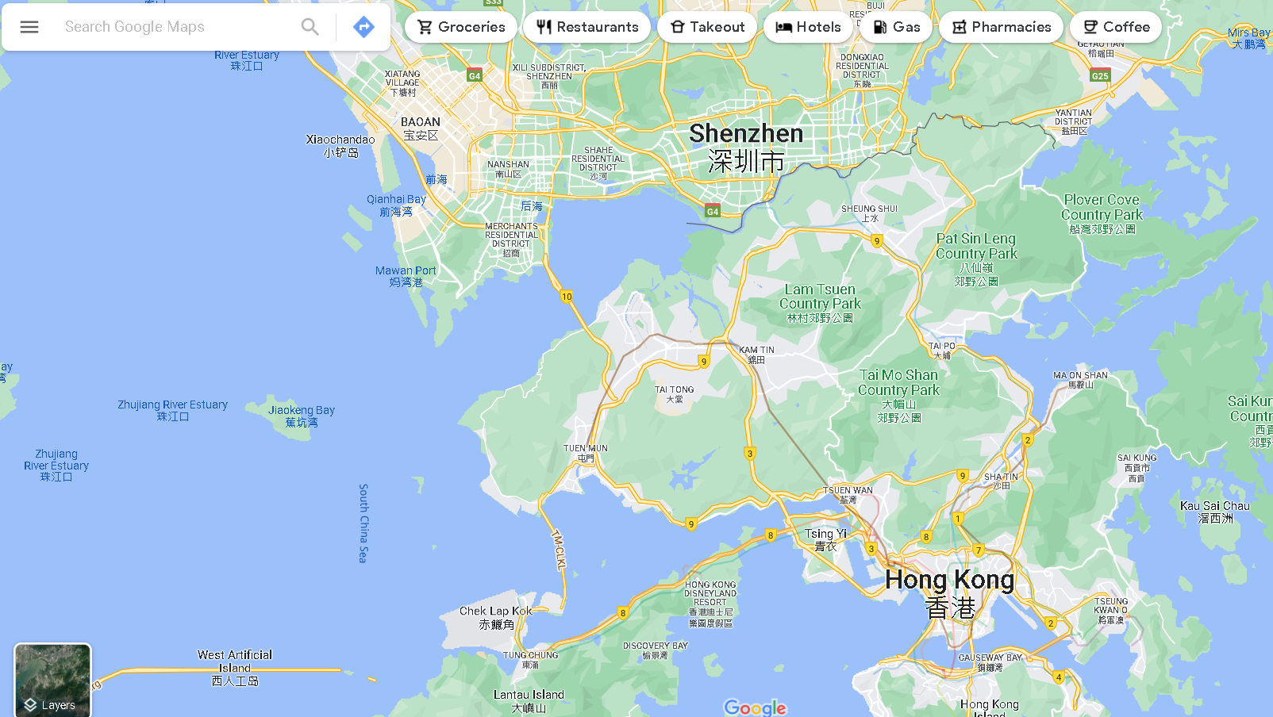










Lead-in
Discover the information around you
Information is received and disseminated in social life in the forms of sound, language, texts, graphics, images, etc. Modern information technology has been integrated into every detail of our life, making information ubiquitous.
Check out the optimal traffic route with automatic navigation
Learn from video clips on YouTube
Friends update their social network status
Search information on the Internet
......

Slide 4





The development of information technology
During the development of human society, the creation of language and writing promoted the dissemination of information; the invention and dissemination of paper-making techniques and movable type printing technique is a great technological advancement in storing, reproducing and disseminating information; the advent of telegraph and telephone in the 19th century led to a major breakthrough in information dissemination; nowadays, the emergence and rapid popularisation of communication technology, computers and computer networks has driven the economic and social transformation and development worldwide.
The emergence of writing
The invention of paper-making techniques and movable type printing technique
The advent of telegraph, telephone and television
The emergence and popularisation of communication technology, computers and computer networks
The creation of language
A
文

Slide 5

The development of information technology
A new round of scientific and technological development represented by information technology is in full swing, showing the characteristics of informatisation, digitalisation and smartisation, which has brought enormous and profound impact on economic activities and social life. Information technology, such as the Internet, social networking websites, and instant messaging software, connects people in real time, and the transmission of information is not limited to texts, which has greatly boosted the speed, depth and breadth of sending and receiving information. The continuous improvement of information technology has promoted global interconnection and interdependence.

Slide 6


The development of information technology
Informatisation, digitalisation and smartisation
Despite varied paces and levels, the transformation brought by informatisation, digitalisation, and smartisation is all over the world. The development and extensive application of information technology has promoted information exchange and knowledge sharing, as well as socioeconomic development and transformation. Information technology facilitates the record, analysis and reorganisation of information and data, fulfills the interpretation and reconstruction of things, and promotes digitalisation of the society. With the support of technologies, such as the Internet, big data, Internet of Things (IoT) and artificial intelligence (AI), information technology can further meet people's various needs, and people in the world are experiencing the convenience brought by smart living.

Slide 7


The development of information technology
Informatisation, digitalisation and smartisation
Over the past 20 years, we have witnessed the unprecedented evolution of information and communication technology (“ICT”) and the increasingly widespread use of ICT-related products (e.g. personal computers, Internet services and mobile services) in businesses, households and society.
Over the last two decades, we have witnessed a period of unprecedented changes in Information and communication technology (ICT) and the pervasive adoption of ICT-related products (e.g. personal computers, Internet services and mobile services) in business, home and the community, which promotes the development of the information society, and is important to enhance economic competitiveness and facilitate the development of the digital economy.
With the supply of ICT and an increase in the quantity and quality of infrastructure, the Internet and smartphones have become indispensable necessities of daily life, and their widespread use has changed people’s communication and business models, and lifestyles.
Reference:
Hong Kong as an Information Society (2022 Edition), Science and Technology Statistics Section, the Census and Statistics Department of the HKSAR Government
(https://www.censtatd.gov.hk/en/data/stat_report/product/B1110006/att/B11100062022AN22B0100.pdf)

Slide 8

The development of information technology
Informatisation, digitalisation and smartisation
With the advancement of information technology, such as smartphones and other smart products, we have easier access to social media information and other data sets on the Internet. Such data is collectively referred as “big data” and may include consumers’ personal information, online search records, Internet browsing habits, purchase history, etc. The essence of big data analytics lies in how to turn data into important information. Big data will continue to generate a significant impact on our socioeconomic development; big data analytics can be applied to a variety of industries, including marketing, finance and airlines, bringing numerous business opportunities.
Reference:
Hong Kong Trade Development Council (https://research.hktdc.com/en/article/MzYzOTY0NTY5)

Slide 9

The development of information technology
Informatisation, digitalisation and smartisation
The application of big data is also valued around the world. According to a study by the Hong Kong Institute for Monetary and Financial Research (HKIMR) in 2021, 71% of firms in the financial services sector in Asia Pacific have adopted or planned to adopt AI and big data technologies in the next 12 months. Market participants identified clear benefits from the adoption of AI and big data , but also highlighted that the shortage of talent is one of the major challenges now and in the next 5 years.
Big data indeed plays a key role in public health, transportation and other fields, setting the direction of planning for the Government.
Source: Hong Kong Monetary Authority
(https://www.hkma.gov.hk/eng/news-and-media/press-releases/2021/10/20211028-3/)

Slide 10

The development of information technology
Informatisation, digitalisation and smartisation
Smartisation had gradually taken place in our lives and it has enhanced and accelerated. Building smart cities has become a new trend in urban planning worldwide. It aims at making the management of urban services and resources more efficient through ICT; whereas ICT infrastructure provides extremely favorable conditions for building smart cities.
An example of the application of technology at the Beijing Daxing International Airport
The staffs members are equipped with AR glasses, which can quickly and automatically identify passengers and assist passengers with check-ins.
The airport adopts a baggage tracking system, which can fulfill the tracking and management of passengers’ baggage throughout the whole process.
Source: www.gov.cn
(http://www.gov.cn/xinwen/2019-09/26/content_5433259.htm)

Slide 11


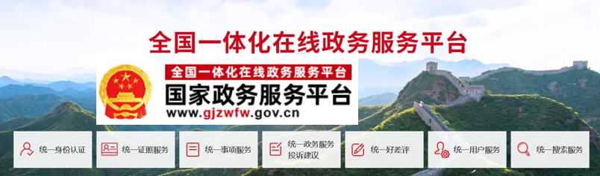


The development of information technology
Reference
Informatisation, digitalisation and smartisation
Examples of IT services
Our country uses information technology to promote the nationwide integration of government affairs to become a “smart” government, which covers all departments of the State Council, as well as provinces, autonomous regions and municipalities directly under the Central Government.
Cross-Provincial Public Services
Single Window System for International Trade
(Click on the image to learn more about the integration of government affairs in the Mainland and pay attention to the latest arrangements.)
Single Portal for Online Government Services
Source: General Office of the State Council (http://gjzwfw.www.gov.cn/index.html)

Slide 12

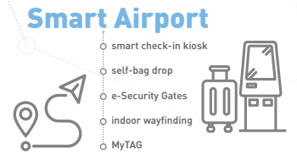
The development of information technology
Reference
Informatisation, digitalisation and smartisation
Example of IT applications in Hong Kong
Click on the image above for more examples of smart living.
Source: Innovation and Technology Bureau*
https://www.smartcity.gov.hk/modules/custom/custom_global_js_css/assets/files/HKSmartCityBlueprint(ENG)v2.pdf
*Innovation and Technology Bureau was renamed to Innovation, Technology and Industry Bureau on 1 July, 2022.

Slide 13



The development of information technology
Reference
Informatisation, digitalisation and smartisation
AI and big data analytics are important technologies for the data-driven improvement of government services and smart city development. The Office of the Government Chief Information Officer (OGCIO) launched a Big Data Analytics platform in September 2020 to step up its efforts to support to bureaux/ departments in making use of relevant technologies in delivering public services.
The OGCIO and the Transport Department are jointly developing a “Traffic Data Analytics System” to facilitate the Transport Department to perform predictive analyses for enhancing traffic management and efficiency with AI and big data analytics.
The Government launched the “iAM Smart” platform, ”, which is a one-stop personalised digital services platform, in end-December 2020, providing a reliable identity verification function for members of the public to log in to their online accounts and use various government and commercial online services, conduct online transactions and perform digital signing with legal backing in a simple and secure manner.
Click on the image below to learn about various types of the government’s mobile applications.
https://www.legco.gov.hk/yr20-21/english/panels/itb/papers/itb20210615cb1-984-3-e.pdf

Slide 14

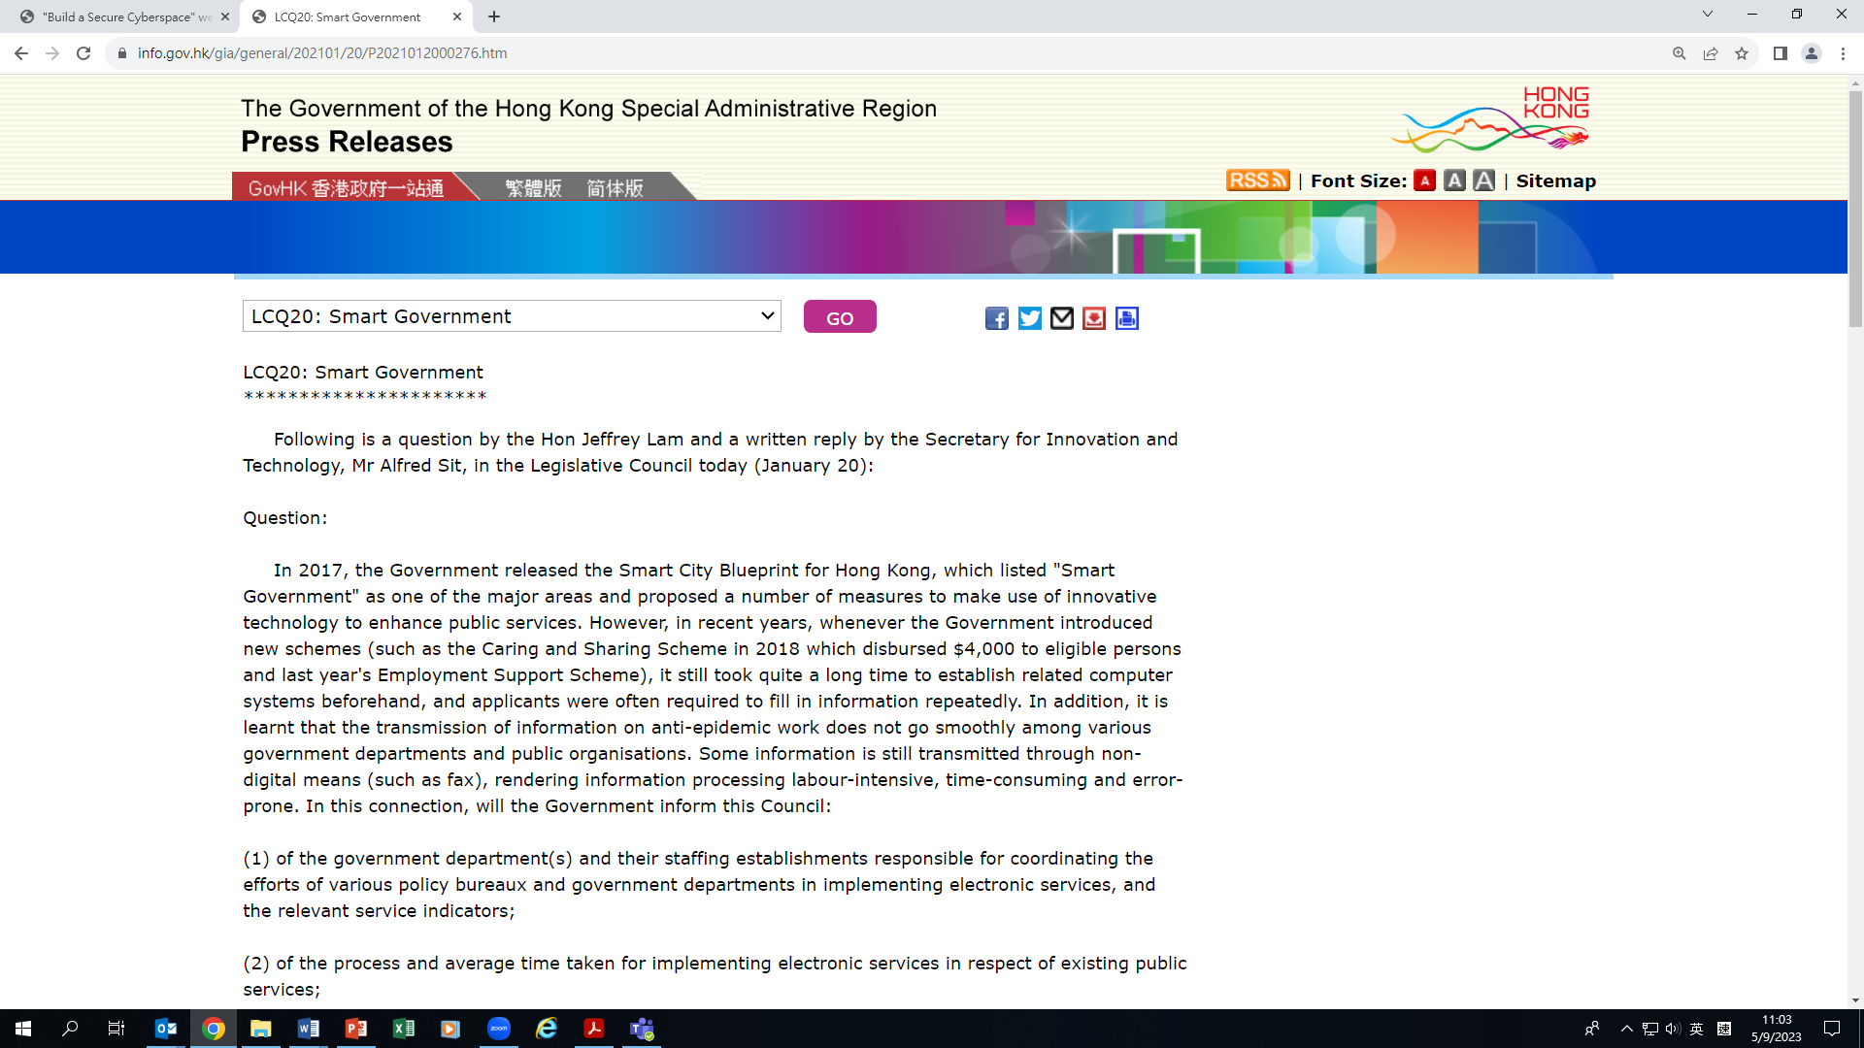

The development of information technology
Reference
Informatisation, digitalisation and smartisation
AI and big data are important technology areas underpinning smart city development. Their applications are conducive to delivery of quality and data-driven public services. The OGCIO launched an AI chatbot "Bonny" on the GovHK portal at the end of 2019 to facilitate the public to search more than 3 300 government forms and e-Government services.
Bonny can understand Chinese and English and analyses inputted texts, tries to understand citizens’ needs and searches the most suitable e-Government services and application forms. URLs to relevant webpages will also be provided to facilitate citizens’ access to Government services.
Sources:
Hong Kong Government Press Release (https://www.info.gov.hk/gia/general/202101/20/P2021012000276.htm?fontSize=1)
GovHK (https://www.gov.hk/en/theme/chatbot/faq/)

Slide 15
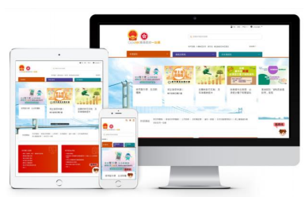
The development of information technology
Reference
Informatisation, digitalisation and smartisation
In September 2020, the OGCIO launched a Big Data Analytics platform to facilitate the implementation of more big data analysis and AI projects, including:
Jointly developing a new Traffic Data Analytics System with the Transport Department to analyse various types of traffic and transport data so as to more accurately assess traffic conditions, enhancing traffic management and improving efficiency.
Collaborating with the Architectural Services Department, the Electrical and Mechanical Services Department and the Food and Environmental Hygiene Department in analysing maintenance records and public complaints related to public toilets using big data analytics technology to strengthen public toilet management and maintenance measures.
Through analysing the usage and search history of GovHK portal, the OGCIO can better understand users' needs for enhancing the portal and user experience.
Source: Hong Kong Government Press Release (https://www.info.gov.hk/gia/general/202101/20/P2021012000276.htm)

Slide 16
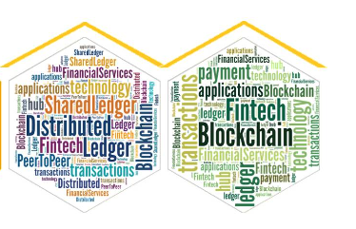

Reference
The development of information technology
Informatisation, digitalisation and smartisation
- Blockchain and digital economy
Blockchain technology can promote the development of the digital economy. It helps Hong Kong align with the national development strategy, facilitate the development of the new economies, build a world-oriented economic system in the Greater Bay Area, and further broaden trade opportunities.
Blockchain is a new technology to create a digital ledger of transactions maintained by a network of computers, obviating the need for the type of middlemen or centralized authorities that traditionally conduct, authorize or verify the transactions. Its applications can go beyond mitigating fraud or lowering the cost of doing business. In trade finance, blockchain helps prevent duplicate financing of the same invoice by different banks.
For the relationship between information technology, the digital economy and the new economies, please refer to the PowerPoint slides “Learning focus – development of new economies and the impact on individuals (consumption and employment) and the development of Hong Kong and our country”.
Source: Data from the Legislative Council (https://www.legco.gov.hk/research-publications/english/essentials-1516ise15-blockchain-technology.htm)

Slide 17
The development of information technology
Informatisation, digitalisation and smartisation
- examples of the applications of Blockchain
Blockchain technology can be applied to food certification and labeling to track the process from the origin of food to packaging. Customers only need to scan the QR code on the package to learn the relevant information. Take the food trade between our country and the EU for example, both sides have put forward a blockchain-based traceability framework to enhance the credibility of food safety during the food trading process.
Some luxury brands have used blockchain to crackdown on counterfeit goods, for example, companies will insert chips in product labels and materials during the production process to record the origin of goods and factories, etc. that can trace the source of goods. For second-hand transactions, chips will save the trading history of the product to prevent frauds and protect the interests of consumers.
References:
www.cfsn.cn (https://www.cfsn.cn/2020/10/27/9926394.html)
Development Asia (https://development.asia/case-study/using-blockchain-technology-fight-counterfeiters)

Slide 18
Reference
The development of information technology
Informatisation, digitalisation and smartisation
- Blockchain and examples of national development
Our country has actively employed blockchain technology in multiple aspects, including promotion of the digital economy and inter-provincial government services.
Since the 18th National Congress of the CPC, our country has attached great importance to the development of the digital economy as a national strategy. It also proposed promoting the in-depth integration of the Internet, big data and AI with the real economy, building a digital China and smart society, and promoting the development of the digital economy. Besides, digital economy has been planned and implemented at national level with rapid progress and remarkable achievements.
In 2021, the Haidian District of Beijing took the lead in launching “blockchain + cross-provincial public services” to promote a new model of government services. It is currently cooperating with Tianjin’s Binhai New Area and Nankai District to achieve coordinated development of the Beijing-Tianjin-Hebei region and facilitate the construction of the Greater Bay Area. It also works with Chengdu, Changsha and other cities to explore a new model of promoting cross-regional one-stop government services through a blockchain technology alliance, with Beijing, Wuhan, Changsha and Suzhou as the central axis.
Sources:
Qiushi, 2022/02 (http://www.mod.gov.cn/big5/topnews/2022-01/15/content_4903041.htm)
www.people.com.cn (http://bj.people.com.cn/BIG5/n2/2021/0422/c82838-34688683.html)

Slide 19



The development of information technology
Reference
Informatisation, digitalisation and smartisation
- digital economy
The HKSAR Government is actively promoting the development of smart city and the digital economy in Hong Kong through a data-drive strategy, by effectively using various emerging digital technologies, such as AI, big data, blockchain, cloud computing and cyber security, as well as the construction of digital infrastructure facilities. Faster Payment System and eTradeConnect are two Fintech infrastructure projects that promote digital economy.
“eTradeConnect” is a blockchain-based trade finance platform. It aims to improve trade efficiency, build better trust among trade participants, reduce trade risks and facilitate trade counterparties to obtain financing by digitising trade documents, automating trade finance processes and leveraging the features of blockchain technology.
Sources: https://www.ogcio.gov.hk/en/news/press_releases/2022/02/pr_20220223_2.html
https://www.info.gov.hk/gia/general/201810/31/P2018103100373.htm
Blockchain is widely used in many countries around the world. For details, please refer to the website of the Organisation for Economic Co-operation and Development (OECD) (https://www.oecd.org/daf/blockchain/).

Slide 20
Integration into overall national development
is closely related to the development of Hong Kong
Developments of the HKSAR Government policies related to the Topic (examples)
The “14th Five-Year Plan” has supported Hong Kong’s development of “eight centres”, including the international innovation and technology (I&T) centre. The delegation for introducing the “14th Five-Year Plan” suggested at a seminar to make good of use of Hong Kong's unique advantages to jointly develop the international I&T centre, and announced a number of measures benefitting Hong Kong.
To better integrate into the overall national development, the HKSAR Government is committed to building the city into an international I&T centre and actively supporting local I&T development with appropriations and policy support. The current Government has unprecedentedly invested over HK$150 billion to support I&T development in the past five years since 2018.
The HKSAR Government has also set up the Steering Group on Integration into National Development to implement short-, medium- and long-term measures concerning its development of eight centres and strengthen Hong Kong’s competitive edge under the 14th Five-Year Plan so as to create strong impetus for growth
(Note: For the introduction of the 14th Five-Year Plan, teachers please refer to the PowerPoint slides about “Theme 2: The development of our country and the integration of Hong Kong into the overall national development”.)
Sources:
Hong Kong Government Press Release https://www.news.gov.hk/chi/2022/11/20221118/20221118_163627_350.html#: ~:text=%E8%A8%BB%EF%BC%9A%E5%85%AB%E5%A4%A7%E4%B8%AD%E5%BF%83%E6%8C%87%E5%9C%8B%E9%9A%9B,%E4%B8%AD%E5%A4%96%E6%96%87%E5%8C%96%E8%97%9D%E8%A1%93%E4%BA%A4%E6%B5%81%E4%B8%AD%E5%BF%83%E3%80%82
The Legislative Council promotes the development of innovation and technology (https://www.itib.gov.hk/en/legislative_council_business/questions/2022/pr_20220525b.html)

Slide 21
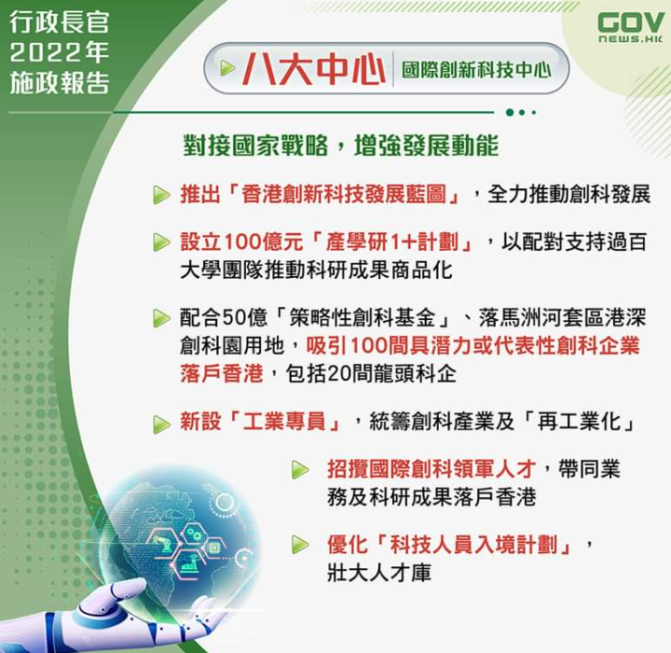
Reference
The “eight centres” and Hong Kong’s integration into the overall national development
The “eight centres” refer to:
International financial centre
International shipping centre
International trade centre
Centre for international legal and dispute resolution services in the Asia-Pacific region
International aviation hub
International innovation and technology centre
Regional intellectual property trading centre
East‑meets‑west centre for international cultural exchange
Sources:
Hong Kong Government Press Release https://www.news.gov.hk/chi/2022/11/20221118/20221118_163627_350.html#: ~:text=%E8%A8%BB%EF%BC%9A%E5%85%AB%E5%A4%A7%E4%B8%AD%E5%BF%83%E6%8C%87%E5%9C%8B%E9%9A%9B,%E4%B8%AD%E5%A4%96%E6%96%87%E5%8C%96%E8%97%9D%E8%A1%93%E4%BA%A4%E6%B5%81%E4%B8%AD%E5%BF%83%E3%80%82
Tamar Talk Facebook of the HKSAR Government
https://www.google.com/search?q=%E9%A6%99%E6%B8%AF%E6%94%BF%E5%BA%9C%EF%BC%8C%E5%85%AB%E5%A4%A7%E4%B8%AD%E5%BF%83&rlz=1C1GCEU_zh-TWHK908HK908&hl=en&sxsrf=AJOqlzXWsiVJPr5njKvvLoOt0cGOBqR3lQ:1675214577188&source=lnms&tbm=isch&sa=X&ved=2ahUKEwi3ya7OlPP8AhUiyDgGHRkaBzc4HhD8BSgDegQIARAF&biw=2133&bih=1041&dpr=0.9#imgrc=ljlcbjYtZvebjM

Slide 22


Conclusion
The governments all over the world are actively promoting the development of information technology at different levels, and introducing policies and measures to promote the applications of information technology in various aspects. The connectivity of the world is irreversible. Understanding the development characteristics of and flexibly using information technology is conducive to solving problems encountered in learning and daily life, closely connecting to the world, and bringing many development opportunities for us and society.
We are part of the society. To seize the opportunities brought by information technology, promotion by the government is important, but so is our cooperation at the same time. All responsible citizens should use information technology in compliance with laws and ethnics with a positive attitude, understand and make good use of the advantages and opportunities brought by information technology to people, society and our country.

Slide 23

The Internet
Since the end of the 20th century, the Internet has completely changed the way people communicate and connect with each other, leading to global transformations, creating new dimensions of life, and enhancing our ability to understand and transform the world. With the development of the Internet, people‘s communication breaks through the limit of time and space. As people can communicate more conveniently across regions, the world has become a "global village".

Slide 24






The Internet
Internet applications and the services provided by the Internet are wide-ranging, including the World Wide Web*, social media, email, mobile applications, multiplayer video games, Internet calls, file sharing, and streaming services.
* The World Wide Web (WWW) is an information system accessed through the Internet that consists of many interconnected hypertexts (including pictures, videos, sounds, software, etc.), with hyperlinks embedded in files linked to another webpage, which can be read and disseminated by users through a web browser.
Click on the image to learn more about WWW

Slide 25
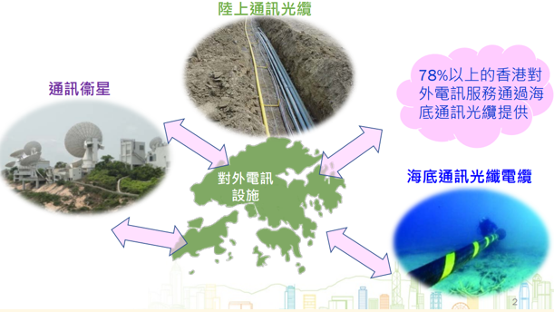

The Internet
The Internet infrastructure
The Internet relies on the construction of network infrastructure.
Among them, submarine optical fibre cable system is a network facility for telecommunications transmission among countries. Optical fibre cables, characterised by their huge capacity, are mainly used for transmitting voice, video and data signals. Through optical fibre cable networks, Hong Kong is connected to data centres, servers and relevant platforms around the world, with access to various online services and applications, and supporting business activities of various trades and industries. In addition, communication satellites and overland optical fibre cables are indispensable infrastructure for the Internet.
Take Hong Kong as an example, more than 78% of external telecommunications services are provided via submarine optical fibre cables.
Source: Office of the Communications Authority
https://www.legco.gov.hk/yr19-20/english/panels/itb/papers/itb20200113cb1-306-3-e.pdf

Slide 26
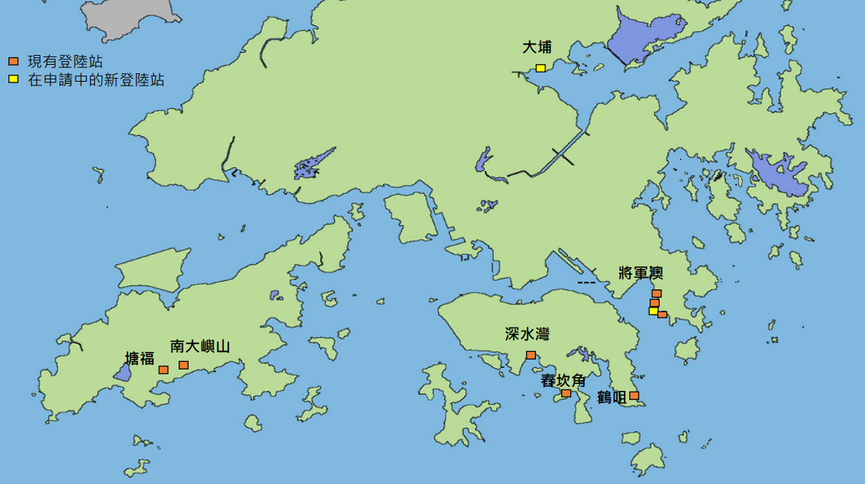
Reference
The Internet
The Internet infrastructure
• As of March 2022, over 99% of Hong Kong's external telecommunications network capacity was provided by 12 optical fibre cable systems (including submarine optical fibre cables connecting to the Asia-Pacific region, Europe and North America, and overland optical fibre cables connecting to the Mainland).
• The capacity of communication satellites is smaller than that of optical fibre cable systems which provide point-to-point telecommunications services. Communication satellites are characterised by their wide coverage which can provide users in the Asia-Pacific region (including relatively remote areas), with satellite telecommunications and television broadcasting services. Hence, they play an equally important role in establishing Hong Kong as a diversified regional telecommunications hub.
Reference: Office of the Communications Authority
https://www.legco.gov.hk/yr19-20/english/panels/itb/papers/itb20200113cb1-306-3-e.pdf

Slide 27

Reference
The Internet
The Internet infrastructure
The South-East Asia - Middle East - Western Europe 3 (SEA-ME-WE 3) is the longest submarine fiber optic cable in the world, with a network of 39 landing points connecting 4 continents (Asia, Africa, Europe and Oceania).
Since the official commencement of China's first submarine fiber optic cable - China-Japan submarine fiber optic cable in 1993, these cables have gradually evolved into the most important medium for China's international communications. China has achieved direct network connection with key countries such as the United States, Japan, Singapore, and the United Kingdom.
Reference: China Institute of Communications - Report on the Frontier of Global Submarine Fiber Optic Cable Engineering Technologies
https: //www.china-cic.cn/Detail/22/15/2831

Slide 28
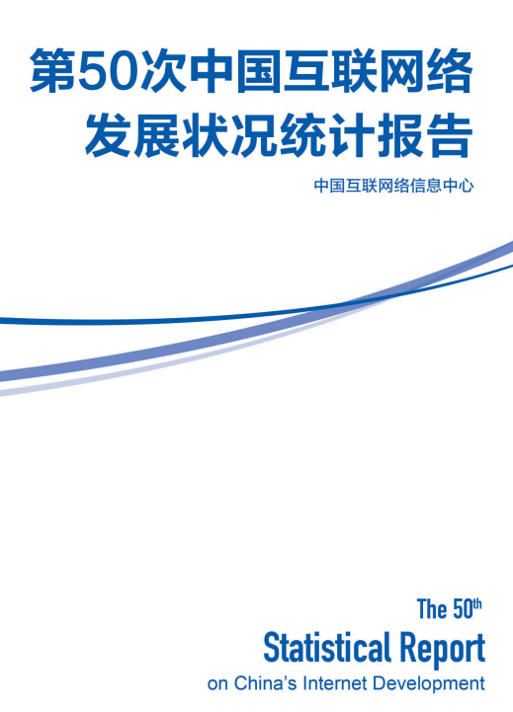
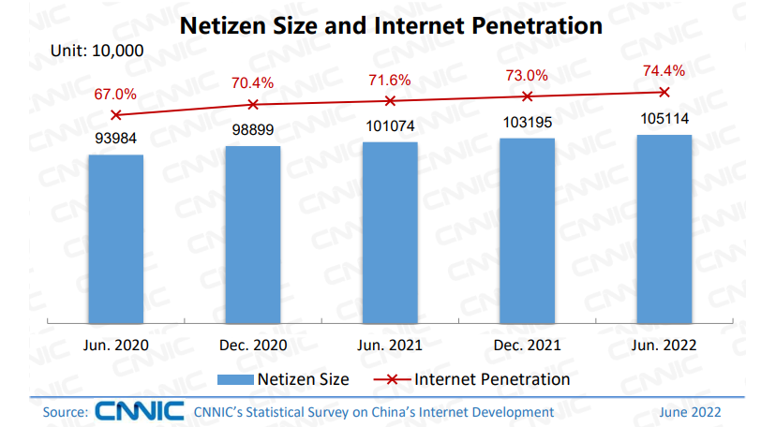
The Internet
The development of the Internet in our country
As of June 2022, the number of Chinese Netizens continued to grow steadily, with an increase of 19.19 million users and the Internet penetration rate rising by 1.4% when compared with December 2021. The construction of Internet infrastructure in rural areas has been comprehensively strengthened, with “broadband access to every village” achieved.
It has become a common practice for Mainland netizens to learn, shop and order takeout foods on the Internet, bringing numerous business opportunities and conveniences to the Mainland.
Click to learn more.
Source: The 50th Statistical Report on China’s Internet Development released in August 2022 (http: //www.cnnic.net.cn/n4/2022/0914/c88-10226.html )

Slide 29

Reference
The Internet
Our country promote online learning on the Internet
By integrating nationwide high-quality teaching resources, our country has launched a national smart education platform for primary and secondary schools for free since 2020 at teachers and students’ disposal. It aims to promote the development and sharing of high-quality educational resources. It is an important application of the Internet plus education.
To ensure the stable operation of the platform, the Ministry of Industry and Information Technology has designated a number of domestic digital enterprises to provide technical support so that it can be used online by 50 million students at the same time.
Click on the image to learn about the national cloud-based network platform for primary and secondary schools
(https://ykt.eduyun.cn/)

Slide 30
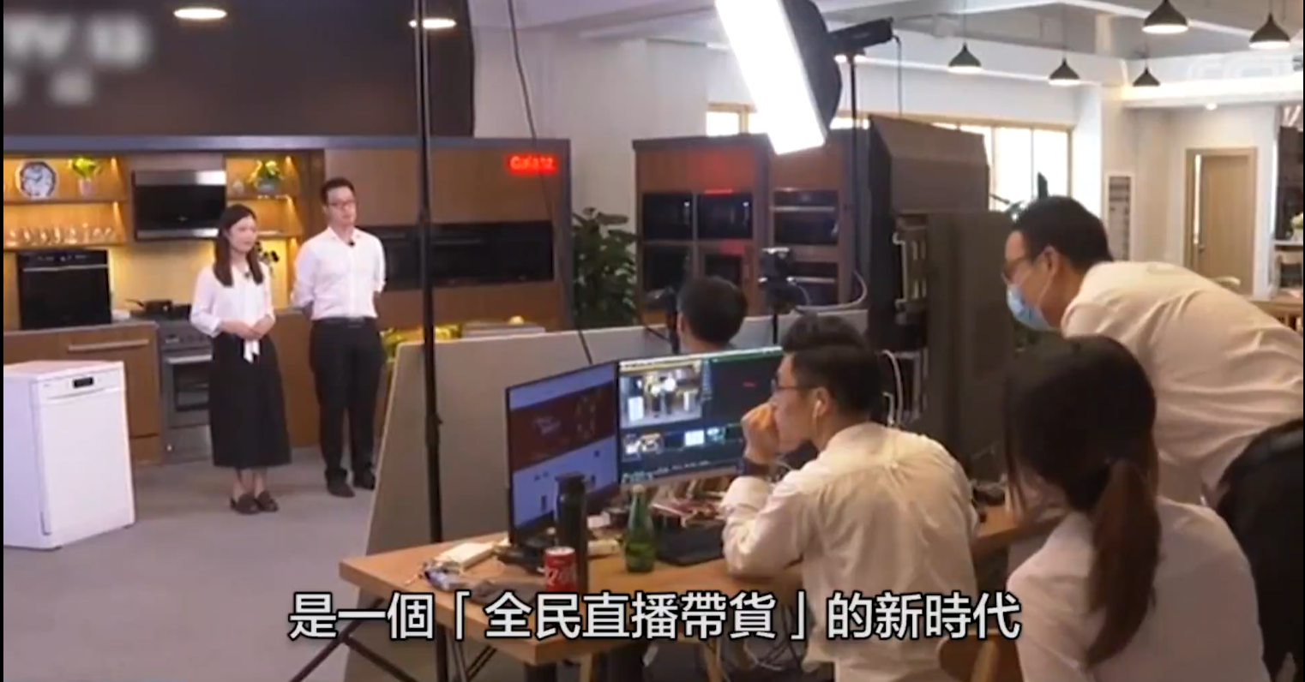

Reference
The Internet
In addition to the applications of the Internet in education, shopping and consumption, the Internet has promoted the socioeconomic development of the Mainland. For example, poverty alleviation through e-commerce which uses e-commerce to help poor areas, especially sales of agricultural products, opening up sales channels, establishment of brands, building infrastructure and nurturing talents. Internet technology is used to sell agricultural goods, increase farmers' income, and assist agricultural transformation and upgrading.
Click on the image to watch the video clip
Source: The China Current
(https://chinacurrent.com/hk/story/20474/live-broadcast-ecommerce)
For the above content, please review the PowerPoint slides “Learning focus: Changes and enhancement of people's quality of life”.

Slide 31
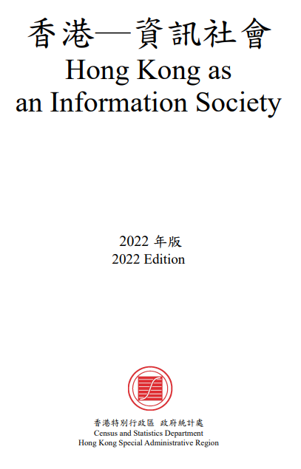
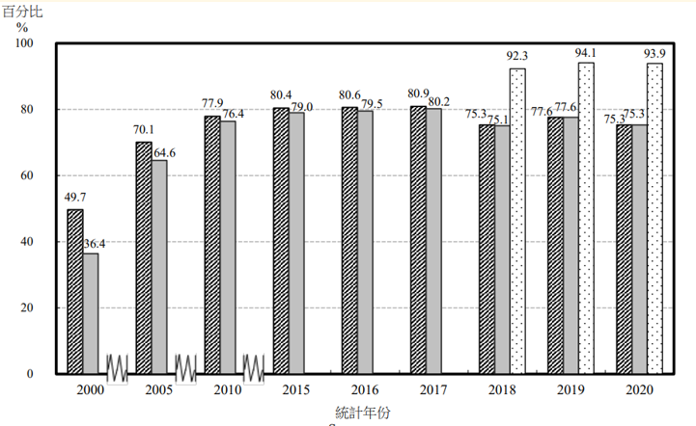
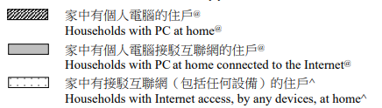

The Internet
Recent developments
Internet usage in Hong Kong soared from 30% in 2000 to 89% in 2017, and then rose from 90.5% in 2018 to 92.4% in 2020. Such increase was particularly significant among those aged 65 and above (up from 56.3% to 65.9%).
In 2020, around 2,511,900 households (accounting for 93.9% of all households in Hong Kong) had Internet access at home, by any devices, including smartphones, personal computers and other devices.
Teachers can click on the image on the left to obtain the relevant information for 2022 from the Census and Statistics Department.
Please also pay attention to the latest information released by the Census and Statistics Department.
Figure: The percentage of households with a personal computer at home, households with personal computers connected to the Internet, and households with Internet access at home among all households in Hong Kong
Sources:
Information Services Division of the Legislative Council Secretariat (https://www.legco.gov.hk/research-publications/english/1920issh15-social-media-usage-in-hong-kong-20191212-e.pdf)
Census and Statistics Department, April 2021
(https://www.censtatd.gov.hk/en/data/stat_report/product/B1130201/att/B11302732021XXXXB0100.pdf)

Slide 32

The Internet
Recent developments
According to data released by the Census and Statistics Department of the HKSAR Government in April 2021:
Of those 5 954 700 persons aged 10 and over who had used the Internet for online social activities during the 12 months before enumeration, 44.3% reported that they had used the Internet for such purpose for less than 10 hours per week. Another 33.2% had done so for 10 to less than 20 hours per week. For those 5 954 700 persons taken together, their average time spent in using the Internet for online social activities per week was 14.0 hours.
With the gradual popularisation of smartphones and tablets with nonstop Internet access, more and more people stay online 24 hours a day, with the flow of information no longer affected by time differences, and people are becoming more dependent on the Internet.
Reflection: Teachers ask students to reflect on how much time they spend online on weekdays. What is the purpose, practical need and significance of surfing the Internet?
Source: Census and Statistics Department(https://www.censtatd.gov.hk/en/data/stat_report/product/B1130201/att/B11302732021XXXXB0100.pdf)

Slide 33
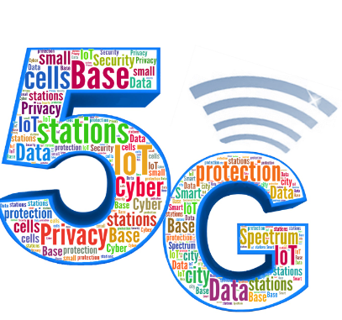


The Internet
The impact of the Internet – 5G
As the fifth- generation of mobile telcommunications, 5G promises much faster data download and upload speeds, lower response time/ latency, wider coverage and more stable connections. 5G services are already available in a number of countries/ regions.
As forecasted by the Groupe Speciale Mobile Association (GSMA), 5G is expected to contribute more than US$2.2 trillion (HK$17.2 trillion) to the global economy by 2034.
Quoted from the Legislative Council’s Essentials on 5G Technology (19-20). Teachers can learn more about the development of 5G. (https://www.legco.gov.hk/research-publications/english/essentials-1920ise06-5g-technology.htm)
Source: GSMA APAC 5G Industry Community
(https://www.gsma.com/asia-pacific/communities/ap5gic/)

Slide 34
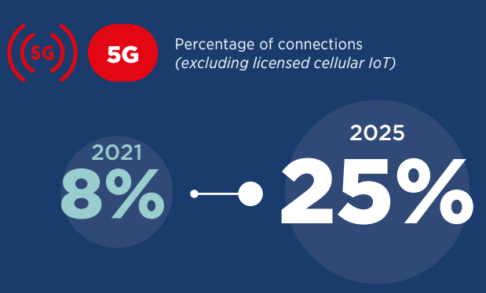
The Internet
The impact of the Internet – 5G
5G has gradually become the mainstream of information technology worldwide. According to a survey, more than 70 countries/regions around the world enjoyed 5G services in January 2022, with the usage rate about to increase from 8% in 2021 to 25% in 2025.
Source: GSMA 2022 Report
(https://www.gsma.com/mobileeconomy/wp-content/uploads/2022/02/280222-The-Mobile-Economy-2022.pdf)

Slide 35

Reference
The Internet
The impact of the Internet – 5G
5G technology
Increased speed: 20 times faster speed than 4G peak speed;
Low latency: end-to-end latency in 5G could reduce to 1 millisecond, which is 50 times shorter than that in 4G;
Higher capacity: 5G is expected to support up to 1 million connected devices per square kilometer which is a 1,000 times increase over 4G capacity.
The Legislative Council’s Essentials on 5G technology (19-20).
(https://www.legco.gov.hk/research-publications/english/essentials-1920ise06-5g-technology.htm)

Slide 36
The Internet
The impact of the Internet – applications of 5G technology
According to the International Telecommunication Union (ITU), 5G technology has three main uses as follows.
5G is expected to provide much faster and more reliable mobile broadband, which can be used in different applications, such as augmented reality (AR), virtual reality (VR), cloud-based services, etc.;
5G has the capability of connecting a large number of devices simultaneously through the Internet. 5G will be the backbone for the IoT, with example application such as smart cities, wearable devices and infrastructure management;
Low-latency 5G networks are expected to provide near-real-time communications with highly reliability, which facilitates delay sensitive applications, such as autonomous vehicles, remote machinery, and mission-critical intelligent applications (e.g. remote medical surge).
Quoted from the Legislative Council’s Essentials on 5G technology (19-20).
(https: //www.legco.gov.hk/research-publications/english/essentials-1920ise06-5g-technology.htm )

Slide 37

Reference
The Internet
The impact of the Internet – applications of 5G technology
The HKSAR Government is actively promoting 5G technology and its applications, including a funding scheme to finance projects covering innovative applications of different types and in various industries, such as remote maintenance of machines, telemedicine guidance and live streaming in higher definition than 4G.
According to the HKSAR Government, 5G has the characteristics of high speed, low latency, high capacity and massive connectivity. 5G offers vast potentials for various innovative commercial services and smart city applications, such as smart home, e-commerce, telesurgery, autonomous driving, etc. Since the launch of 5G services in April 2020 till the end of 2021, 5G services already covered more than 90% of the population. The coverage of 5G networks in core business districts has even reached 99%, laying a solid foundation for the widespread applications of 5G.
Source: Hong Kong Government Press Release 2022
(https://www.news.gov.hk/chi/2022/11/20221108/20221108_122336_431.html)
Source: Policy measures of the Commerce and Economic Development Bureau on telecommunications and broadcasting matters for 2022, the Legislative Council
https://www.legco.gov.hk/yr2022/english/panels/itb/papers/itb20221114cb1-747-3-e.pdf

Slide 38

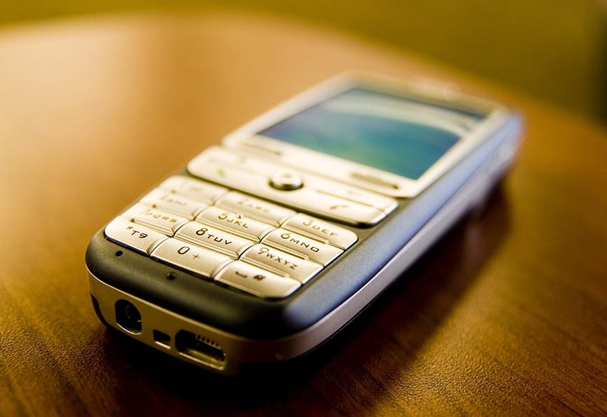


Activity
The Internet
The impact of the Internet – 5G
Do you know how 5G networks are changing our lives?
Take watching sports events for example, different generation of mobile telecommunications provide different experiences, for instance:
With 2G networks, only dynamic texts can be added.
With 3G networks, highlight pictures can be uploaded during matches.
With 4G networks, sports events can be live streamed relatively smoothly.
With 5G networks, sports events can be live streamed in higher definition than 4G.
Source: Office of the Communications Authority (https://www.ofca.gov.hk/trade_fund_report/2021/tc-chapter3.htm)

Slide 39
The Internet
The impact of the Internet – Examples of applications of 5G technology
5G + transportation
5G will enable autonomous vehicles to communicate with each other, and further optimise the safety and stability of autonomous driving, with relevant technologies still under testing. Such connectivity are of vital importance to highways and densely-populated cities, where only 5G can meet such stringent requirements simultaneously.
5G + healthcare
5G+ healthcare is more suitable for low-latency, high-reliability telemedicine scenarios, as it can provide diagnostic services to remote areas and connecting doctors and clinicians for consultation, thereby reducing the cost of medical treatment.

Slide 40
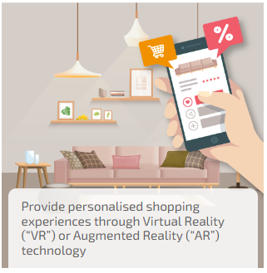
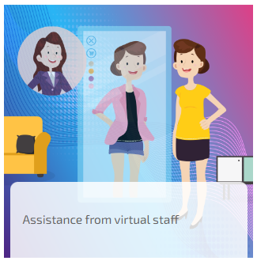
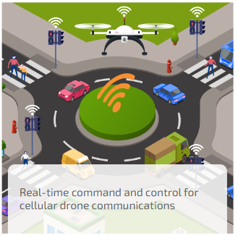

The Internet
The impact of the Internet – applications of 5G technology
5G technology can be widely used in daily life. Below are some examples.
Source: Communications Authority (https://www.5g.gov.hk/en/what-is-5g/applications.html)

Slide 41
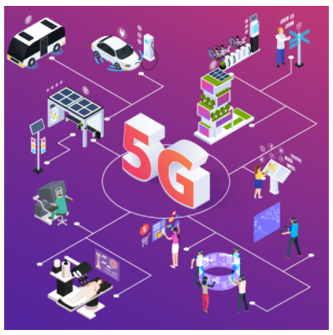


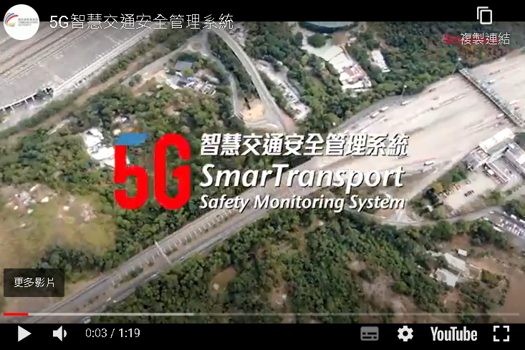
The Internet
The impact of the Internet – applications of 5G technology
Click on the images to see more applications of 5G technology in different fields.
Source: Communications Authority
https://www.5g.gov.hk/en/what-is-5g/applications.html
https://www.ofca.gov.hk/en/industry_focus/industry_focus/exp_sharing_on_5g_applications/index.html

Slide 42

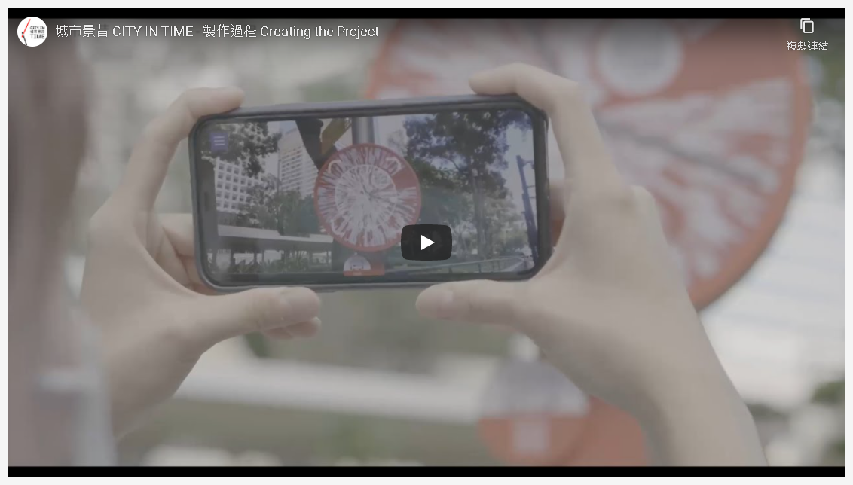
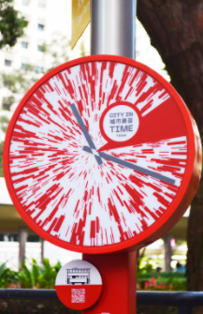


Reference
The Internet
The impact of the Internet – applications of 5G technology
5G's ultra-high-speed and low-latency features can support AR and VR more effectively, making relevant scenes more realistic and stable.
The Tourism Commission launched the City in Time tourism project in 2021, which integrated Augmented Reality (AR) and multimedia technologies to present perfect combinations of historical panoramas and real-life surroundings. Locals and tourists can travel through time and enjoy enriched visual and audio experiences with their smartphones to experience 360-degree historical panoramas featuring heritage photos or illustrations. The mobile app is also equipped with a selfie function that enables citizens and visitors to share their experiences of “CITY IN TIME” on social media platforms, and browse photos and information of the iconic spots with the mobile app to understand more about the history of Hong Kong.
Sources:
https://www.info.gov.hk/gia/general/202103/25/P2021032500181.htm?fontSize=1
https://www.cityintime.hk/en/

Slide 43

Reference
The Internet
The impact of the Internet – applications of 5G technology in China
China's 5G network construction and the application are advancing at an ever faster pace. In September 2022, a total of 1.968 million 5G base stations were completed and put into operation nationwide, and the high-quality external networks of the Industrial Internet covered more than 300 cities across the country. “5G + Industrial Internet” is widely applied in the fields of mining, steel, electric power and petrochemicals, with more than 1,800 projects under construction.
5G has also driven the development of consumption, investment and industrial chains. According to the China Academy of Information and Communications Technology (CAICT), in January-November 2021, China’s cumulative shipments of 5G mobile phones totaled 239 million, representing a year-on-year increase of 65.3%. 5G applications have become an important engine for the promotion of transformation of the economy and society through digitalisation, networkisation and smartisation. There are more than 10,000 cases of 5G innovative application nationwide, covering 22 important industries of the national economy.
Sources:
http://www.gov.cn/xinwen/2022-09/09/content_5709216.htm
http://www.gov.cn/xinwen/2021-12/27/content_5664728.htm
For more information on the applications of 5G technology in China, please refer to the relevant PowerPoints slides on the following “learning focuses”.
Theme 1: Achievements of the country in different areas in recent years (new high-end technologies, medical care and public health, culture and education, infrastructures, poverty eradication)
Theme 2: Enhancement of overall national strength

Slide 44
The Internet
The impact of the Internet - Conveniences brought to life and work
The Internet has brought us lots of conveniences and improved our lives:
The information on the Internet is very rich and diversified, bringing people a lot of conveniences.
The Internet has made learning more convenient, and various courses can be found online.
The Internet has enlarged our social circles without geographical restrictions, allowing us to get into contact with different people.
People from different countries, regions and cultures can work closely together through the Internet. The Internet also provides a variety of new ways to collaborate, such as remote working and video conferencing.
Business opportunities can be explored through the Internet.
...

Slide 45
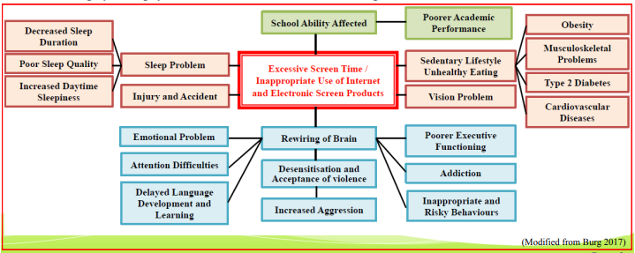

The Internet
The impact of improper and excessive use of the Internet
Have you ever been emotionally affected in the case of a cutoff of Internet signals or poor signal reception? In fact, improper and excessive use of the Internet and electronic screen products poses potential risks to our health, including children and adolescents.
Source: Department of Health (https://www.chp.gov.hk/files/pdf/ncd_watch_march_2019.pdf)

Slide 46


The Internet
The impact of improper and excessive use of the Internet
Excessive use of the Internet can affect daily life, such as spending a long time on online games, which has raised concerns about the problems caused by Internet addiction. In 2018, the World Health Organization (WHO) classified “Gaming Disorder” as a mental illness in the 11th revision of the International Classification of Diseases, pointing out that patients cannot live, work and socialise normally, and notified governments around the world to formally include the disorder into their medical system.
“Gaming Disorder” is characterised by impaired control over gaming, increasing priority given to gaming over other activities to the extent that gaming takes precedence over other interests and daily activities, and continuation or escalation of gaming despite the occurrence of negative consequences.
Source: WHO
(https://www.who.int/news/item/14-09-2018-inclusion-of-gaming-disorder-in-icd-11)

Slide 47



The Internet
The impact of the Internet
The Internet continues to be popularised and widely used around the world. However, due to factors such as technological conditions, social development and individual economic conditions, the Internet has also brought inequalities and differences, resulting in digital divide.
The Digital Divide refers to the gap between individuals, households, businesses and geographic areas at different socio-economic levels with regard both to their opportunities to access information and communication technologies (ICT) and to their use of the Internet for a wide variety of activities.
Panel on Information Technology and Broadcasting of the Legislative Council (https://www.legco.gov.hk/yr00-01/english/panels/itb/papers/1143-02e.pdf)
References:
Organization for Economic Co-operation and Development (2006)
(https://www.oecd.org/sti/1888451.pdf)

Slide 48

Reference
The Internet
The impact of the Internet
According to the United Nations, 37% of the world's population, i.e. 2.9 billion people, still had never used the Internet by 2021. 96% of the 2.9 billion people who remained offline were estimated to live in developing countries. Even among the 4.9 billion Internet users, hundreds of millions might only go online infrequently, using shared devices or facing connection speeds that hamper their internet use. Hence, this may affect their learning and employment opportunities.
Source: United Nations (https://news.un.org/en/story/2021/12/1106862)

Slide 49


Reference
The Internet
Examples of the measures taken by the HKSAR Government to assist students from low-income families to study online
Starting from the 2018/19 school year, the Community Care Fund subsidised the purchase of mobile computer devices for e-learning by underprivileged primary and secondary school students for a period of three years.
The 2020 Policy Address proposed earmarking funds under the Quality Education Fund for a three-year programme. About HK$1.5 billion was earmarked for the provision of mobile computer devices and Internet services support, benefiting about 310,000 students. During the three-year implementation period, schools can apply for a basic grant for each eligible student to purchase mobile computer devices and basic accessories for loan to the students.
Since the 2015/16 school year, the Education Bureau has establish WiFi campuses for all public sector primary and secondary schools in Hong Kong to facilitate students’ e-learning using mobile computer devices in classrooms. The “Quality Education Fund e-Learning Funding Programme – Provision of Mobile Computer Devices and Internet Services Support Scheme” was launched in the 2021/22 school year. Participating schools can apply for funding to purchase mobile computer devices for financially needy students.
Click on the image to learn about the details of the measures.
Sources:
Hong Kong Government News Network (https://www.news.gov.hk/eng/2021/05/20210517/20210517_163805_639.html)
The Education Bureau (https://www.edb.gov.hk/en/edu-system/primary-secondary/applicable-to-primary-secondary/it-in-edu/ite-qef/qef_index.html)

Slide 50
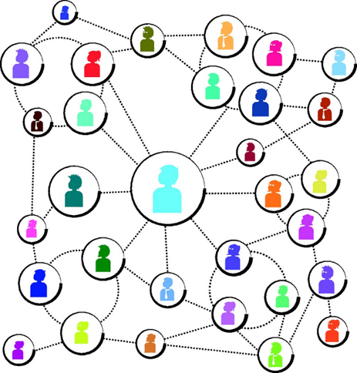

Social networking sites
The Internet has further facilitated the development of online social networks. Online social networks, also known as online social networking sites, online social media, generally refer to the practice of providing Internet users with various contacts, integrating functions such as sharing and forwarding daily life-related photos, videos, various information and news, sending and receiving emails, instant messaging services and livestreaming. Online social networks form a huge virtual network which is spread at an increasingly faster speed, releasing information to everyone and discussing topics.
Social networking sites such as Facebook, Instagram, Weibo, MySpace, Twitter and TikTok allow us to communicate with friends and strangers online, and build network with friends linked by shared hobbies and interests. These sites, as useful resources, can bring benefits to society, but also risks as well.
Reference: Office of the Government Chief Information Officer
https://www.infosec.gov.hk/en/best-practices/person/safe-online-social-networking

Slide 51

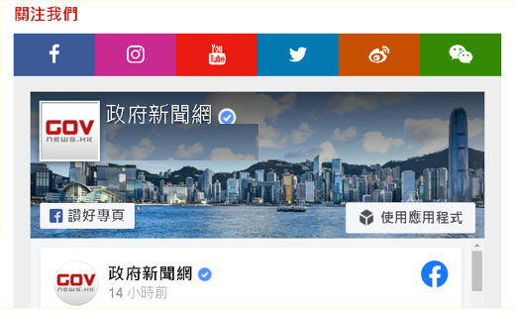



Reference
Social networking sites
Examples of applications in government departments
Online social networks are very popular now. They are not only an indispensable social tool in people's lives, even governments have also actively utilised the Internet and social media to directly release information to citizens, in addition to using the television, radio, media, etc. The Chinese government uses Weibo and WeChat to announce government information such as the State Council’s activities, important meeting information, policy documents, and interpretation manuscripts. The HKSAR Government has also set up a website and the “Tamar Talk” Facebook webpage, and the Information Services Department has also provided various information to the public and extensively release information to society through social media platforms.
Official WeChat account of the State Council

Slide 52
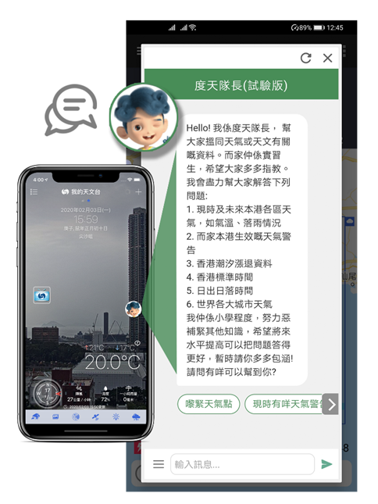


Reference
Social networking sites
Examples of applications in government departments
Different departments of the HKSAR Government also use social networking sites to disseminate the proper knowledge and information to serve the public.
The Fire Services Department's “Anyone” teaches Cardio-Pulmonary Resuscitation (CPR) to citizens in the form of a lighthearted song.
Environment Bureau*’s “Big Waster” promotes environmental protection with an infographic
The HKO’s chatbot “Dr. Tin” can provide weather and astronomical information to users by means of questions and answers.
Sources:
Information Services Department https://www.youtube.com/watch?v=hhln4dpmCnE/
Fire Services Department https://www.hkfsd.gov.hk/eng/education/cpr_aed_olr.html
Official website of Hong Kong Observatory https://www.hko.gov.hk/en/education/weather/data-and-technology/00569-How-Chatbot-Dr-Tin-is-Trained.html
*Renamed as the Environment and Ecology Bureau on 1 July, 2022

Slide 53

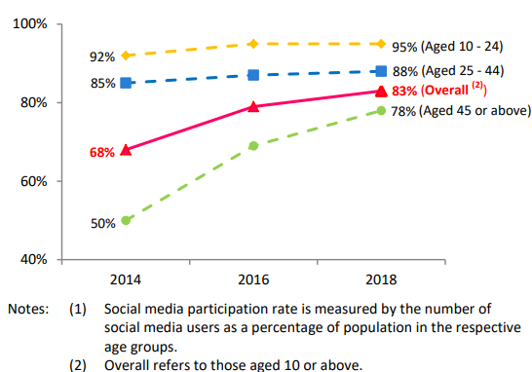

Social networking sites
High-frequency and continuous socialising
Hong Kong residents have also made extensive use of social media. According to the Information Services Division of the Legislative Council Secretariat, the growing popularity of social media in Hong Kong can be seen from the increase in social media participation rate from 68% in 2014 to 83% in 2018.
Source: Information Services Division of the Legislative Council Secretariat (https://www.legco.gov.hk/research-publications/english/1920issh15-social-media-usage-in-hong-kong-20191212-e.pdf)

Slide 54

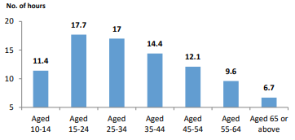
Social networking sites
High-frequency and continuous socialising
The amount of time spent on social media by Hong Kong residents was also on the rise. In 2018, Hong Kong people spent an average of 12.9 hours per week on social media, up from 10.4 hours in 2014. Young people spend relatively more time on social media than other age groups.
In 2018, people aged 15-24 were the heaviest users who spent an average of 17.7 hours on social media per week.
Source: Information Services Division of the Legislative Council Secretariat (https://www.legco.gov.hk/research-publications/english/1920issh15-social-media-usage-in-hong-kong-20191212-e.pdf)

Slide 55
Social networking sites
High-frequency and continuous socialising
Take the data released by the Census and Statistics Department in April 2021 for example:
Among people aged 10 and over who had used the Internet during the 12 months before enumeration, their major purposes of using the Internet were “communication/ interaction”, accounting for up to 99.2%, the highest of all; among which, those did so for “online social activities” accounted for 99.0% (such as WhatsApp, WeChat, LINE, Facebook, Instagram, blogs, online forums, etc.). This was followed by “information searching” (95.2%) and “online entertainment” (90.9%).
They spent an average of 14 hours a week on the Internet for social networking activities.
Census and Statistics Department, April 2021
(https://www.censtatd.gov.hk/en/data/stat_report/product/B1130201/att/B11302732021XXXXB0100.pdf)
Teachers can select the June 2022 edition of the data from Census and Statistics Department to guide students to learn about the latest developments as classroom activities. Teachers should also pay attention to the latest information released.
https://www.censtatd.gov.hk/en/data/stat_report/product/B1110006/att/B11100062022AN22B0100.pdf

Slide 56


Social networking sites
Wide coverage, mutual influence and imitation
The influence of online social networking sites is broad and profound, and social networks are widely used by different age groups, nationalities and occupations for a variety of activities. People all over the world influence, learn from and imitate each other through social networks, yet such widespread participation makes it easy to become a social and even global issue.
Case
"Gangnam Style" that took social networks by storm
The Korean song "Gangnam Style" was spreading all over social networks on the Internet quickly became a global hit, setting a Guinness World Record as the most viewed YouTube video with the most “Likes” (2012). Netizens from different countries also performed different versions of the song in their own ways, and then uploaded them to social networking platforms for sharing again.
Sources: The official website of Guinness World Records
https://www.guinnessworldrecords.com/news/2012/11/psy-receives-guinness-world-records-certificate-for-gangnam-style-45809
https://www.guinnessworldrecords.com/news/2012/12/psys-gangnam-style-becomes-first-video-to-be-viewed-1-billion-times-on-youtube-46462

Slide 57






Instant messaging software
Features: Connectivity, real-time connection
Instant messaging software refers to the software that fulfills real time online chatting, communication and video communication through real-time communication technology. It enables two or more people to use the network to transmit text messages, files, voice and videos in real time.
Different kinds of instant messaging software (such as WhatsApp, Line, Facebook Messenger, Weibo, WeChat) installed on smartphones have become indispensable communication tools in daily life. Video communication (such as Tencent Meeting, Zoom video conferencing) also helps us distance learning and work remotely.

Slide 58


Reference
Instant messaging software
Features: Connectivity, real-time connection
Videoconferencing is a commonly used real-time video communication platform in recent years, especially during the severe outbreak of COVID-19 epidemic. These communication platforms provide us with convenient and effective communication tools to assist us in work and study from home, and provide a fast and stable communication and collaboration platform, allowing multiple people to conduct audio and video conferences, share screens, data and information in real time. Tencent Meeting and Zoom are commonly used real-time audio and video conferencing platforms. They have changed our ways of communication, facilitating us to communicate with people around the world, and promoting the interconnectivity of the world.
In response to the impact of COVID-19, some Legislative Council meetings were also conducted by videoconferencing via Zoom. Members of the public can also watch or listen to the meetings via the "Webcast” system on the Legislative Council website. Archives of all open virtual meetings will also be available for public access via the system.
Source: The Government of the Hong Kong Special Administrative Region Press Releases (https://www.info.gov.hk/gia/general/202202/03/P2022020300616.htm?fontSize=1)

Slide 59


Wide circulation of a large amount of information in a short period of time, accompanied with constant updating and forwarding
Highly interactive
Media such as newspapers, radio, and television are one-way, linear transmissions centered on communicators. Whereas online social platforms or instant messaging programs blur the boundaries between the sender and the audience, who is both the recipient and the disseminator of messages. Audiences not only use mobile communication devices to send and receive the latest information at any time, but also communicate with different people without the limitations of time and space.
Social platforms or instant messaging programs make the spread and dissemination of information faster. Once hot topics or issues are unfolded on the Internet, they are extensively spread in a “point-line-surface” manner within a short period of time, along multiple paths and in all directions.

Slide 60
Reference
Wide circulation of a large amount of information in a short period of time, accompanied with constant updating and forwarding
Highly interactive
At a time when the COVID-19 pandemic has caused social anxiety and even panic, people discovered that the variant virus Omicron was spreading rapidly and hence worried about being infected. Unverified information related to the disease was spreading at an alarming rate...
However, in times of crisis, we should apply critical thinking skills by seeking the truth from multiple perspectives in the spirit of respecting for evidence before sharing reliable and accurate information with others. We should also maintain personal and environmental hygiene, and work together to fight against the pandemic.
Source: Curriculum Development Institute of the Education Bureau, “Citizenship and Social Development Web-based Resource Platform”
學生網上自學資源 高中公民與社會發展科X資訊素養 - 2019冠狀病毒病 (COVID-19)：「辨別虛假資訊」(Chinese only)
Self-learning Online Resources for Students: Morals and conduct in using information technology: Taking COVID-19 as an example
(https://cs.edb.edcity.hk/en/sl_students.php)

Slide 61

Real-time communication, sharing of information and concerted action among people in different geographical locations
Highly interactive
Appeals are made to sponsors through social networking sites or instant messaging apps to support reconstruction after disasters, charity activities, venture capital raising, health campaigns, artistic creation, design & invention, scientific research and public projects.
To promote the message of animal protection, various government departments have collaborated to launch the “Animal Watchers” Scheme through social networks and other means. Many citizens have also used social networks to share message of caring for animals, related knowledge and volunteer activities.
During the COVID-19 epidemic, many famous elite athletes shot short video clips and uploaded them onto social platforms for doing exercise with citizens at home.
Sources:
Papers of the Hong Kong Legislative Council (https://www.legco.gov.hk/yr18-19/english/panels/se/papers/se20190402cb2-1100-6-e.pdf)
Youth.gov.hk (https://www.youth.gov.hk/en/cultural-and-leisure/stories/detail.htm?content-id=2374804&section=CLA)

Slide 62
Instant messaging software and social networking sites
Anxiety, confusion, seduction and crimes related to social networks
Social networking sites and instant messaging software have promoted communication among people and massive social networking groups are formed. Many Internet celebrities having a large number of followers and “fans”. While such virtual social networking expands our social circles, they have also brought about many problems.
Addiction to social networks, obsession with smartphones, anxiety caused by fear of missing out on social network messages, and of not having a mobile phone.
Spending too much time posting photos, videos, etc., being emotionally affected and even uneasy because of other people's comments.
Difficulty in really knowing each other due to the virtual and anonymous characteristics of social networks, and the possibility of being deceived.
Thoughts and behaviors being unconsciously affected, and even loss of ourselves due to imitation of each other...

Slide 63
Reference
Instant messaging software and social networking sites
“Internet celebrity” or KOL (Key Opinion Leader) is a phenomenon that has taken the world by storm in recent years. It has become a popular profession in society, with many of them being freelancers. They make use of social networks, instant messaging programs, YouTube, etc. to become influencers. Celebrities, professionals, ordinary people, and even animals can also become Internet celebrities. But these online activities must also be conducted legally and ethically.
“Internet celebrities” wield a strong influence in different fields, issues and communities. They spread and convey different messages through virtual social platforms to attract public attention, interactions, and even followers. Currently, there are various types of “Internet celebrities” or KOLs, such as those teaching make-up, sharing travel information, sharing daily outfits, and even livestreaming mainly exaggerated performances. Some “Internet celebrities” or KOLs’ videos require a paid subscription. Their opinions are shared by their followers and are more likely to drive or change the audience's decisions. Fans interact with “Internet celebrities” or KOLs through live streaming platforms for sponsorship, gift-giving, and tipping, which is one of the income sources of “Internet celebrities” or KOLs.

Slide 64
Instant messaging software and social networking sites
Crimes committed using instant messaging software and social networking sites
In 2021, the Hong Kong Computer Emergency Response Team Coordination Centre handled a total of 7,725 security incidents, among which phishing accounted for nearly half of the total, and the overall cyber security situation was similar to the global situation.
For phishing cases, many hackers took advantage of the public concern over the epidemic by disseminating false information to lure the victims into visiting malicious websites, disclosing sensitive information, or even defrauding money.
As regards technology crimes, the Hong Kong Police Force recorded a total of 16,159 technology crime cases in 2021, representing an increase of about 25% as compared with 12,916 cases in 2020.
Sources
Hong Kong Government Press Release 2022 (https://www.news.gov.hk/chi/2022/04/20220415/20220415_121527_555.html?type=ticker)
April 19, 2022: Update on information security by the Panel on Information Technology and Broadcasting of the Legislative Council (https://www.legco.gov.hk/yr2022/english/panels/itb/papers/itb20220419cb1-138-2-e.pdf)

Slide 65
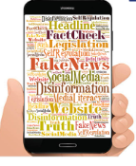


Reference
Instant messaging software and social networking sites
Laws governing crimes related to
instant messaging software and social networking sites
The Basic Law protects the freedom of speech of Hong Kong residents, but such freedoms is not without bounds. There are a number of legal provisions that may be applicable to online speech, including:
Criminal intimidation under the Crimes Ordinance (Cap. 200) and blackmail under the Theft Ordinance (Cap. 210).
Making inappropriate speech online may also breach other offences, such as data protection principles under the Personal Data (Privacy) Ordinance (Cap. 486), infringement of copyrights, libel or the common law offence of inciting public nuisance if such information poses a threat to public safety.
If an electronic message may constitute an offence endangering national security or to cause the occurrence of such an offence, the Police may exercise the power under the Implementation Rules for Article 43 of the National Security Law to take disabling actions on such electronic message.
References:
Data Research Unit, Information Services Division of the Legislative Council Secretariat (https://www.legco.gov.hk/research-publications/english/essentials-1920ise10-measures-to-tackle-online-disinformation.htm#endnote6)
Hong Kong Government Press Release (https://www.info.gov.hk/gia/general/202107/21/P2021072100741.htm)

Slide 66



Reference
Instant messaging software and social networking sites
“Doxxing” and regulations combating “doxxing” acts
Many netizens use social media platforms or instant messaging programs to “dox” and post or repost any information that appears to be “doxxing”. In recent years, personal data has been “weaponised”, with the practice of “doxing” became rampant. The Personal Data (Privacy) (Amendment) Ordinance 2021 was published in the gazette and came into effect. The Ordinance aims to combat malicious doxxing acts so as to protect the public's personal data privacy.
The Amendment Ordinance criminalises doxxing acts and empowers the Privacy Commissioner for Personal Date to carry out criminal investigation and institute prosecution towards doxing-related offences. It also confers on the commissioner statutory powers to issue notices demanding the cessation or restriction of disclosure of doxxing content.
“Doxxing” generally refers to the practice of gathering the personal data of target person(s) or related person(s) (such as family members, relatives or friends) through online search engines, social platforms, discussion forums, public registers, anonymous reports etc., and disclosing such personal data on the Internet, social media or other open platforms (including public places).
Sources:
Hong Kong Government News Network (https://www.news.gov.hk/eng/2021/10/20211008/20211008_124058_315.html)
Office of the Privacy Commissioner for Personal Data (https://www.pcpd.org.hk/english/doxxing/index.html)

Slide 67


Reference
Instant messaging software and social networking sites
Examples of laws and regulations governing online sales in the Mainland
In April 2021, seven departments, including the Office of the Central Cyberspace Affairs Commission, the Ministry of Public Security, the Ministry of Commerce, the Ministry of Culture and Tourism, the State Administration of Taxation, the State Administration for Market Regulation, and the National Radio and Television Administration, jointly issued the Measures for Administration of Live Streaming Marketing Activities (for Trial Implementation). The measures aim to regulate online live streaming marketing, crack down on issues such as live streamers' inappropriate words and deeds, the employment of minors to make profits through live streaming, false advertising and provision of false information, and frequent occurrence of counterfeit and shoddy goods, and address the difficulty in evidence collection for consumer rights protection.
Sources:
http://www.gov.cn/xinwen/2021-04/23/content_5601680.htm
http://www.cac.gov.cn/2021-04/22/c_1620670982794847.htm
For the contents of the Measures for Administration of Live Streaming Marketing Activities (for Trial Implementation), please click on the image. Teachers should also pay attention to the latest release of regulations.

Slide 68
Instant messaging software and social networking sites
Problem: easily lead to information fragmentation
The amount of information available to people is much greater than ever, but the content tends to be fragmented. Due to the influence of the way instant messaging software and social networking sites communicate (such as the limit on the number of characters to be posted), complete information is often broken down into various pieces and spread quickly. As a result, the content of the fragmented information or logic behind is incomplete, which makes it difficult for people to understand the full picture of matters or events, resulting in a lack of in-depth reading, systems thinking and judgment.

Slide 69
Instant messaging software and social networking sites
Widely disseminated information is not necessarily accurate
When people find the views that they agree with gained widespread popularity, they will subconsciously “determine” that these views are “popular” and “assert” that they are “correct and reasonable”. On the contrary, if people do not find the views they agree with, or there is not much support on their agreed views from people, or their views are even criticised and debated by people. They will choose to remain silent and not express their views. The media often pays attention to the views of the majority, so the voice of the minority is unheard. As a result, the voice of the majority is getting loud. The overwhelming “unanimous” opinions on the Internet often do not truly represent the views of everyone or the silent majority.
Reference: Elisabeth Noelle-Neumann: The Spiral of Silence Public Opinion-Our Social Skin 1984

Slide 70

Instant messaging software and social networking sites
Concerns on subjectivity
People tend to pay attention to or focus only on the information that pleases them. As time passes, they could only read the messages that interest them, and neglect other opinions from a macro perspective. If we automatically filter out information we disagree with, our horizons will also be affected.
Reflection: We need to remind ourselves that social networking sites and instant messaging tools make it easier for us to find people with similar interests. But at the same time, social networking tools also filter the types and sources of information according to personal preferences. With time, it tends to make us exposed to information that is consistent with our own values and ignore information incorporating other opinions.
Source: Cass R.Sunstein: Infotopia -How many minds produce knowledge, 2006

Slide 71
Proliferation of false information, which users need to discern carefully
Today, it is more convenient for people to gain access to information, but this also makes people feel troubled. There is too much information with a mix of good and bad contents, which makes it difficult and time-consuming to distinguish and judge whether it is true or false.
Let's discuss:
Have you ever tried reposting unverified information?
Have you or someone close to you been deceived by false information?
How to prevent this from happening?

Slide 72

Proliferation of false information, which users need to discern carefully
Disinformation, fake news
Disinformation is drawing growing global concern, owing to its impact on information flow and broad implications on public safety, security and other social issues. Whilst not a new phenomenon, disinformation has recently been the focus of growing attention in Hong Kong. Particularly, in the digital age, , the effect of disinformation has been amplified by the ubiquity of the Internet and social media networks.
Social networking sites and instant messaging software have become the major means for people to obtain news and information. However, online platforms are also seen as a major channel for spreading disinformation, the spread of which can have a damaging impact and is more likely to break the law.
Reference: Data Research Unit, Information Services Division of the Legislative Council Secretariat
(https://www.legco.gov.hk/research-publications/english/essentials-1920ise10-measures-to-tackle-online-disinformation.htm#endnote6)

Slide 73

Proper and healthy use of
instant messaging software and social networking sites
Be cautious about cyber security
When disseminating information via instant messaging software and social networks, we should think about the following:
Every word and deed in the cyberspace may be recorded, so we should avoid expressing casual and impromptu opinions. It is better to fully verify the facts in advance. Be empathetic and considerate of others’ feelings. Pay attention to whether our speech will affect the credibility and interests of others, and be responsible for personal speech.
Many things are not "black-or-white", and analysing the same thing from different perspectives may draw different conclusions. We should see things from multiple perspectives, verify before dissemination of any information. Try to think from the perspective of others, acquire attitudes of tolerance and acceptance of different opinions.
Pay attention to anonymous messages that deliberately slander others. Do not disclose too much information involving personal privacy in the cyberspace, lest that it would be maliciously used by criminals.
For details, please refer to EdPost of the Hong Kong Education City
(https://www.edcity.hk/hq/zh-hant/content/kol%E4%B8%8D%E6%98%93%E5%81%9A%E3%80%80%E7%B6%B2%E7%B5%A1%E5%AE%89%E5%85%A8%E8%A6%81%E5%AF%A9%E6%85%8E)

Slide 74

Proper and healthy use of
instant messaging software and social networking sites
Office of the Government Chief Information Officer provides a lot of information on the proper and healthy use of instant messaging software and social networking sites.
Safe online social networking
https://www.infosec.gov.hk/en/best-practices/person/safe-online-social-networking
Using Instant Messaging Safely
https://www.infosec.gov.hk/en/best-practices/person/using-instant-messaging-safely

Slide 75

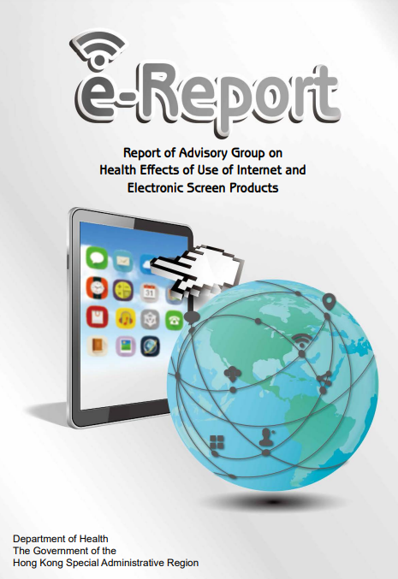

Proper and healthy use of
instant messaging software and social networking sites
Department of Health provides advice and promotes healthy online behaviours, including active participation in physical and outdoor activities, engaging in real-life interactions and limiting screen time, and choosing screen-related activities wisely. Please visit the following webpages for information (including short videos, reports, detailed health advice, etc.).
https://www.studenthealth.gov.hk/english/internet/health_effects.html
The Education Bureau's “Active Students, Active People” Campaign
https://www.edb.gov.hk/en/curriculum-development/kla/pe/asap/index.html

Slide 76


Proper and healthy use of
instant messaging software and social networking sites
Related learning and teaching resources
Education Bureau provides the “Information Literacy Framework for Hong Kong Students” Learning Framework and information kit on e-learning for schools, as well as professional development programmes for teachers to cultivate students' ability and attitude to use information and communication technology. Stay tuned for the latest information.
Source: The Education Bureau (https://www.edb.gov.hk/en/edu-system/primary-secondary/applicable-to-primary-secondary/it-in-edu/information-literacy/il-index.html)
Education Bureau has developed and provided a number of resources and reference materials on information literacy and electronic safety. Please refer to the following:
Source: The Education Bureau (https://www.edb.gov.hk/attachment/en/edu-system/primary-secondary/applicable-to-primary-secondary/it-in-edu/Information-Literacy/ResourcesAndReferenceMaterials(EH).pdf)

Slide 77





Proper and healthy use of
instant messaging software and social networking sites
Related learning and teaching resources
Please refer to the Education Bureau's learning and teaching resources on information literacy
Source: Education Bureau
(https://www.edb.gov.hk/tc/curriculum-development/4-key-tasks/moral-civic/L_and_T/IT_Education/IT_Ed_Lea.html) (Chinese only)

Slide 78
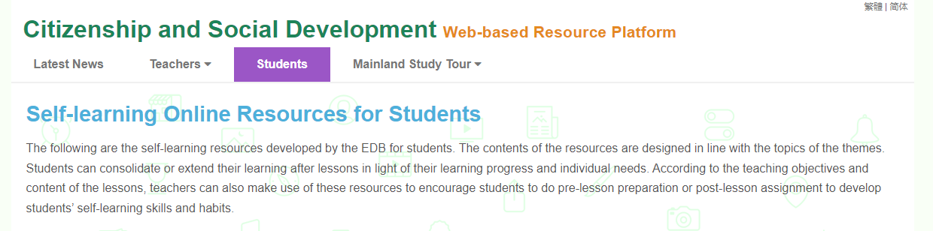
Proper and healthy use of
instant messaging software and social networking sites
Related learning and teaching resources
For senior secondary students: Citizenship and Social Development x Information Literacy - Taking COVID-19 as an example: “Identify false information” (Chinese only)
Morals and conduct in using information technology: Taking COVID-19 as an example

Slide 79
Conclusion
In the information society, the Internet, social networking sites and instant messaging software have enhanced the interconnectivity of the world, provided real-time information and contacts, and brought conveniences to our lives and work. But at the same time, they may also cause anxiety, confusion, seduction and crime.
While promoting the development of information technology, governments of all countries/ regions also attach importance to raising the public’s awareness of how to make good use of information technology through education and publicity, and to formulating and amending laws to protect public interests and crack down on online illegal acts. Therefore, the cyberspace is also governed by laws.
Whether information technology can bring positive impact to the public depends on our attitudes and behaviors. We should learn to make good use of information technology and cultivate positive values, which are the indispensable knowledge, skills and attitudes in the information age.

Slide 80
User Guide
The primary users of this resource are teachers. It aims to provide teachers with content knowledge relevant to the topic to enable teachers to have a deeper understanding of teaching content when preparing for their lessons.
All data, videos, photos, pictures, questions and suggested answers can be used for multiple purposes, such as teachers’ teaching materials, references for curriculum planning and learning and teaching, and student assignments, etc. To align with Citizenship and Social Development Curriculum and Assessment Guide (Secondary 4-6) (2021) (C&A Guide), this resource should be adapted to cater for students’ learning diversity and the needs of classroom teaching, etc.
Teachers may provide appropriate supplementary notes/ explanations to enrich this resource in order to enhance students’ understanding of the topic and information provided.
In accordance with the curriculum rationale and aims, teachers may select other learning and teaching resources which are correct, reliable, objective and impartial to help students build up a solid knowledge base, develop positive values and attitudes as well as enhance critical thinking and problem solving skills, and various generic skills.
If some information cannot be provided in this resource due to copyright issue, teachers may visit relevant websites provided.
Some information may have been updated when being used by teachers, teachers may visit the corresponding websites to obtain the up-to-date information.
Please also refer to the C&A Guide to understand the requirements and arrangements of the learning and teaching of the curriculum. Teachers are welcome to point out the areas need improvement, and welcome to provide updated information to enrich the content for all teachers’ reference.

Slide 81
Notice and Disclaimer
Some sources were not translated into English as the official English version is not available.
In case of any discrepancy between the Chinese and English versions, the Chinese version shall prevail.

