Slide 1
Citizenship and Social Development
Theme 3: Interconnectedness and Interdependence of the Contemporary World
Topic: Economic globalisation
Development of new economies and
the impact on individuals (consumption and employment) and
the development of Hong Kong and our country
March 2023
(Translated version)

Slide 2
Learning objectives
Knowledge
To understand the meaning of economic globalisation, multinational corporations and the new economies, as well as the interdependence and interaction of all countries
To understand major international economic organisations and the main ways they facilitate international economic cooperation
To learn about the major impacts of new economies on individuals, and the development of Hong Kong and our country
Skills
To analyse objectively the impact of economic globalisation through examples of international economic cooperation and develop critical thinking skills
Values
To broaden international perspectives, develop the concept of global economic interdependence and international economic cooperation, and cultivate a sense of personal and social responsibility for contributing to the economic development of our country and Hong Kong

Slide 3
Lead-in
In recent years, online economic activities have spread across various fields, from online shopping to online food ordering & delivery services; from online air ticket booking to bike sharing; from smart wearable devices to smart home appliances and 3D printing; from Internet finance to green industry and biomedicine. Moreover, they are closely related to technological innovation, convenient life, energy conservation and environmental protection, etc., which affects social development and everyone's life.
Activity
Give an example of an online economic activity that you are familiar with or once participated in, and share your feeling.

Slide 4
I. New economies and their development
1. General meaning of new economies
2. Overview of the development of new economies

Slide 5
1. General meaning of new economies
Connotation of new economies
Transition from manufacturing-based economies to technology-based economies.
Reference
About new economies
The term "new economies " generally refers to the economies driven by high-tech industries due to the development of information technology in the context of economic globalisation.
In 2016, the term "new economies" was written into our government work report for the first time, indicating that our country’s development was in a critical stage and must speed up the development of new economies.

Slide 6
Characteristics of new economies
New economies mainly based on technologies including the Internet, big data, cloud computing and artificial intelligence (AI), with research and development as well as services as the focuses of development.
New economies adopt an intensive development mode, emphasise technological innovations, invests in high-end labour force, and involve areas ranging from primary to tertiary industries.
New economies value intellectual property, such as data with significant economic value as a new type of asset.
Source: Xu Xianchun et al., “China's New Economy: Roles, Characteristics and Challenges”, Finance & Trade Economics, 1st Issue of 2020.

Slide 7
Wide scope of new economies
The new economies take shape in course of economic globalisation and the development of information technology. Initially the term mainly refers to industries related to the development of information technology. With technological advancement, especially the development of new technologies such as AI, internet of things (IoT), and big data, the new economies include not only emerging industries such as new-generation information technology and information services industries, new energy vehicles, but also intelligent manufacturing, energy saving and environmental conservation, as well as biomedicine. Others include new business models such as e-commerce, mobile payment, sharing economy, and platform economy.
Source: “Why Do We Need New Economy Indices?”, extracted from www.gov.cn, http://big5.www.gov.cn/gate/big5/www.gov.cn/shuju/2016-08/05/content_5097804.htm

Slide 8
2. Overview of the development of new economies
With a new round of technological progress and faster development of industrial transformation, new technologies such as the Internet, big data, new energy, and biomedicine are extensively applied in various fields of economic and social life, which gives rise to new economic forms such as digital economy, bioeconomy and green economy. It has become an important force for promoting the development of the world economy.

Slide 9


Digital economy
In recent years, breakthroughs and the integrated development of information technology such as the Internet, AI, cloud computing, and blockchain have greatly promoted the rapid development of the digital economy, which has extensively penetrated into various domains of the economy and society, and become an important driving force for economic growth all over the world.
The global digital economic scale in 2021 was
USD38.1 trillion.
The China’s digital economic scale was USD7.1 trillion, ranking second in the world.
Source: China Academy of Information and Communications Technology, “White Paper on the Global Digital Economy”, 2022. http://www.caict.ac.cn/kxyj/qwfb/bps/202212/P020221207397428021671.pdf

Slide 10
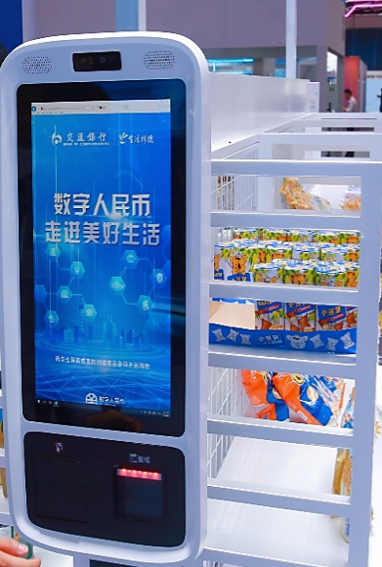
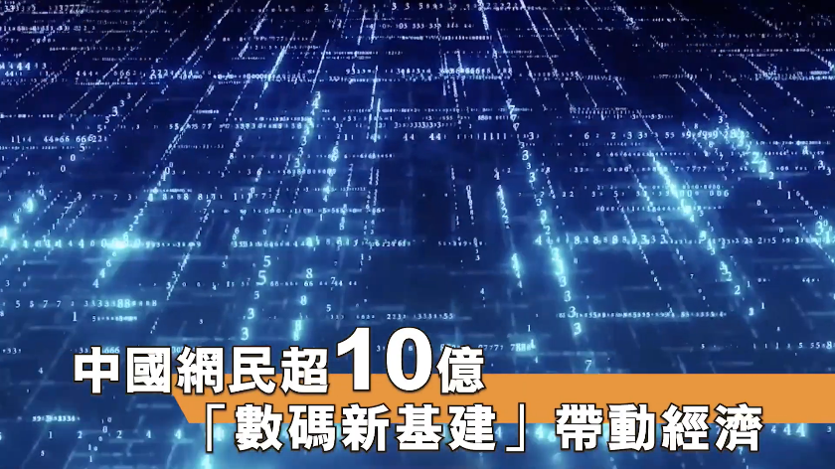
Reference
The development of China's digital economy
In August 2022, the China Internet Network Information Center released the Statistical Report on China’s Internet Development, which shows that the number of Internet users in China reached 1.051 billion, making China the world's largest and most vibrant digital society. At the same time, China is vigorously developing new digital infrastructure, and that a large population of Internet users will give impetus to economic growth of China.
Source: www.gov.cn (http://www.gov.cn/xinwen/2022-09/01/content_5707695.htm)
Name of the video: “With More Than One Billion of China’s Netizen, New Digital Infrastructure Has Become a Driver for Economic Development”
https://www.youtube.com/watch?v=XPjfyBsbl4U&t=22s
This video is produced by the China Institute for Knowledge Limited under the Our Hong Kong Foundation.

Slide 11
Bioeconomy
The bioeconomy covers many fields such as food and nutrition, biopharmaceuticals and health, bioenergy, biomaterials, environmental conservation and ecological services. With the rapid development of modern life sciences and breakthroughs in modern biotechnology, the bioeconomy is evolving into a new economic form at a faster pace, which has a far-reaching impact on production and life for human.
Source: The “13th Five-Year Plan for the Development of the Bioindustry”, extracted from www.gov.cn, http://www.gov.cn/xinwen/2017-01/12/5159179/files/516df96cc5254eb4976d14708e14056f.pdf

Slide 12
Reference
Overview of Hong Kong's biotechnology industry
The HKSAR Government plays an important role in promoting the development of biotechnology. In the 2018-19 Budget, the Government listed biotechnology as one of the four key areas in the field of innovation and technology (with the other three being AI & robotics, smart city and fintech).
There are more than 250 biotechnology-related companies in Hong Kong, most of which are healthcare companies engaged in the fields of pharmaceuticals, traditional Chinese medicinal or health products, or medical devices and diagnostics.
The Hong Kong Science and Technology Park Corporation plays a key role in promoting technological innovations in Hong Kong, and aims to support biomedical research from innovation to commercialisation. As of June 2022, there were a total of 160 biomedical technology companies & start-ups had established their R&D hubs at the Biomedical Technology (BMT) Cluster in the park.
Reference: Extracted from “ Biotechnology, Medical & Healthcare Industry in Hong Kong” on the website of HKTDC, https: //research.hktdc.com/en/article/MzEzOTQ1MjMz

Slide 13
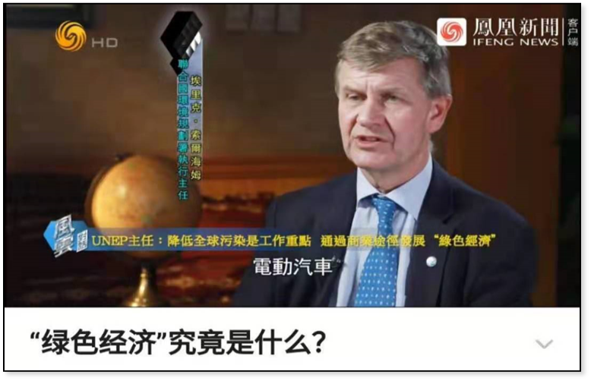
Green economy
Green economy is a low-carbon and highly efficient economic form underpinned by technology and innovation. It mainly includes new energy, energy saving and environmental conservation, new energy vehicles and so on. As the international community pays more attention to the coordinated development of economy and environment, green thinking has gradually gaining popularity. The scale of green technology application has continued to expand, thereby promoting the rapid development of green economy.
Extracted from IFNG News https://vdse.bdstatic.com//8d4d16eab8fe9d38c83aea009d9bf803.mp4?authorization=bce-auth-v1%2F40f207e648424f47b2e3dfbb1014b1a5%2F2021-07-24T07%3A33%3A54Z%2F-1%2Fhost%2F630efc16dcaa8dcba5bca871736408d7992b19ddc052a4c85910dce785bd15c8
Source: Li Huajing “ Green Economy, Green Growth and Green Development:
Conceptual Implications and Research Review”, Foreign Economics & Management, 12th Issue of 2020.

Slide 14
Reference
Major countries in the world are developing new energy vehicles
Integrating a variety of transformative technologies including new energy, new materials, the Internet and AI, new energy vehicles have become the main direction of transformation and development of the global automotive industry, as well as an important engine for promoting the sustained growth of the world economy.
In recent years, the global new energy vehicle industry has developed at a rapid rate, with an annual output of more than 2 million vehicles. In terms of sales volume, around 3.24 million new energy vehicles were sold worldwide in 2020, among which the European and the Chinese market accounted for 43.06% and 41.27% respectively, ranking first and second.
Reference: Qianzhan Industry Research Institute - Analysis Report of Market Perspective and Investment Strategy Planning on China NEV

Slide 15
II. Impact brought by the development of the new economy
1. Impact on the development of individuals
2. Impact on the development of Hong Kong
3. Impact on the development of our country

Slide 16
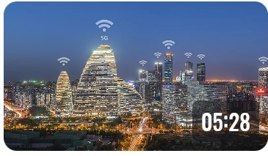
Watch the video “China Built on the Internet"
Lead-in
www.yangshipin.cn: “A Day in the Life of Sean, a China Hand”, https://m.yangshipin.cn/video?type=0&vid=o000022r9bc
Activity
Based on the video and your own experience, share how our lives are affected by the new economies such as the Internet.

Slide 17
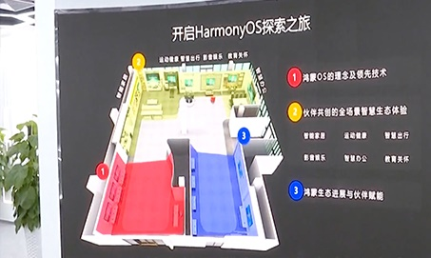
1. Impact on the development of individuals
1.1 The new economies affect personal consumption
The new economies have created new consumer products and services.
The new economies have created new consumer products and services, from smartphones to smart homes, from online games to video consultation services, from collecting free independent travel information to online virtual tours, etc. The continued innovation in, the IoT and other technical means have brought new consumer products, and created brand new consumption scenarios, bringing consumers diversified and personalised consumption experiences.
Name of the video: “Development of Intelligent Technologies in China - Episode 39: Smart Home and the Internet of Things”, produced by the Our Hong Kong Foundation
https://www.youtube.com/watch?v=Uk_yv3XXqEM

Slide 18
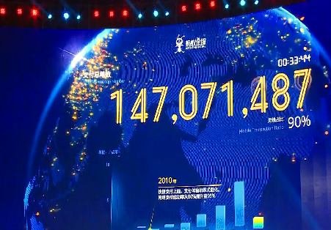
The new economies drive changes in consumption patterns
The rapid development of the Internet-based new economies have prompted online shopping to become a consumer trend. Featuring convenience, safety and high speed, mobile payment integrates various services such as transportation and healthcare to promote consumption upgrading. This mode of integrated online and offline consumption has heightened people's consumption level.
Name of the video: “Our Beautiful Country - Episode 37: Online Shopping Market”, produced by the Our Hong Kong Foundation
https://www.youtube.com/watch?v=yMQQq1BcxUA

Slide 19
The new economies affect people's consumption ideas and consumer behaviors
As online shopping, e-wallets, “buy now, pay later” (BNPL), and other consumption modes are increasingly popular, go green, ecology, sharing and healthiness have also become the consumer values and lifestyles pursued by many people. However, the increasingly convenience of online shopping will also constantly stimulate people's desire to consume, bombarding the cherished traditional Chinese values such as making money in a proper way, frugalness, simplicity and living within one’s means.
Activity
Based on the impact brought by the new economies on daily consumption, analyse the consumer values and patterns of yourself or your classmates, and discuss the proper consumer values that young people should uphold.
Suggested answer:
Young people should uphold the consumer values such as moderation, reasonableness, sharing, healthiness, go green, and low carbon.

Slide 20

1.2 The impact of new economies on employment
The development of the new economies have given rise to new occupations and positions
With the continuous development of the technology industry, especially the development and application of AI, positions at different levels will most likely be replaced by intelligent robots. Yet the development of the new economies have also created new occupations and positions.
wwww.yangshipin.cn: “What will we experience under the wave of the smart economy?”
https://v.cctv.com/2021/02/08/VIDE4r7U0jkDlCHAsgvCAMBY210208.shtml

Slide 21
The Internet and AI have spawned industrial robot system operators and IoT engineering technicians; the development of e-commerce has generated occupations such as delivery personnel for online catering and fresh food orders. In addition, new professions such as food stylists, healthcare practitioners, and respiratory therapists have been developed to meet individual needs.
Food stylists: People who beautify and style food products.
Healthcare practitioners: People who provide health and daily care services by using basic medical care knowledge and skills.
Respiratory therapists: People who, under the guidance of doctors, diagnose, treat, and care for people with cardiopulmonary insufficiency or abnormalities.

Slide 22
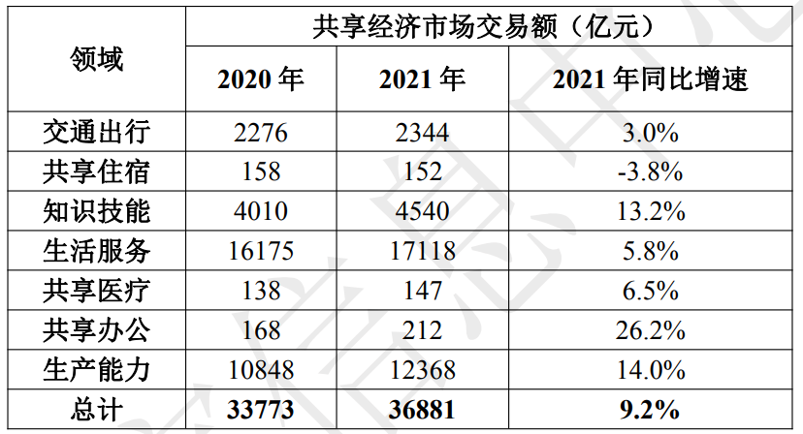
Reference
In March 2021, our country released information on 18 new professions, which have several characteristics: (i) new professions arisen from the development of digital technologies such as “digital forensic analysts”; (ii) new professions arisen from the high-quality development of enterprises such as “enterprise compliance officers”; (ii) new professions arisen from the green development concept and food safety requirements such as "carbon sequestration assessors".
Source: Extracted from “Three departments released information on 18 new professions – the emergence of new professions reflects the new societal needs”, www.gov.cn, http://www.gov.cn/fuwu/2021-03/23/content_5595032.htm
In 2021, the transaction size of China's sharing economy market reached around RMB3,688.1 billion, with 9.2 % significant increase when compared with that of last year.
Source: Extracted from the China’s Sharing Economy Development Report (2022), http://www.sic.gov.cn/archiver/SIC/UpFile/Files/Default/20220222100312334558.pdf
The table above is extracted from the China’s Sharing Economy Development Report (2022).

Slide 23
The new economies have brought about changes in work and employment modes
While generating new jobs, the new economies have also brought changes in working styles and working environments. For example, the digital economy has achieved the optimisation of workforce in a more market-oriented, intelligent, flexible and efficient manner.
The new employment mode of quick matching supply with demand through the Internet and mobile technologies has become a new trend for enterprise recruitments globally. In 2019, the penetration rate of flexible recruitment in the corporate community in Japan and the United States reached 49% and 42%, respectively.
With changes in skill set requirements and the job market, some professions are facing risk of being eliminated or replaced; therefore, it is necessary to continuously strengthen acquired skills and learn new skills, especially the digital-related ones. It is very important to adopt a lifelong learning attitude and adapt to the development trend of the new economies. Seize opportunities to avoid being eliminated.

Slide 24
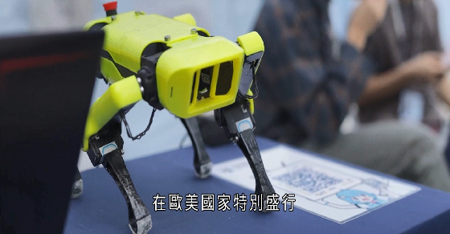
Employees need to change their concept of employment and enhance vocational skills
The new economies involve a wide range of fields, high level of inclusiveness and the employees need strong adaptability. The emergence of new professions has enriched the types of startups and positions, and provided broader employment space and more opportunities. At the same time, the new economies have also put forward new requirements, with which people need to change their employment concepts, enhance entrepreneurial awareness, improve vocational skills, and have a keen sense of market developments and changing trends.
Activity
Select a form of new economies and find out its impact on the future job market.
Develop a career plan for yourself in the light of your own expertise and interests.
Name of the video: “Dancing with the Times - Episode 7: Chinese Makers”, produced by the Our Hong Kong Foundation.
https://www.youtube.com/watch?v=SosKWXVK7PQ

Slide 25
2. Impact on the development of Hong Kong
The new economy has driven Hong Kong's economic transformation
New technologies facilitate Hong Kong's “re-industrialisation” by promoting local innovations, design and manufacturing. The direction for development is based on new technologies and smart production, without requiring much land or labor for advanced manufacturing. It aims to facilitate the transformation and value appreciation of traditional industries with the assistance of new technologies, and to develop emerging industries promoting the diversified development of Hong Kong's economy through high-end production.

Slide 26
Reference
The development of “re-industrialisation” in Hong Kong
“Re-industrialisation” refers to utilising Hong Kong’s existing solid foundation in scientific research, design and intellectual property protection to develop high value-added industries and industrial chains locally. It is a process making use of innovation technologies such as the IoT, AI, new materials and “Industry 4.0” smart production processes.
Hong Kong has strong capabilities in R&D, and advantages of internationalisation and being highly market-oriented. Hong Kong’s re-industrialisation can further stimulate R&D demands, bring new growth drivers to Hong Kong's economy and create quality employment opportunities.
The following is a concrete example of “re-industrialisation”:
With the funding support of Research and Development Cash Rebate Scheme, a local company, with producing plastic products in the Mainland being its core business, commissioned Hong Kong Productivity Council to develop and establish an intelligent production line for manufacturing optical adaptive lenses in Hong Kong. Leveraging this, the company is able to open the Mainland and European markets with its “Made in Hong Kong” products.
Source: Latest Progress of Innovation and Technology Fund and Funding Injection Proposal, April 20, 2021 https://www.legco.gov.hk/yr20-21/english/panels/ci/papers/ci20210420cb1-776-3-e.pdf

Slide 27
Promoting the development of innovations and start-ups in Hong Kong
Hong Kong has world-leading basic research and development strength and research capabilities in the field of smart technology. The development of digital innovation has accelerated in recent years. Cyberport is the largest digital innovation community and the base of financial technology in Hong Kong.
The HKSAR Government attaches great importance to technological innovation, and has invested more than HK$100 billion in developing innovation and technology in recent years. Local start-ups are also thriving, with continuous improvement in scientific and technological innovation capabilities.

Slide 28

Innovation and technology strength of Hong Kong higher education institutions and research institutes
Reference
Hong Kong has five world top-100 universities, and many local scholars and experts have won top international and national research awards, with recognition by our country and the international community. So far, there are 16 State Key Laboratories, 6 Hong Kong branches of Chinese National Engineering Research Centres, and 22 Joint Laboratories with the Chinese Academy of Sciences.
To consolidate Hong Kong's leading position in basic research, in its Policy Address 2022, the government proposed continuing to follow up with the University of Hong Kong and the Chinese University of Hong Kong on the progress of constructing the scientific research building and facilities, and to support the Hong Kong Polytechnic University on using part of the premises for research development.
The two R&D platforms, AIR@InnoHK and Health@InnoHK, established within the Hong Kong Science and Technology Park, bring together top talents from local and overseas universities and research institutes to carry out international collaborative research in the fields of healthcare, AI and robotics.
Hong Kong Science and Technology Park

Slide 29
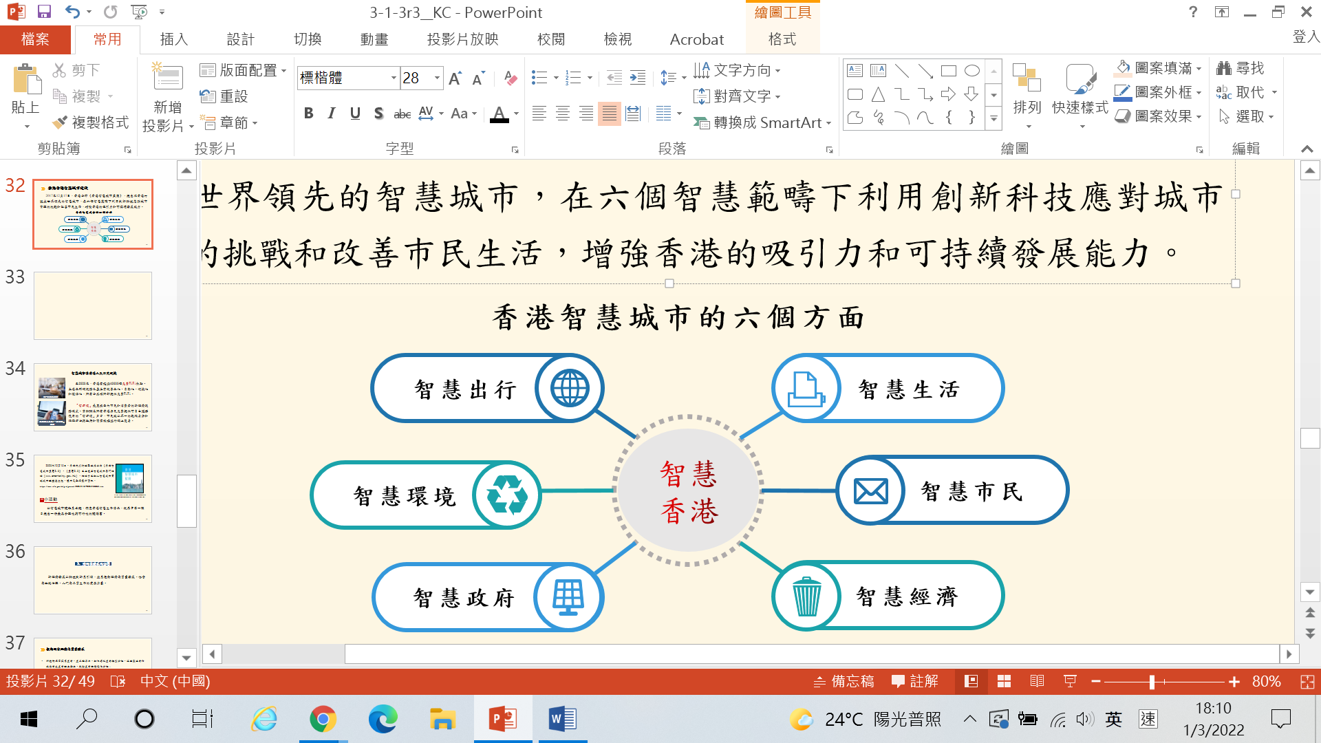
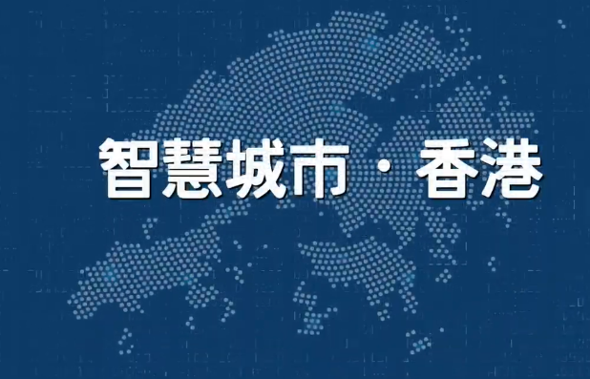
Promoting the building of smart city in Hong Kong
On December 15, 2017, the government published the Smart City Blueprint for Hong Kong, which proposed to build Hong Kong into a world-leading smart city, using innovative technology under six smart areas to meet the challenges of urban management and improve people’s lives, strengthening the attractiveness and sustainable development of Hong Kong.
Six areas of HK smart city
Smart mobility
Smart living
Smart
Hong Kong
Smart
environment
Smart
people
Name of the video: “Explanations for Key Concepts - Smart City · Hong Kong”, produced by the Academy of Chinese Studies
https://www.youtube.com/watch?v=b7LzwKKEsuc
Smart
government
Smart
economy

Slide 30


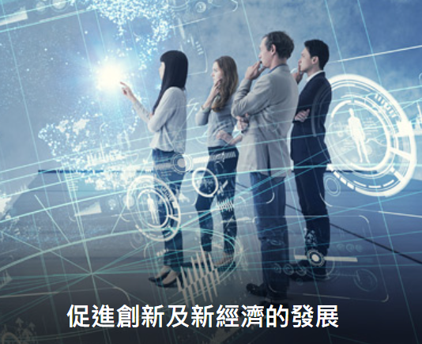
Smart City brings about greater conveniences to Hong Kong people
As of 2022, there were over 40,000 free WiFi hotspots in Hong Kong. Internet services in Hong Kong have basically achieved popularisation, automation, convenience and environmentally friendly. It is now further promoting Wi-Fi services in Hong Kong which are offered by the public and private sectors completely free of charge or time-limited free of charge.
Wi-Fi connected city together
The Office of the Government Chief Information Office has provided free "iAM Smart" accounts to all Hong Kong residents, enabling them to conduct online transactions with government departments and commercial organisations with a single digital identity and authentication method.
"iAM Smart" app
Existing legislations and regulations are being reviewed to remove or update provisions that hinder innovation and the development of the new economies. The government encourages local enterprises/ institutions to adopt technological services or solutions to enhance operational efficiency through the “Technology Voucher Programme”. Efforts are also made to explore the use of new and emerging technology standards to facilitate the certification of companies.
Promoting innovation and the development of the new economies

Slide 31
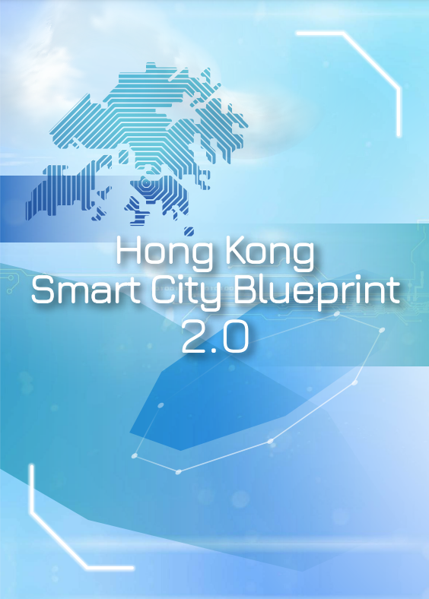
In 2020, the HKSAR Government published the Smart City Blueprint for Hong Kong 2.0, which was uploaded to its official website (www.smartcity.gov.hk). The site has also added the smart city real-time city dashboards to provide the public with the latest information.
Activity
Download and read the Smart City Blueprint for Hong Kong 2.0 from the official website, then research the smart living conditions in Hong Kong under the theme of building a smart city and put forward a reasonable and feasible proposal for one of the strategies.

Slide 32
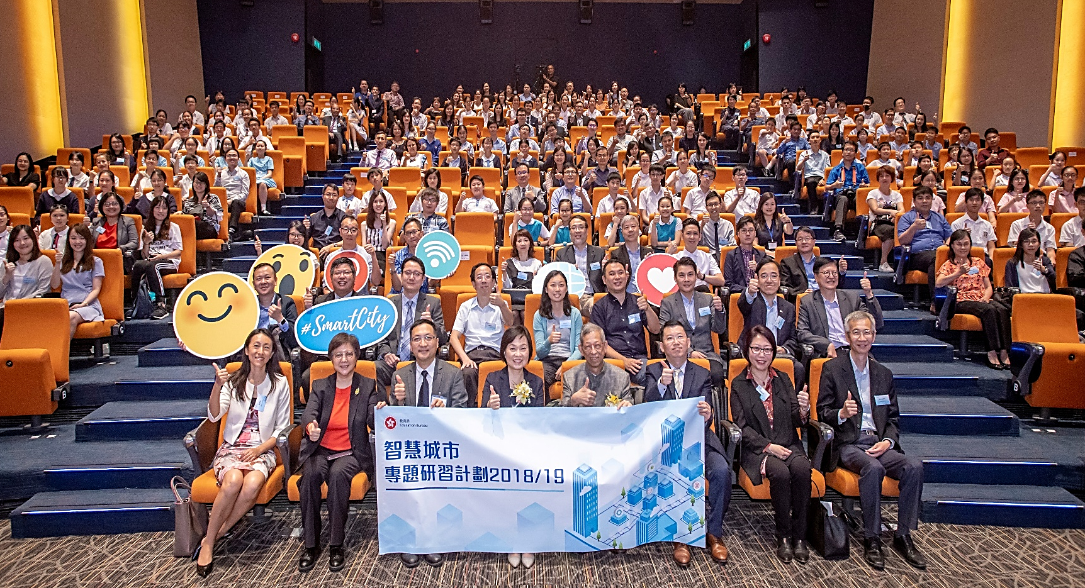
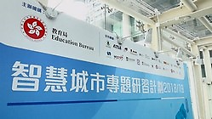
The Education Bureau organised “Smart City Project Programme 2018/19”
Reference
Name of the video: “Highlights of the Smart City Project Programme”, produced by the Education Bureau.
https://cs.edb.hkedcity.net/tc/smartcity2019/file/20190802/sc_highlight_video.mp4
For more details of the “Project Programme”, please surf the following webpage
https: //cs.edb.hkedcity.net/tc/smartcity2019.php

Slide 33
3. Impact on the development of our country
Promoting the quality development of the national economy
The application of new technologies has boosted the competitiveness of industries and products, accelerated the transformation and upgrade of traditional industries, promoted the integration of manufacturing and service industries along the industrial chains, and facilitated the optimisation and upgrade of the industrial structure.
Digitalisation and smartisation have given rise to new business formats and models such as the Industrial Internet of things and Internet + services, accumulating new momentum for economic development.
The new economies have optimised our country’s supply and demand structure, with its innovation ability continuously improving, and the national economy fulfilling reasonable growth in terms of quantity and steady improvement in terms of quality. The Chinese economy has entered a stage of high-quality development.

Slide 34
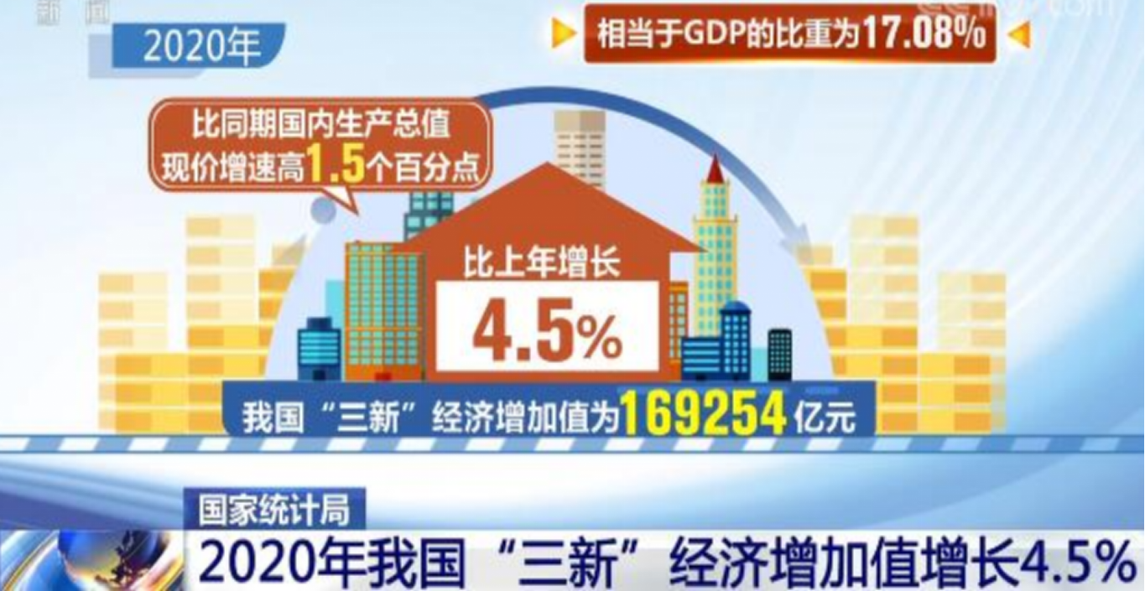
In 2020, China's new economies grew rapidly, among which the “three new” indexes (i.e. new industries, new business formats and new business models) grew the fastest, with an increase by 4.5% compared with those of 2019, and contributed 81.7% to the total index growth, ranking first among all areas. All these indicated that the new economies have become a powerful driver for the high-quality development of the national economy.
Reference: ‘National Bureau of Statistics: China’s “three new” economies added value increased by 4.5% in 2020’, www.cctv.com, https://news.cctv.com/2021/07/06/ARTIag9M5msArVzZjWHxTPX0210706.shtml

Slide 35
Reference
The meaning of the “three new” economies
The “three new” economies refer to economic activities with new industries, new business formats and new business models as the core content.
New industries | refer to the application of new scientific and technological achievements or emerging technologies to form a certain scale of new economic activities, such as new energy, new materials, and big healthcare (a general term for sectors that meet various health needs).
New business formats | refer to those derived from existing industries and fields that cater for diversified and individualised product or service requirements underpinned by technological innovation, such as the Internet of Vehicles, online office, and telemedicine.
New business models | refer to the efficient and uniquely competitive business operation models created through integrated business factors to fulfill user value and the enterprise sustainable profit target. Digital entertainment service is an example.
Reference: ‘In 2020, the added value of China's "three new" economy was equivalent to 17.08% of its GDP’, the State Council of the People’s Republic of China, https://www.gov.cn/xinwen/2021-07/06/content_5622752.htm

Slide 36
Promoting green development and improving the ecological environment
The new economies, such as new energy and new materials, have promoted energy conservation and consumption reduction. It has also helped achieve green and sustainable development, and gradually fulfilled a win-win situation between our country’s socio-economic development and ecological conservation. With the continued improvement in economy and environment, people's sense of happiness and security have been enhancing.
Reference
By the end of 2019, around 8.9 billion kilowatts of coal-fired generating units with ultra-low emissions had been built in China, forming the world's largest ultra-low-emission clean coal-based power supply system. China was also ranked first in the world by the installed capacity of and generated photovoltaic and wind power. Clean energy nationwide accounted for 23.4% of the total energy consumed. In the meantime, our country has maintained a world-leading position for many years in terms of the number of patents, investment, installed capacity and power generation in the field of renewable energy.
Source: The White Paper on Energy in China's New Era, www.gov.cn, https://english.www.gov.cn/archive/whitepaper/202012/21/content_WS5fe0572bc6d0f725769423cb.html

Slide 37

Enhancing social governance and service efficiency
The development of the new economies have accelerated the digital governance and services of the government, promoted the building of smart cities, smart communities and smart rural areas, empowered the governance of urban communities and rural areas through digitalisation and smartisation. It has also improved the efficiency of national government affairs services and social governance. Moreover, the e-government platforms at all levels are currently being launched at a faster pace across our country, and information queries and certificate-related services can be easily handled through government service platforms such as “mobile affairs handling services” and “single portal for online government services”, with government service capabilities significantly enhanced.
Name of the video: “China’s ‘big’ cities are getting ‘smarter’”, extracted from the webpage of The China Current.
https://chinacurrent.com/hk/story/20418/smart-city-china

Slide 38

Creating a better life for people
A panoramic tour of the Forbidden City
In recent years, our country has promoted “Internet + Education”, “Internet + Healthcare”, “Internet + Culture”, etc. The application of digital technology in various areas such as education, employment, elderly care, targeted poverty alleviation, healthcare and food safety has provided people with more intelligent, convenient and higher-quality life services.
http://webapp.vizen.cn/gugong_pano/index.html

Slide 39


Improving the quality of healthcare and elderly care services
“Internet + Healthcare” has alleviated people's difficulty in seeking medical services. Currently, the telemedicine collaboration network has covered more than 24,000 medical institutions in all prefecture-level cities, and 5,595 hospitals above the second level generally provide online services.
In terms of elderly care services, intelligent products for the elderly such as smart companion robots, intelligent nursing beds, and smart watches have entered ordinary homes to help the elderly enjoy their old age.
Name of the video: “Innovations in Medicine and Healthcare” extracted from the China Current
https://chinacurrent.com/story/20424/new-tech-in-healthcare
Source: www.gov.cn (http://big5.www.gov.cn/gate/big5/www.gov.cn/xinwen/2021-07/03/content_5622668.htm)
Name of the video: “A smart pillbox can remind patients to take medicine” extracted from the China Current
https://chinacurrent.com/story/20307/smart-pillbox

Slide 40
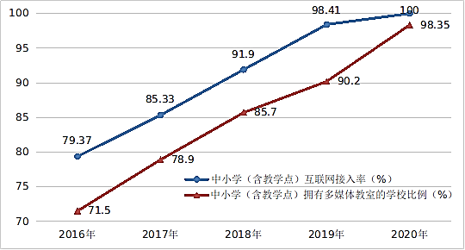
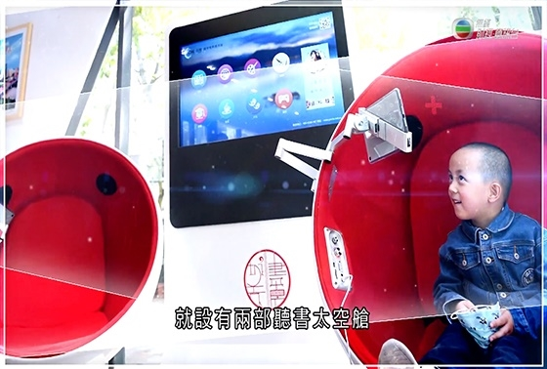
Extensive application of information technology in education
By the end of 2022, the Internet access rate of primary and secondary schools in China rose from 79.37% at the end of 2016 to 100% at the end of 2020, and 98.35% of primary and secondary schools already had multimedia classrooms (see figure on the right).
The Internet access rate of primary and secondary schools in China and the proportion of such schools with multimedia classrooms in 2016-2020
Sources:​
Report on the development of the digital economy 2022-11-28
http://www.gov.cn/xinwen/2022-11/28/content_5729249.htm
“Cyberspace Administration of China Releases the Digital China Development Report (2020)”, http://www.cac.gov.cn/2021-06/28/c_1626464503226700.htm
Name of the video: “Development of Intelligent Technologies in China - Episode 32: Smart Libraries and Smart Learning” from Our Hong Kong Foundation
https://www.youtube.com/watch?v=KQkyIW1Cy0E&t=20s

Slide 41
Integrating into the overall development of our country is closely related to Hong Kong's development
Developments of the HKSAR Government policies related to the Topic (examples)
The “14th Five-Year Plan” has supported Hong Kong's development of “eight centres”, including the international Innovation and Technology (I&T) centre. The delegation for introducing the “14th Five-Year Plan” also suggested to make good use of Hong Kong's unique advantages to jointly develop the international I&T centre and announced a number of measures benefitting Hong Kong.
To better integrate into the overall national development, the HKSAR Government is committed to building Hong Kong into an international I&T centre and actively supporting local I&T development with appropriations and policy support. The current Government has unprecedentedly invested over HK$150 billion to support I&T development in the past five years since 2018.
The HKSAR Government has also set up a Steering Group on Integration into National Development to implement short, medium and long-term measures concerning its development of eight centres and strengthen Hong Kong’s competitive edge under the 14th Five-Year Plan so as to create strong impetus for growth .
(Note: For the 14th Five-Year Plan, teachers please refer to the presentation slides on the topic of “The Development of Our Country and the Integration of Hong Kong into the Overall National Development” under theme 2.)
Source:
Hong Kong Government Press Release, https://www.news.gov.hk/chi/2022/11/20221118/20221118_163627_350.html#: ~:text=%E8%A8%BB%EF%BC%9A%E5%85%AB%E5%A4%A7%E4%B8%AD%E5%BF%83%E6%8C%87%E5%9C%8B%E9%9A%9B,%E4%B8%AD%E5%A4%96%E6%96%87%E5%8C%96%E8%97%9D%E8%A1%93%E4%BA%A4%E6%B5%81%E4%B8%AD%E5%BF%83%E3%80%82
The Legislative Council promotes the development of innovation and technology (https://www.itib.gov.hk/en/legislative_council_business/questions/2022/pr_20220525b.html)

Slide 42
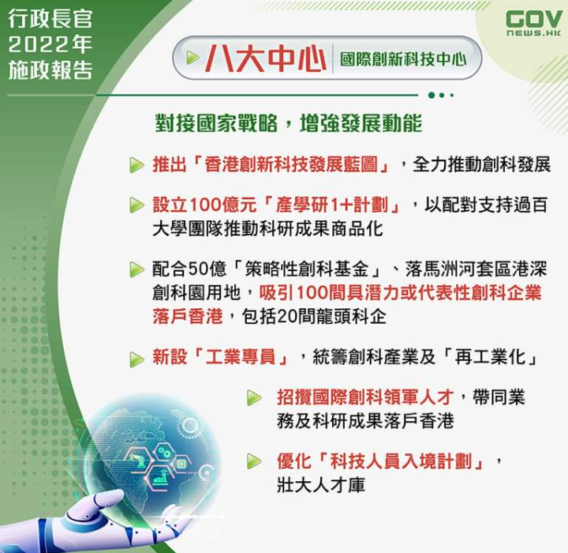
Reference
The “eight centres” and Hong Kong’s integration into the overall national development
The eight centres refer to:
International financial centre
International shipping centre
International trade centre
Centre for international legal and dispute resolution services
in the Asia‑Pacific region
International aviation hub
International Innovation and Technology centre
Regional intellectual property trading centre
East-meets-West centre for international cultural exchange
Sources:
Hong Kong Government Press Release, https://www.news.gov.hk/chi/2022/11/20221118/20221118_163627_350.html#: ~:text=%E8%A8%BB%EF%BC%9A%E5%85%AB%E5%A4%A7%E4%B8%AD%E5%BF%83%E6%8C%87%E5%9C%8B%E9%9A%9B,%E4%B8%AD%E5%A4%96%E6%96%87%E5%8C%96%E8%97%9D%E8%A1%93%E4%BA%A4%E6%B5%81%E4%B8%AD%E5%BF%83%E3%80%82
Tamar Talk Facebook of the HKSAR Government
https://www.google.com/search?q=%E9%A6%99%E6%B8%AF%E6%94%BF%E5%BA%9C%EF%BC%8C%E5%85%AB%E5%A4%A7%E4%B8%AD%E5%BF%83&rlz=1C1GCEU_zh-TWHK908HK908&hl=en&sxsrf=AJOqlzXWsiVJPr5njKvvLoOt0cGOBqR3lQ:1675214577188&source=lnms&tbm=isch&sa=X&ved=2ahUKEwi3ya7OlPP8AhUiyDgGHRkaBzc4HhD8BSgDegQIARAF&biw=2133&bih=1041&dpr=0.9#imgrc=ljlcbjYtZvebjM

Slide 43
Conclusion
The new economies have promoted the high-quality development of the national economy, improved the efficiency of social governance, and created a better life for people. Moreover, the new economies have also promoted Hong Kong's economic transformation and accelerated the development of technological innovation. While changing people's lives, the new economies have also provided individuals with broader development space. Therefore, young people should seize the opportunities brought by the development of our country and Hong Kong, and proactively equip themselves to prepare for future challenges.

Slide 44
Websites for extended references
“Keynote speech made by LI Keqiang at the opening ceremony of the Boao Forum for Asia Annual Conference 2014”, April 11, 2014, website of the Ministry of Foreign Affairs of the People's Republic of China, https://www.fmprc.gov.cn/eng./wjb_663304/zzjg_663340/xws_665282/xgxw_665284/201404/t20140411_600246.html
“The 2016 Government Work Report (full text)”, March 17, 2016, website of the Central People's Government of the People's Republic of China, http://english.www.gov.cn/premier/news/2016/03/17/content_281475309417987.htm
“What is Cloud Computing?”, “InfoCloud” website, https://www.infocloud.gov.hk/home/2?lang=en
“Basic Concept: Blockchain”, “The Chin Family” website of the Investor and Financial Education Council, https://www.ifec.org.hk/web/en/financial-products/fintech/ico-bitcoin/basic-concept-blockchain.page
Prof. Heiwai Tang: “Past, Present, and Future of Hong Kong's Economic Policies”, https://www.edb.gov.hk/attachment/tc/curriculum-development/kla/pshe/references-and-resources/economics/Exploration%20of%20Economic%20Restructuring%20of%20Hong%20Kong_upload.pdf

Slide 45
Websites for extended references
“Video: Greater Bay Area with a Great Future: Young people in Hong Kong are actively involving themselves in the development of the Guangdong-Hong Kong-Macao Greater Bay Area”, app.cctv.com, https://app.cctv.com/special/m/livevod/index.html?vtype=2&guid=7430cef8f2d6482ea3dc6015b4b7cadb&vsetId=C10336t
“Digital skills are needed across a wide variety of jobs”, 16-6-2021, https://www.oecd.org/coronavirus/en/data-insights/digital-skills-are-needed-across-a-wide-variety-of-jobs
“Video: Innovating Hong Kong”, produced by the Innovation and Technology Bureau of the HKSAR Government, https://www.itib.gov.hk/assets/video/The_Best_is_Yet_to_Come_(Innovation_and_Technology)_en.mp4

Slide 46
Websites for extended references
“Hong Kong Factsheet: Innovation, Technology and Industry”, https://www.gov.hk/en/about/abouthk/factsheets/docs/technology.pdf
“The Secretary for Innovation and Technology continued to explain the I&T measures in the Policy Address to industry groups”, October 11, 2021, website of the Innovation and Technology Bureau, https://www.itib.gov.hk/en/speeches/2021/pr_20211011.html
“Video: Industry 4.0 - What is a digital factory?” https://www.youtube.com/watch?v=N3XZsLIE6ag&t=87s
“LCQ5: Re-industrialisation of Hong Kong”, June 2, 2021, https://www.info.gov.hk/gia/general/202106/02/P2021060200591.htm?fontSize=1
The Innovation and Technology Bureau of the HKSAR Government, https://www.itib.gov.hk/en/index.html
Hong Kong Science & Technology Parks, https://www.hkstp.org/

Slide 47
Topic conclusion
In the era of economic globalisation, countries all over the world have become an interconnected and interdependent community with a shared future and highly integrated interests. International economic organisations are actively coordinating international economic affairs, while multinational companies are deepening economic globalisation, which contributed to the rapid and robust development of the new economies. We should have the awareness of tackling the issue of economic globalisation, form a global perspectives on employment and entrepreneurship, proactively think about how to contribute to our country and Hong Kong, and be a responsible citizen.

Slide 48
User Guide
The primary users of this resource are teachers. It aims to provide teachers with content knowledge relevant to the topic to enable teachers to have a deeper understanding of teaching content when preparing for their lessons.
All data, videos, photos, pictures, questions and suggested answers can be used for multiple purposes, such as teachers’ teaching materials, references for curriculum planning and learning and teaching, and student assignments, etc. To align with Citizenship and Social Development Curriculum and Assessment Guide (Secondary 4-6) (2021) (C&A Guide), this resource should be adapted to cater for students’ learning diversity, classroom teaching and assessment needs, among others.
Teachers may provide appropriate supplementary notes/ explanations to enrich this resource in order to enhance students’ understanding of the topic and information provided.
In accordance with the curriculum rationale and aims, teachers may select other learning and teaching resources which are correct, reliable, objective and impartial to help students build up a solid knowledge base, develop positive values and attitudes as well as enhance critical thinking and problem solving skills, and various generic skills.
If some information cannot be provided in this resource due to copyright issue, teachers may visit relevant websites provided.
Some information may have been updated when being used by teachers, teachers may visit the corresponding websites to obtain the up-to-date information.
Please also refer to the C&A Guide to understand the requirements and arrangements of the learning and teaching of the curriculum. Teachers are welcome to point out the areas need improvement, and welcome to provide updated information to enrich the content for all teachers' reference.

Slide 49
Notice and Disclaimer
Some sources were not translated into English as the official English version is not available.
In case of any discrepancy between the Chinese and English versions, the Chinese version shall prevail.

