Slide 1
Citizenship and Social Development
Theme 3 Interconnectedness and Interdependence of the Contemporary World
Topic: Economic globalisation
Learning focus:
Development of Multinational Corporations, Global Labour and Financial Market Integration
March 2023
(Translated version)

Slide 2
Learning objectives
Knowledge
To understand the meaning of economic globalisation, multinational corporations and the new economies, and the interdependence and interaction of economies of all countries
To understand major international economic organisations in the world and the main ways in which they facilitate international economic cooperation
To learn about the main impact of new economies on individuals and the development of Hong Kong and our country
Skills
To analyse objectively the impact of economic globalisation through examples of international economic cooperation and develop critical thinking skills
Values
To broaden international perspectives, develop the concepts of global economic interdependence and international economic cooperation, and to develop a sense of personal and social responsibility of contributing to the economic development of our country and Hong Kong

Slide 3


Introduction
What Are MNCs?
Multinational corporations (MNCs) are important contributors to economic globalisation by facilitating economic ties between countries around the world. What are some of the most influential MNCs you know?
Go to the following webpage to find out more about representative MNCs in global economic development.
Source: https://www.rankingthebrands.com/The-Brand-Rankings.aspx?rankingID=50&year=1392
Think about this:
In 2021, a total of 143 Chinese companies made it to the Fortune Global 500, an increase of 10 companies over the previous year. More than half of the top 20 fastest-growing companies were Chinese companies.
What are some examples of China's MNCs you know?
Go to the following webpage to find out representative MNCs of China.
Reference: Chinese Government Website (http://english.www.gov.cn/news/topnews/202108/03/content_WS610905e0c6d0df57f98ddfb7.html)

Slide 4
What Are MNCs?
MNCs usually refer to enterprises which involve foreign investment and provide goods or services produced in more than one country. They have offices, factories or branches in different countries or regions, often with headquarters to co-ordinate their global operations. By investing abroad, MNCs expand their production advantages and accelerate the global movement of capital.
MNCs became increasingly common after the World War II, and they can be regarded as the key player of economic globalisation. Operations of MNCs in the world market is facilitated not only by the minimal restrictions on international trade and investment but also by technological advances in communication (such as satellite, computers and the Internet) and transport technology (including lowered costs of air and sea transport).
References:
Ministry of Commerce of the People's Republic of China (http://english.mofcom.gov.cn/article/statistic/tradeinservices/, Chinese only)
The Organisation for Economic Co-operation and Development (OECD) (https://www.oecd.org/industry/ind/MNEs-in-the-global-economy-policy-note.pdf)
United Nations World Investment Report 2021 (https://unctad.org/webflyer/world-investment-report-2021)

Slide 5
What Are MNCs?
MNCs are vital to the global economy. In almost every industry, there are MNCs that reach global scale and are making a significant impact in international markets. They have a significant influence in international markets through the substantial funds they manage and their market leadership. Under globalisation, apart from MNCs from developed countries/regions, large corporations from developing countries/ regions are also involved in multinational economic activities.
Involved in business activities outside of their home countries and generally co-ordinating their foreign subsidiaries from their headquarters.
Main characteristics of MNCs include:
Outsourcing production and services to countries/regions with lower production costs in order to save money and increase profits
Taking full of their scale and technological advantages and investing in foreign countries to operate globally, with investment, production and marketing networks

Slide 6

What Are MNCs?
MNCs with diversified operations
Internationalised MNCs also diversify their operations as a business strategy to cater for the diversity of markets in different countries or regions, for the sake of business expansion and greater profitability.
Activity
Since the beginning of reform and opening-up, China has seen the arrival of many foreign companies, while Mainland companies have also made their presence overseas in line with the country's "Go Global" policy. Go to the following webpages and find out which MNCs have diversified operations.
China's Fortune Global 500 companies rise to 143
Source: Chinese Government Website
(http://english.www.gov.cn/news/topnews/202108/03/content_WS610905e0c6d0df57f98ddfb7.html)).
Chapter 4 of the White Paper on the New Dual Circulation Corporate Development Pattern (2021) (Chinese only)
Source: Xinhuanet (http://www.news.cn/tech/download/sxhxfzgj.pdf)

Slide 7
Development and Impact of MNCs
MNCs drive economic globalisation
In order to save costs and increase profits, and to expand their operations in international markets, MNCs outsource their production processes to countries/ regions that can offer lower costs of labour, land and production. This is one of the key drivers of globalisation.
Activity
To take sporting goods and an example, many of these international MNCs have adopted this production approach, with their head offices or regional headquarters responsible for brand design and styling, materials research, etc. The specific production processes, such as manufacturing, packaging and transportation, are contracted out to subsidiaries/ manufacturers in countries with lower labour costs.
Teachers can consider using the operations of some multinational sports brands as examples to illustrate to students the business philosophy and production model of these MNCs.

Slide 8

Development and Impact of MNCs
MNCs drive local development
By outsourcing their production and services, MNCs also bring business management, capital, talent and production technologies to local areas. As a result, many countries/ regions are willing to accept investments from MNCs, which bring about economic development, provide employment opportunities and introduce new technologies.
Many countries/regions have benefited from the training provided by MNCs to the local management and professionals in the course of their economic and social development. This has also become an important driver of local economic development.
Case study
As one of the first four Special Economic Zones in China to open up to the outside world, Shenzhen has always been at the forefront of reform and opening up. More and more MNCs are choosing to set up innovative R&D facilities in the city. Read the following case study on the cooperation between an MNC and local enterprises in Shenzhen. Learn more about the MNC's role in promoting the commercialisation of Shenzhen's innovative R&Ds, helping Shenzhen to develop a high-tech industry chain, and providing more jobs to help Shenzhen's development, etc..
Read more: Shenzhen Municipal People's Government
(http://www.sz.gov.cn/en_szgov/business/news/content/post_1347218.html)

Slide 9

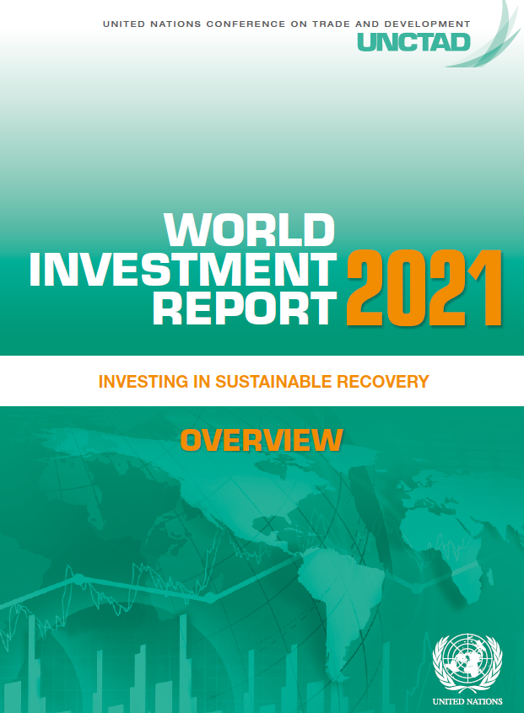
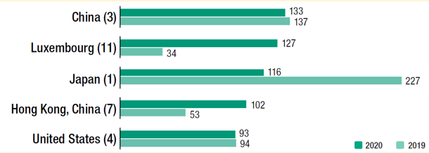

Reference
Development and Impact of MNCs
Importance of MNCs to China's development
MNCs are very important to the economic development of a country/ region. Taking our country’s economic development as an example, since the beginning of reform and opening up, MNCs have been developing in the Mainland, bringing with them capital, technology and job opportunities, and promoting the economic development of the Mainland. In recent years, China has also encouraged Mainland enterprises and capital to "go global", making the country one of the key drivers of global economic development.
According to a relevant UN report, Asia was the only region reporting growth in foreign direct investment (FDI). Outward FDI from China remained at $133 billion, making China the largest investor in the world. Continued expansion of Chinese MNCs and ongoing "Belt and Road Initiative" projects underpinned the FDI in 2020.
Top 5 economies in terms of FDI outflows in 2019 and 2020 (billion USD)
Reference: United Nations World Investment Report 2021 (https://unctad.org/webflyer/world-investment-report-2021)

Slide 10



Reference
Development and Impact of MNCs
Importance of MNCs to China's development
According to the report "Multinationals in China: 40 Years of Investment" by the Chinese Academy of International Trade and Economic Cooperation under the Chinese Ministry of Commerce, FDI has advanced China's reform and opening-up. Having significantly contributed to China's taxation, employment, technological progress, management and learning, market expansion, and international trade, FDI has promoted China's economic and social development, transformation and upgrading. According to the “Statistical Bulletin of FDI in China (2022)” of the Chinese Ministry of Commerce, 47,647 new foreign-invested enterprises were established in 2021, with US$180.96 billion in actual use of foreign investment.
Activity
Regarding the role of MNCs in driving economic development, teachers are advised to refer to Chapter 4 of the 《 雙循環新發展格局企業白皮書 (2021) 》jointly published by Xinhuanet and the Institute of Economics of Chinese Academy of Social Sciences. Teachers can guide students on how some well-known MNCs of sporting and IT brands are developing in the Mainland to achieve a win-win situation.
Click on the image to read the relevant information
Sources:
Chinse Ministry of Commerce (http://dubai.mofcom.gov.cn/article/chinanews/201910/20191002907378.shtml)
Xinhuanet (http://www.xinhuanet.com/tech/20210908/4da2b31d8ff74cadb0a40126ec620dd9/c.html, Chinese only)
People's Daily Online (http://finance.people.com.cn/BIG5/n1/2021/0526/c1004-32114057.html, Chinese only)

Slide 11
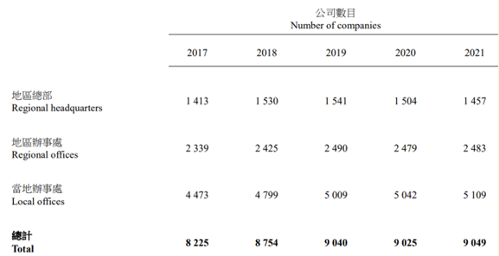
Reference
Development and Impact of MNCs
Importance of MNCs to China's and
Hong Kong's development
Foreign/ Mainland companies have also taken Hong Kong as an ideal and prime location for setting up local offices for local market, regional offices and regional headquarters catering for neighbouring markets outside Hong Kong. Many MNCs see Hong Kong as a location to enter and expand their operations in the Guangdong-Hong Kong-Macao Greater Bay Area.
According to the "2021 Annual Survey of Companies in Hong Kong with Parent Companies Located outside Hong Kong", the number of overseas and Mainland companies in Hong Kong increased by 10% from 8,225 in 2017 to 9,049 in 2021, including 1,457 regional headquarters, 2,483 regional offices and 5,109 local offices.
In terms of employment, the total number of people engaged by these overseas and Mainland companies reached 473,000, an increase of about 7% from 443,000 in 2017.
Number of regional headquarters, regional offices
and local offices in 2017-2021
Sources:
HKSAR Government Press Releases (https://www.info.gov.hk/gia/general/202110/07/P2021100600504.htm?fontSize=1)
Census and Statistics Department (https://www.censtatd.gov.hk/en/data/stat_report/product/B1110004/att/B11100042021AN21B0100.pdf)
LegCo data (https://www.legco.gov.hk/research-publications/english/1920issh27-foreign-mainland-companies-setting-up-offices-in-hong-kong-20200605-e.pdf)
Teachers can browse the websites for the up-to-date information.

Slide 12
Development and Impact of MNCs
Focus on local cultural characteristics as a business strategy
In the process of overseas development, MNCs also take into account the cultural and social environment of different countries/ regions, and integrate better into the local market. For example, they employ local people and incorporate local cultural characteristics, in order to adjust their production and marketing strategies to meet the needs of the local market. By doing so, they gain more room for development and bring more diversified choices to the local community.
Activity
For example, Hong Kong is known as a gourmet paradise with a wide variety of restaurants, including many multinational restaurant chains. With the opening up of China, many multinational restaurant chains are also operating in the Mainland. When developing their business in the Mainland and Hong Kong, they not only introduce their own culinary specialties, but also adapt their menus and marketing strategies with reference to local culinary habits.
Teachers can consider using real-life examples of multinational restaurant chains operating in the Mainland and Hong Kong to introduce students the said investment strategies.

Slide 13

Development and Impact of MNCs
Corporate social responsibility of MNCs
With the entire world as the market, MNCs generate huge profits and contribute to the development of local economies and technologies. Besides, they take social responsibility seriously to enhance their corporate image. Many MNCs have taken on corporate social responsibility (CSR) in areas such as the protection of labour rights, ecological environment, and consumer rights, making contributions to consumers, the environment and society.
Activity
The UN Global Compact promotes CSR through global initiatives that help companies to engage deeply with key sustainability issues, emphasising that responsible companies have a fundamental responsibility to people and the environment by building a culture of integrity in their corporate strategies, policies and processes.
Visit the UN Global Compact website to find out about the 10 principles of the Global Compact and read examples of leading companies practising social responsibility.
United Nations Global Compact:
https://unglobalcompact.org/

Slide 14
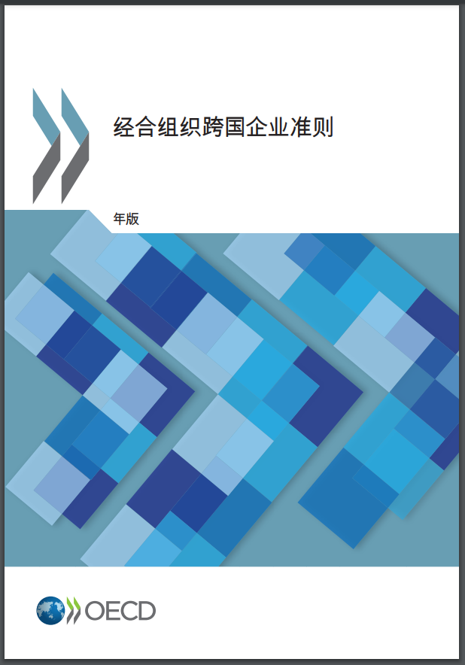
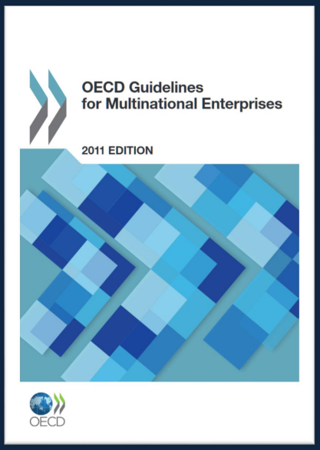


Reference
Development and Impact of MNCs
Corporate social responsibility of MNCs
It has become part of the international ethics for companies to shoulder and practise CSR, with various governments/ organisations/ institutions setting up relevant indicators.
For example, the OECD* Guidelines for Multinational Enterprises (2011) is one of the most important international standards for CSR worldwide and is widely adopted by international companies. The Guidelines help to improve the investment environment for MNCs by promoting greater trust between them and the societies in which they operate. Emphasising the importance of employee rights, the Guidelines promote economic development, environmental protection and social progress, etc..
(OECD = Organisation for Economic Cooperation and Development)
Source: OECD (http://mneguidelines.oecd.org/guidelines/)

Slide 15


Reference
Development and Impact of MNCs
Corporate social responsibility of MNCs
Our country attaches importance to the social responsibility of MNCs. Through the implementation of relevant concepts, a win-win situation can be achieved for the benefit of all parties. This is illustrated mainly through:
CSR by Mainland companies in overseas
CSR by foreign companies in the Mainland
CSR by Mainland companies in overseas
According to the “Research Report on Overseas Social Responsibility of Central Enterprises (2021)" by the State Council and others, while central enterprises are continuously expanding their international business, they have also continued to strengthen their CSR overseas. They actively participate and make remarkable achievements in the global fight against epidemics, the "Belt and Road" initiative and the global poverty alleviation.
Reference:
Chinese Government Website. http://www.gov.cn/xinwen/2021-12/28/content_5664909.htm (Chinese only)
CSR by foreign companies in the Mainland
According to the CCG* report 2021, since the outbreak of COVID-19, MNCs have taken the initiative to donate money and supplies. Also, they have made contributions to education, poverty alleviation and medical care. The report identified the top 30 MNCs in China in terms of their CSR in epidemic fighting, poverty alleviation, market practices, education and environmental protection.
Reference: CCG (http://www.ccg.org.cn/wp-content/uploads/2021/12/2020%E2%80%942021%E5%B9%B4%E5%BA%A6%E5%9C%A8%E5%8D%8E%E8%B7%A8%E5%9B%BD%E4%BC%81%E4%B8%9A%E7%A4%BE%E4%BC%9A%E8%B4%A3%E4%BB%BB-CSR.pdf, Chinese only)
(*CCG = Center for China and Globalization)

Slide 16
Mobility of Global Labour Market and International Division of Labour
International division of labour facilitates mobility of global labour market
Economic globalisation has enhanced the international division of labour and the restructuring of industries. Production processes that used to be completed in one country can now be done in two or more countries. This has also promoted the mobility of the global labour force. MNCs often deploy different types of employees around the world to support the development of their business, thus facilitating the global movement of labour.
Reference
Korea, Turkey, the Philippines and China are involved in construction projects in the Middle East and sub-Saharan Africa. In the oil industry, skilled technical employees are regularly exchanged between investment companies in countries such as Russia and Brazil, as well as between their subsidiaries in other developing countries. Such approach is conducive to improving the economic efficiency of companies and objectively promotes the cross-border movement of labour.
Source: CAO Zongping, International Labour Market and Overseas Employment (in Chinese), Science Press, 2016

Slide 17
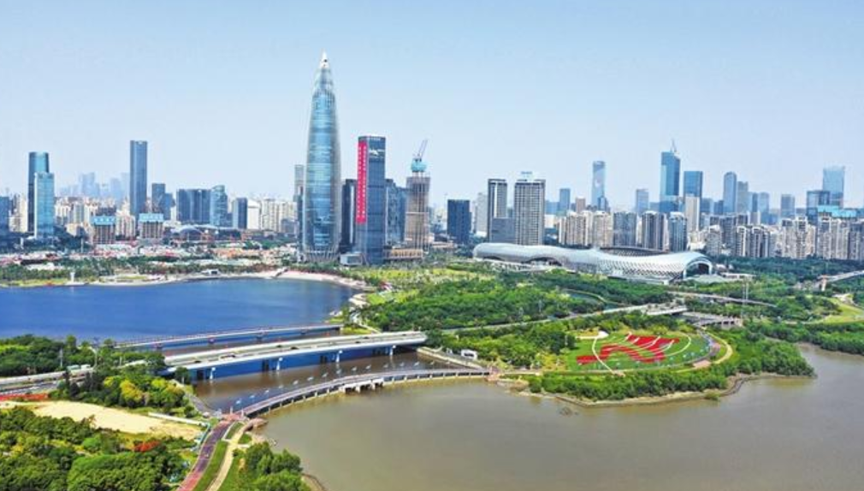
Reference
Mobility of Global Labour Market and International Division of Labour
Shenzhen's development and talent from around the world
Shenzhen's development has benefited from our country's reform and opening up. Statistics show that in 2018, Shenzhen's total foreign trade imports and exports amounted to RMB 3 trillion, a year-on-year increase of 7%, and nearly 60% of the world's top 500 enterprises have business presence in the city.
The introduction of foreign investment and the agglomeration of industries have attracted people from all over the world. In 2018, there were over 250 million inbound and outbound visitors in Shenzhen Boundary Control Points, an increase of more than 80 times compared to 1978. In 2018 alone, Shenzhen brought in 285,000 new talents, an increase of 8.4% year-on-year.
In 2019, Shenzhen had 46 full-time academicians, more than 13,000 high calibre talents, and nine Nobel laureate labs. The Shenzhen authorities are improving the "Talent Special Zone" policy to better retain talents.
Over the past four decades or so, the key to Shenzhen's miracle is the pooling of a large number of outstanding talents from home and abroad. Since 2012, Shenzhen has brought in more than 1.87 million new talents of various kinds and nurtured more than 3,000 innovative research institutions such as the Pengcheng Laboratory, so as to attract MNCs. Now Shenzhen has become a city of talents, full of charm, dynamism, vitality and innovation.
Sources:
People's Daily Online
http://politics.people.com.cn/n1/2019/1122/c429373-31468604.html (Chinese only)
http://edu.people.com.cn/BIG5/n1/2021/1003/c1006-32245251.html (Chinese only)
General Office of Shenzhen Municipal People's Government (http://www.sz.gov.cn/cn/xxgk/zfxxgj/zwdt/content/post_8997153.html, Chinese only)

Slide 18

Mobility of Global Labour Market and International Division of Labour
Global Labour Market and Competition for Talent
Under global economic integration, MNCs are looking for not just local talent, but also talent from abroad. For many countries/ regions and MNCs, bringing in foreign workers to supplement the labour shortage is one way to enhance competitiveness. Many countries/ regions have introduced preferential policies to retain and attract talented people, thus forming the global competition for talent.
China has become a more competitive and attractive which draws in much global highly skilled people seeking vast opportunities there. Many Mainland cities have implemented a variety of preferential policies and incentive schemes to attract talent. Also, lending support is the booming Chinese economy that has created high-end manufacturing and services jobs in large numbers. Many of these new jobs pay as much as comparable positions in developed economies and offer a faster career track.
Reference: Legislative Council, "Global competition for talent" https://www.legco.gov.hk/research-publications/english/1920rb02-global-competition-for-talent-20200601-e.pdf

Slide 19
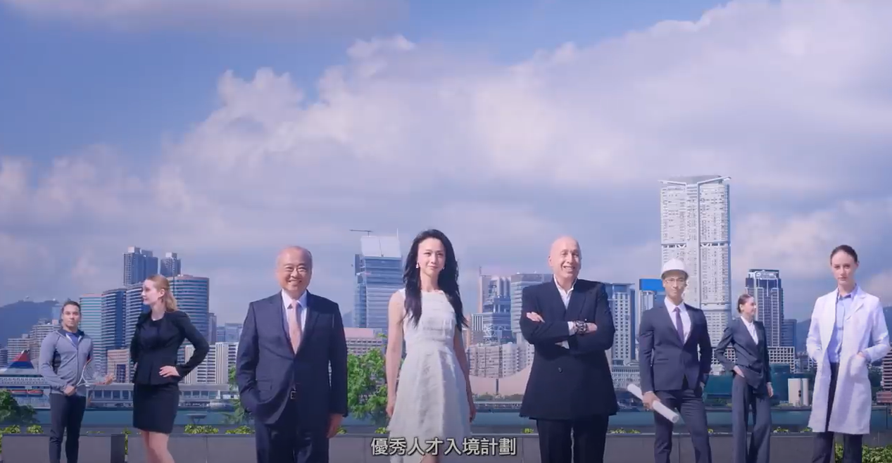
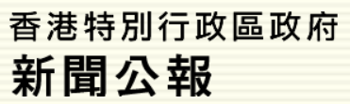


Reference
Positive effects of global labour mobility
In order to attract global talent and to supplement the labour force, the Hong Kong Government has introduced a number of talent admission schemes and the Supplementary Labour Scheme to meet the local development needs. Examples of related policies are shown as follows:
Schemes related to talent attraction
The Quality Migrant Admission Scheme (QMAS), launched in 2006, is always an important channel to attract global highly skilled or talented persons to settle in Hong Kong, thereby enhancing the city's international competitiveness.
Launched in June 2018, the Technology Talent Admission Scheme (TechTAS) provides a fast-track arrangement for admitting non-local technology talent. Successful companies will be given quotas for bringing in such people to undertake R&D work.
"Supplementary Labour Scheme"
Employers carrying on businesses in Hong Kong may apply to import workers at technician level or below to fill vacancies which they have genuine difficulties in recruiting suitable staff locally.
To safeguard the employment opportunities for as well as salaries and benefits of local workers, employers must accord priority to filling available job vacancies with local workers, and take active efforts to train local workers for the vacancies.
https://www.legco.gov.hk/research-publications/english/1819issh29-supplementary-labour-scheme-20190816-e.pdf
Sources:
HKSAR Government Press Releases (https://www.info.gov.hk/gia/general/202101/06/P2021010600312.htm?fontSize=1)
Labour Department of HKSAR Government (https://www.labour.gov.hk/eng/plan/iwSLS.htm)
Information Services Department of HKSAR Government (https://www.isd.gov.hk/eng/tvapi/17_id164.html)
Click on the image to watch the video and learn more about the QMAS.

Slide 20
Opening and Integration of the Global Financial Market
Introduction
Trading hours of major global stock markets
Exchange | Country | Local trading hours | Hong Kong time
HKEX | China | 09:30-16:00 | 09:30-16:00
LSE | United Kingdom | 08:00-16:30 | 16:00-00:30
NYSE | United States | 09:30-16:00 | 22:30-05:00
Questions for thinking
With reference to the above table (based on Hong Kong time), what are the characteristics of the trading hours of the stock markets?
Answer key
Investors can trade stocks at different times throughout the day thanks to the stock exchanges located in different time zones.

Slide 21
Opening and Integration of the Global Financial Market
With the development of international trade, division of labour, and the opening up of international financial markets, capital flows around the world day and night. Financial markets of various countries have become closely connected and integrated. A number of famous international financial centres have emerged, such as Hong Kong, New York, London, Shanghai, Singapore, Tokyo, Dubai, etc., which attract traders from all over the world.
Extract of Market Capitalisation of the World's Top Stock Exchanges (as at end September 2022)
Stock Exchange | Country | Market Capitalisation (US$ billion) | Worldwide Ranking
NYSE | United States | 23,752.5 | 1
SSE | China | 6,328.1 | 3
HKEX | China | 3,927 | 7
LSE | United Kingdom | 2,651.1 | 10
Source: Securities and Futures Commission (Market Capitalisation of the World's Top Stock Exchanges) (https://www.sfc.hk/-/media/EN/files/SOM/MarketStatistics/a01.pdf)

Slide 22
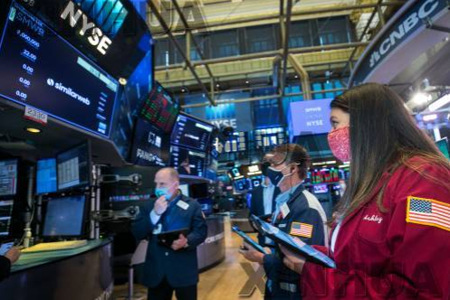
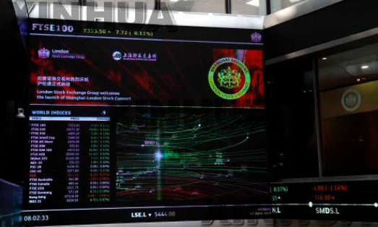
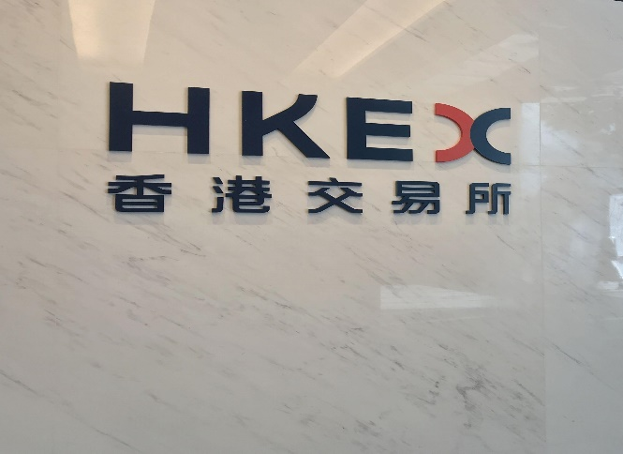
Advantages of Opening and Integration of the Global Financial Market
Facilitating the raising of capital for businesses
Businesses need access to financial markets to raise capital for their growth. The convergence of global financial markets has made it easier for companies to raise funds and attract capital from overseas to support their operations and growth.
The world's three major financial centres: New York, London and Hong Kong
NYSE
London Stock Exchange
HKEX
Source: Global Financial Centres Index
https://www.longfinance.net/programmes/financial-centre-futures/global-financial-centres-index/gfci-31-explore-data/gfci-31-rank/

Slide 23
Advantages of Opening and Integration of the Global Financial Market
Reference
Financial market integration drives national and global economic development
Since the beginning of reform and opening up, China has been opening up its financial sector in an orderly manner. In the midst of the opening and integration of financial markets across the world, China's financial sector has significantly accelerated its pace of opening up to the outside world. Significant measures has been taken to expand its financial sector, resulting in the deep integration of China's financial market with the rest of the world.
Relevant news report:
Completely removing quota restrictions on the qualified foreign institutional investors (QFII) and RMB qualified foreign institutional investors (RQFII) schemes, relaxing the restrictions on the proportion of domestic and foreign currencies in outward remittance by foreign institutional investors, completely removing restrictions on foreign shareholding in banks, securities and fund management, removing restrictions on access to corporate and individual credit ratings, and granting national treatment to foreign investors. In recent years, China has implemented a series of major financial liberalisation measures, and the financial sector has been opening up to the outside world at an "accelerated pace".
Source: China Economic Net
http://www.ce.cn/macro/more/202101/09/t20210109_36205608.shtml, Chinese only)

Slide 24
Advantages of Opening and Integration of the Global Financial Market
Reference
Companies listed in Hong Kong to raise funds
Hong Kong's highly internationalised stock market has attracted companies from around the world to list and raise capital. As at the end of 2021, the market capitalisation of the Hong Kong stock market totalled approximately $42.3 trillion, and most international brokerages have branches in the city. At the year end, 25% of the 638 SEHK trading participants and 53% of the 194 HKFE trading participants were from the Mainland or overseas markets.
(Teachers are advised to check the latest data release for their own updates.)
Reference: Hong Kong Yearbook https://www.yearbook.gov.hk/2021/en/
Major advantages of listing in Hong Kong
1
Diverse pool of international investors
Robust and well-developed regulatory and legal framework
Diversified access to financing and no exchange controls
2
3
Diversification of investment products and a well-developed system
Interconnection with Mainland capital markets under Shanghai-Shenzhen-Hong Kong Stock Connect
4
5

Slide 25
Advantages of Opening and Integration of the Global Financial Market
Reference
Companies listed in Hong Kong to raise funds
As an international financial centre, Hong Kong has also been subject to the volatility in international politics and in the pandemic, which have affected the performance of IPOs. Notwithstanding this, the HKEX received 22 new listing applications in April 2022, and was processing a total of 168 listing applications as at the end of April. This reflected that the demand for listing has not been slowed down.
To cater for the fundraising needs of emerging and innovative companies, the HKEX launched a new listing regime in April 2018 to allow emerging and innovative enterprises that have weighted voting rights (WVR) structures* and pre-revenue/ pre-profit biotechnology companies to list in Hong Kong, and establish a new concessionary route for qualifying issuers to seek secondary listing* in Hong Kong. As at the end of April 2022, a total of 74 companies had been listed through the new regime with $580.7 billion raised, representing over 40 per cent of the total fund raised through IPOs* in the same period. Hong Kong has also become Asia's largest and the world's second-largest fundraising hub for biotechnology.
Notes:
Overseas companies which have (i) a primary listing on the Recognised Stock Exchange; and (ii) the majority of their equity securities traded outside Hong Kong may apply for a “secondary” listing on the Main Board of the Exchange.
IPO = Initial Public Offering
** https://www.hkex.com.hk/-/media/HKEX-Market/News/Research-Reports/HKEx-Research-Papers/2019/CCEO_WVR_201907_e.pdf?la=en
References:
HKSAR Government Press Releases (https://www.info.gov.hk/gia/general/202205/25/P2022052500186.htm?fontSize=1)
HKEX (https://www.hkex.com.hk/Listing/Rules-and-Guidance/Listing-of-Overseas-Companies/Secondary-Listings-in-Hong-Kong?sc_lang=en)

Slide 26


Advantages of Opening and Integration of the Global Financial Market
Diversified choices and convenience for financial investment
In our daily lives, people legitimately use financial instruments (such as savings, bonds, stocks and funds) and financial knowledge and technology to plan their wealth and preserve and grow their assets. The opening up of global financial markets allows people to invest and manage their wealth both locally and globally.
For information on different investment products, please refer to the Investor and Financial Education Council's website "The Chin Matters".
Source: https://www.ifec.org.hk/web/en/investment/index.page

Slide 27

Reference
Advantages of Opening and Integration of the Global Financial Market
"Cross-boundary Wealth Management Connect" enhances the interconnection of different financial markets
The Cross-boundary Wealth Management Connect Scheme in the Guangdong-Hong Kong-Macao Greater Bay Area ("Cross-boundary WMC") is one of the key initiatives under the mutual market access schemes between the capital markets of Hong Kong, Macao and the Mainland. It allows eligible Mainland, Hong Kong and Macao residents in the Guangdong-Hong Kong-Macao Greater Bay Area ("GBA") to invest in wealth management products distributed by banks in each other’s market through a closed-loop funds flow channel established between their respective banking systems.
The Cross-boundary WMC consists of the Northbound Scheme and the Southbound Scheme:
The Northbound Scheme refers to eligible residents in Hong Kong and Macao investing in eligible investment products distributed by Mainland banks;
The Southbound Scheme refers to eligible residents in the Mainland GBA cities investing in eligible wealth management products distributed by banks in Hong Kong and Macao.
The Cross-boundary WMC was launched on 10 September 2021, providing more options of wealth management products for residents in the GBA. For the initial stage, the product scope under the Cross-boundary WMC mainly covers relatively simple wealth management products of low-to-medium risk.
Source: Hong Kong Monetary Authority ( https://www.hkma.gov.hk/eng/news-and-media/press-releases/2020/06/20200629-4/)

Slide 28
Conclusion
Global economic integration, as exemplified by foreign investments by MNCs and the opening up and integration of global financial markets, has brought about interdependence and benefits to all countries. As global economic integration continues to deepen, the integration of the labour market has been facilitated by the cross-border mobility of labour. It brings us new space and opportunities for development, which we should grasp by constantly enhancing ourselves.
The development of a globalised economy is conducive to corporate finance and facilitates people's access to investment and financial management. However, the opening up and integration of global financial markets can also encourage speculative activities and create uncertainties for financial and economic development. When these financial risks spread globally, they could lead to an international financial crisis. There is a need for greater coordination and cooperation on financial stability among countries to promote the stability of the international financial system. On a personal level, it is important for us to have a good understanding of and conduct sufficient research on financial markets and investment products, and to be smart and risk-conscious investors.

Slide 29
User Guide
The primary users of this resource are teachers. It aims to provide teachers with content knowledge relevant to the topic to enable teachers to have a deeper understanding of teaching content when preparing for their lessons.
All data, videos, photos, pictures, questions and suggested answers can be used for multiple purposes, such as teachers’ teaching materials, references for curriculum planning and learning and teaching, and student assignments, etc. To align with Citizenship and Social Development Curriculum and Assessment Guide (Secondary 4-6) (2021) (C&A Guide), this resource should be adapted to cater for students’ learning diversity, classroom teaching and assessment needs, among others.
Teachers may provide appropriate supplementary notes/explanations to enrich this resource in order to enhance students’ understanding of the topic and information provided.
In accordance with the curriculum rationale and aims, teachers may select other learning and teaching resources which are correct, reliable, objective and impartial to help students build up a solid knowledge base, develop positive values and attitudes as well as enhance critical thinking and problem solving skills, and various generic skills.
If some information cannot be provided in this resource due to copyright issue, teachers may visit relevant websites provided.
Some information may have been updated when being used by teachers, teachers may visit the corresponding websites to obtain the up-to-date information.
Please also refer to the C&A Guide to understand the requirements and arrangements of the learning and teaching of the curriculum. Teachers are welcome to point out the areas need improvement, and welcome to provide updated information to enrich the content for all teachers’ reference.

Slide 30
Notice and Disclaimer
Some sources were not translated into English as the official English version is not available.
In case of any discrepancy between the Chinese and English versions, the Chinese version shall prevail.

