Slide 1
Citizenship and Social Development
Theme 3: Interconnectedness and Interdependence of the Contemporary World
Topic: Economic globalisation
Learning focus:
Interdependence of Economies of All Countries and Cooperation of International Economic Organisations
March 2023
(Translated version)

Slide 2
Learning objectives
Knowledge
To understand the meaning of economic globalisation, multinational corporations and the new economies, and the interdependence and interaction of economies of all countries
To understand major international economic organisations in the world and the main ways in which they facilitate international economic cooperation
To learn about the main impact of new economies on individuals and the development of Hong Kong and our country
Skills
To analyse objectively the impact of economic globalisation through examples of international economic cooperation and develop critical thinking skills
Values
To broaden international perspectives, develop the concepts of global economic interdependence and international economic cooperation, and to develop a sense of personal and social responsibility of contributing to the economic development of our country and Hong Kong

Slide 3
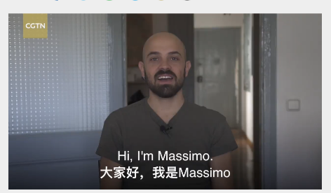

Introduction
In an era of economic globalisation, no country can be completely self-sufficient. The food, vegetables and meat that we eat, and the mobile phones and computers that we use, may all come from other countries. It enables us to enjoy a wider variety of goods and more convenient and diversified services, thus improving the living standards of people in different countries.
Activity
Watch the video "What if global trade ended?". Talk about the positive effects of economic globalisation on our quality of life, taking into account your own experiences. (Click on the image to watch the video)
Source: CGTN (https://news.cgtn.com/news/3d3d514d78676a4e78457a6333566d54/share.html)

Slide 4





Scenario
When we go to the wholesale fruit market, we may see fruits from all over the world, such as avocados from Mexico, strawberries from Japan, oranges from the United States, apples from the Mainland, and so on. Have you ever thought about that we can buy fruits from all over the world in Hong Kong is actually a reflection of economic globalisation?
Under globalisation, companies not only sell their products locally, but also to different parts of the world. It narrows the differences between products sold in commodity markets around the world.
Activity
Many products are sold in different markets around the world. Give some examples.

Slide 5
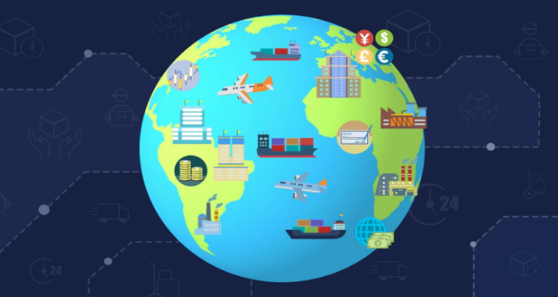
The meaning of
economic globalisation in brief
Introduction
Economic globalisation refers to the increasing economic integration and interdependence of economies across the world through frequent cross-border movement of goods, services, capital, technologies, information and labour. Economic globalisation has facilitated the interaction of people from all over the world.

Slide 6

Historical process of globalisation
Discussion
Discuss how changes in transport and communication technologies have promoted global interdependence.
Ancient times
Modern times

Slide 7


Historical process of globalisation
Economic globalisation is the result of technological advancement. The development of technology has reduced the cost of goods transportation, information dissemination, and labour mobility, especially the advancement of new technologies such as the Internet that promotes global interconnectivity. This has significantly contributed to the rapid flow of goods, services, capital, technology, information, and labour across the globe.
1930s
3 months
Hong Kong
San Francisco
By ship
Now
About 14 hours
Hong Kong
San Francisco
By plane

Slide 8

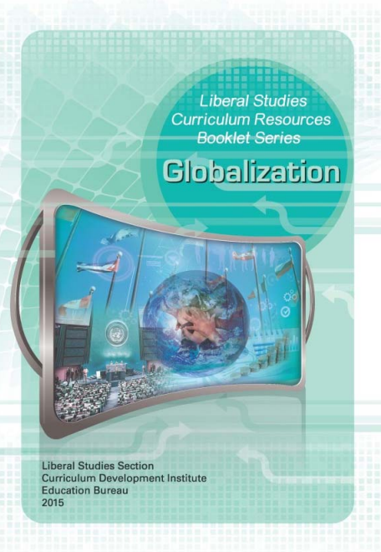
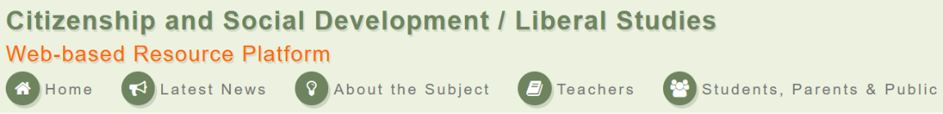
Historical process of globalisation
Reference
For the historical process of globalisation, teachers can refer to the Liberal Studies Curriculum Resource Booklet Series: Globalization, pp. 46 & 47.
Sources:
Citizenship and Social Development/Liberal Studies Section, Curriculum Development Institute, Education Bureau, Liberal Studies Curriculum Resources Booklet Series: Globalization
https://ls.edb.hkedcity.net/file/about/related_publications/globalization_e2.pdf

Slide 9
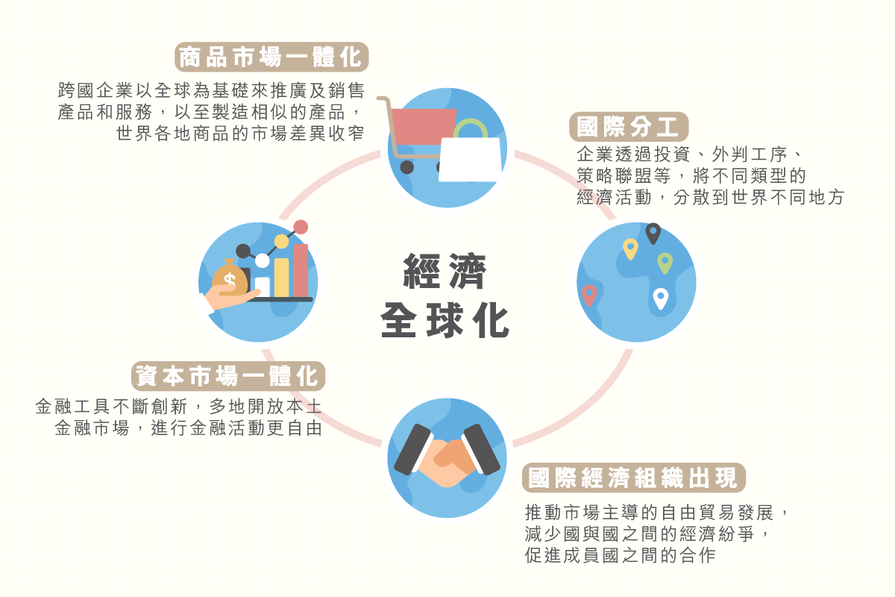
Characteristics of Economic Globalisation
The interdependence and interaction of economies of all countries
Integration of commodity markets
Multinational corporations promote and sell their products and services on a global basis so that they manufacture similar products, narrowing market differences in commodities around the world
International division of labour
The diversification of economic activities into different parts of the world through investment, outsourcing, strategic alliances, etc.
Economic globalisation has made the economies of various countries complementary, interdependent and mutually dependent. It is characterised by integration of commodity and capital markets, international division of labour, and emergence of international economic organisations.
Economic Globalisation
Integration of capital markets
Innovation in financial instruments and the opening up of local financial markets in many places, result in greater freedom to conduct financial activities
Emergence of international economic organisations
Promotion of free trade development, which is market-driven, to reduce economic disputes between countries and promote cooperation among member countries
Source:
Webpage of the Academy of Chinese Studies https://ls.chiculture.org.hk/tc/idea-aspect/480

Slide 10
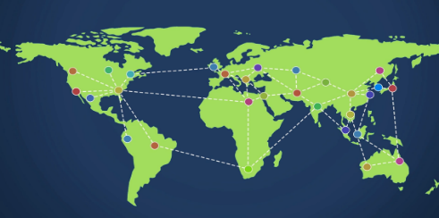
Trends of global market integration
The interdependence and interaction of economies of all countries
Under economic globalisation, production and markets in different economies are becoming increasingly larger and interdependent. Companies no longer rely solely on the local market to raise funds, employ labour or sell goods. The global market gradually transcends national boundaries, integrating the economies of different countries and enabling the market operate on a global basis, resulting in a trend towards "global market integration".

Slide 11
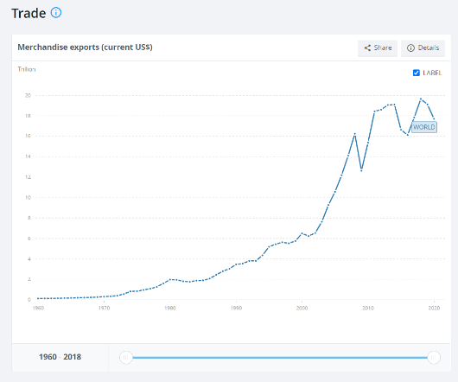

The interdependence and interaction of economies of all countries
In the 1980s, many countries began to shift towards free market economic policies, which were promoted by the International Monetary Fund and the World Bank. The gradual elimination of trade barriers led to reduced costs and an increase in cross-border trade activities, resulting in a significant growth in the total value of world trade.
With the advancement of Internet technology and the well-developed transportation systems, markets around the world have become open. Multinational corporations now base their procurement, manufacturing, promotion and sales activities on a global scale, leading to products being sold around the world. As a result, the variety of goods available in markets worldwide is becoming more diverse, with differences gradually narrowing and moving towards integration.
According to the World Bank, global merchandise exports have grown significantly from approximately US$122.8 billion in 1960 to approximately US$17,706 billion in 2020. Refer to the webpage for detailed figures.
Source: Website of World Bank
(https://data.worldbank.org/topic/trade?view=char0t)

Slide 12
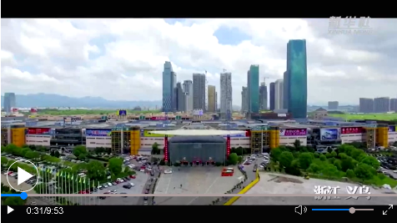

The interdependence and interaction of economies of all countries
Reference
China-Europe Railway Express Brings Chinese Goods to Europe
Yiwu, Zhejiang Province is the world's largest distribution centre for small commodities, with 1.8 million kinds of small commodities being sold to more than 200 countries and regions worldwide. The China-Europe Railway Express (CERE), launched in 2011, travels through eight countries and covers more than 13,000 kilometres in total. Hundreds of thousands of small commodities are transported from east to west across the entire Eurasian continent.
The goods transported by the CERE have gradually expanded from electronic products such as mobile phones and computers to clothing, shoes and hats, cars and accessories, wine, coffee beans, timber, furniture, etc..
Reference: Webpage of the State Council Information Office of the People's Republic of China (Chinese only)
http://www.scio.gov.cn/31773/35507/35513/35521/Document/1548884/1548884.htm
Video: Two Decades after China's Accession to the WTO (Chinese only)
http://www.news.cn/video/2021-12/11/c_1211483112.htm
(Watch the clip 0:27-2:56, which introduces the experience of Yiwu, Zhejiang Province, in becoming a "world supermarket" through economic globalisation.)

Slide 13
The interdependence and interaction of economies of all countries
Trends of capital market integration
The globalisation of financial investment markets took shape in the 1980s, when Europe, the Americas, East Asia, Australia and New Zealand opened up their domestic financial markets and relaxed capital controls, accelerating the process of financial globalisation. In the early 21st century, China's accession to the WTO also led to the gradual opening of its domestic financial market.
People are free to conduct all kinds of financial activities in different countries and regions. For example, companies can raise funds through listing on foreign stock markets or acquire different businesses in other countries and regions. Financial globalisation breaks geographical boundaries, operates on a 24-hour basis and accelerates the integration of capital markets.

Slide 14



Reference
The interdependence and interaction of economies of all countries
Investors can choose to invest in the shares of companies listed locally or elsewhere (e.g. Chinese Mainland, USA, Singapore, Japan). Similarly, companies can choose to raise funds locally or on stock markets in other countries, subject to local regulations and requirements, so as to access capital from around the world. The speed of international capital flows is increasing and large amounts of capital can be legally transferred from one market to another in a short period of time. This also reflects the globalisation of capital markets.
In New York, London and Hong Kong, financial and business activities can be carried out on a 24-hour basis, forming a global commercial and financial network, and these three international financial centres are collectively known as "Nylonkong".
Activity
Search the trading hours (in Hong Kong time) of Hong Kong Stock Exchange, the NASDAQ and London Stock Exchange during Hong Kong time.

Slide 15
The interdependence and interaction of economies of all countries
International division of labour
Under economic globalisation, more and more multinational corporations are using communication and transport technologies to transfer some of their production processes and business operations to other parts of the world through international outsourcing. This allows them to make the best use of local advantages, improve quality, and reduce costs. International division of labour is a feature of economic globalisation. Based on the characteristics and strengths of different places, multinational corporations divide the production process including product design, supply of raw materials, production and assembly, transport, wholesale and retail, and outsources them to the outsourced manufacturers in different countries, forming a subcontracting network connecting different firms across different countries. R&D is carried out in countries with higher levels of technology, while production takes place in developing countries, thus creating an international division of labour.
Economic globalisation has increased labour mobility, allowing people to work in other countries in line with their own needs. Nowadays, it is increasingly common for people to move across borders, contributing to the integration of labour markets.

Slide 16
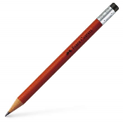
The interdependence and interaction of economies of all countries
Discussion
Think about it: Is the production of a pencil also a result of international division of labour?
Teachers can ask students to watch the video "The Geography of a Pencil" by referring to the following website. Ask them to find out:
The materials needed to produce a pencil; and
The countries or regions in which these materials are produced
Reference:
The Geography of a Pencil: A story of globalisation from your pencil case (David Morgan, 31 March 2021)
(https://storymaps.arcgis.com/stories/6c2c8e3470f4499c9a2a3f8b2b93150b)
Video: The Geography of a Pencil
Interview with the famous economist Milton Friedman
(https://storymaps.arcgis.com/stories/6c2c8e3470f4499c9a2a3f8b2b93150b)

Slide 17
The interdependence and interaction of economies of all countries
Example
To take smartphone production as an example, a smartphone enterprise will take advantage of its home country's strengths in technological research and development (R&D), leaving the R&D processes mainly in the home country. Some of the mineral raw materials are sourced from mineral-rich countries, after which the minerals are sent to countries with more advanced technology for smelting and refining. Then they are transferred to countries with abundant labour resources and lower labour costs for assembly. This is an example of how multinational corporations can take full advantage of the international division of labour in each country.

Slide 18
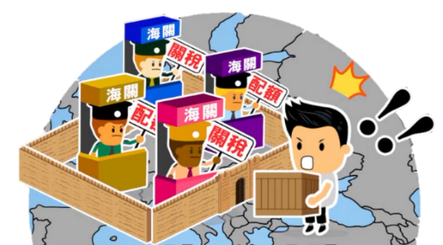

The interdependence and interaction of economies of all countries
Reference
Economic globalisation being challenged by deglobalisation
Economic globalisation has brought economies closer together and they are jointly driving the development of the world economy. However, various forms of trade protectionism create obstacles to the free flow of goods, services and production factors, and economic globalisation is being challenged by deglobalisation.
Teachers can refer to the webpage of the Trade and Industry Department, "Tariff Measures in relation to United States / Mainland Trade Conflicts - Key Developments", for information on the US-China trade war.
Reference: Webpage of Trade and Industry Department
(https://www.tid.gov.hk/english/trade_relations/us/us_mainland_trade_conflicts.html)

Slide 19
The interdependence and interaction of economies of all countries
Reference
China's active participation in economic globalisation.
Even though economic globalisation has encountered some shocks, openness and cooperation are still the trend. Our country will continue to be deeply involved in promoting economic globalisation towards an open, inclusive, balanced and win-win direction.
The 14th Five-Year Plan
We will advance a broader agenda of opening up across more areas and in greater depth. We will enhance international cooperation for mutual benefit by leveraging the strengths of China’s huge market.
A New Open Economy System
We will comprehensively improve the level of opening to the outside world, and promote liberalisation and facilitation of trade and investment. We will promote innovative trade development, enhancing our overall competitiveness in external trade.
Joint Pursuit of the Belt and Road Initiative
We will follow the principle of extensive consultation, joint contributions, and shared benefits. Adhering to the vision of green development, openness, and clean governance, we will step up efforts for practical cooperation, security assurance and common development.
Participating in the Reform and Development of the Global Governance System
We will remain firm in pursuing consultation on an equal footing and mutual benefit, pushing the G20 to play its role in international economic cooperation. We will maintain the multilateral trade system and actively participate in the reform of the World Trade Organization (WTO), striving to make the global governance system more just and reasonable.

Slide 20
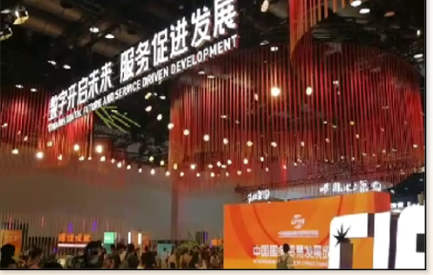

The interdependence and interaction of economies of all countries
Reference
The Global Trade in Services Summit of
the 2021 China International Fair for Trade in Services (CIFTIS)
During President Xi Jinping’s speech at the Summit of the 2021 CIFTIS, he urged countries to use peace, development and win-win cooperation as the "golden key" to address the challenges facing the world economy.
With the theme of "Towards Digital Future and Service Driven Development", the event was attended by more than 10,000 enterprises from 153 countries and regions and resulted in 1,672 achievements, fully utilising its role as a platform for global trade in services.
Source: Video - What Foreigners Say about the CIFTIS (in English and some Spanish with Chinese subtitles)
https://newscenter.ciftis.org/consult?id=8020&type=1
Source: President Xi Jinping's Video Address at the 2021 CIFTIS Submit
(https://www.ciftis.org/article/9581100882063360.html, Chinese only)

Slide 21
Emergence of international economic organisations
Under global economic integration, economic activities are no longer confined to a single country or region. At the same time, cross-country and cross-regional trade activities are becoming more frequent. This has led to the emergence of various organisations to coordinate international trade and economic cooperation, which is one of the features of economic globalisation.
The function of international economic organisations is to promote and facilitate economic cooperation among their member countries. International economic organisations can be broadly classified into global or regional ones. Global organisations include the World Trade Organisation (WTO), the International Monetary Fund (IMF), the World Bank (WB) and the Organisation for Economic Co-operation and Development (OECD).
Examples of regional organisations are the European Union, Asia-Pacific Economic Cooperation (APEC), the Association of Southeast Asian Nations (ASEAN), Shanghai Cooperation Organisation (SCO) and the Regional Comprehensive Economic Partnership (RCEP).

Slide 22
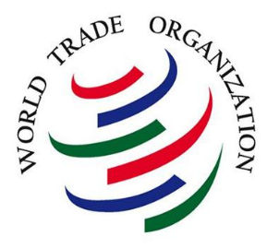


Introduction
International Economic Organisations
Official website:
https://www.wto.org/
Official website:
https://www.worldbank.org/en/home
Official website:
https://www.imf.org/en/Home
Which international economic organisations are represented by the above symbols?
What contribution have these international economic organisations made to international economic cooperation?

Slide 23
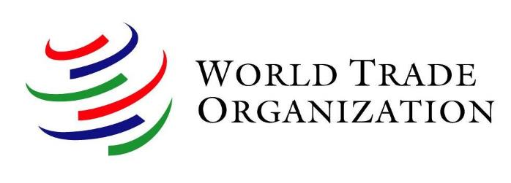
International Economic Organisations
Date of establishment | 1 January 1995
Origin of establishment | Uruguay Round of negotiations (1986-1994)
Headquarters location | Geneva, Switzerland
Membership | 164 members
Secretariat staff in 2020 | 623 members
Official languages | English, French, Spanish
Budget | CHF 197 million in 2020
Website | https://www.wto.org/
The World Trade Organisation (WTO) is the only international body dealing with the rules of trade among countries. The WTO agreements, which provide the basic rules for international trade, are negotiated and signed by most of the world's trading nations.
The WTO's main objective is to help trade flow smoothly, freely, fairly and transparently. As of 2021, the WTO had 164 members.
Sources:
Website of WTO
https://www.wto.org/
2. Webpage of Trade and Industry Department
https://www.tid.gov.hk/english/ito/wto/wto_overview.html

Slide 24
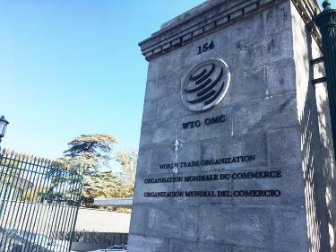
International Economic Organisations
Structure and main functions of the WTO
The WTO's top level decision-making body is the Ministerial Conference. Below this is the General Council and other various councils and committees. The Ministerial Conference usually meets every two years, to discuss, decide and act on all important issues relating to the functions of the WTO. Main functions of the WTO are:
AdministeringWTO trade agreements
Cooperating with other international organisations
Acting as a forum for trade negotiations
Main functions
Building the trade capacity of developing economies
Settling trade disputes
Reviewing national trade policies
The WTO headquarters in Geneva, Switzerland
Source: Website of WTO
https://www.wto.org/english/thewto_e/whatis_e/inbrief_e/inbr_e.htm

Slide 25
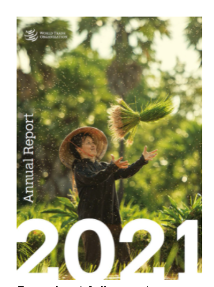

Extended
learning
International Economic Organisations
Work review of the WTO:
Teachers can guide students to read the WTO Annual Report to learn more about the work of the WTO.
The WTO Annual Report 2021 is available below:
Watch animation (about 3 minutes)
Read the textual version
Source: https://www.wto.org/english/res_e/publications_e/anrep21_e.htm

Slide 26
International Economic Organisations
Fundamental principles of the WHO:
The fundamental principles of the WTO, which form the foundation of the multilateral trading system, should be observed by all members in their trade relations:
Trade without discrimination)
Freer trade: gradually, through negotiation
Predictability: through binding and transparency
Promoting fair competition
Encouraging development and economic reform
Source: Website of WTO
https://www.wto.org/english/thewto_e/whatis_e/tif_e/fact2_e.htm

Slide 27
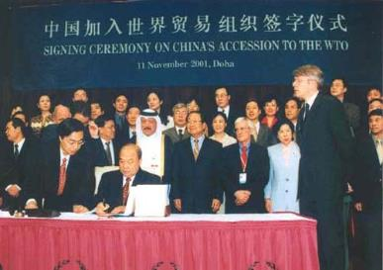
International Economic Organisations
WTO – Participation of our country and Hong Kong (1)
China officially joined the World Trade Organisation in December 2001. Since her accession, China has fulfilled duly its commitments by substantially reducing tariff and non-tariff barriers to imports of goods. The average tariff level has been reduced gradually from 15.3% in 2001 to 7.5% in 2020, which is much lower than the level of most developing countries and close to that of developed countries.
Source: Webpage of General Administration of Customers of the PRC (Chinese only)
http://www.customs.gov.cn/customs/xwfb34/mtjj35/4050515/index.html
Photo credit: Webpage of WTO
https://www.wto.org/images/img_10anniv/phf_500.jpg

Slide 28
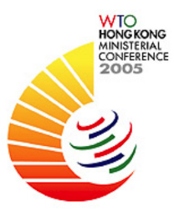
International Economic Organisations
WTO - Participation of our country and Hong Kong (2)
Hong Kong is a founding member of the WTO. Since the establishment of the HKSAR, Hong Kong has continued to participate in the negotiations and discussions of the WTO under the name "Hong Kong, China" in accordance with the Basic Law to safeguard and promote the trade interests of the territory. The rules‑based multilateral trading system under the auspices of the WTO is the cornerstone of Hong Kong’s external trade policy.
Sources:
1. Hong Kong Yearbook 2020
https://www.yearbook.gov.hk/2020/en/pdf/E05.pdf
2. News.gov.hk
https://www.news.gov.hk/isd/ebulletin/en/category/issues/050820/html/050804en03006.htm
The 6th Ministerial Conference of the WTO was held in Hong Kong on 13-18 December 2005.

Slide 29
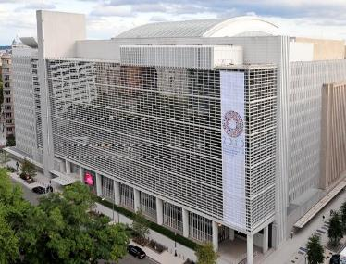
International Economic Organisations
World Bank Group
The World Bank Group (WB), is a global, intergovernmental international economic organisation founded in 1944. As of 2021, the WB had 189 members.
The five institutions under WB are working for sustainable solutions that reduce poverty and build shared prosperity in developing countries.
The WB headquarters in Washington, D.C.
The WB's mission: To end extreme poverty and promote shared prosperity
Reducing the share of the global population that lives in extreme poverty to 3% by 2030
Increasing the incomes of the poorest 40% of people in every country
Source: Website of World Bank https://www.worldbank.org/en/who-we-are

Slide 30





International Economic Organisations
WB's institutions
For developing countries, the five WB institutions share a commitment to reducing poverty, increasing shared prosperity and promoting sustainable development. They provide the funding and knowledge necessary for developing countries.
Five Institutions, One Group
The International Bank for Reconstruction and Development | The International Development Association | The International Finance Corporation | The Multilateral Investment Guarantee Agency |  | The International Centre for Settlement of Investment Disputes
IBRD | IDA | IFC | MIGA |  | ICSID

Slide 31
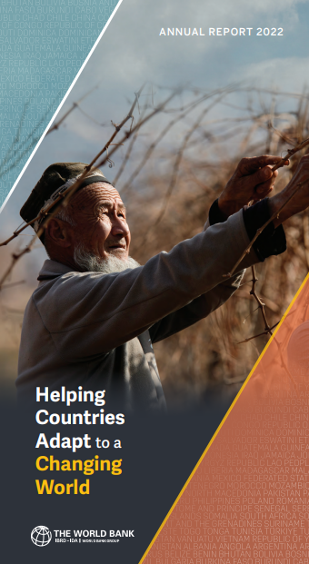

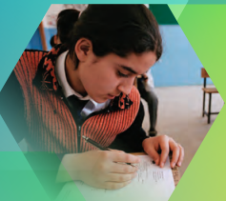
International Economic Organisations
Extended
learning
Work Review of the World Bank Group
Teacher can guide students to read the World Bank's Annual Report 2022 to learn more about its work.
Reference:
https://www.worldbank.org/en/about/annual-report

Slide 32
Reference
International Economic Organisations
WB helps countries cope with
international financial crisis
In response to the 2008 subprime crisis, the WB announced that its subsidiary IFC had tripled the ceiling of trade finance guarantee under its Global Trade Finance Program to $3 billion. During the 2008 subprime crisis, the WB expanded its lending and lent more than USD13 billion to middle income countries. The WB also offered grants and low interest loans to the poorest countries using the USD42 billion of pledges received from donor countries.
Source: Website of World Bank
https://www.worldbank.org/en/news/speech/2008/11/13/thoughts-on-globalization-and-the-global-financial-crisis

Slide 33
Reference
International Economic Organisations
Challenges faced by WB
Since its establishment in 1944, the WB has played a significant role in helping developing countries to develop their economies, providing technical assistance and combating poverty.
As the world economy has developed, the WB faces more challenges. For example, there are suggestions that developed countries control the vast majority of voting power in the WB and that the voices of developing countries are not being adequately reflected.
Allocation of voting power in WB
Allocation of voting power in
International Bank for Reconstruction and Development (IBRD)
Country / region | No. of votes | Percentage of total
United States | 412,252 | 15.84
Japan | 193,741 | 7.44
China | 131,435 | 5.05
Germany | 110,540 | 4.25
France | 98,450 | 3.78
United Kingdom | 98,450 | 3.78
Note: Data as at 31 May 2021.
Source: Website of World Bank, https://www.worldbank.org/en/about/leadership/votingpowers

Slide 34

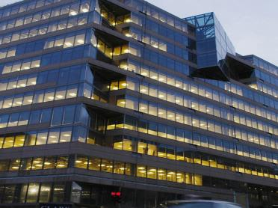
International Economic Organisations
International Monetary Fund
The International Monetary Fund (IMF) is a specialised agency of the United Nations, which began operations in March 1947. Headquartered in Washington, DC, the USA, with 190 member countries, the IMF is committed to enhancing international monetary cooperation and financial stability, promoting balanced development of international trade, fostering high employment and sustainable economic growth, and reducing poverty around the world.
IMF Headquarters in
Washington, D.C., the USA
Photo credit: Webpage of UN news
https://news.un.org/en/story/2013/04/437892-debt-crises-hitting-both-rich-and-poor-countries-threaten-un-development-agenda
Source: Website of IMF https://www.imf.org/en/About

Slide 35
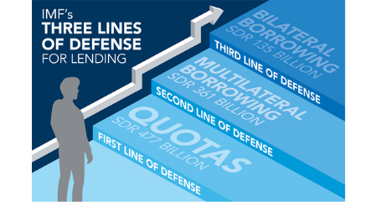
Reference
International Economic Organisations
Sources of IMF funds
First source: Member quotas
  Member quotas are the primary source of IMF funding. A member country’s quota reflects its size and position in the world economy.
  Each IMF member country is allocated a share, which is broadly based on its relative size in the world economy.
Second and third sources: Multilateral and bilateral borrowing
  Borrowing arrangements are made between the IMF and member countries to provide funds for the IMF.
Source: Website of IMF, https://www.imf.org/en/About/Factsheets/Where-the-IMF-Gets-Its-Money

Slide 36
International Economic Organisations
Three key roles of IMF
Economic Surveillance
Lending
Capacity Development
Provides financing to member countries to help them tackle balance of payments problems, rebuild their international reserves, stabilise their currencies, etc.
Offers technical assistance and training, when requested, to help member countries build and strengthen their expertise and institutions to implement sound economic policies.
Oversees the international monetary system and monitors and advises member countries on their economic and financial policies.
Reference: Website of IMF
https://www.imf.org/external/pubs/ft/ar/2019/eng/assets/pdf/imf-annual-report-2019.pdf

Slide 37
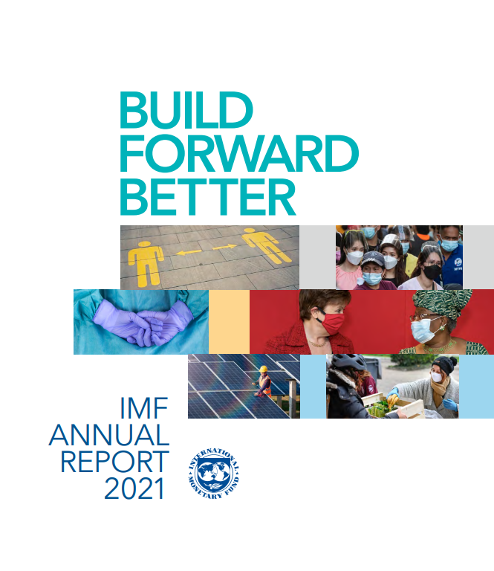
International Economic Organisations
Extended
learning
Work review of IMF
Teachers can guide students to read the IMF Annual Report 2021 to learn more about its work.
IMF Annual Report 2021
Watch video (about 2 minutes): https://www.youtube.com/watch?v=SRuaiXVq6Bg
Read the report:
https://www.imf.org/AR2021

Slide 38
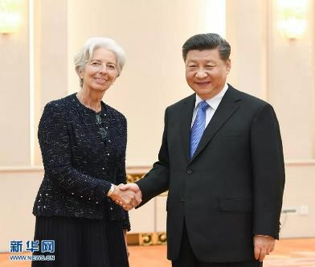
International Economic Organisations
China's role in IMF
China is one of the founding members of the IMF. Since 1980, China and the IMF have established a good relationship of cooperation, with an increasing number of business contacts, which have contributed to the development of the world economy.
Source: Xinhuanet
(http://www.xinhuanet.com/english/2019-04/24/c_138005457.htm)
President Xi Jinping met with IMF Managing Director Christine Lagarde on 24 April 2019.

Slide 39
Reference
International Economic Organisations
Controversies over IMF
The IMF determines the voting power of member countries based on their quota subscriptions. The USA has the largest share in the organisation and therefore has decisive influence within it. Such division of voting power based on economic strength has caused discontent of some countries. The IMF has also been criticised for imposing onerous conditions on borrowing countries when granting loans.
Voting power and passing rate in IMF
Country / region | No. of votes | Percentage of total
United States | 831400 | 16.51
Japan | 309663 | 6.15
China | 306287 | 6.08
Germany | 267802 | 5.32
France | 203009 | 4.03
Source:
Website of IMF
(https://www.imf.org/external/np/sec/memdir/members.aspx#3)
Note: Data as of 31 May 2021.

Slide 40
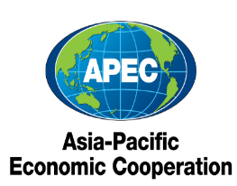




Reference
International Economic Organisations
Examples of other international economic organisations
In addition to the WTO, the WB and the IMF, there are other international organisations that play a coordinating role in economic development, such as the EU, the APEC, the OPEC, the ASEAN and the OECD, which are also important contributors to economic globalisation and regional economic integration.
OPEC
OECD
https://www.opec.org/opec_web/en/
https://www.oecd.org/
APEC
https://www.apec.org/
EU
ASEAN
https://european-union.europa.eu/index_en
https://asean.org/

Slide 41
Reference
International Economic Organisations
Examples of other international economic organisations
International economic organisation | Descriptions
European Union (EU) | The European Union (EU) is an economic and political union made up of 27 EU countries. The EU has common trade, agricultural and fisheries policies. In a unified internal market, there are free flows of goods, labour, capital and services. It has been established as an economic and monetary union with a unified currency within the Eurozone. As an international organisation, the EU is currently the world's most regionally integrated body in the world. Official website: https://european-union.europa.eu/index_en

Slide 42
Reference
International Economic Organisations
Examples of other international economic organisations
International economic organisation | Descriptions
APEC Asia-Pacific Economic Cooperation (APEC) | The APEC was established in 1989 and now has 21 member economies. The APEC is an informal forum for high level government-to-government dialogue on trade and economic issues. The APEC aims to create greater prosperity for the people of the Asia-Pacific region by promoting balanced, inclusive, sustainable, innovative and secure growth and by accelerating regional economic integration. The APEC operates on the basis of non-binding commitments, open dialogue and equal respect for the views of all participants. Unlike the World Trade Organization (WTO) or other multilateral trade bodies, the APEC has no treaty obligations required of its participants. Decisions within the APEC are reached by consensus and commitments are undertaken on a voluntary basis. Official website: https://www.apec.org/

Slide 43
Reference
International Economic Organisations
Examples of other international economic organisations
International economic organisation | Descriptions
OPEC Organization of Petroleum Exporting Countries (OPEC) | The Organization of Petroleum Exporting Countries (OPEC) was established in 1960 and has 13 member countries. Its aim is to coordinate and unify petroleum policies among Member Countries, ensuring price stability of international oil markets and securing a stable revenue for the producing countries. It also aims to provide an efficient, economic and regular supply of petroleum to consuming countries; as well as giving a reasonable return on their capital to those investing in the petroleum industry. Official website: https://www.opec.org/opec_web/en/

Slide 44
Reference
International Economic Organisations
Examples of other international economic organisations
International economic organisation | Descriptions
Organisation for Economic Cooperation and Development (OECD) | The Organisation for Economic Cooperation and Development (OECD) is an international advisory body established in 1961 from the Organisation for European Economic Co-operation (OEEC). It is a group of 38 member countries that work together to address the economic, social and governance challenges of globalisation and to seize the opportunities it brings. OECD is committed to developing better policies for better lives, with the goal of shaping policies that foster prosperity, equality, opportunity and well-being for all. Official website: https://www.oecd.org/

Slide 45
Reference
International Economic Organisations
Examples of other international economic organisations
International economic organisation | Descriptions
Association of Southeast Asian Nations (ASEAN) | Founded in 1967, the Association of Southeast Asian Nations (ASEAN) has 10 member states whose goals and objectives are: To accelerate the economic growth, social progress and cultural development in the region through joint endeavours in the spirit of equality and partnership in order to strengthen the foundation for a prosperous and peaceful community of Southeast Asian Nations; To promote regional peace and stability through abiding respect for justice and the rule of law in the relationship among countries of the region and adherence to the principles of the United Nations Charter; and to promote active collaboration and mutual assistance on matters of common interest in the economic, social, cultural, technical, scientific and administrative fields. Official website: ttps://asean.org/

Slide 46

Reference
International Economic Organisations
Regional Comprehensive Economic Partnership (RCEP):
The world's largest free trade area in economic and trade terms
The Regional Comprehensive Economic Partnership (RCEP), initiated by ASEAN in 2012, was formally signed on 15 November 2020 after eight years and 31 rounds of formal negotiations. On 1 January 2022, the RCEP agreement took effect firstly on the 10 countries that had ratified the agreement (including Brunei, Cambodia, China, Japan, New Zealand, etc.).
RCEP currently has 15 member countries, including China, Japan, Korea, Australia, New Zealand and the 10 ASEAN countries, covering a population of about 2.27 billion and accounting for about 33% of the world's GDP, making it the world's largest free trade agreement in terms of population and scale of trade.
https://rcepsec.org/

Slide 47
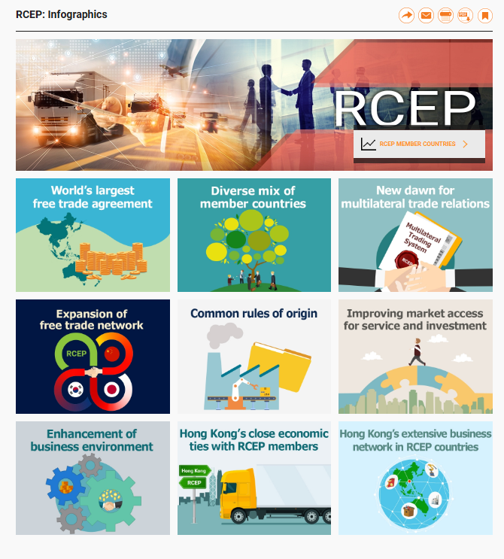

Reference
International Economic Organisations
Teachers can refer to the website of the Hong Kong Trade Development Council for details of the RCEP.
Reference:
RCEP: Infographics
https://research.hktdc.com/en/data-and-profiles/infographics/rcep

Slide 48
User Guide
The primary users of this resource are teachers. It aims to provide teachers with content knowledge relevant to the topic to enable teachers to have a deeper understanding of teaching content when preparing for their lessons.
All data, videos, photos, pictures, questions and suggested answers can be used for multiple purposes, such as teachers’ teaching materials, references for curriculum planning and learning and teaching, and student assignments, etc. To align with Citizenship and Social Development Curriculum and Assessment Guide (Secondary 4-6) (2021) (C&A Guide), this resource should be adapted to cater for students’ learning diversity, classroom teaching and assessment needs, among others.
Teachers may provide appropriate supplementary notes/explanations to enrich this resource in order to enhance students’ understanding of the topic and information provided.
In accordance with the curriculum rationale and aims, teachers may select other learning and teaching resources which are correct, reliable, objective and impartial to help students build up a solid knowledge base, develop positive values and attitudes as well as enhance critical thinking and problem solving skills, and various generic skills.
If some information cannot be provided in this resource due to copyright issue, teachers may visit relevant websites provided.
Some information may have been updated when being used by teachers, teachers may visit the corresponding websites to obtain the up-to-date information.
Please also refer to the C&A Guide to understand the requirements and arrangements of the learning and teaching of the curriculum. Teachers are welcome to point out the areas need improvement, and welcome to provide updated information to enrich the content for all teachers’ reference.

Slide 49
Notice and Disclaimer
Some sources were not translated into English as the official English version is not available.
In case of any discrepancy between the Chinese and English versions, the Chinese version shall prevail.

