Slide 1
Citizenship and Social Development
Theme 2: Our Country since Reform and Opening-up
Topic: Participation in international affairs
Learning focus:
Impact of participation in international affairs on the country’s overall development, and the active role played by Hong Kong
July 2023
(Translated version)

Slide 2
Learning objectives
Knowledge
To understand the impact of the country’s participation in international affairs on national development
To understand the active role played by Hong Kong in the country's participation in international affairs
Skills
To enhance integrated analytical skills through reading and analysing reliable information/ cases, and to comprehensively and objectively evaluate the impact of the country’s participation in international affairs and the active role played by Hong Kong
Values
To enhance the pride of being a Chinese citizen, and to cultivate national identity
To broaden international perspective

Slide 3
Impact of participation in international affairs
on the country’s overall development
1. Maintaining a peaceful environment for national development
China's extensive participation in international affairs has maintained a peaceful external environment for overall development, created new opportunities, expanded its influence, and enhanced its status and influence in the international community. China upholds the international system with the United Nations at its core, enhances mutual trust with other countries, promotes the peaceful settlement of regional issues through diplomatic mediation, and maintains world peace and stability.

Slide 4
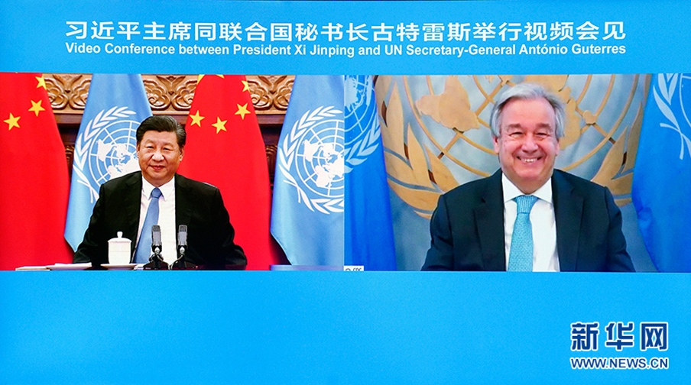
China maintains the order of the United Nations and shapes a peaceful external environment
The Charter of the United Nations clearly sets as its main purposes the maintenance of world peace, the promotion of common development, the advancement of friendly relations among nations and the promotion of the principles of multilateralism. China upholds the international system with the United Nations at its core, and the basic norms governing international relations underpinned by the purposes and principles of the UN Charter, and the international order underpinned by international law, and has also created an overall peaceful external environment for national development.
Source: www.gov.cn (http://www.gov.cn/xinwen/2021-10/25/content_5644772.htm)
In 2021, under the initiative of China, the UN Security Council held a high-level meeting on “Maintenance of International Peace and Security: Upholding Multilateralism and the United Nations-centered International System". All sides stressed the importance of upholding multilateralism, expressed in different ways the need to defend the purposes and principles of the Charter of the United Nations, and reaffirmed their support for the need for the United Nations to play a greater role in international affairs.
In a virtual meeting with UN Secretary-General António Guterres in Beijing on the evening of September 23, 2020, President Xi Jinping said: "In the world, there is only one international system, i.e. the international system with the United Nations at its core. There is only one set of rules, i.e. the basic norms governing international relations underpinned by the Charter of the United Nations."
Source: www.gov.cn (http://big5.www.gov.cn/gate/big5/www.gov.cn/guowuyuan/2021-05/08/content_5605208.htm)
Source: www.xinhuanet.com (http://www.xinhuanet.com/politics/leaders/2020-09/23/c_1126532678.htm)

Slide 5

Reading activity
Click on the image below to read the article to learn more about our country's work at the United Nations to maintain international order and shape a peaceful environment.
Practicing True Multilateralism and Giving Play to China's Unique Role – Ambassador Mr Zhang Jun, Permanent Representative of China to the United Nations, briefed the media on China's presidency of the Security Council in May. (中國擔任安理會輪值主席：踐行真正多邊主義 發揮中國獨特作用)
Source: The State Council of the People’s Republic of China
http://www.gov.cn/xinwen/2021-06/01/content_5614713.htm

Slide 6
China strengthens exchanges
with other countries and enhances mutual trust
Strengthening ties between countries can enhance mutual trust, which is the basis of relations between countries. The key to mutual trust is to respect and accommodate each other's vital interests and concerns and to establish effective communication mechanisms. By participating in international affairs, China has enhanced mutual trust with other countries, which helps build new international partnerships.
Countries should be open and honest with each other, and actively strengthen exchanges and enhance mutual trust with the leaders and people of other countries through various means. In handling mutual relations, the core interests of both parties should not be compromised. The relationship between the two countries is a healthy one and the principle of win-win cooperation should be followed.

Slide 7
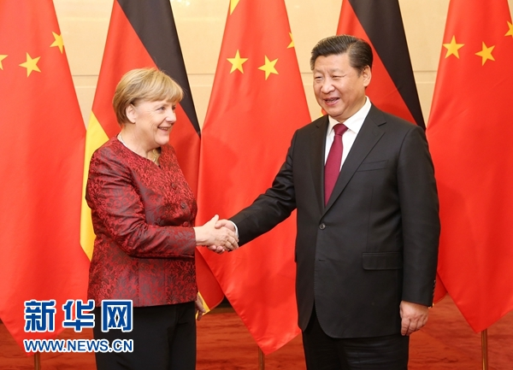
Examples
The leaders of China and Germany jointly advocated the concept and stance of multilateralism, strengthened communication and coordination between the two countries in international affairs, and reached a series of achievements to further deepen mutually beneficial cooperation.
In order to enhance mutual trust between China and the United States and build a new type of major-power relationship between the two countries, President Xi Jinping and then-US President Barack Obama held two dialogues in 2014 and 2015.
President Xi Jinping stressed: "The Pacific Ocean is large enough for both China and the United States to develop. To achieve the China-US relations featuring no conflict, no confrontation, mutual respect and win-win cooperation is a priority of China's diplomatic policy."
Then-US President Barack Obama said: "The United States welcomes the peaceful rise of China. A stable and prosperous China not only meets the interests of the Chinese people, but also in the interests of the United States and the international community."
President Xi Jinping met with then-German Chancellor Angela Merkel in 2019
Source: Office of the Commissioner of the Ministry of Foreign Affairs of the People's Republic of China in the Hong Kong Special Administrative Region
https://www.fmprc.gov.cn/mfa_eng/topics_665678/2015zt/xjpdmgjxgsfwbcxlhgcl70znxlfh/201509/t20150930_705340.html
Source: www.xinhuanet.com (http://big5.news.cn/gate/big5/www.xinhuanet.com//politics/2015-10/29/c_1116983650.htm)

Slide 8
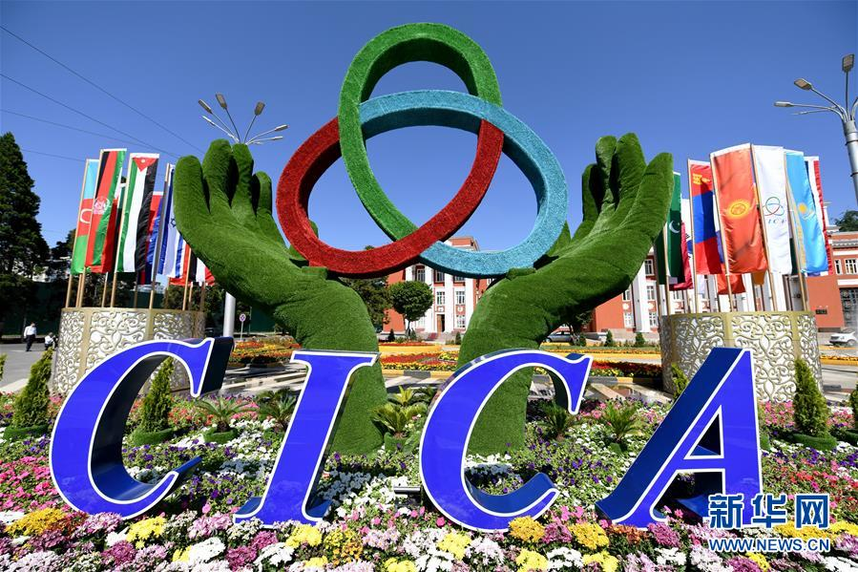
China strengthens regional security co-operation and
promotes stability in its neighborhood
Through participating in regional organisations, China establishes a regional security structure and strengthens regional security mechanisms, security co-operation, and the ability to maintain regional security.
Case
The CICA formulates and implements multilateral confidence-building measures to promote peace and stability in Asia
Founded in 1992, the Conference on Interaction and Confidence-Building Measures in Asia (CICA) is a multi-national forum for enhancing cooperation towards promoting peace, security and stability in Asia, aiming to enhance mutual trust among the 28 member states in Asia (including China, Afghanistan, India and Iraq) and maintain regional security.
As a founding member of the CICA, China actively participates in CICA meetings, strengthens multilateral cooperation with member states, establishes security mechanisms in Asia, jointly combats regional terrorism, and promotes peace, security and stability in Asia through formulating and implementing multilateral confidence-building measures.
Logo of the CICA
Source: Conference on Interaction and Confidence-Building Measures in Asia
(https://www.s-cica.org/index.php?view=page&t=about)

Slide 9
Case
Shanghai Cooperation Organisation
Case
The Shanghai Cooperation Organisation (SCO) is a permanent intergovernmental international organization founded in Shanghai by China, Kazakhstan, Kyrgyzstan, Russia, Tajikistan and Uzbekistan in 2001. Its predecessor was the "Shanghai Five" mechanism.
President Xi Jinping pointed out that over the past 20 years, guided by the “Shanghai Spirit” of “mutual trust, mutual benefit, equality, consultation, respect for diversity of civilisation and pursuit of common development", the SCO has endeavored to promote world peace, development and human progress, and to explore new ground, both theoretical and with actual steps, with a view to building a new type of international relations and a community with a shared future for mankind. The SCO has jointly promoted political mutual trust and created a new model based on partnership and dialogue, rather than alliance or confrontation, and jointly ensured security and stability.
Sources
Official website of the SCO (http://chn.sectsco.org/about_sco/)
The State Council of the People’s Republic of China (http://english.www.gov.cn/news/topnews/202109/18/content_WS61453cafc6d0df57f98e06b1.html)

Slide 10
2. China strengthens economic and trade exchanges with other countries
Since China joined the World Trade Organization* in 2001, its foreign economic and trade exchanges have become increasingly frequent, making it a contributor as well as beneficiary of the global multilateral trading system. China's active participation in international organisations promotes the high-quality development of its national economy, and also allows it to expand economic and trade cooperation with other countries, and to further integrate into the world economy and stay connected to the rest of the world.
The basic principles of the World Trade Organization
The basic principles of the WTO include the principles of nondiscrimination, predictability and transparency, opening trade, fair competition. These basic principles form the foundation of the multilateral trading system.
* World Trade Organization (WTO)

Slide 11

Fulfilling its WTO accession commitments, integrating into the international trading system, and improving the market economy and relevant legal system
Since its accession to the WTO, China has been a strong advocate for free trade, supported the basic principles of rules, openness, transparency, inclusiveness and non-discrimination, fully fulfilled its WTO accession commitments, and upheld the multilateral trading system with concrete actions.
China participates in important international organisations, extensively links with international rules, and conducts comprehensive reform of laws and regulations related to trade and commerce. Our country has also formulated the Foreign Investment Law, revised the Environmental Protection Law and the Patent Law during its participation in international intellectual property protection, the Paris Agreement and other affairs, and gradually improved the market economy and legal system.
Fully fulfilling the commitment to open up markets. After joining the WTO, China fully fulfilled its commitment on opening trade in goods and services, honored its commitment to reduce tariffs in multiple areas, with the total tariff level falling from 15.3% in 2001 to 9.8% in 2018. China started to implement provisional import tax rates lower than the most-favored-nation (MFN) rate for 954 commodities from January 1, 2022.
Providing a fair and orderly market competition environment. After joining the WTO, China has continued to liberalise the entry of foreign capital and built a high standard network of pilot free trade areas.
Creating a transparent and predictable business environment. After joining the WTO, China informs the WTO of the formulation, revision and implementation of relevant domestic laws and regulations, trade policies and measures on a regular basis.
Source: www.gov.cn China and the World Trade Organization
http://big5.www.gov.cn/gate/big5/www.gov.cn/zhengce/2018-06/28/content_5301884.htm
Extended reading: Sharing the Responsibilities of the Times and Jointly Promoting Global Development
(http://www.gov.cn/xinwen/2020-12/15/content_5569594.htm)

Slide 12
Deepening opening up to the outside world and promoting market-oriented reforms
Our country continues to deepen market-oriented reforms, improve efficiency of resources allocation, stimulate the internal impetus of the domestic market, increase its attractiveness to the world, and create richer, more favorable and convenient investment opportunities and business environment for all countries in the world.
Expanding market access for foreign investment
Strengthening international cooperation in intellectual property protection
Increasing imports of goods and services
Effectively implementing coordination of international macroeconomic policy
Valuing the implementation of policies for opening up to the outside world
Source: www.people.com.cn (http://cpc.people.com.cn/n1/2019/0427/c64094-31053281.html)

Slide 13
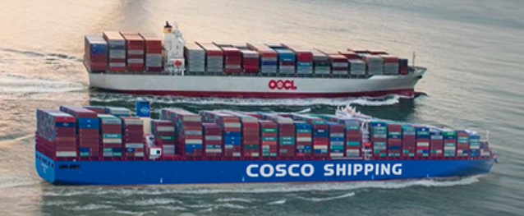
Stimulating the vitality of enterprises and enhancing international competitiveness
Our country participates in international competition and cooperation, effectively stimulates the vitality of domestic enterprises, learns advanced management experience, and gradually improves the level of economic cooperation with other countries.
Case
In 2016, China COSCO Shipping Corporation Limited was formed by the merger of China Ocean Shipping (Group) Company (COSCO) and China Overseas Holdings Limited, shifting from heavily relying on the domestic market in the past to fully covering the global market, with its international competitiveness greatly improved. China COSCO Shipping Corporation Limited's ocean routes have covered more than 1,500 ports in over 160 countries and regions around the world, making it a world leader in terms of fleet size, comprehensive shipping capacity and annual container throughput capacity.
Photo credit: China COSCO Shipping Corporation Limited
http://www.coscoshipping.com/
Source: www.people.com.cn (http://politics.people.com.cn/n1/2019/0125/c421446-30590125.html)

Slide 14
Working closely with other countries
to accelerate the development of free trade areas
Our country has accelerated the development of free trade areas (FTAs), given play to the role of FTAs in promoting trade and investment, and effectively connected the resources of domestic and international markets, building a new development pattern at a faster pace.
As of 2021, China had signed 19 free trade agreements with 26 countries and regions.
Source: The Ministry of Commerce of the People’s Republic of China (http://fta.mofcom.gov.cn/article/rcep/rcepgfgd/202108/45628_1.html)

Slide 15
Reference
China’s free trade agreement | FTAs under negotiation | FTAs under consideration study | Preferential trade arrangements
Regional Comprehensive Economic Partnership (RCEP) | China-Gulf Cooperation Council (GCC) FTA | China-Colombia FTA Joint Feasibility Study | Asia-Pacific Trade Agreement
China-Mauritius FTA | China-Japan-Korea FTA | China-Fiji FTA Joint Feasibility Study
China-Georgia FTA | China-Sri Lanka FTA | China-Nepal FTA Joint Feasibility Study
China-Korea FTA | China-Israel FTA | China-Papua New Guinea FTA Joint Feasibility Study
China-Iceland FTA | China-Norway FTA | China-Canada FTA Joint Feasibility Study
China-Peru FTA | China-Moldova FTA | China-Bangladesh FTA Joint Feasibility Study
China-Singapore FTA (including upgrade) | China-Panama FTA | China-Mongolia FTA Joint Feasibility Study
China-Chile FTA (including upgrade) | China-Korea FTA second phase | China-Switzerland FTA Upgrade Joint Feasibility Study
China-Pakistan FTA (including second phase) | China-Palestine FTA
China-ASEAN FTA (including upgrade) | China-Peru FTA upgrade
China-Maldives FTA
China-Australia FTA
China-Switzerland FTA
China-Costa Rica FTA
China-New Zealand FTA (including upgrade)
China-Cambodia FTA
Mainland and Hong Kong/Mainland and Macao Closer Economic Partnership Arrangement
FTAs of our country and those under negotiation or consideration (as of July 2023)
Source: The Ministry of Commerce of the People’s Republic of China http://fta.mofcom.gov.cn/

Slide 16
Case
Regional Comprehensive Economic Partnership (RCEP)*
The RCEP is a free trade agreement initiated by the 10 ASEAN countries in 2012 to establish a unified market by reducing tariffs and non-tariff barriers.
On 15 November, 2020, a total of 15 Asia-Pacific countries including China, Japan, Korea, Australia, New Zealand and the ten ASEAN countries officially signed the RCEP, which came into effect on 1 January, 2022, marking the official launch of the FTA with the world's largest population (accounting for around 1/3 of the world’s total), biggest economic and trade scale, and greatest development potential.
*Regional Comprehensive Economic Partnership (RCEP)
Source: www.gov.cn (http://big5.www.gov.cn/gate/big5/www.gov.cn/xinwen/2021-11/03/content_5648711.htm)

Slide 17
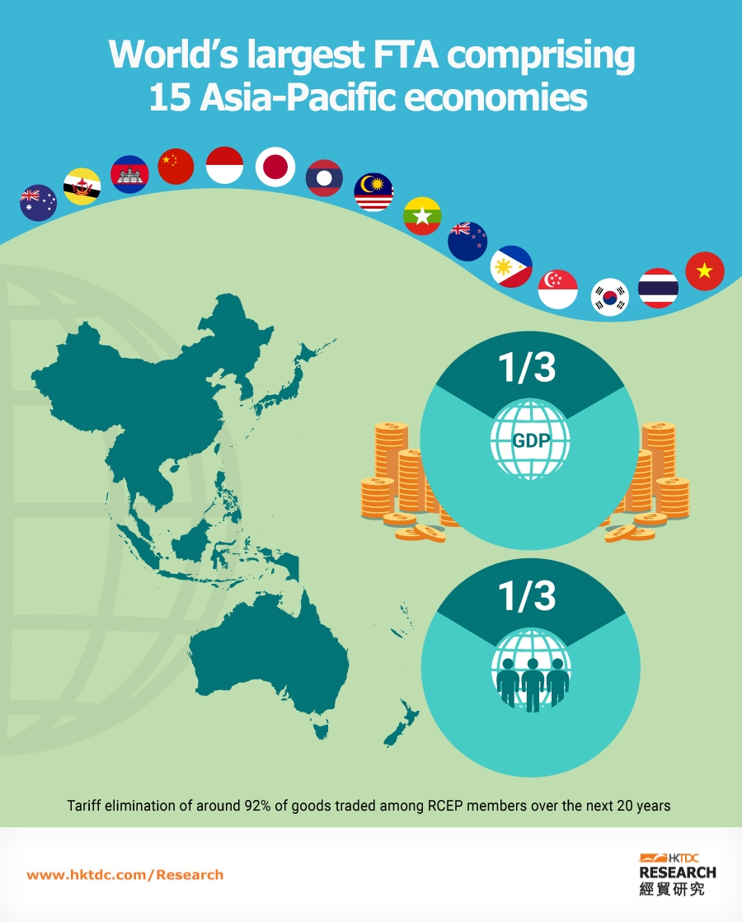
Activity
Apart from China, which countries have participated in the RCEP?
What are the implications of China’s participation in the RCEP for national development?
Photo credit: Hong Kong Trade Development Council (HKTDC ) https://research.hktdc.com/en/data-and-profiles/infographics/rcep

Slide 18
Case
Hainan Free Trade Port
In 2018, construction work on the Hainan Pilot Free Trade Zone (Hainan FTP) is underway, with the project set to extend across the whole of the island, boosting its connectivity with its Indian and Pacific ocean trading partners.
Tourism, the modern services and high-tech industries are the development priorities of Hainan FTP. Market entry has been greatly relaxed with zero tariffs on trade in goods; more liberal policies for talents, border entry & exit and transportation have been implemented; the Hainan FTP Law has been formulated. The FTP policies and related system with Chinese characteristics has been introduced.
Sources:
HKTDC (https://research.hktdc.com/tc/data-and-profiles/mcpc/freetradezones/hainan-free-trade-zone)
The National Development and Reform Commission of the People's Republic of China - Outline of the 14th Five-Year Plan (2021-2025) for National Economic and Social Development and the Long-Range Objectives Through the Year 2035 (https://www.ndrc.gov.cn/xxgk/zcfb/ghwb/202103/P020210323538797779059.pdf)

Slide 19
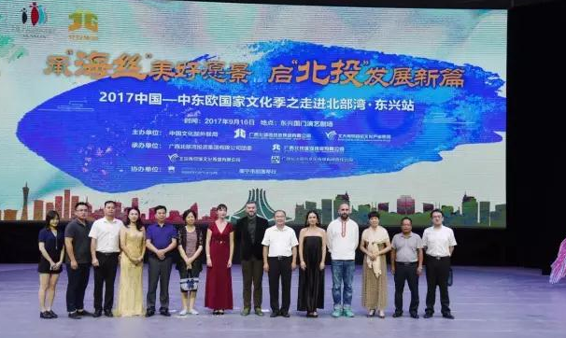
3. Close cultural exchanges between our country and other countries
Promoting cultural exchanges and mutual learning among civilisations
In participating in international affairs, our country has enhanced exchanges with other countries in the world, promoted mutual understanding of cultures, and enhanced the international influence of Chinese culture. Through the mechanism for people-to-people exchanges between China and other countries, more and more Chinese people feel the richness and diversity of world civilisations, and people from other countries come to understand Chinese culture, promoting exchanges and mutual learning between Chinese and foreign civilisations.
Case
Cooperation between China and Central and Eastern European Countries
The “16+1” cooperation (Cooperation between China and Central and Eastern European Countries) is a new cooperation platform jointly established by China and 16 Central and Eastern European countries in 2012. Cultural exchanges are one of the key contents and pillars, building the friendship between the peoples of our country and of Central and Eastern European countries and promoting cooperation among countries.
Source: Cooperation between China and Central and Eastern European Countries http://www.china-ceec.org/eng/jj/zyjz/202112/t20211228_10476286.htm

Slide 20

Conserving cultural relics and protecting cultural heritage
Since joining the World Heritage Convention, our country has successfully declared a number of world heritage sites, natural heritage sites and mixed heritage sites. Chinese cultural heritages are widely recognised by people from all over the world, which has enhanced the attraction of Chinese culture.
As of December 2021, our country has successfully declared
56 world heritage sites
38 cultural heritage sites
14 natural heritage sites
4 mixed heritage sites
Source: United Nations Educational, Scientific and Cultural Organization (“UNESCO”) (https://whc.unesco.org/zh/list/)

Slide 21
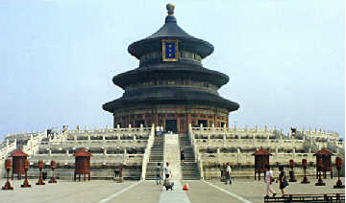
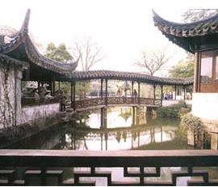
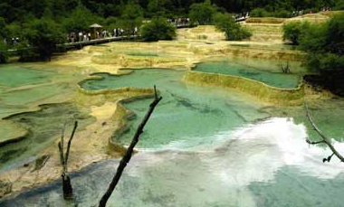
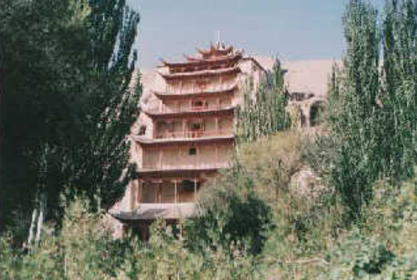
Activity
What is your favorite world heritage site/ cultural heritage site/ natural heritage site/ mixed heritage site in our country? Why? Which of them have you visited?
Built in the first half of the 15th century and located in a royal garden, the Temple of Heaven is a well-preserved altar temple complex that reflects the relationship between heaven and earth, both in its overall layout and in a single building, which occupies a core status in the ancient Chinese cosmology.
Jiuzhaigou Valley stretches over 72,000 hectares in the north of Sichuan province, and this winding and narrow valley is more than 4,800 meters above sea level, thus forming a series of forest ecosystems with different patterns. It is now home to more than 140 species of birds, as well as many endangered species of flora and fauna, including giant pandas and Sichuan takins.
Built in the 16th-18th centuries, Suzhou Garden, known for its finely crafted design, reflects the profound artistic Chinese culture.
The Mogao Grottoes are located at a strategic point along the Silk Road. It was not only a transit point for trade between East and West, but also an interchange of religion, culture and knowledge. Its 492 small grottoes and cave temples, famous for their statues and murals, have showcased Buddhist art that has lasted for thousands of years.
Source: www.gov.cn (http://www.gov.cn/test/2006-05/23/content_288337.htm)

Slide 22
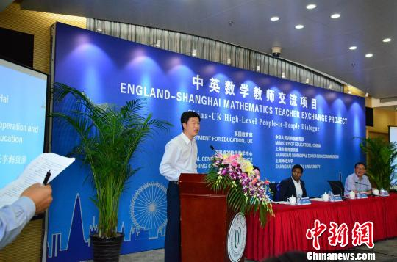
Promoting the improvement of the country's education level
As of September 2020, our country has established educational cooperation and exchange relations with 188 countries and regions and 46 major international organisations, and signed agreements on the mutual recognition of higher education qualifications with 54 countries. China has increasingly frequent exchanges with the international community, and has carried out international education cooperation through participation in the formulation of international education documents, establishment of international educational institutions, and holding of international education conferences to improve the national education level.
Case
In 2017, the 39th Assembly of UNESCO decided that the UNESCO Teacher Education Centre would be founded in Shanghai, China. As a global platform for knowledge production and innovation of teacher education, Shanghai provides UNESCO member states with innovative project suggestions and references for policy improvement, and has preliminarily designed about 10 R&D and training projects involving Southeast Asia, Central Asia, the Middle East and Africa, among others.
The 2017-2018 China-UK mathematics teachers exchange program was launched
Source: The Ministry of Education of the People’s Republic of China (http://www.moe.gov.cn/jyb_xwfb/s5147/201711/t20171105_318450.html)
Source: www.gov.cn (http://big5.www.gov.cn/gate/big5/www.gov.cn/xinwen/2020-09/05/content_5540890.htm)

Slide 23
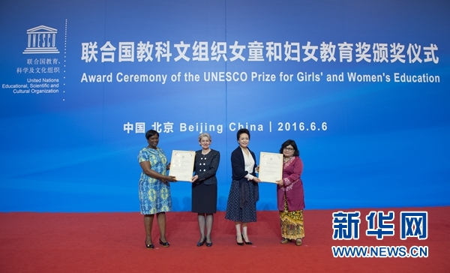
Reference
Our country has cooperated with UNESCO
to establish the Prize for Girls' and Women's Education
In 2015, our country and UNESCO established the UNESCO Prize for Girls' and Women's Education to improve and promote the education prospects of girls and women and in turn, the quality of their lives. Funded by the Chinese government, the Prize has been awarded to a total of 12 laureates worldwide as of 2021, informing the public of their outstanding efforts in favour of girls' and women's education. The Prize has directly contributed to the attainment of the United Nations 2030 Sustainable Development Goals – ensuring quality education for all.
In 2016, the awards ceremony for the first UNESCO Prize for Girls' and Women's Education was held at the Great Hall of the People in Beijing, in the presence of UNESCO Director-General Irina Bokova. Ms. Peng Liyuan, wife of President Xi Jinping and UNESCO's Special Envoy for the Promotion of Girls' and Women's Education also attended and made a speech at the ceremony.
Activity
Which winner of the “UNESCO Prize for Girls' and Women's Education” has touched/ impressed you the most with her work? Why?
Source:
www.xinhuanet.com (http://www.xinhuanet.com//world/2016-06/06/c_1118999970.htm)
UNESCO (https://www.unesco.org/en/prizes/girls-womens-education)

Slide 24
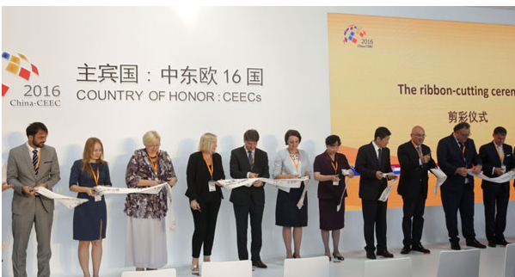
Increasing channels for the exchange of cultural products
International book fairs are an important platform for exchanges between publishers in the Mainland and overseas, which can allow fine books from other countries to be introduced into China, and at the same time introduce outstanding domestic books to the world.
In 2016, the 23rd Beijing International Book Fair was held in Beijing, and representatives of 16 Central and Eastern European countries of honor attended the ribbon-cutting ceremony.
Source: www.gov.cn (http://www.gov.cn/xinwen/2016-08/24/content_5102101.htm)

Slide 25
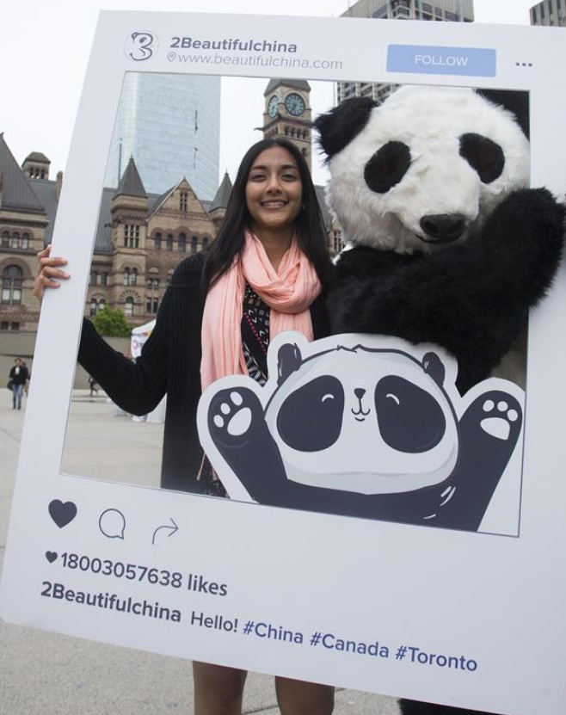
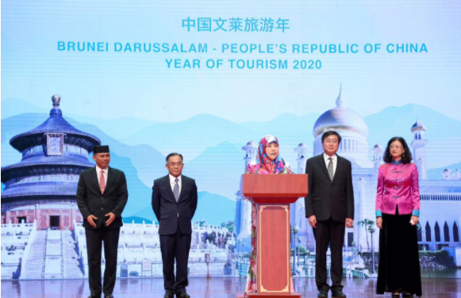
Developing and promoting cultural tourism brands
Our country has established multilateral mechanisms and platforms for cultural tourism cooperation, cultivated and promoted cultural tourism brands, organised a variety of cultural tourism activities for foreigners, and facilitated cultural exchanges and people-to-people bond among countries.
In 2020, the opening ceremony of the "China-Brunei Year of Tourism 2020" was held in Bandar Seri Begawan, the capital of Brunei, to enhance people-to-people exchanges and strengthen cultural exchanges and tourism cooperation.
In May 2017, the 2017 China Culture and Tourism Festival under the theme of "Beautiful China, More than Pandas" was held at Nathan Phillips Square in Toronto.
Photo credit: The Ministry of Culture and Tourism of the People's Republic of China https://www.mct.gov.cn/gtb/index.jsp?url=https://www.mct.gov.cn/whzx/whyw/202001/t20200119_850430.htm
Source: www.people.com.cn (http://world.people.com.cn/n1/2017/1211/c1002-29699603-4.html)

Slide 26
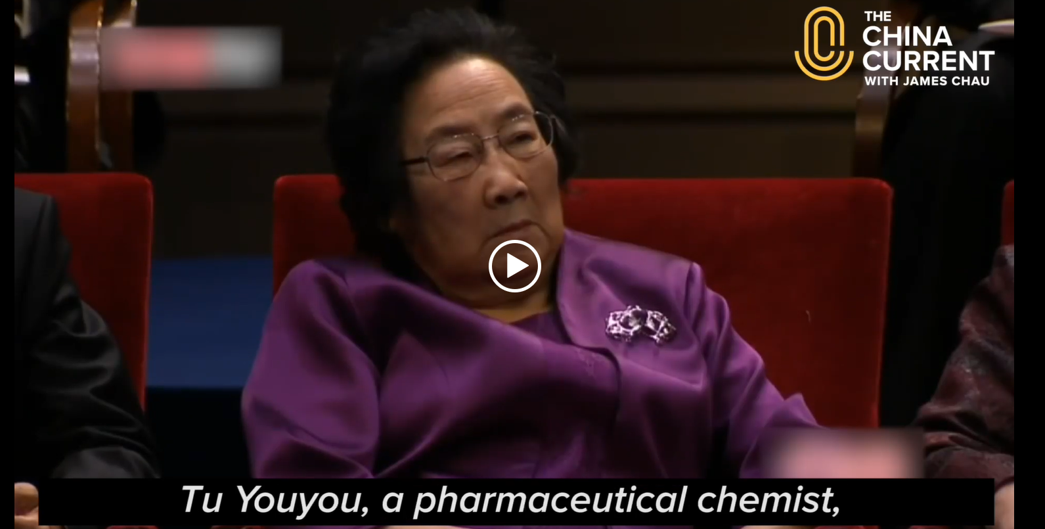
4. Enhancing our country's international status and influence
In the participation of global governance, our country has changed the situation in which a few countries controlled the international discourse power in global governance in the past, and enhanced China's international status and influence.
Video: What actually happens at the UN General Assembly?
Source: The China Current (https://chinacurrent.com/story/18954/what-actually-happens-at-the-un-general-assembly)
Leaders from many countries gathered to discuss issues such as climate change, international security and healthcare - Heads of state gathered at the UN General Assembly to discuss a variety of international issues in search of solutions. China played an important and crucial role on a number of issues. Tu Youyou*'s achievements were mentioned in the video.
*Tu Youyou is the Chief Scientist of the China Academy of Chinese Medical Sciences, a recipient of the Medal of the Republic, and the first Chinese to win the Nobel Prize in Science. In October 2015, she was awarded the Nobel Prize in Physiology or Medicine for the discovery of artemisinin, a drug used to treat malaria that has saved millions of lives worldwide, especially in developing countries.
Click on the image to watch the video

Slide 27
Playing an increasingly important role in global economic governance
Our country actively participates in global economic governance, promotes the reform of global economic governance organisations such as the IMF, World Bank and WTO, and demonstrates China's influence in the international economic realm by increasing the representative of developing countries’ and speaking right.
International Monetary Fund
(IMF)
World Bank
(The World Bank Group)*
In 2010, our country's share of the IMF rose to 6.39%, making it the third largest economy in the organisation, with its voting power rising to 6.07%.
*International Monetary Fund
According to data in 2010, China's voting power in the World Bank increased from 2.77% to 4.42%, surpassing Germany, the United Kingdom and France, ranking third after the United States and Japan. According to data in 2018, China's voting power rose to 5.7%.
*The World Bank Group (World Bank for short)
Source: China News Service (https://www.chinanews.com.cn/cj/2010/11-06/2638773.shtml)
Source: www.yicai.com (https://www.yicai.com/news/5415837.html)

Slide 28
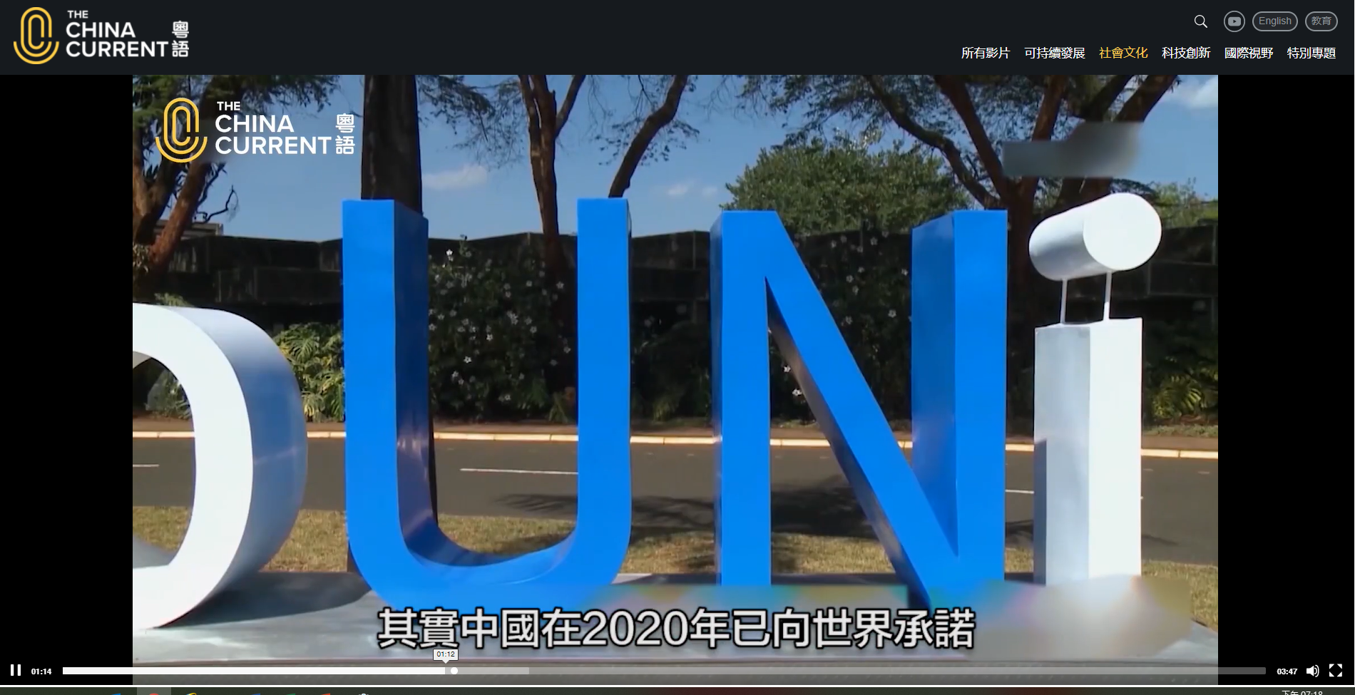
Become a leader in global environmental governance
No country could stay aloof from the global threat of climate change. Our country is committed to upholding the Paris Agreement, following the goals and principles of the United Nations Framework Convention on Climate Change and the Paris Agreement, and striving to implement the 2030 Agenda for Sustainable Development.
Watch the video: The Climate Crisis: China's Commitments and Actions
Common but differentiated responsibilities
The principle of "common but differentiated responsibilities" proposed by our country on the issue of global climate governance is the cornerstone of global climate governance. China proposed that the contribution of developing countries to climate change should be fully recognised and their special difficulties and concerns should be accommodated. Developed countries should show greater determination and action, and at the same time effectively help developing countries improve their ability to cope with climate change, provide financial, technological and capacity building support to developing countries, avoid setting up green trade barriers, prompt them to accelerate the green and low-carbon transformation.
Click on the image to watch the video
Source: The China Current (https://chinacurrent.com/story/22679/2021-10-314-climate-change-china-commitment)
Note: The Paris Agreement, a legally binding global agreement under the United Nations Framework Convention on Climate Change to address greenhouse gas emissions, was adopted by 195 countries, including China, in December 2015 to limit global temperature rise to well below 2 degrees Celsius compared with pre-industrial levels and to strive for 1.5 degrees Celsius.
Source: Papers of the Hong Kong Legislative Council (https://www.legco.gov.hk/yr18-19/chinese/panels/ea/papers/eacb1-1197-7-c.pdf)

Slide 29
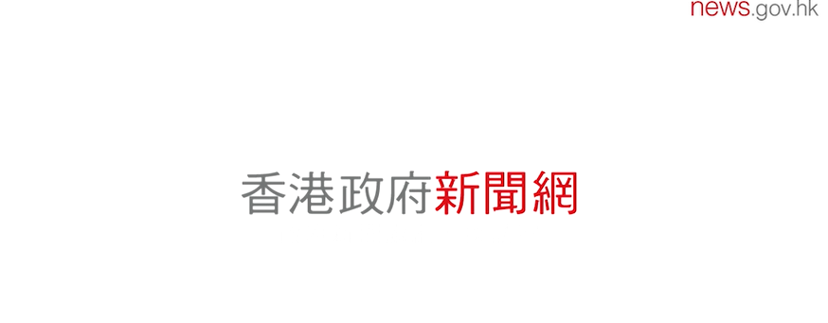
Hong Kong plays an active role
in our country's participation in international affairs
Hong Kong plays the role of a "super-connector"
As a special administrative region and an international city, Hong Kong has extensive international connections, maintaining close ties with the Mainland in many areas such as finance, investment, trade, logistics, professional services, culture and education, and connecting with the rest of the world, playing the role of a "super-connector" to help our country in extending its international connections.
Watch the video and the related introduction to learn how Hong Kong's role as a "super-connector" can help our country in extending its international connections.
Watch the video: Performing Hong Kong's role in promoting international ties
Suggested answer:
Hong Kong's unique role can be discussed from different perspectives such as finance, investment, trade and professional services.
Click on the image to watch the video
Source: news.gov.hk
(https://www.news.gov.hk/chi/2021/12/20211203/20211203_162823_281.html)

Slide 30
1. Serving as an important bridge
between the Mainland and the international market
Hong Kong possesses the unique advantages of "one country, two systems", a large number of top financial talents with international experience, a financial market with complete freedom of capital, standardised market system, advanced infrastructure, a fair and transparent regulatory environment, low tax rates and transaction costs, which makes it an important bridge between the Mainland and the international market.
Hong Kong is better positioned to play its role as an RMB financing and circulation platform. In the future, Hong Kong will evolve into an unprecedented and high-quality offshore RMB hub.
Source: www.people.com.cn http://finance.people.com.cn/GB/n1/2021/0121/c1004-32006820.html

Slide 31
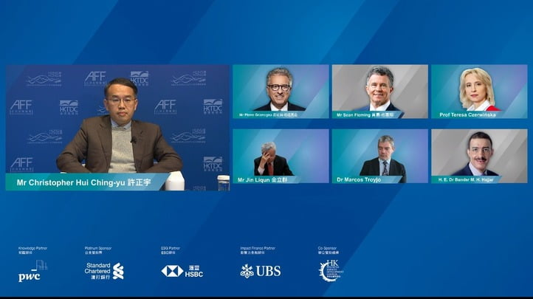
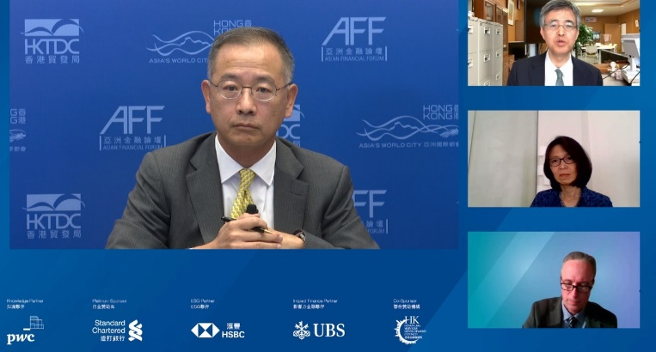
Holding the Asian Financial Forum and playing a bridging role
The “Asian Financial Forum” is an international event co-organised by the HKSAR Government and the Hong Kong Trade Development Council. The forum brings together influential figures in finance and business sectors around the world to discuss the latest developments and trends in the Asian market. Since its inception in 2007, it has become one of the most influential financial events in Asia.
Affected by Covid-19, the 14th Asian Financial Forum was held online in January 2021 under the theme of "Reshaping World Economic Landscape", with the participation of more than 160 political leaders, financial and investment experts, business leaders and economists and over 5,000 viewers from around the world (a higher viewership than the 3,500-plus people when it was held offline in the previous year), showing that Hong Kong has considerable influence as an international financial centre.
Source: www.people.com.cn (http://finance.people.com.cn/GB/n1/2021/0121/c1004-32006820.html)

Slide 32
Joining the Asian Infrastructure Investment Bank (AIIB) to help with project financing
In 2017, Hong Kong has became one of the first members of the AIIB. Hong Kong subscribed to 7,651 shares of AIIB and contributed US$10 million to the bank’s “Project Preparation Special Fund” to support low-income countries. Hong Kong's expertise and financial services sector can contribute to the AIIB, and its accession to the bank will also bring new opportunities to relevant sectors.
Hong Kong's strengths can help the AIIB raise funds to finance the bank's various infrastructure projects. Hong Kong has been internationally recognised for its experience and expertise in designing, building, operating and managing large-scale infrastructure projects.
Source: Hong Kong Government Press Release https://www.info.gov.hk/gia/general/201706/13/P2017061300528.htm

Slide 33
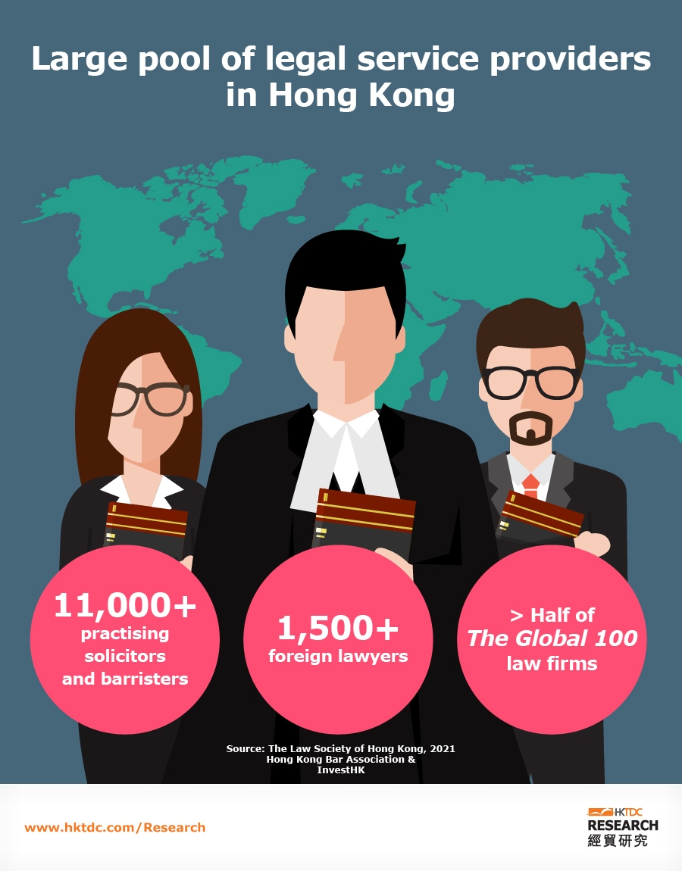
2. Providing professional services
to assist the development of the Mainland
Hong Kong provides ideal international legal and arbitration services for the Mainland and foreign enterprises. 70% of international law firms, including more than half of the global 100 law firms are operated in Hong Kong. Hong Kong has attained a world-leading position in international dispute resolution services, with the offices of world-class arbitration institutions, which can provide international legal and dispute resolution services, including international arbitration and mediation, hereby playing an active role in promoting economic and trade exchanges between our country and the world.
International dispute resolution services
Hong Kong is a leading arbitration centre. A number of well-respected international institutions have chosen Hong Kong as their first global location outside their home jurisdiction. The strong judicial and legal systems have enhanced Hong Kong's strength as an international legal hub.
Source of photo: HKTDC (https://hkservices.hktdc.com/en/industry/legal-services)
Source: Hong Kong News Network (https://www.news.gov.hk/eng/2021/02/20210201/20210201_155733_546.html)

Slide 34
Intellectual property (IP) services industry
Hong Kong's IP services industry has a large pool of professionals who provide a wide range of support services, including IP portfolio management, brokerage, valuation and due diligence. These services are essential in facilitating IP-related licensing and acquisition transactions. Hong Kong is an IP business hub with a variety of professional services. As the most important offshore RMB centre, Hong Kong is an ideal platform for handling IP transactions involving Mainland-based enterprises.
Source: HKTDC (https://research.hktdc.com/en/article/MzExMTM0MzQ0)

Slide 35
Convention and exhibition industry
More than 50 exhibition and convention venues of various sizes are available in Hong Kong, including the Hong Kong Convention and Exhibition Centre (HKCEC), the AsiaWorld-Expo (AWE) and the Hong Kong International Trade and Exhibition Centre in Kowloon Bay. Total available exhibition space in Hong Kong now exceeds 150,000 square metres.
In 2019, Hong Kong hosted more than 100 exhibitions, with more than 1.6 million overseas overnight visitors. The HKTDC organises more than 30 large‑scale exhibitions a year in Hong Kong, connecting around 39,000 exhibitors and more than 750,000 buyers. 11 of these events are the largest marketplaces of their kind in Asia, five of which are the world’s largest, including the electronics, jewellery, gifts, watches & clocks and lighting sectors.
Source: HKTDC (https://research.hktdc.com/en/article/MzEzODk1MDk2)

Slide 36
Reading for thought
Source 1: Hong Kong Logistics: Maritime Prospects and Trends | HKTDC Research
Source 2: Hong Kong to be home to global marine insurance union’s Asian Hub | The Government of the HKSAR Press Release
Question: With an increasing level of internationalisation of and fiercer competition in maritime service, how can Hong Kong give a full play to its a unique strengths in international organisations?
Suggested answer: May consider taking the perspective of giving full play to the advantages of "one country, two systems", maintaining high-end business capabilities, and improving the calibre of talents. Extended reading on the “14th Five-Year Plan” related documents is recommended.
Source:
HKTDC (https://research.hktdc.com/tc/article/ODc2MTE1OTM1)
Hong Kong Government Press Release (https://www.info.gov.hk/gia/general/201610/24/P2016102400345.htm)
www.chinanews.com (http://www.chinanews.com/ga/2016/10-24/8041985.shtml)

Slide 37
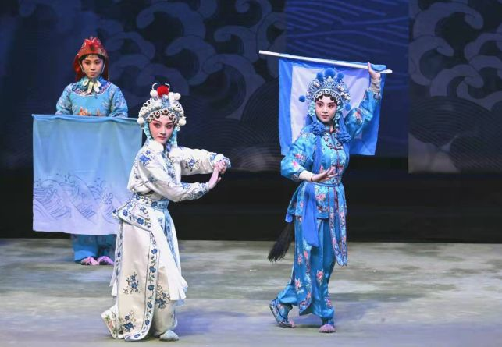
3 Serving as a bridge for cultural exchanges
Building a platform for cultural exchanges
As a bridge for cultural exchanges of East and West and the spread of Chinese culture, Hong Kong displays precious cultural relics of our country through different cultural platforms, including the Xiqu Centre and the M+ Museum in the West Kowloon Cultural District, and the Hong Kong Palace Museum to enhance the understanding of Chinese history and culture of the public and foreign visitors. Moreover, the city also attracts different types of cultural and art exchange activities (such as the Chinese Opera Festival) to be held locally to showcase Chinese culture to the world.
The Hong Kong Chinese Opera Festival focuses on classic Chinese opera and is a platform for our country to display its opera art to the world.
Source:
www.xinhuanet.com (http://www.xinhuanet.com/2019-06/29/c_1124689126.htm)
Hong Kong Government Press Release (https://www.info.gov.hk/gia/general/202107/21/P2021072100575.htm)

Slide 38
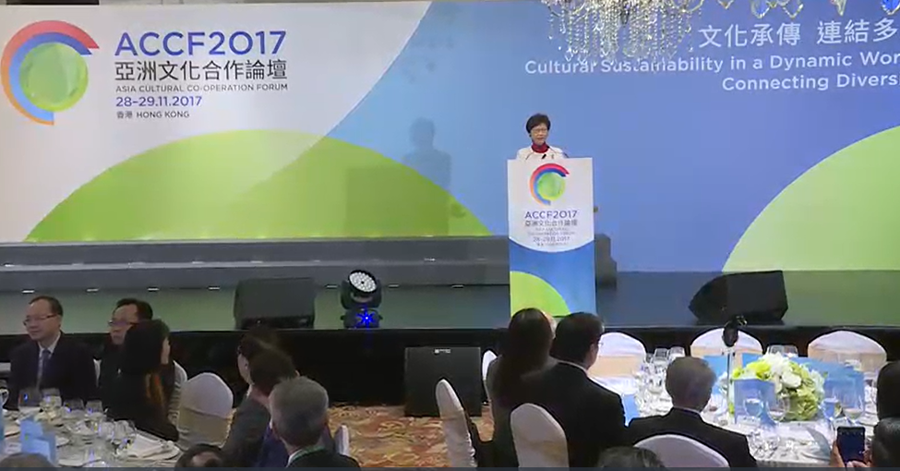
Question for Reflection
The HKSAR Government initiated the “Asia Cultural Co-operation Forum”
After watching the video, analyse the positive impact brought by the Asia Cultural Co-operation Forum held in Hong Kong.
Source: Asia Cultural Co-operation Forum (https://isd.wecast.hk/vod/?id=7621&video=avc/news/2017/ce/ce2811d.mp4)
Suggested answer:
Promote cultural exchanges, facilitate cultural, economic and trade exchanges, etc.
Click on the image to watch the video

Slide 39
The End

Slide 40
User guide
The primary users of this resource are teachers. It aims to provide teachers with content knowledge relevant to the topic to enable teachers to have a deeper understanding of teaching content when preparing for their lessons.
All data, videos, photos, pictures, questions and suggested answers can be used for multiple purposes, such as teachers’ teaching materials, references for curriculum planning and learning and teaching, and student assignments, etc. To align with Citizenship and Social Development Curriculum and Assessment Guide (Secondary 4-6) (2021) (C&A Guide), this resource should be adapted to cater for students’ learning diversity and the needs of classroom teaching, etc.
Teachers may provide appropriate supplementary notes/ explanations to enrich this resource in order to enhance students’ understanding of the topic and information provided.
In accordance with the curriculum rationale and aims, teachers may select other learning and teaching resources which are correct, reliable, objective and impartial to help students build up a solid knowledge base, develop positive values and attitudes as well as enhance critical thinking and problem solving skills, and various generic skills.
If some information cannot be provided in this resource due to copyright issue, teachers may visit relevant websites provided.
Some information may have been updated when being used by teachers, teachers may visit the corresponding websites to obtain the up-to-date information.
Please also refer to the C&A Guide to understand the requirements and arrangements of the learning and teaching of the curriculum. Teachers are welcome to point out the areas need improvement, and welcome to provide updated information to enrich the content for all teachers’ reference.

Slide 41
Notice and Disclaimer
Some sources were not translated into English as the official English version is not available.
In case of any discrepancy between the Chinese and English versions, the Chinese version shall prevail.

