Slide 1
Citizenship and Social Development
Theme 2: Our Country since Reform and Opening-up
Topic: Participation in international affairs
Key points
Actions and initiatives: rescues of various nature and assistance to other countries; setting up international organisations and organising international forums; the Belt and Road Initiative
March 2023
(Translated Version)

Slide 2
Learning objectives
Knowledge
To understand China’s international humanitarian relief and assistance to other countries
To understand how China has formed new international organisations and organised international forums
To understand the main content and significance of the Belt and Road Initiative (B&RI)
Skills
To collect information on international affairs through reliable channels and objectively analyze and evaluate China’s participation in foreign aid and international affairs
Values
To develop an international perspective and understand the importance of cooperation and mutual assistance to foster the spirit of humanistic care

Slide 3
1. Rescues of various nature and assistance to other countries
While committed to its own development, China fulfils its international responsibilities and obligations through active participation in international humanitarian aid and peacekeeping operations and by helping other developing countries enhance their capacity for self-development.
1. International humanitarian aid
2. Peacekeeping operations
3. Assisting developing countries

Slide 4
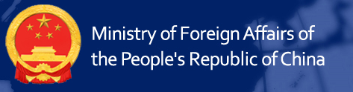
International humanitarian aid
China provides relief supplies, medical assistance, and post-disaster reconstruction, etc. to countries experiencing natural disasters, public health risks, food security threats, and refugee crises, etc.. Our country has made contribution in bolstering disaster response and reduction to major humanitarian crises.
Activity: Reading
Ask students to read the opening remarks by the State Councilor and Foreign Minister Wang Yi at the Exhibition of Achievements on China International Development Cooperation: Working Together to promote development cooperation and create a brighter future for mankind, and summarise some principles of foreign aid and international development cooperation.
Source: Ministry of Foreign Affairs of the People’s Republic of China (https://www.fmprc.gov.cn/wjbzhd/202104/t20210426_9137232.shtml)

Slide 5
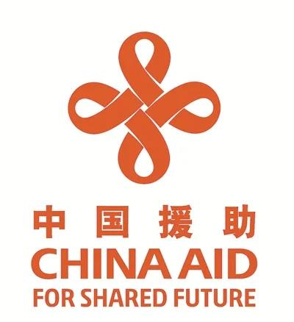
Principles of foreign aid and international development cooperation
Equality and win-win cooperation:
No interference in other countries’ internal affairs and no political strings attached
Keeping promises and seeking results:
To honor our commitments and achieve good results; give full play to its comparative strengths, and perform international duties compatible with its national strength
Staying focused on development and “teaching others to fish”:
To help countries develop and improve their capacity for self-development
Openness, inclusiveness and mutual learning:
All projects are proposed, agreed and led by the recipient country.
Chinese government foreign aid logo
Source: China news (https://www.chinanews.com.cn/gn/2021/04-26/9464782.shtml)

Slide 6
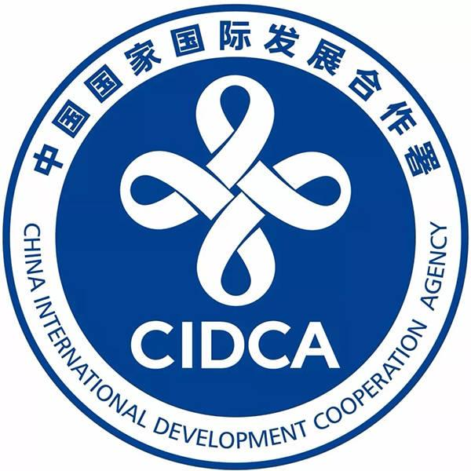
Read more
China International Development Cooperation Agency
Founded in 2018, China International Development Cooperation Agency (CIDCA) is an agency directly under the State Council. The agency formulates strategic guidelines, plans and policies for foreign aid, coordinates and offers advice on foreign aid issues, and advances reform in models of foreign aid. It also develops aid programs and plans, identifies aid projects, and supervises and evaluates their implementation, etc..
Source: China International Development Cooperation Agency
http://en.cidca.gov.cn/

Slide 7
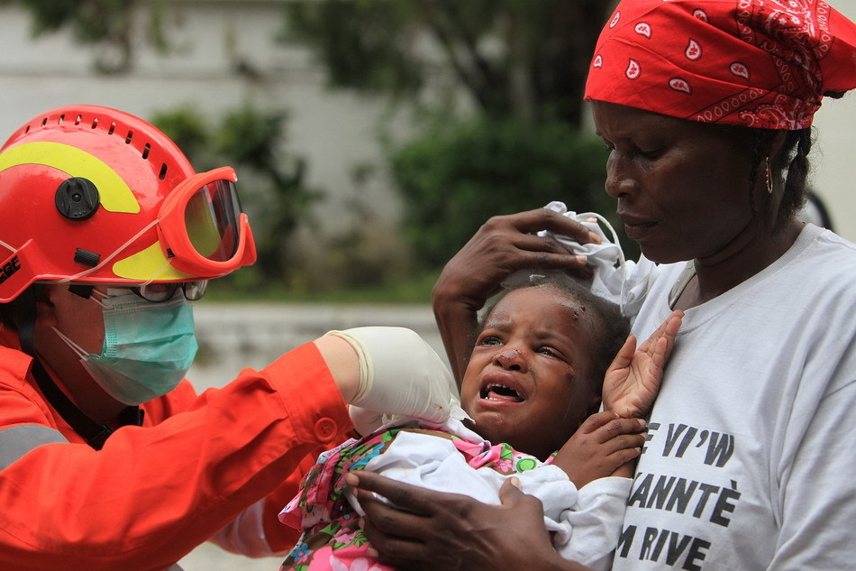
Natural disaster relief
Sending international relief teams and providing relief supplies
Over the years, China has actively participated in international disaster relief and humanitarian aid, such as the earthquake relief in Nepal, the response to typhoon Haiyan in the Philippines, the fight against Ebola in West Africa, the relief in the dam collapse in Laos. These efforts have received praise from the international community.
Case study
In 2010, an earthquake of 7.3 magnitude on the Richter scale hit Haiti, and a large number of buildings collapsed in the capital city Port-au-Prince, causing heavy casualties. The China international rescue team rushed to the disaster area to provide search and rescue, medical assistance, among other services. Rescue equipment, relief supplies and rescue dogs were also transported to Haiti by air, with mobile clinics being quickly set up to treat the injured.
Medical staff from the Chinese International Rescue Team treated the injured in Port-au-Prince, the capital of Haiti
Source: The Central People’s Government of the PRC
http://big5.www.gov.cn/gate/big5/www.gov.cn/jrzg/2010-01/15/content_1510808.htm

Slide 8
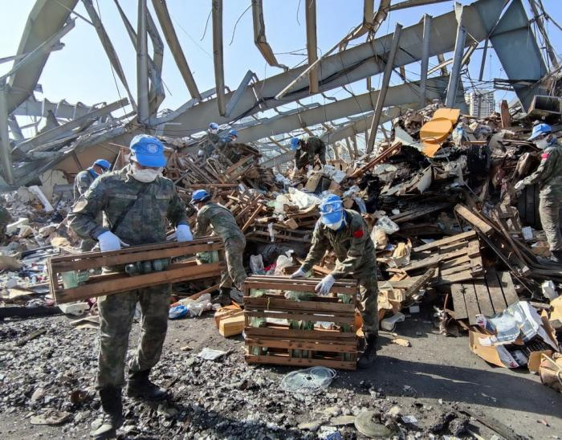

Post-disaster reconstruction
After the emergency relief is over, the affected areas still face food and drinking water shortage, epidemic diseases, house collapse and other problems that require post-disaster reconstruction.
Case-study
In August 2020, when a serious chemical explosion occurred in Beirut, Lebanon, China sent teams to the area to help rebuild the ancient city by clearing debris, searching for artifacts, and fortifying and protecting ancient sites.
Chinese relief workers rebuild city after disaster
Source: people.cn
http://world.people.com.cn/gb/n1/2020/1019/c1002-31896910.html

Slide 9

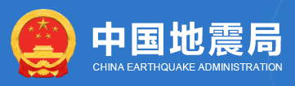
Improvement of disaster prevention and mitigation capabilities
China helps relevant countries overcome obstacles in funding and technology to improve their disaster response capacity by building disaster management facilities, providing disaster prevention and relief reserves, and offering response capacity training.
Reference
Working Mechanism for the Belt and Road Earthquake Risk Reduction Cooperation
China has established the Working Mechanism for the Belt and Road Earthquake Risk Reduction Cooperation with institutions of 22 countries and international organisations. It has implemented projects to assist the construction of earthquake monitoring stations and networks in Laos, Nepal, Kenya and the China-ASEAN Earthquake and Tsunami Monitoring and Early Warning System to improve the capacity of relevant countries for disaster monitoring and alerting.
Source: China Earthquake Administration
https://www.cea.gov.cn/cea/xwzx/fzjzyw/5526978/index.html

Slide 10
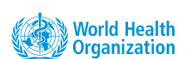
Responding to public health emergency of international concerns
International Health Regulations (2005) defines “public health emergency of international concern (PHEIC) ” as “an extraordinary event which is determined to constitute a public health risk to other States through the international spread of disease, and to potentially require a coordinated international response.”
These emergencies pose a major threat to the lives and health of local people and will spread wide if not properly controlled. Our country has been cooperating with the World Health Organization in coordinating responses to such events, including dispatching medical teams and delivering medical aid to countries concerned to combat the outbreak.
Collecting materials
Ask students to search PHEICs in recent years and find out how China has responded to these public health emergencies.
Source: World Health Organization
(https://www.who.int/news-room/questions-and-answers/item/emergencies-international-health-regulations-and-emergency-committees)

Slide 11


Case-study
Assisting West Africa in the fight against Ebola outbreaks
In 2014, a deadly Ebola epidemic broke out in West Africa. The World Health Organization declared the outbreak as a public health emergency of international concern. China sent medical personnel and experts to the region to provide medical and technical assistance. It also provided emergency aid of about RMB 750 million to 13 African countries.
Read the article:
“Touching China” Awards 2014: Fighting Ebola—Chinese medical team in Africa
Source: CCTV.com (http://big5.cctv.com/gate/big5/news.cntv.cn/2015/02/27/VIDE1425045359484594.shtml)
The TV series Ebola Fighters tells the story of the Chinese medical team fighting against the Ebola virus in 2014.

Slide 12
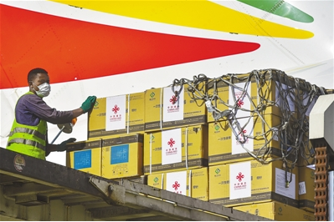
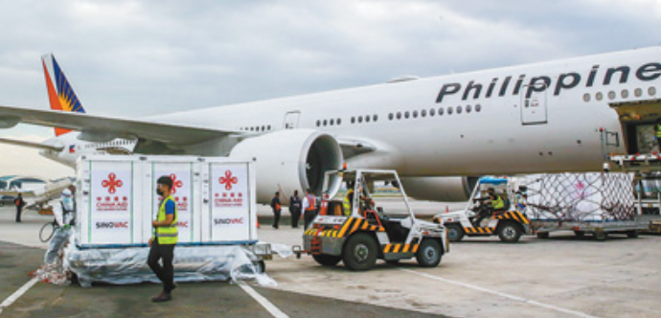
Case-study
Reaching out globally to fight COVID-19
Since the outbreak of the COVID-19 pandemic, China has conducted exchanges and cooperation with the international community. It shared information and experience, developed vaccines, provided humanitarian aid, and exported pandemic materials, making contribution to the global efforts against the pandemic.
The COVID-19 vaccine delivered by the Chinese government to Ethiopia arrived in Addis Ababa, the capital.
The second batch of Sinovac COVID-19 vaccine from China arrived in Manila, the capital of the Philippines, to accelerate vaccination
Read the article:
Chinese vaccine helps fight against the pandemic globally
Source: The Central Government of the PRC
http://www.gov.cn/xinwen/2021-04/04/content_5597713.htm

Slide 13

Activity: Reading
China’s contribution to global fight against COVID-19
Ask students to read the following reports and find out what contribution China has made to the global fight against COVID-19.
1. China brings confidence in the global fight against COVID-19 (China's contribution to the global anti-epidemic and recovery)
Source: people.cn (http://world.people.com.cn/n1/2021/0814/c1002-32192894.html)
2. China’s actions in fighting COVID-19
Source: The Central Government of the PRC
( http://www.gov.cn/zhengce/2020-06/07/content_5517737.htm)
“We will do our utmost to let people breathe because every life matters, regardless of his or her nationality and race”
—Zhao Lijian, spokesperson of the Chinese Ministry of Foreign Affairs, 18 May, 2021
Source: Ministry of Foreign Affairs, the People's Republic of China
(https://www.fmprc.gov.cn/mfa_eng/xwfw_665399/s2510_665401/2511_665403/202105/t20210518_9170746.html)

Slide 14
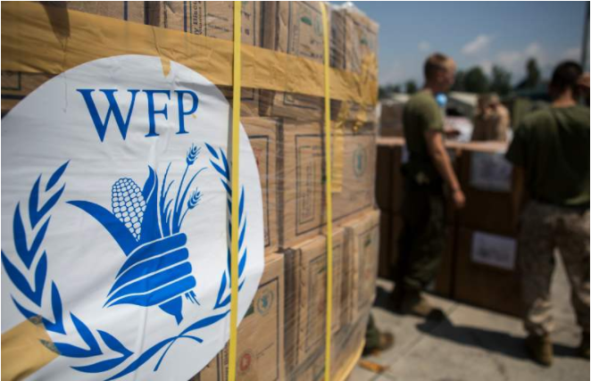
Food aid in response to famines
Affected by extreme weather and war, global food security has become a major concern. China has provided emergency food aid to more than 50 countries in Asia, Africa and South America to meet local food needs.
Cooperation between the Chinese government and the World Food Programme (WFP)
Reference
In the past years, China’s contribution to the WFP amounted to 97.5 million US dollars. In 2019, the Chinese government signed a memorandum with the WFP to promote South-South Cooperation* and to help other developing countries by sharing China’s successful experience in ensuring food security, improving nutrition, and poverty alleviation.
*South-South cooperation: development cooperation in the Global South (mainly developing countries)
Source：
UN World Food Programme (https://zh.wfp.org/news-21)
World Food Programme (https://zh.wfp.org/news/nannanhezuoshijieliangshijihuashujiyujijinguobieshidianxiangmuxilieyantaohui)

Slide 15

Reference
What is the function of the United Nations World Food Programme (UNWFP)?
The UNWFP is the United Nations frontline agency in combating hunger. It is the world's largest humanitarian organisation. Since its founding in 1961, WFP has pursued a vision: a world in which every person, at all times, has access to the food they need for an active and healthy life. WFP worked to save and change the lives of about 158 million people in 2022.
Source: UNWFP
https://www.wfp.org/overview?_ga=2.142338994.1287924248.1668485961-1066165770.1668485961
https://www.wfp.org/stories/wfp-glance

Slide 16
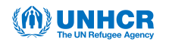

Easing refugee crises
The United Nations High Commissioner for Refugee (UNHCR) statistics show that 1% of the global population is in displacement. Since 2016, in partnership with UNHCR, the Chinese government, through the South-South Cooperation Assistance Fund, has provided assistance to hundreds of thousands of refugees, internally displaced persons and returnees in Afghanistan, Angola, Iraq, and Republic of Congo, Zimbabwe and other countries.
Source: UNHCR
https://www.unhcr.org/cn/https://www.unhcr.org/cn我们的工作/保护和援助
https://www.unhcr.org/hk/en/28383-1percentofhumanitydisplacednewlyreleasedglobaltrendsreport.html
Activity: Reading
Ask students to read the following material to learn why China can play an important role in promoting solutions to refugee crises.
Source: UN refugee chief seeks to deepen cooperation with China
(https://www.unhcr.org/hk/en/14068-un-refugee-agency-chief-seeks-to-deepen-cooperation-with-china.html)

Slide 17

Reference
What is the function of the UNHCR?
UNHCR is responsible for leading and coordinating international action to protect refugees and resolve their problems worldwide. It strives to ensure that everyone can exercise the right to seek asylum and find safe refuge in another country, with the option to return home voluntarily, integrate locally or to resettle in a third country. As a non-political humanitarian agency, UNHCR is mandated by the United Nations to protect refugees and help them find a way out of their plight. Over the past six decades, UNHCR has facilitated governments and international organisations to create conditions conducive to the protection of human rights and the peaceful resolution of disputes in order to reduce forced displacement.
Source: UNHCR
(https://www.unhcr.org/hk/en/63169-work-the-door-to-dignity-and-independence.html)

Slide 18
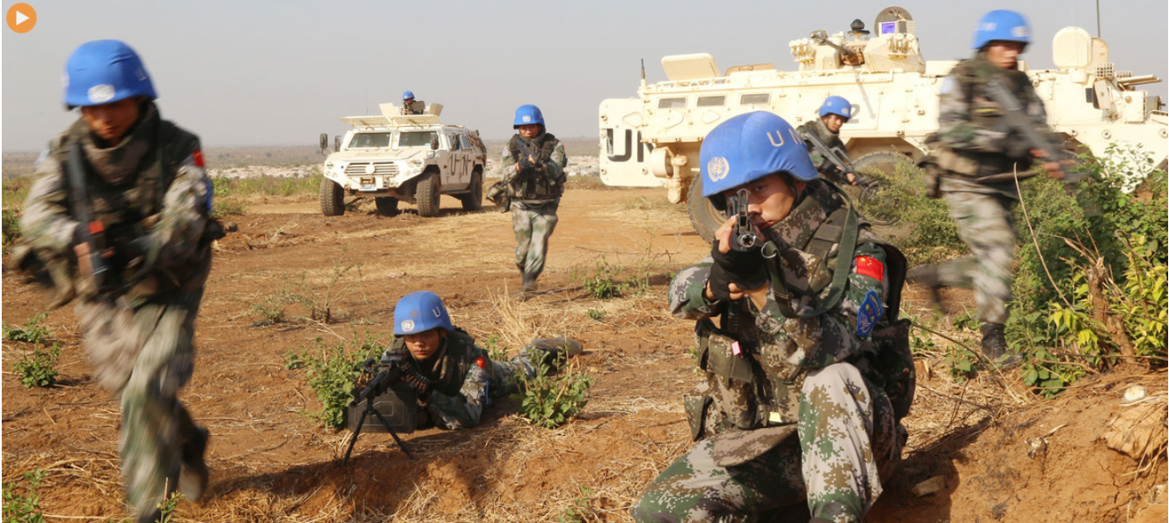
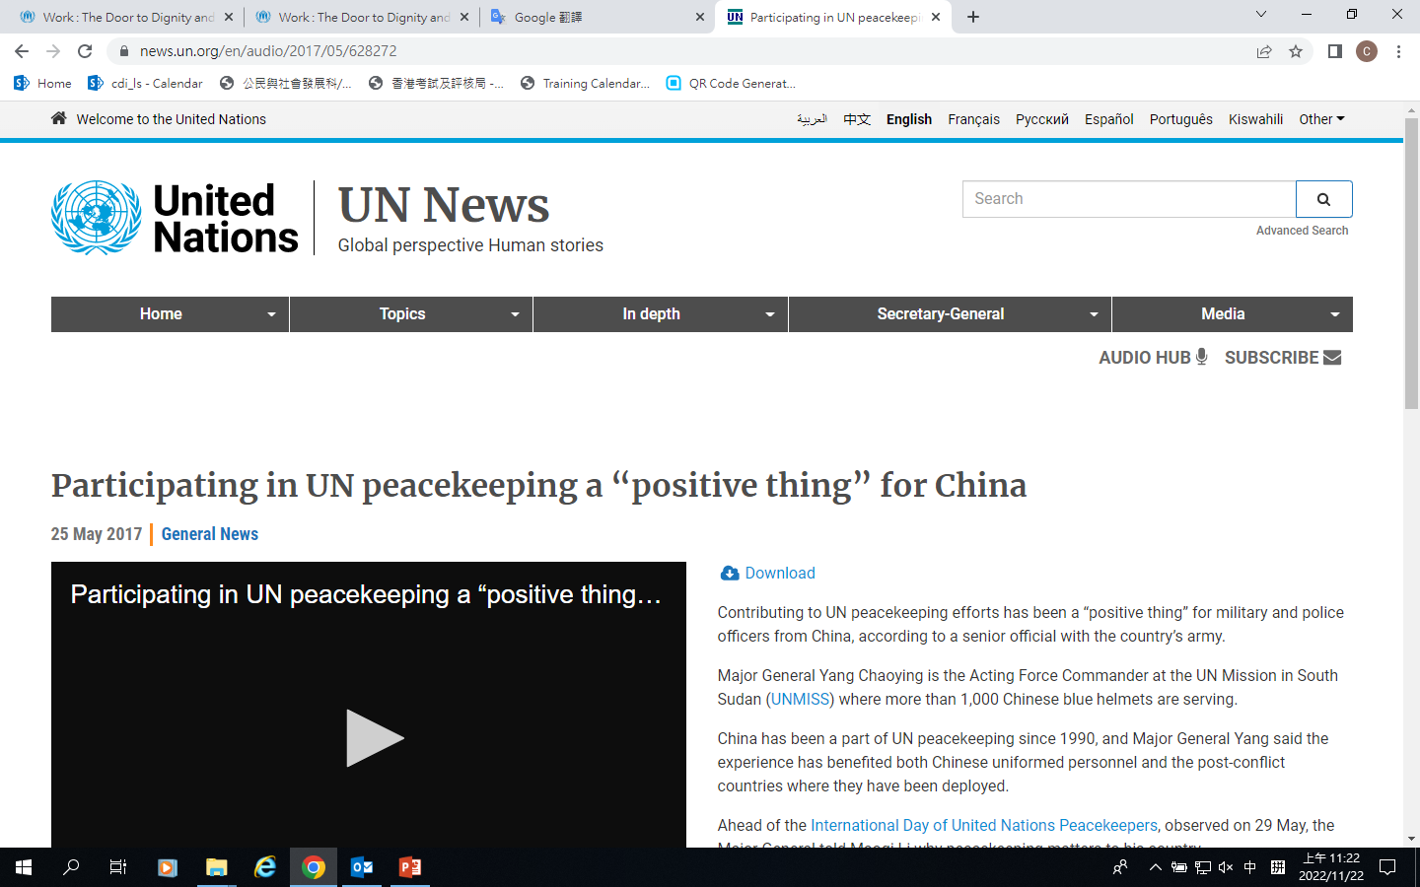
Contributing peacekeeping troops
Participating in peacekeeping operations
Regional conflicts severely affect regional stability and global peace. China has taken a number of actions to maintain regional peace, including contributing troops to the UN peacekeeping operations, naval escorting operations, facilitating peace through dialogue, and mediating regional issues and conflicts in order to maintain international peace.
In order to maintain global peace, Chinese peacekeeping forces have successfully participated in peacekeeping missions in Cambodia, Liberia, Lebanon, Sudan, South Sudan, and Mali, etc. Over the years, China has contributed tens of thousands of peacekeepers to a number of United Nations peacekeeping operations.
Learn more:
Participating in UN peacekeeping a “positive thing” for China
Source: UN News
(https://news.un.org/en/audio/2017/05/628272)

Slide 19
Reference
Launching the Group of Friends on the Safety and Security of United Nations Peacekeepers
Facilitated by China, the Group of Friends on the Safety and Security of United Nations Peacekeepers was launched on 27 April 2021 in the UN headquarters in New York, co-chaired by China, Brazil, Indonesia and Rwanda. The Group of Friends on the Safety and Security of United Nations Peacekeepers provides a platform of communication and enhances the safety and security of peacekeepers.
Source: Xinhuanet
http://www.xinhuanet.com/english/2021-04/28/c_139911891.htm

Slide 20
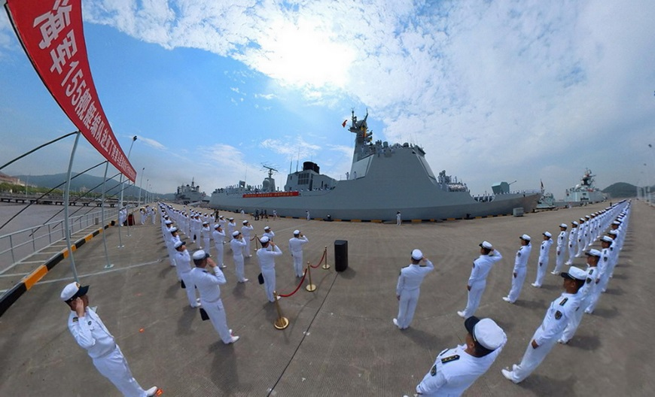

Naval escorting operations
At the end of 2008, the Chinese Navy began patrolling and escorting operations in waters off Somalia and the Gulf of Aden to maintain the security of shipping lanes and protect lives and vessels from pirate attacks.
The 38th Escort Task Force leaves for the Gulf of Aden for escorting operations
Read more:
Female marines in escort operations
Source: Xinhuanet（http://www.xinhuanet.com/politics/2018-12/03/c_1123801754.htm）

Slide 21
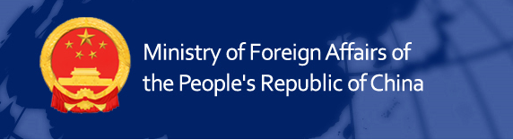
Assisting developing countries
In assisting other developing countries, China upholds the conviction of “teaching people how to fish”. It shares experience and technical knowhow with them in various ways and help them foster talent to improve their own capacity of development.
Reference
Over the seven decades, China and other developing countries have assisted each other and achieved common development through foreign aid and development cooperation. China has provided various types of aid to over 160 developing countries, undertaken thousands of complete sets of projects and material assistance projects, implemented over 10,000 technical cooperation and human resources development programs, and trained over 400,000 people in different professions for other developing countries.
——Opening remarks by the State Councilor and Foreign Minister Wang Yi at the Exhibition of Achievements on China’s International Development Cooperation, 26 April, 2021
Source: Ministry of Foreign Affairs of the People’s Republic of China
https://www.fmprc.gov.cn/mfa_eng/topics_665678/2020zt/kjgzbdfyyq/202104/t20210427_9170930.html

Slide 22

Reference
South-South Cooperation Assistance Fund
In 2015, China established the South-South Cooperation Assistance Fund, providing 3 billion US dollars to assist developing countries in implementing the UN 2030 Sustainable Development Agenda.
The fund has carried out projects in nearly 100 developing countries across Asia, Africa and South America, covering medical and public health, food assistance, health care for women and children, humanitarian assistance, education and capacity building, disaster preparation and mitigation, benefiting nearly 20 million people in recipient countries and winning appreciation from the international community.
Source:
UN news (https://news.un.org/en/story/2019/03/1034941)
China International Center for Economic and Technical Exchanges (http://www.cicete.org.cn/article/ywdh/nnhz/202103/20210303048569.shtml)

Slide 23
Supporting infrastructure development
China helps recipient countries improve infrastructure, including projects in transportation (e.g. roads, bridges, airports), energy (e.g. hydro-power, thermal power), and telecommunication (e.g. fiber optic transmission) .
Read more:
State Councilor and Foreign Minister Wang Yi on debt issues in Africa: China will help Africa realize economic autonomy and sustainable development
Source: Ministry of Foreign Affairs of the People’s Republic of China
https://www.fmprc.gov.cn/mfa_eng/gjhdq_665435/2913_665441/2984_663984/2986_663988/201901/t20190107_544092.html

Slide 24


Sharing state governance experience and assistance in planning
China shares its experience in governance with developing countries regarding the building of rule of law, government reforms, industrial innovation and upgrading; and dispatches experts to assist these countries in formulating development plans, policies and regulations regarding economy, infrastructure, and the power sector.
Case-study
Establishment of the Institute of South-South Cooperation and Development
In 2016, the Institute of South-South Cooperation and Development was founded in Peking University. Over the past five years, the institute has enrolled more than 200 doctoral and master’s candidates from nearly 60 developing countries. It offers courses on national development theories, state governance experience sharing and establishes platforms for research and exchange, contributing to the talent training for state governance in developing countries.
Source:
China International Development Cooperation Agency (http://www.cidca.gov.cn/2021-07/08/c_1211233012.htm)
Institute of South-South Cooperation and Development (https://www.isscad.pku.edu.cn/about/theinstitute/index.htm)

Slide 25
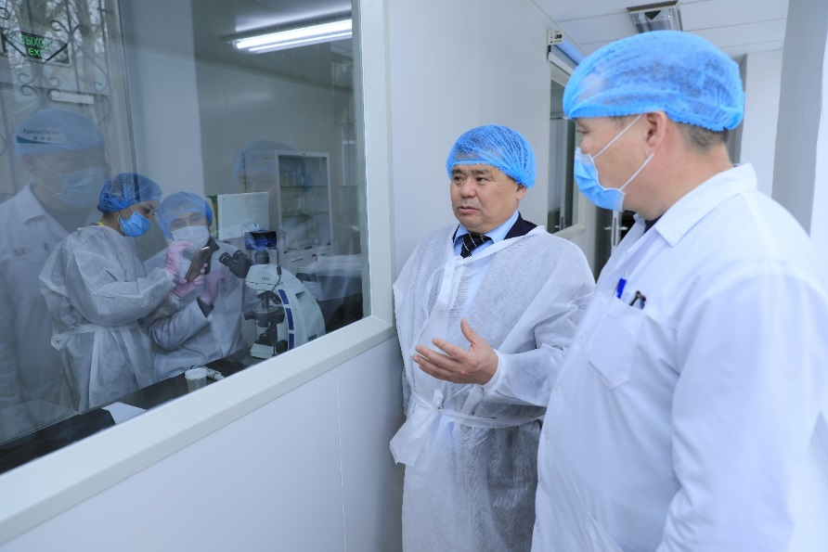
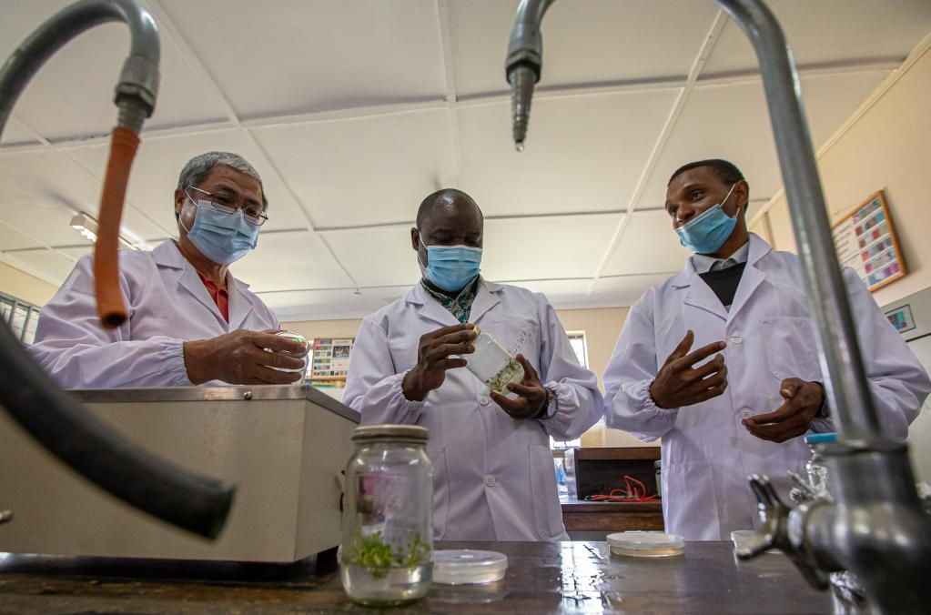
Promoting science and technology
China has established transnational technology transfer centers in many developing countries to achieve technology dovetailing and demonstration training. Joint laboratories or research centers have also been set up in these countries to localise applicable and mature technologies from China.
Researchers visited the China-Kazakhstan Joint Laboratory on Agricultural Sciences in 2021
The Kenya-China Laboratory for Crop Molecular Biology aided by Chinese government was inaugurated in 2016.

Slide 26
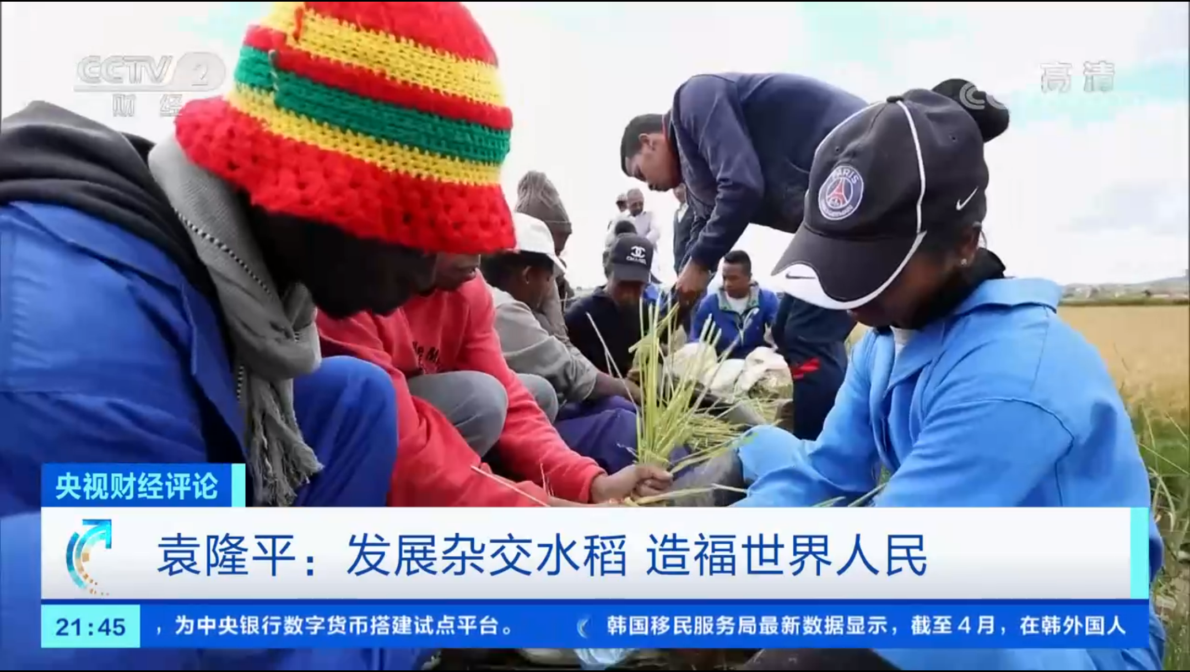

In order to solve the persistent food problems in some regions, China has promoted hybrid rice in many countries in Africa and Asia and provided agricultural technology and development models to increase food production and ensure self-sufficiency.
Case-study
Chinese hybrid rice promoted overseas
The super hybrid rice cultivated by Yuan Longping, an academician with the Chinese Academy of Engineering, has benefited more than 40 countries and regions, with many achieving commercial production enough to feed hundreds of millions of people.
Referenced video:[CCTV Financial Review]Yuan Longping: develop hybrid rice to benefit people worldwide
https://tv.cctv.com/2021/05/24/VIDEgAnv2nqVpSkI5JHcOyip210524.shtml

Slide 27
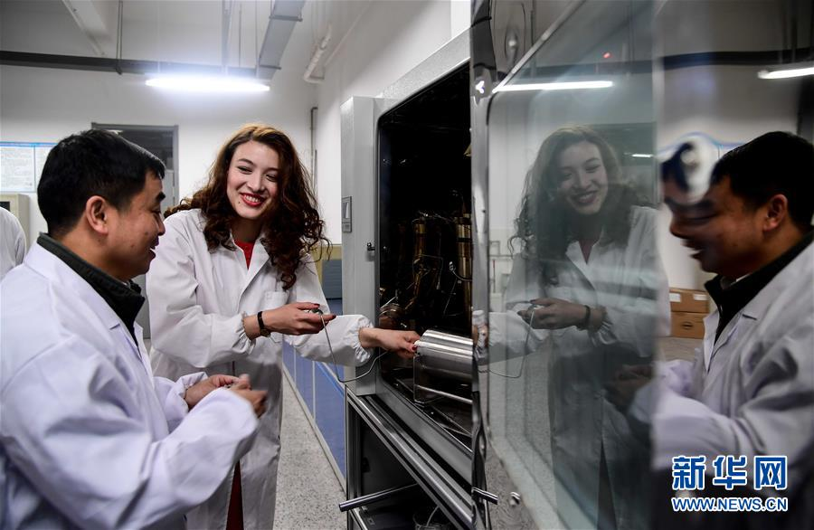
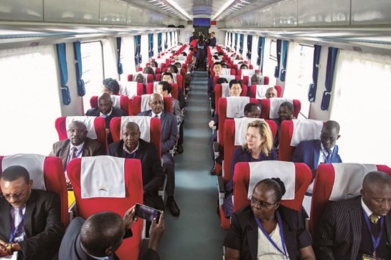
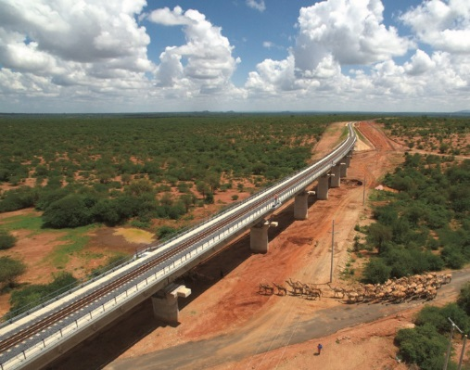

Cultivating technical professionals
China helps developing countries improve their capacity for technological innovation and their workers’ vocational skills by training technical personnel in agriculture, aerospace, and marine biology for many developing countries.
In 2018, teachers at the School of Petroleum Engineering of China University of Petroleum (East China) instructed a Kazakhstan student on experiments.
Case-study
In 2017, a Chinese company built the first railroad in Kenya. China not only brought knowledge, technology and expertise to the region, but also trained local engineers and crew. It even established a long-term operation training center and railroad academy in the region.
Source:
Ministry of Commerce of the People’s Republic of China
(http://www.mofcom.gov.cn/article/beltandroad/ke/chnindex.shtml)
People.cn (http://pic.people.com.cn/BIG5/n1/2018/0608/c1016-30045734-12.html)

Slide 28
Reference
Data on China’s foreign aid and international development cooperation
Since the founding of the People’s Republic of China, the country has
provided RMB 400 billion in aid to 166 countries and international organisations
sent more than 600, 000 aid workers; more than 700 sacrificed their lives
announced 7 times unconditional cancellation of mature interest-free government loans to heavily indebted poor countries and least developed countries
provided medical assistance to 69 countries in Asia, Africa, South America, the Caribbeans and Oceania
helped more than 120 developing countries implement the United Nations Millennium Development Goals (UNMDG)
Source:
The State Council Information Office of the PRC
http://english.scio.gov.cn/whitepapers/2019-09/27/content_75253433.htm
Chinanews.com (https://www.chinanews.com.cn/m/gn/2016/12-01/8080434.shtml)

Slide 29
2. Forming international organisations and organising international forums
Forming international organisations
Since the 21st century, international organisations formed and jointly formed by China have cooperated with other countries to work for a fairer and more rational international order and global governance system and provided solutions to global challenges.
BRICS
Shanghai Cooperation Organisation (SCO)
Asian Infrastructure Investment Bank (AIIB)
Important international organisations formed and jointly formed by China

Slide 30

Shanghai Cooperation Organisation (SCO)
Shanghai Cooperation Organisation (SCO) was preceded by the “Shanghai Five” mechanism. In 1996, in order to solve the border issues between China and Russia, Kazakhstan, Kyrgyzstan and Tajikistan, the heads of state of these countries held their first summit in Shanghai, gradually forming a mechanism for talks between the five countries.
In 2001, the heads of state held their sixth meeting, accepting Uzbekistan into the “Shanghai Five”. On this meeting, the heads of the six countries signed the Declaration on Establishment of Shanghai Cooperation Organisation, and SCO was subsequently established. The organisation has two permanent bodies, the Secretariat based in China (Beijing) and the Executive Committee of the Regional Anti-Terrorist Structure (RATs) based in Uzbekistan.
Based on the Shanghai Spirit of mutual trust, mutual benefit, equality, consultation, respect for diversity of civilizations, and pursuit of common development, the SCO has created a new model of regional cooperation, with fruitful results in security, economic, and cultural cooperation.
Source: Shanghai Cooperation Organisation http://eng.sectsco.org/about_sco/20220810/909141.html

Slide 31
Shanghai Cooperation Organisation (SCO)
Currently, SCO comprises eight member states, four observer states and six dialogue partners, and has established extensive cooperative relations with the UN and other international and regional organisations. With increased international influence, SCO has become one of the most important multilateral cooperation mechanisms between China and Central Asia.
Mutual trust
Mutual benefit
Common development
Shanghai Spirit
Equality
Respect for diversity of civilisation
Consultation
Source: Shanghai Cooperation Organisation
http://eng.sectsco.org/about_sco/20220810/909141.html

Slide 32
BRICS
BRICS is a cooperation mechanism between the worlds’ emerging markets and developing countries. It has driven the cooperation between the member states and their development. China is one of the leading countries enabling BRICS cooperation.
In 2001, the concept of BRICs, which is the acronym of Brazil, Russia, India and China, was introduced by Goldman Sachs. Because BRICs is spelled and pronounced similarly to ‘bricks’ (zhuan), it was translated as jinzhuan (Golden Bricks) countries by the Chinese media and scholars. In 2011, with South Africa officially becoming a member, BRIC was enlarged to BRICS.
In 2006, the foreign ministers of BRIC held the first meeting to mark the beginning of BRIC cooperation. Since then, the foundation of cooperation has been consolidated and the areas of cooperation have been gradually extended to dozens of areas, such as economy and trade, finance, science and technology, agriculture, culture, education, health, think tanks, friendship cities.
Source: the Ministry of Foreign Affairs of the People’s Republic of China
https://www.fmprc.gov.cn/web/wjb_673085/zzjg_673183/gjjjs_674249/gjzzyhygk_674253/jzgj_674283/gk_674285/

Slide 33

New Development Bank (NDB) of BRICS
The BRICS countries planned to set up a New Development Bank to mobilise resources for infrastructure and sustainable development projects among BRICS countries and other emerging economies. In 2014, the BRICS countries signed an agreement for establishing New Development Bank in Brazil. In 2015, the bank was opened in Shanghai. As an important component of the BRICS cooperation mechanism, the founding of the bank helps raise the voice and influence of the BRICS in international financial affairs.
China
According to the following Source, the total initial authorised capital of the New Development Bank was 100 billion US dollars and the initial subscribed capital was 50 billion US dollars, to be equally shared among the five countries.
South Africa
Brazil
$100 billion contingency reserve
India
Russia
Source:
New Development Bank
(https://www.ndb.int/about-us/essence/history)

Slide 34
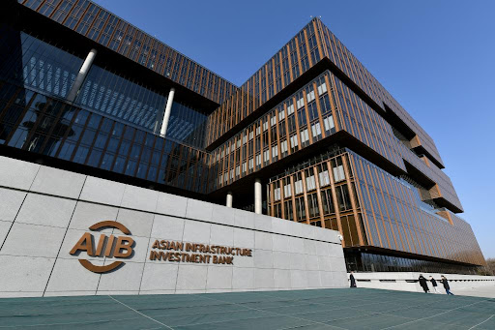
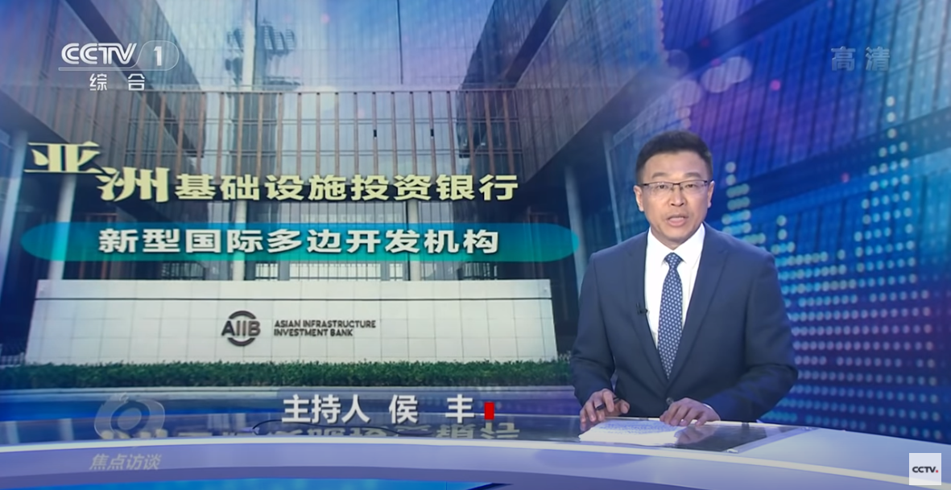
Asian Infrastructure Investment Bank (AIIB)
The Asian Infrastructure Investment Bank (AIIB) is an international multilateral financial cooperation institution that provides financing to Asian governments to improve infrastructure. It was established at the initiative of China and opened in 2016, with headquarters in Beijing and an authorised capital of US$100 billion. Until 2020, AIIB has approved 108 projects with an investment of US$22.02 billion, contributing to regional economic development and global economic recovery.
By 2020, AIIB had 103 member states, including China, India, Vietnam, Singapore, the United Kingdom, France, Germany and Italy.
AIIB headquarters in Beijing
Learning activity
Ask students to watch the video about AIIB’s members and its achievements to understand its investments and functions.
Source:
The Ministry of Foreign Affairs of the People’s Republic of China
https://www.fmprc.gov.cn/web/gjhdq_676201/gjhdqzz_681964/yzjcsstzyh_700178/gk_700180/
CCTV (https://tv.cctv.com/2020/07/28/VIDEVy7CQjpofNEMyzNqdK79200728.shtml)
Click on the image to watch the video

Slide 35
The Group of Twenty (G20)
As a founding member, China participated in the creation of G20 and has been playing an increasing role. G20 has become an important platform for China to participate in global governance.
Establishment--G20 was established in 1999 at the suggestion of the G7 Finance Ministers and was initially as a mechanism for meeting of Finance Ministers and Central Bank Governors. The first leaders’ summit was held in Washington, D.C. in November 2008 to coordinate global responses to the aftermath of international financial crisis. In September 2009, G20 officially became the premier forum for international economic cooperation.
Members--G20 comprises of 20 members, including China, Argentina, Australia, Brazil, Canada, France, Germany, India, Indonesia, Italy, Japan, Republic of Korea, Mexico, Russia, Saudi Arabia, South Africa, Turkey, the United Kingdom, the United States and the European Union.
Features--G20 is widely represented and is able to balance the interests of developed and developing countries as well as between different regions.
Source: Ministry of Foreign Affairs of the People’s Republic of China (https://www.fmprc.gov.cn/web/wjb_673085/zzjg_673183/gjjjs_674249/gjzzyhygk_674253/wsgjt_674255/gk_674257/)

Slide 36
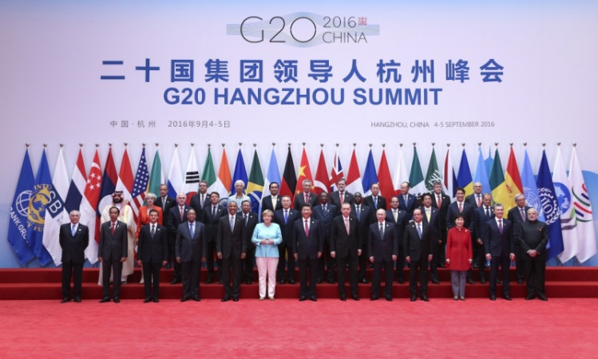
2016 G20 Hangzhou Summit
On 4-5 September, 2016, the G20 Summit was held in Hangzhou. It was the first time China has hosted a G20 Summit, one of the most important diplomatic events hosted by China that year. The theme of the Summit was “Towards an Innovative, Invigorated, Interconnected and Inclusive World Economy.”
Major Outcomes of the Hangzhou Summit
Formulation of documents such as the G20 Blueprint on Innovative Growth and G20 2016 Innovation Action Plan.
Formulation of G20 Strategy for Global Trade Growth, which institutionalised the Trade and Investment Working Group (TIWG).
Formulation of G20 Guiding Principles for Global Investment Policymaking, lays out the first global framework of multilateral rules governing international investment
2016 G20 Leaders’ Summit in Hangzhou
Sources:
people.cn (http://world.people.com.cn/n1/2016/0906/c1002-28695154.html)
PRC government official website (http://www.gov.cn/zhuanti/2016G20/index.htm)

Slide 37
Organising international forums
China has organised many important international forums, which have gradually become periodical. They have attracted people from all countries and fields to come to carry out multilateral cooperation, and exerted positive influence on international exchange and cooperation.
Some important international forums organised by China in the 21st century
International forums | Founding year | Theme | Location
China Development Forum | 2000 | Development | Beijing
Boao Forum for Asia | 2001 | Economy | Boao
Beijing Xiangshan Forum | 2006 | Security | Beijing
Eco Forum Global Guiyang | 2009 | Ecology | Guiyang
World Internet Conference | 2014 | Internet | Wuzhen
Conference on Dialogue of Asian Civilizations | 2019 | Culture | Beijing

Slide 38
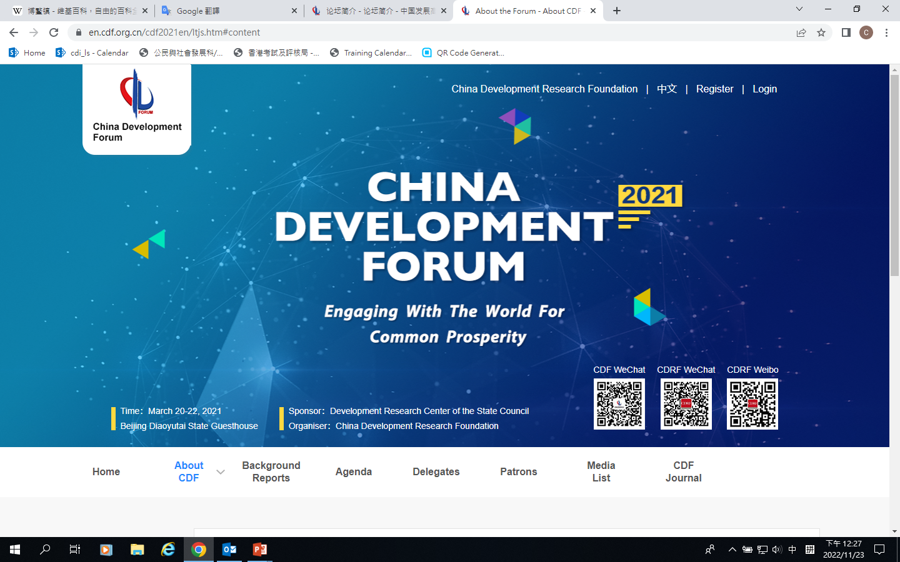
China Development Forum
China Development Forum (CDF) is a major international forum at the national level. Committed to ‘Engaging with the World for Common Prosperity’, the CDF is renowned as a high-level forum serving as an important platform of dialogue for the Chinese government, global businesses, academia, and international organisations.
Source: China Development Forum
https://en.cdf.org.cn/cdf2021en/ltjs.htm#content

Slide 39
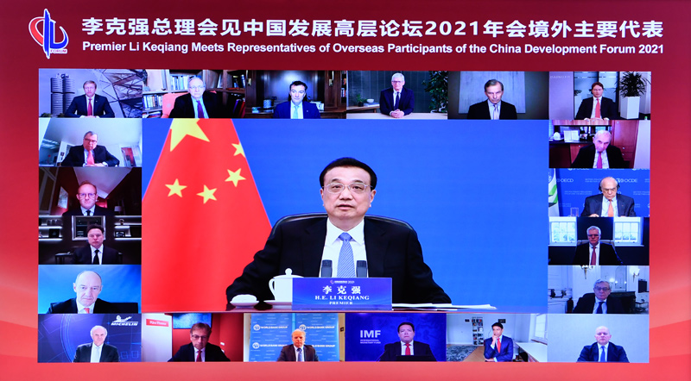
In 2021, the theme of the China Development Forum was “China on a New Journey to Modernization”. Under this theme, CDF 2021 featured new concept of high-quality growth and the a new development paradigm represented by the “dual circulation”. The meeting discussed the direction of China’s economic and social development in 2021 and the next five years, solicited advice and recommendations on China’s development, and elaborated on China’s development blueprint. The meeting consolidated the confidence of the international business community in achieving shared development with China.
At the Great Hall of the People in Beijing, Premier Li Keqiang met by video
with foreign delegates at the 2021 China Development Forum
Source: China Development Forum (https://en.cdf.org.cn/cdf2021en/ltjs.htm#content)

Slide 40
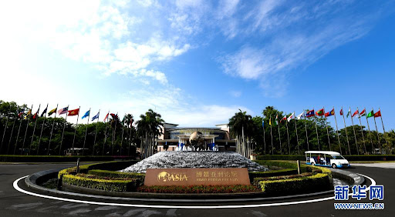
Boao Forum for Asia
Headquartered in China, the Boao Forum for Asia (BFA) is an international organisation jointly initiated by 29 member states. BFA holds its annual conference in Boao, Hainan. The founding purpose of BFA was to promote economic integration in Asia. Its mission now is to pool positive energy for the development of Asia and the world.
The accomplishments of BFA would have been impossible without the strong support and active participation of the governments of member states, member partners, and various communities. It now has become a high-level dialogue platform for political, business and academic leaders from Asia and other continents to discuss key Asian and global issues.
On 12 April, 2002, the first BFA was held in Boao, Hainan Province
Source: Boao Forum for Asia
https://english.boaoforum.org/newsDetial.html?navId=1&itemId=0&permissionId=118&detialId=2090

Slide 41
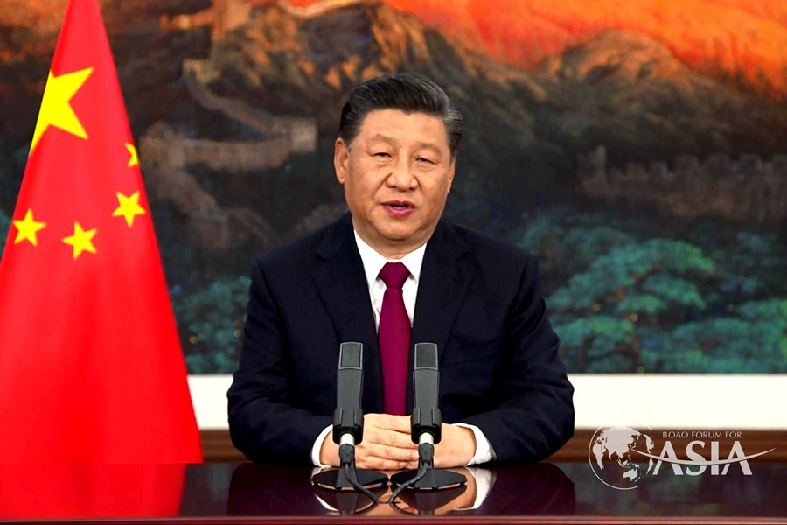
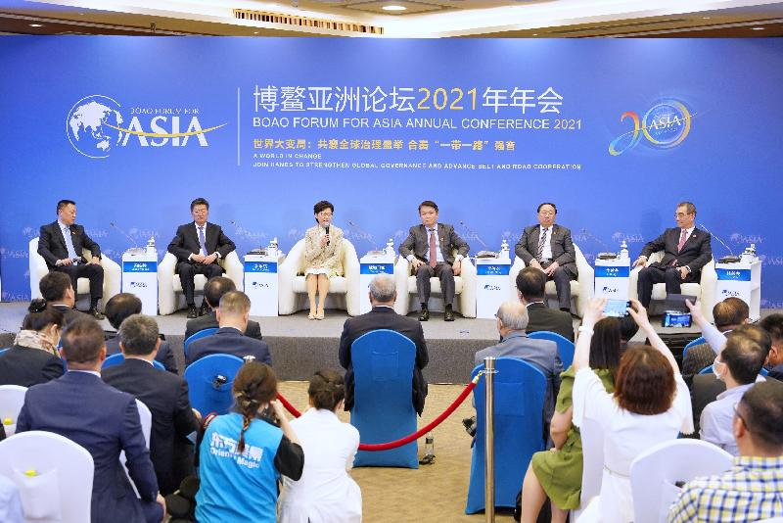
Boao Forum for Asia 2021
The year 2021 marked the 20th anniversary of the Boao Forum for Asia Annual Conference and was the world’s first large-scale conference in 2021 mainly held offline. The theme of the conference was “A world in Change: Join Hands to Strengthen Global Governance and Advance Belt and Road Cooperation.”
President Xi Jinping delivered a keynote speech with the theme on “Pulling together through adversity and toward a shared future for all” through video at the Boao Forum for Asia Annual Conference 2021.
The Chief Executive of HKSAR attended the Boao Forum for Asia Annual Conference 2021 and spoke at the session “Invigorate Development through Vibrant City Clusters: The Guangdong-Hong Kong-Macao Greater Bay Area (GBA) as a Model.”

Slide 42
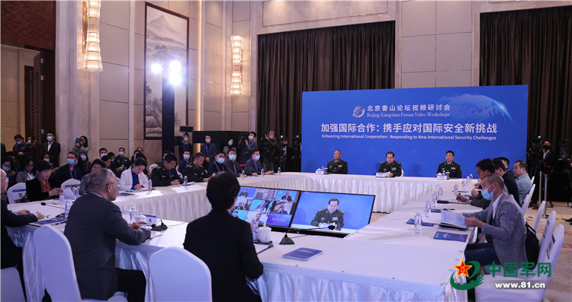
Beijing Xiangshan Forum
Beijing Xiangshan Forum, originally Xiangshan Forum, was initiated by the China Association of Military Science (CAMS) in 2006 as an unofficial platform for the Asia-Pacific security dialogue. The scale of platform has been greatly upgraded since the 5th Forum in 2014 and started to involve wider participants of defense and military leaders, heads of international organisations, former political personages and retired generals, as well as renowned scholars from both in and out of the Asia-Pacific region. Since 2015, Xiangshan Forum has been co-hosted by CAMS and China Institute of International Strategic Studies (CIISS) and is renamed as Beijing Xiangshan Forum in 2018.
The forum upholds the concepts of ‘Equality, Openness, Inclusiveness, Mutual Learning’, and is committed to pool wisdom, expand consensus, and improve mutual trust. It has developed into an important platform on security and defense with significant international influence.
Source: Beijing Xiangshan Forum
http://www.xiangshanforum.cn/index_EN
Opening of the 2020 Beijing Xiangshan Forum Video Workshop

Slide 43
Eco Forum Global Guiyang
Initiated and approved by the Chinese government, the Eco Forum Global Guiyang (EFG) is the first and only high-level international platform on ecological civilization in China. It serves exchange and cooperation among decision-makers of various fields, promotes eco-civilization, and shares knowledge and experience. It also facilitates policy implementation and improvement, identifies opportunities of green economic transformation, and seeks to address challenges of ecological security. The meeting aims for a society that conserves resources, protects the environment, and achieves ecological civilisation.
The objectives of the forum include: promote understanding and friendship, build mutual trust, identify common interests, build consensus and find common solutions, and achieve win-win results through joint contribution, shared use, and co-existence.
Source: Eco Forum Global Guiyang
http://english.guiyang.gov.cn/2021ecoforumglobal.html

Slide 44
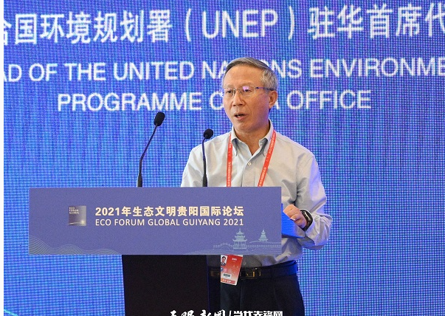
Themed on “Green and Low-carbon Development——Fostering a Community of Life for Man and Nature”, the 2021 Eco Forum Global Guiyang seeks to build consensus, deepen cooperation, and advance global ecological civilisation.
Read more
UN officier praises China's environmental protection efforts
http://english.guiyang.gov.cn/2021-07/15/c_646411.htm
Source: The Guiyang Municipal People's Government
http://english.guiyang.gov.cn/2021-07/15/c_646411.htm

Slide 45
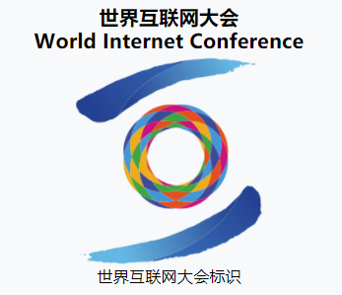
World Internet Conference
The internet brings the world convenience but also poses challenges such as cyber insecurity, cyber crime, and digital gaps. Directing the internet toward healthy development meets the common interests of countries around the globe. The World Internet Conference is an international platform that connects China and the world. It performs three functions: as a forum, an expo and an occasion to publish leading achievements. Issues, such as internet economy, innovation, internet culture, cyber management, and international cooperation, are discussed at the forum.
Source: World Internet Conference
https://www.wuzhenwic.org/

Slide 46
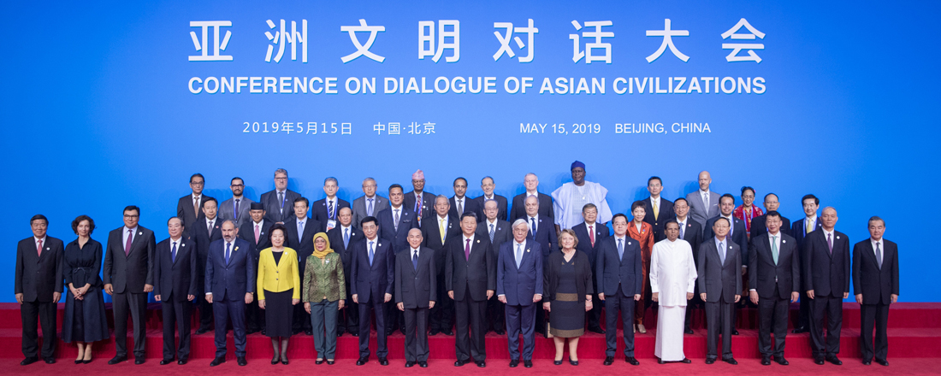
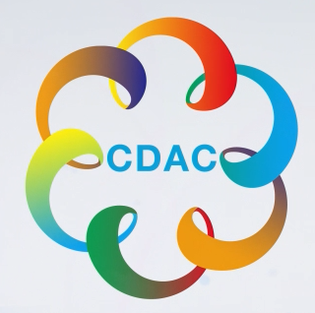
Conference on Dialogue of Asian Civilizations
On 15 May, 2019, the Conference on Dialogue of Asian Civilizations was held in Beijing. The conference focused on exchange and mutual learning between Asian civilizations and building a community with a shared future. It promotes achievements of civilizations in Asia and around the world and establishes a platform for mutual learning and appreciation to achieve common development.
Opening ceremony of the Conference on Dialogue of Asian Civilizations
Source: Conference on Dialogue of Asian Civilizations (http://english.2019cdac.com/)

Slide 47

To know more about the latest information on international organisations formed by China, international organisations and organisation of international forums, please visit the webpage of the Ministry of Foreign Affairs of the People’s Republic of China.
Source: Ministry of Foreign Affairs of the People’s Republic of China
https://www.fmprc.gov.cn/mfa_eng/gjhdq_665435/dqzzywt_665451/2633_665453/

Slide 48
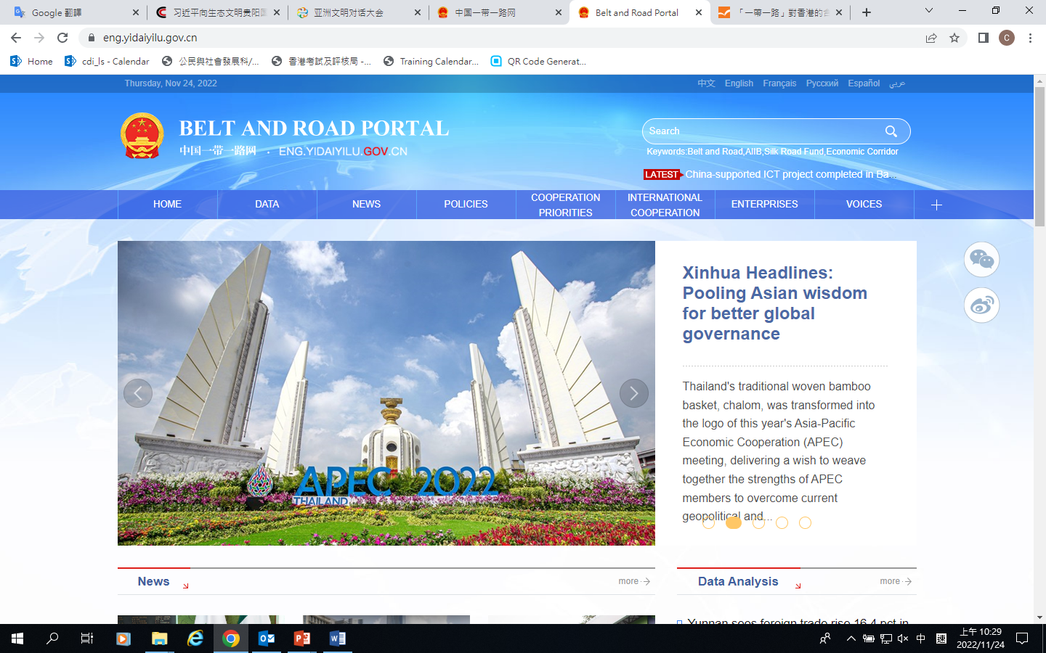

3. The Belt and Road Initiative (B&RI)
1. Vision
In 2013, China proposed the the Belt and Road Initiative (comprising the Silk Road Economic Belt and the 21st Century Maritime Silk Road) for international cooperation. Linking Asia, Europe and Africa, B&RI strengthens infrastructure, connectivity, and coordination of economic polices and development strategies for the purpose of shared development and prosperity. It provides opportunities for other countries and a new space for China’s opening-up and development, thus facilitating global economic governance and the building of a human community of shared future.
Extensive consultation
Reference:
China Belt and Road: https://eng.yidaiyilu.gov.cn/
HKTDC, Belt and Road information
- https://beltandroad.hktdc.com/en/home
- https://beltandroad.hktdc.com/en/insights/one-belt-one-road-initiative-implications-hong-kong
Please read the above websites for latest updates on the B&RI.
Shared benefits
Joint contribution

Slide 49
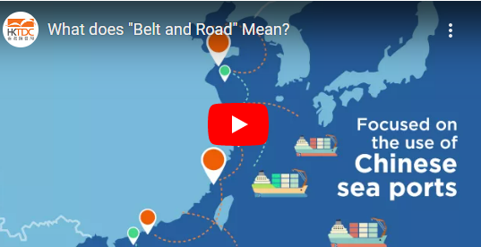
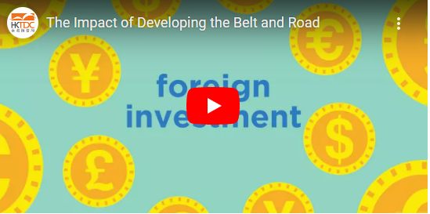
Learning activity
Ask students to watch the video clips from the webpage of Belt and Road Basics by HKTDC (What does “Belt and Road” Mean?, and The Impact of Developing the Belt and Road) and grasp the key points of B&RI.
Click on the image to watch the video
Click on the image to watch the video
What does “Belt and Road” Mean?
Source: HKTDC
https://beltandroad.hktdc.com/en/belt-and-road-basics/what-does-belt-and-road-mean
The Impact of Developing the Belt and Road
Source: HKTDC
https://beltandroad.hktdc.com/en/belt-and-road-basics/impact-developing-belt-and-road

Slide 50
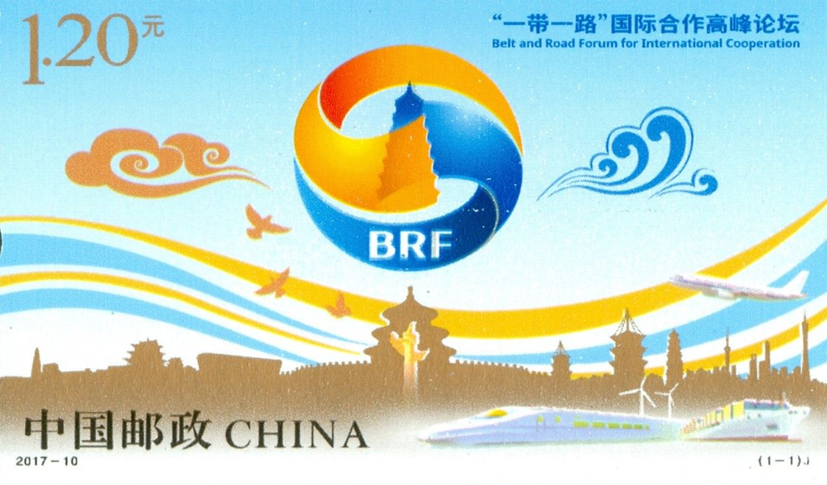
Extensive consultation
Pool ideas from all parties involved to accommodate their interests and concerns so as to give full play to the wisdom and creativity
International conferences and exhibitions in the Belt and Road countries/ regions, the Belt and Road Forum for International Cooperation (BRF) , and the Asia and Pacific High-level Conference on Belt and Road Cooperation served as platforms for consultations among the Belt and Road countries and international organisations on development initiatives.
China has held two sessions of both the BRF and and the Asia and Pacific High-level Conference on Belt and Road Cooperation. At the second BRF, leaders of countries and international organisations held in-depth discussions on issues related to promoting connectivity, providing new impetus for growth, strengthening policy coordination, forging closer partnerships, promoting green and sustainable development and implementing the UN 2030 Agenda for Sustainable Development.
BRF commemorative stamp
Source:
Belt and Road Forum for International Cooperation (http://www.beltandroadforum.org/english/index.html)
The State Council of the People’s Republic of China (http://english.www.gov.cn/statecouncil/wangyi/202006/19/content_WS5eec743bc6d0a6946639c65c.html)

Slide 51
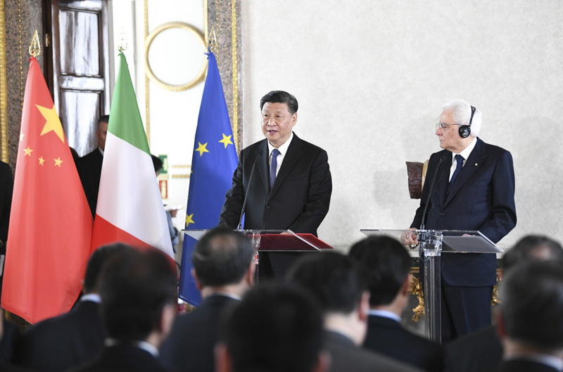
Joint contribution
Giving full play to the strengths and potentials of all parties
Belt and Road countries are equal participants, builders and contributors. Apart from engaging developing countries in B&RI, China also works with many developed countries to promote third-party market.
Third-party market cooperation
This refers to economic cooperation between Chinese businesses and their counterparts from developed countries in the markets of developing countries, mainly to develop local industries, improve infrastructure and raise living standards.
On March 22, 2019, President Xi Jinping and Italian President Mattarella met with representatives of the China-Italy Entrepreneur Committee and China-Italy Third Party Market Cooperation Forum in Rome.

Slide 52


Shared benefits
Building a Belt and Road community of shared interests and future to enable all parties enjoy benefits in a more equal manner.
Example
China’s BeiDou Satellite Navigation System helps the Belt and Road countries narrow digital divide with developed countries. It supports high-tech applications such as 5G communication, AI, cloud computing and driverless cars, and is used by many countries.
BeiDou Satellite Navigation System
Source: (http://en.beidou.gov.cn/)

Slide 53
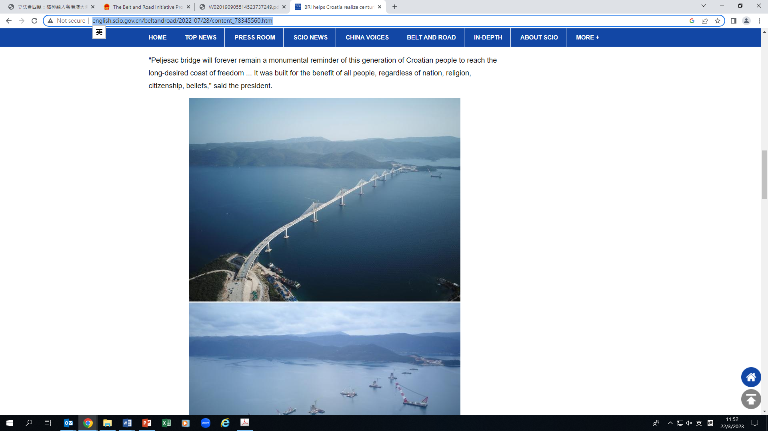

B&RI goals
B&RI focuses on infrastructure building and connectivity and makes it high standards, sustainable and beneficial to the people.
High standards: adopting widely accepted international rules and standards in project development.
Sustainable: projects are aligned with the UN 2030 Agenda for Sustainable Development.
Beneficial to the people: projects bring benefits to local people, improve living standards and create jobs.
Example
In Croatia, China has built a cross-sea bridge to connect its northern and southern territories. Travel time is reduced to 50 minutes from over 3 hours.
Source:
http://world.people.com.cn/n1/2021/0409/c1002-32073333.html
The cross-sea bridge built in Croatia by China
Source: http://english.scio.gov.cn/beltandroad/2022-07/28/content_78345560.htm

Slide 54
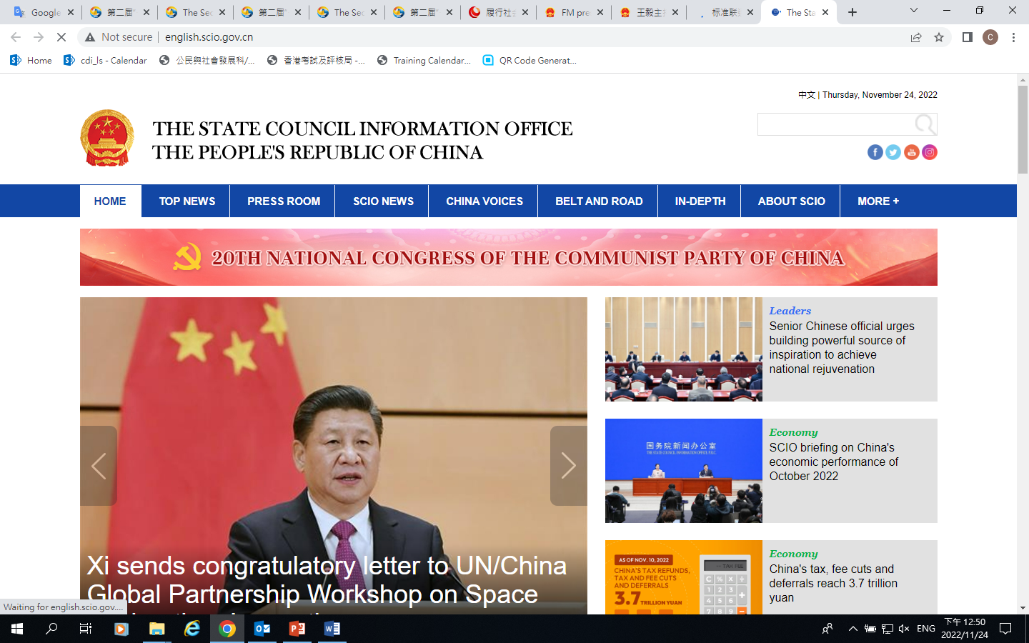
The key of B&RI is connectivity
B&RI connectivity applies to both hard connectivity and soft connectivity. Both are complementary and necessary for the advancement of B&RI cooperation.
Hard connectivity refers connectivity in infrastructure through six means, namely railways, roads, shipping, aviation, pipelines and integrated space information networks. China helps developing countries improve infrastructure and stimulate economic growth.
Soft connectivity refers to connectivity in policies, rules and standards.
Example
In December 2017, China issued the Action Plan for Connectivity of Standards on Joint Efforts to Build the Belt and Road Initiative (2018-2020). Through agreements with other countries and regions, China has promoted mutual recognition of standards and harmonised its standards with international ones and those of other countries.
Source:
State Council Information Office
http://www.scio.gov.cn/xwfbh/xwbfbh/wqfbh/37601/39274/xgzc39280/Document/1641459/1641459.htm

Slide 55
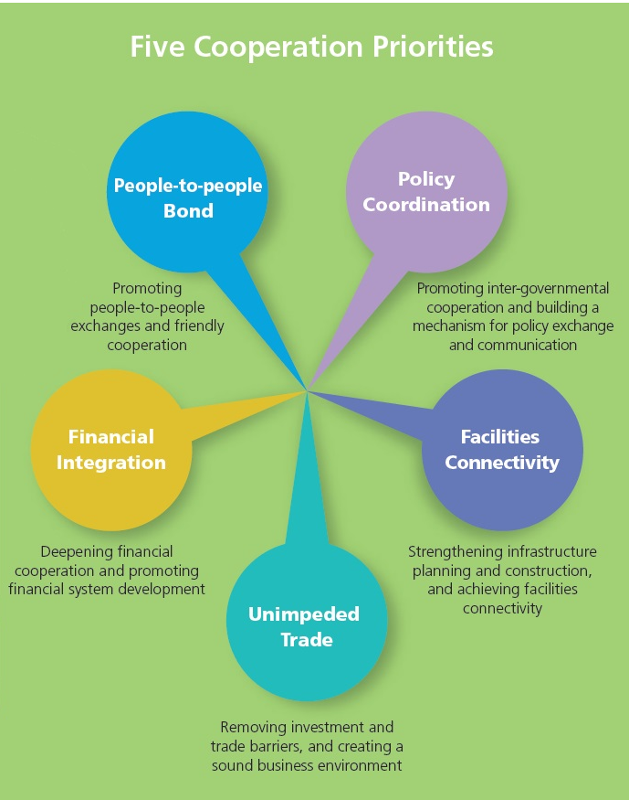
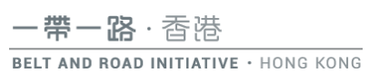
2. B&RI progress
Five cooperation priorities of B&RI, namely policy coordination, facilities connectivity, unimpeded trade, financial integration and people-to-people bond. All have made progress.
Source: Belt and Road Imitative Hong Kong (https://www.beltandroad.gov.hk/overview.html)

Slide 56
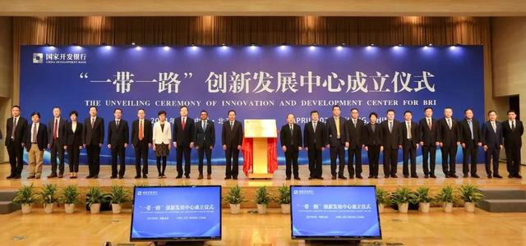
Policy coordination
Policy coordination is an important guarantee for B&RI. China has engaged in thorough communication and coordination with participating countries and international organisations, and reached a broad consensus on international cooperation for building the Belt and Road.
The National Development and Reform Commission (NDRC) and United Nations Development Programme (UNDP) jointly initiated the Innovation and Development Centre for BRI. The Centre plays an active a role in innovative research, project consultation, partnership and capacity building, etc.
By the end of November 2021, China had signed more than 200 cooperation documents with 140 countries and 32 international organisations on B&RI. The B&RI and its core concepts have been incorporated into documents of the United Nations, G20, APEC and regional organisations.
On 9 April 2020, the unveiling ceremony of the Innovation and Development Centre for BRI was held at China Development Bank.
Source: State Council Information Office
http://www.scio.gov.cn/31773/35507/35510/35524/Document/1716615/1716615.htm
Source: National Development and Reform Commission
https://en.ndrc.gov.cn/news/activities/activitiespic/202105/t20210521_1280510.html

Slide 57
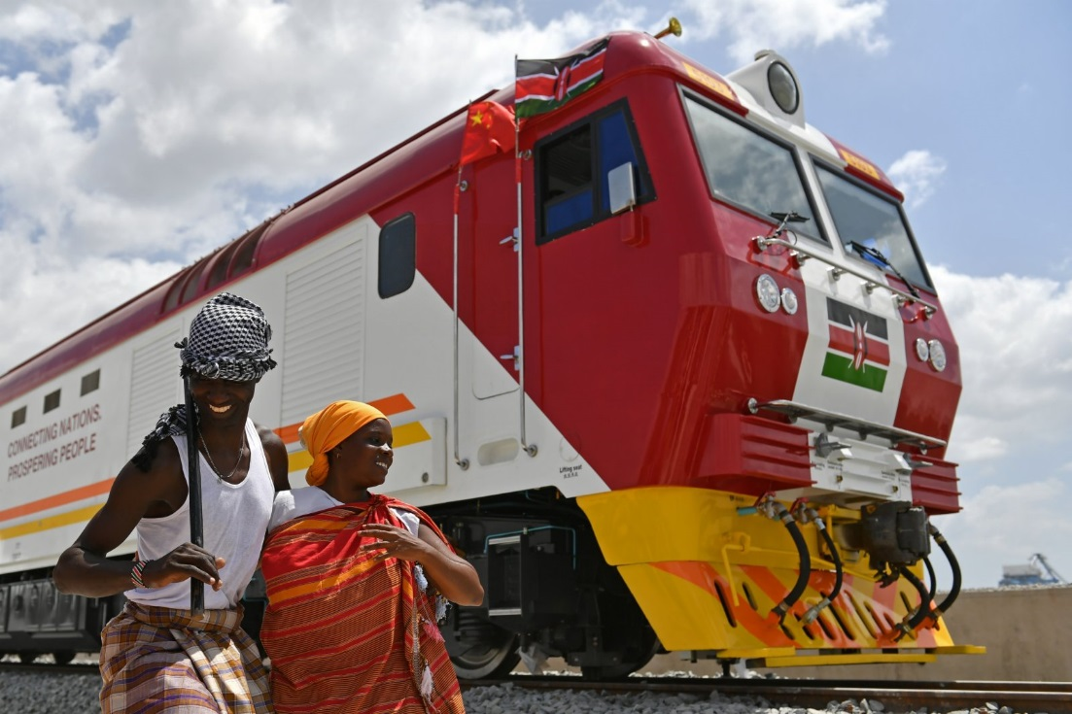
Facilities connectivity
Facilities connectivity is high on the B&RI agenda. China has conducted fruitful collaborations with other countries in developing ports, railways, roads, aviation, energy transmission and communications, forming a large infrastructure network.
Significant progress has been made in the construction of inter-regional and inter-continental railway networks, with the China-Laos Railway, China-Thailand Railway, Hungarian-Serbian Railway and Jakarta-Bandung High Speed Rail as key projects. Known as the “railway of the century” by Kenyans, the Mombasa–Nairobi Railway is the largest infrastructure project undertaken by Kenya since its founding and the first time China has exported complete domestic railway standards overseas.
Local Kenyans beside a Chinese-produced train on the Mombasa–Nairobi Railway on 11 May 2021

Slide 58
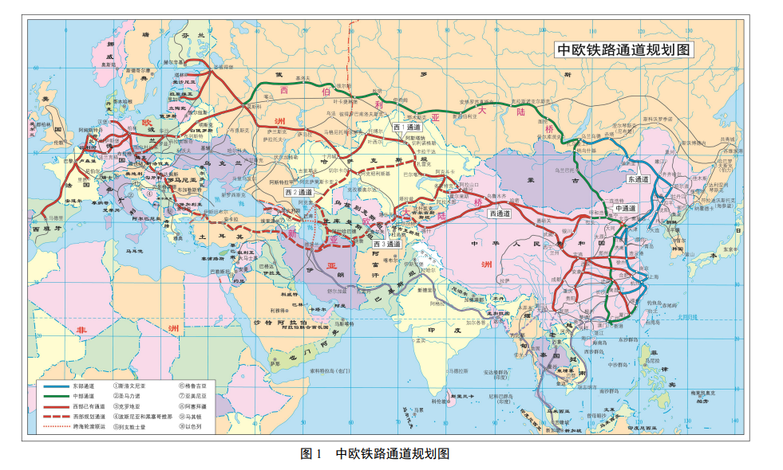
Reference
From camels to trains
The China-Europe Railway Express is an international cargo train linking China and Europe and countries along the Belt and Road. Launched in March 2011, the Express is an important link for facilities connectivity and unimpeded trade between China and other Belt and Road countries. During the COVID-19 pandemic in 2020, the Express has maintained uninterrupted and stable operation, with number of trains even increasing against the general global trade. The number of trips in a single month was at more than 1,000 trains and the annual value of goods transported stood at US$50 billion, reaching over 90 European cities and more than 20 countries.
Map of China-Europe Railway Express
Source: CRCT
https://www.crct.com/uploadfile/2017/1201/20171201813606.pdf
Source: The Central Government of the PRC
http://www.gov.cn/xinwen/2021-01/19/content_5581186.htm

Slide 59
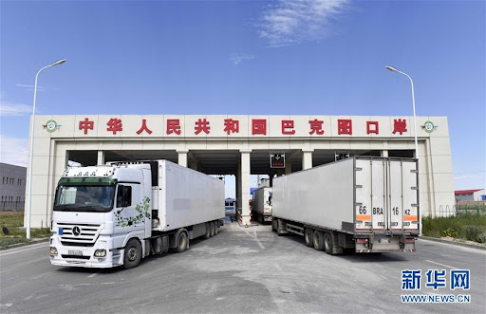
Unimpeded Trade
Unimpeded trade is an important goal of the B&RI. It promotes liberalisation and facilitation of trade and investment in the Belt and Road countries and regions to lower the cost of trade and business and unleash growth potentials. In 2017, China issued the Initiative on Promoting Unimpeded Trade Co-operation Along the Belt and Road, to which 83 countries and international organisations have subscribed.
Facilitating trade and investment
To promote trade facilitation, the Belt and Road countries have taken measures to facilitate customs clearance, including reducing time and costs, simplifying procedures on inspection and quarantine, and facilitating investment for businesses on both sides.
Example
At Baktu port on the border of China and Kazakhstan, vehicles are cleared through a special “green channel”, reducing the time required for customs clearance from three days to three hours and facilitating the import and export of agricultural products.
Source:
The Central Government of the PRC : http://www.gov.cn/xinwen/2019-04/23/content_5385242.htm
The Central Government of the PRC : http://big5.www.gov.cn/gate/big5/www.gov.cn/gzdt/2013-12/24/content_2553321.htm

Slide 60
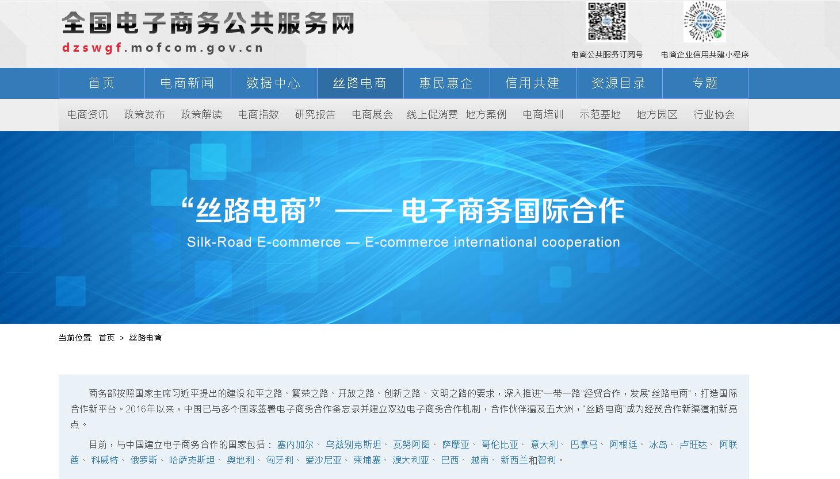
New trade models
New trade models such as cross-border e-commerce are becoming an important driver of trade, and the Silk Road e-commerce prospers. By 2021, China has established bilateral e-commerce cooperation mechanisms with 23 countries, enabling local consumers to purchase products both domestically and overseas through e-commerce platforms.
PRC ministry of commerce
https://dzswgf.mofcom.gov.cn/slds.html

Slide 61
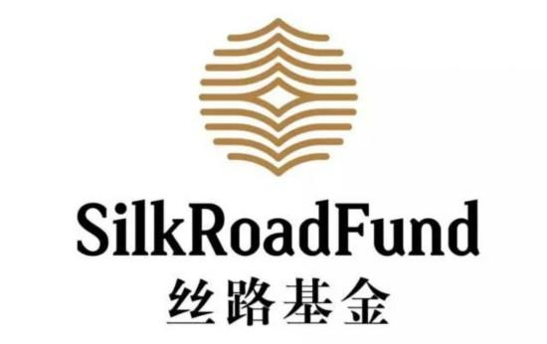
Financial integration
Financial integration is an important pillar of the B&RI. International multilateral financial institutions and commercial banks have played an innovative role in expanding the channels of diversified financing to provide stable, transparent and quality financial support for the B&RI.
Exploring new international investment and financing models
The Silk Road Fund is a facility that China set up in support of the B&RI. It provides medium- to long-term financing for infrastructure, resource extraction and financial cooperation projects in countries and regions along the Belt and Road.
Source: Silk Road Fund
http://www.silkroadfund.com.cn/enweb/23773/index.html

Slide 62
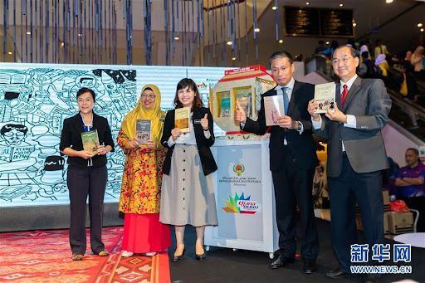

People-to-people bond
People-to-people ties are the cultural foundation for building the Belt and Road. It is the common dream of all peoples to enjoy a peaceful and prosperous life. The Belt and Road countries have carried out diplomatic activities and cultural exchanges of various forms in wide fields, enhancing mutual understanding and recognition.
Know a bit more
The Silk Road Book Project is a major translation project for the Belt and Road countries. It seeks to translate and publish high-quality Chinese works and Chinese-language teaching materials in the Belt and Road countries to enhance their understanding of China.
A book promotion event for China's Silk Road Book Project in Kuala Lumpur, Malaysia
Source: National Radio and Television Administration http://www.nrta.gov.cn/art/2018/1/18/art_113_34845.html

Slide 63

Diverse forms of cultural exchanges
China and the Belt and Road countries have hosted events such as arts festival, film festival, music festival, cultural relics exhibitions and book fairs and have jointly launched new publishing, radio, film and television programs, as well as translating and introducing each other's media programs.
By 2018, China had signed 108 bilateral cultural and tourism cooperation documents with the Belt and Road countries and set up bilateral and multilateral cultural and tourism cooperation mechanisms with ASEAN, Central and Eastern Europe, Russia and Mongolia. International cooperation among cultural institutions continued to deepen, forming alliances for Silk Road International Theatres, museums, art festivals, libraries and art galleries.
Source: PRC ministry of culture and tourism
https://mct.gov.cn/whzx/whyw/201904/t20190424_843055.htm

Slide 64

Shared world cultural heritage
On 22 June 2014, through a combined effort from China, Kazakhstan and Kyrgyzstan, the eastern section of the Silk Road: The Routes Network of Chang'an-Tianshan Corridor has become a UNESCO World Heritage site, making it the first inscription through cross-country collaboration.
Source: ICOMOS International Conservation Center-Xi'an
http://www.silkroads.org.cn/EN/

Slide 65

3. B&RI significance
B&RI is the largest international cooperation initiative in the world. It brings opportunities for improving people’s well-being, economic and social development, as well as cultural exchanges between countries and civilisations.
The Road to Growth
B&RI is a road to growth, unleashing the potential of countries along the route.
According to the World Bank, B&RI
Reducing transport time: The average transport time for Belt and Road corridor economies would be reduced by 3.2%. Transport times between all countries in the world would be reduced by an average of 2.5%.
Reducing trade costs: Average trade costs for Belt and Road corridor economies would be reduced by 2.2%. World trade costs would be reduced by 1.8%.
Attracting more investment: Total foreign direct investment in Belt and Road corridor economies would increase by 4.97%.
Driving income growth: Belt and Road corridor economies would enjoy real income growth of 1.2% .
Source: World Bank
https://openknowledge.worldbank.org/bitstream/handle/10986/31878/9781464813924.pdf

Slide 66
Road to Poverty Reduction
Poverty alleviation is a common challenge around the world and is an important task for the low- and middle-income Belt and Road countries. B&RI paves the way for the countries to work together in poverty alleviation.
Example
In recent years, China-Cambodia poverty reduction assistance projects have been making progress. China's experience has benefited Cambodian villages. The China Foundation for Peace and Development has provided RMB10 million to build village roads, provide clean water, improve education and healthcare, develop livelihood projects such as farming and animal husbandry, provide skill training and improve the rural environment.
According to a World Bank report, by 2030, the B&RI could contribute to lifting 7.6 million people from extreme poverty and 32 million from moderate poverty.
Source:
World Bank (https://www.worldbank.org/en/topic/regional-integration/publication/belt-and-road-economics-opportunities-and-risks-of-transport-corridors)
People.cn ( http://world.people.com.cn/n1/2021/0331/c1002-32065551.html)

Slide 67


Road to Innovation
B&RI paves the way for innovation-driven development. It will help the Belt and Road countries nurture technological talent and achieve innovation-driven development.
ANSO—Alliance of International Science Organizations was founded in 2018 by the Chinese Academy of Sciences with science academies, research institutes, universities and international organisations around the world. Its mission is to improve innovation policies and development, conduct major science and technology cooperation, nurture talent, enhance innovation capacity, and promote sustainable economic and social development.
Example
Source:
http://anso.org.cn/

Slide 68

Road to Development
B&RI has created development opportunities for participating countries and brought business and development opportunities to the people. Many Hong Kong businesses have seized the opportunity of participation.
Activity: Reading
Ask students to click on the image for information and to identify examples of Hong Kong businesses that have expanded through the B&RI.
Source: HKTDC
https://beltandroad.hktdc.com/en/case-references

Slide 69
User guide
The primary users of this resource are teachers. It aims to provide teachers with content knowledge relevant to the topic to enable teachers to have a deeper understanding of teaching content when preparing for their lessons.
All data, videos, photos, pictures, questions and suggested answers can be used for multiple purposes, such as teachers’ teaching materials, references for curriculum planning and learning and teaching, and student assignments, etc. To align with Citizenship and Social Development Curriculum and Assessment Guide (Secondary 4-6) (2021) (C&A Guide), this resource should be adapted to cater for students’ learning diversity and the needs of classroom teaching, etc.
Teachers may provide appropriate supplementary notes/ explanations to enrich this resource in order to enhance students’ understanding of the topic and information provided.
In accordance with the curriculum rationale and aims, teachers may select other learning and teaching resources which are correct, reliable, objective and impartial to help students build up a solid knowledge base, develop positive values and attitudes as well as enhance critical thinking and problem solving skills, and various generic skills.
If some information cannot be provided in this resource due to copyright issue, teachers may visit relevant websites provided.
Some information may have been updated when being used by teachers, teachers may visit the corresponding websites to obtain the up-to-date information.
Please also refer to the C&A Guide to understand the requirements and arrangements of the learning and teaching of the curriculum. Teachers are welcome to point out the areas need improvement, and welcome to provide updated information to enrich the content for all teachers’ reference.

Slide 70
Notice and Disclaimer
Some sources were not translated into English as the official English version is not available.
In case of any discrepancy between the Chinese and English versions, the Chinese version shall prevail.

