Slide 1
Citizenship and Social Development
Theme 2: Our Country since Reform and Opening-up
Topic: Participation in international affairs
Learning focus:
The notion of multifaceted diplomacy
since the 21st Century
May 2022
Translated version

Slide 2
Learning Objectives
Knowledge
To understand the notion, agenda and action of multifaceted diplomacy of our country
Skills
To enhance critical thinking skills; to understand and analyse information on international relations critically by studying cases of how our country engages in international affairs
Values
To recognise our country’s notion of staying on the path of peaceful development and building a human community with a shared future
To develop a sense of national identity with a global perspective

Slide 3
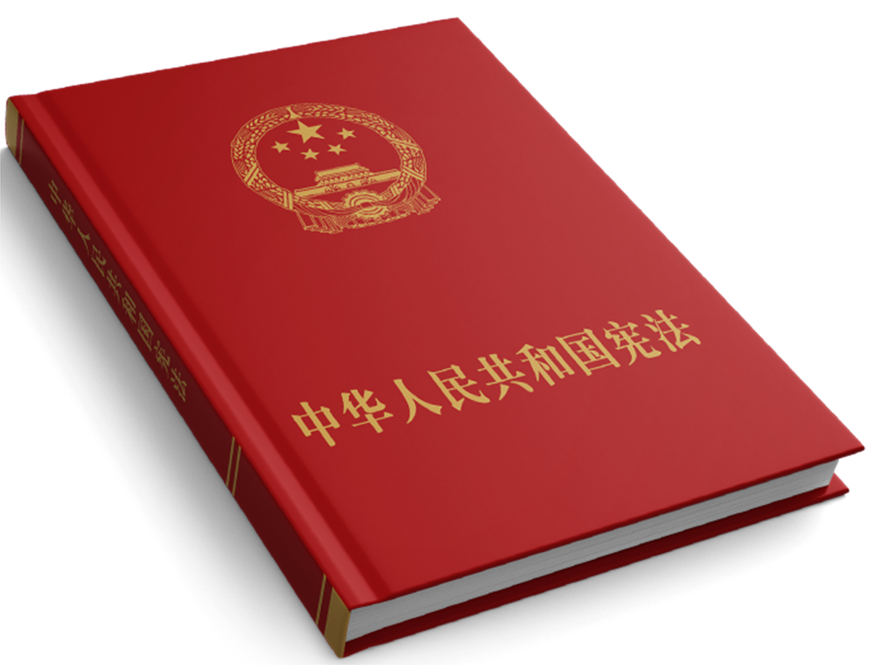
Our country’s foreign policy
Read the following paragraph of The Constitution of the People’s Republic of China on our country’s foreign policy.
“The future of China is closely bound up with the future of the world. China pursues an independent foreign policy, observes the five principles of mutual respect for sovereignty and territorial integrity, mutual non-aggression, mutual non-interference in internal affairs, equality and mutual benefit, and peaceful coexistence, keeps to a path of peaceful development, follows a mutually beneficial strategy of opening up, works to develop diplomatic relations and economic and cultural exchanges with other countries, and promotes the building of a human community with a shared future. China consistently opposes imperialism, hegemonism and colonialism, works to strengthen its solidarity with the people of all other countries, supports oppressed peoples and other developing countries in their just struggles to win and safeguard their independence and develop their economies, and strives to safeguard world peace and promote the cause of human progress.”
Source: Preamble of Constitution (https://www.basiclaw.gov.hk/en/constitution/preamble.html)

Slide 4

The international landscape
facing our country in the 21st century
International relations are experiencing profound changes. Political situations in certain regions remain uncertain and protectionism hampers globalisation, posing challenges to global peace and development. Meanwhile, a new round of technological and industrial revolution is advancing rapidly, and human enters an era of increasing challenges and risks. Our country upholds peaceful development, and through opening-up and participation in international affairs, helps maintain international peace and stability. But the country still faces multiple challenges in foreign relations and development as changes unfold.

Slide 5
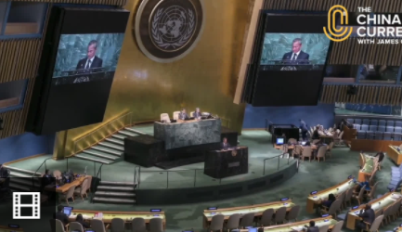



Our country’s participation in global governance
Global governance refers to the management system, rules, methods and actions of the international community to jointly deal with global issues. China actively participates in global governance and has injected impetus into the global governance system.
As the permanent member of the Security Council of the United Nations, China is firmly committed to upholding the leadership of the United Nations in maintaining international peace and security. China plays an important role in international peacekeeping and humanitarian assistance. China is active in promoting financial institution reforms of the International Monetary Fund (IMF) and the World Bank, etc. and supports developing countries in expanding their representation and right of audience in international affairs. In various fields, China has led the formulation of international rules and acted as a responsible country.
Click on the image to watch video (in Cantonese). Learn about our country’s role in the United Nations and international affairs.
Source: The China Current https://chinacurrent.com/hk/story/20308/un-general-assembly
Source:
The Central People’s Government of the People’s Republic of China (http://www.gov.cn/xinwen/2018-01/07/content_5253992.htm)
The Ministry of Foreign Affairs of the People’s Republic of China (http://switzerlandemb.fmprc.gov.cn/web/wjbzhd/202112/t20211220_10471819.shtml)

Slide 6
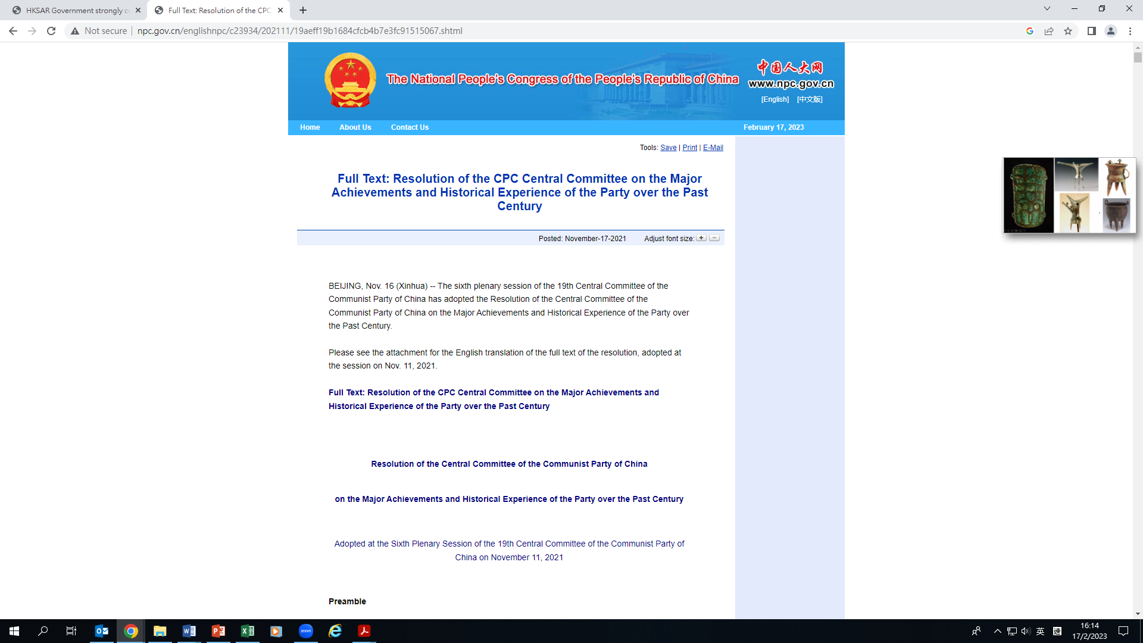
Reference
Our country’s participation in global governance
Resolution of the Central Committee of the Communist Party of China on the Major Achievements and Historical Experience of the Party over the Past Century (2021) also states that “China has actively participated in reform and development of the global governance system. It has worked to safeguard the international system centered on the UN, the international order underpinned by international law, and the basic norms of international relations based on the purposes and principles of the UN Charter. China has upheld and practiced true multilateralism, resolutely opposed unilateralism, protectionism, hegemonism, and power politics, and worked actively to make economic globalisation more open, inclusive, balanced, and beneficial for all.”
Source: Resolution of the Central Committee of the Communist Party of China on the Major Achievements and Historical Experience of the Party over the Past Century (http://www.npc.gov.cn/englishnpc/c23934/202111/19aeff19b1684cfcb4b7e3fc91515067.shtml)

Slide 7


Challenge 1: Containment policy of some western countries
In 1990, the Cold War ended. A bipolar world that featured confrontation between the U.S. and the Soviet Union has been moving toward multi-polarity. Emerging markets and developing countries, which is represented by China, have been rising in the context of economic globalisation. In addition, improvement of China’s strength would make the global governance system fairer and more rational. But some western countries allege that China’s rise is a threat to international peace and security. They propose “China Threat Theory” and make incessant efforts to contain our country, bringing huge challenges for our peaceful development.
Source:
CCTV (http://news.cctv.com/2021/12/31/ARTIUJKQNmDSeHcz2XkrhI6r211231.shtml)
People.cn (http://theory.people.com.cn/n1/2021/0301/c40531-32038916.html)

Slide 8
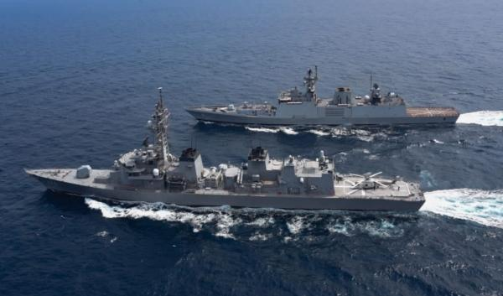
Challenge 2: National security threat
posed by the volatile international security situation
In addition to our territorial disputes with some neighboring countries, other security issues have emerged, such as terrorism and refugees triggered by the instability of several regions. Furthermore, some countries attempt to interfere with China’s internal affairs and keep stirring up troubles in the South China Sea, posing serious threats to our national security. As such, our country has some potential risks in national security.
Photo of a foreign joint military exercise

Slide 9

Challenge 3: Greater uncertainty in
economic development of our country
The trend of globalisation is irreversible, but its effects as a double-edged sword have also been underscored. The 2008 international financial crisis and the COVID-19 pandemic have exerted a broad and far-reaching impact on the global economy, plunging the world into a prolonged slump. Trade protectionism of major western countries is rising, countering the trend of globalisation. Meanwhile, division of labor in the industrial chain has gradually become the major areas of great power competition. In recent years, the United States put its own interests above everything else and launched a trade war against China. In its attempt to “decouple” from China and contain our country’s development, the United States has seriously undermined the international economic order and the stability of the global industrial chain.
Source: The Central People’s Government of the People’s Republic of China
(http://www.gov.cn/guowuyuan/2020-11/25/content_5563986.htm)

Slide 10
Challenge 4: New challenges in the development of
science and technology in our country
A new round of technological revolution and industrial transformation such as artificial intelligence, big data, quantum information and biotechnology will contribute to greater national strength. Therefore, technological innovation has become a battlefield of major power competition. In recent years, the U.S., UK and other developed countries have attempted to contain our development through intensified competition with China in science and technology.
The scientific and technological level of our country has been improved significantly
China’s R&D input ranks second in the world. The number of patient applications filed under the Patent Cooperation Treaty (PCT) ranked first in 2019 and 2020. In some emerging fields, China has caught up with or even surpassed developed countries.
Source: The Central People’s Government of the People’s Republic of China
http://www.gov.cn/xinwen/2020-09/29/content_5548261.htm

Slide 11
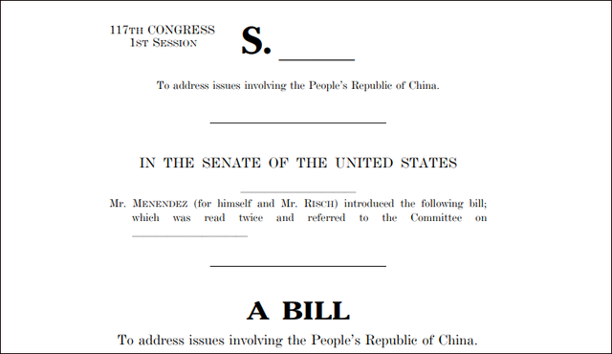

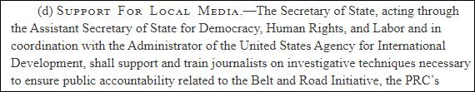
Challenge 5: Attempts of Western media to weaken
China’s international influence
While our country is developing rapidly, some Western media attempt to tarnish our country’s international image and impose Western values on us.
On 22 April 2022, the U.S. Senate Foreign Relations Committee passed a bill entitled Strategic Competition Act of 2021, by which 300 million U.S. dollars will be appropriated for each of fiscal years 2022 through 2026 (a total of 1.5 billion U.S. dollar) for the so-called Countering Chinese Influence Fund. The U.S. Agency for International Development will use these funds to “support and train journalists on investigative techniques necessary to ensure public accountability related to the Belt and Road Initiative.”
Source：Strategic Competition Act of 2021 (https://www.congress.gov/bill/117th-congress/senate-bill/1169/text )

Slide 12
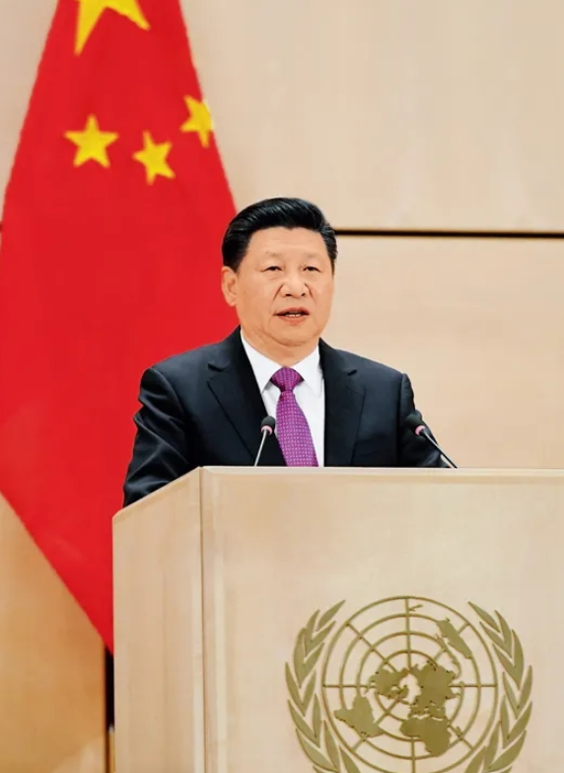
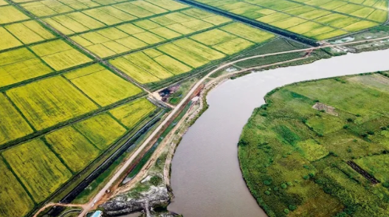
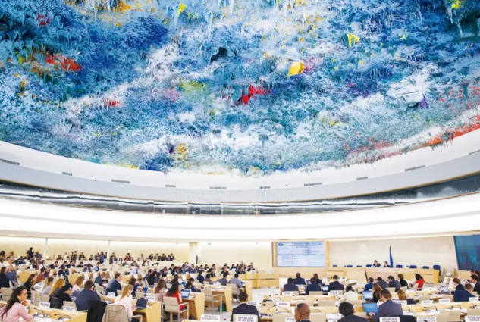
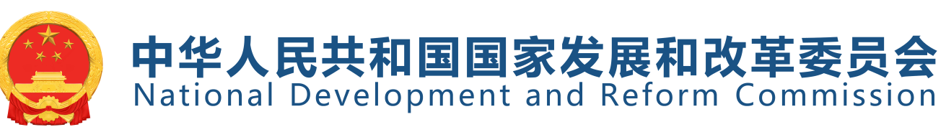

Principles to address the above challenges by our country
Our country upholds the following principles under the changing international landscape:
Commitment to peaceful development and safeguarding sovereignty, development interests and security.
To promote the establishment of a new development pattern featuring “dual circulation”, which takes the domestic market as the mainstay while enabling domestic and foreign markets to interact positively with each other
To seize opportunities of global scientific and technological development and leap forward in basic research, key areas of technology, and achieve control over core technologies.
To strengthen international communication capacity, engage in multifaceted diplomacy, actively participate in global governance, widen the opportunities for our development and maintain world peace.
President Xi Jinping delivers his keynote speech Work Together to Build a Human Community with a Shared Future at Palais des Nations in Geneva., Switzerland
According to the World Bank report, the Belt and Road Initiative could help lift 7.6 million people from extreme poverty and 32 million from moderate poverty.
Photo: The China-Africa Agricultural Cooperation Project in Mozambique greatly alleviates food shortage. Photo on 7 April, 2019.
On 20 March, 2017, China spoke on behalf of developing countries at the United Nations Human Rights Council. Three days later, the Human Rights Council passed a resolution and explicitly expressed the aim of building “a human community with a shared future”.
Source:
CCTV (http://news.cctv.com/2021/12/31/ARTIUJKQNmDSeHcz2XkrhI6r211231.shtml)
The Outline of the 14th Five-Year Plan for Economic and Social Development and Long-range Objectives Through the Year 2035 of the People’s Republic of China (https://www.ndrc.gov.cn/xxgk/zcfb/ghwb/202103/t20210323_1270124.html?code=&state=123)

Slide 13
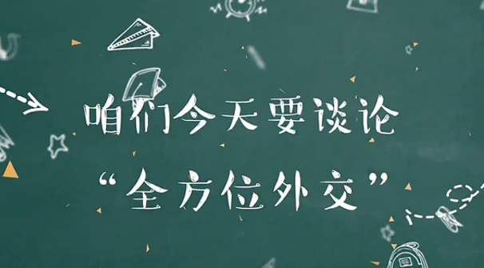

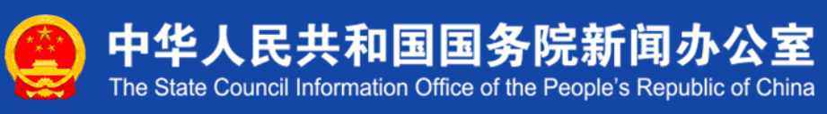
The notion of multifaceted diplomacy
Since the 21st century, China has been committed to an independent foreign policy and to the path of peaceful development. It advocates a new type of international relations and a human community with a shared future. Multifaceted diplomacy is not one-way, but requires mutual exchanges, it embraces exchanges and balanced development.
Our country’s multifaceted diplomacy exemplifies major-country diplomacy with Chinese characteristics in an all-round way. It regards relations with “major countries as the key, with neighboring countries as the priority, with developing countries as the foundation, and multilateral institutions as the important stage.”
Source: China Internet News Center
(http://www.china.com.cn/lianghui/news/2019-02/26/content_74506575.shtml?f=pad&a=true)
Source: Scientific Guide to Major-country Diplomacy with Chinese Characteristics in the New Era
(http://www.scio.gov.cn/m/31773/31774/31779/Document/1664190/1664190.htm)
Click on the image for details and the video.

Slide 14

The notion of multifaceted diplomacy
Report at the 19th National Congress of the Communist Party of China
Further progress has been made in multifaceted diplomacy of our country. We have made all-round efforts in the pursuit of major country diplomacy with Chinese characteristics, thus advancing China’s diplomatic agenda in a comprehensive, multilevel, multifaceted way and creating a favorable external environment for China’s development. We have jointly pursued the Belt and Road Initiative, initiated the Asian Infrastructure Investment Bank, set up the Silk Road Fund, and hosted the First Belt and Road Forum for International Cooperation, the 22nd APEC Economic Leaders’ Meeting, the G20 2016 Summit in Hangzhou, the BRICS Summit in Xiamen, and the Fourth Summit of the Conference on Interaction and Confidence Building Measures in Asia. China champions the development of a human community with a shared future and has encouraged the evolution of the global governance system. With this we have seen a further rise in China’s international influence, ability to inspire, and power to shape; and China has made great new contributions to global peace and development.
Source: people.cn (http://cpc.people.com.cn/BIG5/n1/2017/1028/c64094-29613660.html?ivk_sa=1023345q)

Slide 15
Multifaceted diplomacy
Foreign relations with the U.S., Russia and the EU
Foreign relations with neighboring countries, including maritime and land neighbors
With major powers
With neighboring countries
Foreign relations with developing countries in Asia, Africa, Latin America
Foreign relations with international and regional institutions such as the UN, ASEAN and G20
With developing countries
With multilateral institutions

Slide 16
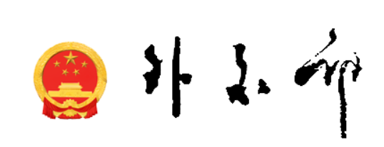
Reference
China and its global partnerships
As of December 2021, China has established diplomatic relations with 181 countries, built different forms of partnerships with more than 100 countries and regional organisations, joined almost all important intergovernmental international organisations and more than 500 international conventions. It plays an important role in multilateral mechanisms such as the United Nations and the World Trade Organization and has been an important member of regional international organisations or mechanisms such as Asia-Pacific Economic Cooperation (APEC) and the ASEAN Plus Three cooperation mechanism.
Source: Ministry of Foreign Affairs
(https://www.fmprc.gov.cn/web/ziliao_674904/2193_674977/)
Please stay tuned for the latest updates from the Ministry of Foreign Affairs.

Slide 17
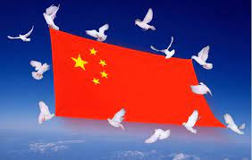
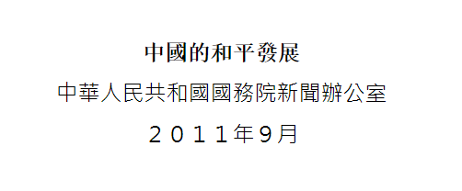

Upholding the path of peaceful development
China is committed to an independent foreign policy and follows the path of peaceful development. Peaceful development means to increase wealth and achieve development goals through our own efforts and independent innovation, rather than colonialism and plundering wealth from other countries. While pursuing peaceful development, China is committed to maintaining global peace and promoting common development and prosperity of all countries. The policy is based on the trend of the times and the fundamental interests of the country.
Please click on the image for more information on the policy of following the path of peaceful development.
Source: The Central People’s Government of the People’s Republic of China
(http://big5.www.gov.cn/gate/big5/www.gov.cn/zhengce/2011-09/06/content_2615782.htm)

Slide 18

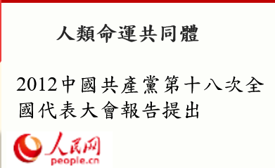
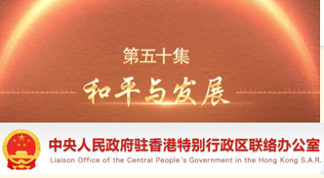
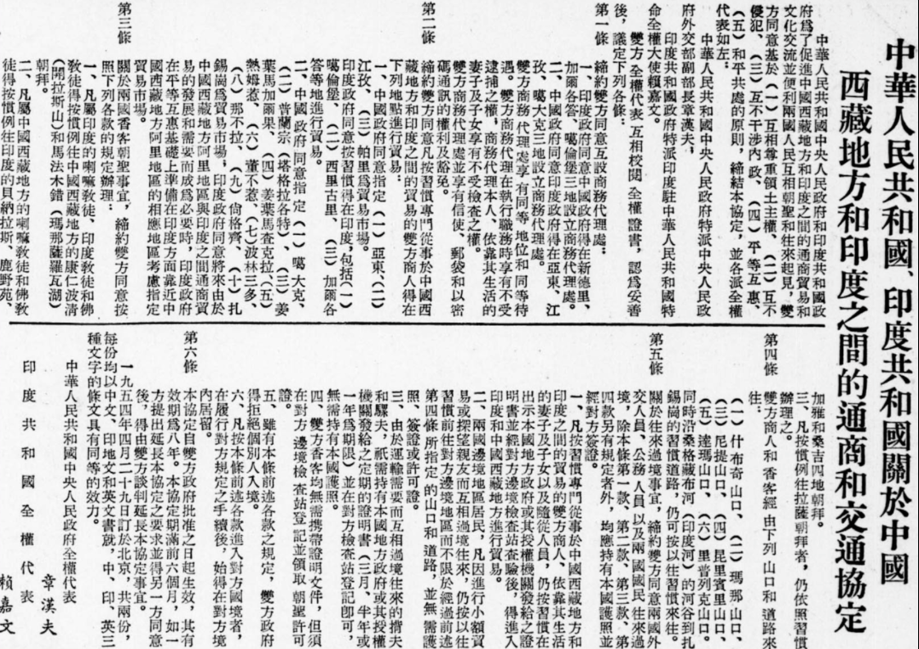
The evolving policy of our country’s peaceful development in three stages
Reference
Reference: White Paper China’s Peaceful Development
http://english.www.gov.cn/archive/white_paper/2014/09/09/content_281474986284646.htm
In the New Era
After Reform and Opening-up
A human community with a shared future
Proposed by the Eighteenth National Congress of the Communist Party of China in 2012
1950s
Peace and development as major themes of the times
Five principles of peaceful coexistence
Proposed by Deng Xiaoping in 1984
Source: people.cn
http://politics.people.com.cn/BIG5/n/2012/1113/c99014-19561369.html
Proposed by Zhou Enlai in 1953
Source: National Library of China
(http://www.nlc.cn/dsb_zt/xzzt/ghgdsj/1954/event4/)
Source of the video: http://www.locpg.gov.cn/jsdt/2021-08/16/c_1211323466.htm
Please click on the images for details and the video

Slide 19

Reference
Five Principles of Peaceful Coexistence
The Five Principles of Peaceful Coexistence was first proposed on 31 December 1953 by Premier Zhou Enlai, when he held talks with the Indian delegation on issues between the two countries, particularly India’s relationship with China’s Tibetan region. Since its inception, these principles have not only been recognized in the treaties, communiqués, declarations and other bilateral relations documents signed between China and other countries, but also have been cited or reaffirmed in many important international conferences and documents. These principles have also become the foundation of China’s independent foreign policy of peace.
Mutual respect for sovereignty and territorial integrity
Mutual non-aggression
Mutual non-interference in each other’s internal affairs
Equality and mutual benefit
Peacefully coexistence
Source: people.cn
http://cpc.people.com.cn/BIG5/n/2014/0628/c64387-25212801.html

Slide 20
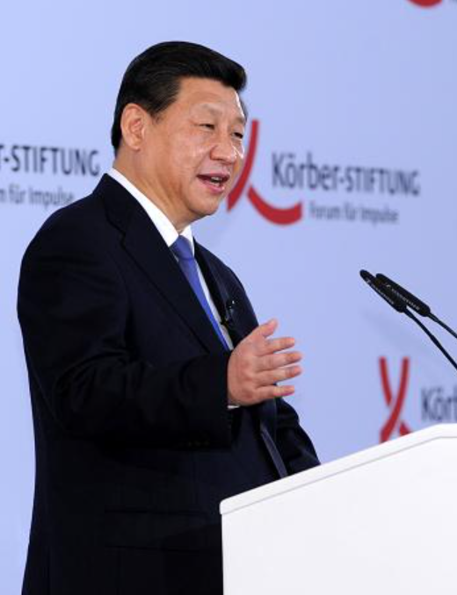

Multifaceted diplomacy upholds the path of peaceful development
The path of peaceful development will be upheld to safeguard core national interests. China will never follow the beaten track of big powers in seeking hegemony, but we will never sacrifice our legitimate rights or core interests. China stands for resolving differences and disputes through consultation and dialogues. On major issues of principle concerning sovereignty and territorial integrity, we will resolutely safeguard our legitimate rights and interests.
President Xi Jinping has clearly stated that China will resolutely safeguard its sovereignty, security, and development interests.
Sources of photo and material:
www.gov.cn (http://big5.www.gov.cn/gate/big5/www.gov.cn/xinwen/2014-03/29/content_2649220.htm)

Slide 21

Reference
Resolution of the Central Committee of the Communist Party of China on the Major Achievements and Historical Experience of the Party over the Past Century (2021)
Resolution of the Central Committee of the Communist Party of China on the Major Achievements and Historical Experience of the Party over the Past Century reiterates and emphasises that:
Peace and development are the themes of our times.
China upholds its fundamental foreign policy goal of preserving world peace and promoting shared development. It adjusts its relations with other major countries, develops friendly relations with neighboring countries, and deepens friendly cooperation with other developing countries. It actively participates in international and regional affairs and creates a new comprehensive and multi-layered framework for foreign relations.
China promotes the development of a multipolar world and the democratisation of international relations and pushes economic globalisation in a direction toward common prosperity. China takes an unequivocal stand against hegemonism and power politics, endeavors to safeguard the interests of developing countries, works for a new international political and economic order that would be fair and equitable, and promotes lasting peace and common prosperity in the world.
Source: Central People’s Government of the People’s Republic of China
http://big5.www.gov.cn/gate/big5/www.gov.cn/zhengce/2021-11/16/content_5651269.htm

Slide 22
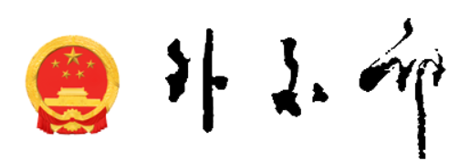

Creating a new model of international relations
Report of the 19th National Congress of the Communist Party of China states that the international community has entered a critical moment of adjustment and transformation. China has developed different state-to-state relations and forged a new form of international relations featuring mutual respect, fairness, justice, and win-win cooperation. Under the guidance of this new model, China has made friends, formed global partnerships, and gradually developed a stable network of relations through continuous adjustments.
Further reading
Foreign Ministry Spokesperson’s Review of China’s Diplomatic Outcomes this Year and Preview of the Next Priorities, 2020
References：
Report of the 19th National Congress of the Communist Party of China
http://www.xinhuanet.com/english/download/Xi_Jinping's_report_at_19th_CPC_National_Congress.pdf
Foreign Ministry Spokesperson’s Review of China’s Diplomatic Outcomes this Year and Preview of the Next Priorities
https://www.fmprc.gov.cn/mfa_eng/xwfw_665399/s2510_665401/2535_665405/202008/t20200810_697066.html

Slide 23
Connotation of the new model of international relations
The basic principles of the new model of international relations are mutual respect, fairness, justice, and win-win cooperation.
Mutual respect
In international relations, our country rejects power politics, and takes a new approach to developing state-to-state relations with communication, not confrontation, and with partnerships, not alliance. Our country commits to settling disputes through dialogue and resolving differences through discussion, coordinates responses to traditional and non-traditional threats, and opposes terrorism in all its forms.
Fairness and justice
China respects the right of the people of all countries to choose their own development path. We endeavor to uphold international fairness and justice and oppose acts that impose one’s own will on others or interfere in the internal affairs of others, as well as the practice of the strong bullying the weak. China will never pursue development at the expense of others’ interest, but nor will China ever give up its legitimate rights and interests. No one should expect us to swallow anything that undermines our interests. China pursues a national defense policy that is in nature defensive. China’s development does not pose a threat to any other country. No matter what stage of development it reaches, China will never seek hegemony or engage in expansion.
Source：Report of the 19th National Congress of the Communist Party of China http://www.xinhuanet.com/english/download/Xi_Jinping's_report_at_19th_CPC_National_Congress.pdf

Slide 24

Connotation of the new model of international relations
Win-win cooperation
China has actively developed global partnerships and expanded the convergence of interests with other countries. China will promote coordination and cooperation with other major countries and work to build a framework for major-country relations featuring overall stability and balanced development. China will deepen relations with its neighbors in accordance with the principle of amity, sincerity, mutual benefit, and inclusiveness and the policy of forging friendship and partnership with its neighbors. China will, guided by the principle of upholding justice while pursuing shared interests and the principle of sincerity, real results, affinity, and good faith, work to strengthen solidarity and cooperation with other developing countries. We will strengthen exchanges and cooperation with the political parties and organisations of other countries.
Source: Report of the 19th National Congress of the Communist Party of China
http://www.xinhuanet.com/english/download/Xi_Jinping's_report_at_19th_CPC_National_Congress.pdf
The new model of relationship with major powers has become an important part of China’s foreign strategy. It is a crucial part in the new model of international relations and should be given priority in China’s foreign relations.
People.cn (http://world.people.com.cn/n1/2016/0213/c1002-28120530.html)

Slide 25
Major-country diplomacy: China-US relations
Reference
China values the responsibilities of the two countries in safeguarding world peace and stability, and promoting global development and prosperity.
China attaches great importance to the bilateral relationship between China and the U.S.. China believes that China-US relations on the right track is closely related to the interests of the Chinese and American people and concerns the global future. Cooperation will benefit both while confrontation will hurt both. Furthermore, cooperation will be beneficial for the world at large, whereas confrontation will bring global disasters. As China and the U.S. are the top two economies, promoting healthy and stable development of China-US relations is an integral part of building a new model of international relations.

Slide 26


Reference
Major-country diplomacy: China-US relations
On March 18, 2022, President Xi Jinping had a video call with President Biden (excerpt).
Peace and development as the themes of the times are facing serious challenges. The world is neither tranquil nor stable. As the permanent members of the UN Security Council and the world’s two leading economies, we should not only guide China-US relations forward along the right track, but also shoulder the international responsibility and work for world peace and tranquility .
Reference: President Xi Jinping Has a Video Call with US President Joe Biden
https://www.fmprc.gov.cn/mfa_eng/zxxx_662805/202203/t20220319_10653207.html

Slide 27
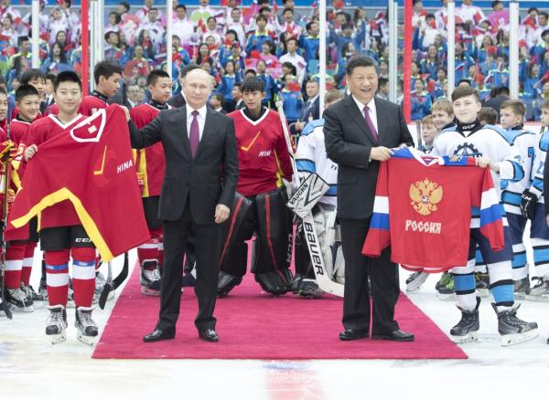

Reference
Major-country diplomacy: China-Russia relations
China and Russia have comprehensive strategic partnership of coordination. After resolving boundary issues, the two countries have maintained good relationships.
Knowing more
On the 20th anniversary of the conclusion of the Treaty of Good-Neighborliness and Friendly Cooperation Between the People’s Republic of China and the Russian Federation (singed on July 16, 2001), the treaty was extended to further promote the spirit established by the treaty, implement its provisions and upgrade the relationship between the two countries to a comprehensive strategic partnership of coordination for the new era.
On June 8, 2018, President Xi Jinping and Russian President Vladimir Putin watched an Ice Hockey Friendly Match between Chinese and Russian youth teams at Tianjin Stadium
Source: Xi, Putin announce extension of China-Russia friendly cooperation treaty
(http://www.xinhuanet.com/english/2021-06/29/c_1310032860.htm)
Source: http://www.xinhuanet.com/english/2018-06/09/c_137240633.htm

Slide 28

Reference
Major-country diplomacy: China-EU relations
China and the EU share extensive common interests, and the key to push forward the China-EU relations is win-win cooperation. On March 31, 2014, in President Xi Jinping’s talks with the president of the European Council in Brussels, he mentioned that China-EU relations should be viewed from a strategic perspective, and the two sides should jointly forge partnerships for peace, growth, reform, and civilisation, in order to inject new impetus into China-EU cooperation and make a greater contribution to the world’s development and prosperity.
Partnership for peace
Partnership for growth
Click on image to read more on the four partnerships
(https://www.globaltimes.cn/content/852241.shtml)
Partnership for reform
Partnership for civilisation

Slide 29
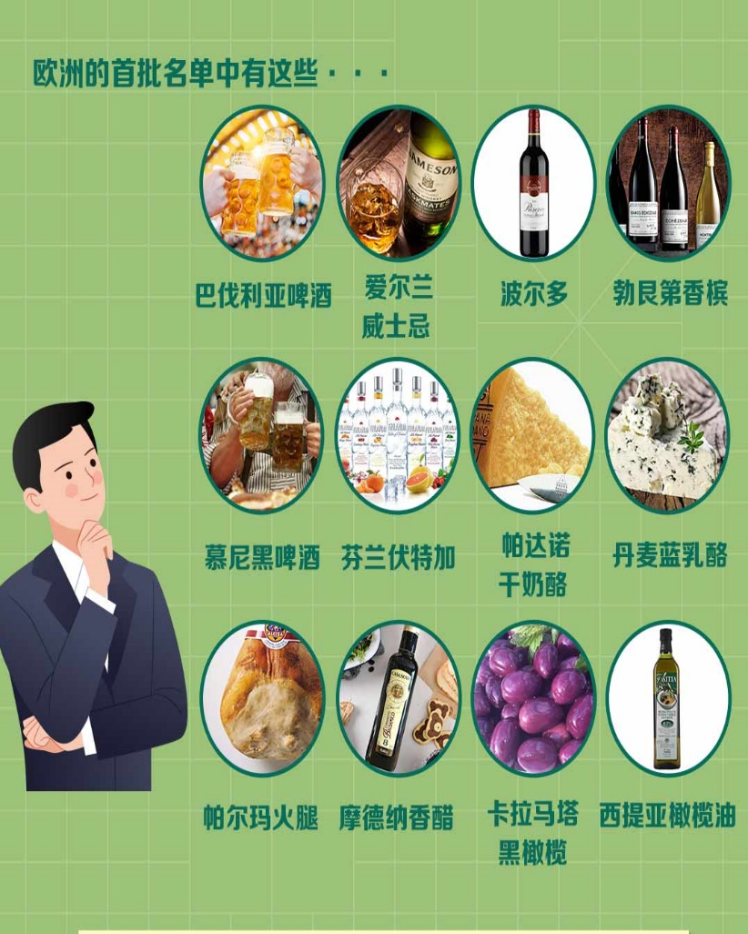

Reference
Major-country diplomacy: Examples of China-EU relations
Agreement on Cooperation and Protection of Geographical Indications (GIs) has taken effect:
The Agreement includes a total of 550 geographical indications (275 of each party), encompassing wines, teas, agricultural products and food products.
The Agreement officially entered into force on 1 March 2021, that the first batch of 100 European GIs and 100 Chinese GIs have been protected. Bringing iconic products into each other’s markets not only protects the interests of Chinese and EU businesses but also reassures customers from both parties. It is China's first bilateral comprehensive and high-level agreement on the protection of geographical indications (GIs), and an important and practical outcome in the development of China-EU economic and trade relations in recent years.
Source: CCTV (https://tv.cctv.com/2021/03/01/ARTIrgRvSOvUU4e1xyD2goUB210301.shtml)
Mission of the People's Republic of China to the European Union (http://eu.china-mission.gov.cn/eng/zgggfz/cega/202301/t20230103_11000259.htm)

Slide 30
Rationales of Neighborhood Diplomacy
Stable relations with neighboring countries are of great strategic importance. Our country promotes friendship with our neighbors, fosters an amicable, secure and prosperous neighborhood, implement the neighborhood policy of amity, sincerity, mutual benefit and inclusiveness, and deepens mutually beneficial cooperation with all neighboring countries.
To treat neighbors with sincerity and pursue friendship and partnership with them
Good-neighborly friendliness and mutual support and assistance
Sincerity
Amity
Mutually beneficial cooperation with our neighbors for win-win results
Mutual benefit
Asia-Pacific Region is large enough for all regional countries to pursue their development
Inclusiveness
Reference: The neighborhood policy of amity, sincerity, mutual benefit and inclusiveness
http://cpc.people.com.cn/xuexi/BIG5/n/2015/0721/c397563-27338114.html

Slide 31

Rationales of Neighborhood Diplomacy
Reference
From October 24 to 25, 2013, the meeting on work of neighborhood diplomacy was held in Beijing. President Xi Jinping emphasised that the basic rationale of neighborhood diplomacy was to promote friendship and partnership, foster an amicable, secure and prosperous neighborhood, and exemplifies the idea of amity, sincerity, mutual benefit and inclusiveness.
Friendship is a consistent principle of neighborhood diplomacy in our country. Under this principle, we emphasise good-neighborly interactions, mutual support and assistance, and frequent reciprocal visits, and is informed by equality, cultural affinity, and empathy. The more we do to win the hearts and minds of our neighbors, the stronger our ties will become. Strengthened amity helps us win support for the goals we pursue on the world stage, and enhances our appeal and our influence in world affairs.
Source: people.cn (http://theory.people.com.cn/BIG5/n1/2017/0906/c413700-29519658.html)
Please refer to the following for China’s practices since 2013 in regard of neighborhood diplomacy :
Source: State Council Information Office of the People’s Republic of China (http://www.scio.gov.cn/31773/35507/35510/35524/document/1640025/1640025.htm)
Click on the image for more information

Slide 32
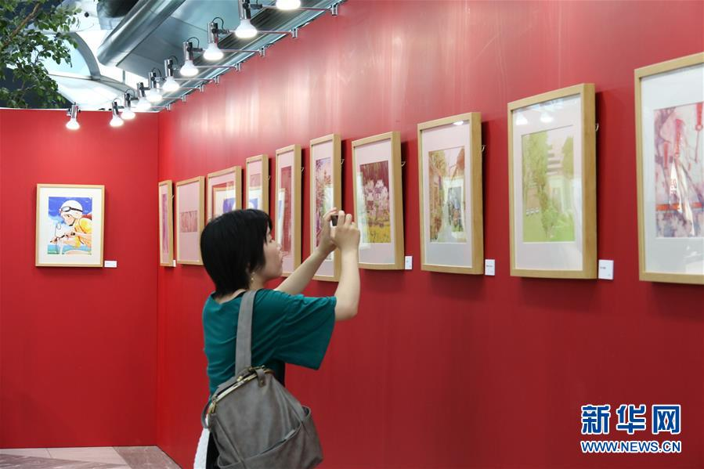
Practices of Neighborhood Diplomacy in our country
Examples of maintaining stability in the neighborhood
Establishment of a China-ASEAN Comprehensive Strategic Partnership
Safeguarding peace and stability in South China Sea
Reducing tension on the Korean Peninsula
Guiding steady development of China-Japan relations
Deepening China-Central Asia friendly relations
China will continue to deepen strategic mutual trust and convergence of interests with neighboring and developing countries. We will practice the concepts of amity, sincerity, mutual benefit and inclusiveness, and advance the building of a neighborhood community of a shared future.
In June 2019, a touring exhibition of animations and comics from China was open in Osaka, Japan. This is the first large-scale official exhibition of Chinese animations and comics in Japan. More than 130 works showcasing the best of Chinese animation since the founding of the People’s Republic of China 70 years ago.
Source: Foreign Ministry Spokesperson on China’s Diplomatic Outcomes this Year and Future Priorities
https://www.fmprc.gov.cn/web/wjdt_674879/zcjd/202008/t20200810_7943742.shtml

Slide 33
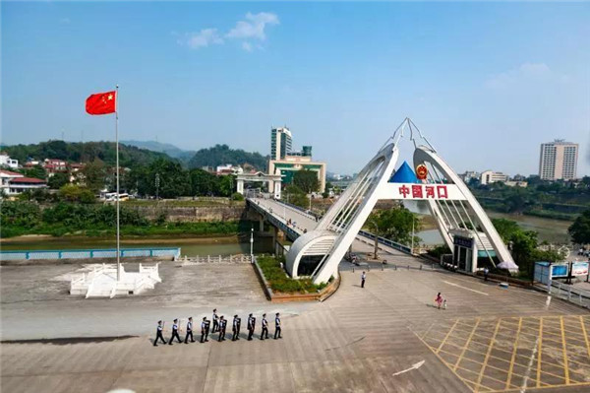
Practices of Neighborhood Diplomacy in our country
Deepening win-win cooperation
We have deepened mutually beneficial cooperation with neighboring countries in economic, commercial, technological, and financial areas and actively participated in regional cooperation.
China is actively developing border trade and economic cooperation with Vietnam. For example, the border trade at Hekou Port in Yunnan is active, with tens of thousands of Chinese and Vietnamese doing cross-border trade with each other every day. Currently, as infrastructure and economy is being upgraded under the Belt and Road Initiative, an International Logistics Park and Trade Center have been completed. The scope of border trade has been expanded, customs clearance facilitated, and port capacity expanded, creating favorable conditions for business activities for both sides.
Hekou port in China

Slide 34
Upholding the principle of pursuing the greater good and shared interests to build up solidarity and cooperation with developing countries
Practices of Neighborhood Diplomacy in our country
China attaches great importance to the relationships with developing countries. We will always be a reliable friend and sincere partner of developing countries. In terms of the principles of shared interests and the greater good, each is of vital importance, but more emphasis is given to the latter.
Guided by the principle of sincerity, real results, amity and good faith and the principle of pursuing the greater good and shared interests, we have strengthened solidarity and cooperation with developing countries, and continued to make use of the potential of the China-Africa, China-Latin America, and China-Arab cooperation mechanisms and platforms.
Reference：
People.cn (http://theory.people.com.cn/n1/2018/0904/c40531-30270065.html)
Foreign Ministry Spokesperson on China’s Diplomatic Outcomes this Year and Future Priorities https://www.fmprc.gov.cn/web/wjdt_674879/zcjd/202008/t20200810_7943742.shtml

Slide 35

Our country’s relationship with developing countries
Reference
Our country upholds the principles of sincerity, real results, amity and good faith for Africa.
On December 4, 2015, President Xi Jinping delivered a keynote speech entitled “A New Era of China-Africa Cooperation and Common Development” at the opening ceremony of the China-Africa Cooperation Forum.
President Xi Jinping undertook ten cooperation programmes with Africa in the next three years, including industrialization, agricultural modernisation, infrastructure, finance, green development, trade and investment facilitation, poverty reduction, public health, cultural exchange, and peace and security.
To ensure the successful implementation of the ten cooperation programmes, China provided US$60 billion of financial support.
African friends are China’s genuine friends
Commitment to Africa must be implemented
Real results
Sincerity
Amity
Good Faith
Respect the wishes and needs of the African people
Foster amity affinity and understanding between Chinese and African people
Reference: www.gov.cn
(http://big5.www.gov.cn/gate/big5/www.gov.cn/xinwen/2019-01/04/content_5354977.htm)
Source: people.cn (http://theory.people.com.cn/BIG5/n1/2017/1012/c40531-29583837.html)

Slide 36
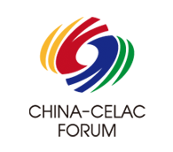
Our country’s relationship with developing countries
Reference
Deepen China-CELAC pragmatic cooperation
Since the establishment of China-CELAC forum, China and CELAC have joined hands to promote comprehensive and cooperative partnership of equality, mutual benefit and common development, and are building a China-CELAC community of a shared future, offering strong prospects for cooperation in various fields for both sides.
The China-CELAC forum stands for the forum of China and Community of Latin American and Caribbean (LAC) States. It is established by China and Community of Latin American and Caribbean States, which includes China and 33 members states of CELAC. The forum is aimed to promote the development of the comprehensive cooperative partnership based on equality, mutual benefit, and common development between China and LAC states. It is a major platform for enhancing China-LAC overall cooperation.
Source: China-CELAC website (http://www.chinacelacforum.org)

Slide 37
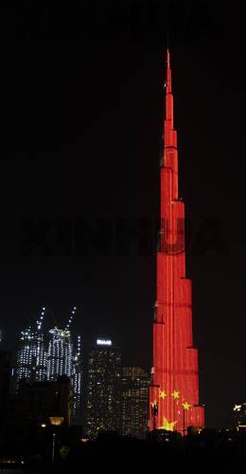
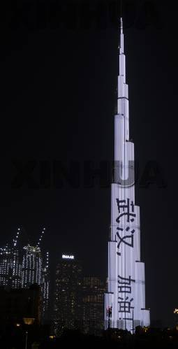
Reference
Jointly building a China-Arab community with a shared future in the New Era
After the outbreak of the Covid-19 pandemic in China, the world’s tallest building in the UAE, Burj Khalifa, put up slogans such as “Go, Wuhan!”. After the outbreak of the pandemic in the Middle East, China quickly provided anti-pandemic supplies to the region, and cooperated with the UAE to conduct the world’s first phase III international clinical trial of a new inactivated Covid-19 vaccine. Until May 2021, people from more than 10 countries in the Middle East have received shots with vaccines produced in China.
The ancient Silk Road connected China and Arab countries. Today, China and Arab countries are natural partners in building the Belt and Road Initiative. In 2004, China-Arab Cooperation Forum was established. In 2014, under the background of the BRI, China and Arab countries further deepened the cooperation.
In 2016, China formulated the first China’s Arab Policy Paper, which laid out policy measures that strengthen China-Arab relations in governance, trade and investment, social development, cultural exchange, peace and security.
In 2020, China maintained its position as the largest trade partner of Arab countries. China imported 250 million tons of crude oil from Arab countries, accounting for half of its total import over the same period. There has been an increasing recognition of Chinese technologies and standards such as 5G, aviation and space technology in Arab countries.
Source: People.cn (http://theory.people.com.cn/BIG5/n1/2017/1012/c40531-29583837.html)
On February 3, 2020, Burj Khalifa, the landmark of UAE light up with the Chinese national flag and the slogan of “Go, Wuhan!”

Slide 38
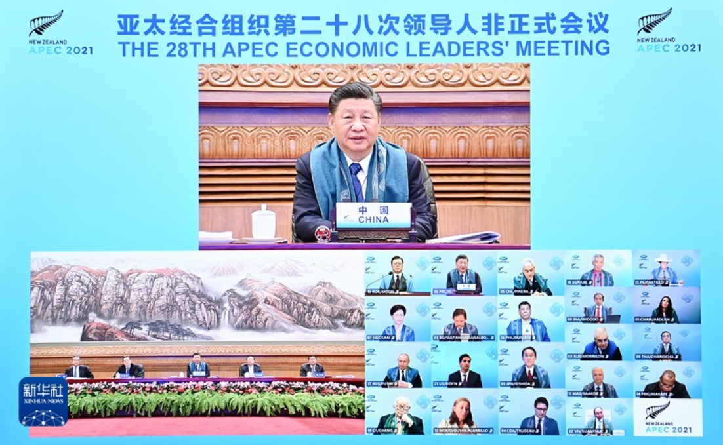

Our country’s multilateral diplomacy
Multilateral diplomacy is an important approach to resolving international issues peacefully. As a responsible major country, China actively participates in international affairs through multilateral platforms.
Advocating reform of the world’s economic governance through the G20 Leaders’ Summit and the APEC Leaders’ Informal Meeting
Driving the establishment of a BRICS leaders’ summit to improve the representation of emerging and developing economies in global governance.
Actively participating in international cooperation on global issues such as security and counter-terrorism, projecting China as a major country.
In November 2021, President Xi Jinping attended the 28th informal meeting of APEC leaders by video from Beijing.
Photo source: Xinhua News (http://www.news.cn/2021-11/12/c_1128059698.htm)

Slide 39
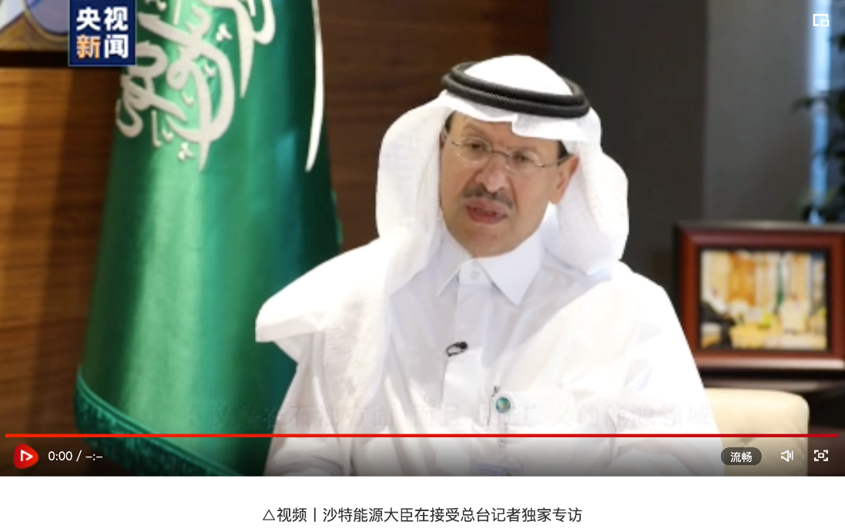


Our country’s diplomatic efforts in various areas
Energy diplomacy
Energy security has become a global issue as well as a serious challenge for our country. It is a major topic for all countries. Energy diplomacy is required to expand sources of international energy supply.
China’s energy cooperation with Saudi Arabia
In 2020, crude oil exported from Saudi Arabia to China reached 84.92 million tons, an increase of 1.9% from the previous year. By March 2021, Saudi Arabia had been the largest supplier to China for seven consecutive years. Chief Executive Officer of Saudi Arabian Oil Company (Saudi Aramco) once said that one of the primary tasks for the company was to ensure China’s energy security in the coming 50 years.
Watch video
https://news.cctv.com/2021/04/26/ARTIvfmIpzTxsthRpE1pDQ7w210426.shtml
Source: https://news.china.com/international/1000/20210426/39514046.html
Click on the image for details and the video

Slide 40
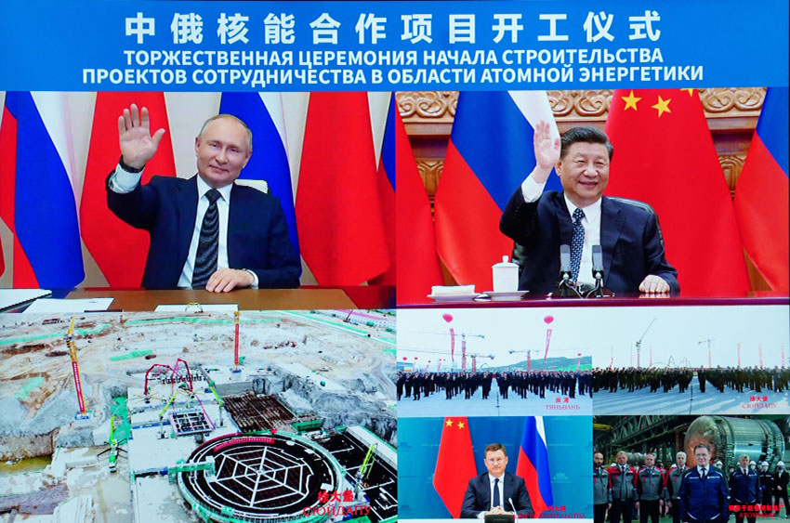

Our country’s diplomatic efforts in various areas
Our country’s energy cooperation with Russia
Nuclear energy cooperation has been a traditional priority between China and Russia. In recent years, the cooperation has developed rapidly, which is significant for maintaining and developing China-Russia comprehensive strategic partnership at a high level in the New Era.
Tianwan nuclear power plan units 7 and 8, and Xudapu nuclear power plant units 3 and 4 are important projects in the cooperation agreement between China and Russia. Once completed, the annual output will reach 37.6 billion kilowatt-hours, which is equivalent to reducing 30.68 million tons of carbon dioxide emissions each year.
Reference:
http://www.mod.gov.cn/big5/shouye/2021-05/19/content_4885710.htm
On 19 May, 2021, President Xi Jinping and Russian President Putin witnessed the commencement of the China-Russia nuclear energy cooperation project through video conference.
Click on the image for details and the video

Slide 41
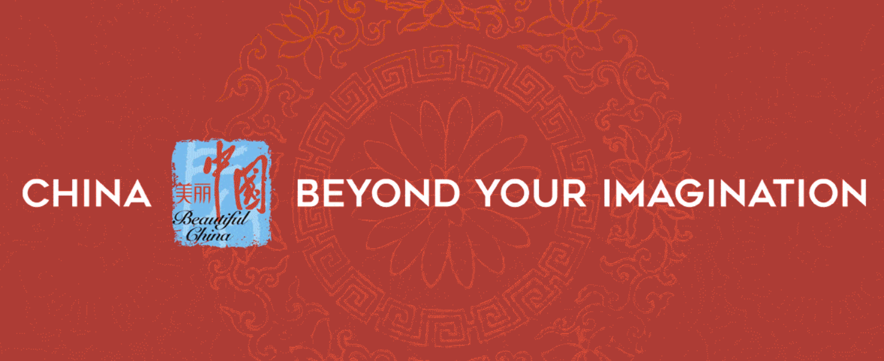

Our country’s diplomatic efforts in various areas
Cultural diplomacy
Cultural diplomacy could enhance understanding and friendship between peoples, thus promoting state-to-state relations. China has been promoting cultural exchanges with countries around the world.
China’s cultural exchange mechanisms include exchanges in film and television, history study, tourism, and higher education. Through setting up Confucius institutes, Confucius classrooms, China Cultural Centers and organising cultural years, etc., Chinese culture is better understood in the world.
The China Cultural Center in Kuala Lumpur is an official cultural and tourism agency of the Chinese government in Malaysia. The center was established and registered in 2018, mainly responsible for promoting China’s tourism in Malaysia and Indonesia.
Source: Chinese Cultural Center
(https://www.chinaculturalcentre.my)

Slide 42


Our country’s diplomatic efforts in various areas
Medical diplomacy
Medical diplomacy has always been an early project in helping our country go global. In 1963, China sent medical teams to Algeria for the first time. Stepping into the 21st century, China has been more active in international medical assistance and undertakes the responsibility as a major country.
The “Peace Ark” hospital ship is a special warship in the Chinese Navy. On its 9 trips abroad, it sailed more than 240,000 nautical miles and visited 43 countries and regions. It provided medical services for more than 230,000 people, performed 1,400 medical operations, and restored the sight of more than 500 cataract patients.
Click on the image to watch video about The Peace Ark
Video source: The China Current (https://chinacurrent.com/hk/story/23041/peace-ark-military-hospital-ship)
Surf the following webpage for more details about the Peace Ark
Xinhua News (http://www.news.cn/politics/ldzt/hpfz/index.htm)

Slide 43
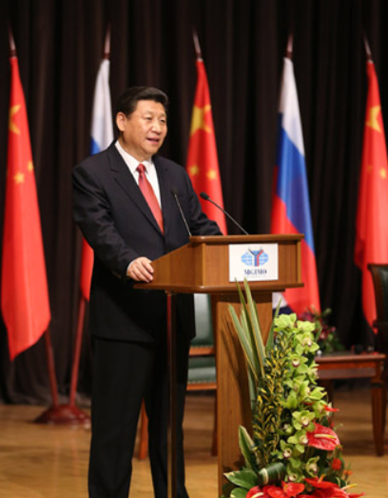
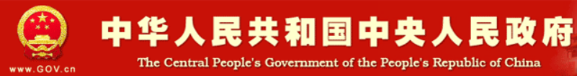

Building a human community with a shared future
The concept of a human community with a shared future means that all countries are interconnected and inter-dependent and share the same future. China advocates a community of a shared future in which people of all countries make concerted efforts to build a world of lasting peace, universal security, common prosperity, openness and inclusiveness, and a world that is clean and beautiful. This concept reflects the common values of humanity.
The initiative was proposed by President Xi Jinping in March 2013, at the Moscow State Institute of International Relations, when he called on the international community to embrace the vision of a community with a shared future in which everyone is bound together. The concept has been written into the Constitution of the Communist Party of China and the Constitution of the People’s Republic of China.
On 23 March 2013, President Xi Jinping delivers the speech “Follow the Trend of the Times and Promote Global Peace and Development” at the Moscow State Institute of International Relations
References:
The Central People’s Government of the People’s Republic of China (http://www.gov.cn/ldhd/2013-03/24/content_2360829.htm)
People’s Daily Online (http://theory.people.com.cn/BIG5/n1/2021/0723/c40531-32167268.html)

Slide 44

Building a human community with a shared future
Key points of a human community with a shared future
Building a world of lasting peace through dialogue and consultation
“No country should willfully wage wars or undermine the international rule of law. Nuclear weapons should be completely prohibited and thoroughly destroyed over time to make the world free of nuclear weapons. Guided by the principles of peace, sovereignty, inclusiveness and shared governance, we should turn the deep sea, the polar regions, outer space and the Internet into new frontiers for cooperation rather than a wrestling ground for competition.”
Building a world of common security for all through joint efforts
“Fighting terrorism is the shared responsibility of all countries. In fighting terror, we should not only treat the symptoms, but also remove the root causes. We should enhance coordination and build a global united front against terrorism so as to create an umbrella of security for people around the world. As terrorism and refugee crises are closely linked to geographical conflicts, resolving conflicts provides the fundamental solution to such problems. Parties directly involved should return to the negotiating table, while others parties should work to facilitate talks for peace. We should all respect the role of the United Nations plays as the main channel for mediation.”
References: Xinhua News (http://www.xinhuanet.com/politics/leaders/2021-01/01/c_1126936802.htm)

Slide 45
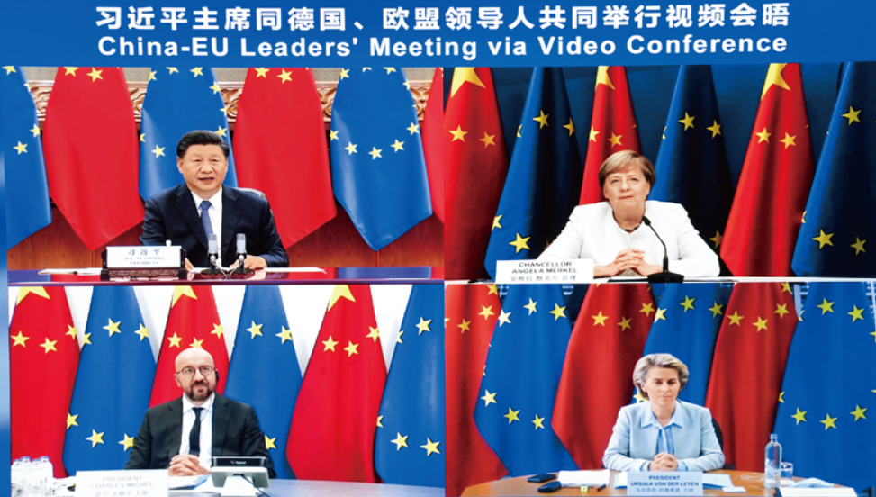
Building a human community with a shared future
Building a world of common prosperity through win-win cooperation
We support an open, transparent, inclusive, non-discriminatory multilateral trading regime and build an open world economy…economic globalisation is moving in the right direction. Challenges such as development disparity, governance dilemma, digital divide still exist…we should strengthen coordination and improve governance so as to ensure sound growth of economic globalisation and make it open, inclusive, balanced and beneficial to all...to ensure justice and equity.
On the evening of September 14, 2020, President Xi Jinping met online with the Chancellor of Germany, which holds the rotating presidency of the European Union, the president of the European Council, and the president of the European Commission.
Reference: Xinhua News
(http://www.xinhuanet.com/politics/leaders/2021-01/01/c_1126936802.htm)

Slide 46

Building a human community with a shared future
Building an open and inclusive world through exchanges and mutual learning
“Diversity of human civilisations not only defines our world, but also drives human progress. There are more than 200 countries and regions, over 2,500 ethnic groups, and multiple religions in our world. There is no such thing as a superior or inferior civilisation, and civilisations are different only in identity and location. Diversity of civilisations should not be a source of global conflict; rather, it should be an engine driving the advance of human civilisations.
Every civilisation, with its own appeal and roots, is a human treasure. Diverse civilisations should draw on each other to achieve common progress. We should make exchanges among civilisations a source of inspiration for advancing human society and a bond that keeps the world in peace.”
Reference: Xinhua News
(http://www.xinhuanet.com/politics/leaders/2021-01/01/c_1126936802.htm)

Slide 47
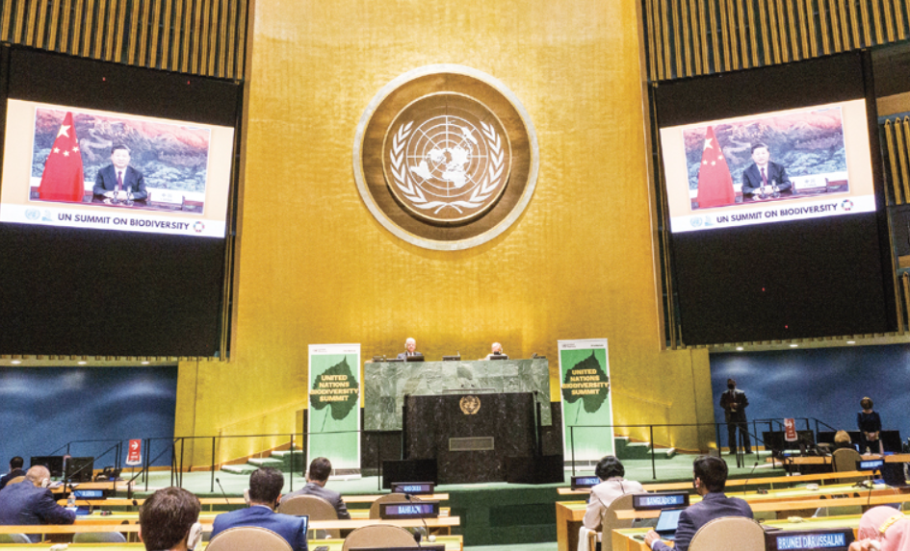
Building a human community with a shared future
Making our world clean and beautiful by pursuing green and low-carbon development
“We should pursue a green, low-carbon, circular, and sustainable way of life and production, advance the 2030 Agenda for Sustainable Development in a balanced manner, and explore a model of sound development that ensures growth, better lives and a good environment.”
In September 2020, China declared that it would achieve carbon peaking before 2030 and carbon neutrality by 2060.
In October 2021, President Xi Jinping delivered a speech via video at the UN Biodiversity Summit
Reference: Xinhua Net
(http://www.xinhuanet.com/politics/leaders/2021-01/01/c_1126936802.htm)

Slide 48

Reference
Carbon peaking and carbon neutrality
Carbon peaking
China has set a goal to achieve peak CO₂ emissions before 2030.
Carbon neutrality
It refers to a scenario in which businesses, groups or individuals measure the total amount of greenhouse gases they have emitted directly or indirectly within a certain period, and then offset the amount by planting trees, saving energy and reducing emissions, thus achieving zero CO₂ emissions on balance.
Please refer to the following website for more information about carbon peaking and carbon neutrality：
http://cpc.people.com.cn/n1/2021/0604/c64387-32122122.html

Slide 49
Reference
Building a human community with a shared future
Resolution of the Central Committee of the Communist Party of China on the Major Achievements and Historical Experience of the Party over the Past Century (2021) stated that “we have advanced major-country diplomacy with Chinese characteristics on all fronts. The concept of a human community with a shared future has become a banner leading trends of the times and human progress. China has broken new ground in its diplomatic endeavors amid profound global changes and turned crises into opportunities amid complex situations on the international stage. These efforts have resulted in a marked increase in China’s international influence, appeal, and power to shape.”
Reference: The Central People’s Government of the People’s Republic of China
http://big5.www.gov.cn/gate/big5/www.gov.cn/zhengce/2021-11/16/content_5651269.htm

Slide 50
User Guide
The primary users of this resource are teachers. It aims to provide teachers with content knowledge relevant to the topic to enable teachers to have a deeper understanding of teaching content when preparing for their lessons.
All data, videos, photos, pictures, questions and suggested answers can be used for multiple purposes, such as teachers’ teaching materials, references for curriculum planning and learning and teaching, and student assignments, etc. To align with Citizenship and Social Development Curriculum and Assessment Guide (Secondary 4-6) (2021) (C&A Guide), this resource should be adapted to cater for students’ learning diversity and the needs of classroom teaching, etc.
Teachers may provide appropriate supplementary notes/ explanations to enrich this resource in order to enhance students’ understanding of the topic and information provided.
In accordance with the curriculum rationale and aims, teachers may select other learning and teaching resources which are correct, reliable, objective and impartial to help students build up a solid knowledge base, develop positive values and attitudes as well as enhance critical thinking and problem solving skills, and various generic skills.
If some information cannot be provided in this resource due to copyright issue, teachers may visit relevant websites provided.
Some information may have been updated when being used by teachers, teachers may visit the corresponding websites to obtain the up-to-date information.
Please also refer to the C&A Guide to understand the requirements and arrangements of the learning and teaching of the curriculum. Teachers are welcome to point out the areas need improvement, and welcome to provide updated information to enrich the content for all teachers’ reference.

Slide 51
Notice and Disclaimer
Some sources were not translated into English as the official English version is not available.
In case of any discrepancy between the Chinese and English versions, the Chinese version shall prevail.

