Slide 1
Citizenship and Social Development:
Theme 2: Our Country since Reform and Opening-up
Topic: The development of our country and the integration of Hong Kong into the overall national development
Learning Focus:
The development plans and policies related to Hong Kong (the development
of the Greater Bay Area, The Mainland and Hong Kong Closer Economic
Partnership Arrangement (CEPA)) and the relationship with the promotion
of the development of Hong Kong
Feb 2023
(Translated Version)

Slide 2
Learning Objectives
Knowledge
To understand the focuses of national development plans and policies related to Hong Kong.
To understand the trend and significance of Hong Kong’s integration into the overall development of our country.
Skills
Based on objective evidence, analyse the pattern of Hong Kong’s integration into national development from multiple perspectives, and to improve critical thinking skills.
To analyse the implications of relevant policies and plans for promoting the long-term development of Hong Kong.
Values
To care about national development, enhance sense of national identity, and cultivate patriotism.
To view the opinions and perspectives of others in an objective, unbiased and empathetic manner, and develop positive values and attitudes.

Slide 3
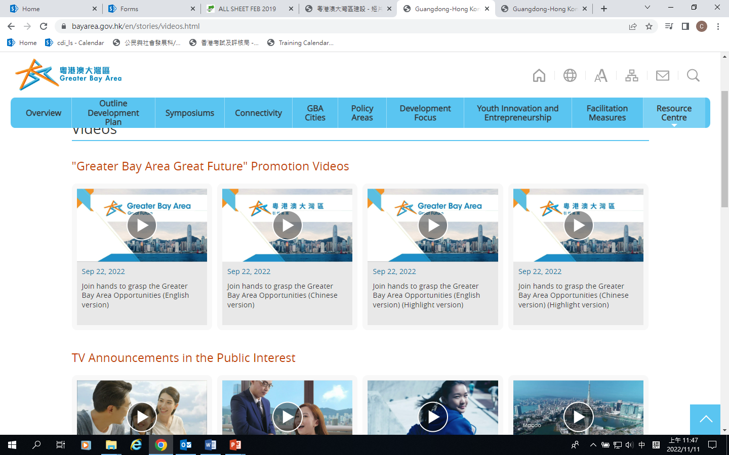


Lead-in
Watching videos for discussion
Video 1
Watch Video 1 and explain why our country listed the development of the Guangdong-Hong Kong-Macao Greater Bay Area (Greater Bay Area) into the Five-Year plan of Guangdong as a national strategy in the 14th Five-Year Plan for the first time?
Direction of discussion
Our country attaches great importance to and set the directions for the development of the Greater Bay Area.
This reflects Hong Kong’s integration into the overall development of the country, and also shows the importance of development of the Greater Bay Area.
click on the image to watch the video
Source：https://www.bayarea.gov.hk/en/stories/videos.html
Video 2
Watch Video 2 to understand:
Important moments of the development of the Greater Bay Area as one of the major national development strategies in the reform and opening-up.
Development focus of the Greater Bay Area.
click on the image to watch the video
Source：https://www.bayarea.gov.hk/tc/stories/videos.html

Slide 4
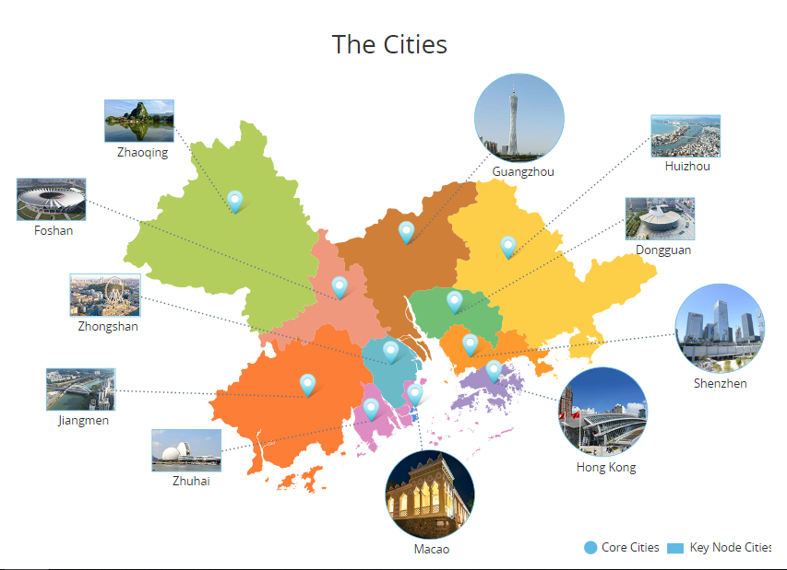

Overview of the development of Greater Bay Area
The Greater Bay Area comprises the two Special Administrative Regions (SARs) of Hong Kong and Macao, and the nine municipalities of Guangzhou, Shenzhen, Zhuhai, Foshan, Huizhou, Dongguan, Zhongshan, Jiangmen and Zhaoqing in Guangdong Province. The total area is around 56,000 km², the total population in the Greater Bay Area was over 86 million and the GDP was USD 1,668.8 billion in 2020.
The development of the Greater Bay Area is a major national development strategy in the new era of reform and opening-up. The objectives are to further deepen cooperation amongst Guangdong, Hong Kong and Macao, fully leverage the composite advantages of the three places, facilitate in-depth integration within the region, and promote coordinated regional economic development, with a view to developing an intentional first-class bay area ideal for living, working and travelling.
Source: Website of Greater Bay Area https://www.bayarea.gov.hk/en/home/index.html
Source: Website of the Greater Bay Area (https://www.bayarea.gov.hk/en/about/overview.html)

Slide 5


Reference
Hong Kong residents usually staying in the Guangdong Province
Based on data from Immigration Department, the Census and Statistics Department estimated that as at mid-2019, there were about 538,000 Hong Kong permanent residents usually staying in the Guangdong Province, of whom 16.5% (or about 89,000) were aged 65 or above.
Constitutional and Mainland Affairs Bureau said, according to the Hong Kong and Macao Affairs Office of the State Council, as at May 2020, more than 230,000 Hong Kong residents had applied for Residence Permits.
83.8% of usual place of residing / staying substantially in the Mainland of China happens in the Guangdong Province.
Note: Since 2016, based on immigration records of Hong Kong permanent residents, the Census and Statistics Department has estimated on Hong Kong residents usually staying in the Guangdong Province, referring to people who have stayed in accumulative for no less than six months in Guangdong Province between 6 months before the reference time point and 6 months after it.
Source:
Labour and Welfare Bureau (https://www.lwb.gov.hk/tc/blog/post_25102020.html)
Press Releases (https://www.info.gov.hk/gia/general/202006/17/P2020061700287.htm)

Slide 6
Reference
Overview of the development of Greater Bay Area
On 1 July 2017, witnessed by President Xi Jinping, the National Development and Reform Commission and the governments of Guangdong, Hong Kong and Macao signed The Framework Agreement on Deepening Guangdong-Hong Kong-Macao Cooperation in the Development of the Bay Area in Hong Kong. The Framework Agreement sets out the goals and principles of cooperation and established the key cooperation areas in the development of the Bay Area.
In the 2018 Policy Address, the Chief Executive announced the establishment of a high-level Steering Committee for the Development of the Guangdong-Hong Kong-Macao Greater Bay Area. The Steering Committee is chaired by the Chief Executive and comprises all Secretaries of Department and Directors of Bureau as members, and is responsible for the overall coordination of matters relating to the Hong Kong Special Administrative Region’s participation in the development of the Greater Bay Area.
The promulgation of The Outline Development Plan for the Guangdong-Hong Kong-Macao Greater Bay Area on 18 February 2019 signified a new stage in the development of the Greater Bay Area.
On 23 November 2020, the Constitutional and Mainland Affairs Bureau set up the Guangdong-Hong Kong-Macao Greater Bay Area Development Office and appointed the Commissioner for the Development of the Guangdong-Hong Kong-Macao Greater Bay Area to implement the relevant work.
Source: Website of the Greater Bay Area (https://www.bayarea.gov.hk/en/about/overview.html)

Slide 7
Reference
Overview of the development of Greater Bay Area
The development foci of the Greater Bay Area include: developing an international innovation and technology hub; facilitating the development of industries in which Hong Kong enjoys strengths into the Greater Bay Area; and through policy innovation and breakthroughs as well as facilitation measures for Hong Kong residents studying, working and living in the Greater Bay Area, fostering the flow of people, goods, capital and information and improving the overall connectivity of the Greater Bay Area under the principle of “One Country, Two Systems”.
Being the most open and international city in the Greater Bay Area, Hong Kong is known for its status as international financial, transportation, trade centers and aviation hub as well as its renowned professional services. Enjoying the dual advantages of “One Country, Two Systems”, Hong Kong plays an important role in the Greater Bay Area Development. On the one hand, Hong Kong will facilitate and support the economic development of the region, with a view to enhancing the role and functions of the Greater Bay Area in the country’s two-way opening up; on the other hand, we will facilitate the development of industries in which Hong Kong’s strengths lie in the Greater Bay Area, capitalising on Hong Kong’s strengths to serve the country’s needs.
Source: Website of the Greater Bay Area (https://www.bayarea.gov.hk/en/about/overview.html)

Slide 8
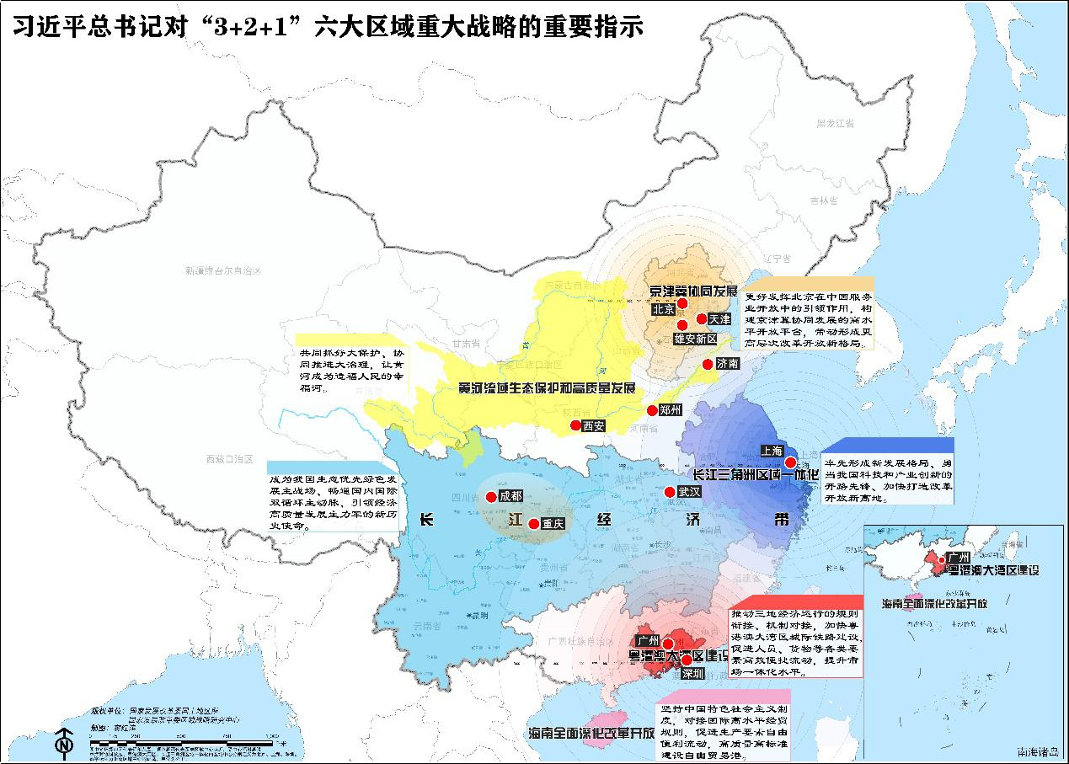

Reference
National Regional Development Plan
The Development of the Greater Bay Area is part of the Six National Regional Strategy「3+2+1」.
「3+2+1」regional key strategy refers to:
The Coordinated Development of Beijing-Tianjin-Hebei Region
The Development of the Greater Bay Area
The Integrated Development of the Yangtze River Delta
The Yangtze River Economic Belt Development
The Ecological Protection and High-quality Development of the Yellow River Basin
Deepening All-round Reform and Opening up in Hainan
Source: https://www.ndrc.gov.cn/xxgk/jd/wsdwhfz/202105/t20210507_1279334.html?code=&state=123
Click on the image for details

Slide 9
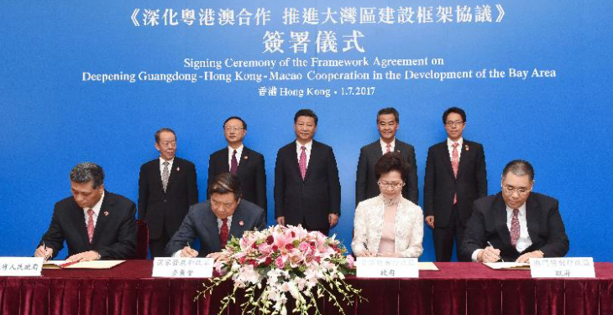
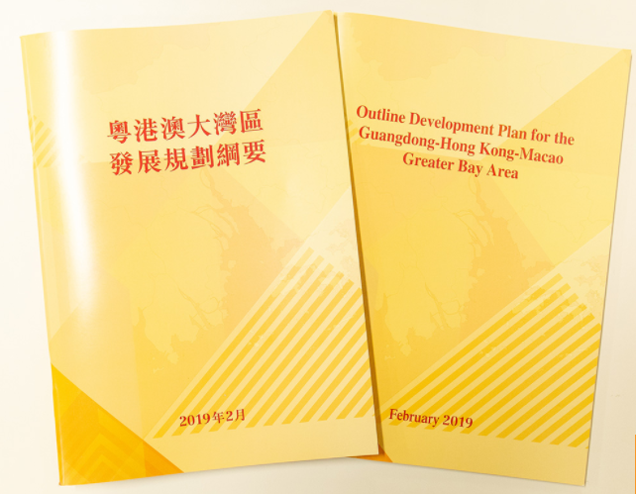
Policy documents of the development plan of the Greater Bay Area
Framework Agreement on Deepening Guangdong-Hong Kong-Macao Cooperation in the Development of the Greater Bay Area (1 July 2017)
On 18 February 2019, the State Council issued Outline Development Plan for the Guangdong-Hong Kong-Macao Greater Bay Area
Click on the images and read relevant policy documents
Source: Website of the Greater Bay Area (https://www.bayarea.gov.hk/en/outline/plan.html)

Slide 10
Development objectives of the Greater Bay Area
By 2022, the combined strength of the Greater Bay Area should increase substantially, the cooperation among Guangdong, Hong Kong and Macao should be deepened and broadened, the internal driving forces for development should be further enhanced in the region, and the framework for an international first-class bay area and world-class city cluster that is vibrant and highly innovative with an optimised industrial structure, a smooth flow of various factors and a pleasant ecological environment should essentially be formed.
By 2035, the Greater Bay Area should become an economic system and mode of development mainly supported by innovation, with its economic and technological strengths vastly increased and its international competitiveness and influence further strengthened; the markets within the Greater Bay Area should basically be highly connected, with very effective and efficient flow of various resources and factors of production; the coordination of regional development should remarkably improve, with the influence on neighbouring regions further strengthened; the people should become wealthier; the level of social civility should reach new heights, with cultural soft power demonstrably strengthened, Chinese culture influence broadened and deepened, and exchange and integration between different cultures further enhanced; the levels of conservation and efficient use of resources should be significantly improved, the ecological environment should be effectively protected, and an international first-class bay area for living, working and travelling should be fully developed.
The Outline Development Plan for the Guangdong-Hong Kong-Macao Greater Bay Area, pp 9-10.
(https://www.bayarea.gov.hk/filemanager/en/share/pdf/Outline_Development_Plan.pdf)

Slide 11
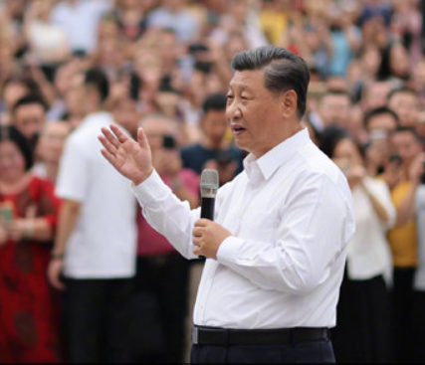


The Overview of the Development of Greater Bay Area
In 2020, President Xi Jinping proposed that the development of the Greater Bay Area is a key national development strategy, and Shenzhen is an important engine for the development of the Greater Bay Area.
It is important to seize the significant historical opportunity brought by the development of the Greater Bay Area, strengthen the regulatory interface and connectivity of the economy of the three places, accelerate the construction of inter-city railways in the Greater Bay Area, facilitate the efficient and convenient flow of factors of production such as people and goods, and enhance the level of market integration.
President Xi Jinping
Source:
Guangdong-Hong Kong-Macao Greater Bay Area (http://www.cnbayarea.org.cn/news/rdbd/gddykc/ttxw/content/post_274550.html)
People’s Daily Online (http://politics.people.com.cn/BIG5/n1/2020/1014/c1024-31891731.html)

Slide 12

Reference
The 14th Five-Year Plan and the Development of the Greater Bay Area
Chapters on the development of the Greater Bay Area in the Outline of the 14th Five-Year Plan(2021-2025) for National Economic and Social Development and Vision 2035 of the People’s Republic of China
Chapter 31 Major Regional Development Strategies
Section 3 Actively and steadily taking forward the development of the Guangdong-Hong Kong-Macao Greater Bay Area
Strengthening the coordinated development of industries, academia and research institutes in Guangdong, Hong Kong, and Macao., Improving the "Two Corridors and Two Poles" framework system which comprises the Guangzhou Shenzhen-Hong Kong, Guangzhou-Zhuhai-Macao Innovation and Technology Corridors and the Shenzhen-Hong Kong Loop, Guangdong-Macao-Hengqin Innovation and Technology Poles. Promoting the setting up of an integrated national science centre and facilitating the cross-boundary exchange of innovative elements. Expediting the construction of intercity railways, coordinating planning for the positioning of ports and airports, optimizing the allocation of maritime and aviation resources. Deepening the customs clearance reforms to facilitate effective and convenient flow of people, goods and vehicles. Expanding the scope of mutual recognition of professional qualifications between the Mainland, Hong Kong and Macao, and further strengthening the regulatory interface and connectivity in key areas. Facilitating young people of Hong Kong and Macao to study, take up employment and start businesses in the Mainland cities of GBA and and establishing a brand of quality exchanges among the youths of Guangdong, Hong Kong and Macao.
Source: https://en.ndrc.gov.cn/policies/index_1.html

Slide 13
Reference
The 14th Five-Year Plan and the Development of the Greater Bay Area
Chapters on the development of the Greater Bay Area in the Outline of the 14th Five-Year Plan(2021-2025) for National Economic and Social Development and Vision 2035 of the People’s Republic of China
Chapter 61 Maintaining the long-term prosperity and stability of in Hong Kong and Macao
Section 1 : Supporting Hong Kong and Macao to reinforce and enhance their competitive advantages
Supporting Hong Kong to enhance its status as an international financial, transportation and trade centre as well as an international aviation hub. Strengthening Hong Kong's status as a global offshore Renminbi business hub, an international asset management centre and a risk management centre. Supporting Hong Kong to develop into an international innovation and technology hub. Supporting Hong Kong to promote service industries for high-end and high value-added development. Supporting Hong Kong to establish a centre for international legal and dispute resolution services in the Asia-Pacific region and a regional intellectual property trading centre. Supporting Hong Kong to develop into a hub for arts and cultural exchanges between China and the rest of the world.
Source: https://en.ndrc.gov.cn/policies/index_1.html

Slide 14
Reference
The 14th Five-Year Plan and the Development of the Greater Bay Area
Chapters on the development of the Greater Bay Area in the Outline of the 14th Five-Year Plan(2021-2025) for National Economic and Social Development and Vision 2035 of the People’s Republic of China
Chapter 61 Maintaining the long-term prosperity and stability of in Hong Kong and Macao
Section 2 Supporting Hong Kong and Macao to better integrate into the overall development of the country:
Promoting high-quality development of the Guangdong-Hong Kong-Macao GBA. Deepening Guangdong-Hong Kong-Macao cooperation as well as Pan-Pearl River Delta regional cooperation. Taking forward the establishment of major cooperation platforms in the Guangdong-Hong Kong Macao GBA, e.g. Qianhai of Shenzhen, Nansha of Guangzhou, Hengqin of Zhuhai, the Shenzhen Hong Kong Loop, etc.
Strengthening exchanges and cooperation between the Mainland, and Hong Kong and Macao on different fronts. Improving policy measures to facilitate Hong Kong and Macao residents to develop and live in the Mainland. Strengthening education on the Constitution and the Basic Law and national development, and enhancing national awareness and patriotism among Hong Kong and Macao people.
Source: https://en.ndrc.gov.cn/policies/index_1.html
Click on the image to read Outline of the 14th Five-Year Plan(2021-2025) for National Economic and Social Development and Vision 2035 of the People’s Republic of China
Source: National Development and Reform Commission (https://en.ndrc.gov.cn/policies/index_1.html)

Slide 15

Development of the Greater Bay Area and
the Integration of Hong Kong
Report: Make use of the advantages to grasp the timing of the development of Greater Bay Area
Read the Report to learn about the following topics:
How does the HKSAR Government support the development of the Greater Bay Area?
What are the advantages of the HKSAR itself? What are the opportunities for Hong Kong in the development of the Greater Bay Area?
What roles can Hong Kong play?
Click on the image to read the report
Source: news.gov.hk
https://www.news.gov.hk/chi/2021/03/20210319/20210319_140450_739.html

Slide 16
Development of the Greater Bay Area and the Integration of Hong Kong
Since the promulgation of The Outline Development Plan for the Guangdong-Hong Kong-Macao Greater Bay Area, the Hong Kong SAR government has always attached great importance to it, the Chief Executive has personally chaired a high-level, inter-departmental and intra-governmental committee to press ahead with the development of the Greater Bay Area, and encourage active participation by different sectors of society.
As the country’s international financial center, Hong Kong benefits from the huge Mainland market on the one hand, and can help the country deepen the reform and opening up of the financial market on the other hand. Hong Kong can make good use of the connectivity with the Mainland and the world, and play the effective roles of being the gateway to, the intermediate hub and the prime platform to participate the Mainland market.
Being a highly market-oriented and an international economy underpinned by the rule of law, Hong Kong’s development opportunities are evident. Hong Kong can make good use of the advantages of “One country, Two systems” to further strengthen its role as an intermediary in the international cycle. On the other hand, Hong Kong can focus on the business opportunities in the Mainland market, better integrate proactively become a “participant” in domestic circulation and a “facilitator” in international circulation into the overall development of the country.
Click on the image to read the report
Source: news. gov. hk https://www.news.gov.hk/chi/2021/03/20210319/20210319_140450_739.html

Slide 17
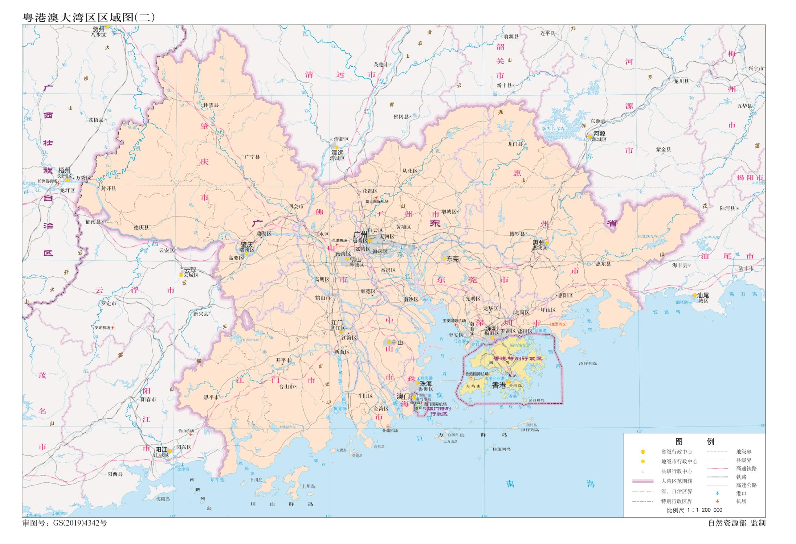
Overview of the Greater Bay Area
The Bay Area economy is a regional economic form formed by the evolution and development of the industrial structure, developed on the basis of seaports and the physical geographical conditions of the bay area. It has outstanding advantages such as open economic structure, efficient resource allocation ability, strong agglomeration and spillover functions and developed international communication network.
The Greater Bay Area consists of the HKSAR, the Macao SAR, and the municipalities of Guangzhou, Shenzhen, Zhuhai, Foshan, Huizhou, Dongguan, Zhongshan, Jiangmen and Zhaoqing in Guangdong Province.
Click on the map to get a closer look at the locations of the 11 cities in the Greater Bay Area.
Sources：
Chinese National Geography, Issue 11, 2020, The Four Largest Bay Areas in the World
http://www.dili360.com/cng/article/p5fb1efcae19ba61.htm
Source: Website of the Guangdong-Hong Kong-Macao Greater Bay Area (http://www.cnbayarea.org.cn/introduction/content/post_165071.html)
Source: Website of Greater Bay Area (https://www.bayarea.gov.hk/en/home/index.html)
Activity: Students whose hometowns are in the Greater Bay Area could share with others in class.

Slide 18
Overview of the Greater Bay Area
The world’s three other bay areas generally refer to the New York Bay Area, the San Francisco Bay Area and the Tokyo Bay Area.
According to the World Bank data, 60% of the world’s big cities are located in the bay area, and 75% of the total economic output is concentrated in the bay area.
The Greater Bay Area is built under the conditions of one country, two systems, three customs territories, and three currencies, without any precedents internationally.
Source: People’s Daily Online (http://finance.people.com.cn/n1/2019/0318/c1004-30980277.html）
Note:
The two systems refer to Socialism with Chinese Characteristics and Capitalism in Hong Kong and Macao Special Administrative Regions;
The three customs territories are the Mainland, Hong Kong and Macao;
The three currencies refer to RMB, HKD and MOP.

Slide 19
Overview of the Greater Bay Area
The 11 cities in the Greater Bay Area have different positions: Hong Kong is an international financial centre, Shenzhen is an international innovation and technology hub, Guangzhou is a global business and trade centre, Dongguan and other cities are manufacturing centres.
The Greater Bay Area is one of the most dynamic regions in our country with a vast hinterland and market space.
The development of the Greater Bay Area is a key national development strategy.
The goal is to further deepen cooperation among Guangdong, Hong Kong and Macao, fully leverage the composite advantages of the three places, facilitate in-depth integration within the Greater Bay Area, promote coordinated regional economic development, with a view to developing a world-class Bay Area that is ideal for living, working and travelling.
Source:
Outline Development Plan for the Guangdong-Hong Kong-Macao Greater Bay Area (https://www.bayarea.gov.hk/filemanager/en/share/pdf/Outline_Development_Plan.pdf )
The Greater Bay Area: Building a world-class economic platform
(https://news.cctv.com/2021/05/29/ARTIC6OVriRZ9ykQCJpyPrWN210529.shtml)
Overview of the Greater Bay Area of the Legislative Council Secretariat
https://www.legco.gov.hk/research-publications/chinese/1718fs03-overview-of-guangdong-hong-kong-macao-bay-area-20180223-c.pdf

Slide 20
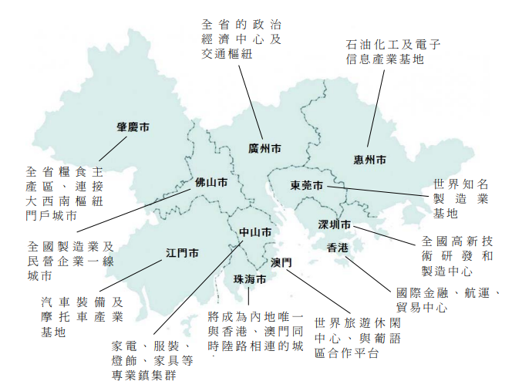
Spatial Layout of the Greater Bay Area
Core cities: To take Hong Kong, Macao, Guangzhou and Shenzhen as the core of regional development, driving the development of surrounding regions.
Key node cities: To support Zhuhai, Foshan, Huizhou, Dongguan, Zhongshan, Jiangmen and Zhaoqing in fully leveraging their strengths, deepen reform and innovation, enhance the composite strengths of the cities, and form key node cities with distinct characteristics, complementary functions and competitiveness.
Source: Overview of the Greater Bay Area of the Legislative Council Secretariat
https://www.legco.gov.hk/research-publications/chinese/1718fs03-overview-of-guangdong-hong-kong-macao-bay-area-20180223-c.pdf
Reference: The Outline Development Plan for the Guangdong-Hong Kong-Macao Greater Bay Area, pp. 11-12.
(https://www.bayarea.gov.hk/filemanager/en/share/pdf/Outline_Development_Plan.pdf)

Slide 21
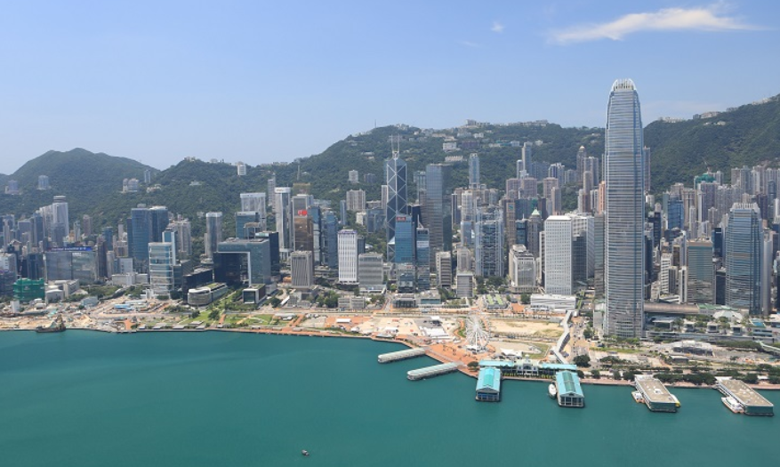
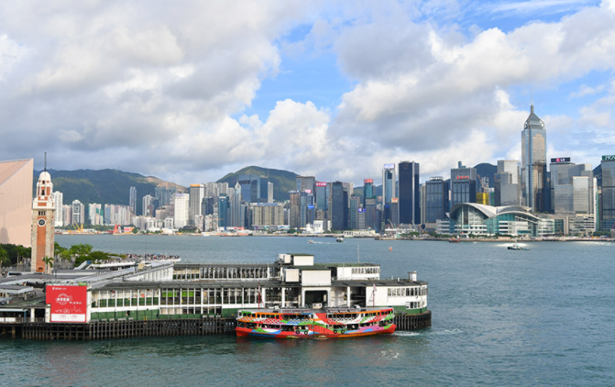
Spatial Layout of the Greater Bay Area-Hong Kong
Development Focus:
To consolidate and enhance Hong Kong’s status as an international financial, transportation and trade centre as well as an international aviation hub, strengthen its status as a global offshore RMB business hub and its role as an international asset management centre and a risk management centre, promote the development of high-end and high value-added financial, commercial and trading, logistics and professional services, etc., make great efforts to develop the innovation and technology industries, nurture emerging industries, establish itself as the centre for international legal and dispute resolution services in the Asia-Pacific region, and develop into an international metropolis with enhanced competitiveness.
The Greater Bay Area has made great efforts to expedite infrastructural connectivity
Victoria Harbour, Hong Kong
Reference: The Outline Development Plan for the Guangdong-Hong Kong-Macao Greater Bay Area, p. 12.
(https://www.bayarea.gov.hk/filemanager/en/share/pdf/Outline_Development_Plan.pdf)

Slide 22
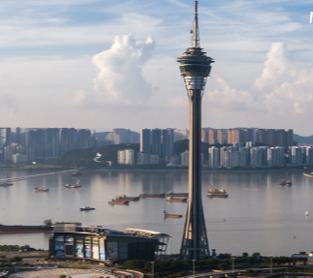
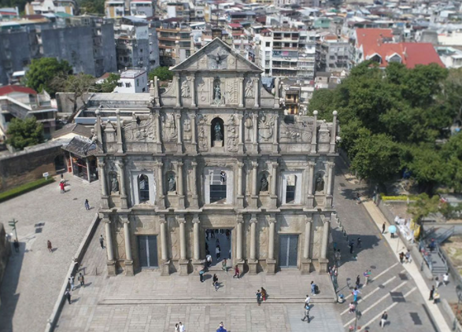
Spatial Layout of the Greater Bay Area-Macao
Development Focus:
To develop into a world-class tourism and leisure centre and a commerce and trade cooperation service platform between China and Lusophone countries, promote an appropriate level of diversified economic development, and develop into a base for exchange and cooperation where Chinese culture is the mainstream and diverse cultures coexist.
Macau Tower
The Ruins of St. Paul’s
Reference: The Outline Development Plan for the Guangdong-Hong Kong-Macao Greater Bay Area, p. 12.
(https://www.bayarea.gov.hk/filemanager/en/share/pdf/Outline_Development_Plan.pdf)

Slide 23
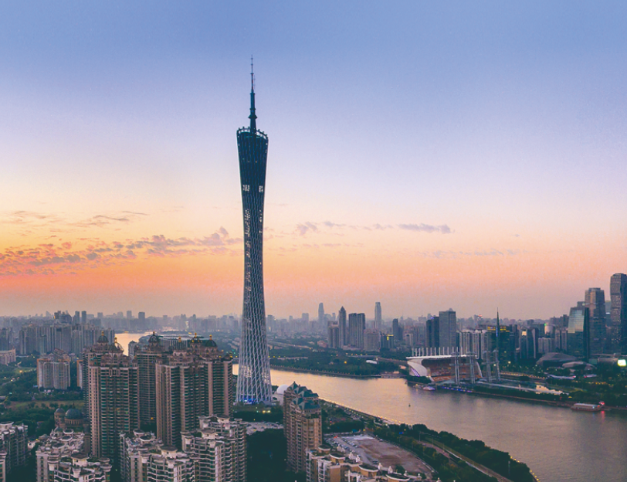
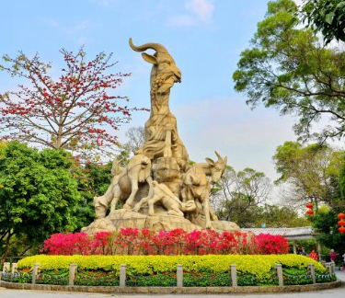
Spatial Layout of the Greater Bay Area-Guangzhou
Development Focus:
To fully leverage its leading function as a national core city and an integrated gateway city, comprehensively strengthen its functions as an international commerce and industry centre and integrated transport hub, enhance its function as technological, educational and cultural centres, and develop into a global metropolis.
Canton Tower
The Five-Ram Sculpture in Yuexiu Park, Guangzhou
Reference: The Outline Development Plan for the Guangdong-Hong Kong-Macao Greater Bay Area, p. 12.
(https://www.bayarea.gov.hk/filemanager/en/share/pdf/Outline_Development_Plan.pdf)

Slide 24
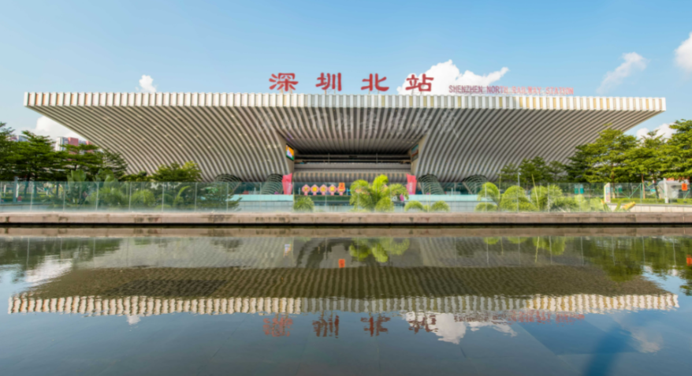
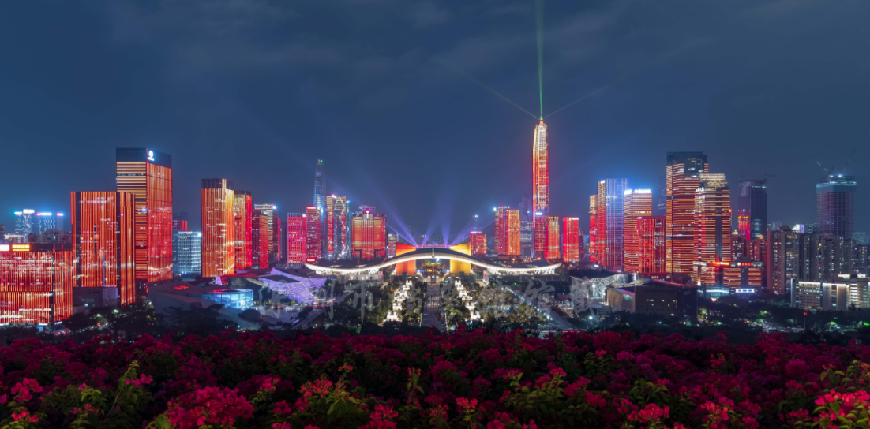
Spatial Layout of the Greater Bay Area-Shenzhen
Development Focus:
To leverage its leading role as a special economic zone, a national economic core city and a national innovation city, expedite its transformation into a modern and international city, and strive to become a capital of innovation and creativity with global influence.
Shenzhen North Railway Station
Night View of Futian, Shenzhen
Reference: The Outline Development Plan for the Guangdong-Hong Kong-Macao Greater Bay Area, p. 12.
(https://www.bayarea.gov.hk/filemanager/en/share/pdf/Outline_Development_Plan.pdf)

Slide 25
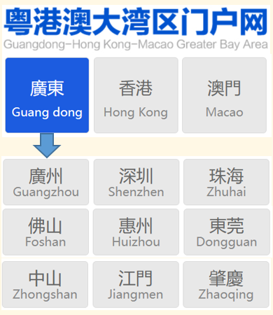
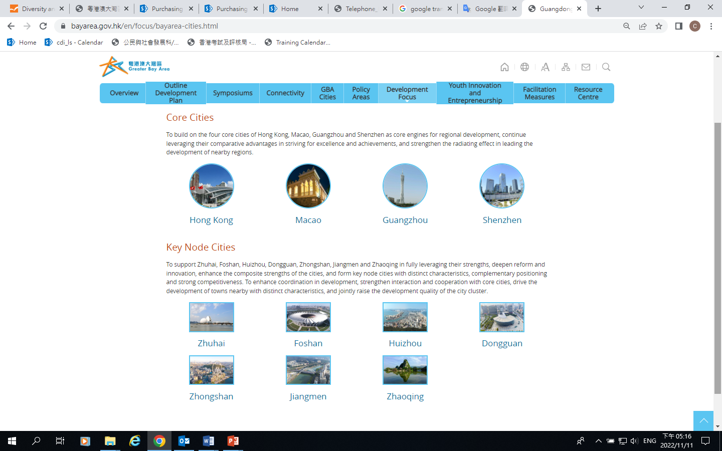
Spatial Layout of the Greater Bay Area
Reference
For more information on the development priorities of each city in the Greater Bay Area, please click on the images below and read the relevant materials.
Source: Website of Guangdong-Hong Kong-Macao Greater Bay Area
Source: Website of the Greater Bay Area
http://www.cnbayarea.org.cn/city/index.html
https://www.bayarea.gov.hk/en/focus/bayarea-cities.html

Slide 26
The Main Contents of the Development of the Greater Bay Area
Developing an International Innovation and Technology Hub
To pursue the development of the “Guangzhou-Shenzhen-Hong Kong-Macao” innovation and technology corridor, and jointly develop a Greater Bay Area big data centre as well as platforms for international innovation.
To support the development of major technological infrastructure facilities, research and development institutes as well as innovation platforms in the Greater Bay Area.
To optimise the allocation of resources for innovation, and develop and nurture a batch of platforms for technological innovation for industries, manufacturing innovation centres and enterprise technological centres.
To support Guangdong, Hong Kong and Macao in establishing in-depth collaboration in areas such as entrepreneurship and incubation, financial technologies, international technology transfer and the technology services industry, and jointly develop national level bases for the incubation of technological achievements and bases for start-up businesses and employment for young people from Guangdong, Hong Kong and Macao.
Primary Goal: to develop into a world-class technology and innovation bay area
Reference: The Outline Development Plan for the Guangdong-Hong Kong-Macao Greater Bay Area, pp. 15-17.
(https://www.bayarea.gov.hk/filemanager/en/share/pdf/Outline_Development_Plan.pdf)

Slide 27
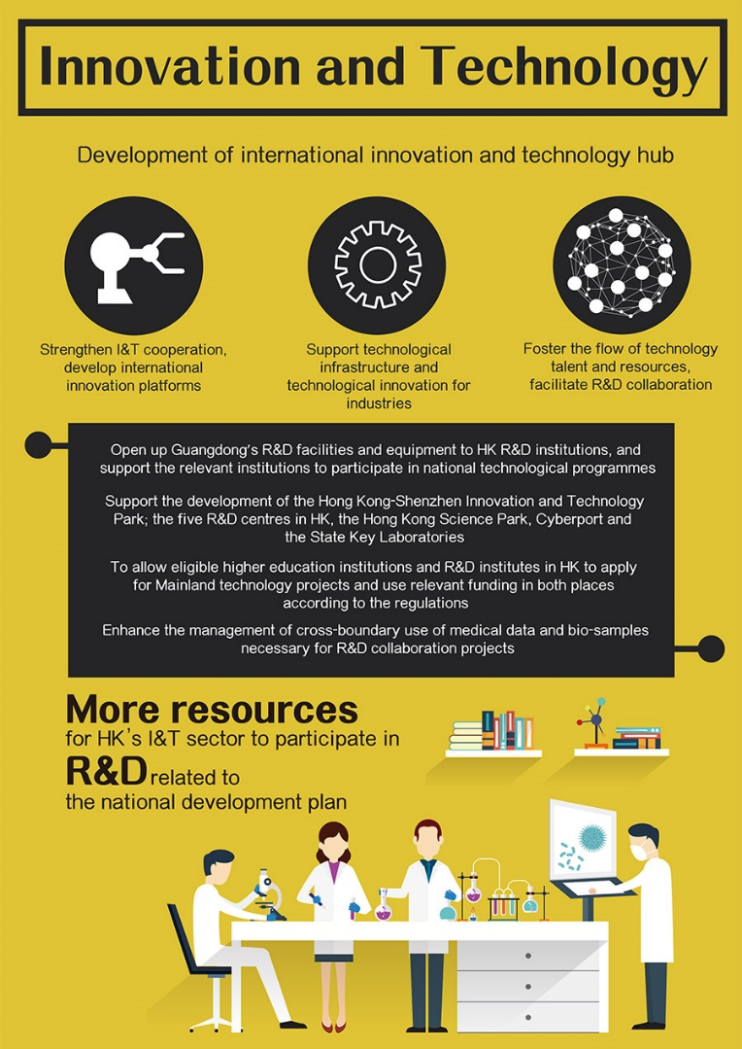
Developing an International Innovation and Technology Hub
Strengthen innovation and technology cooperation, develop international innovation platforms
Encourage Guangdong, Hong Kong, and Macao enterprises and scientific research institutes to participate in international innovation and technology cooperation.
Open up Guangdong’s research and development (R&D) facilities and equipment to Hong Kong R&D institutions, and support the relevant institutions to participate in national technological programmes.
Support technological infrastructure and technological innovation for industries
Support the development of the Hong Kong-Shenzhen Innovation and Technology Park, the five R&D centres in Hong Kong, the Hong Kong Science Park, Cyberport and the State Key Laboratories.
Nurture platforms for technological innovation for industries, manufacturing innovation centres.
Source: Website of the Greater Bay Area (https://www.bayarea.gov.hk/en/opportunities/mainpoints-it.html)

Slide 28
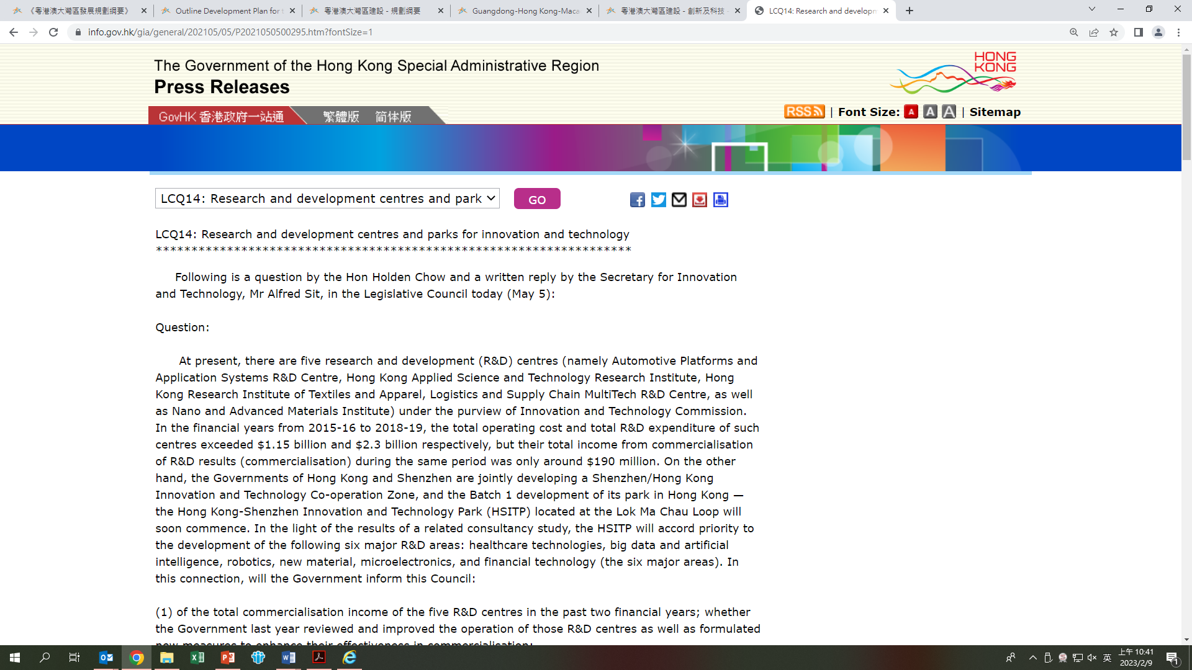
Reference
Five R&D Centres in Hong Kong
The Government has set up five R&D centres to drive and coordinate applied R&D in selected focus areas. The five R&D centres are：
(1) Automotive Platforms and Application Systems R&D Centre (2) Hong Kong Applied Science and Technology Research Institute (3) Hong Kong Research Institute of Textiles and Apparel (4) Logistics and Supply Chain MultiTech R&D Centre (5) Nano and Advanced Materials Institute
Click on the image to read the report
Source:
https://www.info.gov.hk/gia/general/202105/05/P2021050500295.htm?fontSize=1

Slide 29
Developing an International Innovation and Technology Hub
Foster the flow of technology talents and resources, facilitate R&D collaboration
To allow eligible higher education institutions and R&D institutes in Hong Kong to apply for Mainland technology projects and use relevant funding in both places according to the regulations.
Enhance the management of cross-boundary use of medical data and bio-samples necessary for R&D collaboration projects.
Enable Hong Kong R&D institutes in Guangdong to enjoy the same treatment as other Mainland R&D institutes.
Study facilitation measures relating to immigration to encourage exchanges between technological and academic talents.
Source: Website of the Greater Bay Area (https://www.bayarea.gov.hk/en/opportunities/mainpoints-it.html)

Slide 30
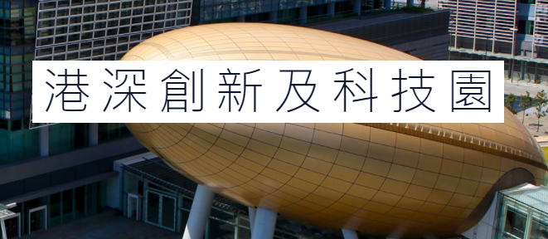
Reference
Developing an International Innovation and Technology Hub
By March 2021, important breakthroughs had been made in the innovation-driven development of the Greater Bay Area, the construction of a number of major national science and technology infrastructure was accelerated, and the construction of a comprehensive national science centre in the Greater Bay Area has been approved.
The total number of state key laboratories and provincial key laboratories has reached 30 and 396 respectively; the total number of national-level high-tech enterprises in Guangdong Province has reached 53,000, ranking first in China in terms of total number, total income and net profit.
Source: the Outline of the 14th Five-Year Plan for National Economic and Social Development and Vision 2035 of Guangdong Province http://www.gd.gov.cn/zwgk/wjk/qbwj/yf/content/post_3268751.html
The Hong Kong SAR government has established two research clusters, on healthcare technologies and on artificial intelligence and robotics technologies, in Hong Kong Science Park to attract the world class scientific research institutions and technology companies to Hong Kong to conduct more R&D projects in collaboration with local universities and scientific research institutions,. The clusters pool and nurture more scientific and technological talents for Hong Kong.
Sources:
Website of the Greater Bay Area
https://www.bayarea.gov.hk/en/opportunities/it.html
Hong Kong-Shenzhen Innovation and Technology Park
https://www.hsitp.org/en/about-us/index.html
Hong Kong-Shenzhen Innovation and Technology Park

Slide 31
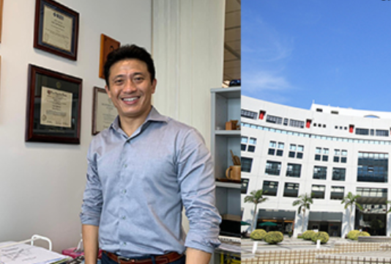

Developing an International Innovation and Technology Hub
Reference
The team led by Professor YUE Jie of the Department of Electronic and Computer Engineering at the Hong Kong University of Science and Technology, collaborated with two mainland universities to develop a chip that can be used for 5G network transmission. With about HK $3.5 million in R&D funding awarded by the Department of Science and Technology of Guangdong Province through the Guangdong Provincial Key Areas R&D Programme, it is one of the first research projects in Hong Kong to receive. the remittance of Mainland research and development (R&D) funding to Hong Kong.
Since permission was granted for the remittance of Mainland R&D funding to Hong Kong, the State Ministry of Science and Technology, Guangdong Provincial Government and Shenzhen Municipal Government in the past two years have approved over RMB 340 million for universities and research institutes in Hong Kong to conduct R&D or set up laboratories, thereby adding impetus for local R&D activities.
Source: The Budget 2021 (https://www.budget.gov.hk/2021/eng/budget31.html)
Click on the image to read the details
YUE Jie, Professor, Dept. of Electronic and Computer Engineering, HKUST
Source: Hong Kong Trade Development Council
https://hkmb.hktdc.com/en

Slide 32
Expediting Infrastructural Connectivity
To consolidate and enhance Hong Kong’s status as an international maritime centre, support Hong Kong’s development of high-end maritime services such as ship management and leasing, ship finance, marine insurance as well as maritime law and dispute resolution services, and provide such services to Mainland and Macao enterprises.
To increase the overall capacity of international shipping services of Guangzhou and Shenzhen, further enhance the service capacity of infrastructural facilities including ports and fairways, form a complementary and mutually beneficial system of port, shipping, logistics and ancillary services with Hong Kong.
Reference: The Outline Development Plan for the Guangdong-Hong Kong-Macao Greater Bay Area
To consolidate and enhance Hong Kong’s status as an international aviation hub, raise the competitiveness of Guangzhou’s and Shenzhen’s airports as international hubs, strengthen the functions of airports such as those in Macao and Zhuhai, and promote the development of airports in the Greater Bay Area.
(https://www.bayarea.gov.hk/filemanager/en/share/pdf/Outline_Development_Plan.pdf)

Slide 33
Expediting Infrastructural Connectivity
To improve comprehensive transport links connecting the Greater Bay Area with nearby provinces and regions via eastern, western and northern Guangdong.
To focus on connecting the Mainland with Hong Kong and Macao, as well as connecting the east and west banks of the Pearl River Estuary, build a rapid inter-city transport network mainly involving high-speed rails, inter-city railway links and high-grade motorways, and to reduce travelling time among major cities within the Greater Bay Area to one hour or less.
To strengthen cooperation among Guangdong, Hong Kong and Macao on smart cities, explore the establishment of common standards, open up data ports, develop interconnected public application platforms, develop information infrastructure facilities including full coverage of Internet of Things, a smart city information cloud platform.
Reference: The Outline Development Plan for the Guangdong-Hong Kong-Macao Greater Bay Area
(https://www.bayarea.gov.hk/filemanager/en/share/pdf/Outline_Development_Plan.pdf)
Note: The objects are connected together through the network, and can exchange data and make the required commands. Objects are sensors, mobile smart devices, home appliances, cars, etc.

Slide 34
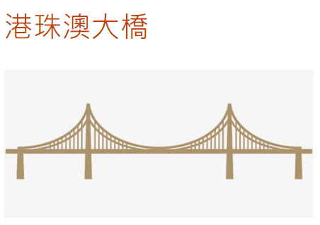
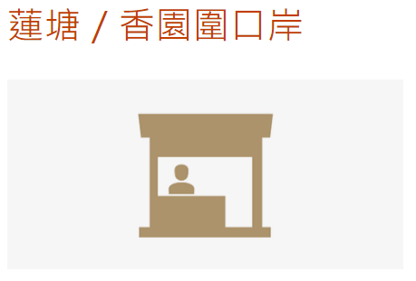
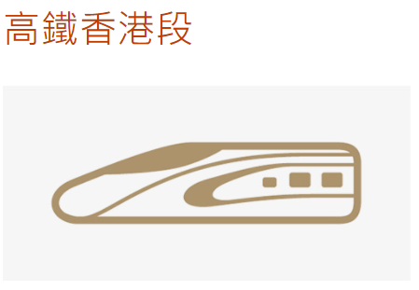
Expediting Infrastructural Connectivity
Example of infrastructure
High-speed rail (Hong Kong section )
Hong Kong-Zhuhai-Macao Bridge
Liantang Port /Heung Yuen Wai Boundary Control Point (BCP)
Opened in September 2018, and connect to the national high-speed rail network of over 30,000 km
Direct train service to 58 Mainland destinations Shortest travelling time for trains departing from West Kowloon Station:
About 14 minutes to Futian
About 18 minutes to Shenzhen North
About 46 minutes to Guangzhou South
Opened in October 2018, the longest bridge-cum-tunnel sea-crossing in the world, with a total length of 55 kilometers
Travel time between Zhuhai and Kwai Tsing Container Terminals is about 75 minutes
Travel time between Zhuhai and Hong Kong International Airport is about 45 minutes
Incorporation of the western part of the Pearl River Delta into a reachable three-hour commuting radius of Hong Kong
Opened in August 2020, the 7th land crossing between Hong Kong-Shenzhen boundary.
Equipped with direct access facilities for both passengers and vehicles The average travelling time from Tai Po of Hong Kong to Longgang of Shenzhen is about 31 minutes
Daily handling capacity estimated at 17 850 vehicle trips and 30 000 passenger trips. In May 2019, the Heung Yuen Wai Highway connecting the BCP with Fanling Highway was opened to traffic
Source: Website of the Greater Bay Area
(https://www.bayarea.gov.hk/en/connectivity/key.html)

Slide 35
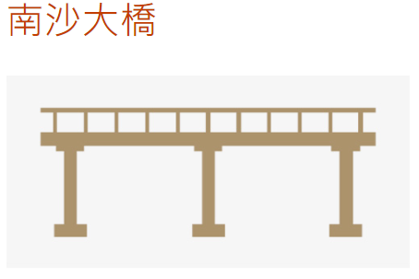
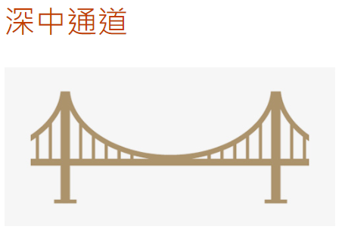
Expediting Infrastructural Connectivity
Example of infrastructure
Nansha Bridge
Shenzhen-Zhongshan Bridge
Opened to traffic in April 2019
The widest steel box girder bridge in the world, with a total length of about 13 kilometers
An important cross-river channel connecting the two sides of the Pearl River
The transportation distance from Dongguan to Panyu has been shortened by at least 10 kilometers
Expected to open in 2024, consisting of a cluster of infrastructure, including a sea-crossing bridge, a subsea tunnel, artificial islands and an underground interchange, with a total length of about 24 kilometers
Connecting Shenzhen, Zhongshan and Nansha, Guangzhou. There will be four lanes in each direction with a speed of 100 km/ hr
The only direct expressway connecting “Shenzhen-Dongguan-Huizhou” and “Zhuhai-Zhongshan-Jiangmen” in the Pearl River Delta
Shortening of travelling time from Shenzhen to Zhongshan to about 20 minutes
Source: Website of the Greater Bay Area (https://www.bayarea.gov.hk/en/connectivity/key.html)

Slide 36
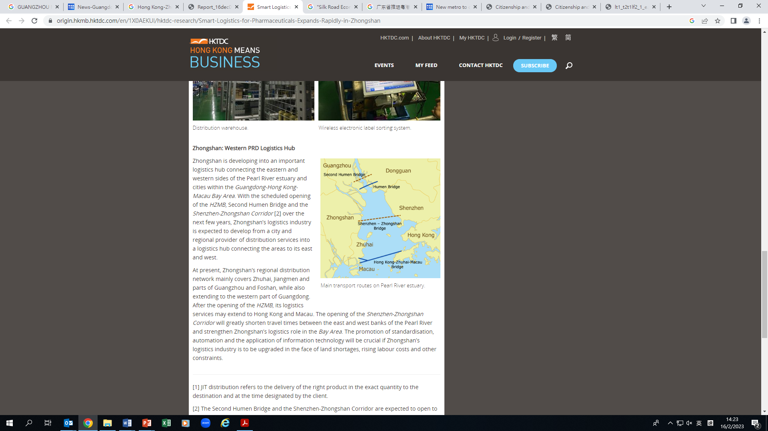
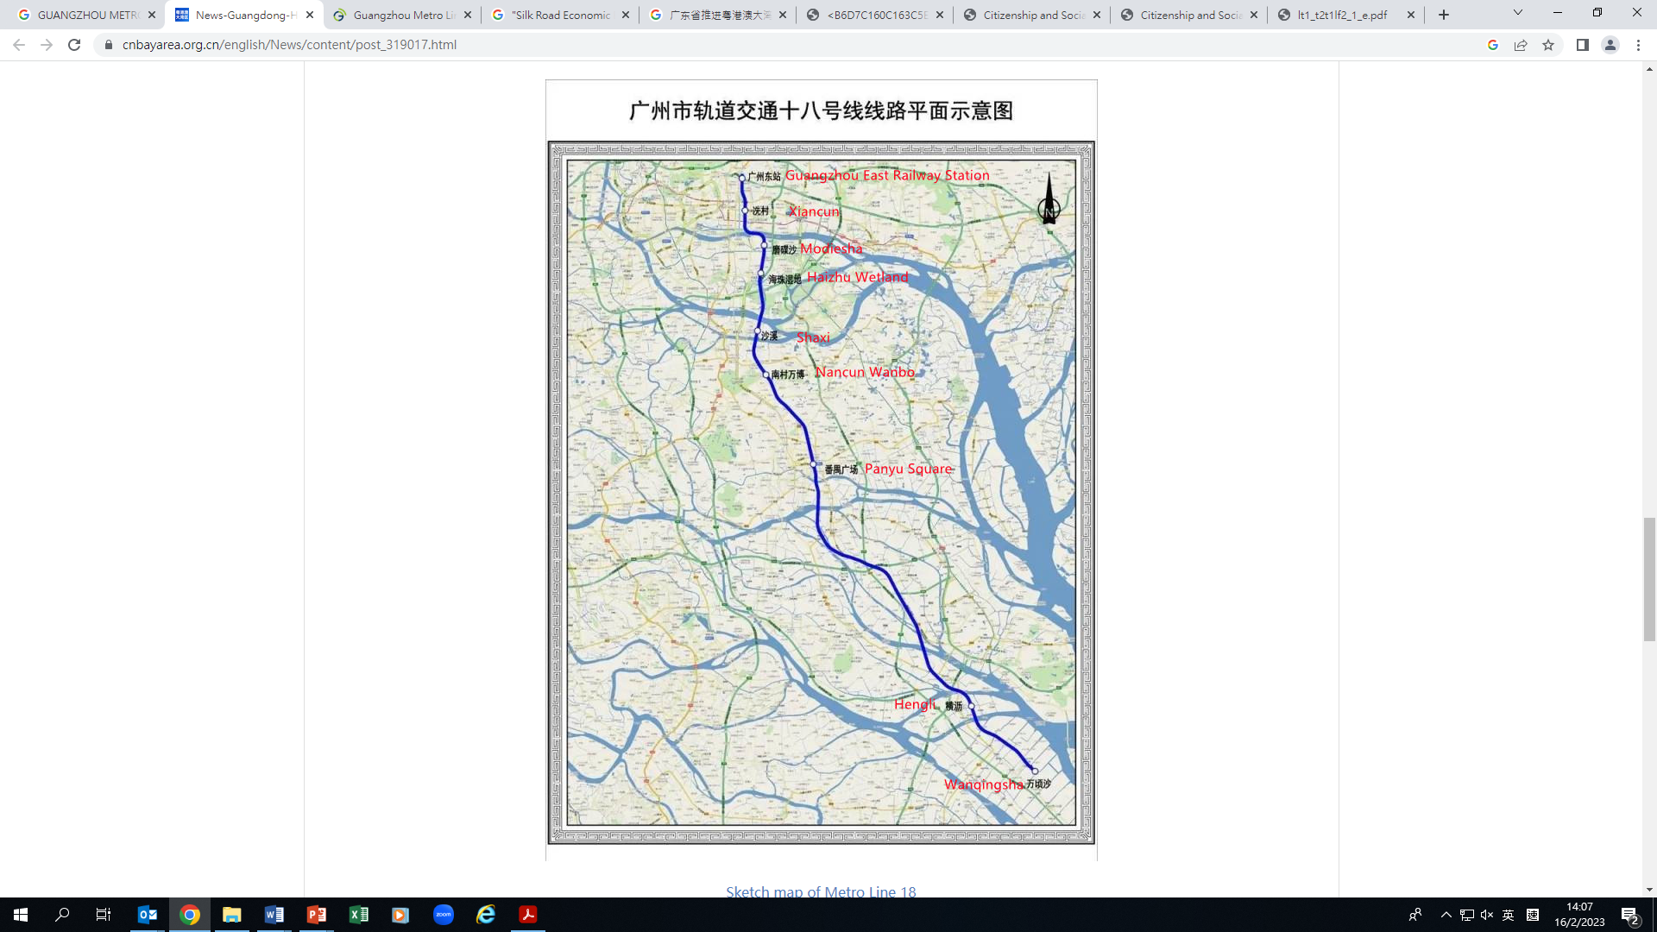
Expediting Infrastructural Connectivity
Source: https://origin.hkmb.hktdc.com/en/1X0AEKUI/hktdc-research/Smart-Logistics-for-Pharmaceuticals-Expands-Rapidly-in-Zhongshan
With the completion and opening of the Hong Kong-Zhuhai-Macao Bridge and the Nansha Bridge, the construction of the Shenzhen-Zhongshan Channel and the Huangmaohai Cross-Sea Channel has been accelerated.
Activity:
What is the fastest way to get to your hometown? How long does it take?
Guangzhou Metro Line 18, which has the highest speed in the Greater Bay Area, opened on 20 April, 2021.
Source: https://www.cnbayarea.org.cn/english/News/content/post_319017.html
Source: Liaison Office of the Central People’s Government in the Hong Kong SAR http://www.zlb.gov.cn/2021-05/21/c_1211166665.htm

Slide 37
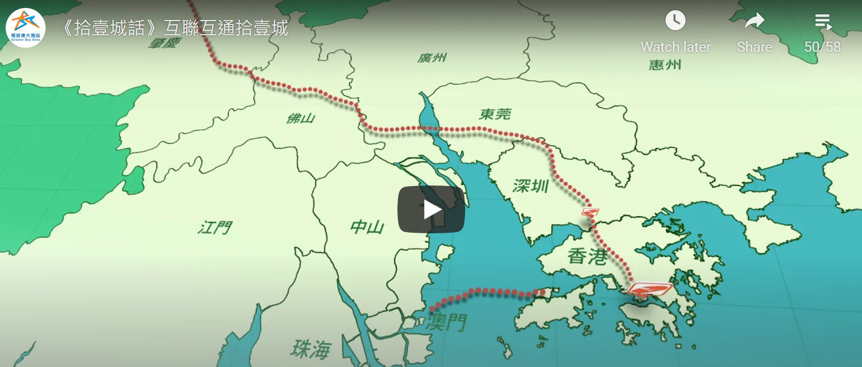

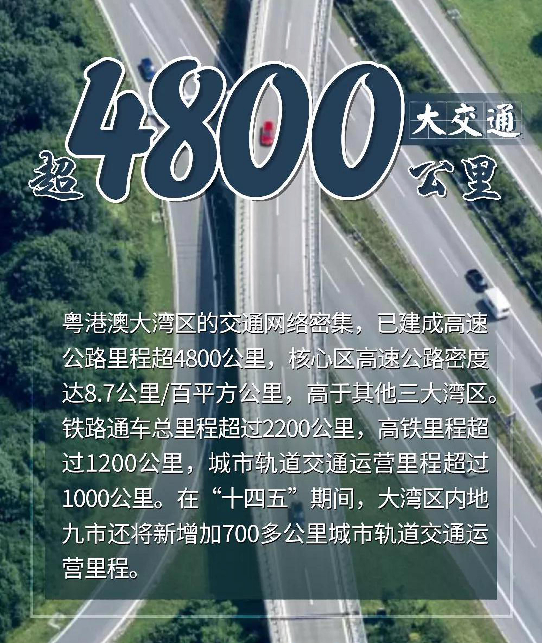


Expediting Infrastructural Connectivity
Guangdong focuses on promoting transportation connectivity in the Greater Bay Area
About 40 new highways of 1,394 kilometers have been built in Guangzhou-Foshan-Zhaoqing, Huadu-Dongguan and so on. People in the Pearl River Delta can reach highways within 30 minutes.
The number of high-speed ferry routes has increased to 29. The four ports on both sides of the Pearl River, i.e., Guangzhou, Shenzhen, Zhuhai, and Dongguan, have become one-hundred-million-tons ports, and Guangzhou Port and Shenzhen Port rank among the top in the world in terms of container throughput.
The highways of Greater Bay Area are over 4800 KM
Source:
Source:
With a total length of 24kms, the Shenzhen-Zhongshan Bridge connecting Shenzhen and Zhongshan across the river has been under construction since 2016 and is expected to be completed and open to traffic in 2024. By then, the travelling time from Shenzhen Bao’ an International Airport to Zhongshan will be reduced from the current 2 hours to 20 minutes.
Source:
People’s Daily Online (http://jx.people.com.cn/BIG5/n2/2021/0129/c347922-34554566.html)
The China Current (https://chinacurrent.com/hk/story/22627/shenzhen-zhongshan-bridge)
Website of the Constitutional and Mainland Affairs Bureau (https://www.bayarea.gov.hk/en/stories/videos.html)
Click on the above images to watch the videos and learn about the connectivity of the 11 cities in the Greater Bay Area

Slide 38


During the 14th Five-Year Plan period, Guangdong Province focused on promoting transportation connectivity in the Greater Bay Area
To build a “three horizontal and four vertical” comprehensive transport corridor with the Greater Bay Area as the core, connecting the west coast of the Strait in the east, connecting the Yangtze River Delta region, connecting Guangxi-Yunnan-Guizhou in the west, connecting the Chengdu-Chongqing region, Hunan-Jiangxi-Hubei in the north, and connecting the Beijing-Tianjin-Hebei region. By 2025, the operating mileage of railways in the province will reach 6,500 kilometers, including 3,600 kilometers of high-speed railways, and the operating mileage of expressways of 12,500 kilometers.
To speed up the construction of intercity railways in the Greater Bay Area.
To form a transportation and logistics network with coastal ports as nodes, facing the world and radiating inland.
To accelerate the development of general aviation and build a number of general airports in Guangzhou, Jiangmen, Qingyuan, Chaozhou, etc.. By 2025, the annual passenger capacity of civil aviation will reach 250 million, and the annual cargo capacity will reach 6.5 million tons.
Source:
Click on the image to learn more
Department of Transport of Guangdong Province
Activity: Find out which areas in the mainland are Guangxi-Yunnan-Guizhou, Chengdu-Chongqing, Hunan-Jiangxi-Hubei, and Beijing-Tianjin-Hebei?
Source:
Website of the Guangdong Provincial Development and Reform Commission (http://drc.gd.gov.cn/zcjd5635/content/post_3272021.html)
Website of the Department of Transport of Guangdong Province (http://td.gd.gov.cn/gkmlpt/content/3/3270/post_3270497.html?jump=false#1479)

Slide 39


Forming the “12312” traffic circle in the Greater Bay Area
The Greater Bay Area will realize a one-hour traffic circle with Hong Kong-Shenzhen, Guangzhou-Foshan, Macao-Zhuhai as the core.
The Greater Bay Area can be reached by land in 2 hours from cities in eastern Guangdong, western Guangdong and northern Guangdong.
It takes 3 hours to reach the surrounding provincial capital cities by road.
It takes 12 hours to access major cities around the world, basically reaching the development level of a world-class bay area.
Go to the following pages to learn more
Source: People’s Daily Online
(http://gd.people.com.cn/BIG5/n2/2021/0118/c123932-34533061.html)
Website of the Department of Transport of Guangdong Province http://td.gd.gov.cn/dtxw_n/tpxw/content/post_3140625.html
Activity: What means of transportation can we use to reach the above major Mainland cities from Hong Kong? Invite students to report and share their personal experiences.

Slide 40

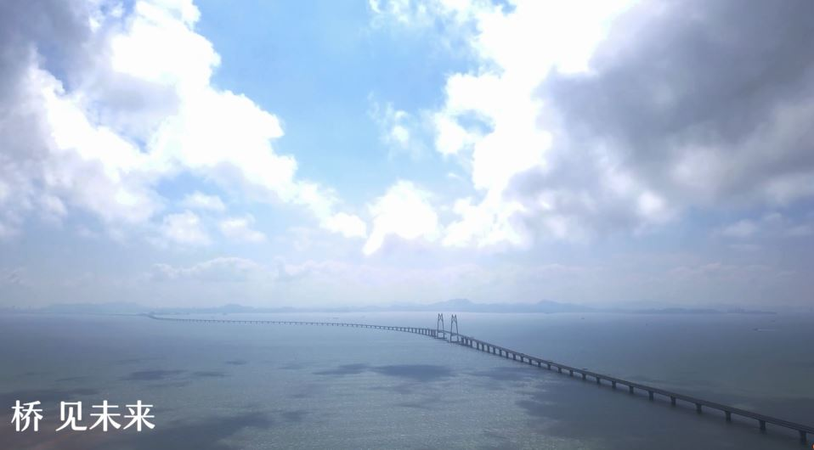
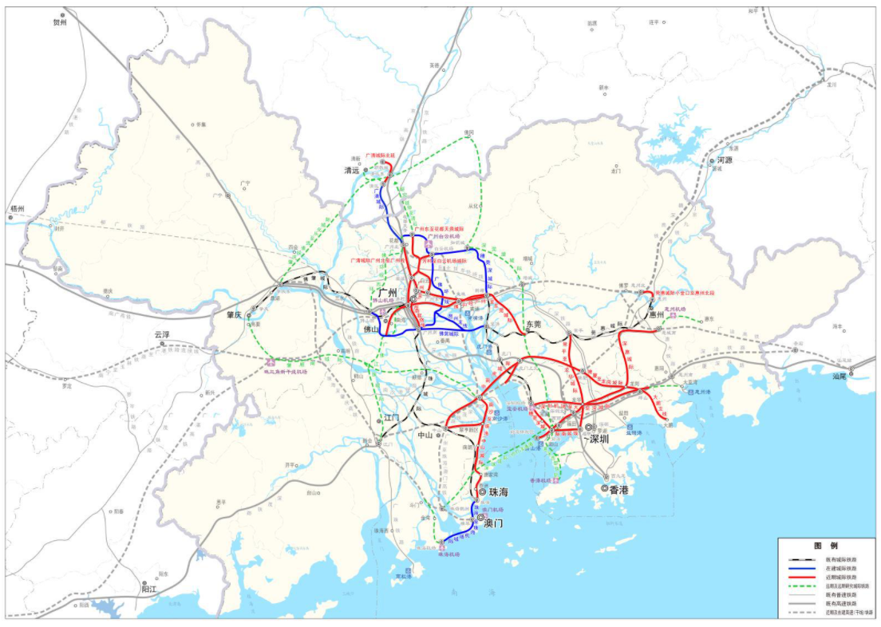



A Convenient and Efficient Multi-modal and Multi-channel Transportation System is Basically Formed
Video: The Greater Bay Area on Track
Video: Hong Kong-Zhuhai-Macao Bridge
Map: Good Accessibility
Source: http://www.cnbayarea.org.cn/
Source: http://www.hzmb.org/
Source:
https://www.ndrc.gov.cn/xxgk/zcfb/tz/202008/P020200804381038186602_r75.jpg
Click on the image to learn more

Slide 41
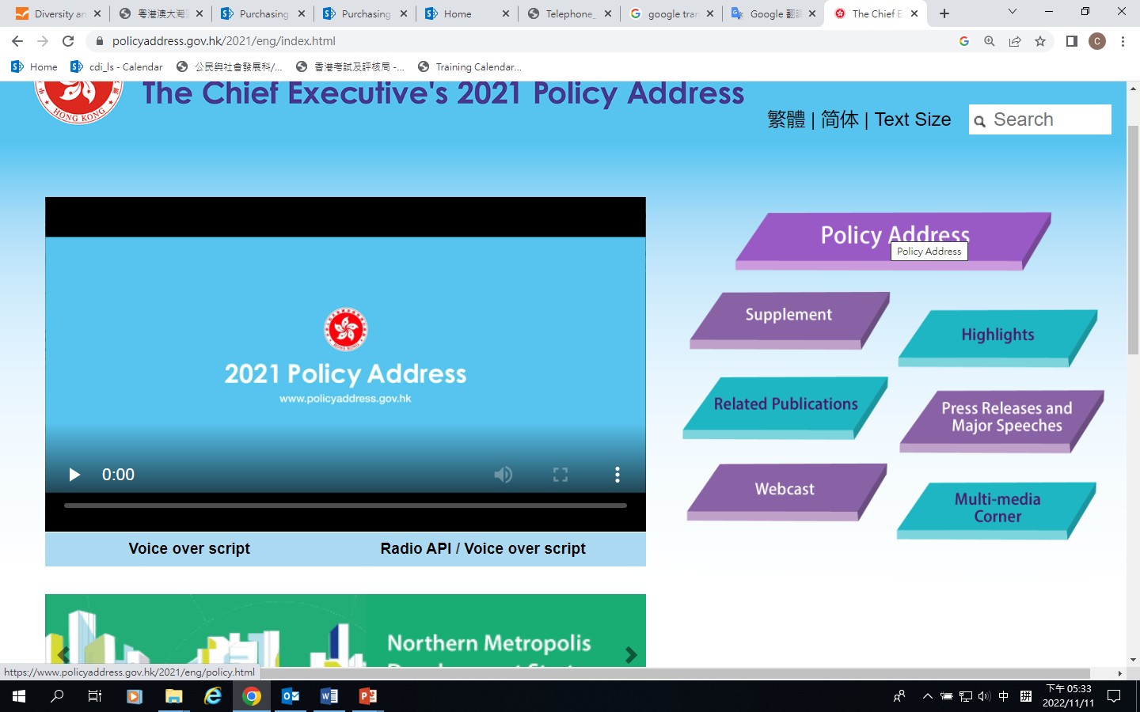
Reference
2021 Policy Address “Smart Port” and “Greater Bay Area on the Rail”
(4) New Impetus to the Economy: Integration into the National Development
Enhancing Hong Kong’s Status as an International Transportation Centre
43. To enhance Hong Kong’s status as an international transportation centre, our port has to maintain its strengths of high efficiency, good connectivity and wide coverage. We will also need to promote wider application of digital technology in business processes and operations by the maritime and port industry for the development of a “Smart Port”. We will explore, in collaboration with the industry, concrete initiatives to drive the development of a “Smart Port”. On logistics, we have to further facilitate the flow of logistics information in the GBA and improvements to intermodal operation. We also need to develop high value‑added logistics and encourage the logistics industry to make wider use of technology to enhance productivity.
Source: 2021 Policy Address
(https://www.policyaddress.gov.hk/2021/eng/policy.html)

Slide 42
Reference
2021 Policy Address “Smart Port” and “Greater Bay Area on the Rail”
(4) New Impetus to the Economy: Integration into the National Development
Enhancing Hong Kong’s Status as an International Transportation Centre
45. In terms of cross‑boundary land transport, three major cross-boundary infrastructure projects, namely the Hong Kong Section of the Guangzhou‑Shenzhen‑Hong Kong Express Rail Link, the Hong Kong-Zhuhai‑Macao Bridge (HZMB) and the Liantang Port/Heung Yuen Wai Boundary Control Point, were completed one after another in the past few years, thereby helping Hong Kong integrate into the “one‑hour living circle” in the GBA and enhancing connectivity of infrastructure in the GBA. The governments of Hong Kong and Shenzhen have established the “Task Force for Hong Kong‑Shenzhen Co‑operation on Cross‑Boundary Railway Infrastructure” to jointly develop the “GBA on the Rail”. Besides, the governments of Guangdong and Hong Kong are pressing ahead with the “Quota‑free Scheme for Hong Kong Private Cars Travelling to Guangdong via the HZMB”. After the epidemic situation is brought under control and the removal of quarantine requirements for cross‑boundary travel is gradually implemented, the Scheme will allow eligible Hong Kong private cars to travel between Hong Kong and Guangdong via the HZMB without the need to obtain a regular quota in advance. The governments of Guangdong and Hong Kong have also agreed to extend the Scheme to cover another land boundary control point in due course.
Source: 2021 Policy Address
(https://www.policyaddress.gov.hk/2021/eng/policy.html)

Slide 43
Building a Globally Competitive Modern Industrial System
Key Examples
Expediting the Development of the Advanced Manufacturing Industry
To actively promote in-depth integration of the internet, big data and artificial intelligence with the real economy, vigorously pursue the transformation, upgrading and optimised development of the manufacturing industry.
(For example: smart home, industrial robot applications)
To give an impetus to the manufacturing industry for branching out from processing and production to R&D, design, branding, marketing, and recycling, etc.
Promoting Emerging Industries
To pursue the development and growth of new pillar industries including new-generation information technology, biotechnology, high-end equipment manufacturing and new materials.
(For example: 5G and mobile Internet, biopharmaceuticals such as protein, genetic testing, high-end medical diagnosis and treatment equipment, 3D printing, new energy vehicles).
Reference: The Outline Development Plan for the Guangdong-Hong Kong-Macao Greater Bay Area
(https://www.bayarea.gov.hk/filemanager/en/share/pdf/Outline_Development_Plan.pdf)

Slide 44
Building a Globally Competitive Modern Industrial System
Key Examples (continued)
Expediting the Development of Modern Service Industry
To develop an international financial hub:
According to the advantages of each region, we will establish financial service platforms in Hong Kong, Guangzhou, Macao and Shenzhen
To progressively promote mutual financial markets access:
To progressively expand the scale and scope of the cross-boundary use of RMB in the Greater Bay Area.
To widen the scope for cross-boundary investment by Hong Kong and Mainland residents and institutions, and steadily expand the channels for Mainland and Hong Kong residents to invest in financial products in each other’s market.
To develop a system of modern service industries:
Focus on: maritime and logistics services, travel services, cultural and creative industries, human resources services, convention and exhibition and other professional services (e.g., accounting and auditing, legal and dispute resolution services, management consultancy, testing and certification, intellectual property rights, construction and related engineering works, etc.)
Reference: The Outline Development Plan for the Guangdong-Hong Kong-Macao Greater Bay Area
(https://www.bayarea.gov.hk/filemanager/en/share/pdf/Outline_Development_Plan.pdf)

Slide 45
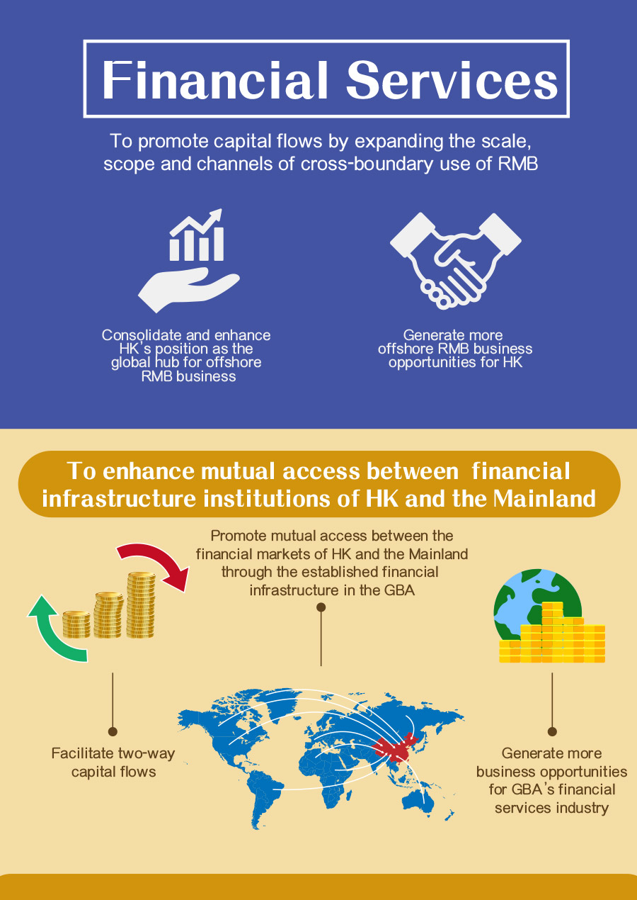
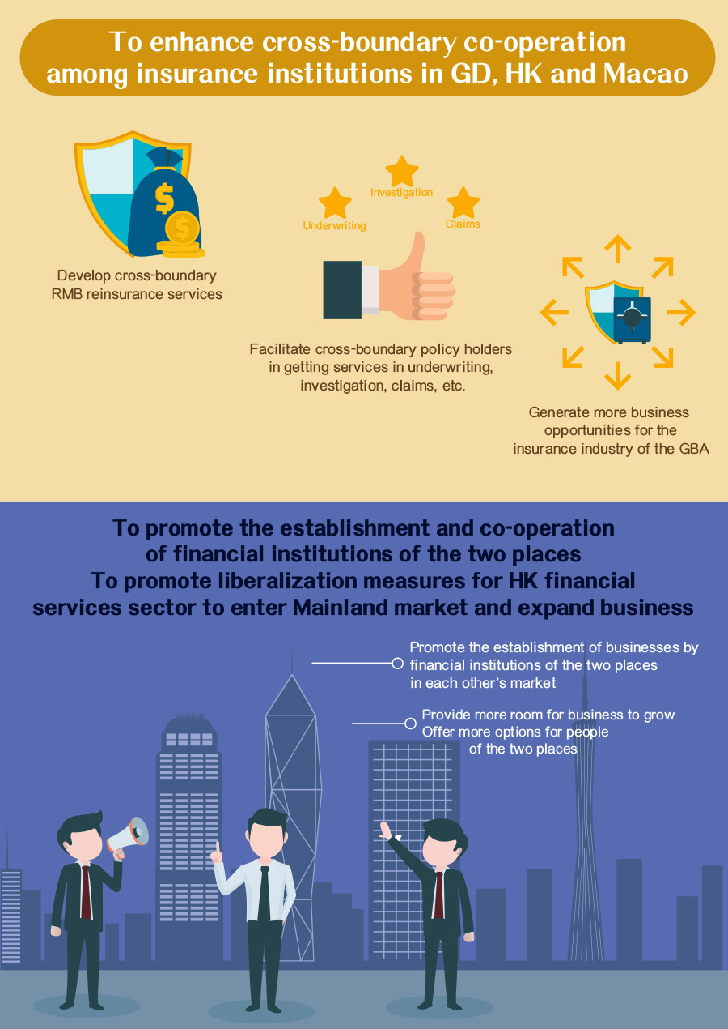
Building a Modern Industrial System with Interconnected Financial Markets
Development focus
Support the consolidation and enhancement of Hong Kong’s status as an international financial center, strengthen its status as a global offshore RMB business hub, and its roles as an international asset management center and a risk management center, and promote the development of high-end and high value-added financial and professional services.
Reference: The Outline Development Plan for the Guangdong-Hong Kong-Macao Greater Bay Area
(https://www.bayarea.gov.hk/filemanager/en/share/pdf/Outline_Development_Plan.pdf)
Source: Website of the Greater Bay Area https://www.bayarea.gov.hk/en/opportunities/mainpoints-finance.html

Slide 46
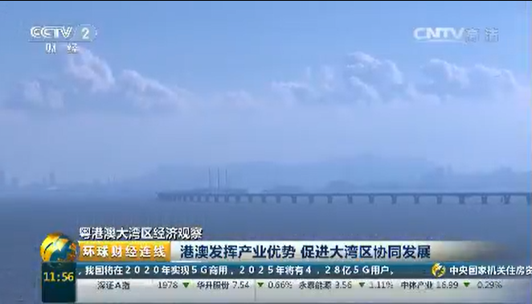
Building a Globally Competitive Modern Industrial System
Make use of the competitive advantages in industry, create an industrial structure with complementary advantages and close cooperation, and accelerate the development to the global high-end level.
Expert’s viewpoint:
Hong Kong and Macao should leverage their industrial advantages to promote the coordinated development of the Greater Bay Area.
Click on the image to watch the video
The source of video: https://tv.cctv.com/2017/06/30/VIDEaEehP311kZ4oJnrGrbXB170630.shtml

Slide 47
Measures taken by our Country to build a quality living circle for living, working and traveling
Hong Kong and Macao Youth Employment and Entrepreneurship Plan
To expand space for youth entrepreneurship in Hong Kong and Macao. To support the launch of the Greater Bay Area Youth Employment Scheme by encouraging enterprises with operations in both Hong Kong and the Greater Bay Area to recruit and deploy local university/ tertiary institution graduates to work in the Mainland cities of the Greater Bay Area. The Scheme will provide 2 000 places, around 700 of which are designated for innovation and technology (I&T) posts.
Enhancing the cultural soft power of the Greater Bay Area and building a Bay Area for leisure
To further enhance residents’ cultural sophistication as well as the degree of social civility, and jointly shape and enrich the substance of a cultured bay area. To promote the development of tourism in the Greater Bay Area leverage its characteristic advantages.
Promoting cooperation and development in education
To support higher education institutions from Guangdong, Hong Kong and Macao in jointly operating education institutions, encourage higher education institutions of the three places to explore cooperation and exchange in the mutual recognition of academic credits of specified courses, the implementation of more flexible arrangements for exchange students, the sharing and conversion of results of scientific research, etc.
Pay attention to ecological conservation
To strengthen the protection of the surrounding mountains, hills and forest ecosystems in the Pearl River Delta, and develop an ecological barrier with a continuous line of forested mountains in the north. To strengthen the environmental protection of marine resources and take forward the “Blue Bay” remediation action plans.
Source: The Outline Development Plan for the Guangdong-Hong Kong-Macao Greater Bay Area (https://www.bayarea.gov.hk/filemanager/en/share/pdf/Outline_Development_Plan.pdf)

Slide 48
Activity
Developing a quality Living Circle for Living, Working and Travelling
Please share: as a young Hong Kong resident, if you choose to study, work and live in the Mainland, what are your considerations?
Considerations may include:
For example, mutual recognition of academic qualifications, the nature of cooperative education between higher education institutions in the Greater Bay Area and higher education institutions in Hong Kong, and mutual recognition of vocational qualifications, etc.
Concessionary policies related to employment and entrepreneurship, such as personal income tax, subsidies, etc.
In terms of living conditions, such as property purchase qualifications, convenient access between the Mainland and Hong Kong and Macao, etc.
Q: Can candidates for the Hong Kong Diploma of Secondary Education Examination
apply for the Mainland universities?

Slide 49
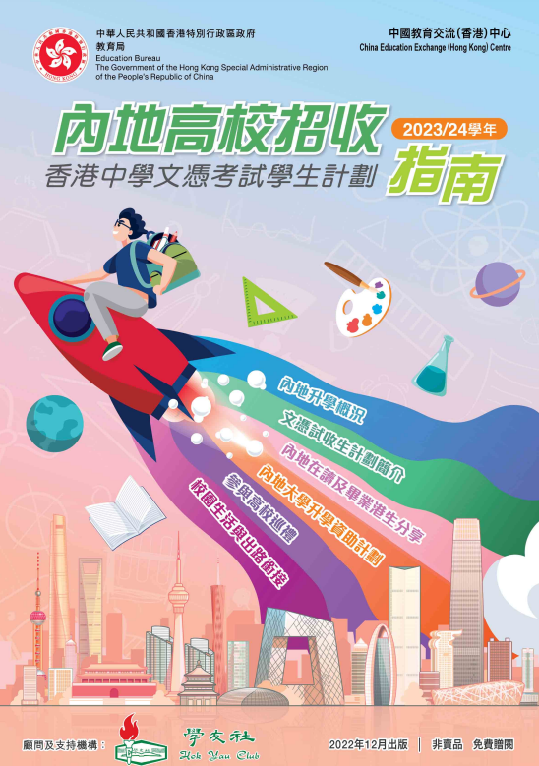

Developing a quality Living Circle for Living, Working and Travelling
Reference
Handbook on the Scheme for Admission of Hong Kong Students to Mainland Higher Education Institutions (2023/24)
Since the 2012/13 school year, the Ministry of Education of the People’s Republic of China has launched the “Scheme for Admission of Hong Kong Students to Mainland Higher Education Institutions” to provide Hong Kong high school graduates with multiple study pathways and opportunities to connect with the country’s development. Participating Mainland institutions of higher education can select Hong Kong students for admission based on their Hong Kong Diploma of Secondary Education Examination results, thus exempting students from taking the Joint Entrance Examination for Mainland institutions or additional examinations held by individual Mainland institutions of higher education.
For the list of Mainland universities participating in the HKDSE Student Recruitment Scheme for the 2023/24 academic year and for more details, please visit the Education Bureau’s website:
https://www.edb.gov.hk/en/edu-system/postsecondary/policy-doc/pilot-scheme.html
Click on the image for details

Slide 50
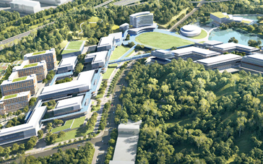
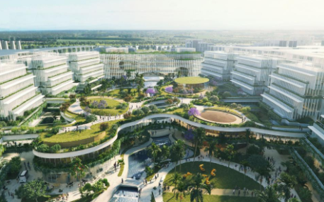
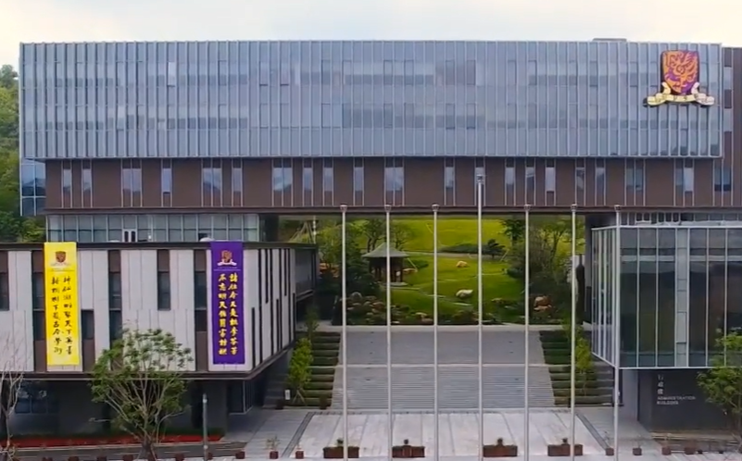
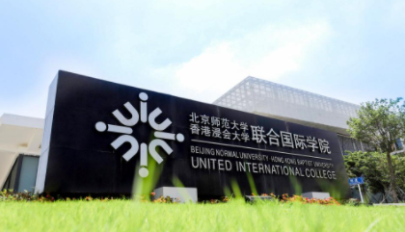
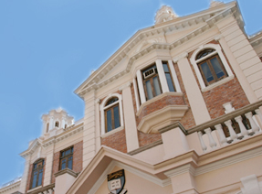





Reference
Examples of Hong Kong universities
establishing branch campuses in the Greater Bay Area
HKUST (Guangzhou)
City University of Hong Kong signed a cooperation agreement with the Dongguan Municipal People’s Government and Dongguan Institute of Technology in early 2020, intending to jointly apply for the establishment of a cooperative education institution with independent legal personality in Songshan Lake City University of Hong Kong (Dongguan). City University of Hong Kong (Dongguan) plans to officially open in September 2023.
In 2018, Hong Kong University of Science and Technology, Guangzhou Municipal People’s Government and Guangzhou University signed a tripartite agreement. According to the agreement, HKUST received the full support of the local authority and partners to jointly prepare for the establishment of HKUST (Guangzhou) in Nansha District, Guangzhou.
The Chinese University of Hong Kong, Shenzhen (CUHK-Shenzhen) is an institution approved by the Ministry of Education and established in accordance with the regulations on Chinese-foreign Cooperative in Running Schools. Taking the responsibility of being a first-class research university based in China and facing the world, it is committed to cultivating innovative talents with a global perspective, Chinese tradition and social responsibility.
Located in Zhuhai, a livable city in the Greater Bay Area, Beijing Normal University-Hong Kong Baptist University Joint International College is the first university jointly established by the higher education sector of the Mainland and Hong Kong.
On September 6, 2021, the Shenzhen Municipal Government and the University of Hong Kong signed a memorandum on cooperation in running schools in Shenzhen. They will cooperate in the establishment of the University of Hong Kong (Shenzhen) (tentative name) in Shenzhen.
https://www.uic.edu.cn/en/about_us/overview/introducing.htm
http://www.gd.gov.cn/gdywdt/dsdt/content/post_3509193.html
https://hkust-gz.edu.cn/
http://www.gaoxiaojob.com/zhaopin/zhuanti/xgcsdx2021/index.html
https://www.cuhk.edu.cn/en
Some information may have been updated when teachers use it. Teachers can browse the website for the latest information.

Slide 51
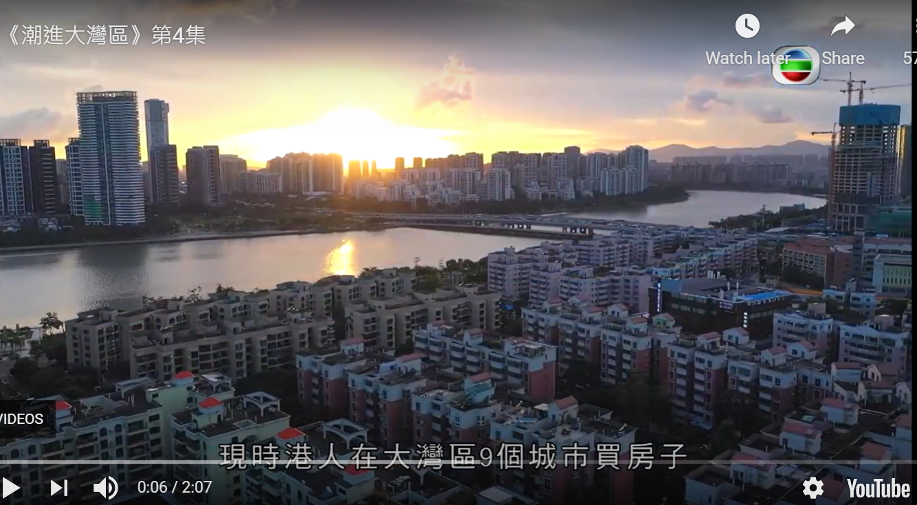
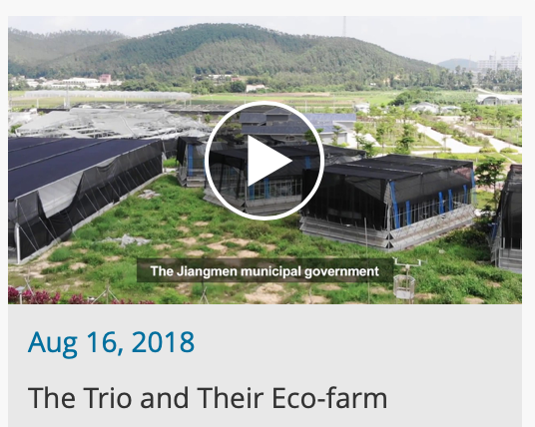

Developing a quality Living Circle for Living, Working and Travelling
Watch the videos below to learn more about Hong Kong people living in the Greater Bay Area in terms of living, property ownership, entrepreneurship, etc.
Video 1
Video 2
《潮進大灣區》第四集
《看見大灣 • 那些人那些事》系列
90後的魚菜共生夢
The source of video 1 and video 2: Website of the Greater Bay Area https://www.bayarea.gov.hk/en/stories/videos.html
For more information, please visit the link below to watch the sharing session on youth in the Greater Bay Area.
National “14th Five-Year Plan” Seminar: Vitality and Opportunities to Build a Beautiful Bay Area Youth Sharing Session
Source: Radio Television Hong Kong
(https://app7.rthk.hk/elearning/gba/related_forum.php)

Slide 52

Measures to develop a quality living circle in the Greater Bay Area
On 6 November, 2019, the central government promulgated 16 policies measures which would benefit Hong Kong people and facilitate the development of various sectors in the Greater Bay Area, including the following:
Benefiting the general public
Hong Kong residents to be treated as local residents in buying properties in the Mainland cities of the Greater Bay Area
To support Hong Kong residents in the convenient use of mobile electronic payment in the Mainland
Pilot scheme for Hong Kong residents to open Mainland personal bank accounts in the Greater Bay Area remotely by attestation
To ensure that children of Hong Kong and Macao residents working in Guangdong enjoy the same educational arrangements as children of Mainland residents
To explore the establishment of a cross-border wealth management mechanism
Foreigners holding Hong Kong Permanent Identity Cards to be able to apply to the relevant Mainland authorities for a visa or permission for residence with a validity of up to two to five years to stay or reside in Mainland cities in the Greater Bay Area. (Go to the following page to learn more)
Source: Website of the Greater Bay Area https://www.bayarea.gov.hk/en/facilitation/measures.html

Slide 53

Measures to develop a quality living circle in the Greater Bay Area
On 1 March, 2019, the central government promulgated 8 policies measures to promote the development of the Greater Bay Area, which will facilitate Hong Kong residents to develop, work and live in the Mainland cities of the Greater Bay Area, and enhance the convenience flow of people and goods within the Greater Bay Area.
Examples:
The calculation method of “183 days” for paying individual income tax payment in the Mainland: if the day of stay in the Mainland is less than 24 hours, it is not counted as a day of residence in the Mainland.
Providing tax relief by municipal governments to non-Mainland (including Hong Kong) high-end talents and talents in short supply by offsetting the tax differential between the two places; the actual individual income tax rate is 15% with effective from 1 January 2019 and on trial for one year.
Supporting public institutions in the Greater Bay Area to openly recruit Hong Kong and Macao residents.
Encourage young people from Hong Kong and Macao for innovation and entrepreneurship in nine Mainland cities in the Greater Bay Area, etc. (Go to the following page to learn more)
Source: Website of the Greater Bay Area https://www.bayarea.gov.hk/en/facilitation/measures.html

Slide 54

Measures to develop a quality living circle in the Greater Bay Area
Hong Kong residents living in the Mainland who meet the relevant criteria can apply for residence permits. A residence permit holder is entitled to enjoy, in accordance with the law, three categories of rights, six basic public services and nine facilitation measures in the place where he or she is residing. This covers areas relating to daily living including employment, education, medical care, travel, financial services, etc.
The People's Government of Shenzhen Municipality announced on 21 August 2019 the expansion in the scope of facilitation measures for senior citizens who have reached the age of 60. Hong Kong and Macao residents living in Shenzhen who are holders of residence permit are also eligible. Shenzhen is the sixth Greater Bay Area mainland city after Dongguan, Huizhou, Zhuhai, Foshan and Jiangmen to offer free public transports to Hong Kong senior citizens. (Go to the following page to learn more)
Source: Website of the Greater Bay Area
https://www.bayarea.gov.hk/en/facilitation/measures.html

Slide 55


Reference
Measures to develop a quality living circle in the Greater Bay Area
With the acceleration of the development of the Greater Bay Area, exchanges and interactions among residents in the Greater Bay Area have become increasingly close, and the enhancement of cross-border medical service guarantee capabilities has become an important part of the coordinated development process of the Greater Bay Area.
In 2021, Shenzhen has formally reviewed and approved the “Several Measures on Accelerating the Cross-border Connection of Medical Services”, covering all aspects of health care sector integration. In the foreseeable future, high-quality medical resources in the Greater Bay Area will be more inclusive, Hong Kong and Macao residents will be more convenient to seek medical treatment in Shenzhen, the medical system will be connected more smoothly, and the blueprint of “Healthy Bay Area” can be painted together.
Source: People’s Daily Online (http://sz.people.com.cn/BIG5/n2/2021/0314/c202846-34619829.html)
Source：Liaison Office of the Central People’s Government in the Hong Kong SAR
(http://www.locpg.gov.cn/jsdt/2021-03/01/c_1211046133.htm)

Slide 56
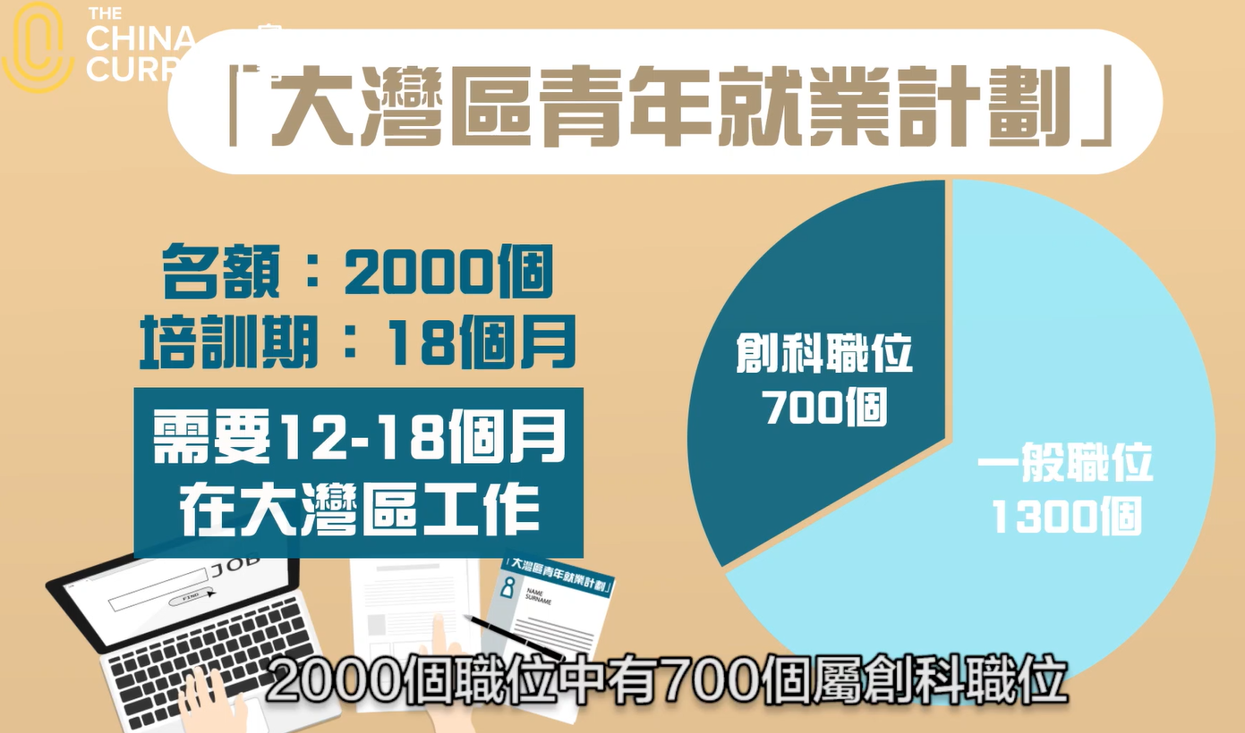
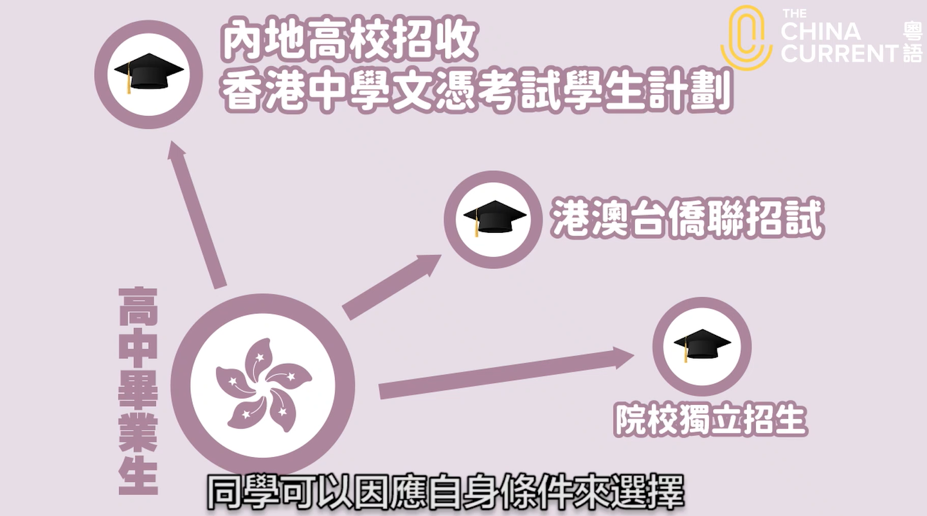
Developing a quality Living Circle for Living, Working and Travelling
Reference
The Hong Kong government has launched the “Greater Bay Area Youth Employment Scheme” to create employment opportunities for university graduates and help them gain work experience, as well as provide opportunities for graduates to experience the latest developments in the Mainland and broaden their horizons.
There is no age limit for graduates participating in the scheme, as long as they are Hong Kong residents who can be legally employed in Hong Kong and hold a bachelor’s degree or above from a university or tertiary institution in Hong Kong or outside Hong Kong between 2019 and 2021.
Youth development is no longer limited to one place or one city. DSE candidates who intend to enter tertiary institutions in the Mainland can apply mainly in three ways, including the “Scheme for Admission of Hong Kong Students to Mainland Higher Education Institutions”, National Education Exams Authority, People’s Republic of China Joint Entrance Exam for Universities in PRC (JEE, PRC) and Independent Enrolment of Colleges and Universities. Students can choose according to their own conditions.
Click on the images above to watch the videos
Source:
Source: The China Current (https://chinacurrent.com/hk/story/21187/greater-bay-area-youth-employment-scheme-education-pathways)

Slide 57

Reference
Developing a quality Living Circle for Living, Working and Travelling
Two years after the publication of the Outline Development Plan for the Guangdong-Hong Kong-Macao Greater Bay Area, Nansha has organically linked the construction of the Pilot Free Trade Zone with the Development of the Greater Bay Area, and created China’s first platform for alignment of rules between Guangdong, Hong Kong and Macao, and established a mechanism for regular contact and research visit between Nansha, Hong Kong and Macao, to promote constant and in-depth exchanges between the governments, industries and think tanks of Guangdong, Hong Kong and Macao.
Source: Nansha District People’s Government
(http://nansha.guangdong.chinadaily.com.cn ）
“Chuanghui Valley” Guangdong-Hong Kong-Macao Youth Cultural and Creative Community
“Chuang Hui Gu” (Hub of Creativity, Innovation and Entrepreneurship - Cultural and Creative Community for Youth People in Guangdong, Hong Kong and Macao)
Under the guidance of the national development of free trade zones, and based on Start-Up Incubation Bases for Youths in Nansha New District of Guangzhou, “Chuang Hui Gu” consists of four functional areas, namely Start-Up Incubation Bases for Youths, youth entrepreneurship academy, youth creative workshops, and Talent Apartment for Young Innovative Talents. With a usable area of 20,000 square meters, the community can accommodate 100 entrepreneurial teams at the same time.
Source: Website of the Greater Bay Area Sci-Tech Collaborative Innovation Alliance (https://www.cgbast.org.cn/portal/park/1252098070682931202.html)

Slide 58
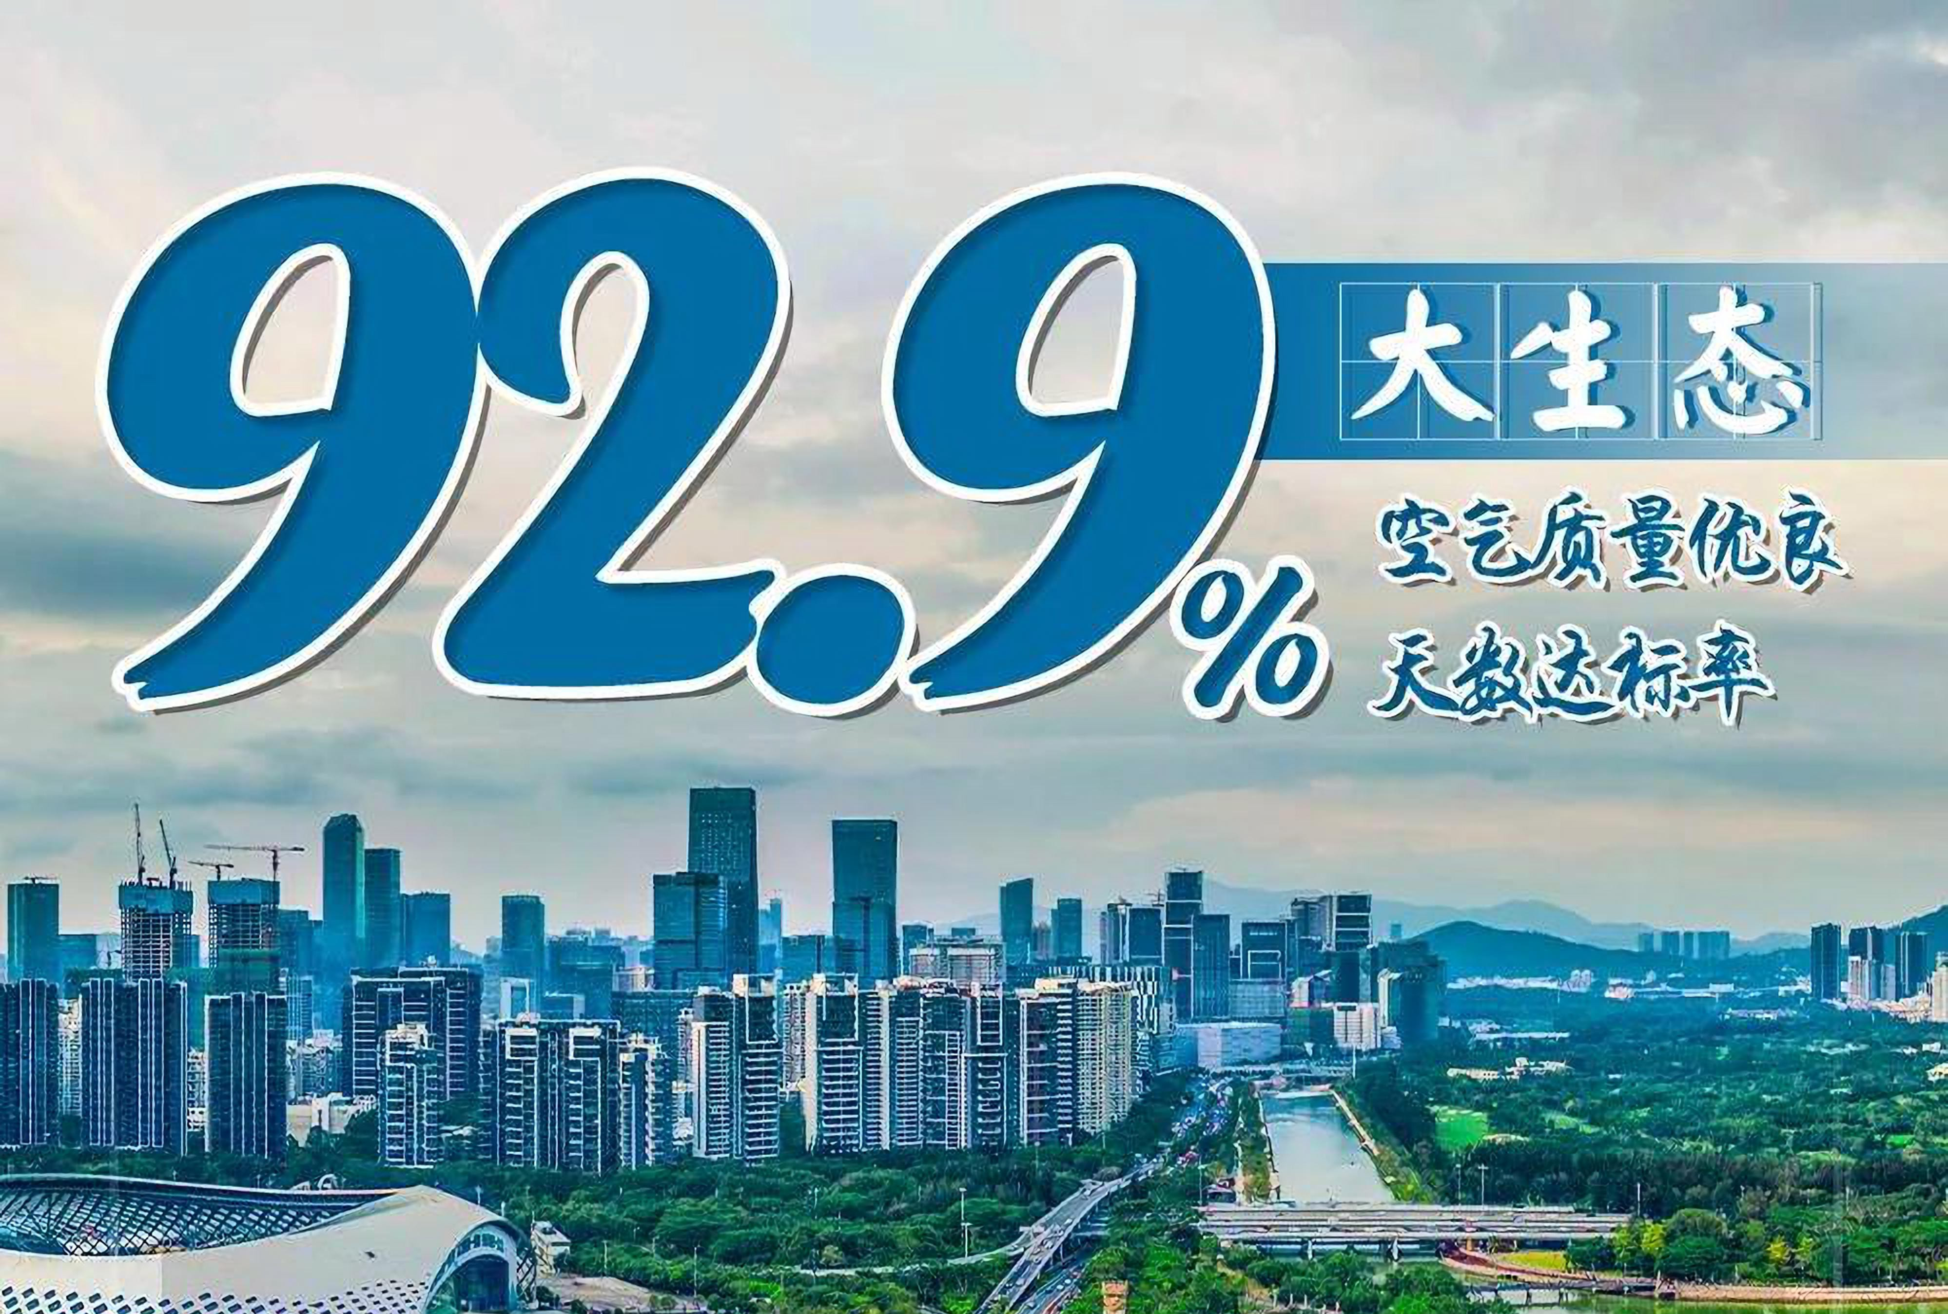
Reference
Developing a quality Living Circle for Living, Working and Travelling
Ecology (good air quality, 92.9% of days in a year meet the standard)
Pay attention to ecological conservation
In 2020, the number of days with good air quality in 9 cities in the Greater Bay Area reached the standard rate of 92.9%, and the annual average PM2.5 concentrations were 22 μg/m³, which has reached the WHO’s second-stage target (25 μg/m³).
The forest coverage rate in the Pearl River Delta region has reached 51.73%, and all 9 cities have been awarded the title of “National Forest City”, and the country’s first national forest city cluster has been established.
Click on the image above to enter the webpage and learn more
Source: Website of the Hong Kong and Macao Affairs Office, the People’s Government of Guangdong Province
http://hmo.gd.gov.cn/ygahz/content/post_3244050.html

Slide 59



Future development prospects of the Greater Bay Area
Policy Advantages of the Greater Bay Area
The Greater Bay Area carries a number of important national development strategies. It is not only a gateway to opening up to the outside world, but also an important node of the “Belt and Road” initiative, and it is also a pilot for our country’s free trade zones.
The Outline Development Plan for the Greater Bay Area is a programmatic document that guides the current and future cooperation and development of the Greater Bay Area, with a near term to 2022 and a long-term outlook to 2035.
The Outline of the 14th Five-Year Plan for National Economic and Social Development and Vision 2035 of the People’s Republic of China proposes to deepen and expand the interconnection of financial markets between the Mainland and Hong Kong, strengthen exchanges and cooperations between the Mainland and Hong Kong in various fields, and for the first time the Shenzhen-Hong Kong Loop has been included in the development of a major cooperation platforms among Guangdong, Hong Kong and Macao.
Click on the image below and enter the webpage to learn more
https://www.ndrc.gov.cn/fzggw/wld/hlf/lddt/202106/t20210601_1282402.html?code=&state=123
http://sw.gz.gov.cn/ztzl/tzgz/zxzx/content/post_2433576.html
http://cppcc.china.com.cn/2019-02/20/content_74483286.htm

Slide 60
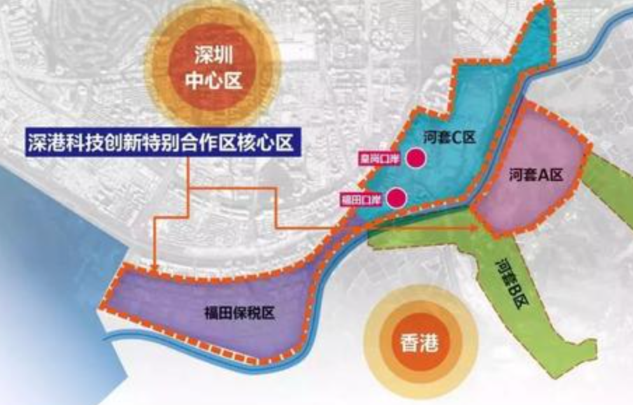
Reference
Shenzhen-Hong Kong Loop
The Hong Kong-Shenzhen Innovation and Technology Park is jointly developed by the Hong Kong SAR Government and the Shenzhen Municipal People’s Government at the 87-hectare Lok Ma Chau Loop. It is the largest innovation and technology platform in Hong Kong’s history.
The Central Government also supports the development of the “Shenzhen-Hong Kong Innovation and Technology Cooperation Zone” from the “Hong Kong-Shenzhen Innovation and Technology Park” located in the Lok Ma Chau Loop and the “Shenzhen Science and Technology Innovation Zone” adjacent to the Loop on the north side of Shenzhen River, formulating supporting policies for the flow of people, capital, goods, and information, etc..
Source: Website of the Greater Bay Area
(https://www.bayarea.gov.hk/en/opportunities/it.html)
Shenzhen CBD
Shenzhen-Hong Kong Innovation and Technology Co-operation Zone
Huanggang Port
Futian Port
Image source: Wen Wei Po
(http://news.wenweipo.com/2019/05/07/IN1905070041.htm)

Slide 61
Institutional Advantages of the Greater Bay Area
The Greater Bay Area is currently a multi-institutional structure of “one country, two systems and three customs zones”.
“One Country” and “Two Systems” are the dual advantages of the Greater Bay Area, which fully reflects the support of China.
economic system
Guangdong
financial system
One Country, Two Systems
Hong Kong
Three independent market systems
currency issuance
development plan
Macao
Independent customs area

Slide 62

Regional Advantages of the Greater Bay Area
The Greater Bay Area has the following advantages:
-It is the shipping route of the Pacific and Indian Oceans.
-It is an important transportation hub in Southeast Asia and even the world.
-It is the intersection of the Silk Road Economic Belt and the 21st Century Maritime Silk Road. (Note)
-It is the economically developed area with the closest distance between our country and countries along the Maritime Silk Road.
The Greater Bay Area has advantageous geographical conditions, with a long coastline, good port clusters and vast sea areas. The Pan-Pearl River Delta region has about one-fifth of national land area, one-third of national population and one-third of national economic output.
Facing the South China Sea, the Greater Bay Area is the closest economically developed area to the South China Sea and is the bridgehead for China to develop the South China Sea.
Note: The Belt and Road Initiative
References: Ministry of Commerce of the People’s Republic of China
Vision and Actions on Jointly Building Silk Road Economic Belt and 21st-Century Maritime Silk Road
(http://zhs.mofcom.gov.cn/article/xxfb/201503/20150300926644.shtml)

Slide 63
Industrial Advantages of the Greater Bay Area
The nine municipalities in the Greater Bay Area have relatively complete industrial systems and solid manufacturing foundations.
The industrial structure of the Greater Bay Area is dominated by advanced manufacturing and modern service industries. It is upgrading to advanced manufacturing industry, and has formed an industrial system driven by advanced manufacturing and modern service industry.
The Greater Bay Area has a well-developed shipping industry, with the world’s busiest ports and airports, passenger and cargo volume rank among the top in the world. It is our country’s important gateway to the world.
Hong Kong and Macao are dominated by modern service industries, with developed industries such as finance, health care, tourism, trade, logistics, legal, etc.

Slide 64
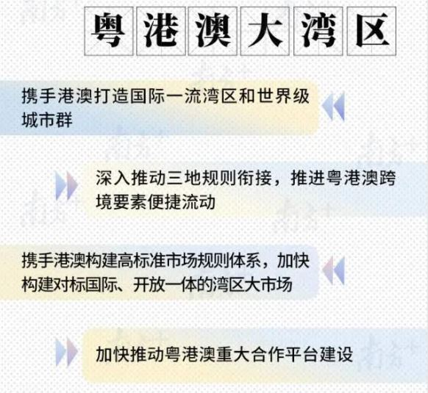




Development Opportunities in the Greater Bay Area
Greater Bay Area
Shenzhen Pilot Demonstration Zone
In the Outline of the 14th Five-Year Plan for National Economic and Social Development and Vision 2035 of the Guangdong Province released on 25 April, 2021, the main development line of “dual-region driven” was confirmed.
Source: Website of the People’s Government of Guangdong Province
http://www.gd.gov.cn/zwgk/wjk/qbwj/yf/content/post_3268751.html
Go to the website of the Office of the Leading Group on Construction of Guangdong-Hong Kong-Macao Greater Bay Area of Guangdong Province to learn how different people perceive the opportunities in the Greater Bay Area.

Slide 65
Reference
Opportunities in the Greater Bay Area--Integration of the Three Regions
To promote the mutual integration of the Greater Bay Area in talent training, mutual recognition of qualifications, and standard setting. There are 15 joint venture law firms from the Mainland, Hong Kong and Macao, and 97 Hong Kong and Macao lawyers practice in the joint venture; more than 1,600 Hong Kong professionals have obtained the qualifications registered in the mainland through mutual recognition.
On 31 July, 2021, the Ministry of Justice of the People’s Republic of China established the Greater Bay Area Legal Professional Examination, which actively responded to the opinions and expectations of the Hong Kong legal community and provided a broad platform for the industry to develop in the Mainland.
Source：
People’s Daily Online (http://hm.people.com.cn/n1/2021/0521/c42272-32109449.html)
Website of the news.gov.hk （https://www.news.gov.hk/eng/2021/07/20210731/20210731_170326_276.html）

Slide 66


Hong Kong’s advantages in the development of the Greater Bay Area
Hong Kong has many advantages to play a unique role in the Greater Bay Area
Hong Kong is closely connected with Guangdong, occupying a “geographical advantage”.
The cultures of Guangdong and Hong Kong are similar, and it is easy to enhance mutual understanding.
Hong Kong has top tertiary institutions, outstanding scientific research achievements, a sound intellectual property protection system, and advanced financial infrastructure. It is an international business hub, with free flow of information and a thriving business environment.
Hong Kong attaches great importance to biliteracy and trilingualism, and English is the international business language of Hong Kong. Hong Kong brings together companies with expertise in different fields, as well as people with business knowledge and skills.
Liantang/Heung Yuen Wai Port officially opened in the Greater Bay Area with a new logistics channel

Slide 67



Hong Kong’s advantages in the development of the Greater Bay Area
Hong Kong’s legal system is well positioned to play a unique role in the Greater Bay Area
The Basic Law is the constitutional document of the Hong Kong SAR of China. Under “One Country, Two Systems”, the SAR exercises a high degree of autonomy in accordance with the law. Hong Kong is the only jurisdiction in the country that implements common law, and the Hong Kong SAR enjoys independent judicial power, including that of final adjudication, and retains strong rule of law protections and a sound legal system. Hong Kong has also been at the top of international rankings related to the rule of law and judicial independence since its return to the motherland.
Hong Kong’s freedom of contracts and its well-established legal infrastructure have attracted overseas and the Mainland companies to set up and develop businesses in Hong Kong. As the leading centre for international legal and dispute resolution service in the Asia-Pacific region, Hong Kong is an ideal location for conducting transactions and resolving disputes in the region.
Source: https://www.brandhk.gov.hk/en/home/investors-or-entrepreneurs

Slide 68


As an international financial center, it is a super-connector between China and foreign countries
Opportunities and roles of Hong Kong in the development of the Greater Bay Area
The development of the Greater Bay Area not only requires the participation of a large number of foreign investments, but also encourages enterprises in the Greater Bay Area to “go global” and participate in international competition by means of foreign investment. As a super-connector between China and foreign countries, Hong Kong is innately equipped to serve the two strategies of “going global” and “attracting foreign investment” in the Greater Bay Area.
Case: Alibaba chooses to list in Hong Kong
The advantage of listing in Hong Kong is firstly to raise funds to expand business, and secondly, Alibaba’s business sources are mainly in Greater China. Listing in Hong Kong can increase Alibaba’s influence in Greater China and is conducive to future business development.
Source: https://news.rthk.hk/rthk/en/component/k2/1659344-20220726.htm

Slide 69

Opportunities and roles of Hong Kong in the development of the Greater Bay Area
As an international financial center, it is a super-connector between China and foreign countries
Hong Kong’s business network spans many countries and regions. Supply chain management linking the Greater Bay Area with other regions should be able to provide a comprehensive range of services, including production processes, equipment, logistics and environmental protection services.
Source:
If enterprises in the Greater Bay Area want to take Hong Kong as a bridge to “go global”, they can also use Hong Kong’s legal counsel services to obtain more diversified advice and services.
By the end of 2020, Hong Kong’s stock market was the third largest in Asia and fifth largest globally in terms of market capitalization.
Hong Kong is an important banking and financial center in the Asia-Pacific region.
Hong Kong is also one of the world’s busiest container ports.
Click on the image above to learn more
Source:
Legco Secretariat Information Research Unit (https://www.legco.gov.hk/research-publications/chinese/1718fs04-guangdong-hong-kong-macao-bay-area-opportunities-and-challenges-for-hong-kong-20180223-c.pdf)
The Hong Kong Trade Development Council (https://research.hktdc.com/en/article/MzIwNjkzNTY5)

Slide 70


Opportunities and roles of Hong Kong in the development of the Greater Bay Area
Financial Services
Hong Kong is the world’s largest and most important offshore RMB business hub, providing a wide range of RMB financial services, including clearing, settlement, financing, asset management and risk management.
Hong Kong is the world’s leading IPO centre and, as of the end of 2019, the second largest private equity market in Asia.
Source
Click on the image above to learn more
Robust regulatory environment
Facilitating financial services
Promoting financial services
Premier Offshore RMB Business Hub
Asset and Wealth Management
Source:
The Hong Kong Trade Development Council (https://research.hktdc.com/en/article/MzEzOTI4MDY3)
Hong Kong Monetary Authority https://www.hkma.gov.hk/eng/key-functions/international-financial-centre/hong-kong-as-an-international-financial-centre/dominant-gateway-to-china/

Slide 71

Opportunities and roles of Hong Kong in the development of the Greater Bay Area
Professional service
Hong Kong must make full use of its advantages, such as maritime legal services, ship financing, marine insurance, etc., and seize the opportunities brought about by the country’s “Belt and Road Initiative” and the development of the Greater Bay Area, in order to continue to enhance Hong Kong’s status.
Hong Kong provides a very comprehensive range of maritime services, including arbitration and dispute resolution services. We have arbitrators and lawyers from different professional backgrounds and jurisdictions. Many of them are proficient in both Chinese and English. They understand both Western culture and Mainland conditions. With professional maritime knowledge, we provide high-end maritime legal and arbitration services for shipowners, charterers and cargo owners in various fields, such as ship financing, shipbroking, and maritime insurance.
Click on the image above to learn more
Source: Website of the news.gov.hk (https://www.news.gov.hk/eng/2020/10/20201031/20201031_103642_696.html)

Slide 72


Opportunities and roles of Hong Kong in the development of the Greater Bay Area
Legal service
Hong Kong is one of the most popular arbitration centres for international business people in Asia, ranking only after London and Paris globally. For Mainland enterprises in the Greater Bay Area, Hong Kong is the most suitable venue for handling disputes or conflicts involving foreign enterprises, mainly because Hong Kong has a good reputation in the world along with international arbitration centres such as London and Singapore.
Hong Kong should capitalise on this professional advantage, in the process of the development of the Greater Bay Area and the development of the “Belt and Road” initiative, to strengthen its publicity in international arbitration and dispute resolution services, and attract more enterprises to choose to use dispute resolution services in Hong Kong.
Source:
Source: The Hong Kong Trade Development Council https://research.hktdc.com/en/article/NTgxNzEzMjk1

Slide 73





Extended reference materials on the Greater Bay Area
Stories about young people chasing their dreams in the Greater Bay Area and the Mainland. Different young people share their feelings and gains from the development of the country.
The Greater Bay Area and different urban landscapes.
Introduction of the current situation, performances and latest information of Cantonese opera artists in the three places.
Episodic real-life documentaries of 10 people with special backgrounds, introducing living, work, study, entertainment, food and drink in the Greater Bay Area.
Click on the image above to learn more

Slide 74


Relationship between the Mainland and Hong Kong Closer Economic Partnership Arrangement (CEPA) and the promotion of Hong Kong’s development
Video: Trade and Industry Department introducing CEPA
Watch the video and answer the following questions:
1. What is CEPA?
2. What does CEPA cover?
3. What positive effects do the respondents in the video think CEPA has on the development of the Mainland and Hong Kong?
Click on the image above to watch the video
Source: Trade and Industry Department
(https://www.tid.gov.hk/english/cepa/webcast/cepa_202209.html)
C-
Closer
E-
Economic
A-
Arrangement
P-
Partnership
CEPA: Mainland and Hong Kong Closer Economic Partnership Arrangement. The goal is to promote freer and smoother trade between the Mainland, Hong Kong and Macao, cancel tariffs and non-tariff measures on trade in goods, and gradually eliminate various restrictions on trade in services, to facilitate trade and investment and improve the level of economic and trade cooperations.
Source: China Government Network (http://big5.www.gov.cn/gate/big5/www.gov.cn/test/2005-06/24/content_9318.htm)

Slide 75

Reference
On 29 June, 2003, the Ministry of Commerce of the People’s Republic of China, on behalf of the Central Government, signed the Mainland and Hong Kong Closer Economic Partnership Arrangement with the Hong Kong Special Administrative Region.
According to Article 19 of CEPA, the Mainland and Hong Kong have established a “Joint Steering Committee”, to amend relevant laws and regulations, promote the liberalization of trade in goods between the Mainland and Hong Kong, and expand the opening-up of trade in services to Hong Kong and Macao.
Mainland and Hong Kong signed CEPA cooperation agreement

Slide 76
Background of CEPA
a. Addressing regional economic cooperation challenges
In the 21st century, faced with increasing uncertainties in the world economy, the process of regional economic integration has been accelerating. Many countries and regional organisations have signed regional trade agreements, which have become an important means for countries and regions to expand foreign economic and trade cooperation and promote economic development.
Since China’s reform and opening up, Hong Kong has always been the Mainland’s most important trading partner, a key conduit of foreign investment and destination of outbound investment. On the basis of the existing close economic and trade relations between the Mainland and Hong Kong, for further development, it is necessary to innovate the cooperation mechanism and methods.
——Vice Minister of Commerce Q&A on the third anniversary of the signing of the “Arrangement” between the Mainland, Hong Kong and Macao, on June 26, 2006
Source: Website of Ministry of Commerce http://www.gov.cn/zwhd/2006-06/26/content_319846.htm

Slide 77
Background of CEPA
b. Strengthening economic and trade cooperation between the Mainland and Hong Kong-Macao
To promote the gradual elimination of trade barriers between the two places, and promote the free flow of economic factors and integration of economy.
c. Promoting the deepening of reform and opening up in the Mainland
More and faster entry of Hong Kong enterprises into the Mainland will promote the development of mainland industries, enhance the competitiveness of mainland service industries, and accumulate experience for expanding opening up.
d. Promoting healthy economic development of Hong Kong
In order to get rid of the economic difficulties caused by the impact of the Asian financial crisis, the Hong Kong SAR government proposed the policy of “backed by the Mainland and engaged globally”, hoping to combine the advantages of Hong Kong’s international financial, trade and shipping centers with the resources and market advantages of the Mainland and realize the common development of economy in the two places.
Source: Department of Taiwan, Hong Kong and Macao, Ministry of Commerce of the People’s Republic of China
(http://tga.mofcom.gov.cn/article/zt_cepa/subjectii/200606/20060602454588.shtml )

Slide 78

Reference
CEPA is Open
CEPA is an open and evolving free trade agreement.
With regard to trade facilitation, three dedicated chapters have been added: “Customs Procedures and Trade Facilitation”, “Sanitary and Phytosanitary Measures” and “Technical Barriers to Trade”, which set out the commitments of the two sides in facilitating trade between the two places, simplifying customs procedures, enhancing transparency of relevant measures and strengthening cooperation, etc. in the relevant areas.
There is a dedicated chapter on “Trade Facilitation Measures Guangdong-Hong Kong-Macao Greater Bay Area”, which agrees to implement trade facilitation measures between the 9 Pearl River Delta municipalities and Hong Kong to promote the convenient and efficient flow of production factors in the Greater Bay Area.
For details and development, please refer to the Trade and Industry Department of the Hong Kong SAR:
Source: Trade and Industry Department
(https://www.tid.gov.hk/english/cepa/press/files/CEPA_leaflet.pdf)

Slide 79


The Main Content of CEPA
Trade in goods: Trade in goods has been fully liberalized. All Hong Kong products that comply with the CEPA rules of origin can enjoy zero-tariff treatment upon importation into the Mainland.
Trade in services: The Mainland and Hong Kong have basically achieved the liberalization of trade in services. Enterprises and individuals engaged in the service industry in Hong Kong can carry out and expand their business in most sectors in the Mainland with preferential arrangements.
Investment: Hong Kong investments and investors enjoy investment protection and facilitation in the Mainland.
Economic and technical cooperation: The two sides have agreed to strengthen economic and technical cooperation in various areas, with a view to catering for and supporting the development between the two places, as well as promoting the cooperation in the economic and trade areas of the “Belt and Road” Initiative and Sub-regional Cooperation.
Source: Trade and Industry Department
(https://www.tid.gov.hk/english/cepa/press/files/CEPA_leaflet.pdf)
Click on the images for details

Slide 80

Scope of CEPA
Reference
a. Trade in Goods
b. Trade in Services
Since 1 January, 2004, the Mainland has implemented zero tariffs on many products from Hong Kong, and trade in goods has been fully opened up.
Non-tariff measures (import quotas, licenses) and tariff quotas on Hong Kong products were abolished with effect from 1 January 2004. On 1 January, 2006, the Mainland implemented zero tariffs on all products originating in Hong Kong and Macao.
Since 1 January 2004, the Mainland has opened wider to Hong Kong and Macao in 27 service sectors, including logistics, distribution, audiovisual services, tourism, telecommunications, banking and insurance.
The following opening-up measures will be adopted for some industries:
To implement China’s commitments on opening up to WTO members ahead of schedule.
To abolish equity restriction on investment and allow sole proprietorship.
To relax restrictions on geographic and business scope.
To lower the minimum registered capital and qualification requirements.
To allow Hong Kong accountants, lawyers, doctors and other professionals to take professional examinations in the Mainland to obtain professional qualifications.
Source: Ministry of Commerce of the People’s Republic of China http://www.gov.cn/zwhd/2006-06/26/content_319846.htm
http://tga.mofcom.gov.cn/article/zt_cepa/subjectii/200606/20060602454549.shtml

Slide 81


Scope of CEPA
Reference
c. Trade and Investment
d. Economic and Technical Cooperation
The Mainland and Hong Kong have reached agreements in 10 areas (trade and investment promotion, customs clearance facilitation, cooperation of small and medium enterprises, cooperation in traditional Chinese medicine industry, electronic business, transparency in laws and regulations, commodity inspection and quarantine, food safety, quality and standardization, cooperation in industries, cooperation on branding and cooperation on education). At the same time, the contents of cooperation in the fields of finance and tourism have been determined, and the qualifications of professionals have been mutually recognized.
The two sides will strengthen economic and technical cooperation in many fields, coordinate and support the development of industries in the two places.
Economic and technical cooperation between Mainland and Hong Kong in 22 fields
Source: China News Network
(https://news.sina.com.cn/c/2003-06-29/1741288711s.shtml)
Trade and Industry Department
(https://www.tid.gov.hk/english/cepa/facilitation/summary_invest.html)
Source: Trade and Industry Department
(https://www.tid.gov.hk/english/cepa/press/files/CEPA_leaflet.pdf)

Slide 82

Reference
Scope of CEPA
Expanding opening-up
The Agreement Concerning Amendment to the CEPA Agreement on Trade in Services was signed in 2019. New liberalization measures were introduced in many fields, such as financial services, legal services, television, motion pictures, tourism services, etc. In order for Hong Kong enterprises to expand their business in the Mainland, Hong Kong residents can directly obtain practising qualifications in the Mainland, and more services can be provided to the Mainland market.
Source: Trade and Industry Department of the Hong Kong SAR
(https://www.tid.gov.hk/english/cepa/press/files/CEPA_leaflet.pdf)

Slide 83



Questions
Watch the video: Supplement to CEPA signed in Hong Kong to promote closer economic partnership between the Mainland and Hong Kong.
According to the video, what are the positive effects of signing and implementation of CEPA and its supplements on your daily life?
Click on the image to watch the video
Reference answers:
With the increasing development of transportation, it is more convenient to travel in the Mainland;
The increasingly close economic and trade exchanges between the Mainland and Hong Kong will drive and create some jobs;
After launching of the Individual Visit Scheme in the Mainland, the income of the relevant tourism industry in Hong Kong has increased;
Films and other cultural products are increasingly diversified, enriching cultural life. And so on ……
Source: CCTV
http://tv.cctv.com/2017/06/29/VIDEcoZRJdWhjSOh8DNhnU0X170629.shtml
For how CEPA promotes economic growth, please refer to the data released by the Ministry of Commerce of the People’s Republic of China on 28 February, 2019. (Teachers are advised to pay attention to the latest data announcement)
Source: Ministry of Commerce of the People’s Republic of China (http://tga.mofcom.gov.cn/article/sjzl/cepa/201903/20190302844200.shtml)

Slide 84
The Mainland and Hong Kong benefit from CEPA
Based on data provided by the Hong Kong Trade and Industry Department on Hong Kong’s trade with the Mainland, some highlights are as follows:
Signed by Hong Kong and the Mainland in June 2003, the Mainland and Hong Kong Closer Economic Partnership Arrangement (CEPA) provides tariff free treatment to all Hong Kong-origin goods meeting the CEPA rules of origin, thus furthering the development potential of the trade between the two places.
In 2021, Hong Kong was the fourth largest trading partner of the Mainland (after the United States, Japan and South Korea), and the trade volume between the two places accounted for 6.0% of the total trade of the Mainland.
As of the end of 2020, Hong Kong was the mainland’s largest source of realised foreign direct investment, accounting for 53.3% of the national total, with a cumulative total of HK$10,094.2 billion (US$1,301.3 billion).
Most of Hong Kong’s investment in the Mainland is concentrated in the Guangdong Province. In 2021, Guangdong Province's realised direct investment from Hong Kong reached RMB 143.2 billion, representing an increase of 20.4%.
Source: Trade and Industry Department of the Hong Kong SAR (Updated Nov 2022) (https://www.tid.gov.hk/english/aboutus/publications/factsheet/china.html)

Slide 85
How does Hong Kong benefit from CEPA?
Manufacturers in Hong Kong: All goods manufactured in Hong Kong that meet the CEPA rules of origin can enjoy zero-tariff benefit upon importation into the Mainland.
Service suppliers in Hong Kong (enterprises and individuals): They can make use of liberalisation and facilitation measures to provide services in most sectors in the Mainland.
Professionals in Hong Kong: They may make use of the measures under CEPA such as the opening-up of the Mainland professional qualification examinations, mutual recognition of professional qualifications between the two places, and facilitation of registration and practice, etc. to enter the Mainland market.
Investors from Hong Kong: Hong Kong investors can enjoy facilitation measures in investing in the Mainland, and their investments are better protected, including the availability of a specific mechanism for settlement of investment disputes.
Source: Trade and Industry Department of the Hong Kong SAR https://www.tid.gov.hk/english/cepa/press/files/CEPA_leaflet.pdf

Slide 86
How does Hong Kong benefit from CEPA?
Investors from outside Hong Kong: CEPA does not impose restriction over the source of capital beneficiaries. For trade in goods, investors from outside Hong Kong can set up production lines in Hong Kong to produce goods that meet the CEPA rules of origin so as to enjoy zero tariffs benefit on importation into the Mainland. For trade in services, the companies incorporated and set up in Hong Kong by investors from outside Hong Kong can make use of the CEPA measures to start business in the Mainland, provided that they satisfy the eligibility criteria of Hong Kong Service Supplier stipulated under CEPA.
The business community of Hong Kong: The Mainland and Hong Kong have been strengthening cooperation in various trade and investment facilitation areas to enhance the competitiveness of the two places. Cooperation in the economic and trade aspects of the “Belt and Road” Initiative and Sub-regional Cooperation also provide Hong Kong businesses with good opportunities for participation in national development strategies.
Source: Trade and Industry Department of the Hong Kong SAR https://www.tid.gov.hk/english/cepa/press/files/CEPA_leaflet.pdf

Slide 87

Read successful stories under CEPA
Activity
Read the successful stories and think about how does CEPA achieve mutual benefits between the Mainland and Hong Kong?
Tips:
How can Hong Kong businessmen and professionals gain more development opportunities through CEPA?
How does CEPA expand the business opportunities brought about by the development of the Greater Bay Area?
Click on the image to read the CEPA successful stories
Source: Trade and Industry Department of the Hong Kong SAR (https://www.tid.gov.hk/english/cepa/press/files/CEPA_success.pdf)

Slide 88

Reference
Real in-depth cooperation in the film industry began with the signing of CEPA
With the signing of CEPA in 2003, the filmmaking industry was among the first to be liberalized. CEPA removed quota restriction on Hong Kong films and also relaxed the rules governing joint-production films. Since then, it opened the door of an enormous market to all the Hong Kong professional filmmakers. When CEPA was first implemented, the number of joint-productions increased from around only 10 movies each year to more than 50 films in 2016.
In the past, when Hong Kong films were imported, the producer could only earn about 15% of the box office revenue. According to the CEPA regulations, there is no longer an upper limit on the number of Hong Kong films shown in the Mainland, and the producer’s share has increased to about 35%. This has greatly stimulated the creative enthusiasm of the Hong Kong film industry.
Source: Trade and Industry Department of the Hong Kong SAR
(https://www.tid.gov.hk/english/cepa/press/files/CEPA_success.pdf)
Source:
People’s Network (http://culture.people.com.cn/n1/2017/0622/c1013-29354692.html)
Hong Kong Trade and Industry Department CEPA success stories (https://www.tid.gov.hk/english/cepa/press/files/CEPA_success.pdf)

Slide 89
Positive Effects of CEPA
CEPA is a free trade agreement signed between the our nation and Hong Kong as a separate customs territory. It is also the first free trade agreement fully implemented in the Mainland. It is a new path of institutional cooperation between Hong Kong and the Mainland, a milestone of economic and trade exchange and cooperation between Hong Kong and the Mainland, and a successful practice of the “One Country, Two Systems” principle.
The economic and trade cooperation in the “Belt and Road” Initiative, Guangdong-Hong Kong-Macao Greater Bay Area, Pan-Pearl River Delta region, and the Mainland Free Trade Pilot Zone are brought under the framework of CEPA, providing Hong Kong businesses with good opportunities to participate in the national development strategies.
In order to maintain long-term prosperity and stability, and to consolidate and enhance its international competitiveness, Hong Kong must seize the new opportunities of national strategic development and actively integrate into the national development process in the new era.

Slide 90
User Guide
The primary users of this resource are teachers. It aims to provide teachers with content knowledge relevant to the topic to enable teachers to have a deeper understanding of teaching content when preparing for their lessons.
All data, videos, photos, pictures, questions and suggested answers can be used for multiple purposes, such as teachers’ teaching materials, references for curriculum planning and learning and teaching, and student assignments, etc. To align with Citizenship and Social Development Curriculum and Assessment Guide (Secondary 4-6) (2021) (C&A Guide), this resource should be adapted to cater for students’ learning diversity and the needs of classroom teaching, etc.
Teachers may provide appropriate supplementary notes/ explanations to enrich this resource in order to enhance students’ understanding of the topic and information provided.
In accordance with the curriculum rationale and aims, teachers may select other learning and teaching resources which are correct, reliable, objective and impartial to help students build up a solid knowledge base, develop positive values and attitudes as well as enhance critical thinking and problem solving skills, and various generic skills.
If some information cannot be provided in this resource due to copyright issue, teachers may visit relevant websites provided.
Some information may have been updated when being used by teachers, teachers may visit the corresponding websites to obtain the up-to-date information.
Please also refer to the C&A Guide to understand the requirements and arrangements of the learning and teaching of the curriculum. Teachers are welcome to point out the areas need improvement, and welcome to provide updated information to enrich the content for all teachers’ reference.

Slide 91
Notice and Disclaimer
Some sources were not translated into English as the official English version is not available.
In case of any discrepancy between the Chinese and English versions, the Chinese version shall prevail.

