Slide 1
Citizenship and Social Development:
Theme 2: Our Country since Reform and Opening-up
Topic 2: The development of our country and the integration of Hong Kong into the overall national development
Learning Focus：
The focuses and policies of the recent Five-Year Development Plans of our country, and the connection of these focuses and policies with the promotion of the development of our country and Hong Kong
February 2023
(Translated version)

Slide 2
Learning Objectives
Knowledge
To understand the country’s new development concept, and the focuses and related policies in the 14th Five-Year Plan and the Long-Range Objectives Through the Year 2035.
To understand how national development plans and policies are related to the development of our country and Hong Kong.
Skills
Based on objective evidence, analyse the impact of national development plans on the development of China and Hong Kong.
Values
To enhance young people’s sense of responsibility and commitment so that they will contribute to our country and society.

Slide 3


The Five-Year Plan of China
China has adopted a five-year planning system since 1953, which formulates the development direction, strategies and indicators for the economic and social development of the country for the next five-year period. The National Five-Year Plan can be classified at three planning levels: national, provincial/municipal and individual specific projects. The one at the national level attracts more public discussion. It is formally known as “The Outline of the Five-Year Plan for National Economic and Social Development of the People's Republic of China” or, in brief, the “National Five-Year Plan”.
Source: Constitutional and Mainland Affairs Bureau, (https://www.cmab.gov.hk/en/issues/12th_5yrsplan_q_a.htm)

Slide 4
The Five-Year Plan of China
The Five-Year Plan is an important part of China’s national economic plan. It is a plan for major national construction projects, distribution of productive forces and key proportion of the national economy, setting goals and directions for the long-term development of the national economy. It is also the most important macroeconomic and social management tool, as well as an important way of governance.
The Five-Year Plan is formulated by the Central Government and implemented by local governments and market entities.
Suggested reading for students: Browse the following webpage to learn about the recent three Five-Year Plans and how the HKSAR’s work complement the blueprint of the national plan.
Webpage: Constitutional and Mainland Affairs Bureau, https://www.cmab.gov.hk/en/issues/5yrsplan.htm

Slide 5
Characteristics of the Five-Year Plan
The Five-Year Plan has its clear positioning, role and function.
Guiding economic and social development as an important way of national governance
Nature of the plan
Building national consensus
Co-ordinating the actions of all stakeholders in the society
Guiding the direction of development
Functions of the plan
Guiding the allocation of resources
Providing public services

Slide 6
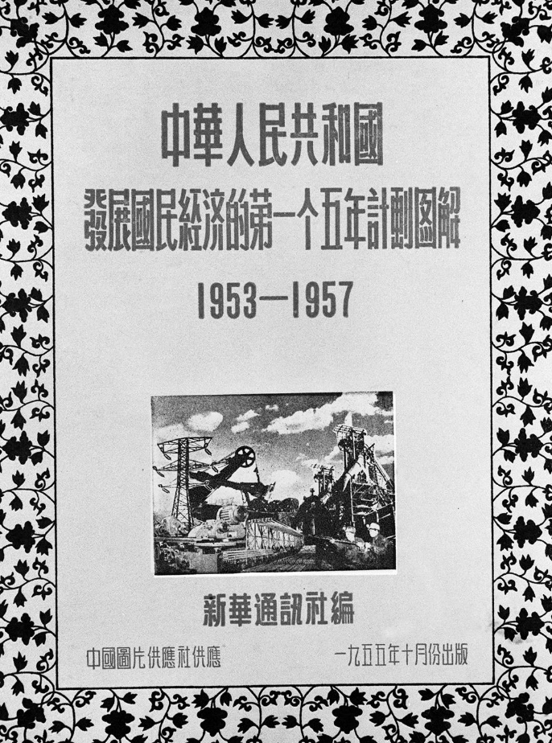
Reference
The birth and early development of the Five-Year Plan
In 1951, China began to formulate the First Five-Year Plan, which was put into implementation in 1953. In 1958, the implementation of the Second Five-Year Plan began. The Five-Year Plans have been implemented ever since, with every five years as a phrase.
Illustration of the First Five-Year Plan of the People’s Republic of China for the Development of the National Economy (1953-1957)

Slide 7
An overview of the early five national Five-Year Plans
Reference
Years | Full name of the plan | Examples of key tasks
1953-1957 | The First Five-Year Plan of the People’s Republic of China for the Development of the National Economy | To realise the industrialisation of our country
1958-1962 | Recommendations of the Eighth National Congress of the Communist Party of China on the Second Five-Year Plan for the Development of the National Economy | To develop metallurgy and heavy industry to catch up with and surpass the USA and UK
1966-1970 (Note) | Outline of the Report on the Arrangements for the Third Five-Year Plan | To make preparations for war and famine, carry out the Third Front Movement, and develop heavy industry
1971-1975 | Outline of the Fourth Five-Year National Economic Plan (Draft Amendment) | To promote the country’s industrialisation through military industry
1976-1980 | Outline of the Ten-Year Plan for the Development of the National Economy during 1976 to 1985 : first five-year period (Amendment) | To establish a relatively comprehensive industrial and national economic system.
Note: The period from 1963 to 1965 was the period of national economic adjustment, and no "five-year plan" was formulated.

Slide 8
Reference
An overview of the national 6th Five-Year Plan and onwards
Years | Full name of the plan | Examples of key tasks
1980-1985 | Outline of the Sixth Five-Year Plan for National Economic and Social Development of the People’s Republic of China (Note) | To adjust the national economy, put into effect the household responsibility system, and expand the autonomy of urban management
1986-1990 | Outline of the Seventh Five-Year Plan for National Economic and Social Development of the People’s Republic of China | To enhance economic benefits, maintain a balance between total demand and supply, and adjust industrial structure
1991-1995 | Outline of the Ten-Year Plan and Eighth Five-Year Plan for National Economic and Social Development of the People’s Republic of China | To maintain the sustained, stable and co-ordinated development of national economy
1996-2000 | Outline of the Ninth Five-Year Plan for the National Economic and Social Development of the People's Republic of China and Vision 2010 | To quadruple per capita GNP in comparison with that of 1980, and enable the people to have a moderately prosperous life
Note: Different from the previous five-year plans, the subsequent five-year plans have included social development in addition to the national economic development.

Slide 9
An overview of the national 6th Five-Year Plan and onwards
Reference
Years | Full name of the plan | Examples of key tasks
2001-2005 | Outline of the Tenth Five-Year Plan for National Economic and Social Development of the People’s Republic of China | To improve the people’s living standards as the fundamental starting point, and uphold the co-ordinated development of economy and society
2006-2010 | Outline of the Eleventh Five-Year Plan for National Economic and Social Development of the People’s Republic of China (Note) | To expand domestic demand, optimise industrial structure, save resources, innovate independently, and persevere in the ‘people-oriented’ spirit.
2011-2015 | Outline of the Twelfth Five-Year Plan for National Economic and Social Development of the People’s Republic of China | To pursue development in a scientific way
2016-2020 | Outline of the Thirteenth Five-Year Plan for National Economic and Social Development of the People’s Republic of China | To establish a moderately prosperous society in all respect, adhere to the five concepts of innovation, co-ordination, greenness, openness, and sharing and take the supply-side reform as the main guideline for the new normal of the economy
Note: Since the 11th Five-Year Plan in 2006, the Chinese expression for “plan” has been changed from jihua (計劃) to guihua (規劃).

Slide 10
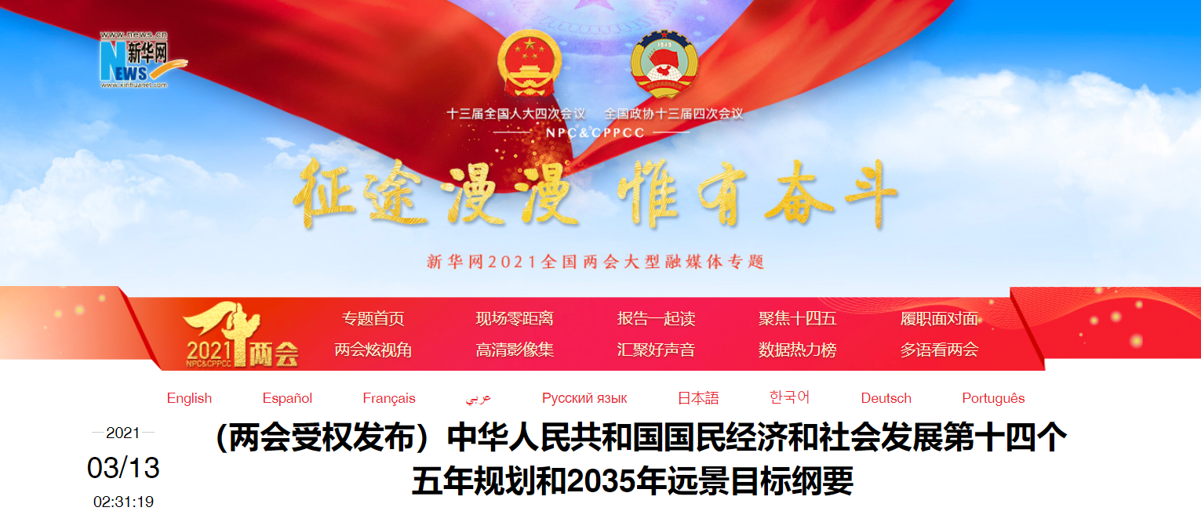
Background of the implementation of the 14th Five-Year Plan
Outline of the 14th Five-Year Plan for the National Economic and Social Development and the Long-Range Objectives Through the Year 2035 (2021-2025) is referred to as the 14th Five-Year Plan. The Central Government has also released a vision for the longer-term goal of basically achieving socialist modernization by 2035, 15 years earlier than its original goal of achieving it by the middle of the century.
The full text of the 14th Five-Year Plan
Source: Xinhua Net (http://www.xinhuanet.com/fortune/2021-03/13/c_1127205564.htm)
Click on the image for details.

Slide 11

Background of the implementation of the 14th Five-Year Plan
During the 13th Five-Year Plan period, China’s economic, scientific and technological, and comprehensive national strength have jumped to a new stage. In 2020, our GDP exceeded RMB 100 trillion yuan, and 55.75 million rural residents were lifted out of poverty. The annual grain output has remained stable for five consecutive years, over 1.3 trillion catty. More than 60 million urban jobs have been created, more than 1.3 billion people have been covered by basic medical insurance, and nearly 1 billion people participated in the basic old-age insurance. Significant achievements have been made in the prevention and control of the COVID-19 pandemic. The achievements in the 13th Five-Year Plan have laid a solid foundation for the implementation of the 14th Five-Year Plan.

Slide 12

Background of the implementation of the 14th Five-Year Plan
With the completion of the goals and tasks of the 13th Five-Year Plan, China has succeeded in building a moderately prosperous society in all respect, which signifies that China has achieved the first centenary goal of the “two centenary goals”. We are standing at a new starting point, having started a new journey towards comprehensively building a modern socialist country, and moving toward the second centenary goal.
The 14th Five-Year Plan is a blueprint for national development. It defines the focuses of the government’s work, guides and regulates the behavior of market entities, and pool together all efforts of the society.
References:
Explanation on the Recommendations of the Central Committee of the Communist Party of China for Formulating the 14th Five-Year Plan for Economic and Social Development and Long-Range Objectives through the Year 2035
(http://www.gov.cn/xinwen/2020-11/03/content_5556997.htm)

Slide 13
Reference
Preparation for the 14th Five-Year Plan
The preparation for the Five-Year Plan was a brainstorming decision-making process.
As far as the 14th Five-Year Plan is concerned, based on the assessment of the 13th Five-Year Plan interim report, the National Development and Reform Commission (NDRC) came up with the basic ideas of ​​a new plan through preliminary research. The Political Bureau of the Community Party of China (CPC) Central Committee established a document drafting committee headed by Xi Jinping, General Secretary of the CPC Central Committee, and drafted proposals under the leadership of the Standing Committee of the CPC Political Bureau. The proposals were adopted and announced to the public at the Fifth Plenary Meeting of the 19th Central Committee of the CPC on October 29, 2020. After the proposals were passed, the NDRC started to prepare a draft outline according to the proposals.

Slide 14
Reference
Preparation for the 14th Five-Year Plan
The Standing Committee of the CPC Political Bureau approved the draft in principle, and the Fifth Plenary Session of the State Council deliberated the draft before issuing it for comments from local governments, departments and experts. On Feb 26, 2021, the Standing Committee of the CPC Political Bureau held a meeting to discuss the draft that the State Council was going to submit to the National People’s Congress for review. On March 5, 2021, the National People’s Congress reviewed the draft and proposed amendments, and passed the draft on March 11.
The basic process of formulation of the 14th Five-Year Plan
Mid-term assessment of the 13th Five-Year Plan
The early stage of the study
Forming basic ideas
The proposal drafted by the CPC Central Committee
Proposals from the CPC Central Committee
Drafting the outline of the plan
Consulted widely
Passed by the National People's Congress
Source:
China Government Network (http://www.gov.cn/xinwen/2020-11/03/content_5556997.htm)
Legislative Council of Hong Kong (https://www.legco.gov.hk/research-publications/english/2021fs06-national-14th-five-year-plan-20210610-e.pdf)

Slide 15
14th Five-Year Plan and national development
1. To consolidate the building of a moderately prosperous society in all aspects
Based on the achievements of the 13th Five-Year Plan, more achievements during the 14th Five-Year Plan period will be made. The target is to consolidate the achievements of building a moderately prosperous society in all aspects, ensure high-quality development of our country, and develop from a middle-income country into a high-income country.
2. To start a new journey of building a modernized country
The 14th Five-Year Plan marks the beginning of a new journey toward building a modern socialist country in all aspects. We are heading for the second centenary goal and striving for the rejuvenation of the Chinese nation.
3. To realise the Chinese Dream and share the great rejuvenation of the Chinese nation
The Chinese dream stands for the rejuvenation of the Chinese nation. Hong Kong should continue to play an irreplaceable role in the new era of the 14th Five-Year Plan and ensure the steady and long-term implementation of “one country, two systems”.

Slide 16
14th Five-Year Plan and the new development philosophy
In the 40 years of reform and opening up, our country’s overall national strength has been enhancing. The living standards of the Chinese people have been greatly improved, and we have started a new journey of development, the foundation of which has become more solid. The development conditions have undergone new changes, and we are facing new opportunities and challenges. To enter a new stage of national development, we need to have new philosophy of development and construct a new development pattern.
The new development philosophy is written into
the preamble of the Constitution
On March 11, 2018, the First Session of the 13th National People’s Congress passed the amendment to the Constitution of the People’s Republic of China, to which “apply the new development philosophy” was added.

Slide 17
14th Five-Year Plan and the new development philosophy
The new development philosophy is formed based on the analysis of the domestic and international development trend, challenges and risks, taking account into the domestic and foreign development experiences and lessons. The 13th Five-Year Plan was formulated in accordance with the new development philosophy with the vision featuring innovative, coordinated, green, open and shared development, and it has also become the guideline for China’s economic and social development during the 14th Five-Year Plan period.

Slide 18

14th Five-Year Plan and the new development philosophy
The new development philosophy is proposed to solve prominent problems in the national development, such as ecological problems, unbalanced regional development and income disparities. Its content and requirements are originated from the continuous thinking and experience, aiming at solving new problems and challenges arising from the development. With the improvement of living standards, people have higher requirements for the quality of life and living environment, and pay more attention to social equity and justice and their own rights and interests. The development of our country must respond to the new demands of the people.

Slide 19


Significance of the new development philosophy
As China is becoming more influential in the world, independent innovation has become a driving force for its economic and social development. China needs to continuously promote innovation in theory, system, science, technology, culture and other aspects.
Coordinated development refers to the coordination of various elements, including economy, politics, culture, society and ecological environment so that the development can be optimised and the problem of unbalanced development can be solved.
Green development refers to green and low-carbon recycling, resources saving, environmental protection and sustainable development.

Slide 20
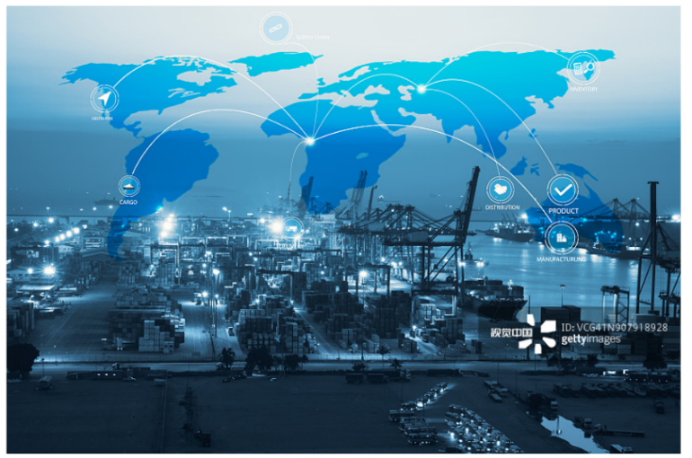
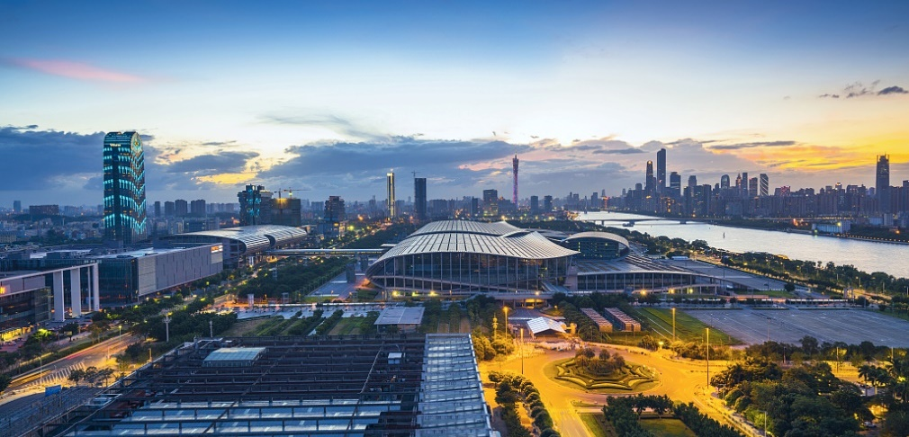
Significance of the new development philosophy
Opening-up means that we should further open up, strengthen international exchanges and cooperation, and achieve common prosperity.
Sharing. China is trying its best to improve the basic public services system, and the people’s wellbeing and the social governance system featuring joint efforts and shared governance. China has formulated the outline for our action to achieve common prosperity so as to narrow regional, urban-rural and income gaps and ensure that the fruits of development benefit all the people.

Slide 21
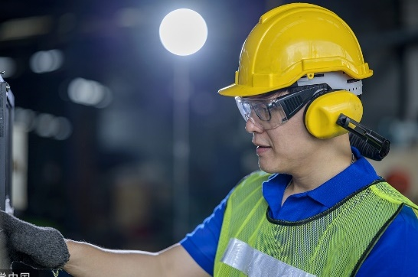
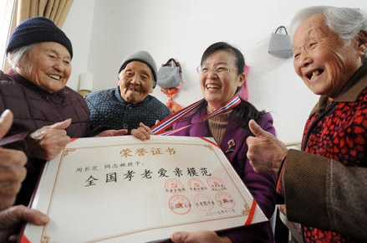


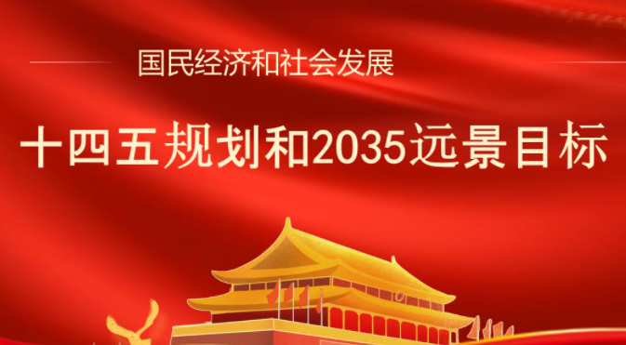

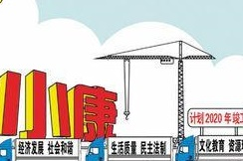
Major objectives of the 14th Five-Year Plan and
the Long-Range Objectives Through the Year 2035
“Six New” goals
The 14th Five-Year Plan sets out six “new” major objectives for the country’s economic and social development in the coming five years.
New achievements in economic development
Improvements in public civility
New strides in reform and opening-up
Improvements in people’s wellbeing
Advances in ecological conservation
More effective national governance

Slide 22
Major objectives of the 14th Five-Year Plan and
the Long-Range Objectives Through the Year 2035
New achievements in economic development. In the coming years we will achieve sustained and healthy economic development based on improvements in quality and efficiency and fully tap the growth potential. We will energize the domestic market and improve the economic structure. To achieve improvement in innovation capacity, we will build a highly modernized industrial chain. We will further strength the foundation of agriculture, coordinate the development between urban and rural areas, and construct a modern socialist economic system.
New strides in reform and opening up. We will improve the socialist market economy and basically complete the development of a high-standard market system. Market entities will grow in dynamism, and major progress will be achieved in the reform of the property rights system and the market allocation of factors of production (land, labour, capital, technology, etc.). Improvements will be made to the systems for promoting fair competition. A new and better open economic system will take shape. Liberalization and facilitation of trade and investment will be promoted, and the interconnection of domestic and foreign capital markets will be deepened.
Source: The Outline of the 14th Five-Year Plan for Economic and Social Development and Long Range Objectives through the Year 2035 of the People’s Republic of China https://en.ndrc.gov.cn/policies/202203/P020220315511411039433.pdf )

Slide 23
Major objectives of the 14th Five-Year Plan and
the Long-Range Objectives Through the Year 2035
Improvements in public civility. We will promote the outstanding traditional Chinese culture, raise the people’s general ethical and moral standards, scientific and cultural levels, as well as improve the health and psychological quality. We will improve the public cultural services system and cultural industry system to, enrich people’s spiritual and cultural life. The influence of Chinese culture and the cohesion of the Chinese nation will be enhanced.
Advances in ecological conservation. We will better develop and protect the territorial space, achieve green transformation on production and lifestyle, and allocate energy and resources more effectively. We will reduce the total emission of pollutants, consistently improve the environment with a stronger shields for ecological security, and improve the living environment in urban and rural areas.
Source: The Outline of the 14th Five-Year Plan for Economic and Social Development and Long Range Objectives through the Year 2035 of the People’s Republic of China https://en.ndrc.gov.cn/policies/202203/P020220315511411039433.pdf

Slide 24
Main objectives of the 14th Five-Year Plan and
the Long-Range Objectives Through the Year 2035
Improvements in people’s wellbeing. We will provide more higher-quality employment opportunities, keep the income growth in line with economic growth, and significantly improve the income distribution structure. Access to basic public services will become more equitable and the educational level of the population will continue to rise. We will also improve the social security system and the health care system, consolidate the achievements of poverty alleviation and improve the people’s livelihood, and promote rural revitalization on all fronts.
More effective national governance. We will strengthen socialist democracy and the rule of law. Social fairness and justice will be manifested. The government will enhance its administrative efficiency and credibility which will promote social governance. We will prevent and mitigate major risks by increasing our ability in guarding against natural disasters.
Source: The Outline of the 14th Five-Year Plan for Economic and Social Development and Long Range Objectives through the Year 2035 of the People’s Republic of China https://en.ndrc.gov.cn/policies/202203/P020220315511411039433.pdf

Slide 25
Reference
The 14th Five-Year Plan for National Economic and Social Development and the Long-Range Objectives Through the Year 2035
The 14th Five-Year Plan also outlines a vision to basically achieve socialist modernization by 2035.
1 | China’s economic strength, scientific and technological capacities and overall national strength will increase significantly. The economic aggregate and per capita income of urban and rural residents will make new strides.
2 | We will basically complete new industrialization, informatization, urbanization and agricultural modernization, and complete building a modernized economic system.
3 | We will have basically modernized the governance system and capacity, our people will be fully ensured their rights to equal participation and development, and the rule of law for the country, the government, and society will be comprehensively in place.
4 | Our nation will have a thriving culture, first-class education, a high-caliber workforce, sporting excellence, and high standards of health. We will further improve the well-rounded development of our people and raise standards of public civility, and China’s cultural soft power will be enhanced.
5 | Eco-friendly work practices and lifestyles will be established, and carbon emissions will be reduced. There will be a fundamental improvement in the ecological environment.
6 | A new pattern of opening up will have taken shape, and our new strengths in international economic cooperation and competition will be significantly enhanced.
7 | The per capita GDP will reach the level of moderately developed countries and the size of the middle-income group will be significantly expanded. Equitable access to basic public services will be ensured. Disparities in development between urban and rural areas and between regions, and in living standards will be significantly reduced.
8 | The modernization of national defense and the armed forces will be basically achieved.
9 | Our people will lead even better lives, with more substantive advances in people’s well-rounded development and common prosperity.

Slide 26
Strategies for the implementation of the 14th Five-Year Plan
Innovation-driven development: During the 13th Five-Year Plan period, China has made a series of major technological innovation breakthroughs in key fields on its way to becoming a country strong in science and technology. We must continue to be innovative, strengthen the development of core science and technology, and cultivate innovative advantages in core and key technologies and forward-looking projects that meet urgent and long-term needs of the country. At the same time, we should strengthen basic research and original innovation ability.
Development of a modern industrial system: We will facilitate the deep integration of advanced manufacturing and modern service industries, strengthen infrastructure, build a modern industrial system featuring coordinated development of the real economy, scientific and technological innovation, modern finance and human resources, and promote industrial optimization and upgrading to achieve a high-end, intelligent and green industry.

Slide 27
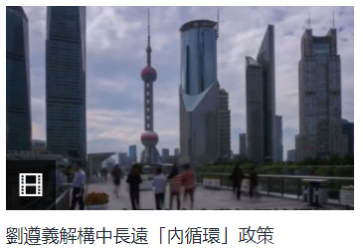

Strategies for the implementation of the 14th Five-Year Plan
Creating a new pattern of development: We will accelerate the creation of a new pattern of development that focuses on domestic economic flows and features positive interplay between domestic and international flow. The industrial structure will be optimized and our innovation capacity will be enhanced. We will release the potential of domestic demand and accelerate the development of a complete domestic demand system. We will open up at a high level and improve the efficiency and level of domestic circulation through international circulation.
Prof. Lawrence J. Lau, Ralph and Claire Landau Professor of Economics at CUHK, pointed out the “dual circulation” refers to the “domestic circulation” and the “international circulation”. Circulation means that the supply meets the demand.
Prof. Lawrence J. Lau explained the policy of domestic circulation
Source: The China Current (https://chinacurrent.com/story/20415/prof-lawrence-lau-china-econ)
Click on the image for details.

Slide 28
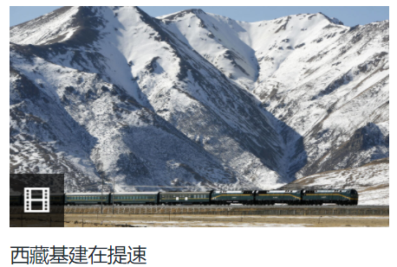
Strategies for the implementation of the 14th Five-Year Plan
Optimising the spatial distribution of development: To solve the problem of unbalanced development between regions, China will promote coordinated development among regions. Through further development of the west, revitalization of the northeast, promoting the rise of the central region, speeding up the development of the east and supporting the development of remote areas and regions of ethnic minorities to strike a relative balance development.
Case
The Qinghai-Tibet Railway has greatly improved the quality of life of the Tibetan people. Its success has accelerated the construction of the Sichuan-Tibet Railway, which, as the second route to open up the main artery into Tibet, will directly connect Tibet, Sichuan, Chengdu-Chongqing Economic Circle and the Yangtze River economic belt. The Sichuan-Tibet Railway will be even more economically significant than the Qinghai-Tibet Railway.
Speeding up the infrastructure development in Tibet
Click on the image for details.
Source: The China Current
(https://chinacurrent.com/hk/story/21143/infrastructure-development-plan-for-Tibet)

Slide 29
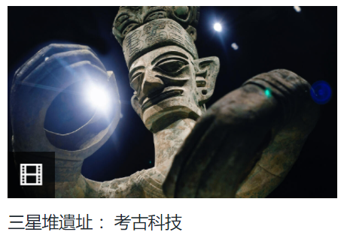

Strategies for the implementation of the 14th Five-Year Plan
Improving the soft power of Chinese culture: We will implement programmes to pursue the inheritance and development of the fine traditions of Chinese culture, improve the systematic protection of important cultural and natural heritage and intangible cultural heritage, and promote the creative transformation and development of fine traditional Chinese culture to increase the influence of Chinese culture. We will improve the modern cultural industry system and accelerate the integrated development of culture and tourism.
Case
The 14th Five-Year Plan attaches great importance to the protection of archaeological sites, and proposes the construction of relic parks at Sanxingdui and other national archaeological sites.
Source: The 14th Five-Year Plan, Section 3, Chapter 36, Part X,
Xinhua Net (http://www.xinhuanet.com/fortune/2021-03/13/c_1127205564.htm)
Source: The China Current
(https://chinacurrent.com/hk/story/21189/sanxingdui-archeology-revolution-in-technology)
Sanxingdui ruins: archaeological technology
Click on the image for details.

Slide 30
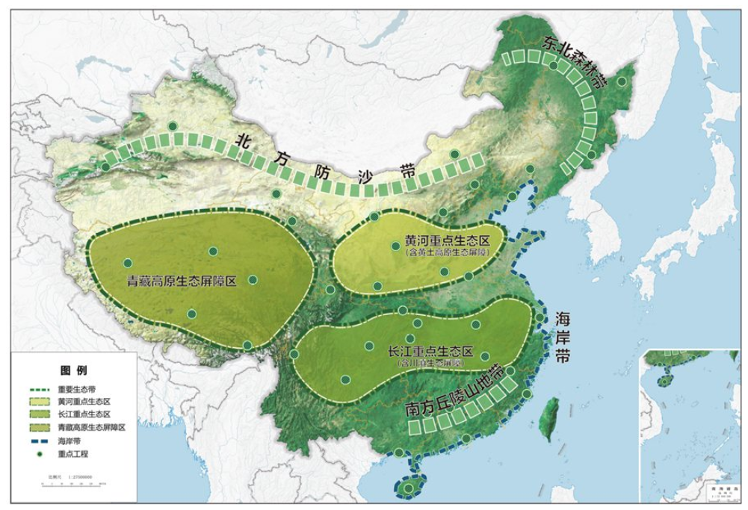
Strategies for the implementation of the 14th Five-Year Plan
Promoting the harmonious coexistence between people and Nature: We will respect Nature, follow Nature’s laws and protect Nature. We will prioritize resource conservation, environmental protection, and let nature restore itself, put emphasis on sustainable development, and build an ecological civilization system for a beautiful China.
Case: The Huanghe Eco-zone
The Huanghe Eco-zone covers the Loess Plateau, Qinling Mountains and Helan Mountains, where we will strengthen comprehensive control of soil erosion, protect and restore wetlands such as the Huanghe Delta, and restore additional two million hectares of eroded land and 800,000 hectares of desertified land.
Major ecosystem protection and restoration projects during the 14th Five-Year Plan period

Slide 31
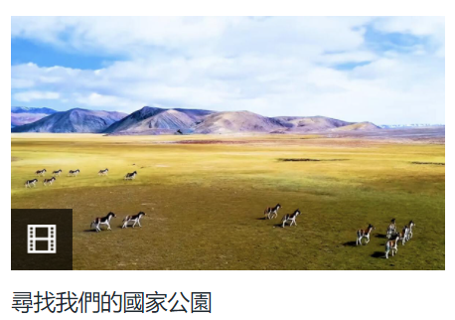
Strategies for the implementation of the 14th Five-Year Plan
Reference
The 14th Five-Year Plan proposes: “We have scientifically designated protected areas and functional zones of nature reserves, accelerate the integration and optimization of various types of protected areas, and build a protected area system with national parks as the mainstay, supported by nature reserves, and supplemented by nature parks.”
Source: The 14th Five-Year Plan, Section 2, Chapter 37, Part XI.
Xinhua Net (http://www.xinhuanet.com/fortune/2021-03/13/c_1127205564.htm)
To strengthen the protection of biodiversity, China is speeding up the construction of national parks, putting natural ecosystems, unique natural landscapes, natural heritage and areas with the richest biodiversity into the national park system step by step. It has created its first batch of national parks including the Three-River-Source National Park, the Giant Panda National Park, the Northeast China Tiger and Leopard National Park, the Hainan Tropical Rainforest National Park, and the Wuyishan National Park.
Looking for our national parks
Click on the image for details.
Source: The China Current (https://chinacurrent.com/hk/story/22722/china-national-parks)

Slide 32
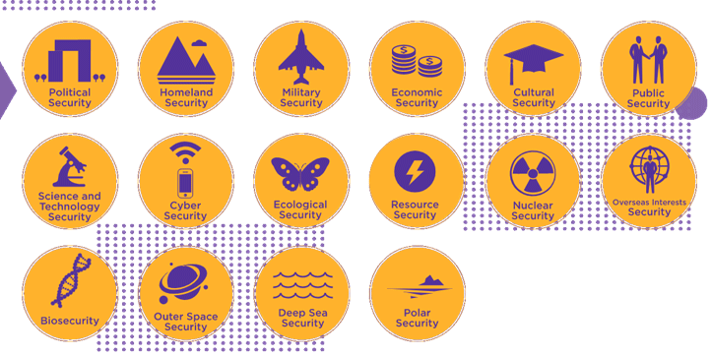
Strategies for the implementation of the 14th Five-Year Plan
Coordinating development and security: We will implement the national security strategy, safeguard national security, defuse various risks, strengthen the building of the national security system, ensure national economic security, protect the people’s lives, and maintain social stability and security.
Traditional security
Non-traditional security
Source: National Security Education Day for All, 2021 https://www.nsed.gov.hk/
New domain security

Slide 33

The 14th Five-Year Plan and the development of Hong Kong
Hong Kong’s social and economic development has always been closely linked to that of the Mainland, and its stability and prosperity is an important part of the development of our country. The 14th Five-Year Plan underscores a commitment to the “dual circulation” concept for economic development, driven by reform and innovation, led by quality supply and creating new demands, with the domestic market as the mainstay, while enabling domestic and foreign markets to interact positively with each other. Hong Kong will proactively become a “participant” in domestic circulation and a “facilitator” of international circulation in the “dual circulation” development strategy. The inclusion of Hong Kong in the national medium and long-term development plan will help to highlight Hong Kong’s dual positioning advantages and internal and external connection functions, consistently enhance its competitiveness, and promote its continuous prosperity.
For the role of Hong Kong in the country’s 14th Five-Year Plan, please refer to the following source for details:
Source: HKSAR Government
(https://www.brandhk.gov.hk/docs/default-source/factsheets-library/hong-kong-themes/2021-10-05/hong-kongs-role-in-the-national-14th-five-year-plan-e.pdf?sfvrsn=544ef8d5_3)

Slide 34
The 14th Five-Year Plan and Hong Kong’s development
China, the world’s second largest economy, is an important engine of the world economy. Hong Kong has been included in the national planning, so it has got on board the express train of national development, thus gaining wider space for development.
Hong Kong has positioned itself in the country’s new development landscape, making full use of its advantages as a free economy, driven by the development of the national market economy.
Our country will strive to ensure social stability of Hong Kong, which can make full use of its advantages to develop emerging industries and promote its prosperity.

Slide 35

Chapters in the 14th Five-Year Plan on Hong Kong and the Greater Bay Area
Chapter 31 Major Regional Development Strategies
Section 3 Proactively and progressively taking forward the development of the Guangdong-Hong Kong-Macao Greater Bay Area (GBA)
Strengthening the coordinated development of industries, academia and research institutes in Guangdong, Hong Kong, and Macao. Improving the "Two Corridors and Two Poles" framework system which comprises the Guangzhou Shenzhen-Hong Kong, Guangzhou-Zhuhai-Macao Innovation and Technology Corridors and the Shenzhen-Hong Kong Loop, Guangdong-Macao-Hengqin Innovation and Technology Poles. Promoting the setting up of an integrated national science centre and facilitating the cross-boundary exchange of innovative elements. Expediting the construction of intercity railways, coordinating planning for the positioning of ports and airports, optimizing the allocation of maritime and aviation resources. Deepening the customs clearance reforms to facilitate effective and convenient flow of people, goods and vehicles. Expanding the scope of mutual recognition of professional qualifications between the Mainland, Hong Kong and Macao, and further strengthening the regulatory interface and connectivity in key areas. Facilitating young people of Hong Kong and Macao to study, take up employment and start businesses in the Mainland cities of GBA and establishing a brand of quality exchanges among the youths of Guangdong, Hong Kong and Macao.
Source: The National Development and Reform Commission, https://www.ndrc.gov.cn/xxgk/zcfb/ghwb/202103/t20210323_1270124.html?code=&state=123

Slide 36
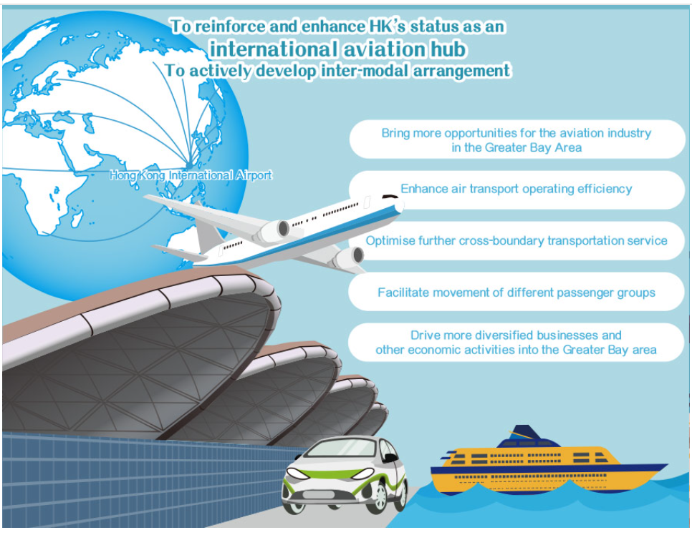

Chapters in the 14th Five-Year Plan on Hong Kong and the Greater Bay Area
Chapter 61 Maintaining the long-term prosperity and stability of Hong Kong and Macao
Section 1 : Supporting Hong Kong and Macao to reinforce and enhance their competitive advantages
Supporting Hong Kong to enhance its status as an international financial, transportation and trade centre as well as an international aviation hub. Strengthening Hong Kong's status as a global offshore Renminbi business hub, an international asset management centre and a risk management centre. Supporting Hong Kong to develop into an international innovation and technology hub. Supporting Hong Kong to promote service industries for high-end and high value-added development. Supporting Hong Kong to establish a centre for international legal and dispute resolution services in the Asia-Pacific region and a regional intellectual property trading centre. Supporting Hong Kong to develop into a hub for arts and cultural exchanges between China and the rest of the world.
Source:
National Development and Reform Commission, https://www.ndrc.gov.cn/xxgk/zcfb/ghwb/202103/t20210323_1270124.html?code=&state=123
InvestHK (https://gba.investhk.gov.hk/en-hk/facilitation-measures/transportation-and-logistics.html)

Slide 37
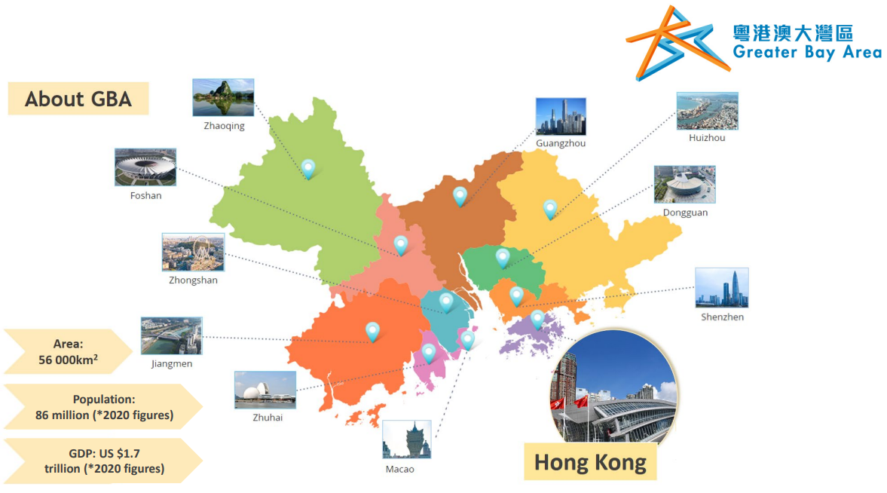

Chapters in the 14th Five-Year Plan on Hong Kong and the Greater Bay Area
Chapter 61 Maintaining the long-term prosperity and stability of Hong Kong and Macao
Section 2 Supporting Hong Kong and Macao to better integrate into the overall development of the country :
Promoting high-quality development of the Guangdong-Hong Kong-Macao GBA. Deepening Guangdong-Hong Kong-Macao cooperation as well as Pan-Pearl River Delta regional cooperation. Taking forward the establishment of major cooperation platforms in the Guangdong-Hong Kong Macao GBA, e.g. Qianhai of Shenzhen, Nansha of Guangzhou, Hengqin of Zhuhai, the Shenzhen Hong Kong Loop, etc.
Strengthening exchanges and cooperation among the Mainland, Hong Kong and Macao on different fronts. Improving policy measures to facilitate Hong Kong and Macao residents to develop and live in the Mainland. Strengthening education on the Constitution and the Basic Law and national development, and enhancing national awareness and patriotism among Hong Kong and Macao people.
Source:
National Development and Reform Commission, https://www.ndrc.gov.cn/xxgk/zcfb/ghwb/202103/t20210323_1270124.html?code=&state=123
Constitutional and Mainland Affairs Bureau, (https://https://www.gov.hk/en/theme/bf/pdf/46BFACPaper8_21.pdf)

Slide 38
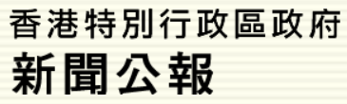
The 14th Five-Year Plan and the Development of Hong Kong
“The 14th Five-Year Plan is the blueprint and action agenda for the social and economic development of the country in the next five years. I am delighted that contents relating to Hong Kong can be found in its chapter 61 on maintaining the long-term prosperity and stability of Hong Kong and Macao, and chapter 31 on proactively and progressively taking forward the development of the Guangdong-Hong Kong-Macao Greater Bay Area (GBA). Indeed, the 14th Five-Year Plan has incorporated many concrete proposals put up by the HKSAR Government after more than a year of study, demonstrating the Central Government's unwavering support for Hong Kong.” For the importance of the 14th Five-Year Plan Outline in terms of economic development, high-quality construction of the Guangdong-Hong Kong-Macao Greater Bay Area and social development, please refer to the source below:
Source: HKSAR Government welcomes National 14th Five-Year Plan and will proactively integrate Hong Kong into national development.
Source: The HKSAR Government Press Release, (https://www.info.gov.hk/gia/general/202103/11/P2021031100464.htm?fontSize=1)

Slide 39
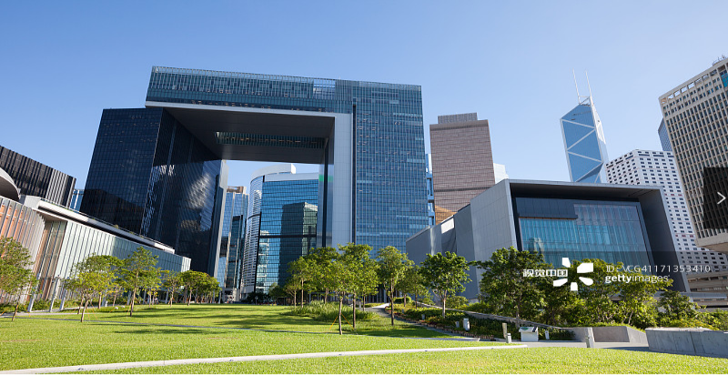
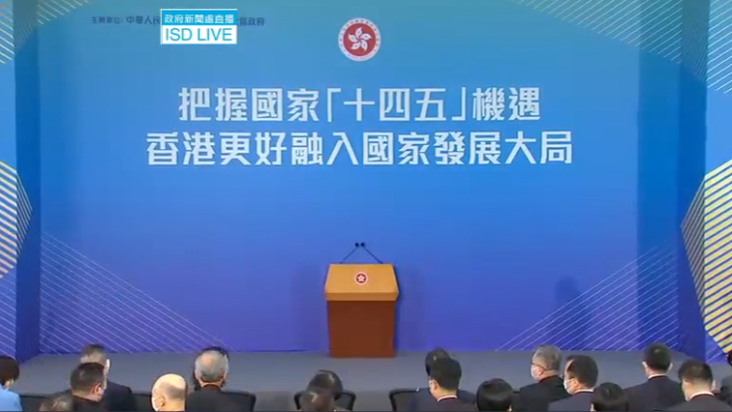
The 14th Five-Year Plan and the Development of Hong Kong
Consolidate and enhance the competitiveness of Hong Kong
The country supports Hong Kong in maintaining its original competitive edge and fostering its new competitiveness, encourages Hong Kong to consolidate its existing strengths, to play the role of a bridge of two-way opening between China and the world, and to continuously enhance its competitiveness.
The HKSAR Government (HKSAR) held the talk on National 14th Five-Year Plan under the theme of “Actively Seizing the Opportunities of the National 14th Five-Year Plan, Hong Kong to Proactively Integrate into the Country’s Overall Development”.
Source: Constitutional and Mainland Affairs Bureau,
Hong Kong's role, opportunities and development space in the 14th Five-Year Plan,
(https://www.cmab.gov.hk/en/issues/talk-14th-5year-plan.htm)

Slide 40
The 14th Five-Year Plan and the Development of Hong Kong
The 14th Five-Year Plan has added the following contents regarding Hong Kong and Macao.
What’s New in the 14th Five-Year Plan
A hub | an international aviation hub
Four Centres | an international risk management centre
 | an international innovation and technology centre
 | a regional intellectual property trading centre
 | East-meets-West centre for international cultural exchange
For more details, please refer to the next learning focus – PowerPoint presentation files on “The development plans and policies related to Hong Kong (the development of the Greater Bay Area, The Mainland and Hong Kong Closer Economic Partnership Arrangement (CEPA)) and the relationship with the promotion of the development of Hong Kong”.

Slide 41
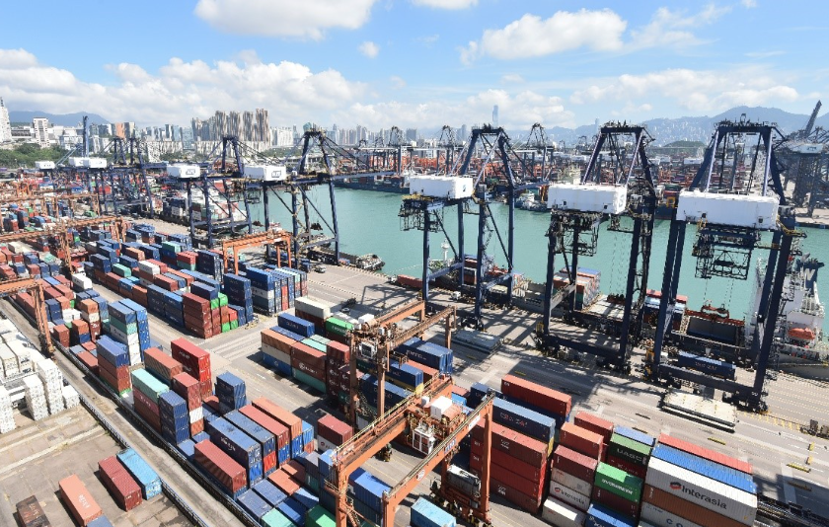
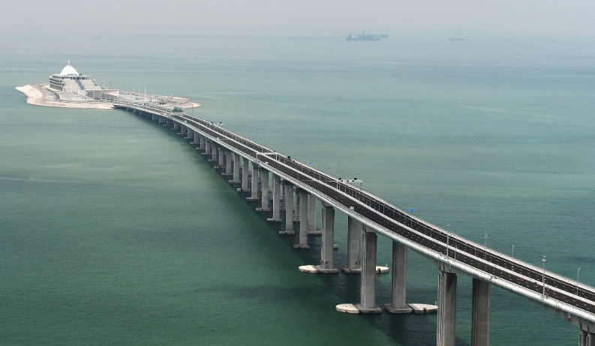
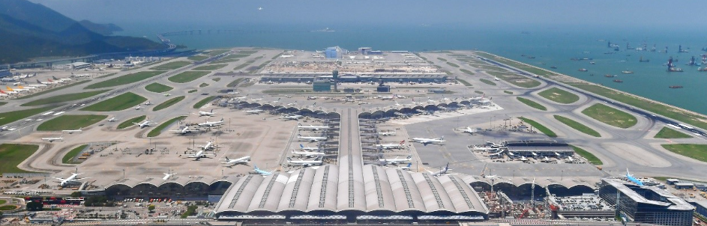
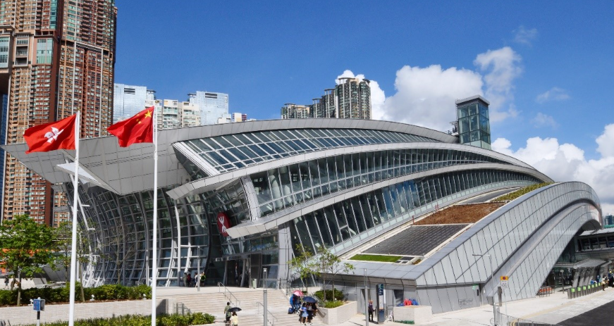
The 14th Five-Year Plan and the Development of Hong Kong
Consolidate Hong Kong’s status as an international financial, trade and maritime centre
China will consolidate the original competitive edge of Hong Kong by including it in the national development plan, support Hong Kong in enhancing its status as an international financial, shipping, and trade centre and an international aviation hub, and strengthen its functions as a global offshore RMB business hub and an international centre for asset management and risk management. Hong Kong can make full use of its financial advantages, research and develop more RMB trading products, and promote more cross-border investment and financing activities of RMB funding. The country will support competitive enterprises in listing in Hong Kong, encourage the development of green finance there, and support mutual access between the Mainland and Hong Kong financial market such as the Cross-boundary Wealth Management Connect Scheme in the Guangdong-Hong Kong-Macao Greater Bay Area.
Kwai Tsing Container Terminal
Hong Kong-Zhuhai-Macao Bridge
Source: InvestHK (https://gba.investhk.gov.hk/en-hk/facilitation-measures/transportation-and-logistics.html)
Hong Kong International Airport
Hong Kong Station of Guangzhou-Shenzhen-Hong Kong Express Rail

Slide 42
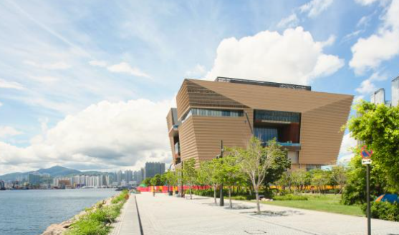
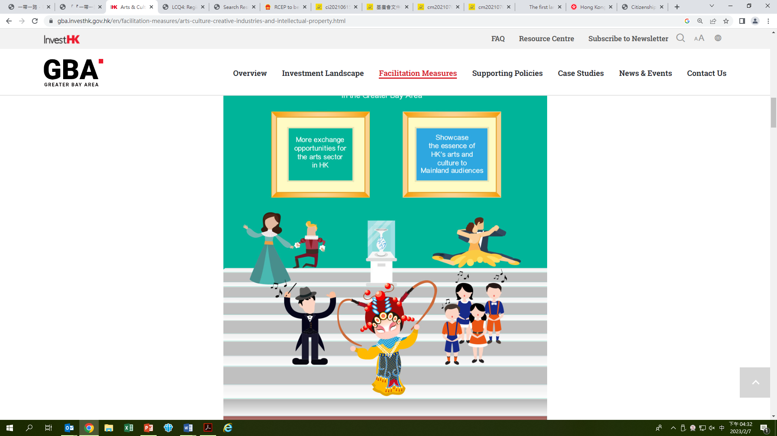
An international aviation hub
The 14th Five-Year Plan and the Development of Hong Kong
China supports the construction of the third runway, a premium logistic centre and SKYCITY in Hong Kong Airport. It supports Hong Kong’s investment in Zhuhai Airport, optimizes airspace management in the Pearl River Delta, supports the development of aviation finance and aircraft leasing, strengthens Hong Kong’s functions of an aviation management training centre, and makes Hong Kong an international aviation hub.
The Hong Kong Palace Museum regularly hosts special exhibitions of Chinese culture and art, as well as art from all over the world.
International cultural and art exchange centre
China supports Hong Kong in developing itself into an East-meets-West Centre for International Cultural Exchange. Diverse cultures coexist in Hong Kong, with a free, open and active cultural atmosphere, so it has the conditions for developing itself into an East-meets-West Centre for International Cultural Exchange. It is estimated that there are more than 5,000 art groups in Hong Kong, which is conducive to cultural and art exchanges between China and foreign countries. With the completion of the Hong Kong Palace Museum and the West Kowloon Cultural District, Hong Kong cultural venues and other infrastructures have been gradually improved, and it will become an international hub for cultural and art exchanges.
Source:
National Development and Reform Commission (https://www.ndrc.gov.cn/xxgk/zcfb/ghwb/202103/t20210323_1270124.html?code=&state=123)
Hong Kong Palace Museum (https://www.westkowloon.hk/en/hong-kong-palace-museum-exhibitions#overview)
InvestHK (https://gba.investhk.gov.hk/en/facilitation-measures/transportation-and-logistics.html)

Slide 43
The 14th Five-Year Plan and the Development of Hong Kong
Better integration into the overall national development
During the “14th Five-Year Plan” period, Hong Kong can further consolidate its status as the prime platform and key link of the “Belt and Road”, and can make good use of its international experience and professional advantages to help the country “go global”. It can also carry out the Mainland Enterprises Partnership Exchange and Interface Programme to arrange exchanges between Mainland enterprises and professional service sectors in Hong Kong to promote cooperation, deepen the capacity-building of both parties, and enhance the internationalization, marketization and professionalization of projects.
The construction of the Guangdong-Hong Kong-Macao Greater Bay Area is a major initiative to enrich the practice of “one country, two systems” and a powerful measure to further deepen reform and opening-up. It is aimed to support and promote Hong Kong’s better integration into the national development. Hong Kong should seize the great opportunity of development and actively participate in the construction.
For more details, please refer to the next learning focus – PowerPoint presentation files on “The development plans and policies related to Hong Kong (the development of the Greater Bay Area, The Mainland and Hong Kong Closer Economic Partnership Arrangement (CEPA)) and the relationship with the promotion of the development of Hong Kong”.

Slide 44
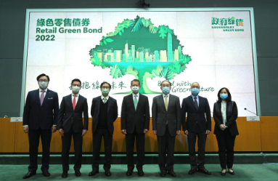
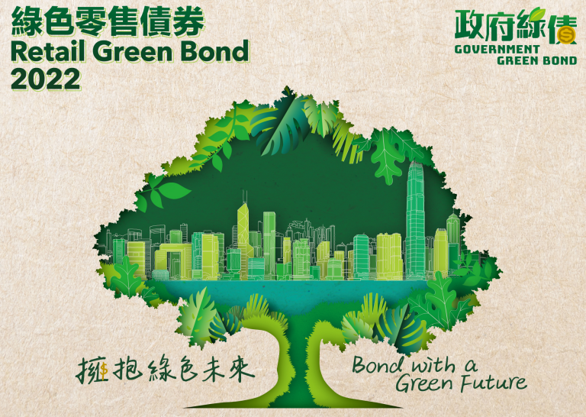
Examples of the HKSAR Government’s work in response to the 14th Five-Year Plan
The HKSAR Government has been actively cooperating with the national “14th Five-Year Plan” to seize the opportunities brought by national development to consolidate and enhance the competitiveness of Hong Kong.
Statement in the Plan Outline | The latest work progress of the HKSAR government (example)
Section 1 Support Hong Kong’s in reinforcing and enhancing its competitive advantages and in enhancing its status as an international financial centre | The HKSAR government continues to implement various measures to promote cross-border application of Fintech in Hong Kong and the Mainland, and in concert with the financial regulators, actively encourage the industry to explore and test various Fintech solutions and products with cross-boundary applications involving the Greater Bay Area. Hong Kong will further consolidate and develop its position as a green and sustainable financial hub in the region. Hong Kong will promotes more GBA entities to make use of Hong Kong’s capital market for green investment, financing and certification, thereby supporting green enterprises and projects in the Greater Bay Area. We have expanded the scale of the Government Green Bond Programme and issued retail green bonds, and have launched a new Green and Sustainable Finance Great Scheme to provide impetus to the green and sustainable finance market development.
The green retail bond was issued on 22 March 2022 and listed on the Hong Kong Stock Exchange on 23 March 2022
Source: HKSAR Government Press Release, https://www.info.gov.hk/gia/general/202202/15/P2022021500299.htm
Source: The Legislative Council Panel on Commerce and Industry: Hong Kong Special Administrative Region’s positioning and supporting measures under the National 14th Five-Year Plan, 15 June 2021
(https://www.legco.gov.hk/yr20-21/english/panels/ci/papers/ci20210615cb1-987-3-e.pdf) .Teachers should also pay attention to the latest information released by the HKSAR Government.

Slide 45
Examples of the HKSAR Government’s work in response to the 14th Five-Year Plan
Statement in the Plan Outline | The latest work progress of the HKSAR government (example)
Support Hong Kong in enhancing its status as an international maritime centre | Legislative amendments have been enacted in mid-2020 to provide tax concessions to the ship leasing and marine insurance business. Enhancement and broadening of the service coverage of Hong Kong Shipping Register has been commenced in phases. The International Chamber of Shipping established its first overseas office in Hong Kong, and the Baltic and International Maritime Council included Hong Kong as the fourth named arbitration venue in its maritime contract. Tax concession measures are provided to attract more shipping commercial principals (such as ship managers, agents and brokers) to Hong Kong.
Source: The Legislative Council Panel on Commerce and Industry: Hong Kong Special Administrative Region’s positioning and supporting measures under the National 14th Five-Year Plan, 15 June 2021
(https://www.legco.gov.hk/yr20-21/english/panels/ci/papers/ci20210615cb1-987-3-e.pdf) .Teachers should also pay attention to the latest information released by the HKSAR Government.

Slide 46
Examples of the HKSAR Government’s work in response to the 14th Five-Year Plan
Statement in the Plan Outline | The latest work progress of the HKSAR government (example)
Support Hong Kong in enhancing its status as an international trade centre | The HKSAR government has signed eight free trade agreements with 20 economies and 22 investment agreements with 31 overseas economies. Hong Kong has started proceedings to join the Regional Comprehensive Economic Partnership (RCEP) in 2022. (Note)
(Note)
The Regional Comprehensive Economic Partnership (RCEP) is an agreement initiated by the ten countries of the Association of Southeast Asian Nations.
The agreement was signed in November 2020 by 15 economies including China, the ten countries of the Association of Southeast Asian Nations (ASEAN), Australia, Japan, Republic of Korea and New Zealand. It is currently the world’s largest free trade agreement, covering about 30% of the world’s total population. The combined gross domestic product accounts for one-third of the world’s GDP. The successful signing and implementation of RCEP has become an important milestone in regional economic integration, which will promote free and open trade and increase investment in the region, and foster regional economic cooperation.
Source: HKSAR Government Press Release (https://www.info.gov.hk/gia/general/202105/12/P2021051200280.htm)
Source: The Legislative Council Panel on Commerce and Industry: Hong Kong Special Administrative Region’s positioning and supporting measures under the National 14th Five-Year Plan, 15 June 2021 (https://www.legco.gov.hk/yr20-21/english/panels/ci/papers/ci20210615cb1-987-3-e.pdf) .Teachers should also pay attention to the latest information released by the HKSAR Government.

Slide 47


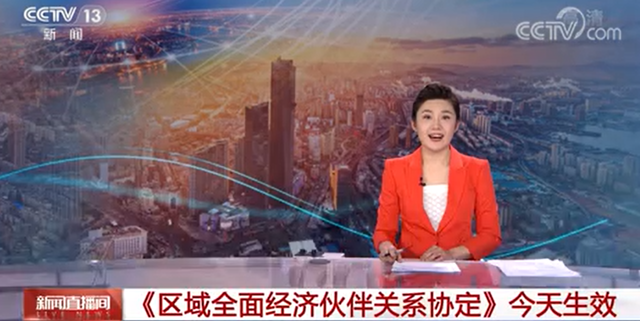
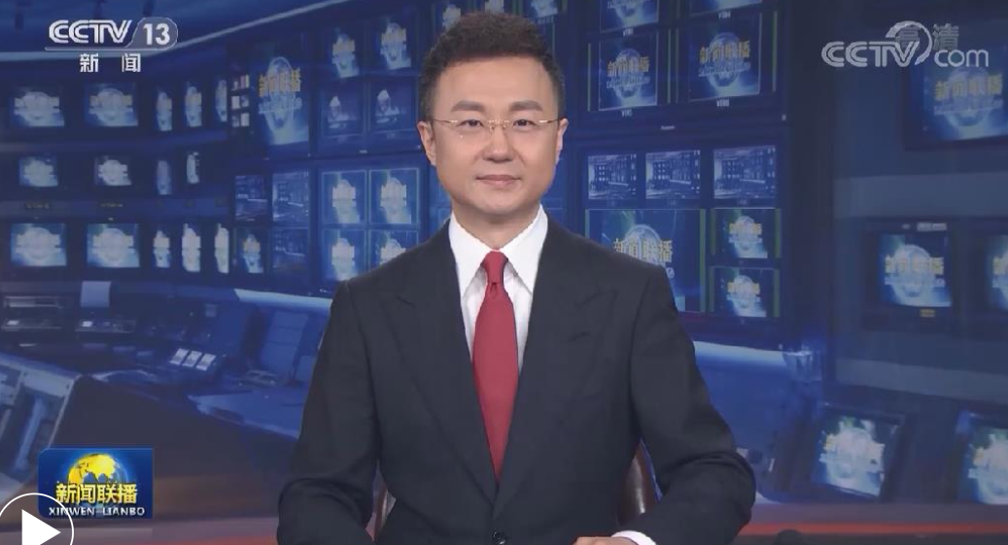


Regional Comprehensive Economic Partnership (RCEP)
Reference
RCEP came into effect on January 1, 2022, and China has begun to fully implement all its commitments and obligations. Click on the images below to see RCEP content and related reports.
Source:
Central People's Government of the People's Republic of China (http://www.gov.cn/xinwen/2022-01/01/content_5666055.htm)
Ministry of Commerce of the People's Republic of China (http://fta.mofcom.gov.cn/rcep/rcep_new.shtml)
CCTV Net (https://news.cctv.com/2022/01/01/ARTIoLAsbUDt8M6IH27koieU220101.shtml)

Slide 48
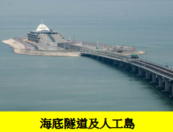
Examples of the HKSAR Government’s work in response to the 14th Five-Year Plan
Statement in the Plan Outline | The latest work progress of the HKSAR government (example)
Support Hong Kong in enhancing its status as an international aviation hub | The Airport Authority is taking forward various developments under the Airport City vision in an orderly manner, including the development of automated car parks and Airport City Link on the Hong Kong-Zhuhai-Macao Bridge’s Hong Kong Boundary Control Facility Island. The Airport Authority and the Zhuhai Municipal Government signed a memorandum of understanding in November 2022, marking the deepening of co-operation between the airports of both cities for mutual development and prosperity.
Source: Legislative Council Papers (https://www.legco.gov.hk/yr20-21/english/panels/tp/papers/tp20210115cb4-359-3-e.pdf)
Source: The Legislative Council Panel on Commerce and Industry: Hong Kong Special Administrative Region’s positioning and supporting measures under the National 14th Five-Year Plan, 15 June 2021 (https://www.legco.gov.hk/yr20-21/english/panels/ci/papers/ci20210615cb1-987-3-e.pdf) .Teachers should also pay attention to the latest information released by the HKSAR Government.

Slide 49
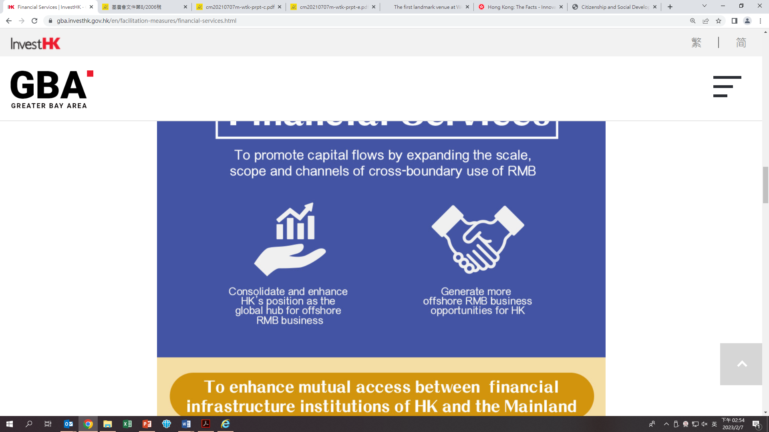
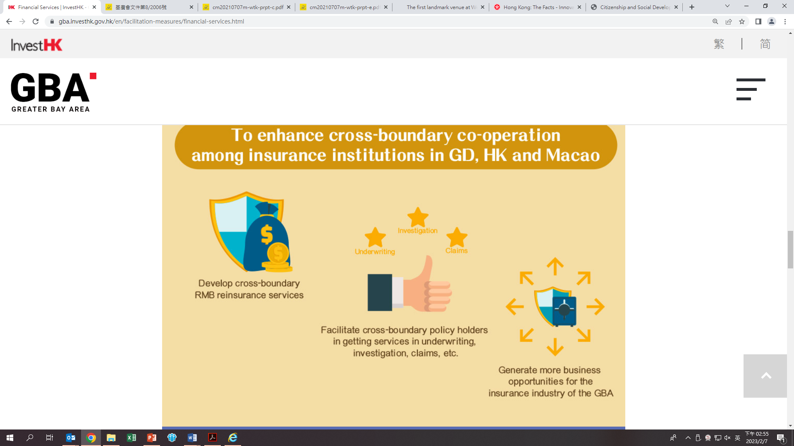
Examples of the HKSAR Government’s work in response to the 14th Five-Year Plan
Statement in the Plan Outline | The latest work progress of the HKSAR government (example)
Support Hong Kong in strengthening its functions as a global offshore Renminbi business hub, an international asset management centre and a risk management centre | To strengthen Hong Kong’s role as an international asset management centre, the HKSAR government strives to diversify the fund structures, including introducing the open-ended fund company and limited partnership fund regimes tailored to private equity funds. In addition, we provide tax concession for carried interest distributed by private equity funds operating in Hong Kong, establish a mechanism to attract existing foreign funds to re-domicile to Hong Kong. To facilitate mutual access for the insurance market, we are striving for establishment of after-sales service centres by the Hong Kong insurance industry in the Mainland cities of the Greater Bay Area, with a view to providing Hong Kong, Macao and Mainland residents who are holders of Hong Kong policies with comprehensive support in different areas including enquiries, claims and renewal of policies.
Source: The Legislative Council Panel on Commerce and Industry: Hong Kong Special Administrative Region’s positioning and supporting measures under the National 14th Five-Year Plan, 15 June 2021 (https://www.legco.gov.hk/yr20-21/english/panels/ci/papers/ci20210615cb1-987-3-e.pdf) .Teachers should also pay attention to the latest information released by the HKSAR Government.
Source: InvestHK (https://gba.investhk.gov.hk/en/facilitation-measures/financial-services.html)

Slide 50
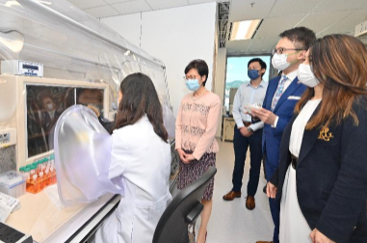
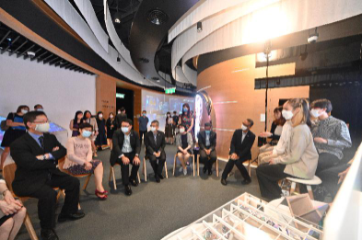
Examples of the HKSAR Government’s work in response to the 14th Five-Year Plan
Statement in the Plan Outline | The latest work progress of the HKSAR government (example)
Support Hong Kong in developing into an international innovation and technology hub | InnoHK research clusters is the HKSAR Government’s flagship project, with a view to developing Hong Kong as the hub for global research collaboration. The first two clusters focus on healthcare technologies and artificial intelligence and robotics technologies respectively. 28 research laboratories involving collaboration between over 30 institutions from 11 economies, and seven local universities and research institutions, and pooling around 2 000 researchers locally and from all over the world have commenced operation. The picture shows the Chief Executive visiting the R&D Centre of InnoHK R&D Platforms in Hong Kong. Source: HKSAR Government Press Release (https://www.info.gov.hk/gia/general/202108/26/P2021082600742.htm)
Source: The Legislative Council Panel on Commerce and Industry: Hong Kong Special Administrative Region’s positioning and supporting measures under the National 14th Five-Year Plan, 15 June 2021 (https://www.legco.gov.hk/yr20-21/english/panels/ci/papers/ci20210615cb1-987-3-e.pdf) .Teachers should also pay attention to the latest information released by the HKSAR Government.

Slide 51
Examples of the HKSAR Government’s work in response to the 14th Five-Year Plan
Statement in the Plan Outline | The latest work progress of the HKSAR government (example)
Support Hong Kong in developing into a centre for international legal and dispute resolution services in the Asia-Pacific region | The Department of Justice of Guangdong Province, the Secretariat for Administration and Justice of the Macao Special Administrative Region and DoJ established the Guangdong-Hong Kong-Macao Bay Area Legal Departments Joint Conference (“Joint Conference”) in September 2019. The Joint Conference has so far held four meetings. The Joint Conference held in December 2020 endorsed the establishment of a mediation platform. In 2020, Pilot Scheme on Facilitation for Persons Participating in Arbitral Proceedings in Hong Kong was launched to provide facilitation for eligible non-Hong Kong residents participating in arbitral proceedings in Hong Kong on a short-term basis. In 2020, the Hong Kong Legal Hub was established and over 20 reputable local, regional and international law-related organisations have set up offices.
Source: The Legislative Council Panel on Commerce and Industry: Hong Kong Special Administrative Region’s positioning and supporting measures under the National 14th Five-Year Plan, 15 June 2021 (https://www.legco.gov.hk/yr20-21/english/panels/ci/papers/ci20210615cb1-987-3-e.pdf) .Teachers should also pay attention to the latest information released by the HKSAR Government.

Slide 52

Examples of the HKSAR Government’s work in response to the 14th Five-Year Plan
Statement in the Plan Outline | The latest work progress of The HKSAR government (example)
Support Hong Kong in promoting its service industries for high-end and high value-added development | The HKSAR government encourages the public and private sectors to deploy 5G technology early so that 5G can be widely adopted as soon as possible. The HKSAR government supports the creative industries in meeting the challenges brought by the global changes in the sectors’ value chain and business environment, e.g. the use of online/ offline activities and platforms, encourage cross-media and cross-sector co-operations etc., thereby promoting the development of high-end, high-value-added creative products and services, both in terms of quality and diversity. The Travel Industry Authority, which was established in 2020, handles various duties such as the licensing and regulation of the tourism industry. The HKSAR government continues to deepen tourism co-operation with the Mainland and encourages the trade to launch Greater Bay Area multi-destination tourism products by leveraging on Hong Kong’s cross-border infrastructure and rich tourism resources.
Source: The Legislative Council Panel on Commerce and Industry: Hong Kong Special Administrative Region’s positioning and supporting measures under the National 14th Five-Year Plan, 15 June 2021 (https://www.legco.gov.hk/yr20-21/english/panels/ci/papers/ci20210615cb1-987-3-e.pdf) .Teachers should also pay attention to the latest information released by the HKSAR Government.

Slide 53
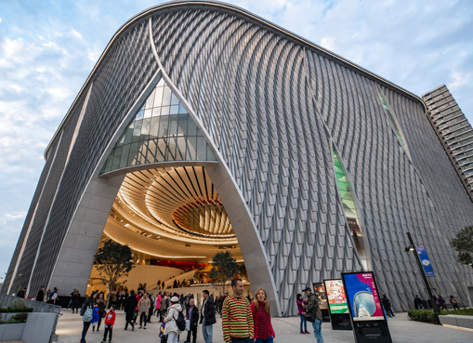
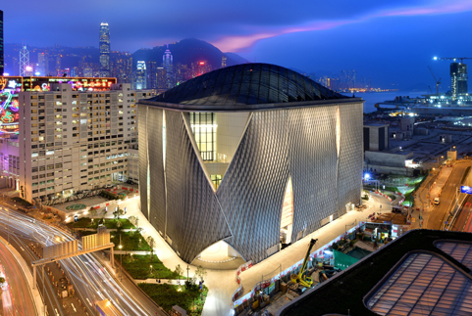
Examples of the HKSAR Government’s work in response to the 14th Five-Year Plan
Statement in the Plan Outline | The latest work progress of The HKSAR government (example)
Support Hong Kong in developing into a hub for arts and cultural exchanges between China and the rest of the world | The HKSAR government continues to promote cultural exchanges between Hong Kong and the Mainland (including the Greater Bay Area) and the world and thus showcase the soft powers of Chinese culture to the world. The Culture, Sports and Tourism Bureau organised the 12th Asian Cultural Co-operation Forum in December 2022. The HKSAR government continues to take forward the construction and improvement works at West Kowloon Cultural District (WKCD) and other venues, as well as promote arts and cultural exchanges. The M+ Museum and the Hong Kong Palace Museum are scheduled for opening in 2021 and 2022 respectively. The Lyric Theatre Complex of WKCD is scheduled for completion in 2024 and will become a centre of excellence showcasing the best of Hong Kong and international dance and theatre.
The Xiqu Centre in the WKCD, a performing arts venue in the West Kowloon Cultural District, was opened on 20 January 2019. It will focus to present quality programmes, promote the development of new repertory, research, education, training and exchanges.
Source: The West Kowloon Cultural District Authority https://www.westkowloon.hk/en/press-release/the-first-landmark-venue-at-west-kowloon-the-xiqu-centre-opens-its-doors-in-january-2019
Source: The Legislative Council Panel on Commerce and Industry: Hong Kong Special Administrative Region’s positioning and supporting measures under the National 14th Five-Year Plan, 15 June 2021 (https://www.legco.gov.hk/yr20-21/english/panels/ci/papers/ci20210615cb1-987-3-e.pdf) .Teachers should also pay attention to the latest information released by the HKSAR Government.

Slide 54
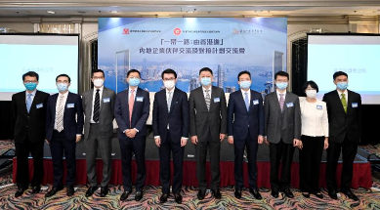
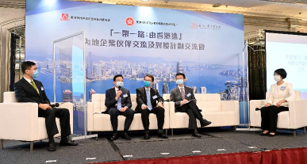
Examples of the HKSAR Government’s work in response to the 14th Five-Year Plan
Statement in the Plan Outline | The latest work progress of The HKSAR government (example)
Support Hong Kong in participating and assisting in the country’s all-round opening up and development into a modern economy, and in jointly establishing a functional platform for the Belt and Road Initiative | Organised a high-level roundtable in conjunction with the State-owned Assets Supervision and Administration Commission of the State Council in January 2021 to promote exchanges and co-operation between state-owned enterprises and Hong Kong’s business and professional services sector. In addition, the Mainland Enterprises Partnership Exchange and Interface Programme was launched in May 2021, and the first sharing session under the Programme was organised to foster exchanges and ties between Mainland enterprises and Hong Kong’s professional services sector. “Belt and Road: Hong Kong-IN”: Mainland Enterprises Partnership Exchange and Interface Programme Sharing Session held on 14 May, 2021”. Source: Government Press Release (https://www.info.gov.hk/gia/general/202105/14/P2021051400323.htm)
Source: The Legislative Council Panel on Commerce and Industry: Hong Kong Special Administrative Region’s positioning and supporting measures under the National 14th Five-Year Plan, 15 June 2021 (https://www.legco.gov.hk/yr20-21/english/panels/ci/papers/ci20210615cb1-987-3-e.pdf) .Teachers should also pay attention to the latest information released by the HKSAR Government.

Slide 55
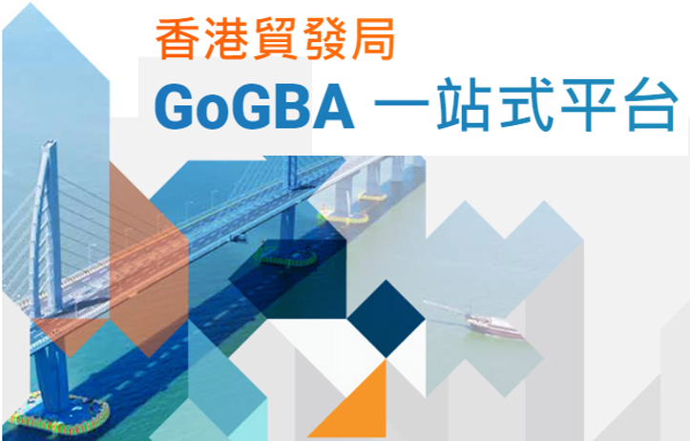
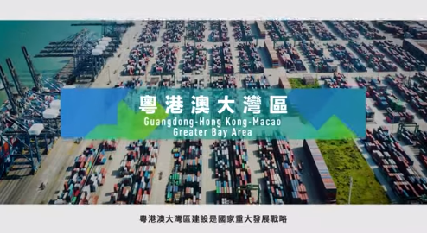


Examples of the HKSAR Government’s work in response to the 14th Five-Year Plan
Statement in the Plan Outline | The latest work progress of The HKSAR government (example)
Deepen the Mainland’s co-operation with Hong Kong in commerce and trade | The Hong Kong Trade Development Council (HKTDC) launched a one-stop GoGBA platform in June 2021 to provide market information on the Greater Bay Area and related government policies, enquiry service and training, as well as business promotion, development and matching services. The HKSAR Government continues to liaise with the Ministry of Commerce to explore new liberalisation measures and new subjects for co-operation under CEPA.
Source: The Legislative Council Panel on Commerce and Industry: Hong Kong Special Administrative Region’s positioning and supporting measures under the National 14th Five-Year Plan, 15 June 2021 (https://www.legco.gov.hk/yr20-21/english/panels/ci/papers/ci20210615cb1-987-3-e.pdf) .Teachers should also pay attention to the latest information released by the HKSAR Government.
The Hong Kong Trade Development Council (HKTDC) has launched GoGBA, which provides business information through its website and WeChat apps for companies wish to expand their market in the Greater Bay Area.
Click the image to watch the video to learn more.
Source: HKTDC (https://www.go-gba.com/en/)

Slide 56
Examples of the HKSAR Government’s work in response to the 14th Five-Year Plan
Statement in the Plan Outline | The latest work progress of The HKSAR government (example)
Deepen and widen the mutual access between the financial markets of the Mainland and Hong Kong | We have implemented the expansion of the scope of eligible securities under the Southbound Trading of Stock Connect from end of December 2021 to cover pre-revenue/pre-profit biotechnology companies listed in Hong Kong under the new listing regime and the inclusion of eligible A-shares listed on the Mainland’s STAR Market into Stock Connect from February 2021.
Source: The Legislative Council Panel on Commerce and Industry: Hong Kong Special Administrative Region’s positioning and supporting measures under the National 14th Five-Year Plan, 15 June 2021 (https://www.legco.gov.hk/yr20-21/english/panels/ci/papers/ci20210615cb1-987-3-e.pdf) .Teachers should also pay attention to the latest information released by the HKSAR Government.

Slide 57




More references for the 14th Five-Year Plan
Source: https://www.cmab.gov.hk/en/issues/14th_5yrsplan_index.htm
Source: https://www.rthk.hk/radio/pth/programme/greaterchina2018

Slide 58

More references for the 14th Five-Year Plan
Radio Television Hong Kong(RTHK) produces many programmes on the 14th Five-Year Plan, covering different fields. Teachers can arrange students to visit the RTHK website to listen/watch the programmes to learn more according to their needs.
Seminar on Strategic Planning of the 14th Five-Year Plan and the Opportunities for Hong Kong, https://www.rthk.hk/radio/pth/programme/2021fourteenth
Talk on 14th Five-Year Plan: Seize the New Opportunities Offered by the 14th Five-Year Plan and Integrate into the New Dual Circulation Pattern, https://www.rthk.hk/tv/dtt31/programme/national14_5yearplan_legco
On Overall Plan for the Guangdong-Macao In-depth Cooperation Zone in Hengqin and Plan for Comprehensively Deepening Reform and Opening up of Qianhai Shenzhen-Hong Kong Modern Service Industry Cooperation Zone” , https://app7.rthk.hk/elearning/gba/related_forum.php
(Continue on the next slide.)

Slide 59
More references for the 14th Five-Year Plan
On Planning and Election, https://www.rthk.hk/tv/dtt31/programme/planningandelection
Huangtingshijie: As the 14th Five-Year Plan Action Plan for Plastic Pollution Control Has Been Released, Can We Say Goodbye to White Pollution? https://www.rthk.hk/radio/pth/programme/huantingshijie/episode/773033?lang=en
Talk on Central Government’s Polices for Hong Kong Youth, https://www.rthk.hk/tv/dtt31/programme/talkonyouthpolicytohk
Seminar on the 14th Five-Year Plan: Summit Seminar on Embracing 14th Five-Year Plan and Integrating into Dual Circulation, https://www.rthk.hk/tv/dtt31/programme/national14_5yearplan_hkcec
We must retain a high spirit of bravely changing the course, https://www.rthk.hk/tv/dtt31/programme/makinganewchina

Slide 60
The End

Slide 61
User guide
The primary users of this resource are teachers. It aims to provide teachers with content knowledge relevant to the topic to enable teachers to have a deeper understanding of teaching content when preparing for their lessons.
All data, videos, photos, pictures, questions and suggested answers can be used for multiple purposes, such as teachers’ teaching materials, references for curriculum planning and learning and teaching, and student assignments, etc. To align with Citizenship and Social Development Curriculum and Assessment Guide (Secondary 4-6) (2021) (C&A Guide), this resource should be adapted to cater for students’ learning diversity and the needs of classroom teaching, etc.
Teachers may provide appropriate supplementary notes/ explanations to enrich this resource in order to enhance students’ understanding of the topic and information provided.
In accordance with the curriculum rationale and aims, teachers may select other learning and teaching resources which are correct, reliable, objective and impartial to help students build up a solid knowledge base, develop positive values and attitudes as well as enhance critical thinking and problem solving skills, and various generic skills.
If some information cannot be provided in this resource due to copyright issue, teachers may visit relevant websites provided.
Some information may have been updated when being used by teachers, teachers may visit the corresponding websites to obtain the up-to-date information.
Please also refer to the C&A Guide to understand the requirements and arrangements of the learning and teaching of the curriculum. Teachers are welcome to point out the areas need improvement, and welcome to provide updated information to enrich the content for all teachers’ reference.

Slide 62
Notice and Disclaimer
Some sources were not translated into English as the official English version is not available.
In case of any discrepancy between the Chinese and English versions, the Chinese version shall prevail.

