Slide 1
Citizenship and Social Development
Theme 2: Our Country since Reform and Opening-up
Topic: Change in people’s life and overall national strength
Learning focus:
Brief introduction to the development of China’s reform and opening-up (key stages) and related strategies
Translated version
May 2022

Slide 2
Learning objectives
Knowledge
To understand the course of development of the reform and opening-up.
To understand the related strategies of each stage of the reform and opening-up.
Skills
To enhance the data analysis skill, thinking skill from multiple perspectives, and critical thinking skill.
To learn to express one’s own arguments, and consider others’ opinions and points of view in an objective and fair manner.
To make reasonable judgments and decisions with facts and evidence.
Values
To enhance students’ national identity and patriotic sentiment.

Slide 3
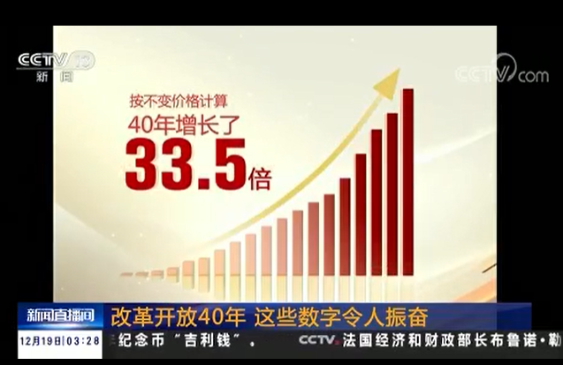
Lead-in
Understanding the changes of
40-year reform and opening-up from data
2018 marked the 40th anniversary of China’s reform and opening-up. The commemorative conference on the 40th anniversary of China's reform and opening-up was held in the Great Hall of the People on 18 December 2018.
Watch the following video to understand the milestones and achievements since reform and opening-up.
Click on the image to watch the video
Source: CCTV. http://tv.cctv.com/2018/12/19/VIDE2v13qkS6A6z26JT2yaoJ181219.shtml

Slide 4
From the video, there were quantum leaps in various aspects from 1978 to 2017. For example:
China’s gross domestic product (GDP) grew 33.5 times with an annual growth rate of 9.5%. China was ranked second in the world.
The industrial production value grew 53 times with an annual growth rate of 10.8%. China was ranked the first in the world.
The volume of trade import and export in service grew over 147 times.
Total volume of trade import and export in goods grew 198 times.
The per capita disposable income (DI) of Chinese people grew from RMB171 to RMB25,947, with an increase of 22.8 times.

Slide 5
The previous video showed great changes in our country and the lives of people were brought by the achievements of reform and opening-up through data.
The learning focus of “Brief introduction to the development of China’s reform and opening-up (key stages) and related strategies” can help you understand the origin, course of development and related strategies of the reform and opening-up.

Slide 6
Background of reform and opening-up
The need to get rid of domestic economic conundrum
Major problems of national economy
The 10 years of Cultural Revolution brought great set-back and loss since the founding of the People’s Republic of China in 1949 on the Communist Party of China, the country and people from all ethnic backgrounds. The internal chaos of the Cultural Revolution directly hit and damage the production capacity, causing a tremendous material loss. The speed of economic development slowed down after the Cultural Revolution. Economic efficiency greatly reduced.

Slide 7

Reference
Despite the relatively comprehensive industrial system established since the founding of the People’s Republic of China until the reform and opening-up, the development under planned economy lacked dynamism and developed slowly.
Accumulated problems of the economic system | Low efficiency of industries | Unbalanced industrial structure | Slow growth of total grain yield affected people’s livelihood
Socio-economic development were severely hindered by inefficient allocation of resources. | The cost effectiveness of industries was low. Compared with other countries, the cost for producing USD1 of Gross National Product was high in China. | Heavy industries were emphasised and light industries set back. Within heavy industries, the focus was processing and manufacturing industries. Energy and transportation were less developed. | In 1976, the annual grain consumption per capita was only 381 catty reflecting the problem of starving.
Source: Department of Comprehensive Reform of Economic System & Institute of Economic System and Management, National Development and Reform Commission, Research Centre of National Development and Reform and Management. Thirty Years of Reform and Opening-up: From History to the Future. Beijing: People’s Publishing House. November 2008, p. 11.

Slide 8
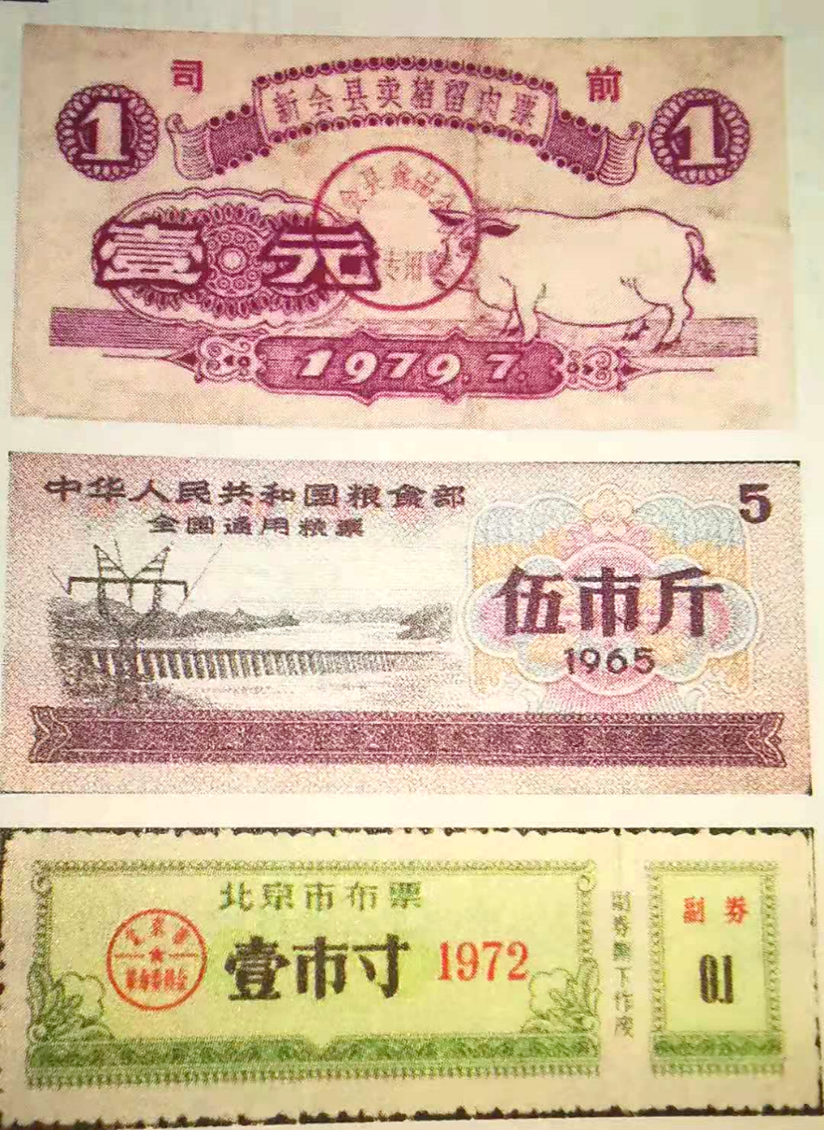
Standard of living was stagnant
From 1960-1977, salary for urban employees was stagnant. Major light industry products and agricultural by-products were in serious shortage. Basic necessities were provided through the ration system with coupons.
Rationing coupons for meat, staple food, and cloth in 60s and 70s of the 20th century

Slide 9
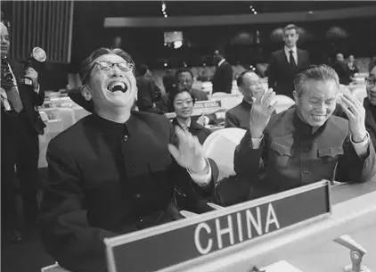
Adaption to the changes in international situation
In October 1971, the United Nations restored China’s lawful seat. Thereafter, the relationship between China and the USA was normalised. China also established diplomatic relationships with Japan and major developed countries in the western Europe. The global environment was becoming favourable for China’s development.
Chinese delegates at the 26th United Nations General Assembly in October 1971
Source: Xinhua News Agency

Slide 10
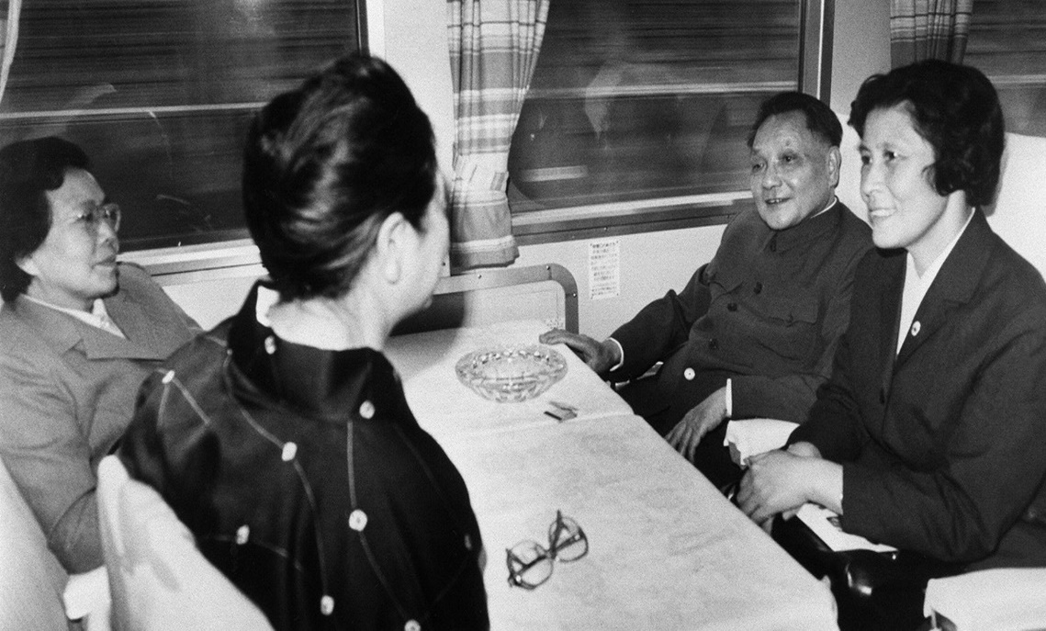
State leaders determined to increase national strength
Before the reform and opening-up, our country’s economic and technological power was far below the international level. In the late 1970s, the state leaders went abroad for visits. They felt the immense external pressure and gradually reached the consensus that the nation must reform to increase its national strength.
In 1978, Deng Xiaoping visited Japan. On 26 October, he and his wife Zhuo Lin took the “Light-81” Shinkansen bullet train from Tokyo to Kyoto. He commented that it’s fast, like urging people to run. That was the type of vehicle for them.
Source: Xinhua News Agency

Slide 11
The beginning of reform and opening-up
Adjustment of development strategy
The reform and opening up began
On 18 December 1978, the Communist Party of China (CPC) held the third plenary session of the 11th Central Committee of the CPC which ended “taking class struggle as the key link” and refocused on economic development, resulting in a major shift in China’s development strategy. Two decisions were also made at the session: first, to open China up to the world; second, to promote modernisation of the nation through reforms. These decisions marked the beginning of the reform and opening-up.

Slide 12
Reference
The Central Committee elected by the National Congress of the Communist Party of China (CPC) is also known as the “CPC central government” or “the Party Central Committee”. During the recess of the CPC National Congress, the Central Committee implements the resolutions of the Congress and leads the work of the CPC.
The number of National Congress is the same as the number of Central Committee. The current Central Committee is elected by the 19th National Congress, therefore, it is the 19th Central Committee.
The CPC Central Committee generally holds one plenary session each year. Each Central Committee holds several plenary sessions, so they are called the first plenary session… the fifth plenary session etc. Therefore, you can see there was the third plenary session of the 11th Central Committee.

Slide 13
Overall development strategy and its adjustment:
The strategic objectives of “Three-step Development Strategy”
The Proposal of “Three-step Development Strategy” (1987)
Following the start of the reform and opening-up, China made strategic planning to achieve socialist modernisation. The “Three-step Development Strategy” was proposed at the 13th National Congress of the CPC in 1987 to help turn the goal of socialist modernisation into feasible steps and to provide a specific development direction. It has became the action plan for the entire nation.

Slide 14
The formulation of the “Three-step Development Strategy”
The “Three-step Development Strategy” was formulated according to the strategic steps to modernisation by Deng Xiaoping:
In December 1979, when meeting Japan’s Prime Minister Masayoshi Ohira, Deng Xiaoping pointed out “The four modernisations we are going to realize are in Chinese style. Our concept of four moderisations (agriculture, industry, national defense, and science and technology) is different from yours. We aim to achieve a ‘moderately prosperous society (xiaokang 小康)’.”
In 1982, the 12th National Congress of CPC confirmed the two-step strategic goal: from 1980 to 2000, the first decade laid a solid foundation to create an ideal environment for achieving economic prosperity in the second decade.
In April 1987, Deng Xiaoping clearly stated the “Three-step Development Strategy” for modernisation. This strategy was recognized in the 13th National Congress of CPC.

Slide 15
Content of the “Three-step Development Strategy”
prosperity
Third step
Second step
By the mid-21st century, increase the per capita GNP level to that of moderately developed countries to ensure a relatively affluent life for the people and to realise basic modernisation.
Moderate prosperity
First step
By the end of the 20th century, double the GNP in 1990 to achieve moderate prosperity.
By 1990, double the GNP of 1980 and provide adequate food and clothing.
Meeting the most basic needs of the people

Slide 16
Content of the “Three-step Development Strategy”
At the 13th National Congress of CPC, the “Three-step Development Strategy” was confirmed. The first step was meeting the most basic needs of the people, the second step was achieving a moderately prosperous society and the third step was reaching the level of moderately developed countries.
The planning for the first two steps was more detailed and specific as they were relatively more short-term goals to be achieved from 1978 to the end of the 20th century. The third step was a more general long-term goal for the early and middle of the 21st century. Concrete planning was drawn up in a later stage.
Building a “moderately prosperous” society was the direction of development of the country in the second step. It aimed to increase people’s income to alleviate poverty, to meet the most basic needs of the people and to move towards prosperity gradually.

Slide 17
Adjustment of the “Three-step Development Strategy”:
the New “Three-Step” (1997)
The New “Three-Step Development Strategy”
Based on the changes of China’s social and economic development, the 15th National Congress of CPC proposed a new “three-step development strategy” when the goal of the second step is within reach. It outlined the next stage of the plan in realising the third step, by further dividing it into 3 steps.

Slide 18

Content of the New “Three-step Development Strategy”
Double the GNP of 2000 to make people’s xiaokang (小康) life even better off.
Expedite economic development and improve all relevant systems
Realise basic modernisation and develop China into a modern socialist country which is prosperous, strong, democratic and culturally advanced
New first step
New second step
New third step
15th National Congress of CPC in 1997
2010
2021 - 100th anniversary of the founding of the CPC
2049 - 100th anniversary of the founding of the People’s Republic of China
The new “three-step development strategy” was derived from the third step of the original “three-step” plan

Slide 19
The significance of the New “Three-step Development Strategy”
After 20 years of reform and opening-up, by the end of the 20th century, our country realised the first and second steps of the strategy by building a moderately prosperous society. A more concrete plan would be needed for the development of the country in the 21st century, which was the original third step.
The evolution of the new “three-step” plan from its original version reflected that concrete planning was made according to the development of the country and in line with the First Centenary Goal set for the 100th anniversary of the founding of Communist Party of China (in 2021) and the People’s Republic of China (in 2049) to enhance the national strength and raise the standard of living.

Slide 20
Adjustment of the New “Three-step Development Strategy” (2017) to establish the modern socialist China through strategic planning
In 2017, integrated the two centenary goals, the 19th National Congress of CPC made strategic plans and arrangements for securing success in building a moderately prosperous society in all respects and for embarking on a journey to fully build a modern socialist China.
Since the second step of the new “three-step” plan was almost achieved, President Xi Jinping divided the next 30 years (until the mid-21st Century) into two stages of national development.

Slide 21
Adjustment of the New “Three-step Development Strategy” (2017) to establish the modern socialist China through strategic planning
Achieving the country's development goals in two stages (over a total of 30 years) from 2020 to the mid-21st century:
The first stage (2020 to 2035): On the basis of building a moderately prosperous society in all respects, China would strive for 15 more years to achieve basic socialist modernisation of the country.
The second stage (2035 to mid-21st century): On the basis of achieving basic socialist modernisation, the nation would strive for another 15 years and develop into a great modern socialist country which is prosperous, strong, democratic, culturally advanced, harmonious and beautiful.
Source: Report of the 19th National Congress of the Chinese Communist Party
http://big5.www.gov.cn/gate/big5/www.gov.cn/zhuanti/2017-10/27/content_5234876.htm

Slide 22
Adjustment of the New “Three-step Development strategy” (2017) to establish the modern socialist China through strategic planning
Completed
Develop China into a great modern socialist country which is prosperous, strong, democratic, culturally advanced, harmonious and beautiful
The first step of meeting the most basic needs of the people and the second step of achieving a moderately prosperous society were achieved.
The GNP in 2000 doubled, making people’s “xiaokang” (小康) life even better off.
Build a moderately prosperous (小康) society in all respects.
Achieve basic socialist modernisation of the country.
First stage
Second step
Second stage
15th National Congress of CPC, 1997
2010
100th anniversary of the founding of the CPC in 2021
2035
100th anniversary of the founding of People’s Republic of China in 2049
New “Three-step”

Slide 23
The significance of adjustment of the New “Three-step development strategy”
Both the original and the new “Three-step” Plans clearly stated the target GNP. However, it is not mentioned in the strategic adjustment, reflecting that that the country no longer focused on fast-growing economic development but high-quality development. Through raising the people's living standards, the country's all-round development is promoted.
From 2035 to mid-21st century, the country is to be developed into a great modern socialist country, which is prosperous, strong, democratic, culturally advanced, harmonious and beautiful. The addition of “beautiful” and “strong” shows that China not only pursues national strength but also values environmental protection.

Slide 24
Questions
Compare the content of each adjustment of the “three-step development strategy” and answer the following questions.
Q(1): Describe the relationship between the country’s modernisation and the “three-step” strategy.
Q(2): Considering the adjustments of the “Three-step Development Strategy”, what are the adjustments in the goal of modernisations?
Suggested answers
1) Realisation of modernisation is the long-term strategic goal of the country. The on-going adjustments and improvements of “Three-step Development Strategy” are the concrete, feasible steps to achieve the goal. In the course of reform and opening-up, strategic adjustments of the development goal have been made according to the progress of modernisation. These strategic goals facilitate the smooth implementation of moderisation of our country.
2) The goal of modernisation has been adjusted from “GNP per capita level reaches moderately developed countries, the livelihood of the people is prosperous” to “prosperous, strong democratic and culturally advanced”, and to “prosperous, strong, democratic, culturally advanced, and harmonised”, and then to “a prosperous, strong, democratic, culturally advanced, harmonious and beautiful”. Such changes show that the goal of modernisation has become more comprehensive.

Slide 25
Summary
The implementation of the “Three-step Development Strategy” represents the timeline and roadmap of the course of modernisation of China. It provides clear and specific strategic goals, implementation strategies in addition to reviews and adjustments during implementation. The strategy promotes the rapid and healthy social and economic development of China in a powerful and continuous manner.

Slide 26
The beginning of Reform and Opening-up (1978-1992)
The Cultural Revolution during 1966-1976 caused great damage and loss to the country and people. After this, China required development in all sectors. At the end of 1978, the third plenary session of the 11th Central Committee of CPC decided to shift its economic development focus. This shift marked the beginning of reform and opening-up. Since then, China has taken a series of strategies to develop from rural to urban areas, from piloting to scaling up and from special economic zones to open port cities, etc.

Slide 27

Rural reform as the forerunner
A collective decision of 18 farming households in Xiaogang Village, Fengyang County of Anhui Province, marked the historic beginning of the reform.
Click on the image to watch the video
Source: https://article.xuexi.cn/articles/video/index.html?art_id=1741593575667399928&part_id=1110817797155973026&study_style_id=video_default&showmenu=false&source=share&share_to=wx_single

Slide 28
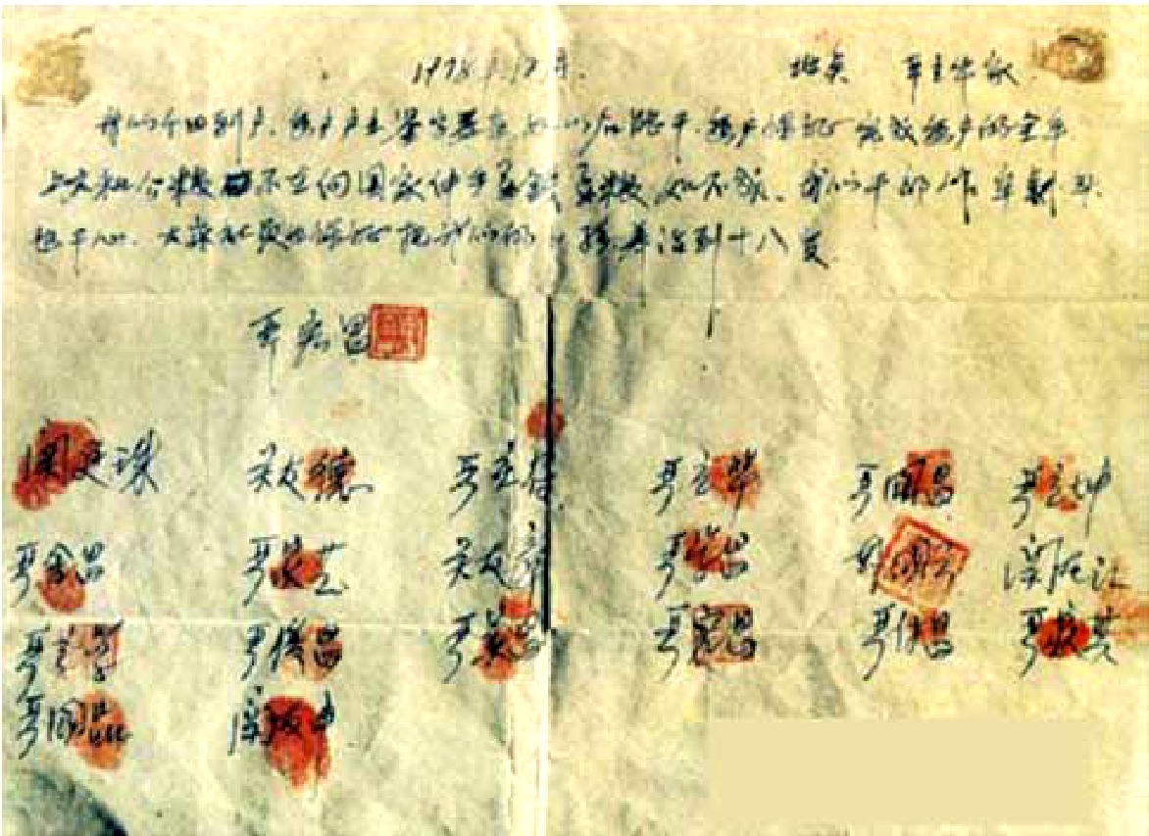
Reference
On the night of 24 November 1978, 18 farming households in Xiaogang Village, Fengyang County, of Anhui Province, affixed their thumbprints on an "household production contract" (see the photo on the right). They promised that each household would produce the target amount of grain yield to submit to the country and would no longer ask the country for money and grain. Their decision was the prelude to the reform of China's rural economy and even the entire economic system.
Source: Xinhua News Agency
In May 1980, Deng Xiaoping published “On Questions of Rural Policy” which stated that after the liberalisation of rural policy, some places implementing “Baochan Daohu (later referred as “household contract responsibility system”). There was “big increase in production. The effect is great. The change is rapid.” He specially mentioned that the new ”baochan daohu” method used by the Fengyang Country “would not affect the collective economy”.
Source:
Deng Xiaoping, “The Question of Rural Policy”, Selected articles of Deng Xiaoping (volume 2). Beijing: People’s Press. 1983, p. 315.

Slide 29
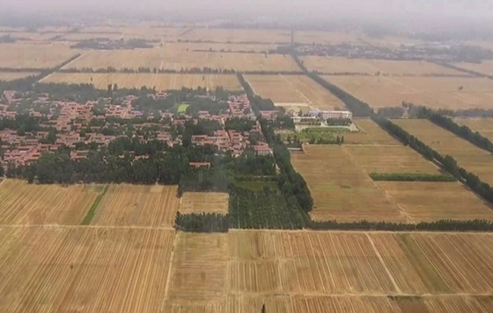
Implementing the “household contract responsibility system”
With the country’s support, the “household contract responsibility system” quickly promoted throughout the nation. This reform arouse farmers’ enthusiasm to work. It not only increased farmers’ income, but also encouraged rapid growth in agricultural production. In 1982, a rare good harvest occurred in China. Total agricultural production increased by 11.2% from 1981. This brought positive changes in rural areas.
Reference
Video: China - 40 Amazing Years (神州40年), episode 4: the first group of rich farmers
Producer: Our Hong Kong Foundation
https://www.youtube.com/watch?v=w0700YDzbQE
Click on the image to watch the video

Slide 30

Reference
Rural economic reform freed up agricultural productivity and ended enduring stagnation in rural productivity. Total grain yield grew from 305 million tons in 1978 to 407 million tons in 1984. Farmers’ actual income showed an annual growth of 15.1%, while the per capita income of urban households during the same period had an annual growth of 7.93%. The differences between urban and rural areas narrowed significantly in this period.
On 1 December 1983, the country announced that it would abandon the 30-year rationing of cotton. In 1994, the retail prices of grain and oil became flexible. Country-wide grain rationing was also abandoned. Rationing coupons which were used over three decades became history.
Source: Department of Comprehensive Reform of Economic System & Institute of Economic System and Management, National Development and Reform Commission, Research Centre of National Development and Reform and Management. Thirty Years of Reform and Opening-up: From History to the Future. Beijing: People’s Publishing House. November 2008, p. 20.

Slide 31
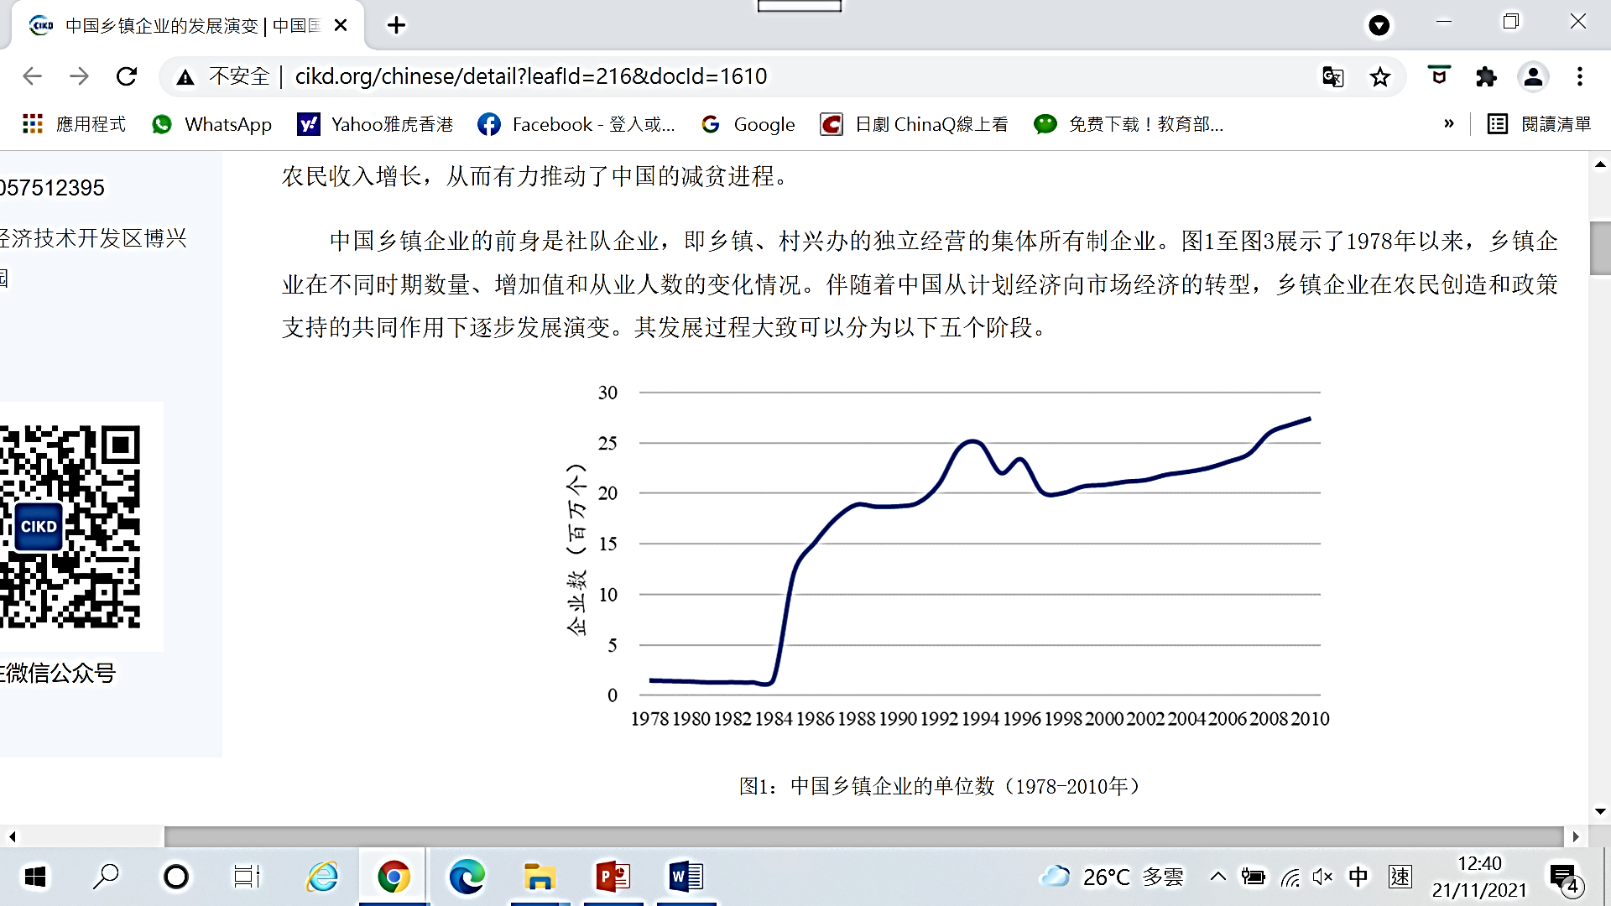
Driving the development of township and village enterprises
The success of rural reform freed up the huge agricultural labour force to enter non-agricultural industries. For example, in the seventh Five-Year Plan (1986-1990), 22 million people from the rural labour force entered township and village enterprises, resulting in a rapid development of these enterprises.
1978-2010 The number of township and village enterprises in China
The No.1 Central Document (the first document released by the central government each year) in 1986 pointed out that township and village enterprises helped overcome the difficulties of limited arable land, labour surplus and shortage of capital. These enterprises found an effective way to establish a new rural-urban relationship.
Number of enterprises (in million)
Source:
National Bureau of Statistics of China. Statistical Communiqué of the Seventh Five Year Plan on National Economic and Social Development
.
Chen Xiao. Development of Township and Village Enterprises in China. Center for International Knowledge on Development. http://www.cikd.org/detail?leafId=216&docId=1610
Number of enterprises (in million)

Slide 32
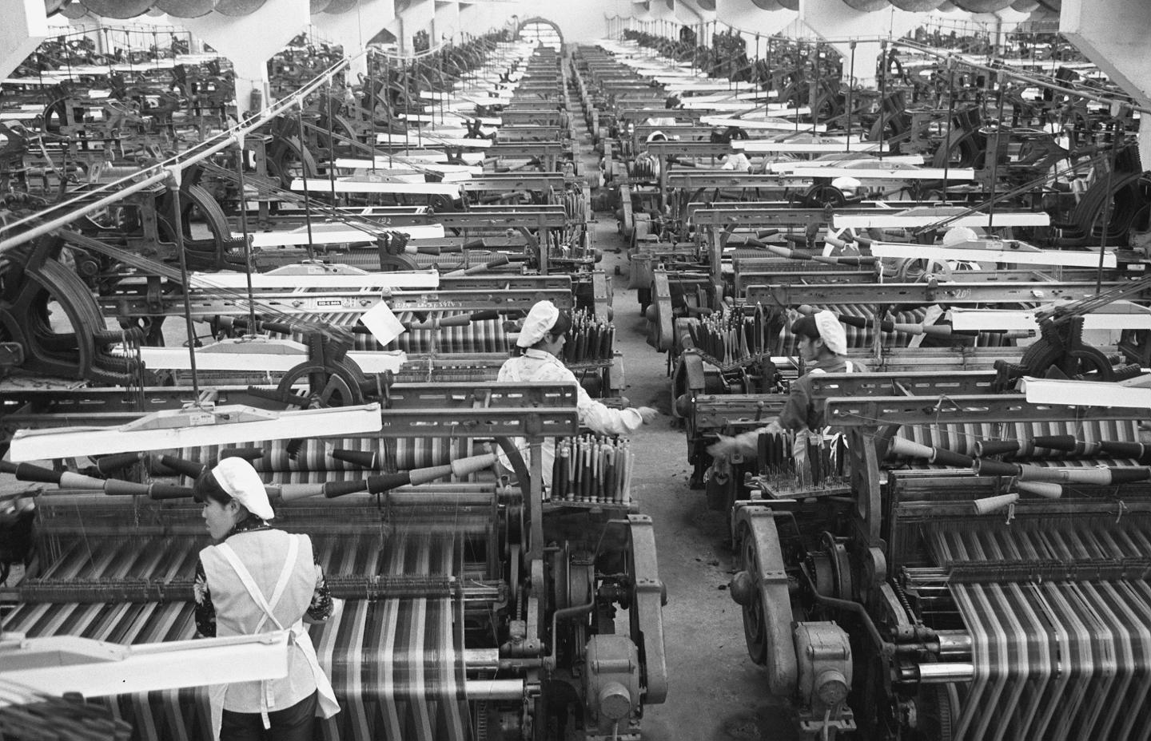
Reference
Development model of Township and village Enterprises
Township and village enterprises started to develop in the coastal area of eastern China since the mid-1980s. Three typical regional economic development models, namely Sunan (southern Jiangsu) model, Wenzhou model, and Zhujiang model, were established.
The Sunan model: Township and village enterprises mainly ran in the collective economic style led by the local town government
The Wenzhou model: Township and village enterprises were mainly family business in specialised markets
The Zhujiang model: Township and village enterprises took advantage of their geographical proximity to Hong Kong and Macao to attract foreign capital to develop processing and compensation trade
Township and village enterprises leading the Sunan rural economy.
Chen Xiao. Evolution of Township and Village Enterprises in China. Center for International Knowledge on Development. http://www.cikd.org/detail?leafId=216&docId=1610
Source of the picture: Xinhua News Agency

Slide 33
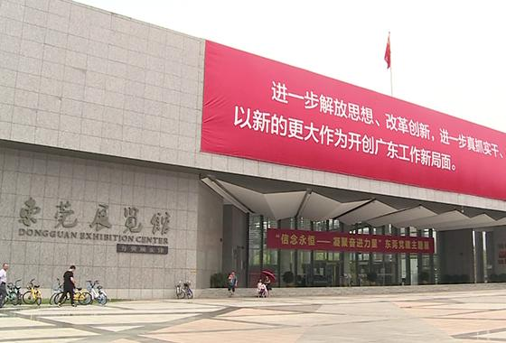
Reference
Processing and compensation trade
Due to the lack of capital in the early days, many enterprises in Shenzhen used a barter system to get equipment for expansion. The first practitioner was Liantang Stone Factory (蓮塘石廠), which had large reserves of stones but lacked good equipment. At that time, Hong Kong needed a vast quantity of stone for reclamation projects. The two sides liaised and immediately agreed on a deal to exchange stone with equipment.
Source: Exchange of stone for equipment starts the processing and compensation trade (石頭換設備 促成「三來一補」廠落戶), Ta Kung Pao. 26 August 2020.
Video: China - 40 Amazing Years (神州40年), episode 5: Processing and compensation trade. Producer: Our Hong Kong Foundation
https://www.youtube.com/watch?v=_lmSZAliN6k&t=67s
Click on the image to watch the video

Slide 34
Urban economic reform from piloting to scaling up
Expand the managerial autonomy of state-owned enterprises to enhance their vitality
The experiment of urban economic reform started by granting more autonomy to the management of state-owned enterprises. This addressed the problems of rigid management and lack of vitality in the enterprises. In 1978, with the approval of the State Council, 6 state-owned enterprises in Sichuan piloted this experiment. In 1979, the central government issued multiple documents to scale up the piloting practice in multiple locations.
Building on the above foundation, urban reform gradually moved to the economic responsibility system. Economic benefits of an enterprise and of their workers were linked to their responsibility and economic efficiency. Workers became more active. Since then, the economic responsibility system has been adopted in different industries throughout the country.

Slide 35
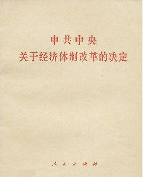
Dismantling the dichotomy of planned economy verse market economy
In October 1984, the third Plenary Session of 12th Central Committee of CPC adopted the “CPC Central Committee’s Decision on Economic Restructuring” as the guiding document of economic reform.
The Decision represented a significant breakthrough, dismantling the traditional dichotomy of planned economy versus market economy. It stated that China’s socialist economy is “a planned commodity economy on the basis of public ownership”, in which the “ownership and management right can be appropriately separated”. It also emphasised that “a fully developed commodity economy… is the necessary precondition to realise economic modernisation in China.”
Source: A Brief History of the People’s Republic of China. People’s Publishing House, Contemporary China Publishing House. August 2021, p. 166.

Slide 36
Promoting a structural reform of ownership
Adopt strategies that support urban collective economy and private economy
In 1979, to reduce the unemployment pressure, China adopted strategies that supported urban collective economy and private economy. It started the reform of having multiple, co-existing economic models with public ownership as the mainstay. Since then, the ownership structure of China has undergone tremendous changes.
At that time, many people became sole proprietors. This addressed the employment problem that had been growing for years. It also further improved the ownership structure.

Slide 37
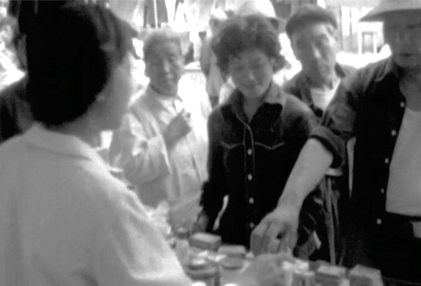
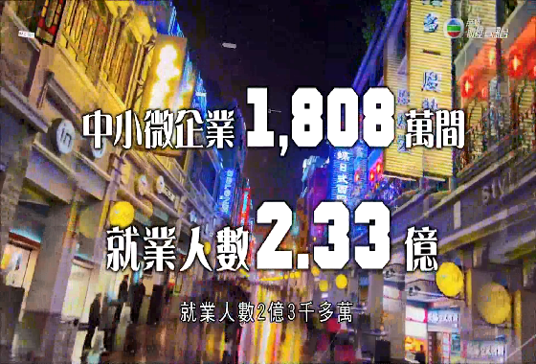
Reference
Cases of private business emerging in the early 1980s
Video: China - 40 Amazing Years (神州40年), episode 2: The First Privately owned Hotel.
Producer: Our Hong Kong Foundation
https://www.youtube.com/watch?v=d2qnPZ6B_aU
Click on the image to watch the video
Video: China - 40 Amazing Years (神州40年), episode 20: The First Sole Proprietor.
Producer: Our Hong Kong Foundation
https://www.youtube.com/watch?v=kFHG8-sS7yM&t=6s
Click on the image to watch the video

Slide 38
The strategy of “Allowing and encouraging some people and some areas to get rich first to achieve common prosperity” was adopted
Rural and urban reforms brought immediate results. However, there was a development gap between urban and rural areas and across regions. The national policy allowed some people and some areas become rich first through honest work and lawful business (誠實勞動、合法經營). Their prosperity could inspire and show the way to those areas that lag behind. The ultimate goal was to achieve common prosperity.

Slide 39

Opening-up Strategy
Attract foreign investments
At the initial stage of the reform and opening-up, China adopted a policy with the strategy of “market in exchange of capital” at its core to attract foreign investments. This was intended to tackle a lack of capital, managerial experience and technology. Foreign-funded enterprises (China-foreign joint ventures, China-foreign cooperative enterprises and foreign-owned enterprises) and Enterprises of processing and compensation trade were established.
Reference
During the seventh Five-Year Plan (1986-1990), foreign capital of USD46.09 billion was invested, of which USD30 billion were in loans, and USD14.17 were in foreign direct investment. By the end of 1990, there were about 29,000 foreign direct investment projects and over 10,000 enterprises have been established.
Source: National Bureau of Statistics of China. Statistical Communiqué of the Seventh Five Year Plan on National Economic and Social Development.

Slide 40
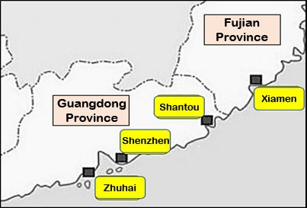
Establishment of Special Economic Zones
One of the major opening-up strategies was to establish special economic zones (SEZs). Special policies and flexible measures have been adopted in these SEZs. The Zones act as windows for opening-up, pilot areas for economic system reform and demonstration zones for economic development.
On 26 August 1980, China established special economic zones in Shenzhen, Zhuhai, Shantou of the Guangdong Province, and Xiamen of the Fujian Province.

Slide 41
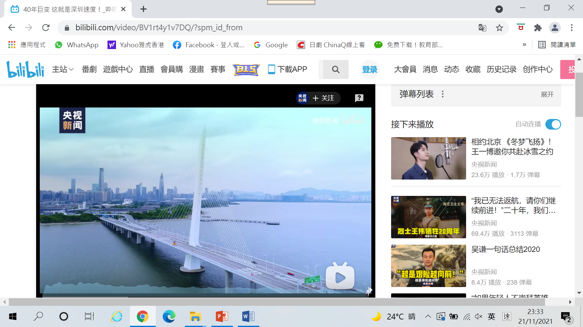
Reference
Setting up of special economic zones and the development of Shenzhen
After the third plenary session of 11th CPC Central Committee held in December 1978, the idea of establishing special economic zones was gradually formed. In April 1979, during a meeting of the CPC Central Committee, the responsible person of the Guangdong Provincial Committee suggested that the central government delegate certain powers to allow the establishment of export processing zones in Shenzhen and Zhuhai, which are near Hong Kong and Macao, as well as Shantou, which is an important hometown of overseas Chinese. This suggestion was valued by the CPC Central Committee leaders. When Deng Xiaoping spoke with the Guangdong provincial committee, he stated, “It’s better to call them special zones… The Central Government doesn’t have the money, but we can set up policies to support you. You surge forward and make it a success."
Source: excerpt from Setting up Special Economic Zones, People.cn. 12 October 2019.
http://politics.people.com.cn/BIG5/n1/2019/1012/c1001-31396585.html
Video: 40 Years of Change: Shenzhen Speed (40年巨變 這就是深圳速度！)
Source: https://www.bilibili.com/video/BV1rt4y1v7DQ/
Click on the image to watch the video

Slide 42
Gradual opening-up of coastal cities
Given the outstanding achievements of the SEZs of Shenzhen, Zhuhai, Shantou and Xiamen, the central government decided to further open up coastal cities and establish coastal economic open zones.
On 4 May 1984, the country opened up 14 coastal cities including Tianjin, Shanghai, Dalian, Qinhuangdao, Yantai, Qingdao, Lianyungang, Nantong, Ningbo, Wenzhou, Fuzhou, Guanzhou, Zhanjiang and Beihai.
In February 1985, the country designated the Changjiang Delta, Zhujiang Delta and Xiamen-Zhangzhou-Quanzhou triangle in Southern Fujian Province (閩南廈漳泉三角地區) as coastal economic open zones.
In April 1988, the country approved the establishment of Hainan Special Economic Zone.
In April 1990, the country approved the development and opening-up of Pudong, Shanghai.
資料來源：《中華人民共和國史》，高等教育出版社，人民教育出版社，第295頁，第335-337頁。

Slide 43

Reference
Setting up and development of Pudong Development Zone, Shanghai
In the 1980s, Shanghai was lagging behind China's reform and opening-up. However, since Pudong opened up, Shanghai has taken a leading position in the economic reform. The opening-up of Pudong provided a great modelling effect for the reform. At that time, a common expression said “In the 80s, look at Shenzhen. In the 90s, look at Pudong.” According to Deng Xiaoping, Pudong’s development was a trump card played by China. He also said, “developing Shanghai is a shortcut.”
Source: Excerpt from “Pudong’s opening-up and development in the eye of a journalist of the same generation – interview of Xie Guoping, author of ‘the China Legend: the Development History of Pudong‘(「同代記者」眼中浦東開發開放—專訪《中國傳奇：浦東開發史》作者謝國平)”. China Pictorial. October 2018.
Video: The development of Pudong, Shanghai is the trump card against international sanction.
Source: https://www.youtube.com/watch?v=bZzNab_NYCA
Click on the image to watch the video

Slide 44
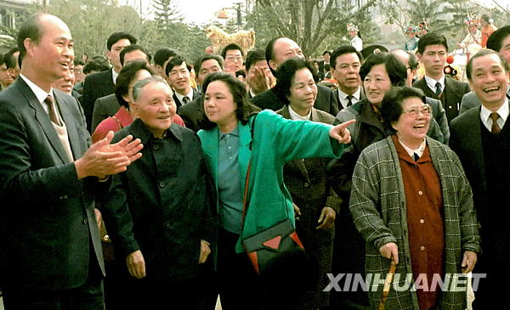
Deng’s Southern Tour promoted the Reform and Opening-up (1992—2001)
From 18 January to 21 February 1992, Deng Xiaoping toured Southern China and gave a speech. He answered many major questions that had been plaguing the people. This lifted the reform and opening-up to the next stage.
Source: Xinhua News Agency
After this visit, the country set up reform targets and the basic framework of a socialist market economy. A series of measures were introduced in order to accelerate reform and development and promote a model of economic reform with state-owned enterprises as a focus for in-depth expansion. In addition, the measures introduced would expand the opening-up, build a comprehensive opening-up structure and guarantee the realisation of the goal of moderately prosperity (總體小康).

Slide 45

Adopting the major strategy to build a socialist market economy
In 1992, the country identified the goal for economic reform as building a socialist market economy system. The focus of the reform was to properly manage the relationship between the planned and the market economies so that the market could play the fundamental role of resource allocation under national macro-regulation.
A socialist market economy shares the commonalities of market economy while maintains its own features: Public ownership is the mainstay; the ultimate goal is common prosperity and scientific macro-regulation is implemented.
Deng’s Southern Tour Speech
Click on the image to watch the video
Source: https://article.xuexi.cn/articles/video/index.html?art_id=1892714815530139406&read_id=9aef3fc3-e336-4da8-bbba-8aa90feba70c&ref_read_id=74ec279e-ecd1-4705-8516-ed08cdfdcc9b&reco_id=&mod_id=&cid=&source=share&study_style_id=video_default

Slide 46
Adopting measures to strengthen macro-regulation
After setting up the goal of socialist market economic reform, there was high enthusiasm throughout the country. The economy developed rapidly and there was a fever for company start-ups. However, as some locations and some industries were overenthusiastic in seeking speedy development, an overheated economy phenomenon ensued.
In response to this, the country adopted appropriate fiscal and monetary policies. In 1996, China successfully achieved a “soft landing” with a “high growth rate and a low inflation rate”. In this way, the country avoided drastic economic fluctuations.

Slide 47
Reference
Macro-regulation
Macro-regulation refers to the national-level activities to regulate and control the market economic volume and structure through various macro-economic policies and regulations to meet the preset targets. The main mission of macro-regulation is to achieve a balanced economic volume, curb inflation, promote major economic structural optimization and realise stable economic growth.
In addition to the necessary administrative measures taken, macro-regulation in the country in the 1990s mainly focused on economic and legal measures. Through comprehensive reform in the areas of pricing, taxation, fiscal measures, finance, foreign trade and investment, etc., the new national macro-regulation system based on market was basically established.

Slide 48
Pressing for a comprehensive rural reform
The management system and agricultural structure were not compatibility with market economy. The country implemented strategic adjustments to agricultural structure. Land contractual term was extended for 30 years, and the strength of poverty alleviation measures was enhanced. The country also established a basis for household contract management (家庭承包經營) in order to adapt the rural economic system to the requirements of a socialist market economy.

Slide 49
State-owned enterprises being the priority of reform
After 1992, the country adjusted the economic layout of state-owned enterprises. The economic reform process entered a stage of overall advancement and breakthroughs, focusing on the control and influence of state-owned enterprises.
At this stage, there were two main lines for reforming state-owned enterprises. The first was to pilot modern enterprise management systems in medium to large-scale state-owned enterprises. The second was to carry out reform of the property rights system through various forms such as reorganisation, alliance, merger, joint-stock cooperative system, leasing, contract management and sale.

Slide 50
Reference
Establishing modern enterprise system
The modern enterprise system has the following characteristics: clear property rights, accountability, separation between government and enterprise, and scientific management.
After 1992, the State Council approved the piloting of modern enterprise system in 100 state-owned enterprises according to the system requirements. 2,343 local enterprises also participated. The enterprises in the pilot projects were allowed to restructure their corporate system and stock system to turn themselves into self-managed, self-financing, self-developing and self-regulating market entities.
By 2000, most key state-owned enterprises had undergone corporate system reform. A certain number of them became listed companies in and outside China. In 2000, state-owned and state-controlled industrial enterprises earned a profit of RMB 239.2 billion, which was 2.9 times that earned in 1997.
Source: The Institute of Contemporary China Studies: “70 Years of the PRC”. Beijing: Contemporary China Publishing House . January 2019, p. 229.

Slide 51
Implementing the opening-up strategy and
build an all-around opening-up pattern
All-round, multi-level, wide-range opening-up pattern
While implementing coastal economic development strategy, the country also opened up cities on its borders, along the rivers and inland. In the mid-1990s, it basically formed an all-round, multi-level, wide-range opening-up pattern of “special economic zones – opening coastal cities – coastal open economic belts – opening riverside and inland cities – opening border cities”. After 2000, following the implementation of the “Go West” strategy, the opening-up policy further expanded into the hinterland of the country.

Slide 52
Reference
Cities that opened up since 1990
Cities along Changjiang
Wuhu, jiujiang, Yueyang, Wuhan, Chongqing, and the Three Gorges Reservoir area.
Inland provincial cities
Taiyuan, Hefei, Nanchang, Zhengzhou, Changsha, Chengdu, Guiyang, Xian, Lanzhou, Xining, Yingchuan.
Border cities
Hunchun, Suifenhe, Heihe, Manzhouli, Erlianhot, Yining, Tacheng, Bole, Ruili, Wanding, Hekou, Pingxiang, Xingdong.

Slide 53
Implementation of “go global” strategy
Following the trend towards globalisation, the country implemented the “go global” strategy by combining “attract foreign investment” and “go global”. The “go global” strategy fully utilises international and domestic markets as well as their resources to promote quality over quantity and a diversified market. It facilitated the development of an open economy.

Slide 54

Reform and opening-up after joining World Trade Organization (WTO) (2001—2012)
China’s accession to WTO
On 11 December 2001, China officially became a Member State of the WTO. This was an important milestone in the country’s reform and opening-up journey. It also represented an important opportunity for the country’s further opening-up.
After its accession to the WTO, China upheld free trade ideals and fulfilled its promise by opening-up its market for mutual benefits and a win-win situation.
Click on the image to watch the video
Source: https://article.xuexi.cn/articles/video/index.html?art_id=9624569443852382528&read_id=4f87234b-d481-4ada-beff-ed717193163f&ref_read_id=9aef3fc3-e336-4da8-bbba-8aa90feba70c&reco_id=&mod_id=&cid=&source=share&study_style_id=video_default

Slide 55
Reference
World Trade Organization
The World Trade Organization (WTO), founded in 1995, was formerly the General Agreement on Tariffs and Trade (GATT) signed in 1947. Its headquarters is in Geneva, Switzerland. As of 2021, there were 164 member states in the WTO.
In July 1986, China applied to restore its status as a contracting party in GATT and began its negotiation with the parties concerned. In 2011, China became the 143rd member of the WTO. In 1986, Hong Kong joined GATT as a separate customs territory and, in 1995, became a founding member of the WTO. After its return to the Mainland in 1997, Hong Kong maintained its separate membership as “Hong Kong, China”.
The WTO’s main activities include monitoring the implementation of multilateral trade agreements, presiding over multilateral trade negotiations, resolving trade disputes, reviewing trade policies of the Member States, enhancing trading capacities of developing countries, and collaborating with the International Monetary Fund and the World Bank to formulate global economic policies.
Source:
A Brief History of Reform and Opening-up (改革開放簡史), People’s Publishing House, China Social Sciences Press. P. 130-131.
The website of the Ministry of Foreign Affairs of the People’s Republic of China. https://www.mfa.gov.cn/web/gjhdq_676201/gjhdqzz_681964/lhg_681966/jbqk_681968/200802/t20080229_9380022.shtml

Slide 56

Improvement of the socialist market economy
In the early 21st century, through the exploration during the course of the reform and opening-up, the country basically established a socialist market economy and maintained generally sound economic development. However, there were still many problems with the system which needed to be resolved through further economic reform.
Examples of some major problems with the socialist market economy: unreasonable economic structure, unsettled distribution relationships, slow growth of farmers’ income, prominent employment conflict, stressed resource environment, weak overall economic competitiveness
Source: Decision of the Central Committee of the Communist Party of China on Some Issues concerning the Improvement of the Socialist Market Economy. Website of the Central People’s Government of People’s Republic of China. http://big5.www.gov.cn/gate/big5/www.gov.cn/test/2008-08/13/content_1071062.htm

Slide 57
The approach to accelerate change in economic development
To solve the economic problems (see the reference below), the country proposed a strategic mission to accelerate the transformation of economic development approach from extensive growth to intensive growth to facilitate the all-round sustainable economic development.
Reference
In 2003, the country’s GDP accounted for a mere 4% of the world’s total production. However, its resource consumption in different sectors was relatively higher. China’s consumption was 7.4% in oil, 31% in coal, 27% in steel, 25% in aluminium oxide and 40% in cement. China’s water consumption is comparable to that of the USA, but its GDP was only 1/8 of that of the USA. The GDP produced per ton of standard coal was only 30% of world’s level. Therefore, the extensive development approach with high investment, high consumption and low output no longer met the development needs.
Source: Extensive economic growth approach should be changed. Website of the Central People’s Government of People’s Republic of China. 9 October 2005.
http://www.gov.cn/ztzl/2005-10/19/content_79564.htm

Slide 58
Reference
Extensive economy and intensive economy
Extensive economy | An extensive economy increases production by raising the input of production factors, such as increasing investment, expanding factories, increasing labour input. Its basic characteristic is to expand its production scale by increasing the factors of production in order to promote economic growth. To achieve economic growth through this approach involves higher consumption and cost, but without much improvement in the quality of production. It has lower economic efficiency.
Intensive economy | While the production scale remains unchanged, elements such as new technologies and skills, improved equipment and facilities and increased use of technology are introduced to increase production. Its basic characteristic is to raise the quality of production input and to enhance the efficiency for economic growth. To achieve economic growth through this approach involves lower consumption and cost, with a continuous improvement in the quality of production. It has higher economic efficiency.
Source: Extensive and Intensive Economies. SuoWen Civil Service Information Network. 29 October 2021. http://www.chinagwyw.org/gjgwy/582501.html

Slide 59

Deepening reform of the state-owned enterprises and
state-owned asset management system
Along with the acceleration of shareholding and corporate reforms of state-owned enterprises, the monitoring system of these state-owned assets was gradually developed and improved. Responsibility for preserving and increasing the value of these assets has been undertaken. Through the alliance and reorganisation of these state-owned enterprises, a wave of internationally competitive companies and large enterprises has emerged.
Reference
Video: China - 40 Amazing Years (神州40年), episode 21: Reform of State-owned enterprises.
Producer: Our Hong Kong Foundation
https://www.youtube.com/watch?v=L3EVNJ_SzII
Click on the image to watch the video

Slide 60
Co-ordination of urban and rural development
Unbalanced urban-rural development has impeded China’s economic and societal development. To co-ordinate urban and rural development, The country adopted the principle of “giving more, taking less, loosening control” in its course of developing socialist new rural area (see the reference below). China abolished agricultural tax to increase farmers’ income. China entered the development stage that agricultural and rural development was being promoted by industry and urban development.
Reference
Giving more | Increase agriculture input, enhance basic infrastructure in rural areas and promote advancement in agricultural technology to create conditions to boost farmers’ income
Taking less | While consolidating existing successes, gradually abolish taxation that should not be borne by farmers so as to create conditions for the standardisation of taxation in urban and rural areas
Loosening control | Give farmers more flexibility to vitalise the rural economy. Deepen the reform of rural operation system to motivate farmers to start businesses
Source, “Document No. 1 Explained: Maintain Giving More, Taking Less, Loosening Control” Principle. Sina Web. 10 February 2004.
http://news.sina.com.cn/c/2004-02-10/15591765676s.shtml

Slide 61
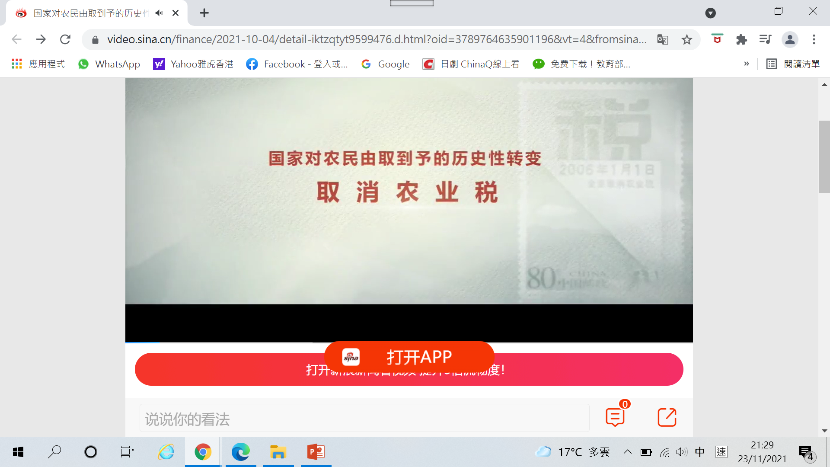
Reference
On 1 January 2006, China abolished the “Regulation of the People's Republic of China on Agricultural Tax”. Since then, agriculture has no longer been taxed, ending the levy that had existed for 2,600 years. The abolishment of agricultural tax and various surcharges relieved farmers from overwhelming financial burdens and brought benefits to millions of farmers.
Source: “Abolishing agricultural tax”. Website of the Central People’s Government of People’s Republic of China . 6 March 2006. http://big5.www.gov.cn/gate/big5/www.gov.cn/test/2006-03/06/content_219801.htm
Video: From Taking to Giving: Historical Changes in National Policy: Abolishing Agriculture Tax
https://video.sina.cn/finance/2021-10-04/detail-iktzqtyt9599476.d.html?oid=3820029017659471&vt=4
Click on the image to watch the video

Slide 62
Co-ordination of regional development
Unbalanced regional development has been a problem that impeded the country’s economic and social development. In March 2001, the central government released the Report on the 10th Five-Year Plan and announced the concrete plan of “ Go West”.
At the same time, the central government focused on achieving co-ordinated regional development. It proposed some major decisions such as revitalising the old industrial bases in the northeastern region and promoting the rise of the central region. This formulated and enriched the overall strategy of regional development.

Slide 63
Reducing tariff, expanding the opening-up, promoting reform
To meet WTO’s regulations, China fulfilled its promise and reduced its tariffs drastically. By 2010, the overall tariff was reduced from 15.3% in 2001 to 9.8%. Specifically, the tariff on industrial goods was reduced from 14.8% to 8.9% and that on agricultural products from 23.2% to 15.2%. This agricultural tariff was about ¼ of the world average on agricultural products. It was also much lower than the average level of 56% for developing countries and 39% for the developed countries.
On the other hand, the country has been revising laws and regulation on a large scale. During 2001 to 2010, the central government revised more than 2,300 laws and regulations including departmental regulations. The local governments cleaned up more than 190,000 local policies and regulations.
Source: “China and World Trade Organization”, People.cn. 19 June 2018.
http://politics.people.com.cn/BIG5/n1/2018/0629/c1001-30095141.html

Slide 64
New era of reform and opening-up after the 18th National Congress (2012-present)
Comprehensively deepening the reforms
With the deepening of the reform and opening-up, the difficulty in forging forward the reform has also increased. It has become necessary to enhance the strength and depth of the reform in order to address the development needs then.
In November 2013, the third plenary session of the 18th National Congress was held, with the theme of comprehensively deepening reforms. It was the first time such a theme was proposed as the overarching aim. Specifically, the goal was to “improve and develop socialism with Chinese characteristics, and promote modernisation of the state governance system and its governing capacity”. To deepen the reform, proper arrangement has been made to achieve this overarching aim through formulating systematic approaches and methods, and focusing on the innovation of major system. Reform has been deepened in full steam, with multiple breakthroughs and in-depth advancement.

Slide 65
Reference
The third plenary session of each National Congress of CPC usually makes important decisions regarding economic reform. Therefore, these key reform issues attracts great attention. The following table shows the key reform issues for each National Congress since the implementation of the reform and opening-up.
Name of the conference | Key reform issues
The third Plenary Session of 11th National Congress (December 1978) | Reform and opening-up
The third Plenary Session of 12th National Congress (October 1984) | Reform of economic system
The third Plenary Session of 13th National Congress (September 1988) | Consolidations and deepening reform
The third Plenary Session of 14th National Congress (November 1993) | Establishing socialist market economy system
The third Plenary Session of 15th National Congress (October 1998) | Rural reform
The third Plenary Session of 16th National Congress (October 2003) | Optimising socialist market economy
The third Plenary Session of 17th National Congress (October 2008) | Promoting rural reform and development
The third Plenary Session of 18th National Congress (November 2013) | Comprehensively deepening reforms
The third Plenary Session of 19th National Congress (February 2018) | Deepening the reform of Party and State institutions

Slide 66
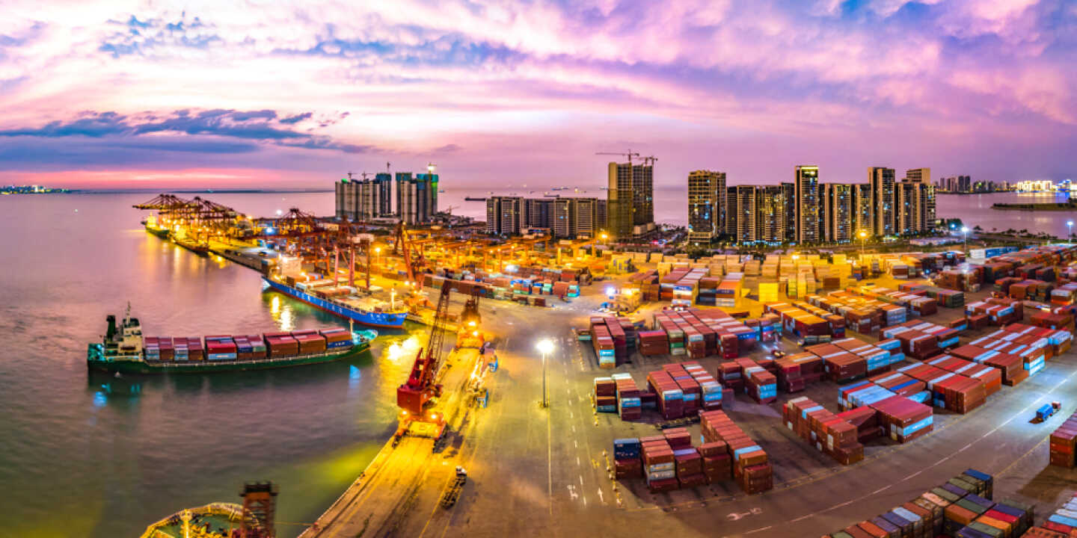
Establishment of pilot free trade zones
As high-level carriers of reform under the opening-up policy, pilot free trade zones explored new ways and accumulated new experiences for comprehensively deepening reforms.
The first pilot free trade zone was set up in Shanghai in September 2013. Subsequently, free trade zones were founded in Guangdong, Tianjin, Fujian, Liaoning, Hainan and Shandong. Currently, free trade zones have been spread across various provinces, acting as testbeds for reform.
Reference
Video: Free trade zones facing the world
Source: The China Current https://chinacurrent.com/education/article/2020/06/21997.html
Click on the image to watch the video

Slide 67
The new normal for economic development
After 2011, China’s economic growth slowed down. The country has come to the conclusion that its economic development has entered the ‘new normal. “Understanding the new normal, adapting to the new normal, and leading the new normal” has become the overarching logic of China’s economic development since the 18th National Congress.
新常態下我國經濟發展的主要特點
Growth rate
High speed
Medium-high speed
Development approach
Scale and speed
Quality and efficiency
Focus on quantity
and expansion
Adjust the stock, focus on both quality and quantity
Economic structure
Development momentum
Driven by production factor
and investment
Driven by innovation

Slide 68
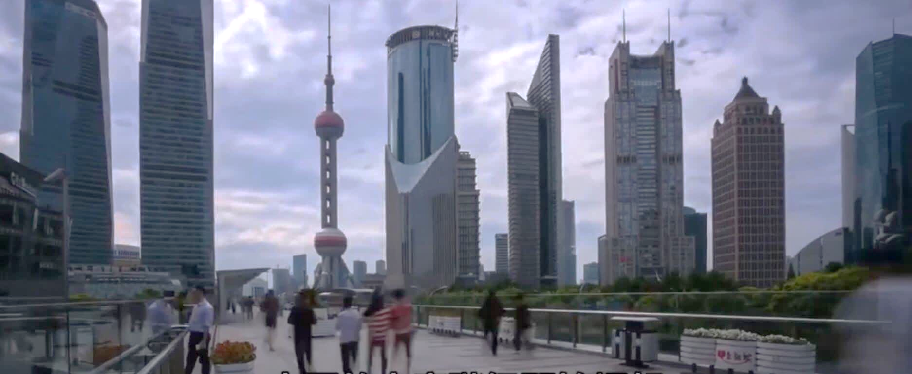
New development model of domestic and international ‘dual cycle’
This economic policy would make full use of China’s super large-scale market and its domestic demands to establish the new development model of ‘dual cycle’, with domestic and foreign markets boost each other.
Video: Lawrence Lau Juen-yee explains the mid-to long-term policy of “internal circulation”
Source: The China Current https://chinacurrent.com/education/article/2021/06/22561.html
Click on the image to watch the video

Slide 69
Bringing comprehensive opening-up to a new level
The scale of the country’s opening up will increase. The country bring comprehensive opening-up to a new level with the focus on the “Belt and Road” Initiative (see the reference in the next slide). It maintains its policy of “attract foreign investment” and “go global” and follows the principles of extensive consultation, joint contribution and shared benefits. These will enhance open co-operation in building innovation capacity and bring two-way opening-up links running eastward and westward over land and sea.

Slide 70

“Belt and Road” Initiative
Reference
When visiting Central Asia and South East Asia in September to October 2013, President Xi Jinping put forward the “Silk Road Economic Belt” and the “21st Century Maritime Silk Road”. These were ideas for a regional economic collaboration strategy, which was later shortened to and known as the “Belt and Road” Initiative. The countries along the “Belt and Road” have different natural resources and thus have strong economic complementarity. Therefore, there is great potential and space for international co-operation. In March 2015, China released the “Vision and Actions on Jointly Building the Silk Road Economic Belt and 21st-Century Maritime Silk Road”.
See people.cn. (http://ydyl.people.com.cn/BIG5/n1/2017/0425/c411837-29235511.html) which detailed the principle, co-operation priorities, and co-operation mechanism of the “Belt and Road” Initiative.
Video: Silk Road, Belt and Road
Source: The China Current
https://chinacurrent.com/education/article/2021/06/22148.html
Click on the image to watch the video

Slide 71
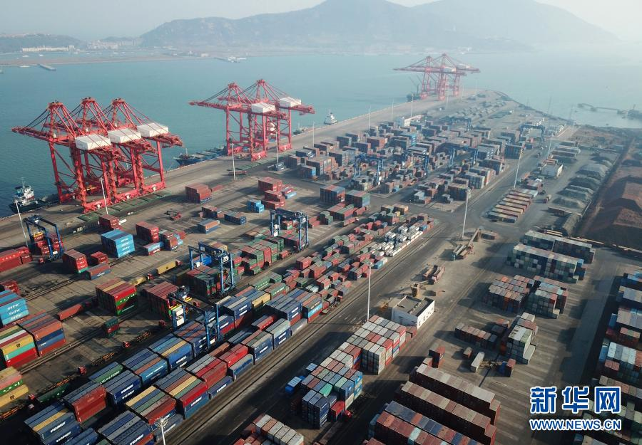
Accelerating the establishment of trading power
The country has accelerated the optimisation of trade in goods, promoted innovation in trade in service promote new mode of trade, implement more proactive import policy.
According to statistics released by the General Administration of Customs of the PRC, China’s total value of import and export for trade in goods increased by 1.9% and reached RMB32.16 trillion in 2020. It made a historic high despite multiple pressures such as the COVID-19 pandemic, unilateralism and trade protectionism. The country was the only major economy with positive growth in trade in goods.
Source: Xinhua News Agency
http://www.xinhuanet.com/fortune/2021-01/14/c_1126982348.htm
Source: Xinhua News Agency
Container terminal of Lianyungang, Jiangsu

Slide 72
Reference
Introduction of China International Import Expo
Since 2018, the country has been organising the China International Import Expo. As of 2021, four Expos have been successfully held. The Expo is the world’s first national-level expo with import as its theme, showing the world that China is actively expanding imports and is willing to open up its market and share development opportunities. The following was the introduction of the 4th China International Import Expo which was held in November 2021.
Source: “An Ever Widening Golden Door: Observations from the 4th China International Import Expo”. Xinhua Net. 8 November 2021.
https://my-h5news.app.xinhuanet.com/xhh-pc/article/?id=202058b953495f42a680e0b40b7b3606&timestamp=98572

Slide 73
Optimizing the layout of regional opening-up
The western region’s economic and social development has improved greatly since the reform and opening-up. However, great differences still remain between the eastern and western regions. In order to accelerate and promote the economic development of the west, the country decided to increase the development effort in that region. It was expected that by 2035, the west would achieve socialist modernisation in terms of, basic public service, basic accessibility to infrastructure, and living standard similar to the east.
Hainan is China’s largest special economic zone. The country’s supports Hainan in gradually becoming a free trade zone with Chinese characteristics. There would be various stages in establishing free trade port policies and an institutional system. In this way, Hainan can become an important gateway that is open to the world and leading the country into a new era.
Establishing a pilot free trade zone is an important measure to promote the reform and opening-up. The country allows for greater autonomy regarding trading and investment facilitation in free trade zones. The goal is to build a new development pattern with domestic market as the mainstay while enabling domestic and foreign markets to interact positively with each other. Additionally, the pilot free trade zone can also better demonstrate its successful experience.
Sources:
“Guiding Opinions of the CPC Central Committee and the State Council on Promoting the Formation of a New Pattern in the Large-scale Development of China‘s Western Regions ”. Website of the Central People’s Government of People’s Republic of China. 17 May 2020. http://www.gov.cn/zhengce/2020-05/17/content_5512456.htm
“ Master Plan for the Construction of Hainan Free Trade Port”. Website of the Central People’s Government of People’s Republic of China. 1 June 2020. http://www.gov.cn/zhengce/2020-06/01/content_5516608.htm
Notice by the State Council of Issuing Several Measures for Promoting the Reform and Innovation of Trade and Investment Facilitation in Pilot Free Trade Zones. Website of the Central People’s Government of People’s Republic of China. 3 September 2021. http://www.gov.cn/xinwen/2021-09/03/content_5635218.htm

Slide 74
Improving the environment for foreign investment, promoting free and convenient trade and investment
Since the reform and opening-up, the rule of law has been in line with the opening-up policy and mutually supporting each other’s progress. A legal system on foreign invested enterprises and sino-foreign joint ventures has been established. As a result, the management system of foreign investment and the protection of intellectual property has been strengthened. This provides legal protection for further opening-up.
Source: “Legal protection for opening-up in China” . Website of the National People’s Congress. 24 August 2021. http://www.npc.gov.cn/npc/wgggkf40nlfcjgs/202108/9235893672c841b4a411dc371be77c75.shtml
Reference
The country has been improving its open and transparent foreign related legal system, strengthening the protection of intellectual property, optimising the business environment and protecting the legitimate rights of foreign invested enterprises. The following are examples of the related laws.
The “Foreign Investment Law of the People’s Republic of China” was passed in March 2019, clarifying the basic legal framework of foreign investment. It has provided uniform regulations on the entry, promotion, protection, and management of foreign investment.
In October 2019, the “Regulations on Improving the Business Environment” was promulgated to further create an international and convenient business environment that is based on the rule of law.

Slide 75
Summary
In 1978, the third plenary session of the 11th National Congress of CPC marked the beginning of reform and opening-up. Since then, the country has been gradually achieved moderisation via the “Three-step Development Strategy”.
Since the country’s reform and opening-up, various reform strategies and relevant measures, including from rural to urban areas, from piloting to scaling up, from economic reform to comprehensively deepening reforms, have greatly enhanced people’s living standard. They have also promoted China’s development and its national strength. Significant achievements have caught the attention of the world. In the future, the reform and opening-up will be continued to further improve people’s living standard.

Slide 76
References
Website of the Central People’s Government of People’s Republic of China. http://english.www.gov.cn/
National Bureau of Statistics of China. http://www.stats.gov.cn/english/
40 Years of Reform and Opening-up. Xinhua Net http://www.xinhuanet.com/english/special/Chinareform/index.htm
40 Years of Reform and Opening-up. People.cn. https://www.dswxyjy.org.cn/BIG5/427277/422466/index.html
The China Current. https://chinacurrent.com/education/
Academy of Chinese Studies – Beautiful Chinese Culture. https://chiculture.org.hk/en
Our Hong Kong Foundation – China 40 Years videos. https://www.bilibili.com/video/BV1nC4y1t7vY?p=4

Slide 77
The End

Slide 78
User guide
The primary users of this resource are teachers. It aims to provide teachers with content knowledge relevant to the topic to enable teachers to have a deeper understanding of teaching content when preparing for their lessons.
All data, videos, photos, pictures, questions and suggested answers can be used for multiple purposes, such as teachers’ teaching materials, references for curriculum planning and learning and teaching, and student assignments, etc. To align with Citizenship and Social Development Curriculum and Assessment Guide (Secondary 4-6) (2021) (C&A Guide), this resource should be adapted to cater for students’ learning diversity and the needs of classroom teaching, etc.
Teachers may provide appropriate supplementary notes/ explanations to enrich this resource in order to enhance students’ understanding of the topic and information provided.
In accordance with the curriculum rationale and aims, teachers may select other learning and teaching resources which are correct, reliable, objective and impartial to help students build up a solid knowledge base, develop positive values and attitudes as well as enhance critical thinking and problem solving skills, and various generic skills.
If some information cannot be provided in this resource due to copyright issue, teachers may visit relevant websites provided.
Some information may have been updated when being used by teachers, teachers may visit the corresponding websites to obtain the up-to-date information.
Please also refer to the C&A Guide to understand the requirements and arrangements of the learning and teaching of the curriculum. Teachers are welcome to point out the areas need improvement, and welcome to provide updated information to enrich the content for all teachers’ reference.

Slide 79
Notice and Disclaimer
Some sources were not translated into English as the official English version is not available.
In case of any discrepancy between the Chinese and English versions, the Chinese version shall prevail.

