Slide 1
Positive significance of the characteristics of cultural diversity to Hong Kong society: promoting inclusion of cultures; facilitating cultural innovations and reflections; promoting harmony among different ethnic groups; nurturing citizenship rooted in Chinese culture with a global perspective
Citizenship and Social Development
Theme 1: Hong Kong under “One Country, Two Systems”
Topic: Characteristics of cultural diversity of Hong Kong society
Learning focus:
Translated version
August 2021

Slide 2
Learning Objectives
Knowledge
To understand the characteristics of cultural diversity in Hong Kong and their positive significance to the Hong Kong society
Skills
To identify the integration of Chinese culture with other cultures in real life, and analyse the positive significance of cultural diversity to the Hong Kong society from multiple perspectives
Values
To recognise the positive significance of cultural diversity, develop a respectful and inclusive attitude towards different cultures, and cultivate civic literacy rooted in Chinese culture with a global perspective

Slide 3
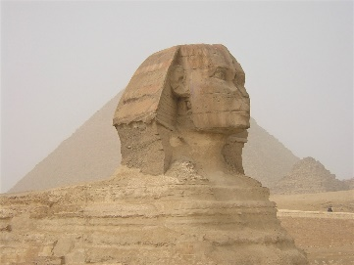
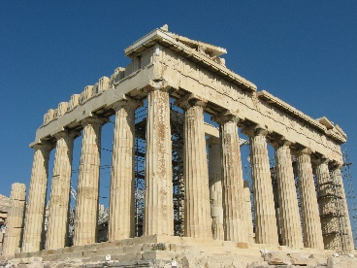
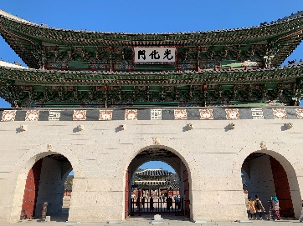
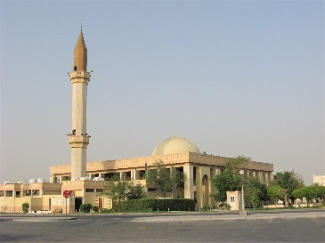
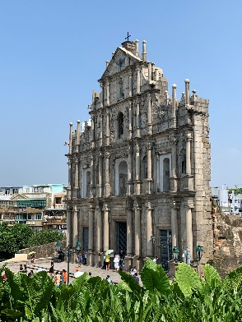
Promoting cultural inclusiveness
Cultures are diversified
Each ethnic group or country has its own distinctive culture. The cultures of different ethnic groups and countries with their own characteristics together constitute the rich and colourful cultural phenomena of mankind.
Photo credit: Photos were taken by the resource developer

Slide 4

Cultures are diversified
As China is a vast country, the differences in geology, topography, climate and other factors give rise to cultural differences between the south and the north, and between the coastal and western regions of the country, resulting in the development of distinctive regional / local cultures.
Click on the image to learn more about the geology, topography and climate of the country.

Slide 5
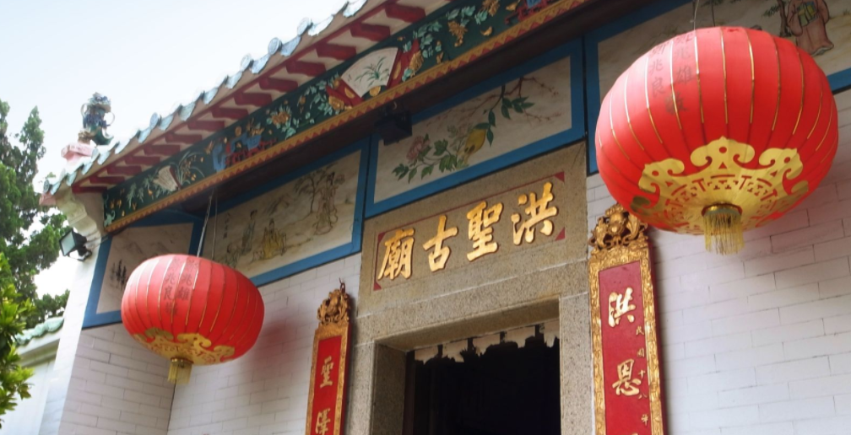
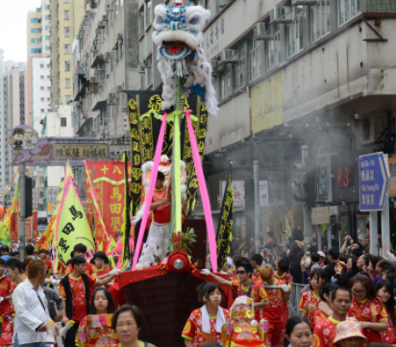
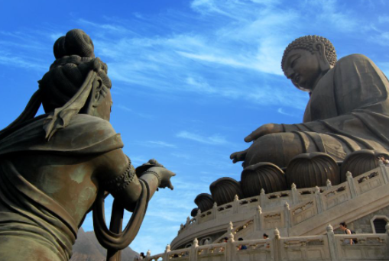
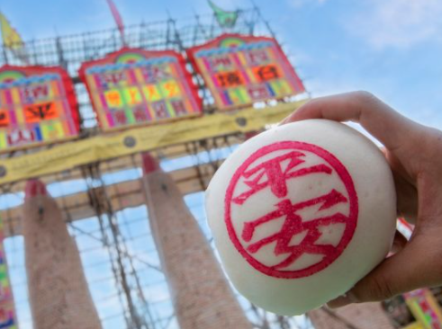
Characteristics of cultural diversity with Chinese culture as the mainstay in Hong Kong society
Hong Kong culture is rooted in Chinese culture and influenced by other cultures. With its unique geographical location and historical background, Hong Kong has become a place where the Chinese and Western cultures meet. Not only people can enjoy Cantonese opera and other Chinese local operas, but also ballet and orchestra performances. Apart from valuing traditional Chinese festivals, Hong Kong people also celebrate Western ones. As crucial cultural assets of Hong Kong, Chinese traditional culture, customs and festive celebrations are inherited and developed to attract foreign tourists.
Hung Shing Festival
Birthday of Tin Hau
Birthday of Buddha
Cheung Chau Bun Festival
Photo credit: Hong Kong Tourism Board
(https://www.discoverhongkong.com/eng/explore/culture/celebrate-in-hong-kong-with-time-honoured-festivities.html)

Slide 6

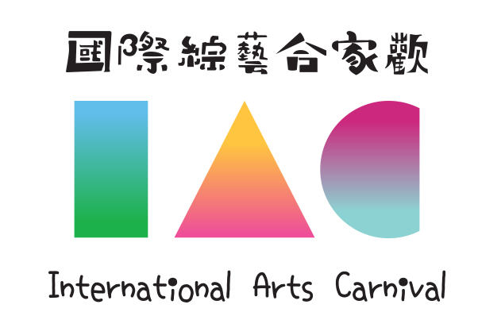

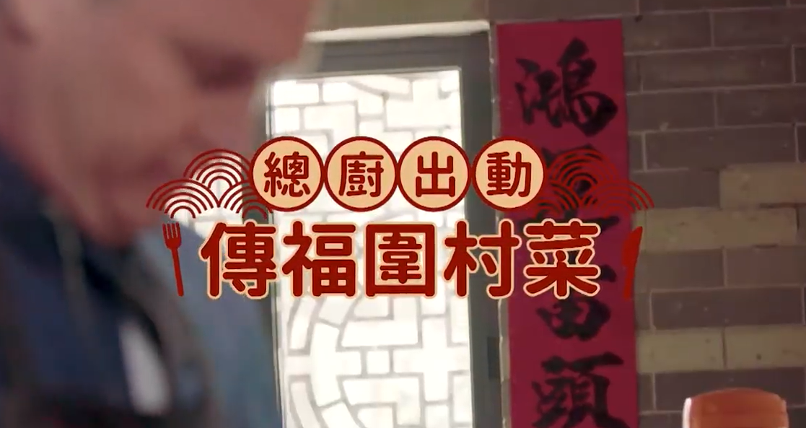
Characteristics of cultural diversity with Chinese culture as the mainstay in Hong Kong society
The integration of diverse cultures in Hong Kong is manifested in the rich and colourful development of its arts and culture.
The examples below illustrate the development of arts and culture in Hong Kong.
(Click on the images to learn more)
The cultural heritage based on Chinese traditional culture attracts people worldwide. Click on the image and watch the video to learn more.

Slide 7
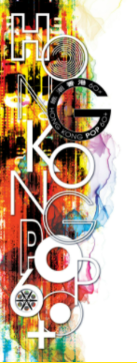

Characteristics of cultural diversity with Chinese culture as the mainstay in the Hong Kong society
The features of Hong Kong as a cosmopolitan city, where Chinese and Western cultures meet and flourish, are also reflected in its pop culture. The influence of foreign cultures on local culture is usually most obvious in pop culture. This is because pop culture spreads widely and rapidly with the help of media, which enables easy imitation. For example, European, American, Japanese and Korean pop cultures are well received and popular among Hong Kong people.
Click on the images to learn more about the development of diversified pop culture in Hong Kong.

Slide 8
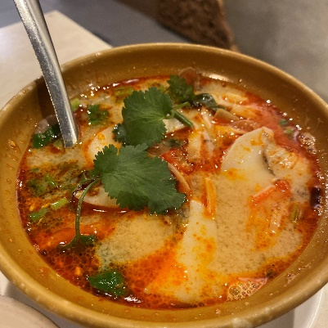
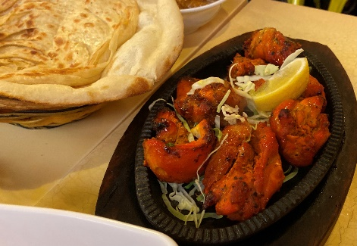
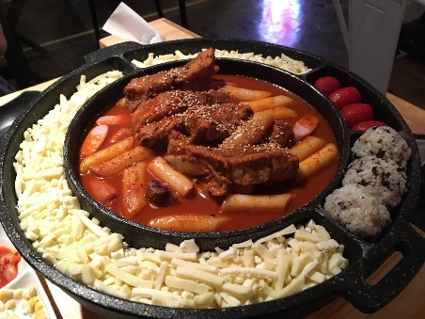
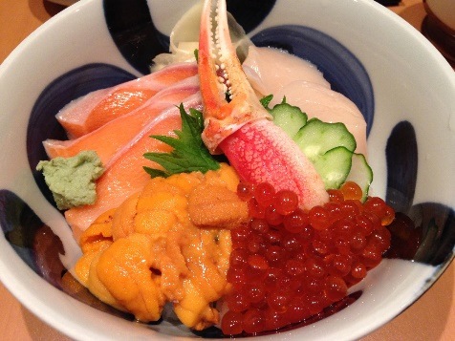
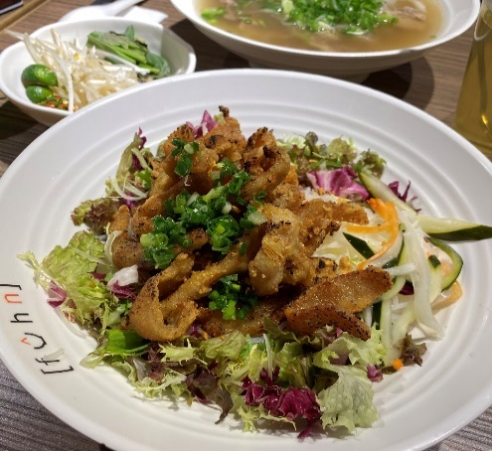
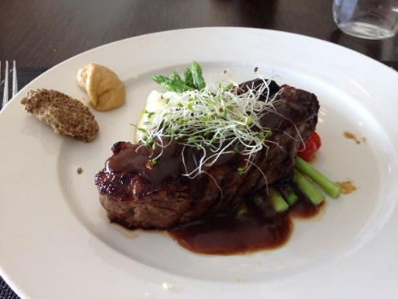
Diverse cuisines
Hong Kong offers cuisines from all parts of China. Apart from Cantonese, Hakka, Chiu Chow food and other local cuisines, there are also delicacies from Shanghai, Ningbo, Anhui, Sichuan, Hunan, Beijing, etc.
Indian
Thai
Besides western restaurants, Japanese, Korean, Vietnamese, Thai and Indian ones are also common in Hong Kong. These diverse flavours contribute to Hong Kong’s diversified cuisine culture.
Can you think of other examples?
Korean
Japanese
Western
Vietnamese
Photo credit: Photos were taken by the resource developer

Slide 9
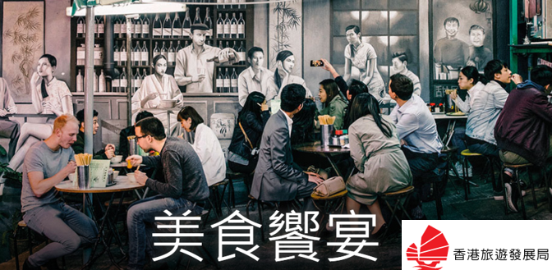

Diverse cuisines
Hong Kong gourmet cuisines from all over the world attract international tourists, bringing business opportunities.
Let’s explore how Hong Kong’s gourmet cuisines make Hong Kong a foodie’s paradise.
Click on the images to learn more about Hong Kong’s eclectic food culture.
Click on the image to learn more about how Hong Kong Tourism Board introduces Hong Kong cuisines.
The melding of Chinese and foreign cultures in Hong Kong, as well as the integration of different cultures all over the world, are also reflected in fusion cuisines. Please give an example to illustrate how fusion cuisines reflect cultural integration and creativity in Hong Kong.
Food Expo gathers numerous exhibitors. Fusion cuisines are often promoted to create business opportunities for Hong Kong.

Slide 10
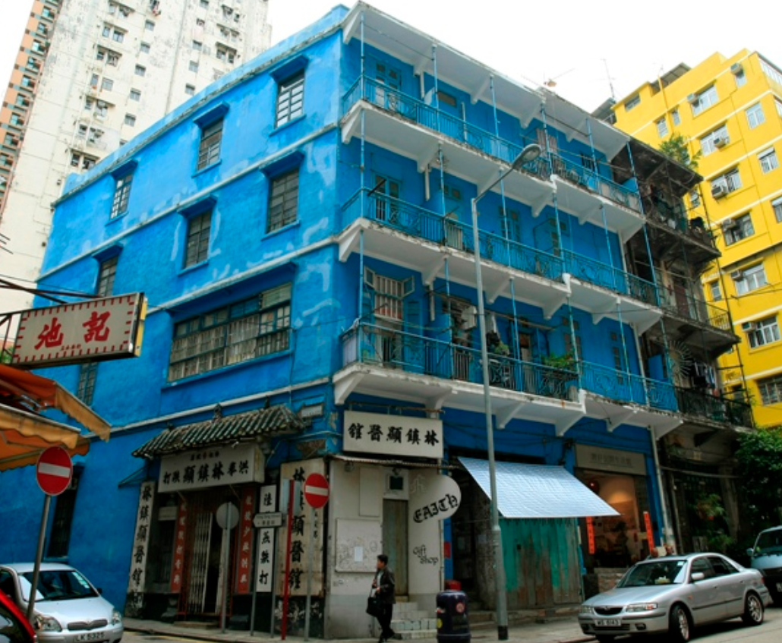
Various architectural styles
Century-old buildings scattered everywhere, like architectural museums, confirming the richness and diversity of Hong Kong. Early walled villages and ancestral halls feature the architectural style of regions like Lingnan. Pre-war Guangzhou-style arcade-houses (qilou buildings) maintain traditional Chinese style with elements of Western elements.
An example:
The Blue House is mainly built with brick and wood.
It is the only existing Tong Lau with balconies in Hong Kong.
* Address: 72, 72A, 74, 74A Stone Nullah Lane, Wan Chai
* G.F.A.: About 1,035 sq. m.
* Year Built: 1923-1925
* Grading: Grade 1
Source: Commissioner for Heritage's Office, Development Bureau
(https://www.heritage.gov.hk/en/revitalisation-scheme/batch-ii-of-revitalisation-scheme/virtual-tour-on-batch-ii-historic-buildings/the-blue-house-cluster/index.html)

Slide 11
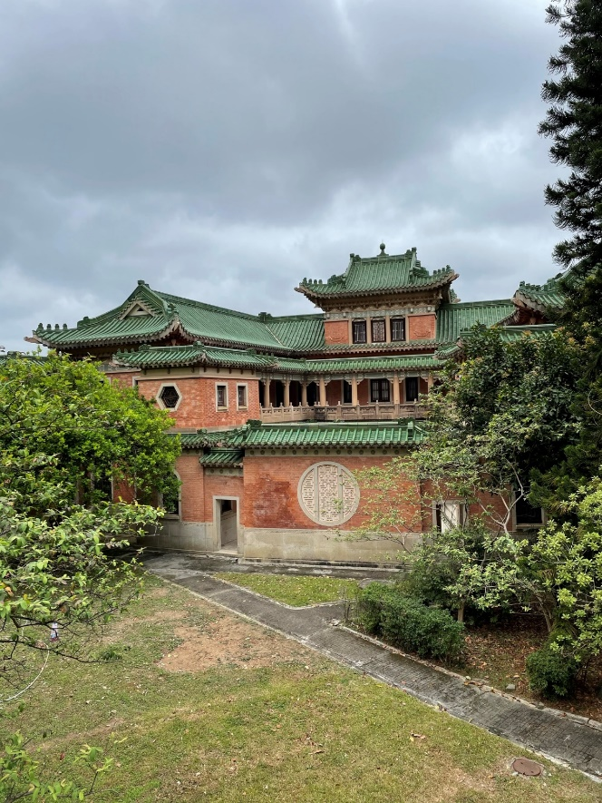
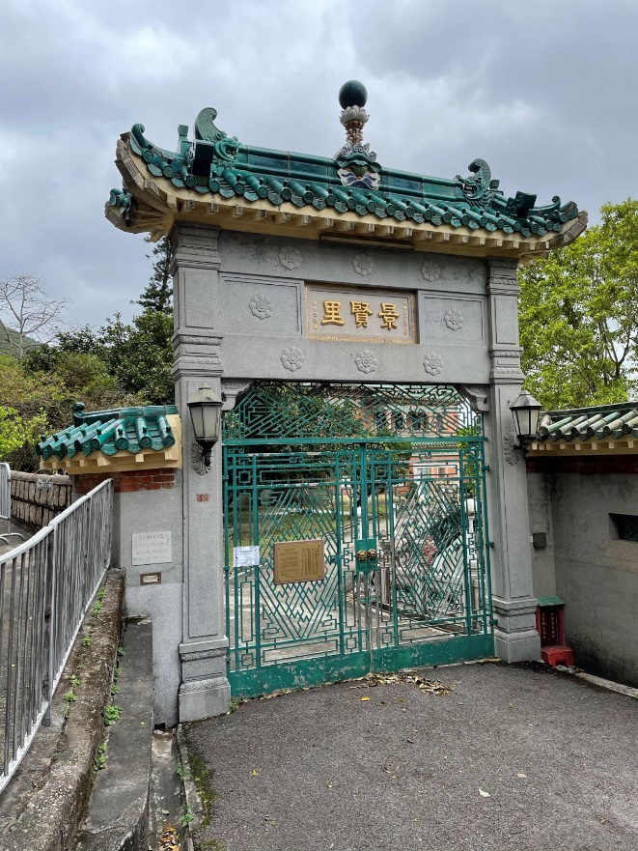
Reference
King Yin Lei
King Yin Lei, originally named “Hei Lo”, was built in 1937. This historic mansion presents sophisticated and intricate Chinese architectural features, and blends western building style in structure, material and design.
King Yin Lei is located in the Mid-levels of Hong Kong Island.
Photo credit: Photos were taken by the resource developer

Slide 12
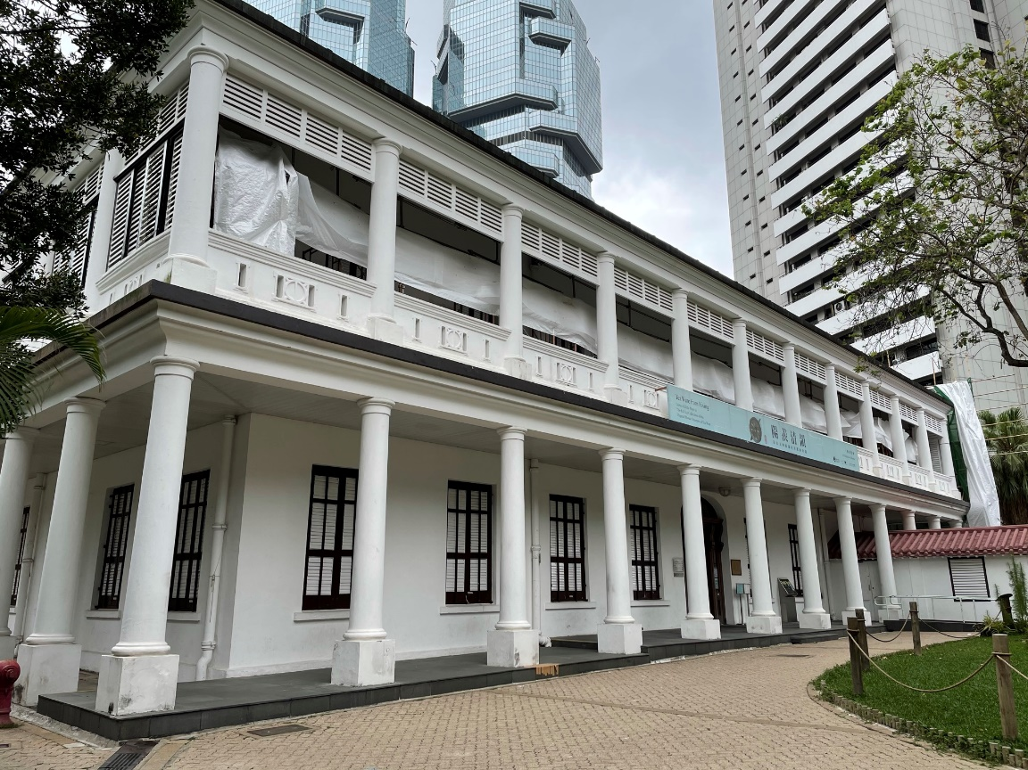
Reference
Flagstaff House Museum of Tea Ware
Admiralty
Flagstaff House Museum of Tea Ware is located inside Hong Kong Park. It was built in 1846 and was the residence of Commander-in-chief of the British forces. It is a western building in Greek Revival style.
Photo credit: Photos were taken by the resource developer
12

Slide 13
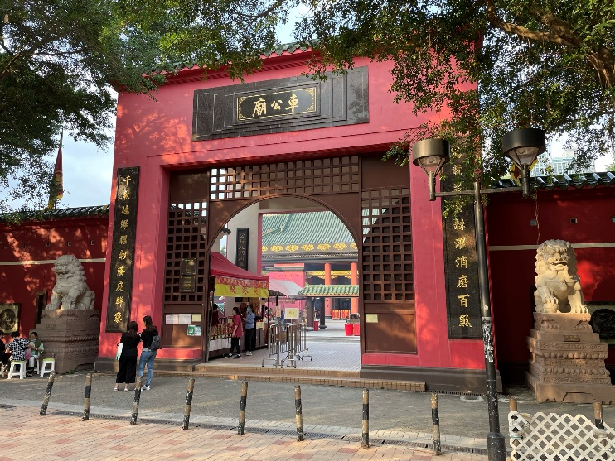
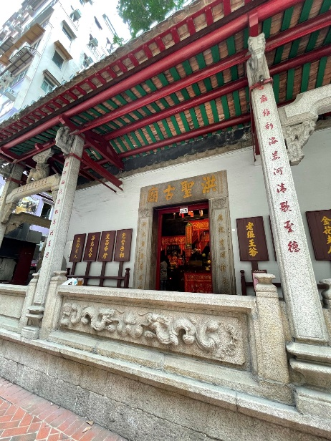
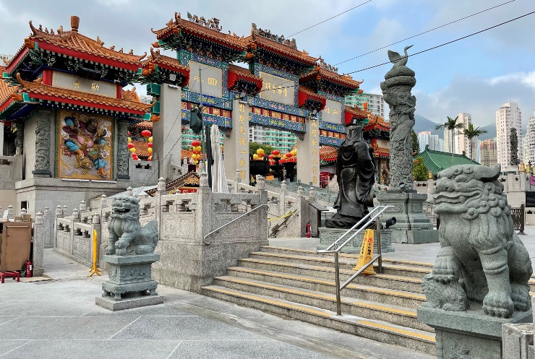
Reference
Religious buildings
Che Kung Temple, Sha Tin
Hung Shing Temple, Wan Chai
Wong Tai Sin Temple, Wong Tai Sin
Photo credit: Photos were taken by the resource developer

Slide 14
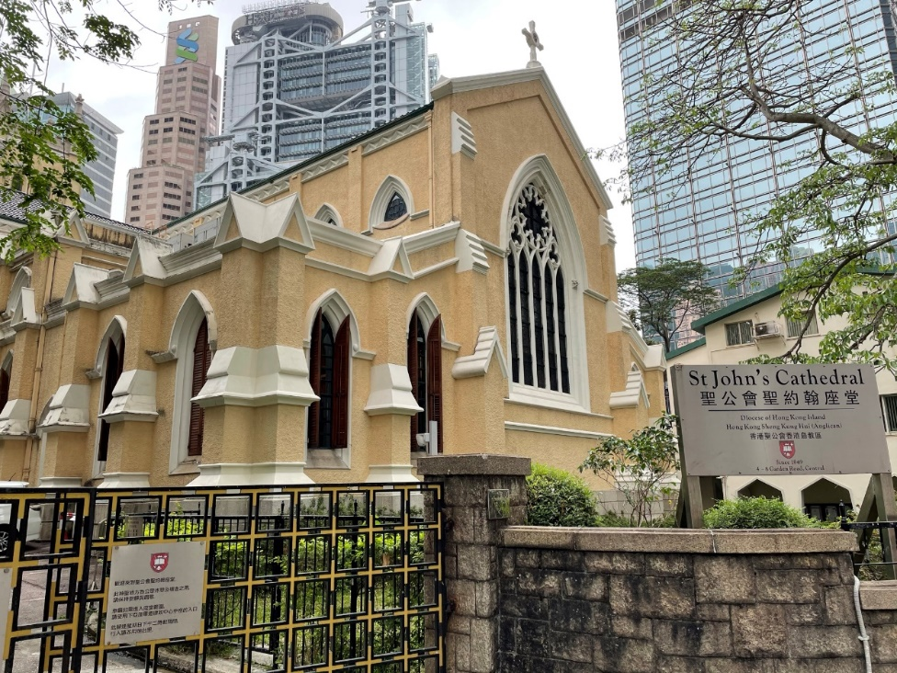
Reference
St John’s Cathedral
St John’s Cathedral is located in Central District, the most bustling and modern district of Hong Kong. It is the mother church and cathedral of the Anglican Diocese of Hong Kong Island under the Hong Kong Sheng Kung Hui. Its construction spanned the years from 1847 to 1849. It is the oldest Western ecclesiastical church building in Hong Kong.
Garden Road, Central District
Photo credit: Photos were taken by the resource developer
14

Slide 15
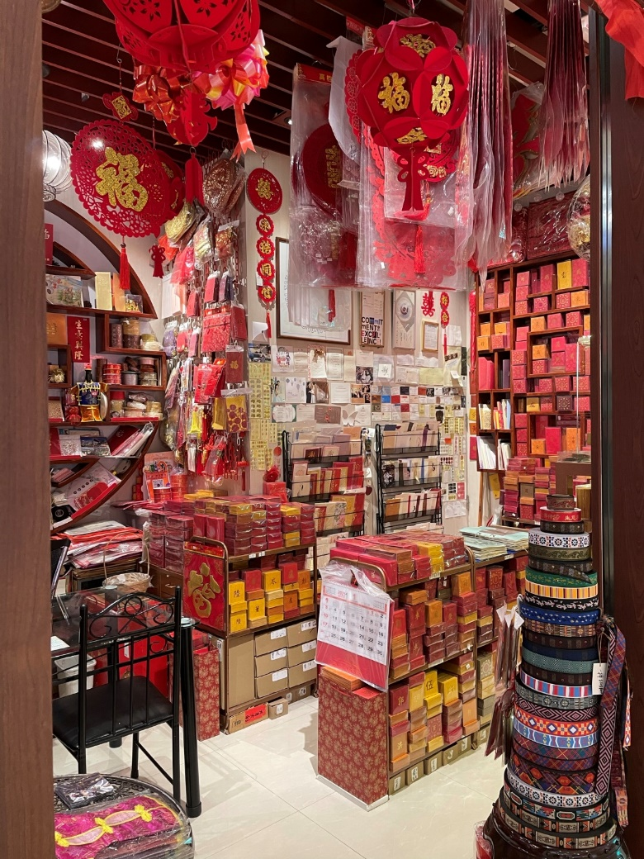
Reference
Handing out “Lai See”
Hong Kong values Chinese festive traditions. The Lunar New Year is one of the most important traditional festivals in Hong Kong.
Red packets (with money inside) are called “Lai See”. During the Lunar New Year, elders in the family hand out red packets to the younger generations as a blessing for good luck in the coming year.
Photo credit: Photos were taken by the resource developer

Slide 16
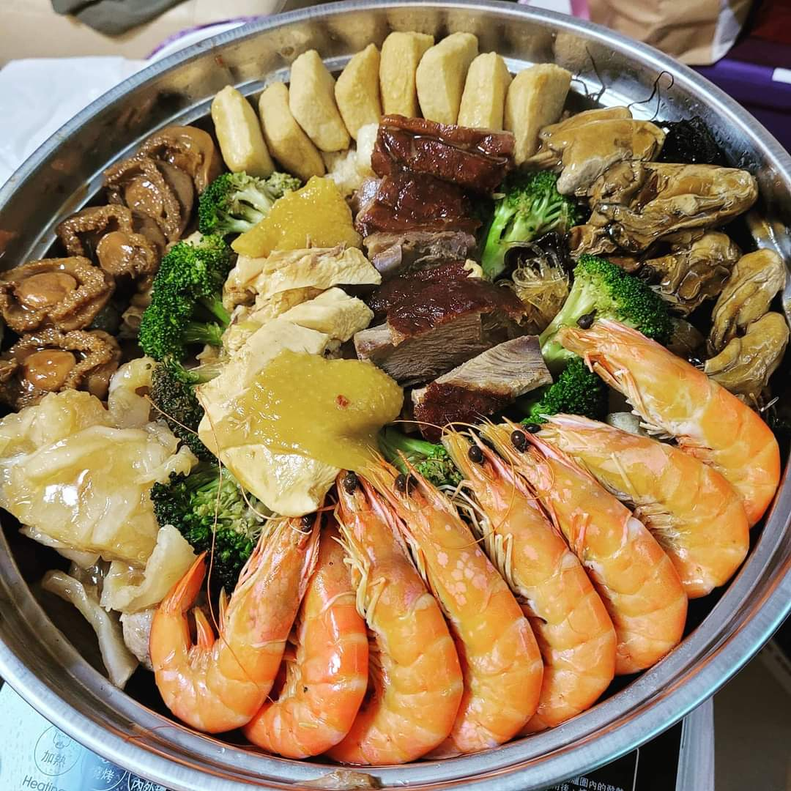
Reference
Feasting on Poon Choi
Poon Choi is a traditional new year dish in Hong Kong.
Dating back to the Song Dynasty, Poon Choi is a dish with many layers of different stewed ingredients served in a basin. The overflowing ingredients signify family reunion and an abundance of wealth and prosperity. The deeper meaning of having Poon Choi during Chinese New Year lies in the joyous and clamorous reunion with the whole family sitting together to share one dish.
Photo credit: Photos were taken by the resource developer

Slide 17
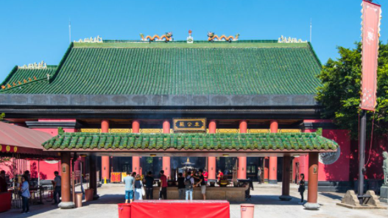
Reference
Birthday of Che Kung
During the second day of the Lunar New Year (Che Kung Festival), many believers of Che Kung go to Che Kung Temple to pray for his blessings. But in general, people often flock to the temple on the third day of the Lunar New Year. This day is called “Cek Hau”, which is said to be a day of quarrel, and therefore not suitable for visiting others. Hence, many Hong Kong people visit Che Kung Temple and spin the copper windmills to pray for good luck in the new year.
Source: Hong Kong Tourism Board
(https://www.discoverhongkong.com/eng/explore/culture/find-your-zen-in-the-best-temples-in-hong-kong.html)
17

Slide 18
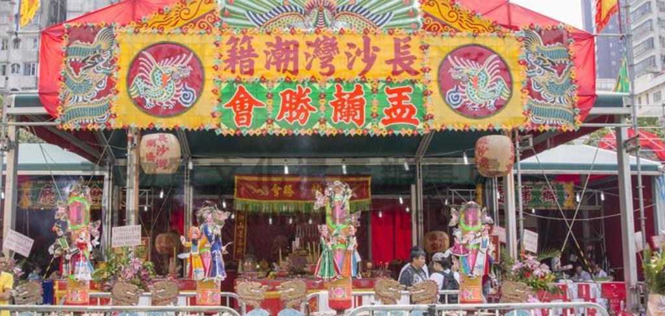
Reference
Festivals reflect Hong Kong’s unique integration of Chinese and Western cultures
Many traditional customs of Lunar New Year are preserved in Hong Kong. Apart from shopping at flower markets on Lunar New Year’s eve, people offer incense and watching float parade on the first day. The second day is for enjoying fireworks. On the third day, believers visit Che Kung Temple for blessing and requesting lottery poetry. While traditional festivals are celebrated, the start of a new year on 1 January, Christmas and Easter are also valued by Hong Kong people.
The traditional Chinese festival, Yu Lan Festival of the Hong Kong Chiu Chow Community has been inscribed on the national list of intangible cultural heritage, and the western festival of Halloween is also getting attention in recent years.
Click on the image to learn more about the traditional Chinese festival, Yu Lan Festival of the Hong Kong Chiu Chow Community

Slide 19
World-oriented culture
This is Hong Kong
Complementary relationship between tradition and modernity
Wide variety of cuisines
Hong Kong capitalises on its strengths of its unique geographical location and diversified cultural development, and it has been playing the role and bond between the Chinese culture and other around the world.
Signature customs
Diverse architectural styles
World orientation
Harmonious coexistence of different religions
Thriving arts
……

Slide 20
What is cultural inheritance?
Innovation based on tradition
Cultural inheritance is the extension and continuous development of a culture. Its significance lies in enhancing the next generation’s understanding of history and tradition, fostering a sense of belonging to the country and sense of national identity among them, as well as understanding the significance of traditional culture and its impact on the modern world.

Slide 21
Innovation based on tradition
Inheriting traditional culture does not mean to cling to traditions indiscriminately, but to be adapted to the progress of a society to achieve cultural innovation.
With the development of society, some practices or ideas in traditional culture may become outdated or even be abandoned as a result. However, many good qualities in traditional culture are worth preserving.
Fine
traditional culture
Inherits and develops
adapted to modern society
achieve cultural innovation

Slide 22
Reference
The Chinese culture offers plenty of fine and precious heritages that should be passed on and perpetuated and promoted.
For example:
Devotion to one’s family, the country and the world;
An ever-improving spirit;
Filial piety being the top virtue;
The concept of harmonious coexistence between man and nature, etc.
22

Slide 23

Reference
Mindfulness and the unity of nature and man
In recent years, mindfulness has drawn much attention for its extensive application in clinical treatment and mental health.
Mindfulness means paying attention to oneself in the present moment purposefully and non-judgementally for the awareness of one’s own thinking, emotions and physical responses.
Mindfulness is considered an experience when the unity of man and nature is practised, spiritual independence is pursued and getting access to everything is possible.
To learn more, please refer to: https://www.fhs.gov.hk/english/health_professional/OMP_eNewsletter/enews_20161230.html
23

Slide 24
Reference
Chinese Culture provides rich content for Hong Kong films and TV dramas
Chinese culture provides rich content for many Hong Kong films and TV dramas. Chinese traditional classical novels and operas such as Journey to the West, The Butterfly Lovers, and Romance of the Three Kingdoms have been adapted on screen.
Activity: Please suggest examples to explain how Chinese culture contributed to Hong Kong films and TV productions and what the adaptations were.

Slide 25
Reference
The Butterfly Lovers (I)
The Butterfly Lovers, one of China’s Four Great Folktales, was inscribed in the First National List of Intangible Cultural Heritage of China in 2006.
This well-known story is a typical example of the inheritance of Chinese culture and art in Hong Kong. It has been presented in different artistic styles through various interpretations by local artists and creators.
To learn more:
Plot: This is a love story of Liang Shanbo and Zhu Yingtai. Liang and Zhu, a girl disguised as a boy, were classmates and sworn “brothers”. Liang later learned that Zhu was a girl, and they vowed to spend their lives together. However, Zhu’s family had already arranged a marriage for her. Knowing this, Liang was heartbroken and passed away. On Zhu’s wedding day, she passed by Liang’s grave. Suddenly the grave broke open, and Zhu threw herself into the grave. The two lovers then transformed into two white butterflies.

Slide 26
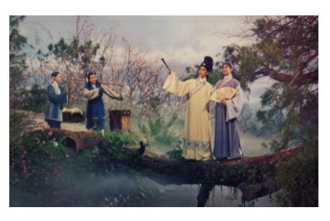
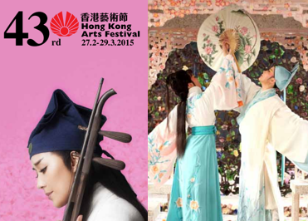
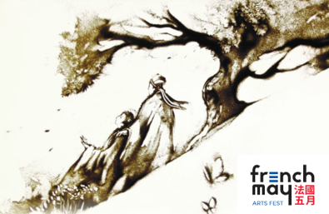
The Butterfly Lovers (II)
Reference
Click on the images to learn more
The Love Eterne (1963) produced by Shaw Brothers Studio is a classic in Hong Kong film history, starring Betty Loh Ti, Ivy Ling Bo, Jen Chieh, Li Kwun and Ching Miao.
Source: Hong Kong Film Archive
(https://www.filmarchive.gov.hk/en_US/web/hkfa/pe-event-2021-ths-fs-film22.html)
The New Butterfly Lovers, a creative interpretation of the folktale, was performed by the Zhejiang Xiaobaihua Yue Opera Troupe during an arts festival.
Source: Hong Kong Arts Festival
(https://www.iatc.com.hk/theatre2015/?a=doc&id=95547)
French pianists Duo Jatekok and the renowned Hong Kong sand painting artist Hoi Chiu, presented a creative version of this interpretation of this Chinese classic folktale.
Source: French May
(https://www.frenchmay.com/en/events/the-butterfly-lovers/)

Slide 27
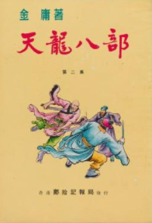
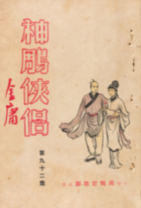
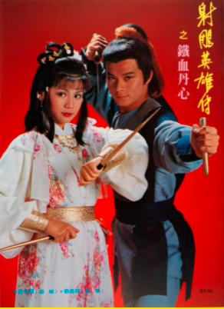
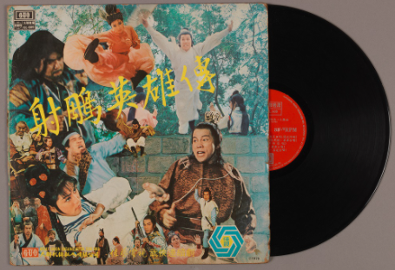
Reference
Hong Kong martial arts novels based on Chinese history and culture
Contemporary martial arts novels have gained great gained popularity and cast vast influence in Chinese communities since the first publication in Hong Kong in the 1950s of the 20th century.
Dr. Louis Cha (pen name Jin Yong) was a world known local newspaper founder and social activist, as well as an internationally renowned literature writer, community leader and literary giant. He has published 15 martial arts novels that are enormously popular worldwide since 1955. Jin Yong was the most influential martial arts novel writer in the 20th century.
Source: Hong Kong Heritage Museum
(https://www.heritagemuseum.gov.hk/en_US/web/hm/exhibitions/permanent_exhibitions/permanent_jin-yong-gallery.html)
27

Slide 28
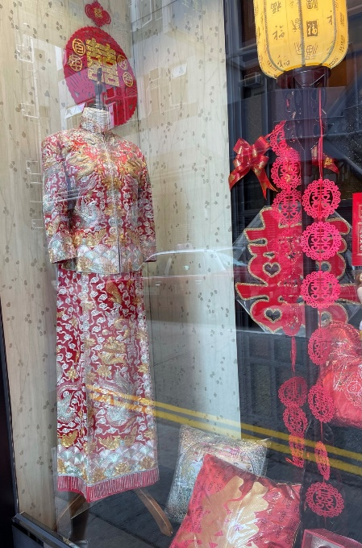
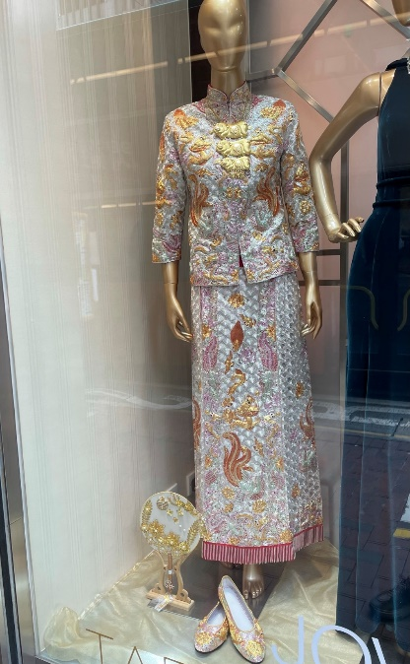
Reference
Contemporary Chinese style costumes are in fashion
The sewing technique of Hong Kong Chinese style Cheongsam and Kwan Kwa wedding costumes has a history of nearly a century in Hong Kong. Hong Kong fashion designers give this traditional craftsmanship a modern touch and add new elements to cutting, accessories, fabrics and designs. As a result, the costumes not only maintain their traditional characteristics but also make their way to the international fashion industry.
Photo credit: Photos were taken by the resource developer

Slide 29
Cultural diversity promotes the development of Hong Kong
Drive
While Hong Kong people recognise the fine traditional Chinese culture, they are also receptive to foreign cultures. Hong Kong has an eclectic culture. The clashes and exchanges with foreign cultures enhance the development of its own culture.
Cultural development and innovation
Promote
Cultural exchanges
Cultural diversity
Drive
Hong Kong’s culture contributes to the spirit and qualities of diligence, pragmatism, self-confidence, perseverance, tolerance, integrity, innovation and courage to accept challenges among Hong Kong people. These attributes promote cultural prosperity and enhance socio-economic development in Hong Kong.

Slide 30
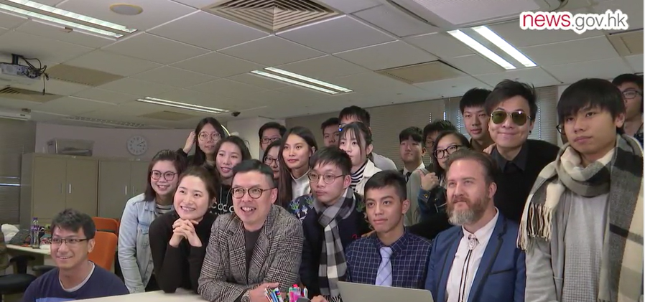
Promoting harmony among different ethnic groups
We live in a world of different cultures, ethnicities, colours, religions and social systems. People of various countries maintain exchanges on culture, thoughts and values. People should treat each other equally and respectfully, learn from each other, and live harmoniously. This is the only way to sustain the development of a city, a country and of the whole world.
Watch the following video, and talk about how you feel in your interactions with other ethnic groups.
Film-making project on community inclusion: learn to respect and be inclusive
Source: news.gov.hk
https://www.news.gov.hk/eng/2019/04/20190404/20190404_130833_659.html
30

Slide 31
Hong Kong: an international metropolis of multi-ethnic coexistence
Various ethnic groups take residence in Hong Kong. With different languages, colours, nationalities, religions and races, together they have contributed a multi-lingual culturally diverse society.

Slide 32
Hong Kong’s demographic structure
Place of birth | Population
Hong Kong | 4 451 493
The Mainland / Macao / Taiwan | 2 272 293
Elsewhere | 612 799
Source: 2016 By-census Results
https://www.bycensus2016.gov.hk/en/bc-pob.html
(Please refer to the latest census updates)

Slide 33
Hong Kong’s ethnic composition
Non-Chinese population in Hong Kong
Hong Kong society is predominantly made up of Chinese, who account for 92% of the total population.
According to the 2019 population census, the non-Chinese population in Hong Kong included Filipinos, Indonesians, Indians, Thais, Nepalese, Pakistanis, Americans, Malaysians, Canadians, and British, with a total of 543,300 people.
Population census at the end of 2019
Origin (as reported) | Total population
Filipinos | 200 925
Pakistanis | 22 445
Indonesians | 177 530
Americans | 19 444
Indians | 35 012
Malaysians | 15 241
Thais | 27 171
Canadians | 13 375
Nepalese | 23 337
British | 8 848
Source: Hong Kong 2019: The Facts (https://www.yearbook.gov.hk/2019/en/pdf/Facts.pdf)
(Please refer to the latest census updates)

Slide 34
Languages of Hong Kong residents
Hong Kong is a society of various languages and dialects. Besides Cantonese, Putonghua and English, Chinese dialects such as Hakka, Fukien, Chiu Chow and Shanghainese, as well as the languages such as Indonesian, Tagalog and Japanese are also spoken in Hong Kong.
According to 2016 Population By-census, among ethnic minorities aged 5 and over, Mixed with Chinese parent recorded the highest proportion of being able to read Chinese, at 83.9%. This was followed by Koreans (39.8%), Japanese (35.1%), Pakistanis (33.8%) and Thais (31.4%).
Source: 2016 Population By-census
https://www.bycensus2016.gov.hk/en/Snapshot-08.html
https://www.statistics.gov.hk/pub/B11201002016XXXXB0100.pdf
(Please refer to the latest census updates)

Slide 35
Languages of Hong Kong residents
Generally speaking, younger ethnic minorities had better ability in reading Chinese. In 2016, 64.3% of ethnic minorities aged 5-14 were able to read Chinese. Among this young generation, Thais had a higher proportion of being able to read Chinese, at 83.1%, followed by Filipinos (72.2%) and Pakistanis (71.5%).
As for the ability in reading English, the majority (86.1%) of ethnic minorities reported that they were able to read English. Ethnic groups with a higher proportion of being able to read English include Filipinos (99.1%), Whites (98.6%), Koreans (93.2%), Nepalese (92.0%) and Japanese (90.5%).
Source: 2016 Population By-census
https://www.bycensus2016.gov.hk/en/Snapshot-08.html)
https://www.statistics.gov.hk/pub/B11201002016XXXXB0100.pdf
(Please refer to the latest population census)
35

Slide 36
Supporting social inclusion of ethnic minorities
In real life, some ethnic minorities encounter barriers to social inclusion, such as language, education, income, employment, pursuing studies, and public engagement.
Rationalism, inclusion, inclusiveness, diversity, freedom and openness are crucial values in Hong Kong society, and the cornerstone for Hong Kong’s long-term prosperity and stability. The core values of Hong Kong are manifested in the provision of comprehensive support for ethnic minorities so that they have equal opportunities to be integrated into society.
Source: news.gov.hk – More support for ethnic minorities (https://www.news.gov.hk/eng/2019/10/20191027/20191027_093632_116.html)

Slide 37
The HKSAR Government supports ethnic minorities
The HKSAR Government strives to build a caring and inclusive society. The Steering Committee on Ethnic Minority Affairs was set up to enhance the co-ordination of cross-bureau / inter-departmental collaboration on the support for ethnic minorities.
The Home Affairs Department convenes the Committee on the Promotion of Racial Harmony which advises the Government on issues concerning ethnic minorities. The Race Relations Unit of in the Home Affairs Department provides a number of support services for ethnic minorities to facilitate their integration into the society and access to public services, in collaboration with non-governmental organisations (NGOs) and district organisations.

Slide 38
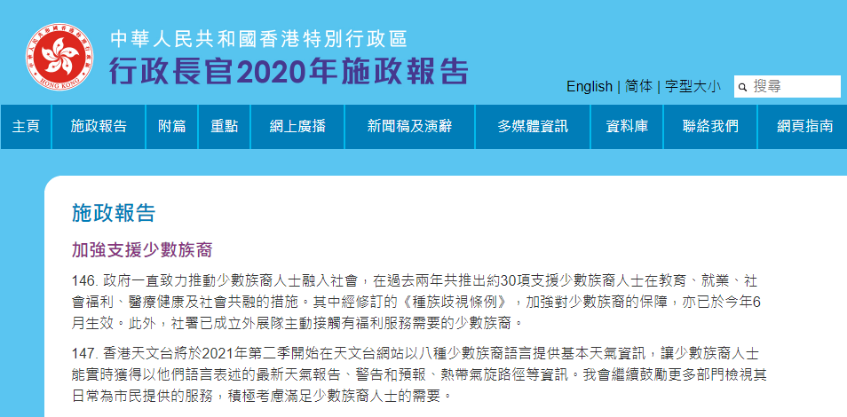
The HKSAR Government attaches importance to supporting ethnic minorities
In the Chief Executive’s 2020 Policy Address of the HKSAR, “Strengthening Support for Ethnic Minorities” was listed and elaborated under “Continuously Improving People’s Livelihood”.
Click on the image to learn more

Slide 39
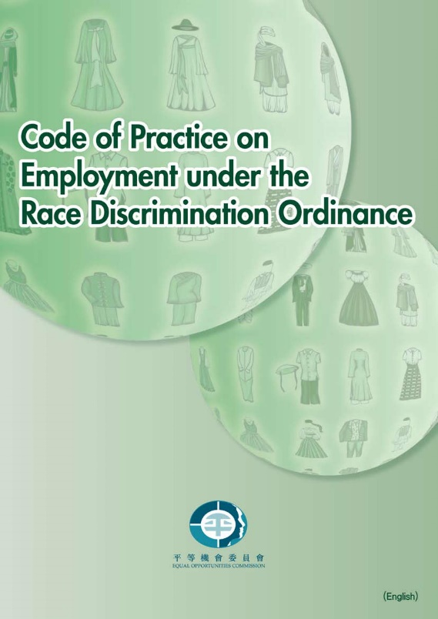
Upholding ethnic equality, opposing racial discrimination
The HKSAR Government has promulgated and implemented the Race Discrimination Ordinance. Being unfamiliar with certain ethnic customs, cultures and languages may result in prejudice and stereotyping, which may sometimes lead to discrimination, harassment or racial abuse.
To protect people against discrimination, harassment or racial abuse on the ground of race, the Race Discrimination Ordinance came into effect on 10 July 2009. The Equal Opportunities Commission of the HKSAR Government is responsible for its enforcement.
Code of Practice on Employment under the Race Discrimination Ordinance has been produced after consultation with the public and stakeholders. It is intended to explain the law, and to provide practical guidance on how to comply with the Race Discrimination Ordinance in relation to employment matters as well as to promote racial equality in the workplace.

Slide 40



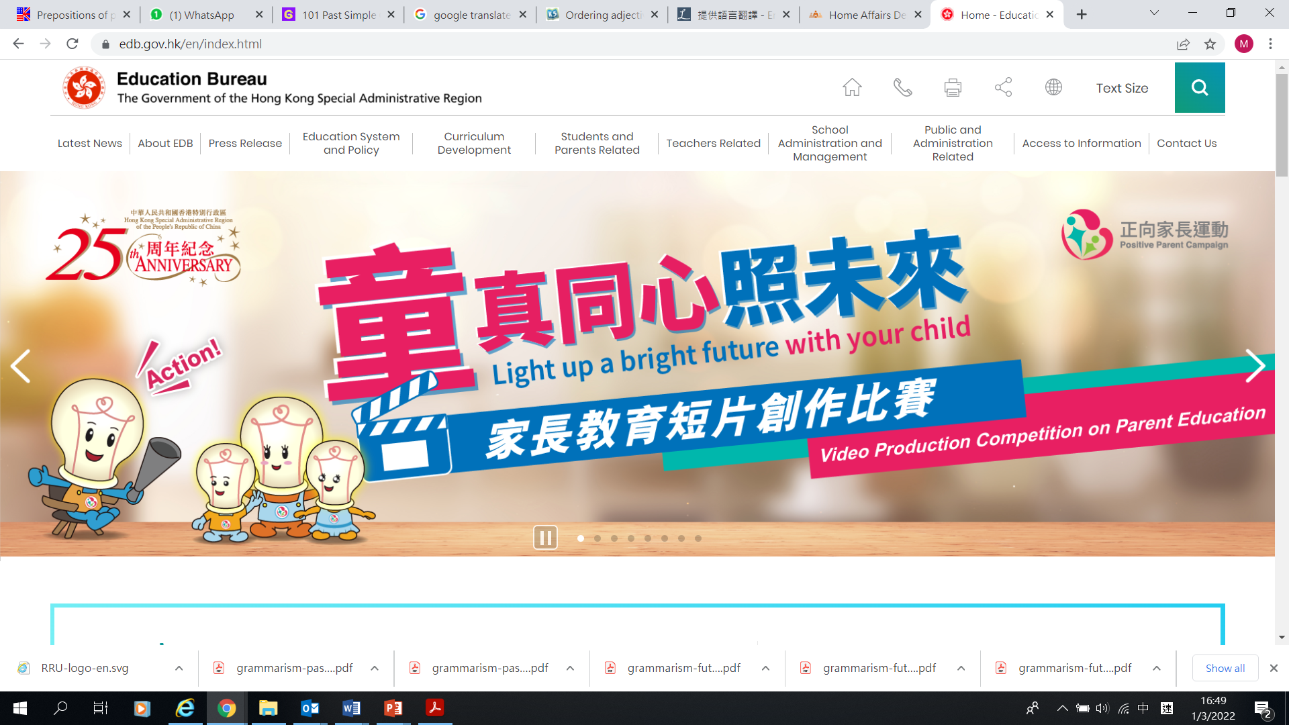
Providing explanations in ethnic languages
Language may be an obstacle for ethnic minorities to get included in the local community and access to public services.
The HKSAR Government strengthens the support services for ethnic minorities by broadcasting radio programmes in various languages of ethnic minorities, so as to facilitate their integration into the community.
All public and private medical institutions in Hong Kong offer language interpretation services for the convenience of ethnic minorities seeking for medical treatment.
Click on the images to learn more about measures to support ethnic minorities.

Slide 41

Fostering exchanges among different ethnic groups
The Home Affairs Department has launched the District-based Programmes for Racial Harmony with the aim to encourage interaction and exchange between ethnic minorities who have settled permanently in Hong Kong and local Chinese residents. Non-governmental organisations (NGOs) are invited to organise district-based activities with a view to promoting racial harmony in the districts. We expect these activities can also increase the participants’ knowledge in the culture of other ethnic groups and/or empower participants for better integration into the community.
NGOs organised different activities in 2019-20 to promote racial harmony.
Source: Home Affairs Department
https://www.had.gov.hk/rru/english/programmes/district_based_programmes.htm
Click on the image to learn more

Slide 42
Nurturing civic literacy rooted in Chinese culture with global perspectives
Leapfrog developments in technology have boosted social progress and brought convenience in our everyday life. However, traditional culture still has its function and values worthy of preservation in modern society. For instance, filial piety and respect for the elderly are still crucial in today’s society. These values bring harmony to the family and support for the elderly, and also pass on traditional Chinese ethics.

Slide 43
National identity
National identity refers to the sense of belonging to the historic events, culture, and landscape of the country felt by that country’s nationals. They recognise the same roots and respect the country’s social systems, and defend the security, honour and interests of their motherland.

Slide 44
Preserve and promote the fine Chinese traditional culture
To preserve and develop fine traditional Chinese culture, the following concepts should be advocated:
Core thoughts and ideals such as benevolence, people-orientation, integrity, righteousness, social harmony, and sharing common ground.
Traditional Chinese virtues such as striving for personal growth, diligence, sociability, helping those in need, acting bravely for a just cause, showing filial respect to the elderly and loving the family.
Thoughts and cultural elements that promote social harmony and encourage the pursuit of righteous causes.
Excerpts from the Opinions on Implementing the Project of Inheriting and Developing Fine Traditional Chinese Culture
Source: gov.cn, http://www.gov.cn/zhengce/2017-01/25/content_5163472.htm
44

Slide 45




Reference
Examples of traditional Chinese quotes
The gentleman seeks harmony without uniformity; the mean man seeks uniformity without harmony. — Zi Lu, the Analects of Confucius
Respect others’ elders as one respects one’s own, and care for others’ children as one cares for one’s own. — Liang Hui Wang I, Mencius
Accepting a hundred rivers, the sea is tolerant and therefore vast; impervious to lures, the towering cliff stands steady and firm. — Lin Zexu, statesman, thinker and poet in the Qing Dynasty

Slide 46

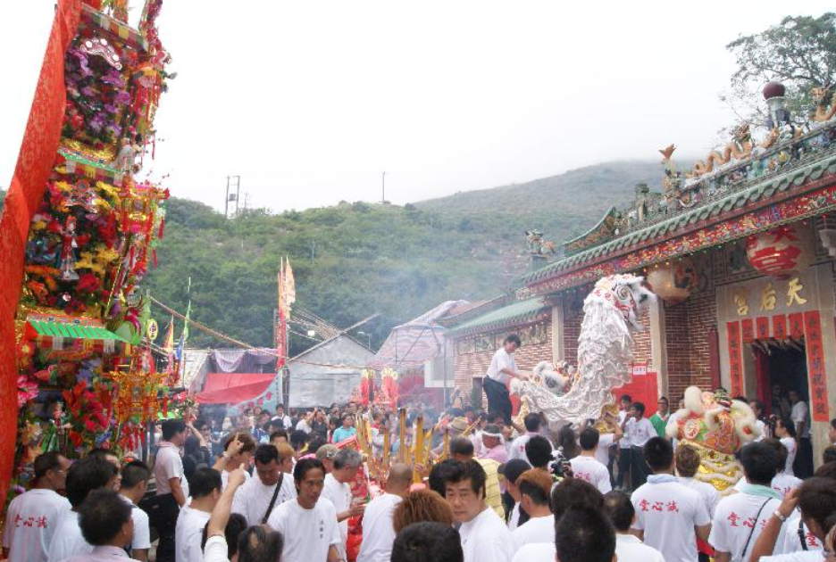
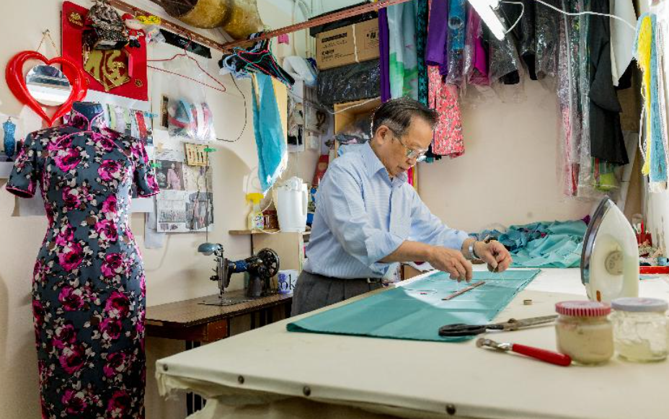
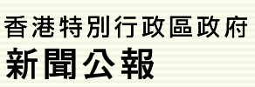
Activity
Relevant examples
Conserving cultural heritage
Conserving cultural heritage promotes cultural inheritance. Cantonese opera (Yueju) was listed as a world intangible cultural heritage item in 2009.
In addition, how many intangible cultural heritage items in Hong Kong are inscribed on the national list of intangible cultural heritage?
Tin Hau Festival in Hong Kong
Click on the following image to learn more
Press Releases of the Government of the HKSAR
Hong Kong Cheongsam-making technique
46

Slide 47
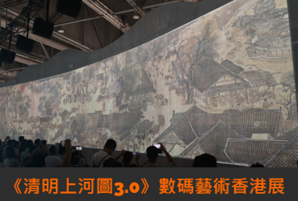
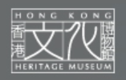
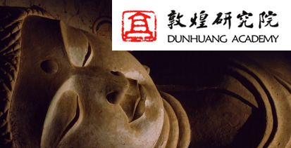
Reference
How to conserve and promote cultural heritage more effectively?
Conserving cultural heritage is crucial. Cultural heritage is passed down through generations, which promotes the development of cultural diversity, enhances the cultural vibes of the community, provides community and group identity and forge national solidarity.
Along the River During the Qingming Festival 3.0 is a combination of art, culture and technology. The details and the historical background of the original artwork were digitalised to provide viewers with three-dimensional visual effects. The audience can immerse themselves in the painting and appreciate it in a more comprehensive way.
(Click on the image to learn more)
Digital Dunhuang is a display created by Dunhuang Academy. The Academiy uses science and technology to conserve and promote cultural relics. The Academy is a pioneer among the mainland museums with remarkable achievements in digital image recording, 3D information capture, virtual reality representation, and promotion via the Internet and multimedia programmes.
(Click on the image to learn more)

Slide 48
Hong Kong continues to play its role in the course of opening-up of the country
The country is building a new development paradigm, and widening its door of openness. The country will share more development opportunities with other countries and promote global economic recovery and development.
In 2019, during the Caixin Summit Hong Kong, the Chief Executive of the HKSAR Government stated that “Hong Kong is the economy that enjoys the greatest level of freedom and openness in the world. We are encouraged by the continuous progress towards openness of the country and we believe Hong Kong can make a contribution.” In fact, last year when President Xi met with a delegation from all walks of life in Hong Kong while celebrating the 40th anniversary of reform and opening up of the country, he mentioned four expectations for Hong Kong. One of them was that Hong Kong could be more aproactive in facilitating the comprehensive opening-up of the country, and develop itself into an important bridgehead for the two-way openness of the country.”
Source
Gov.cn: http://www.gov.cn/xinwen/2021-03/10/content_5591895.htm
news.gov.hk: https://www.info.gov.hk/gia/general/201906/10/P2019061000485.htm

Slide 49
Summary
Rooted in Chinese culture and nurturing global perspectives help enhance our cultural identity and cultural confidence. Hong Kong culture is featured with cultural diversity with Chinese culture as the mainstay. Its inclusiveness promotes cultural integration and innovation, enhancing harmony among different ethnic groups.
Hong Kong has unique strengths. We should learn to conserve the culture together, pursue virtues, enhance our sense of social responsibility, and promote the development of Hong Kong society. We should be actively adapted to the fast-changing world so that we can contribute to the Chinese culture and world civilisation, and become citizens with affection for the family and country, and global perspective.
49

Slide 50
The End
50

Slide 51
User Guide
The primary users of this resource are teachers. It aims to provide teachers with content knowledge relevant to the topic to enable teachers to have a deeper understanding of teaching content when preparing for their lessons.
All data, videos, photos, pictures, questions and suggested answers can be used for multiple purposes, such as teachers’ teaching materials, references for curriculum planning and learning and teaching, and student assignments, etc. To align with Citizenship and Social Development Curriculum and Assessment Guide (Secondary 4-6) (2021) (C&A Guide), this resource should be adapted to cater for students’ learning diversity and the needs of classroom teaching, etc.
Teachers may provide appropriate supplementary notes/ explanations to enrich this resource in order to enhance students’ understanding of the topic and information provided.
In accordance with the curriculum rationale and aims, teachers may select other learning and teaching resources which are correct, reliable, objective and impartial to help students build up a solid knowledge base, develop positive values and attitudes as well as enhance critical thinking and problem solving skills, and various generic skills.
If some information cannot be provided in this resource due to copyright issue, teachers may visit relevant websites provided.
Some information may have been updated when being used by teachers, teachers may visit the corresponding websites to obtain the up-to-date information.
Please also refer to the C&A Guide to understand the requirements and arrangements of the learning and teaching of the curriculum.

