Slide 1
Citizenship and Social Development
Theme 1: Hong Kong under “One Country, Two Systems”
Topic: Situation of the country and sense of national identity
Learning focus:
Brief introduction to the contemporary situation of the country
1. Political structure of the country
2. Composition of the Chinese nation
3. Concept of Chinese nationality and Chinese citizens
Translated version
July 2021

Slide 2
Learning objectives
Knowledge
To know about the political structure and political system of the country
To know about the composition of the Chinese nation
To know about the concepts of Chinese nationality and Chinese citizens
Skills
To construct arguments based on facts and evidence from multiple perspectives
To acquire generic skills, including communication, collaboration and critical thinking
Values
To respect the political structure of the country
To be aware of the need to safeguard the national political security
To cultivate patriotism and sense of identity to the Chinese nation, and to become informed and responsible citizens

Slide 3
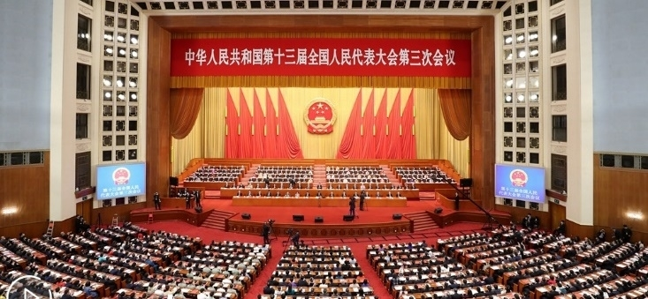
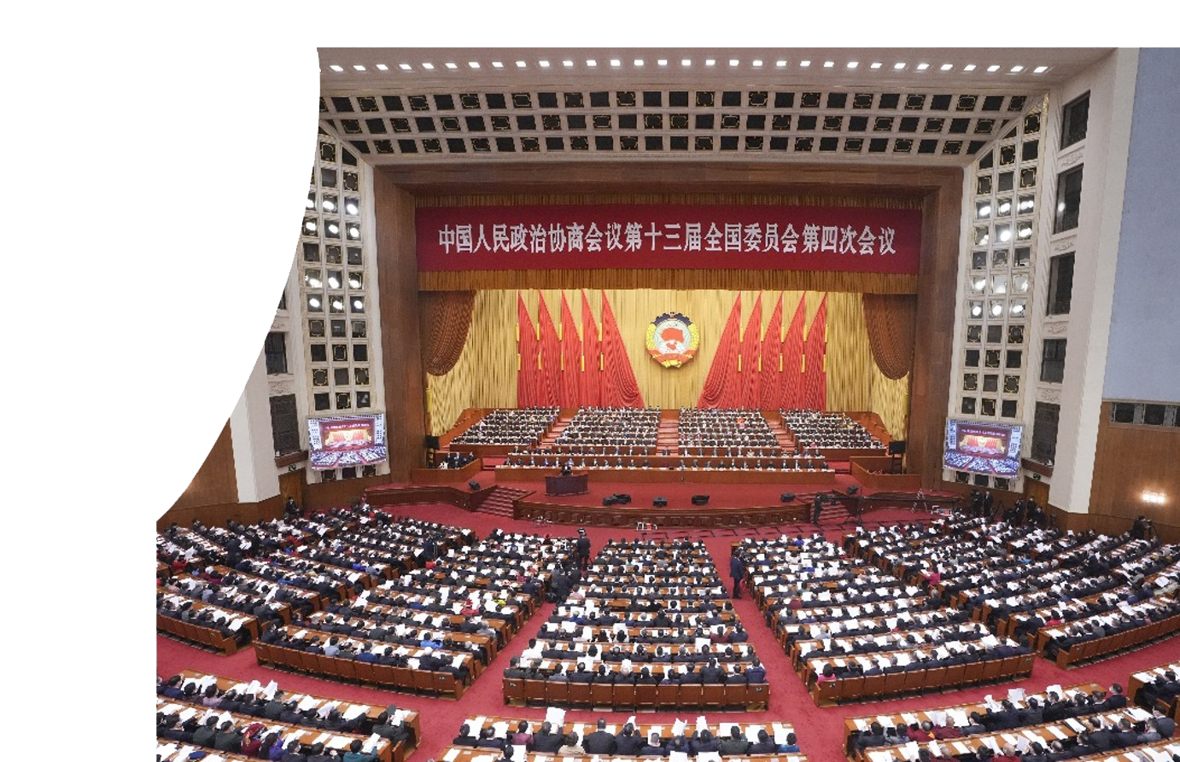
Lead-in questions
Every March, there are reports in news media on the “two meetings”, at which National People’s Congress (NPC) and Chinese People’s Political Consultative Conference (CPPCC) deputies from Hong Kong are also present. Do you know what the “two meetings” are?
The “two meetings” are held every year. What are the important agendas in response to Hong Kong affairs in 2021?

Slide 4
Suggested answer
The “two meetings” refer to the National People’s Congress (NPC) and the Chinese People’s Political Consultative Conference (CPPCC).
To improve the electoral system of the HKSAR was in response to the agenda related to Hong Kong affairs.

Slide 5
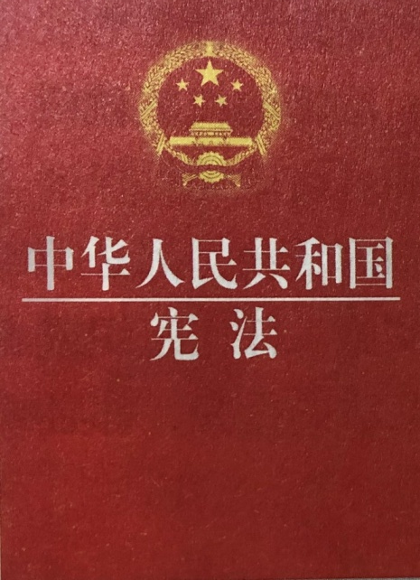
The socialist system is the fundamental system of the People’s Republic of China, and it determines the country’s political system.
The fundamental system
Article 1 of The Constitution of the People’s Republic of China
(the Constitution):
The People’s Republic of China is a socialist state governed by a people’s democratic dictatorship that is led by the working class and based on an alliance of workers and peasants.
The socialist system is the fundamental system of the People’s Republic of China. Leadership by the Communist Party of China is the defining feature of socialism with Chinese characteristics. It is prohibited for any organization or individual to damage the socialist system.

Slide 6
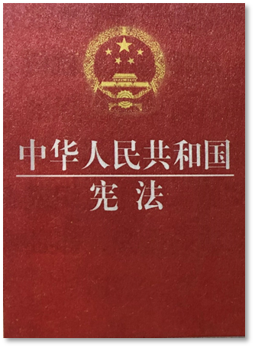
The People’s Congress System
Article 2(1) and (2) of the Constitution stipulates that all power in the People’s Republic of China belongs to the people. The organs through which the people exercise state power are the National People’s Congress and the local people’s congresses at all levels.
  The National People’s Congress of the People’s Republic of China is the highest organ of state power, which exercises the highest power of the state. The system of the National People’s Congress is the fundamental political structure of China.

Slide 7
What is the People’s Congress system?
  It is an organizational form of political power compatible with the governing system of the people's democratic dictatorship
The People’s Congress system
  It is the core of China’s political structure.
  The National People’s Congress and the local people’s congresses at various levels are constituted through democratic elections. They are the organs through which people exercise state power and the other organs of the state are created by the people’s congresses.

Slide 8


To amend the Constitution and to supervise the enforcement of the Constitution;
To enact and amend basic national laws;
To elect and decide on the leaders of state organs, including the President and the Vice-President, to decide on the choice of the Premier and all other members of the State Council, to elect the Chairman and to decide on the choice of all other members of the Central Military Commission, to elect the Chairman of the National Supervisory Commission, and to elect the President of the Supreme People’s Court and the Procurator-General of the Supreme People’s Procuratorate;
To examine and approve the plan for national economic and social development and the report on its implementation;
To examine and approve the state budget and the report on its implementation;
To decide on other key issues of the nation.
Functions and powers of the National People’s Congress
Source: http://www.npc.gov.cn/zgrdw/npc/sjb/2013-02/19/content_1755080.htm

Slide 9
Characteristics of the People’s Congress System
It is conducive to centralising public opinion and gathering wisdom from people.
01
People have the right to supervise and remove from office the deputies they have elected.
02
Other organs of the state are created by the people’s congresses to which they are responsible and by which they are supervised.
03
All state powers are vested in the people’s congresses, leading to higher efficiency in state governance.
04

Slide 10
Election of the Deputies of the People’s Congress
  According to Article 59(1) of the Constitution, the National People’s Congress shall be composed of deputies elected from the provinces, autonomous regions, cities directly under central government jurisdiction, special administrative regions and armed forces. All ethnic minorities should have an appropriate number of deputies.

Slide 11


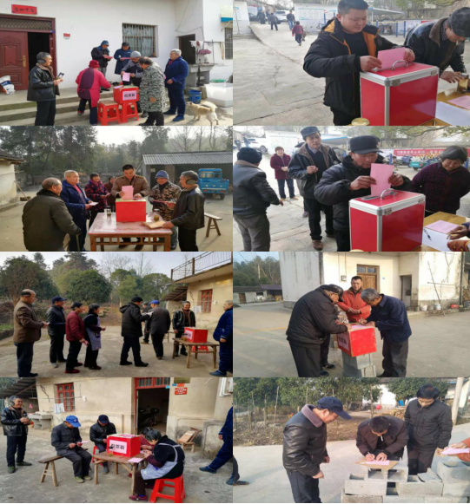
Supplementary information: Who has the right to elect deputies of the people’s congress?
Article 34 of the Constitution
All citizens of the People’s Republic of China who have reached the age of 18, regardless of ethnicity, race, gender, occupation, family background, religious belief, level of education, property status or length of residence, shall have the right to vote and stand for election; persons deprived of political rights in accordance with law shall be an exception.
Video: How is the National People’s Congress deputy elected?
http://news.cctv.com/2018/02/28/ARTI3fXmvHwuo6wxs62nqjEI180228.shtml
The photo shows villagers of Guantang Village in Nanling County of Wuhu, Anhui Province electing deputies to people’s congresses in county-level regions.

Slide 12


Supplementary information: How are the HKSAR deputies to the National People’s Congress elected?
Measures for the Election of Deputies to the Thirteenth National People’s Congress from the Hong Kong Special Administrative Region of the People’s Republic of China (2017)
Source: https://www.hmo.gov.cn/zcfg_new/xf/201801/t20180129_2166.html

Slide 13
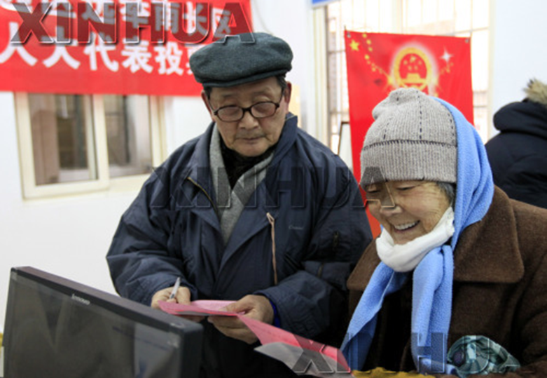
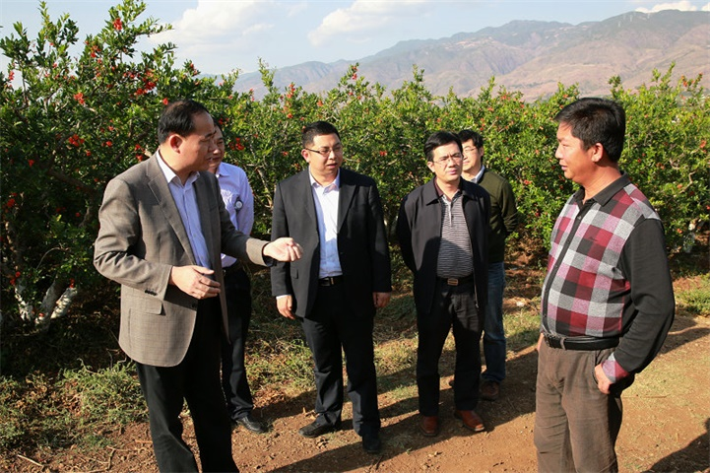
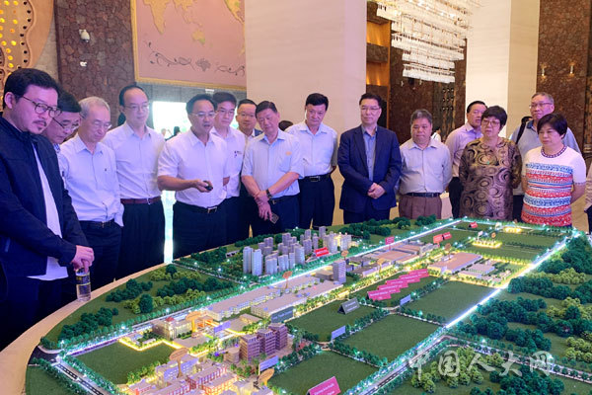
References
Voting in the elections
Grassroots investigation by the deputies to the National People’s Congress
Research by Hong Kong deputies to the National People’s Congress in Jiangdong New Area of Haikou City

Slide 14
References
Agenda of the Fourth Session of the 13th National People’s Congress
I. Review the Report on the Work of the Government
II. Review the draft outline of the 14th Five-Year Plan (2021-2025) for national economic and social development and Vision 2035 of the People’s Republic of China
III. Review the reports on the implementation of the plan for national economic and social development 2020 and on the draft plan for national economic and social development 2021, and review the draft plan for national economic and social development
IV. Review the reports on the implementation of local and central budgets 2020 and on the drafts of local and central budgets 2021, and review the drafts of local and central budgets 2021
V. Review the proposal of the Standing Committee of the National People’s Congress for reviewing the National People’s Congress Organization Law of the People’s Republic of China (Amendment Draft)
VI. Review the proposal of the Standing Committee of the National People’s Congress for reviewing the Rules of Procedure of the National People’s Congress of the People’s Republic of China (Amendment Draft)
VII. Review the proposal of the Standing Committee of the National People’s Congress for reviewing the Decision of the National People’s Congress on Improving the Electoral System of Hong Kong Special Administrative Region (Draft)
VIII. Review the Report on the Work of the Standing Committee of the National People’s Congress
IX. Review the Report on the Work of the Supreme People’s Court
X. Review the Report on the Work of the Supreme People’s Procuratorate

Slide 15
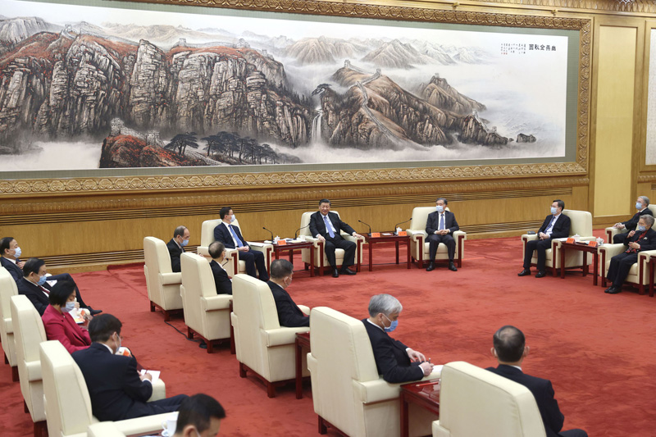
The System of Multi-party Cooperation and Political Consultation led by the Communist Party of China
  Apart from the Communist Party of China, there are eight democratic parties in China. The Communist Party of China and the democratic parties work in close collaboration and dedicate to achieving socialism.
  All democratic parties are participating parties who enjoy the right to participate in state affairs. They participate in and deliberate on state affairs. Their participation mainly takes the following forms: participating in the exercise of state power, consultation on fundamental state policies and the choice of state leaders, the administration of state affairs, and the formulation and implementation of state policies, laws and regulations.
  The basic principle on the cooperation between the Communist Party of China and the democratic parties is “long-term coexistence, mutual supervision, treating each other with sincerity and sharing each other’s weal and woe.”
On 1 February 2021, Xi Jinping, Wang Yang and Han Zheng held a talk with democratic party members and personages without party affiliation in the Great Hall of the People.

Slide 16
Learn more
Eight Democratic Parties
  Revolutionary Committee of the Chinese Kuomintang (RCCK) Founded in 1948
  China Democratic League (CDL) Founded in 1941
  China National Democratic Construction Association (CNDCA)Founded in 1945
  China Association for Promoting Democracy (CAPD) Founded in 1945
  Chinese Peasants and Workers Democratic Party (CPWDP) Founded in 1930
  China Zhi Gong Dang (CZGD) Founded in 1925
  Jiusan Society Founded in 1946
  Taiwan Democratic Self-Government League (TSL) Founded in 1947

Slide 17
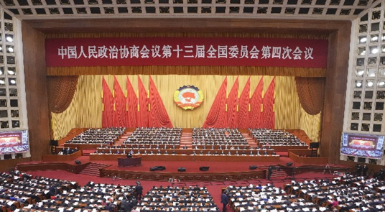
The System of Multi-party Cooperation and Political Consultation led by the Communist Party of China
The Chinese People’s Political Consultative Conference (CPPCC)
The CPPCC is an organisation of the Chinese people’s patriotic united front, an important institution of CPC-led multiparty cooperation and political consultation, a major form for promoting socialist democracy in China’s political life.

Slide 18
The System of Multi-party Cooperation and Political Consultation led by the Communist Party of China
Political consultation refers to consultations on the country's basic policies and important political, economic, cultural and social issues before a decision is made and implemented. It also includes consultation on major issues arising from the process of policy implementation.
Political consultation
Functions of CPPCC
Supervision through suggestions and criticisms on the implementation of the Constitution, laws and regulations, the implementation of major principles and policies, and the work of state organs and their functionaries.
Democratic supervision
Participation in the deliberation and administration of state affairs
Opinions and suggestions to the CPC and state organs are put forward through study reports, proposals, recommendations and other forms.

Slide 19



Extended Learning: There are other systems such as
Regional Ethnic Autonomy
Self-governance of Primary-level People

Slide 20
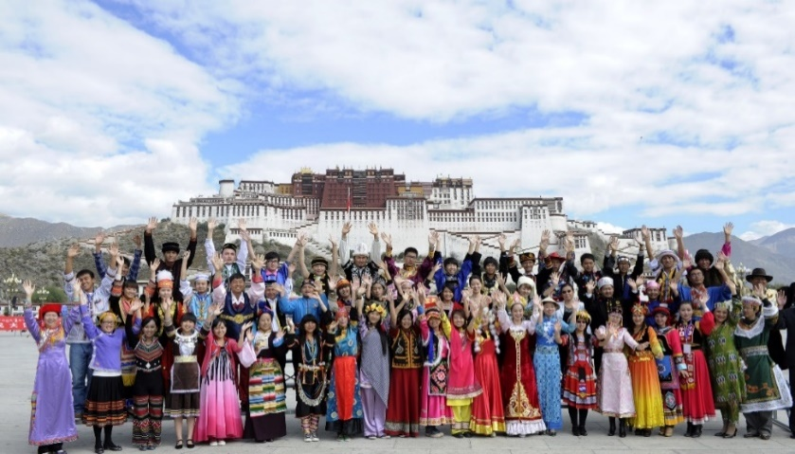

Extended Learning: Regional Ethnic Autonomy
The People’s Republic of China is a unified multi-ethnic state.
The People’s Republic of China is a unified multi-ethnic state. It has 56 ethnic groups, among whom socialist ethnic relations based on equality, unity, mutual assistance, and harmony have been established from long-term communication, exchange and integration.
A photo of representatives from 56 ethnic groups
Video: How many ethnic minority groups does China have?
https://haokan.baidu.com/v?vid=10586831975894646222&pd=bjh&fr=bjhauthor&type=video

Slide 21
Extended Learning: The regional ethnic autonomy is a basic political system of China
Regional ethnic autonomy means that the minority nationalities, under unified state leadership, practise regional autonomy in areas where they live in concentrated communities and set up organs of self-government for the exercise of the power of autonomy.
National autonomous areas shall be classified into autonomous regions, autonomous prefectures and autonomous counties (qi旗). All national autonomous areas are integral parts of the People's Republic of China.
By the end of 2019, 155 ethnic autonomy regions had been set up, including 5 autonomous regions, 30 autonomous prefectures and 120 autonomous counties (qi).

Slide 22
Extended Learning:
Self-governance of primary-level people
Article 111(1) of the Constitution states that: “Residents committees and villagers committees, established among urban and rural residents on the basis of their place of residence, are primary-level people's organizations for self-governance …”
Self-governance at the grass-roots level is a democratic system and governance mode in which the people exercise democratic rights in accordance with laws so as to enable them to exercise self-management, self-education, self-service and self-supervision under the leadership of urban and rural grass-roots CPC committees in their place of residence, and on the basis of mass organisations at the grass-roots level.
Mass organisations at the grass-roots level are villagers committees in rural areas and residents committees in urban areas.

Slide 23
Extended Learning
The residents committees are responsible for:
  Publicising the Constitution, laws, regulations and state policies and safeguarding the residents’ lawful rights and interests;
  Handling public affairs and public welfare services of the residents in local residential areas;
  Mediating disputes among the residents;
  Helping maintain public order;
  Assisting the local people’s government or its agencies in its work related to the interests of the residents, such as public health, family planning, special care for disabled servicemen and for family members of revolutionary martyrs and servicemen, social relief, and juvenile education; and
  Conveying residents’ opinions, demands and making suggestions to the local people's government or its agencies.
Source: http://www.npc.gov.cn/wxzl/gongbao/1989-12/26/content_1481131.htm

Slide 24
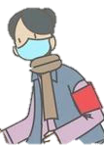
During COVID-19 pandemic, what do the residents committees often ask?
Activity
Happy New Year! Sorry to disturb you, but is anyone of your family having a fever?
Have you been to any other place during the Spring Festival? If yes, how did you get there?
Please feel free to tell us about your need. Fourteen days is a long period, but for the safety of everyone, please hold on.
Please fill out the Registration Form for Visitors.
Question: Which task of the residents committees does this case belong to?

Slide 25
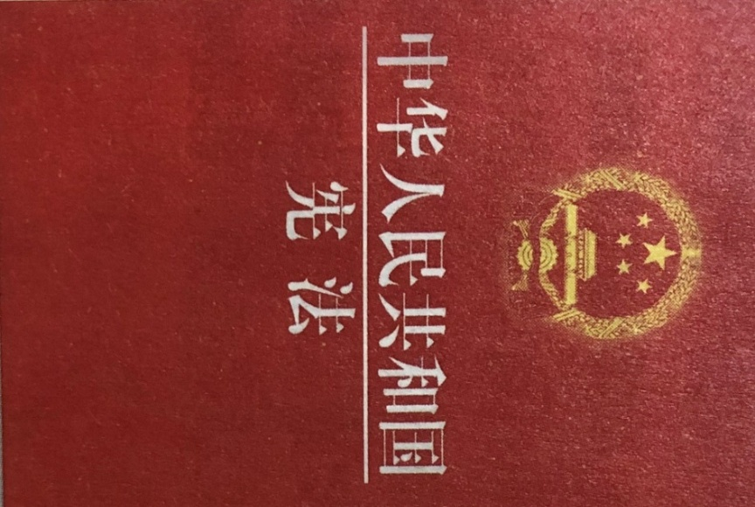
Central Government Organs
National People’s Congress
President of the People’s Republic of China
State Council
Central Military Commission
National Supervisory Commission
Supreme People’s Court
Supreme People’s Procuratorate
CONTENTS
CHAPTER I GENERAL PRINCIPLE
CHAPTER II THE FUNDAMENTAL RIGHTS AND DUTIES OF CITIZENS
CHAPTER III THE STRUCTURE OF THE STATE
SECTION 1 NATIONAL PEOPLE'S CONGRESS
SECTION 2 THE PRESIDENT OF THE PEOPLE’S REPUBLIC OF CHINA
SECTION 3 THE STATE COUNCIL
SECTION 4 THE CENTRAL MILITARY COMMISSION 5 THE LOCAL PEOPLE'S CONGRESSES AND LOCAL PEOPLE'S GOVERNMENTS AT VARIOUS LEVELS
SECTION 6 THE ORGANS OF SELF-GOVERNMENT OF Ethnic Autonomy Regions
SECTION 7 SUPERVISORY COMMISSIONS
SECTION 8 THE PEOPLE'S COURTS AND THE PEOPLE'S PROCURATORATES
CHAPTER IV THE NATIONAL FLAG, THE NATIONAL ANTHEM, THE NATIONAL EMBLEM AND THE NATIONAL CAPITAL

Slide 26
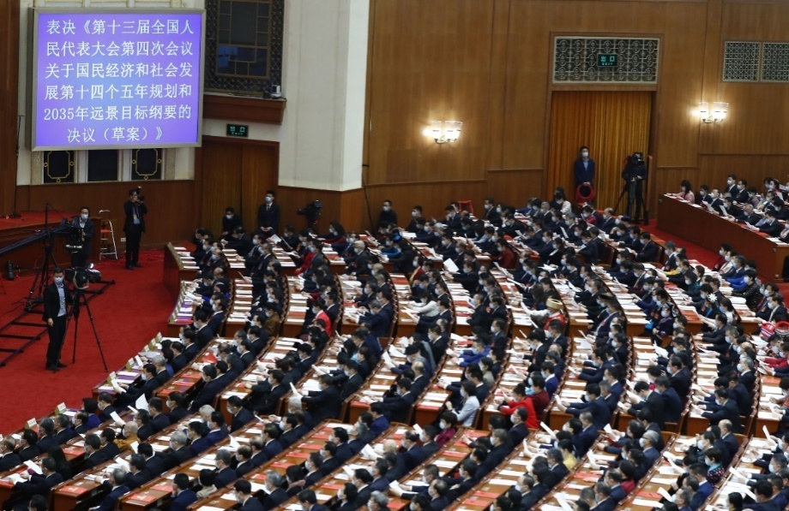
National People’s Congress
The National People’s Congress
is the highest organ of state power.
is composed of deputies elected by the provinces, autonomous regions, cities directly under the central government jurisdiction, special administrative regions and the armed forces. All ethnic minorities should have an appropriate number of deputies.
exercises its functions and powers through congresses. It holds a plenary session every year, and interim sessions when necessary.
The Fourth Session of the 13th National People’s Congress was reviewing the drafts of the 14th Five-Year Plan (2021-2025) for National Economic and Social Development and Vision 2035 (Draft).

Slide 27
Learn more
Since the 9th National People’s Congress in 1998, deputies from the Hong Kong Special Administrative Region have been present at the congress as members of the HKSAR delegation rather than as members of the Guangdong provincial delegation.

Slide 28
Activity
Videos of the National People’s Congress in 2021
(http://www.npc.gov.cn/npc/dbdh13j4c/13j4c.shtml)
Opening Ceremony
Agenda
The Premier on the Work of the Government
Closing ceremony
Know about how the National People’s Congress manages state affairs.

Slide 29
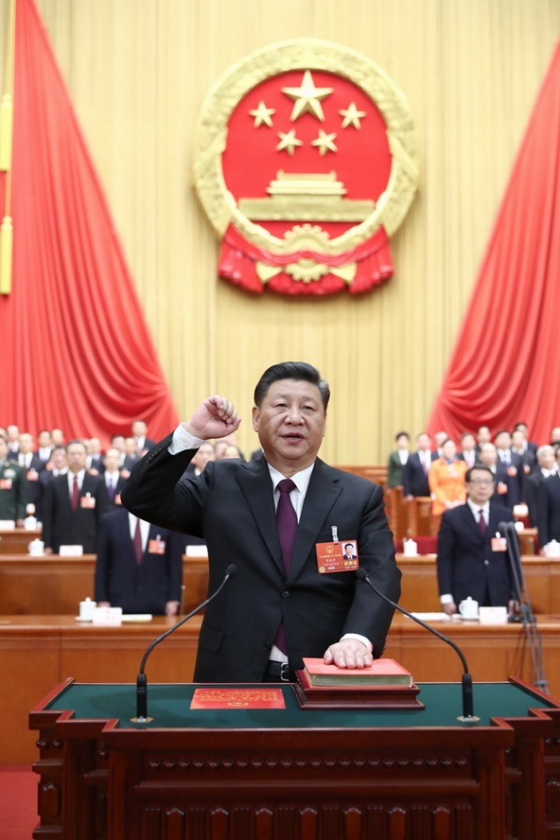
President of the People’s Republic of China
The President of the People’s Republic of China
is the head of state of the People’s Republic of China , who exercises the functions and powers endowed by the Constitution on behalf of the country.
shall be elected by the National People’s Congress.
shall have the same term of office as that of the National People's Congress.
During the fifth plenary meeting of the First Session of the 13th National People’s Congress, Xi Jinping was elected President of the People’s Republic of China and Chairman of the Central Military Commission of the People’s Republic of China. The photo shows Xi Jinping taking an oath to the Constitution.

Slide 30
Functions and Powers of the President of the People’s Republic of China
Article 80 of the Constitution
The president of the People’s Republic of China, pursuant to decisions of the National People's Congress and the National People's Congress Standing Committee,
promulgates Laws;
appoints or removes the premier, vice-premiers, state councillors, ministers of ministries, ministers of commissions, the auditor general and the secretary general of the State Council;
confers national medals and titles of honour;
issues orders of special pardons, declares a state of emergency, declares a state of war, and issues mobilization orders.
Article 81 of the Constitution
represents the People’s Republic of China, and engages in affairs of state and receives foreign diplomatic envoys on behalf of the People's Republic of China and, pursuant to decisions of the National People's Congress Standing Committee, appoints or recalls plenipotentiary representatives abroad and ratifies or abrogates treaties and important agreements concluded
with foreign countries.
Constituion of the People’s Republic of China

Slide 31
References
Promulgating laws
and issuing orders
On 20 March 2018, the First Session of the 13th National People’s Congress approved the Supervision Law of the People’s Republic of China by voting. PRC President Xi Jinping promulgated it by signing Presidential Decree No.3.
The power to manage foreign affairs
During 21-26 March 2019, PRC President Xi Jinping was invited to pay state visits to Italy, Monaco and France.
On 18 March 2018, according to the nomination made by PRC President Xi Jinping, the First Session of the 13th National People’s Congress decided by voting that Li Keqiang was to become Premier of the State Council of the People’s Republic of China. PRC President Xi Jinping issued Presidential Decree No. 1, in pursuance of the decision made by the National People’s Congress, to appoint Li Keqiang as Premier of the State Council.
The power to appoint and remove
On 11 August 2020, PRC President Xi Jinping issued Presidential Decree, in pursuance of the Decision of the Standing Committee of the National People’s Congress to Award the National Medal and the National Honorary Title to Outstanding Contributors in the Fight Against the Coronavirus Pneumonia Outbreak adopted in the 21st Session of the Standing Committee of the 13th National People’s Congress, awarded Zhong Nanshan “Medal of the Republic”.
The power to award honours

Slide 32
State Council
The State Council of the People’s Republic of China, namely, the Central People’s Government, is the executive organ of the highest state organ of power; it is the highest state administrative organ.
The State Council shall have the same term of office as that of the National People’s Congress.
The State Council shall be responsible to the National People’s Congress and shall report to the Congress on its work; when the National People’s Congress is out of session it shall be responsible to the National People’s Congress Standing Committee and shall report to the Standing Committee on its work.
The Premier assumes overall responsibility for the work of the State Council. The Premier shall direct the work of the State Council.

Slide 33
Major functions and powers of the State Council
stipulating administrative measures, formulating administrative regulations and issuing decisions and orders in accordance with the Constitution and the law;
submitting proposals to the National People's Congress or the National People's Congress Standing Committee;
drawing up and implementing plans for national economic and social development and state budgets;
directing and managing economic work, urban and rural development and ecological conservation;
directing and managing education, science, culture, health, sports and family planning work;
managing foreign affairs and concluding treaties and agreements with foreign countries;
changing or revoking inappropriate decisions and orders issued by local state administrative organs at all levels;
exercising other functions and powers accorded to it by the National People's Congress and the National People's Congress Standing Committee.

Slide 34
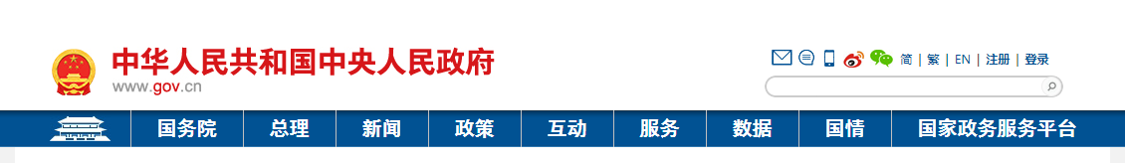
Activity
Visit the website of the Central Government of the People’s Republic of China to understand the organisations constituting the State Council. Choose a column that appeals to you and find out how the government works.
Central People’s Government of the People’s Republic of China
State Council, Premier, News, Policies, Interactions, Services, Data, Situation of the Country, National Political Service Platform
(Source: http://www.gov.cn/)

Slide 35
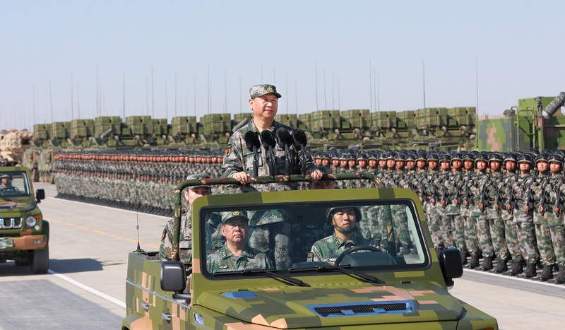
Extended Learning: Central Military Commission
The Central Military Commission of the People's Republic of China shall lead the country's armed forces.
The Central Military Commission shall have the same term of office as that of the National People's Congress
The chairperson of the Central Military Commission shall be responsible to the National People's Congress and the National People's Congress Standing Committee.
On 30 July 2017, at the parade held to celebrate the 90th anniversary of the founding of the People’s Liberation Army, the chairperson of the Central Military Commission, Xi Jinping took a ride to inspect the troops.

Slide 36
Extended Learning: Supervisory Commission
The National Commission of Supervision of the People's Republic of China is the highest supervisory organ.
The National Commission of Supervision shall be responsible to the National People's Congress and the National People's Congress Standing Committee.
Commissions of supervision shall, in accordance with the provisions of law, independently exercise supervisory power, and shall not be subject to interference from any administrative organ, social organization or individual.
The supervisory organs, in handling cases of duty-related malfeasance or crime, shall work together with adjudicatory organs, procuratorial organs and law enforcement departments; they shall act as a mutual check on each other.
Source: Website of the National Supervisory Commission, http://www.ccdi.gov.cn/

Slide 37
Extended Learning: Supreme People’s Court
The Supreme People's Court is the highest adjudicatory organ. The president of the Supreme People's Court shall have the same term of office as that of the National People's Congress
The Supreme People's Court shall be responsible to the National People's Congress and the National People's Congress Standing Committee. It reports its work to the National People’s Congress.
The Supreme People’s Court is composed of Criminal Adjudication Tribunal, Civil Adjudication Tribunal, Administrative Adjudication Tribunal, and other necessary tribunals and Circuit Courts.
Source: Website of the Supreme People’s Court, http://www.court.gov.cn/

Slide 38
Extended Learning: People’s Procuratorate
The people's procuratorates of the People's Republic of China are the legal oversight organs of the state. The Supreme People’s Procuratorate is the highest procuratorial organ. The procurator general of the Supreme People's Procuratorate shall have the same term of office as that of the National People's Congress
The Supreme People's Procuratorate shall be responsible to the National People's Congress and the National People's Congress Standing Committee. It reports its work to the National People’s Congress.
The people's procuratorates shall, in accordance with the provisions of law, independently exercise procuratorial power, and shall not be subject to interference from any administrative organ, social organization or individual.
Source: Website of the Supreme People’s Procuratorate, https://www.spp.gov.cn/

Slide 39

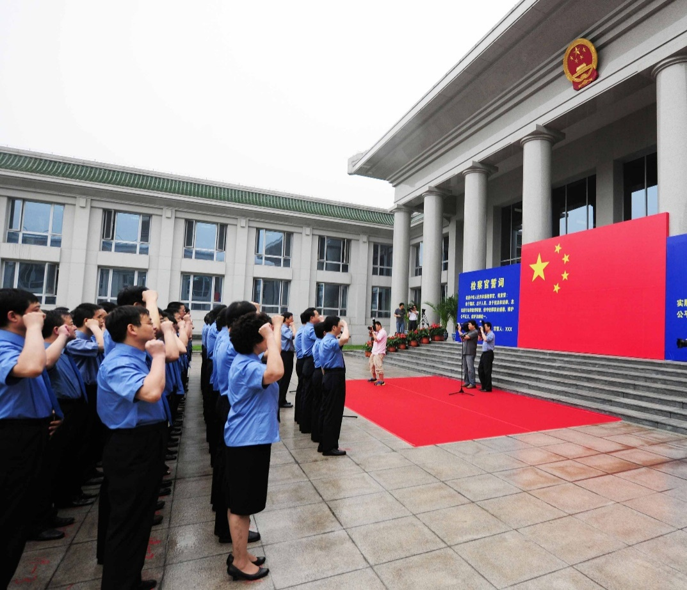
Learn more
Procurators’ oath
I am a procurator of the People’s Republic of China. I swear that I shall be loyal to the state, to its people, to its Constitution and the law. I shall faithfully perform my duty of legal supervision, observe the ethical principles of procuratorship, safeguard equality and justice, and maintain legal consistency.
Oath taker: [name]
On 1 July 2010, procurators from the Supreme People’s Procuratorate held the first oath-taking ceremony together.
Source: Regulation on the Oath of Procurators in the People’s Republic of China (Provisional)

Slide 40
China is a unified multi-ethnic state
There are 56 ethnic groups in China
China is a unified multiethnic state of 56 ethnic groups. The Chinese nation is the collective name for the people of all ethnic groups.
As the population of the 55 ethnic groups is relatively less than that of the Han ethnic group, the 55 ethnic groups are conventionally referred to ethnic minorities. 18 ethnic minorities has a population of over 1 million each, among which the Zhuang (壯族), the Hui (回族), the Manchu (滿族) and the Uyghur (維吾爾族) have the largest population of over 10 million each. The ethnic minorities that have the least population are the Gaoshan (高山族), the Lhoba (珞巴族) and the Tatar (塔塔爾族), with a population of less than 5,000 people each.

Slide 41
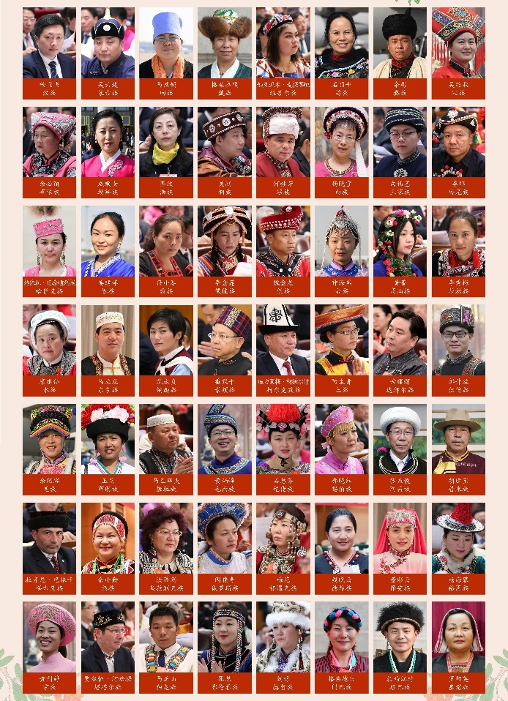

Learn more
56 ethnic groups in China
There are 56 ethnic groups in China, namely, the Han, Mongolia, Hui, Tibetan, Uyghur, Miao, Yi, Zhuang, Bouyei, Korean, Manchu, Dong, Yao, Bai, Tujia, Hani, Kazak, Dai, Li, Lisu, Va, She, Gaoshan, Lahu, Shui, Dongxiang, Naxi, Jingpo, Kirgiz, Tu, Daur, Mulam, Qiang, Blang, Salar, Maonan, Gelo, Xibe, Achang, Pumi, Tajik, Nu, Ozbek, Russian, Ewenki, De’ang, Bonan, Yugur, Jing, Tartar, Drung, Oroqen, Hezhe, Moinba, Lhoba and Jino.
Representatives of 56 ethnic groups gathered in Beijing at the opening ceremony of the First Session of the Thirteenth National People’s Congress, 5 March 2018

Slide 42
Learn more
China is a unified multi-ethnic state
56 ethnic groups in China
According to the 7th national population census (2021), the Han population is 1,286.31 million, accounting for 91.11% of the total population; the population of all ethnic minorities is 125.47 million, making up 8.89% of the total population. As compared with 2010, the Han population increased by 4.93%, and the population of all ethnic minorities increased by 10.26%, representing an increase of 0.40% in proportion.
Source: http://www.stats.gov.cn/tjsj/zxfb/202105/t20210510_1817176.html

Slide 43
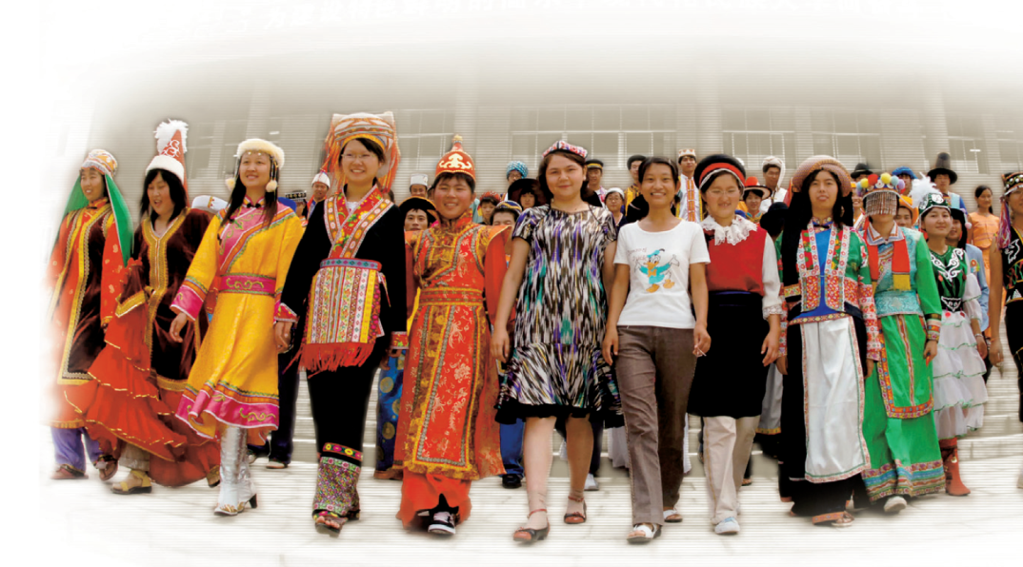
China is a unified multi-ethnic state
and each ethnic group having distinctive culture
Due to the differences in the natural environment and production conditions, people of ethnic groups have their own lifestyles and folk customs, forming their distinctive cultures.
43

Slide 44
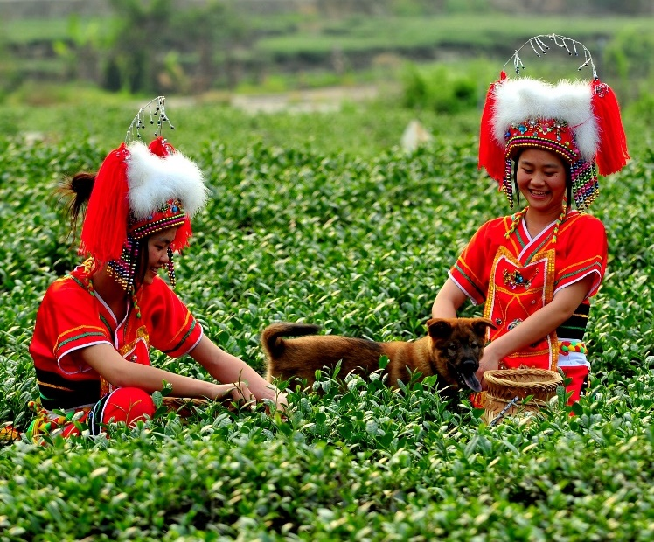
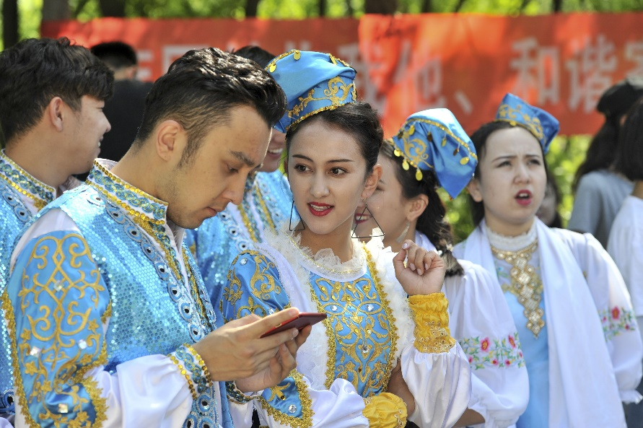
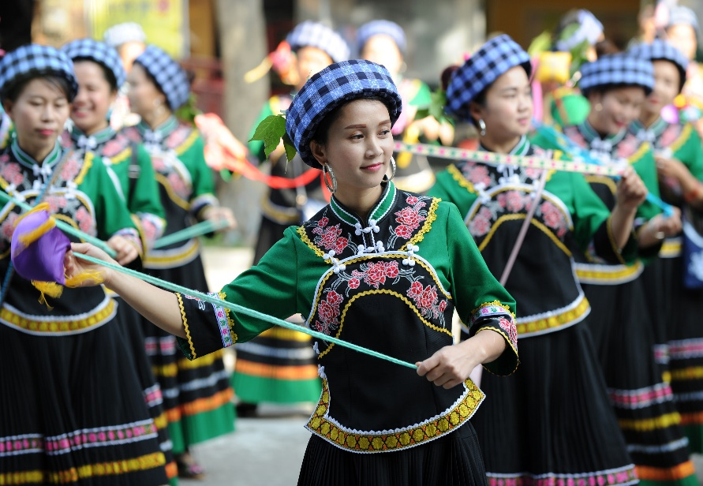
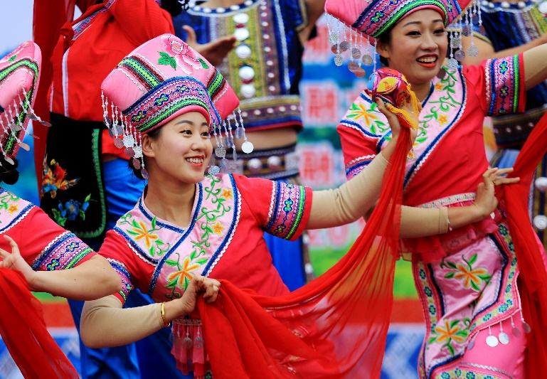
Learn more
Costume
Costume contains information about the environment, physiology, and characteristics of group psychology. Each ethnic group has its own costume traditions. In terms of appearance, it is reflected in clothing, colours, crafts and components; in terms of folk customs, it forms a series of costume conventions and taboos.
Gaoshan
Tartar
Zhuang
Bouyei

Slide 45
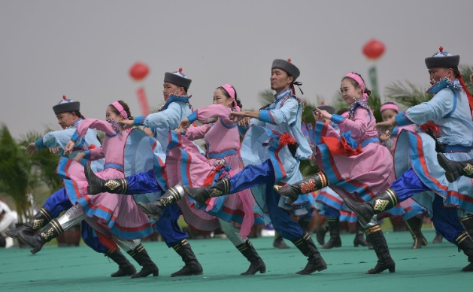
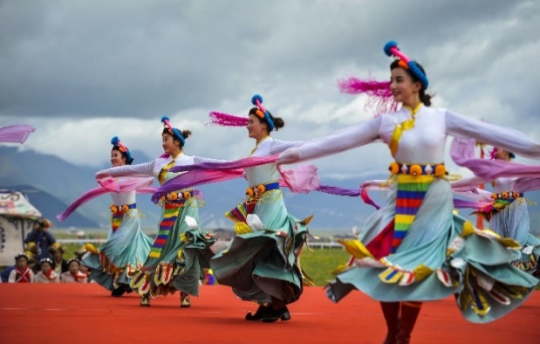
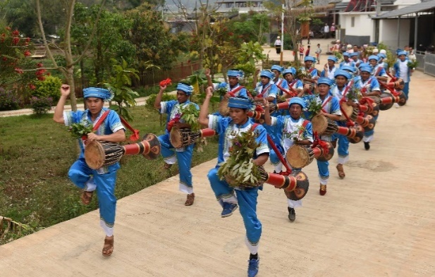
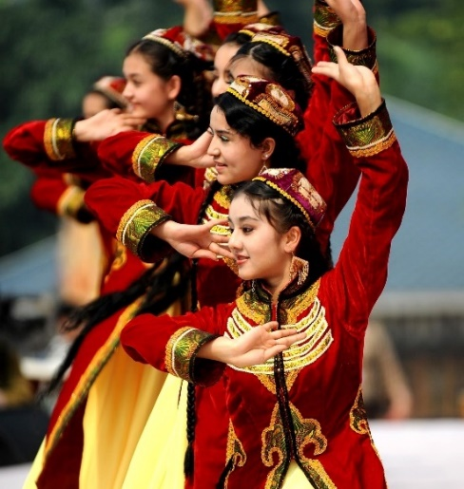
Learn more
Folk Dance
Under different geographical environment, social life, folkways and customs, and economic and cultural conditions, every ethnic group has developed different types and styles of folk dances in the long-term historical development. For example, as the Mongolians and Kazaks living in the northern grasslands of the mainland have nomadic lives for long, their dances with powerful motion and strong rhythm often include shoulder movements that are commonly seen when riding horses. In contrast, the dances of the ethnic groups living in southern farming areas, such as those performed by the Zhuang, Bai, Hani and Li, are characterised by gentle movements and soft rhythms and usually reflected their working lives of tea picking, rice pounding and shrimp catching, etc.
Mongolian Dance
Tibetan Dance
Dai Dance
Uyghur Dance

Slide 46
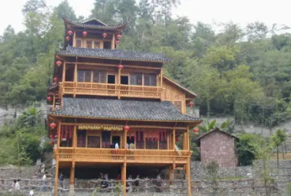
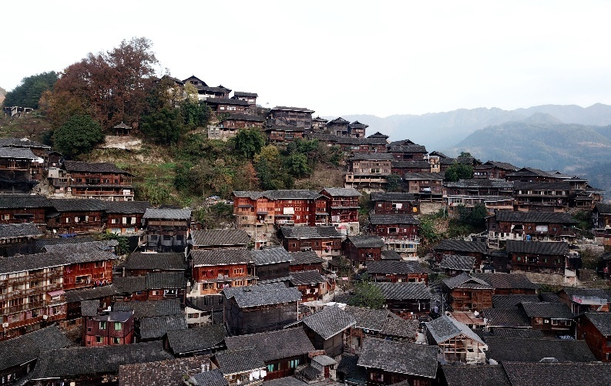
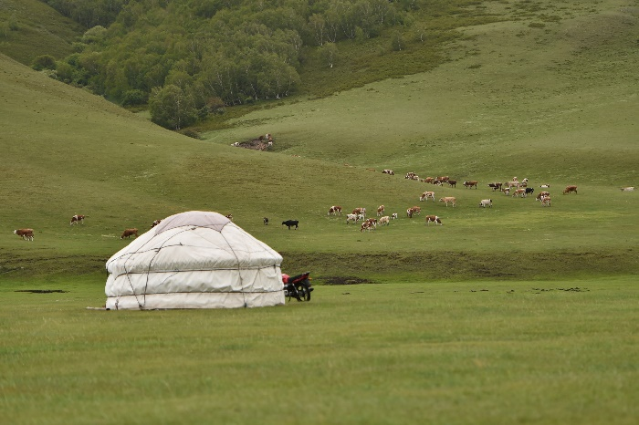
Learn more
Living Places
Under the influence of natural environments, cultural environment, as well as residents’ socio-economic conditions, and different historical traditions, ethnic groups in our country have developed various types of living places.
Stilt House
One-Thousand-Household Miao Village
Yurt

Slide 47
Learn more
Festivals of ethnic groups
Festivals of ethnic groups, which embody local customs, religious beliefs and moral ethics of the lives of ethnic groups, are the legacies / long-term accumulation of the history and culture of ethnic groups. Celebrations of ethnic festivals are the display of the cultures of ethnic groups.
Ethnic Groups | Festivals
the Yi (彝族), the Achang (阿昌族), the Bai (白族), etc. | Torch Festival (火把節)
the Dong (侗族) | Lusheng Festival (蘆笙節)
the Miao (苗族) | Dragon Boat Festival (龍船節)
the Tajik (塔吉克族), the Va (佤族) | Sowing Festival (播種節)
the Mongolian (蒙古族) | Naadam festival (那達慕大會)

Slide 48
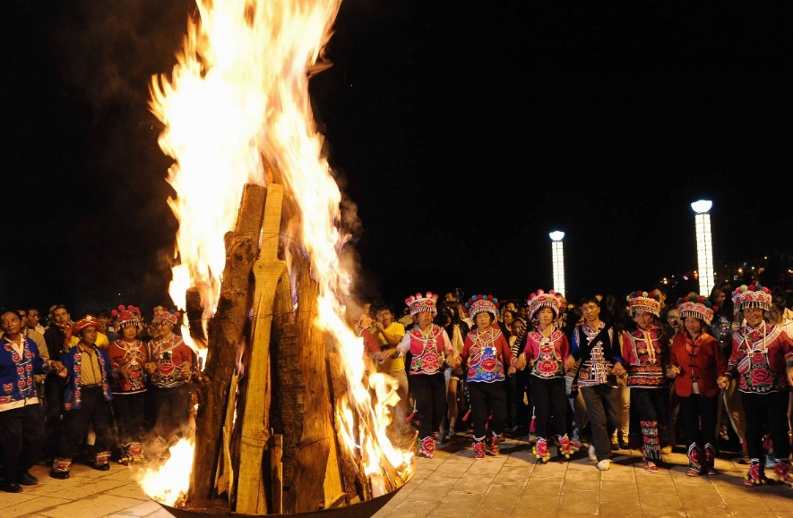
Learn more
The Torch Festival is an important festival for the Yi ethnic group. Generally, it is usually celebrated on the 24th of June of the lunar calendar, and often associated with the Fire Totem of the Yi. A folk proverb of the Yi says that “The Torch Festival is a festival of the eyes.” There are many collective entertainment activities during the Torch Festival, such as horse- racing, bull-fights, sheep-fights, wrestling, and pageant, etc. At night, bonfires are lit everywhere in the fields, resembling “countless stars falling into the human world”.
The Yi celebrating the Torch Festival in Shuangbai County, Yunnan Province

Slide 49
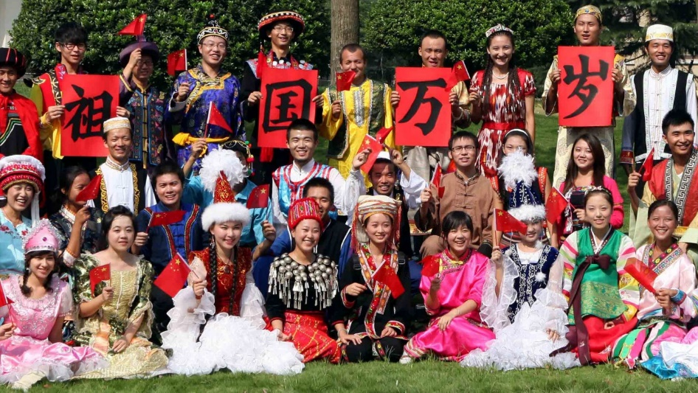
All ethnic groups merge into the community of Chinese nation through interaction and exchanges
All ethnic groups in China have merged with one another through ongoing interaction and exchanges, building an interdependent relationship in which every ethnic group is bound together. They constitute the community of Chinese nation, which is featured by the largest population in the world with a standardised writing system, and a set of commonly shared values.
Students of various ethnic groups warmly celebrating the National Day by holding the sign of “Long Live the Motherland”

Slide 50
Ethnic equality
Article 4(1) of the Constitution stipulates that all ethnic groups of the People’s Republic of China are equal.
Constitution of the People’s Republic of China
Ethnic groups only differ in population size and levels of development, with no difference in social status. People of all ethnic groups are the masters in our country, all of whom shall enjoy equal rights in political, economic, cultural and social aspects in accordance with the law and fulfil equal obligations in accordance with the law.

Slide 51
Learn more
In order to guarantee that all ethnic groups have an appropriate number of representatives, since the Fifth National People’s Congress (NPC), there has been a specific regulation about the proportion of representatives from ethnic minorities to the total number of representatives in the decisions made by each NPC concerning the number of representatives and issue of election. For this, the decision (the draft version) stipulates: “the number of representatives from ethnic minorities should make up approximately 12% of the total number of representatives. For ethnic groups with an exceptionally small population, there should be at least one representative”, which is the same as the 12th National People’s Congress.
——Wang Chen, March 2017, Explanations of the Decisions (the draft version) made in the Fifth Session of the 12th National People’s Congress concerning the number of representatives and issues of election in the 13th National People’s Congress
All ethnic minorities should have an appropriate number of representatives. What rationale is behind this regulation?
Answer: To safeguard the equal rights of ethnic minorities in participating in the management of state affairs.

Slide 52
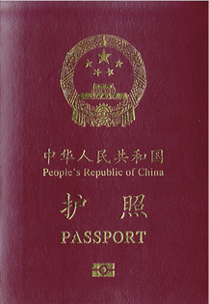
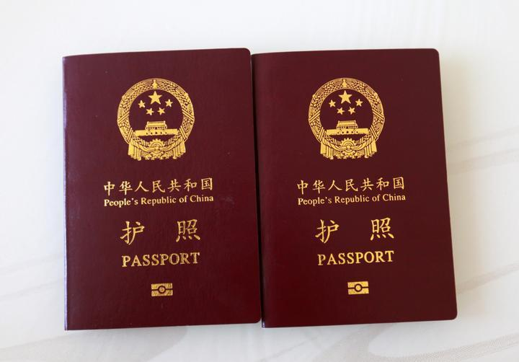
The concept of nationality and citizen
Refers to an individual’s legal identity of belonging to a particular nation, representing the close legal relationship between individuals and the nation.
Nationality
Refers to the individuals who have a particular nationality. He / She who is governed by the law of that nation, shall enjoy the rights and fulfil corresponding obligations prescribed by the law of that nation.
Citizen

Slide 53
Chinese citizens are those who have the Chinese nationality
Published version of the Standing Committee of the
National People’s Congress
Nationality Law of the People’s Republic of China
Chinese Democracy and Law Press
Article 2 of the Nationality Law of the People’s Republic of China stipulates:
The People’s Republic of China is a unitary multinational state; persons belonging to any of the nationalities in China shall have Chinese nationality.
Article 33(1) of the Constituion stipulates:
All persons holding the nationality of the People’s Republic of China are citizens of the People’s Republic of China.
Constitution of the People’s Republic of China

Slide 54


Two ways of obtaining the Chinese nationality
Learning activity
Method One: by birth
Any person born in China whose parents are both Chinese nationals or one of whose parents is a Chinese national shall have Chinese nationality.
Any person born abroad whose parents are both Chinese nationals or one of whose parents is a Chinese national shall have Chinese nationality. But a person whose parents are both Chinese nationals and have both settled abroad, or one of whose parents is a Chinese national and has settled abroad, and who has acquired foreign nationality at birth shall not have Chinese nationality.
Any person born in China whose parents are stateless or of uncertain nationality and have settled in China shall have Chinese nationality.
Method Two: by application
Foreign nationals or stateless persons who are willing to abide by China’s Constitution and laws and who meet one of the following conditions may be naturalised upon approval of their applications:
A. They are near relatives of Chinese nationals;
B. They have settled in China; or
C . They have other legitimate reasons.
Nationality Law of the People’s Republic of China
https://www.immd.gov.hk/hkt/residents/immigration/chinese/law.html

Slide 55
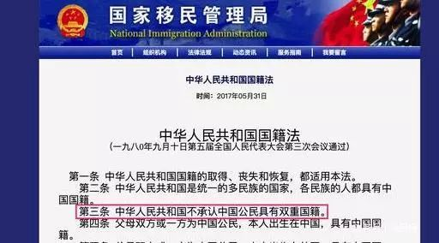
The Chinese government does not recognise dual nationality
Different countries have different policies for nationality. Some countries recognise dual nationality, while others do not.
Article 3 of the Nationality Law of the People’s Republic of China stipulates that dual nationality is not recognised for any Chinese national.
Nationality Law of the People’s Republic of China
(Adopted at the Third Session of the Fifth National People’s Congress, 10 September
1980)
Article 1 This Law is applicable to the acquisition, loss and restoration of nationality of the People’s Republic of China.
Article 2 The People’s Republic of China is a unitary multinational state; persons belonging to any of the nationalities in China shall have Chinese nationality.
Article 3 The People’s Republic of China does not recognise dual nationality for any Chinese national.
Article 4 Any person born in China whose parents are both Chinese nationals or one of whose parents is a Chinese national shall have Chinese nationality.

Slide 56
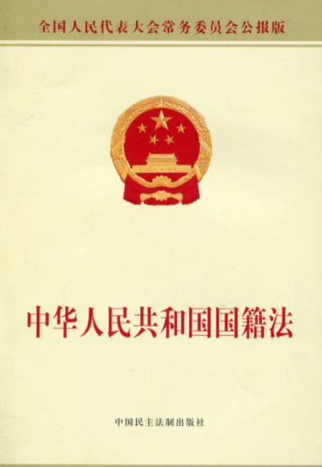
Stipulations on dual nationality in Nationality Law of the People’s Republic of China
Supplementary information
The Nationality Law of the People’s Republic of China explicitly stipulates that the People’s Republic of China does not recognise dual nationality for any Chinese national. The attitudes held by the Chinese government concerning dual nationality are:
Any person shall have only one nationality. No Chinese national is allowed to have dual nationality.
Individuals’ wishes shall be respected. No individuals shall be coerced to choose nationality against their own free will.
Any Chinese national who has been naturalised as a foreign national or has acquired foreign nationality shall automatically lose Chinese nationality. However, the Chinese nationality can be restored when necessary.
Published version of the Standing Committee of the National People’s Congress
Nationality Law of the People’s Republic of China
Chinese Democracy and Law Press

Slide 57
Fundamental obligations to be fulfilled by Chinese citizens as set out in the Constitution
Examples
The obligation to safeguard national unity and the solidarity of all the country’s ethnic groups.
1
Must abide by the Constitution and the law, keep state secrets, protect public property, observe discipline in the workplace, observe public order, and respect social morality.
2
The obligation to safeguard the security, honor and interests of the motherland; they must not behave in any way that endangers the motherland’s security, honor or interests.
3
It is the sacred duty of every citizen of the People’s Republic of China to defend the motherland and resist aggression. It is an honorable obligation of citizens of the People’s Republic of China to perform military service or join the militia in accordance with law.
4
When exercising their freedoms and rights, citizens shall not undermine the interests of the state, society or collectives, or infringe upon the lawful freedoms and rights of other citizens.
5
6
The obligation to pay taxes in accordance with law.

Slide 58
Nationality of Hong Kong residents
Hong Kong residents can be classified as Chinese nationals, non-Chinese nationals and stateless persons on the basis of nationality.
Chinese nationals
Hong Kong residents
Non-Chinese nationals
Stateless persons

Slide 59
Stance of the Chinese government concerning the nationality issue of Hong Kong residents
Where a Hong Kong resident is of Chinese descent and was born in the Chinese territories (including Hong Kong), or where a person satisfies the criteria laid down in the Nationality Law of the People’s Republic of China for having Chinese nationality, he is a Chinese national.
To maintain the prosperity and stability of the HKSAR, and to guarantee the smooth implementation of the Nationality Law of the People’s Republic of China, taking into consideration of the history and actual situation of the Hong Kong, the Standing Committee of the National People’s Congress passed ‘Explanations of Some Questions Concerning the Implementation of the Nationality Law of the People’s Republic of China in the HKSAR’ in 1996.
All Hong Kong Chinese compatriots are Chinese nationals, whether or not they are holders of the “British Dependent Territories Citizens passport” or “British National (Overseas) passport”. With effect from 1 July 1997, Chinese nationals mentioned above may, for the purpose of travelling to other countries and territories, continue to use the valid travel documents issued by the Government of the United Kingdom. However, they shall not be entitled to British consular protection in the Hong Kong Special Administrative Region and other parts of the People’s Republic of China on account of their holding the above mentioned British travel documents.
Conclusion: Hong Kong residents who are of Chinese descent and were born in China are Chinese nationals. Even if they travel with travel documents issued by foreign governments, they are still Chinese nationals.

Slide 60
China’s Ministry of Foreign Affairs announces that China no longer recognises British National (Overseas)[BN(O)] passport
References
Regarding the announcement made by the British Government that the amended policies for the British National (Overseas) Passport (BN(O) Passport) and visa would take effect from 31 January 2021, the spokesperson of China’s Ministry of Foreign Affairs Zhao Lijian announces in a regular press conference on 29 January 2021: The British Government has paid no respect to the fact that Hong Kong has returned to China for 24 years and disregarded China’s solemn position, and has openly violated the British pledge. It insisted on introducing the so-called “bespoke” policy for Hong Kong residents who hold the (BN(O)) status to reside and citizenship in the UK, and further expanded the scope of application of such policy. The British Government attempts to turn a large number of Hong Kong people into second-class British “citizens”, and has completely altered the nature of BN(O) passport. The so-called BN(O) passport mentioned by the UK now is no longer the original one. This move of the UK has seriously infringed on China's sovereignty and blatantly interfered in Hong Kong affairs and China's internal affairs. It has also severely violated international law and the norms governing international relations. China expresses strong indignation at and firm opposition to that. The spokesperson announced that with effect from 31 January, China will no longer recognise the so-called BN(O) passport as a valid travel document and proof of identity and reserve the right to take further actions.
Source: Official website of the Ministry of Foreign Affairs of the People’s Republic of China (https://www.fmprc.gov.cn/web/wjdt_674879/fyrbt_674889/t1849552.shtml )
Reference: https://www.info.gov.hk/gia/general/202101/29/P2021012900763.htm?fontSize=1

Slide 61
Our country creates conditions for equal treatment of
Hong Kong residents
References
The Measures Regarding the Application for and Issuing Residence Permits for Hong Kong, Macao and Taiwan Residents have taken effect on 1 September 2018. A residence permit holder is entitled to rights to participate in social insurance, rights of employment, and basic public services and other conveniences, covering areas of education, medical care and so on. These measures have made it more convenient for Hong Kong residents to live in the Mainland. The Mainland, for the first time, specifies in law the registration of citizen identification numbers for Hong Kong and Macao residents, and the numbering system in accordance with the national standard so as to align with other provinces, autonomous regions, and municipalities in the Mainland.
Source: Takungpao (http://www.takungpao.com.hk/news/232108/2018/0817/203990.html)
Reference: General Office of the State Council Notification on Printing and Disseminating The Regulations for the Application and Issue of Residence Permit for Hong Kong, Macau and Taiwan Residents , Issued by the General Office of the State Council 〔2018〕No. 81 (http://www.gov.cn/zhengce/content/2018-08/19/content_5314865.htm)
Reference: https://www.bayarea.gov.hk/en/resource/mainland-policies-measures-20180806.html

Slide 62

National identity
I take pride in the rapid development of my country since the reform and opening-up.
Our country has managed to develop aerospace technology under difficult circumstances and has made remarkable achievements. This is very touching and thus enhanced my confidence as a Chinese national.
A sense of identity is a sense of being proud of one’s own country.
What do you think national identity is? Please illustrate with an example and share with your classmates.

Slide 63
What do you think national identity is? Please illustrate with an example and share with your classmates.
I’d like to visit the mainland to witness the development of the motherland.
I’m a Chinese and I love traditional Chinese culture.
I feel very proud when the athletes from the mainland and Hong Kong winning medals in the Olympic Games for the glory of our country.
63

Slide 64
The End

Slide 65
User guide
The primary users of this resource are teachers. It aims to provide teachers with content knowledge relevant to the topic to enable teachers to have a deeper understanding of teaching content when preparing for their lessons.
All data, videos, photos, pictures, questions and suggested answers can be used for multiple purposes, such as teachers’ teaching materials, references for curriculum planning and learning and teaching, and student assignments, etc. To align with Citizenship and Social Development Curriculum and Assessment Guide (Secondary 4-6) (2021) (C&A Guide), this resource should be adapted to cater for students’ learning diversity and the needs of classroom teaching, etc.
Teachers may provide appropriate supplementary notes/ explanations to enrich this resource in order to enhance students’ understanding of the topic and information provided.
In accordance with the curriculum rationale and aims, teachers may select other learning and teaching resources which are correct, reliable, objective and impartial to help students build up a solid knowledge base, develop positive values and attitudes as well as enhance critical thinking and problem solving skills, and various generic skills.
If some information cannot be provided in this resource due to copyright issue, teachers may visit relevant websites provided.
Some information may have been updated when being used by teachers, teachers may visit the corresponding websites to obtain the up-to-date information.
Please also refer to the C&A Guide to understand the requirements and arrangements of the learning and teaching of the curriculum.

Slide 66
Notice and Disclaimer
Some sources were not translated into English as the official English version is not available.
In case of any discrepancy between the Chinese and English versions, the Chinese version shall prevail.

