Slide 1
Citizenship and Social Development
Theme 1: Hong Kong under “One Country, Two Systems”
Topic: The meaning and implementation of “one country, two systems”
Learning focus:
Fundamental rights and duties of Hong Kong residents as stipulated in the Basic Law
Translated version
July 2021

Slide 2
Learning objectives
Knowledge:
Fundamental rights and duties of Hong Kong residents as stipulated in the Basic Law
Skills:
To acquire generic skills, such as communication, collaboration, critical thinking, and synthesis and analytical skills
Values:
To nurture responsible citizens with a sense of national identity and law-abidingness
To understand the relationship between fundamental rights and duties, and learn the appropriate attitudes and behaviours in exercising individuals’ fundamental rights and fulfilling constitutional obligations
To understand that rights are not unlimited and are subject to legal restrictions, while respecting social ethics and moral standards

Slide 3
Permanent residents of Hong Kong
According to Article 24 of the Basic Law, permanent residents of the Hong Kong Special Administrative Region shall be defined as persons who are:
  (1) Chinese citizens born in Hong Kong before or after the establishment of the Hong Kong Special Administrative Region;
  (2) Chinese citizens who have ordinarily resided in Hong Kong for a continuous period of not less than seven years before or after the establishment of the Hong Kong Special Administrative Region;
  (3) Persons of Chinese nationality born outside Hong Kong of those residents listed in categories (1) and (2);
  (4) Persons not of Chinese nationality who have entered Hong Kong with valid travel documents, have ordinarily resided in Hong Kong for a continuous period of not less than seven years and have taken Hong Kong as their place of permanent residence before or after the establishment of the Hong Kong Special Administrative Region;
  (5) Persons under 21 years of age born in Hong Kong of those residents listed in category (4) before or after the establishment of the Hong Kong Special Administrative Region; and
  (6) Persons other than those residents listed in categories (1) to (5), who, before the establishment of the Hong Kong Special Administrative Region, had the right of abode in Hong Kong only.

Slide 4
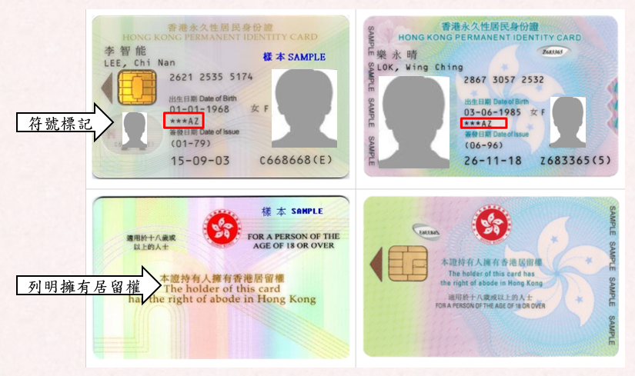
Samples of Hong Kong permanent identity card (ID card)
Meaning of symbols on the ID card
*** means the holder is aged 18 or above and is eligible for a HKSAR Re-entry Permit.
A means the holder has the right of abode in Hong Kong.
Z means the holder’s reported place of birth is Hong Kong.
C means the holder’s stay in Hong Kong is limited by the Director of Immigration at the time of registration of the card.
O means the holder’s reported place of birth is other countries.
Symbols on the ID card
Statement of the right of abode
For more information on the symbols of Hong Kong ID card, please visit the website of the Immigration Department: https://www.immd.gov.hk/hkt/

Slide 5
Non-permanent residents of Hong Kong
According to Article 24 of the Basic Law, non-permanent residents of the Hong Kong Special Administrative Region shall be “persons who are qualified to obtain Hong Kong identity cards in accordance with the laws of the Region but have no right of abode.”
Example: Foreign domestic helpers

Slide 6
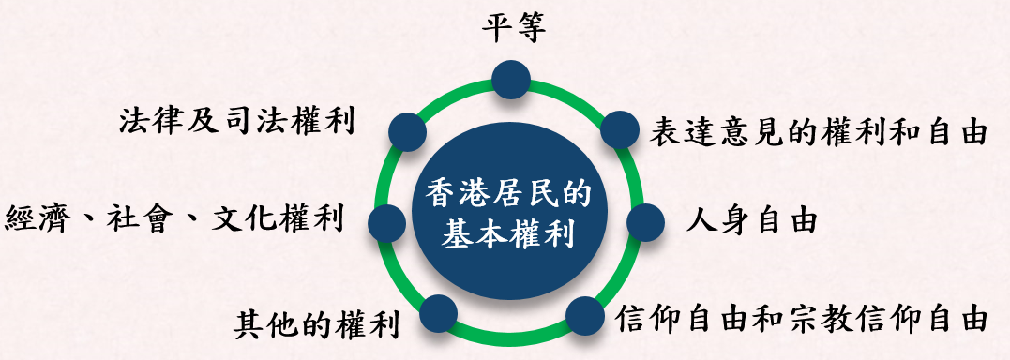
Fundamental rights of Hong Kong residents
The Basic Law safeguards the fundamental rights of Hong Kong residents
The fundamental rights of Hong Kong residents as stipulated in Chapter III
Rights as stipulated in other chapters
The fundamental rights of Hong Kong residents as stipulated in the Basic Law are broadly classified into the following categories:
Equality
Legal and judicial rights
Right and freedom to express opinions
Economic, social and cultural rights
Freedom of the person
Other rights
Freedom of conscience and freedom of religious belief

Slide 7

Everyone is equal before the law
The Basic Law stipulates that all Hong Kong residents shall be equal before the law.
Question:
Which article of the Basic Law does the above principle refer to?

Slide 8
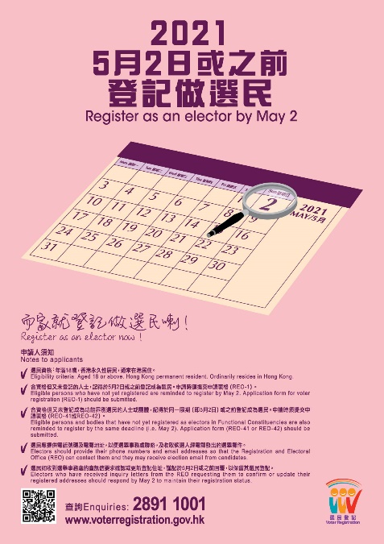
Rights of Hong Kong residents
Relevant provisions of such rights in the Basic Law
1
Article 26
2
Article 27
1
Permanent residents of the Hong Kong Special Administrative Region shall have the right to vote and the right to stand for election in accordance with law.
2
The right and freedom to express opinions
The poster provided by the HKSAR Government

Slide 9

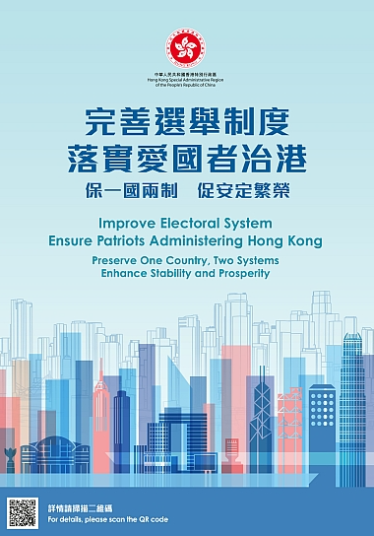

The right to vote and the right to stand for election
Article 26 of the Basic Law:
“Permanent residents of the Hong Kong Special Administrative Region shall have the right to vote and the right to stand for election in accordance with law.”
For details, please refer to the website of the Registration and Electoral Office:
https://www.reo.gov.hk/

Slide 10
The rights and freedom of speech, of peaceful assembly and of association
Article 27 of the Basic Law:
“Hong Kong residents shall have freedom of speech, of the press and of publication; freedom of association, of assembly, of procession and of demonstration; and the right and freedom to form and join trade unions, and to strike.”

Slide 11
The rights and freedom of speech, of assembly and of association are not without limitations
Article 16 of the Hong Kong Bill of Rights - Freedom of opinion and expression
(1) Everyone shall have the right to hold opinions without interference.
(2) Everyone shall have the right to freedom of expression; this right shall include freedom to seek, receive and impart information and ideas of all kinds, regardless of frontiers, either orally, in writing or in print, in the form of art, or through any other media of his choice.
(3) The exercise of the rights provided for in paragraph (2) of this article carries with it special duties and responsibilities. It may therefore be subject to certain restrictions, but these shall only be such as are provided by law and are necessary—
(a) for respect for the rights or reputations of others; or
(b) for the protection of national security or of public order (ordre public), or of public health or morals.
[cf. ICCPR Art.19]
Source: https://www.elegislation.gov.hk/hk/cap383

Slide 12
The rights and freedom of speech, of assembly and of association are not without limitations
Article 17 of the Hong Kong Bill of Rights
The right of peaceful assembly shall be recognized. No restrictions may be placed on the exercise of this right other than those imposed in conformity with the law and which are necessary in a democratic society in the interests of national security or public safety, public order (ordre public), the protection of public health or morals or the protection of the rights and freedoms of others.
[cf. ICCPR Art. 21]
Article 18 - Freedom of association
(1) Everyone shall have the right to freedom of association with others, including the right to form and join trade unions for the protection of his interests.
(2) No restrictions may be placed on the exercise of this right other than those which are prescribed by law and which are necessary in a democratic society in the interests of national security or public safety, public order (ordre public), the protection of public health or morals or the protection of the rights and freedoms of others. This article shall not prevent the imposition of lawful restrictions on members of the armed forces and of the police in their exercise of this right.
(3) Nothing in this article authorizes legislative measures to be taken which would prejudice, or the law to be applied in such a manner as to prejudice, the guarantees provided for in the International Labour Organization Convention of 1948 concerning Freedom of Association and Protection of the Right to Organize as it applies to Hong Kong.
[cf. ICCPR Art. 22]
Source: https://www.elegislation.gov.hk/hk/cap383

Slide 13
Freedom of the person
01
The freedom of the person shall be inviolable.
Freedom of the person
02
Personal freedom is protected by legal procedures when it is restricted
03
extends to other freedoms associated with the person, including inviolability of the home, freedom of communication, freedom of movement, emigration, and freedom to enter or leave the Hong Kong Special Administrative Region

Slide 14
The freedom of the person shall be inviolable
Freedom of the person
“The freedom of the person of Hong Kong residents shall be inviolable.”
“No Hong Kong resident shall be subjected to arbitrary or unlawful arrest, detention or imprisonment. Arbitrary or unlawful search of the body of any resident or deprivation or restriction of the freedom of the person shall be prohibited. Torture of any resident or arbitrary or unlawful deprivation of the life of any resident shall be prohibited.”
Article 28 of the Basic Law
Article 28 of the Basic Law

Slide 15
Freedom of the person
Residential inviolability
Article 29 of the Basic Law:
“The homes and other premises of Hong Kong residents shall be inviolable. Arbitrary or unlawful search of, or intrusion into, a resident’s home and other premises shall be prohibited.”

Slide 16
Freedom of the person
Freedom and privacy of communication
Article 30 of the Basic Law
“The freedom and privacy of communication of Hong Kong residents shall be protected by law. No department or individual may, on any grounds, infringe upon the freedom and privacy of communication of residents except that the relevant authorities may inspect communications in accordance with legal procedures to meet the needs of public security or of investigation into criminal offences.”

Slide 17

Freedom of the person
Freedom of movement, emigration and freedom to enter or leave the Region
Article 31 of the Basic Law stipulates that “Hong Kong residents shall have freedom of movement within the Hong Kong Special Administrative Region and freedom of emigration to other countries and regions. They shall have freedom to travel and to enter or leave the Region. Unless restrained by law, holders of valid travel documents shall be free to leave the Region without special authorization.”
Residents using smart identity card to enter or leave the Region
Photo credit: website of the Immigration Department of the HKSAR

Slide 18
Freedom of conscience and freedom of religious belief
“Hong Kong residents shall have freedom of conscience.
Hong Kong residents shall have freedom of religious belief and freedom to preach and to conduct and participate in religious activities in public.”
“The Government of the Hong Kong Special Administrative Region shall not restrict the freedom of religious belief, interfere in the internal affairs of religious organizations or restrict religious activities which do not contravene the laws of the Region.”
Article 32 of the Basic Law
Article 141 of the Basic Law

Slide 19
Economic, social and cultural rights
Property rights
The Basic Law
Article 6: “The Hong Kong Special Administrative Region shall protect the right of private ownership of property in accordance with law.”
Article 105: “The Hong Kong Special Administrative Region shall, in accordance with law, protect the right of individuals and legal persons to the acquisition, use, disposal and inheritance of property and their right to compensation for lawful deprivation of their property.”

Slide 20


Economic, social and cultural rights
Freedom of choice of occupation
Article 33 of the Basic Law: “Hong Kong residents shall have freedom of choice of occupation.”
Of course, the aforementioned freedom of occupation is subject to conditions. For example, in order to pursue a profession such as doctor, lawyer, and accountant, Hong Kong residents need to obtain the corresponding professional qualifications in accordance with the law.
A Guide to Job Hunting from the Labour Department

Slide 21
Economic, social and cultural rights
The right to social welfare
Article 36 of the Basic Law:
“Hong Kong residents shall have the right to social welfare in accordance with law. The welfare benefits and retirement security of the labour force shall be protected by law.”
Article 145 of the Basic Law
Article 146 of the Basic Law
“On the basis of the previous social welfare system, the Government of the Hong Kong Special Administrative Region shall, on its own, formulate policies on the development and improvement of this system in the light of the economic conditions and social needs .”
“Voluntary organizations providing social services in the Hong Kong Special Administrative Region may, on their own, decide their forms of service, provided that the law is not contravened. ”

Slide 22

Economic, social and cultural rights
Freedom of marriage and right to raise a family freely
Article 37 of the Basic Law:
“The freedom of marriage of Hong Kong residents and their right to raise a family freely shall be protected by law.”

Slide 23

Economic, social and cultural rights
The right and freedom to engage in educational, science and cultural activities
Article 34 of the Basic Law stipulates that “Hong Kong residents shall have freedom to engage in academic research, literary and artistic creation, and other cultural activities.”
Article 137 stipulates that “Educational institutions of all kinds may retain their autonomy and enjoy academic freedom. They may continue to recruit staff and use teaching materials from outside the Hong Kong Special Administrative Region. Schools run by religious organizations may continue to provide religious education, including courses in religion. Students shall enjoy freedom of choice of educational institutions and freedom to pursue their education outside the Hong Kong Special Administrative Region. ”

Slide 24

Legal and judicial rights
The right to file lawsuits and seek judicial remedies
Article 35 of the Basic Law stipulates that “Hong Kong residents shall have the right to confidential legal advice, access to the courts, choice of lawyers for timely protection of their lawful rights and interests or for representation in the courts, and to judicial remedies.”
Source: https://www.judiciary.hk/en/home/index.html

Slide 25

Legal and judicial rights
The right to a fair trial
  Article 87 of the Basic Law provides that: “In criminal or civil proceedings in the Hong Kong Special Administrative Region, the principles previously applied in Hong Kong and the rights previously enjoyed by parties to proceedings shall be maintained. Anyone who is lawfully arrested shall have the right to a fair trial by the judicial organs without delay and shall be presumed innocent until convicted by the judicial organs.”

Slide 26
In addition to the above rights, Chinese citizens who are residents of the Hong Kong Special Administrative Region shall have the opportunity to participate in the management of state affairs according to law.
Article 21 of the Basic Law:
“Chinese citizens who are residents of the Hong Kong Special Administrative Region shall be entitled to participate in the management of state affairs according to law. In accordance with the assigned number of seats and the selection method specified by the National People’s Congress, the Chinese citizens among the residents of the Hong Kong Special Administrative Region shall locally elect deputies of the Region to the National People’s Congress to participate in the work of the highest organ of state power. ”

Slide 27

Duties of Hong Kong residents
Rights and duties are closely related. Without duties, rights cannot be safeguarded.
Article 42 of the Basic Law stipulates that “Hong Kong residents and other persons in Hong Kong shall have the obligation to abide by the laws in force in the Hong Kong Special Administrative Region.” *
In addition to abiding by the law, Hong Kong residents have a duty to respect the Constitution and to fulfill the obligations of citizens prescribed by the Constitution, to care for the development of the country and to protect the national security, honour and interests.
* In addition to Hong Kong residents, there are some people who are temporarily working or staying in Hong Kong, such as those who come to Hong Kong for business or pleasure, to study or to attend meetings while some of the others are refugees and illegal immigrants. According to Article 41 of the Basic Law, these persons are classified as “Persons in the Hong Kong Special Administrative Region other than Hong Kong residents shall, in accordance with law, enjoy the rights and freedoms of Hong Kong residents prescribed in this Chapter.”
Rights
Duties

Slide 28

One shall abide by the Basic Law
The Basic Law is the constitutional law of the Hong Kong Special Administrative Region. It is the primary obligation of Hong Kong residents to abide by the Basic Law.
Photo credit: Information Services Department of the HKSAR Government

Slide 29
One shall abide by the laws previously in force in Hong Kong which have been maintained
In accordance with Article 8 of the Basic Law, the laws previously in force in Hong Kong shall be maintained, except for any that contravene the Basic Law, and subject to any amendment by the legislature of the Hong Kong Special Administrative Region.
Hong Kong residents shall abide by the laws previously in force in Hong Kong which have been maintained as aforesaid.

Slide 30
One shall abide by the laws enacted by the Legislative Council of the HKSAR
The Legislative Council is the legislature of the Hong Kong Special Administrative Region. The bills passed by the Legislative Council shall not take effect until they are signed by the Chief Executive and published in the Gazette.
Hong Kong residents shall abide by the laws enacted by the Legislative Council.
HKSAR Government to draft and introduce bills
to consult the Executive Council
to publish the bill in the Gazette
to introduce the bill to the Legislative Council for review and passage through three readings
the Chief Executive to sign and promulgate
to enact the law through publication in the Gazette
to report to the Standing Committee of the National People's Congress for record
Law-making process of the HKSAR
For details, please visit the website of the Legislative Council https://app.legco.gov.hk/PhotoGallery/english/VideoPlayer.aspx?id=178

Slide 31


One shall abide by the laws enacted by the Legislative Council of the HKSAR and the national laws listed in Annex III to the Basic Law
Article 18 of the Basic Law stipulates that “National laws shall not be applied in the Hong Kong Special Administrative Region except for those listed in Annex III to this Law. The laws listed therein shall be applied locally by way of promulgation or legislation by the Region. The Standing Committee of the National People’s Congress may add to or delete from the list of laws in Annex III after consulting its Committee for the Basic Law of the Hong Kong Special Administrative Region and the government of the Region. Laws listed in Annex III to this Law shall be confined to those relating to defence and foreign affairs as well as other matters outside the limits of the autonomy of the Region as specified by this Law.”
Source: Constitutional and Mainland Affairs Bureau
Basic Law - National Laws to be Applied in the Hong Kong Special Administrative Region
https://www.basiclaw.gov.hk/en/basiclaw/national-laws.html
Photo credit: Information Services Department

Slide 32
The national laws to be applied in the Hong Kong Special Administrative Region as listed in Annex III to the Basic Law
Resolution on the Capital, Calendar, National Anthem and National Flag of the People’s Republic of China [Applied by promulgation]
Resolution on the National Day of the People’s Republic of China [Applied by promulgation]
Law of the People’s Republic of China on the National Emblem [Applied by legislation：National Flag and National Emblem Ordinance]
Declaration of the Government of the People’s Republic of China on the Territorial Sea [Applied by promulgation]
Nationality Law of the People’s Republic of China [Applied by promulgation]
Regulations of the People’s Republic of China Concerning Diplomatic Privileges and Immunities [Applied by promulgation]
Law of the People’s Republic of China on the National Flag [Applied by legislation：National Flag and National Emblem Ordinance]
Regulations of the People’s Republic of China concerning Consular Privileges and Immunities [Applied by promulgation]
Law of the People’s Republic of China on the Territorial Sea and the Contiguous Zone [Applied by promulgation]
Law of the People’s Republic of China on the Garrisoning of the Hong Kong Special Administrative Region [Applied by promulgation]
Law of the People’s Republic of China on the Exclusive Economic Zone and the Continental Shelf [Applied by promulgation]
Law of the People’s Republic of China on the National Anthem [Applied by legislation: National Anthem Ordinance]
Law of the People’s Republic of China on Safeguarding National Security in the Hong Kong Special Administrative Region [Applied by promulgation]
Source: Constitutional and Mainland Affairs Bureau
Basic Law - National Laws to be Applied in the Hong Kong Special Administrative Region
https://www.basiclaw.gov.hk/en/basiclaw/national-laws.html

Slide 33
In addition, one shall abide by the relevant national laws applied to the HKSAR under special circumstances such as in a state of war or a state of emergency
According to Article 18(4) of the Basic Law,
“In the event that the Standing Committee of the National People’s Congress decides to declare a state of war or, by reason of turmoil within the Hong Kong Special Administrative Region which endangers national unity or security and is beyond the control of the government of the Region, decides that the Region is in a state of emergency, the Central People’s Government may issue an order applying the relevant national laws in the Region.”

Slide 34
The End

Slide 35
User guide
The primary users of this resource are teachers. It aims to provide teachers with content knowledge relevant to the topic to enable teachers to have a deeper understanding of teaching content when preparing for their lessons.
All data, videos, photos, pictures, questions and suggested answers can be used for multiple purposes, such as teachers’ teaching materials, references for curriculum planning and learning and teaching, and student assignments, etc. To align with Citizenship and Social Development Curriculum and Assessment Guide (Secondary 4-6) (2021) (C&A Guide), this resource should be adapted to cater for students’ learning diversity and the needs of classroom teaching, etc.
Teachers may provide appropriate supplementary notes/ explanations to enrich this resource in order to enhance students’ understanding of the topic and information provided.
In accordance with the curriculum rationale and aims, teachers may select other learning and teaching resources which are correct, reliable, objective and impartial to help students build up a solid knowledge base, develop positive values and attitudes as well as enhance critical thinking and problem solving skills, and various generic skills.
If some information cannot be provided in this resource due to copyright issue, teachers may visit relevant websites provided.
Some information may have been updated when being used by teachers, teachers may visit the corresponding websites to obtain the up-to-date information.
Please also refer to the C&A Guide to understand the requirements and arrangements of the learning and teaching of the curriculum.

Slide 36
Notice and Disclaimer
Some sources were not translated into English as the official English version is not available.
In case of any discrepancy between the Chinese and English versions, the Chinese version shall prevail.

