Slide 1
Learning focus: Significance of rule of law: law-abidingness; judicial independence; equality before the law; fair and open trial
Citizenship and Social Development
Theme 1: Hong Kong under “One Country, Two Systems”
Topic: The meaning and implementation of “one country, two systems”
Translated version
July 2021

Slide 2
Learning Objectives
Knowledge
To know the meaning of the rule of law and its spirit.
To understand the meaning of law-abidingness, equality before the law, judicial independence, fair and open trial, etc.
To recognise that safeguarding the rule of law is a shared value in Hong Kong, and the foundation for the development of the Hong Kong society and the country as a whole.
Skills
To be able to adopt the mindset of rule-of-law to solve real-life problems.
To acquire generic skills, such as communication, collaboration and critical thinking skills.
Values
To nurture law-abiding awareness and the spirit of the rule of law.
To appreciate the core values of the rule of law.
To safeguard the rule of law in Hong Kong.

Slide 3
Lead-in: Independent Commission Against Corruption (ICAC)
Hong Kong is long famous for a strong rule of law, which is the cornerstone of the city’s success. A law-abiding government and citizenry, fair and robust enforcement and judicial and prosecutorial independence are the fundamental pillars of our integrity system.
Since its establishment in February 1974, the ICAC has been fighting corruption independently without fear or favour. Its independent status is derived from the ICAC Ordinance which stipulates the statutory mandate of the ICAC in combatting corruption through investigation, prevention and education. The independence of the ICAC is further enshrined in Article 57 of The Basic Law of the HKSAR of the PRC (The Basic Law) which provides constitutional guarantee against any interference of our work.
Hong Kong is known as a society that upholds the rule of law. Can you name any other organisations in Hong Kong which safeguard the rule of law?
Suggested Answer
- The Judiciary, Department of Justice, and the Police Force, etc.

Slide 4




Basic meaning of the rule of law
Supplementary information
All are equal before the law;
Laws must be observed by all; both citizens and the government must abide by the law;
Government and all public officials derive their authority from the law as expressed in legislations and the judicial decisions made by courts;
Courts must be independent of the executive branch;
No one may do anything that constitutes a legal wrong or affects the personal liberty of another unless there is a legal basis for doing so;
The rule of law is based on the respect for the law and the rights of others;
The purposes to be achieved are:
To maintain social peace and stability
To protect individual safety and property
The rule of law should be of dual significance: established laws are universally observed. And the laws that are observed by all should themselves be well-enacted laws.
-- Aristotle
Source:
Politics. Written by Aristotle. The Chinese version was translated from English by Wu Shoupeng (1981), p.199, Hong Kong: The Commercial Press Co. Ltd.
法者，天下之程式也，萬事之儀表也。
——【春秋】管仲
For more information on Hong Kong’s legal system and the rule of law, please refer to: https://www.doj.gov.hk/en/our_legal_system/rule_of_law.html
Source: Reference has been made to The Constitution and the Basic Law Education Wall-chart Resources developed by the Education Bureau.
https://www.edb.gov.hk/tc/curriculum-development/kla/pshe/basic-law-education/cble_wallcharts/index.html [Chinese version is currently available]

Slide 5
The spirit of the rule of law
The spirit of the rule of law means respecting the authority of the law, abiding by the law, upholding judicial independence, equality before the law, fair and open trial, and a series of beliefs. For instance, the legislative process must be just, the law must be open and stable.

Slide 6

Learning Activity
Reference: Rule of law
https://www.cmab.gov.hk/en/video/bl30a.htm
Reference: Our legal system – The rule of law (Department of Justice, the Government of the HKSAR)
https://www.doj.gov.hk/en/our_legal_system/index.html
With reference to the above websites, analyse how Hong Kong’s legal system embodies the spirit of the rule of law.
Hong Kong upholds the spirit of the rule of law for the following reasons:
The legal system is mature, highly transparent, fair and reliable
The Department of Justice conducts criminal prosecutions, free from any interference
The courts of the HKSAR shall exercise judicial power independently, free from any interference
A comprehensive and robust legal aid system protects the equality of Hong Kong residents before the law

Slide 7
Significance of safeguarding the spirit
of the rule of law
The protection of human rights and the realisation of fairness and justice are key elements of the spirit of the rule of law, which ensure that there are fair rights, fair opportunities and fair processes among members of society.
Human rights are not unrestricted but are subject to limits. Exerting one’s rights should not impinge on the rights of others, social order, or national security. When individual freedom is in conflict with the interests of society as a whole or the rights of others, individual freedom must be restricted by law.

Slide 8
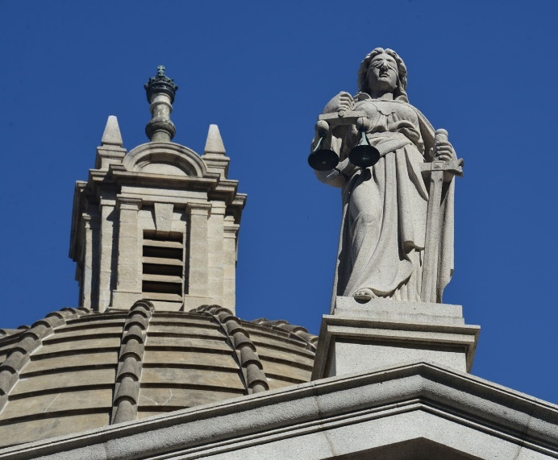
Learning Activity
In this picture, the Statue of Justice is dressed in a white robe, blindfolded, holding a pair of scales in her right hand and a sword in her left hand. How does it embody the spirit of the rule of law?
Answer
Photo credit: Hong Kong Court of Final Appeal
The white robe symbolises moral integrity and uprightness.
The blindfold symbolises that justice is reason-based. It should be applied without regard to suspect’s appearance, identities or status, representing impartiality and selflessness.
The pair of scales is a metaphor for the fairness in the judicial process, in which everyone gets what he or she deserves, no more, no less.
The sword indicates severe punishment with no tolerance.

Slide 9
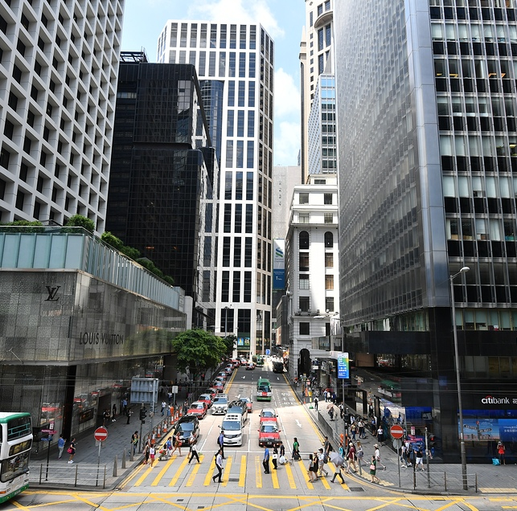
Maintaining social order and stability
The rule of law is widely recognised as one of the most important cornerstones of a civilised, safe and orderly society in Hong Kong. If everyone upholds the rule of law, social stability will be maintained and the society will be fair and just.
Photo credit: Information Services Department

Slide 10

Promoting economic and social development and prosperity
The rule of law helps create a fair and just business environment. When disputes arise in business, the cases can be tried fairly and impartially in court. This would attract investors from all over the world to invest in Hong Kong, increasing employment opportunities and promoting economic development.
Photo credit: Information Services Department

Slide 11

Universal compliance with the law is a prerequisite for the rule of law.
Without compliance with the law, how can the rule of law be realised?
Without the rule of law, how can the spirit of the rule of law be grounded?
To safeguard the spirit of the rule of law, one must first comply with the law.

Slide 12


Features of the law
Laws must be open and clear
Laws are the code of conduct that guides one’s behaviours.
Laws must be open to the public so that the general public is clear about the contents of the laws and they can follow. This is the manifestation of the spirit of the rule of law.
If laws are not open and clear, and cannot provide guidance for people’s behaviors, the crucial function of laws will be lost.
The website of Hong Kong e-Legislation provides access to all the statutory laws of Hong Kong, which are available in three languages, namely traditional Chinese, simplified Chinese and English.
Source: Hong Kong e-Legislation. https://www.elegislation.gov.hk/

Slide 13
The HKSAR practises the common law
According to the respective historical traditions and forms of law adopted in different countries and regions, legal systems are divided into civil law and common law jurisdictions, etc. The common law originated from the United Kingdom and is a uniform legal system based on judicial precedents.
Hong Kong inherited the common law system before its return to China. After the reunification, the common law tradition in Hong Kong shall be retained, as stipulated in Article 8 of the Basic Law.

Slide 14
Laws must be stable and
Keep up with the times
Laws must be stable and cannot be changed haphazardly; otherwise it may cause confusion to society.
Maintaining the stability of laws allows citizens to foresee the legal consequences of various actions.
Laws can be reviewed/amended in a timely manner when necessary in response to social development.
Laws can be amended in a timely manner when necessary, and judges are not rigid in their adjudication of cases, so that the law is both stable and flexible in its implementation and responsive to the development of society.

Slide 15

Relevant judgement of the Court of Final Appeal (excerpt)
While the fact that an offence arises out of an occasion when constitutional rights to assemble and protest are being exercised is relevant to the background and context of the offending, the fact of a conviction of the offence will necessarily mean that the offender has crossed the line separating the lawful exercise of constitutional rights from unlawful activity subject to sanctions and constraints, and so there is little merit in a plea for leniency on the ground that the offender was merely exercising his constitutional rights.
Rights
Obligations

Slide 16
The judgement of the Court of Final Appeal has made it clear that no matter what aspirations are being pursued, if such acts are not peaceful and non-violent, they are against the law and violate the spirit of law-abidingness and the rule of law in Hong Kong, which is not allowed by the law.
Hong Kong is an internationally recognised society that upholds the rule of law. People can express their views peacefully and rationally through various lawful channels, and act in a manner permitted by the Basic Law and the relevant laws of Hong Kong, but they cannot pursue so-called justice in an illegal manner.

Slide 17
The principle of non-retroactivity
Unless otherwise provided, in principle, a law does not have retroactive effect on acts that occurred before its entry into force.
Article 20 of the Interpretation and General Clauses Ordinance provides that:
(1) An Ordinance shall be published in the Gazette.
(2) An Ordinance commences—
(a) at the beginning of the day on which it is published; or
(b) if provision is made for it to commence on another day, at the beginning of that other day.
Also, Article 39 of the Law of the People’s Republic of China on Safeguarding National Security in the Hong Kong Special Administrative Region (the National Security Law) provides that this Law shall apply to acts committed after its entry into force for the purpose of conviction and imposition of punishment.

Slide 18
The Basic Law provides that the courts of the HKSAR shall exercise judicial power independently, free from any interference. If there is interference from outside, there is no guarantee that a fair judgment will be rendered.
Judicial independence is therefore an important system for safeguarding the spirit of rule of law.

Slide 19
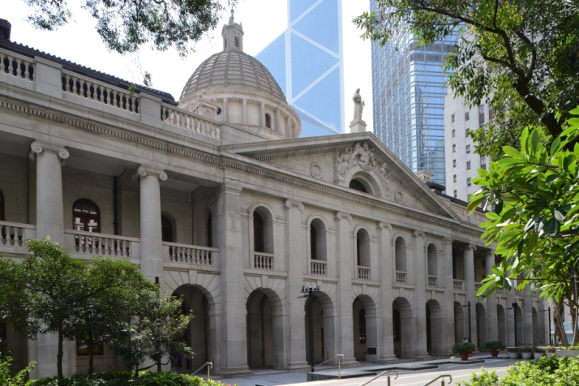
The HKSAR shall be vested with independent judicial power, including that of final adjudication
Before Hong Kong’s return to China, the power of final adjudication of Hong Kong was vested in the Judicial Committee of the Privy Council of the United Kingdom.
After its return to China, the HKSAR enjoys independent judicial power and that of final adjudication according to the Basic Law.
Photo credit:
Hong Kong Court of Final Appeal
Sources:
Article 82 of the Basic Law
The Role of the Court of Final Appeal (Hong Kong Court of Final Appeal) https://www.hkcfa.hk/en/faqs/role_cfa/index.html

Slide 20
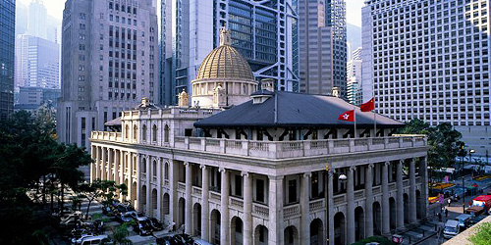
The Judiciary is free from any interference in adjudicating cases
Article 85 of the Basic Law provides that the courts of the Hong Kong Special Administrative Region shall exercise judicial power independently, free from any interference. Members of the judiciary shall be immune from legal action in the performance of their judicial functions.
The Court of Final Appeal of the HKSAR

Slide 21

Article 80 of the Basic Law provides that the courts of the Hong Kong Special Administrative Region at all levels shall be the judiciary of the Region, exercising the judicial power of the Region.
The courts of the HKSAR shall be composed of the Court of Final Appeal, the High Court, District Courts, Magistrates’ Courts and other special courts, which shall exercise judicial power independently.
Source:
Department of Justice, the Government of the HKSAR. (2014). The Focus – Independence of the Judiciary. Basic Law Bulletin Issue No 16 (December 2014). https://www.doj.gov.hk/en/publications/pub20030002_i16.html

Slide 22
Judicial independence and the spirit of the rule of law
An independent judiciary does not mean it is not accountable to the community. Of course the Judiciary and its judges are accountable, but it is of critical importance to understand the duties and responsibilities of our judges.
A proper understanding of the concept of justice, the administration of justice in Hong Kong and the duties and responsibilities of judges will enable anyone to comprehend and appreciate the value of the rule of law. These components of the rule of law, in particular the independence of the judiciary, are all referred to and clearly guaranteed under the Basic Law. They are also constants in the way the law operates; in good times, in not so good times, at all times.
Source:
Excerpt from the Government of the HKSAR. (2020). The Speech by the Chief Justice of the Court of Final Appeal at the Ceremonial Opening of the Legal Year 2000. https://www.info.gov.hk/gia/general/202001/13/P2020011300622.htm

Slide 23
A good mechanism for appointing and removing judges is a guarantee of judicial independence
The quality and independence of judges directly affects judicial independence.
The Basic Law has strict provisions on the mechanism of appointing and removing judges in order to guarantee judicial independence.

Slide 24
Question
The statement that “the interpretation of the Basic Law by the Standing Committee of the National People’s Congress (NPCSC) undermines the judicial independence of Hong Kong” is wrong.
Explain and analyse your answer in accordance with the provisions of Article 67(4) of The Constitution of the PRC (The Constitution) and Article 158 of the Basic Law.

Slide 25
Suggested Answer
The function and power of the NPCSC to interpret the Basic law is derived from the Constitution and the Basic Law.
According to Article 158 of the Basic Law, the power of interpretation of the Basic Law shall be vested in the Standing Committee of the National People’s Congress.
The power of interpretation of the Basic Law exercised by the courts of the HKSAR in adjudicating cases is derived from the authorisation of the NPCSC.
The NPCSC does not interfere with the adjudication of cases by courts. The interpretation of NPCSC does not affect any cases which have been adjudicated.
Conclusion
The interpretation of the Basic Law by the NPCSC does not contradict the judicial independence in Hong Kong.

Slide 26

Meaning of equality before the law
Equality before the law is important manifestation of the spirit of the rule of law and no one is above the law.
No Hong Kong residents should be discriminated against on the basis of nationality, race, ethnicity, gender, language, religion, political or ideological beliefs, cultural level, economic or social status, etc. They are all equal before the law.
Source: Our Legal System – The rule of law (Department of Justice, the Government of the HKSAR) https://www.doj.gov.hk/en/our_legal_system/rule_of_law.html

Slide 27


Legal grounds for equality before the law
Article 33 of the Constitution:
All citizens of the People’s Republic of China are equal before the law.
Article 25 of the Basic Law:
All Hong Kong residents shall be equal before the law.

Slide 28
Realisation of equality before the law in Hong Kong
Designated bodies: Courts, Department of Justice, Equal Opportunities Commission, Legal Aid Department, Office of the Privacy Commissioner for Personal Data, etc. to ensure that all people are equal before the law.
Examples of local legislation: Hong Kong Bill of Rights Ordinance, Sex Discrimination Ordinance, Disability Discrimination Ordinance, Family Status Discrimination Ordinance, and Race Discrimination Ordinance. These discrimination ordinances are designed to protect the disadvantaged groups.

Slide 29
Fair and open trials
In a society that upholds the rule of law, anyone convicted of a crime should be given an impartial trial.
Fair and open trials are important manifestations of the spirit of the rule of law.

Slide 30
Legal basis for
fair and open trials
Article 87 of the Basic Law provides that anyone who is lawfully arrested shall have the right to a fair trial by the judicial organs without delay and shall be presumed innocent until convicted by the judicial organs.
Prosecution
Investigation
Trial
Adjudication

Slide 31
Exceptions to
Fair and Open Trials
In accordance with the principle of open justice, all court hearings, save for some very limited exceptions (e.g. involving children), are open to the public. Judgments, reasons for verdict and reasons for sentence for District Court and above are also available on the Judiciary website. All this ensures transparency.*
According to Article 10 of the Hong Kong Bill of Rights [cf. Article 14.1 of the International Covenant on Civil and Political Rights], the press and the public may be excluded from all or part of a trial for reasons of morals, public order (ordre public) or national security in a democratic society, or when the interest of the private lives of the parties so requires, or to the extent strictly necessary in the opinion of the court in special circumstances where publicity would prejudice the interests of justice” The law also prohibits the press and the public from observing all or part of the trial proceedings.
Article 41(4) of the National Security Law provides that the trial shall be conducted in an open court. When circumstances arise such as the trial involving State secrets or public order, all or part of the trial shall be closed to the media and the public but the judgment shall be delivered in an open court.
*Source: Excerpt from Hong Kong Judiciary Annual Report 2020 https://www.judiciary.hk/en/publications/annu_rept_2020r/eng/review.html

Slide 32
Defendants shall have the right to a fair trial without delay
Anyone who is lawfully arrested shall have the right to a fair trial by the judicial organs as soon as possible, without any delay.
Delay in the administration of justice is tantamount to denial of justice.

Slide 33
Defendants shall have the right of silence
The defendants may remain silent when questioned by the police or in the course of court proceedings.

Slide 34

Presumption of innocence
According to the principle of presumption of innocence, the burden of proof is on the prosecution, which has to convince the court that the accused person is guilty of the offence beyond reasonable doubt. The accused person is not required to prove that he or she is not guilty.

Slide 35

Defendants shall have the right to defend themselves
The defendant shall have the right to defend himself/herself on his/her own or through counsel.
The court must give him/her the opportunity to present evidence, call witnesses, cross-examine witnesses, make statements, and defend himself/herself.
The judge must state the reasons for his/her adjudication in the judgement.

Slide 36




Conclusion
To abide by the laws and to uphold the rule of law and order are the basic obligations of Hong Kong residents, the shared value of the Hong Kong society, and the cornerstone of Hong Kong’s prosperity and stability.
Judicial independence is a crucial mechanism for safeguarding the spirit of the rule of law.
Equality before the law manifests the spirit of the rule of law. Fair and open trials are a crucial manifestation of the spirit of the rule of law.
The younger generations in Hong Kong should strive to uphold the rule of law and safeguard the spirit of the rule of law in Hong Kong.

Slide 37
The End

Slide 38
User guide
The primary users of this resource are teachers. It aims to provide teachers with content knowledge relevant to the topic to enable teachers to have a deeper understanding of teaching content when preparing for their lessons.
All data, videos, photos, pictures, questions and suggested answers can be used for multiple purposes, such as teachers’ teaching materials, references for curriculum planning and learning and teaching, and student assignments, etc. To align with Citizenship and Social Development Curriculum and Assessment Guide (Secondary 4-6) (2021) (C&A Guide), this resource should be adapted to cater for students’ learning diversity and the needs of classroom teaching, etc.
Teachers may provide appropriate supplementary notes/ explanations to enrich this resource in order to enhance students’ understanding of the topic and information provided.
In accordance with the curriculum rationale and aims, teachers may select other learning and teaching resources which are correct, reliable, objective and impartial to help students build up a solid knowledge base, develop positive values and attitudes as well as enhance critical thinking and problem solving skills, and various generic skills.
If some information cannot be provided in this resource due to copyright issue, teachers may visit relevant websites provided.
Some information may have been updated when being used by teachers, teachers may visit the corresponding websites to obtain the up-to-date information.
Please also refer to the C&A Guide to understand the requirements and arrangements of the learning and teaching of the curriculum.

Slide 39
Notice and Disclaimer
Some sources were not translated into English as the official English version is not available.
In case of any discrepancy between the Chinese and English versions, the Chinese version shall prevail.

