Slide 1
Political structure of the Hong Kong Special Administrative Region
Citizenship and Social Development
Theme 1: Hong Kong under “One Country, Two Systems”
Topic: The meaning and implementation of “one country, two systems”
Learning focus:
Translated version
Content Enrichment:
Information about the 2025 Legislative Council General Election has been enriched on slides 29 to 39.
December 2025

Slide 2
Learning Objectives
Knowledge
To understand the features of the political structure of the Hong Kong Special Administrative Region
To understand the powers and functions of the Chief Executive of the Hong Kong Special Administrative Region and the major executive authorities
To understand the decision-making process of the Government of the Hong Kong Special Administrative Region
To understand the significance of the principle of “patriots administering Hong Kong” and improving the electoral system in ensuring the implementation of “one country, two systems”
Skills
To acquire generic skills, including communication, collaboration, critical thinking, synthesis and analytical skills
Values
To cherish Hong Kong, and to appreciate the Hong Kong Special Administrative Region’s system
To respect and safeguard Hong Kong Special Administrative Region’s political structure under “one country, two systems”
To recognise improving the electoral system and the principle of “patriots administering Hong Kong” , thereby providing support to long-term development of Hong Kong and our country.

Slide 3



Lead-in
Questions:
Which aspects of public affairs in Hong Kong are illustrated in the above? Which government bureaux / departments are in charge of these public affairs?

Slide 4
Answers
Constitutional and Mainland Affairs Bureau
Office of the Government Chief Information Officer
Education Bureau
Questions:
Which aspects of public affairs in Hong Kong are illustrated in the above? Which government bureaux / departments are in charge of these public affairs?

Slide 5
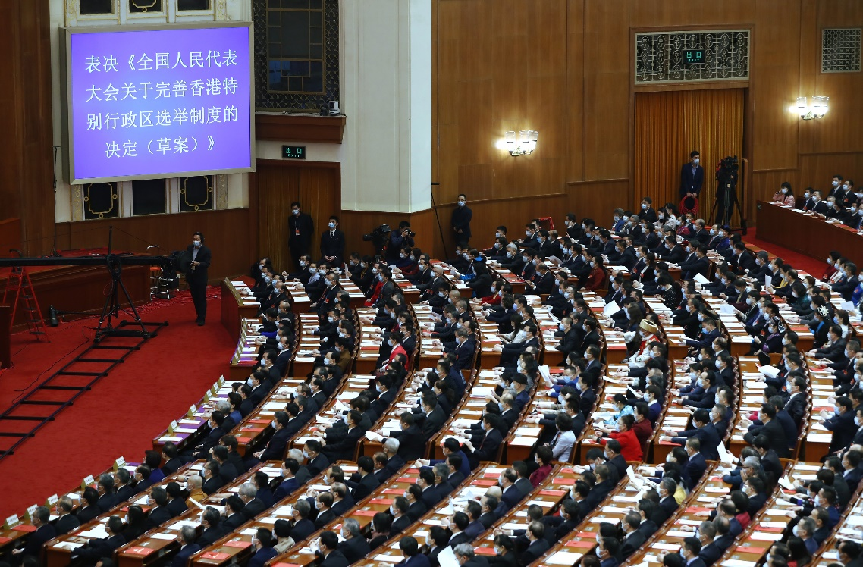
In 2021, the National People’s Congress exercised the power to decide on the system of special administrative regions and adopted a Decision on Improving the Electoral System of the Hong Kong Special Administrative Region.
On 11 March 2021, The Decision on Improving the Electoral System of the Hong Kong Special Administrative Region was passed in the fourth Session of the 13th National People’s Congress.
Question: Why is the political structure of the Hong Kong Special Administrative Region (HKSAR) decided by the Central Authorities?

Slide 6
The decision on the political structure of the HKSAR lies with the Central Authorities
Suggested Answers:
The HKSAR shall be a local administrative region of the People’s Republic of China (PRC), which shall come directly under the Central People’s Government.
The National People’s Congress authorizes the Hong Kong Special Administrative Region to exercise a high degree of autonomy.
The systems instituted in special administrative regions, including political structure of special administrative regions shall, in light of specific circumstances, be prescribed by laws enacted by the National People's Congress.

Slide 7
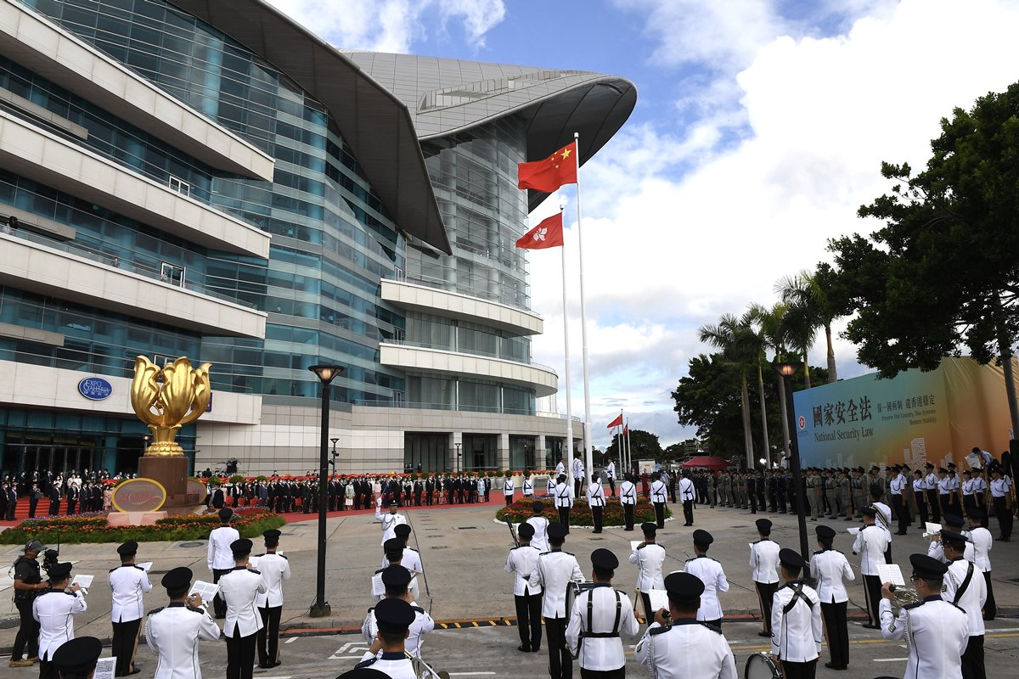
Features of the political structure in the HKSAR
The powers that the HKSAR enjoy are authorised by the Central Authorities. Its political structure is an executive-led system. The executive authorities, the legislature and the judiciary perform their respective functions, complementing each other and exercising judicial independence. The Chief Executive shall be accountable to the Central People's Government.
Source:
https://www.news.gov.hk/chi/2020/09/20200901/20200901_110605_194.html
https://www.doj.gov.hk/en/community_engagement/sj_blog/20200905_blog1.html
The political structure of the HKSAR is an executive-led system. The executive authorities and the legislature both complement, and keep a check and balance on, each other’s functions; the courts of Hong Kong exercise judicial power independently.
The Chief Executive represents the Hong Kong Special Administrative Region and shall be accountable to the Central People's Government.
7

Slide 8


What is an executive-led system?
Click this image to browse the website of Hong Kong's political system
An executive-led system refers to a system where the executive authorities headed by the Chief Executive, plays a leading role in the operation of the government.
The executive authorities play an active and leading role in formulating public policies, legislative agenda as well as government’s operation.
Source: The China Current
https://chinacurrent.com/education/article/2022/08/23932.html

Slide 9
What is an executive-led system?
Executive-led system
Before Hong Kong’s return to China, it was functioned under an executive-led system. When drafting the Basic Law, the Central People’s Government clearly stated that it should draw on the experience of the existing effective system in Hong Kong in order to better maintain the stability and overall interests of Hong Kong.
Articles 43 and 48 of the Basic Law stipulate the legal status and powers of the Chief Executive, manifesting the executive-led principle.

Slide 10
What is an executive-led system?
The “three powers” under the framework of the Basic Law refer to executive power, i.e., the power to administer public affairs and to provide public services; legislative power, i.e., the power to enact, amend or repeal laws; and judicial power, i.e., the power to adjudicate according to laws.
The National People's Congress authorizes the Hong Kong Special Administrative Region to enjoy executive, legislative and judicial power. In the executive-led system, the “three powers” belong to different branches. They perform their respective functions, complementing each other and operate with due checks and balances.

Slide 11
The core position of the Chief Executive in the political structure of the HKSAR
The selection of the Chief Executive
After Hong Kong’s return to China, according to the Basic Law and Annex I, the Chief Executive shall be elected in accordance with this Law by an Election Committee which is broadly representative, suited to the actual situation in the Hong Kong Special Administrative Region (HKSAR), and represents the overall interests of society, and shall be appointed by the Central People’s Government.

Slide 12
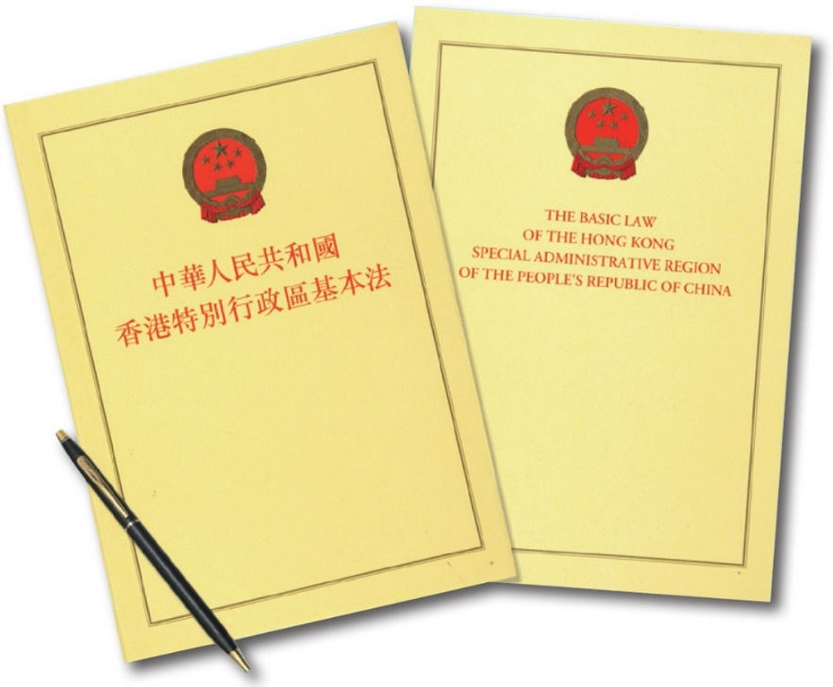
Eligibility and the term of office of the Chief Executive
Articles 44 and 46 of the Basic Law stipulate the eligibility and the term of office of the Chief Executive:
The Chief Executive of the Hong Kong Special Administrative Region shall be a Chinese citizen of not less than 40 years of age who is a permanent resident of the Region with no right of abode in any foreign country and has originally resided in Hong Kong for a continuous period of not less than 20 years.
The term of office of the Chief Executive of the Hong Kong Special Administrative Region shall be five years. He or she may serve for not more than two consecutive terms.

Slide 13
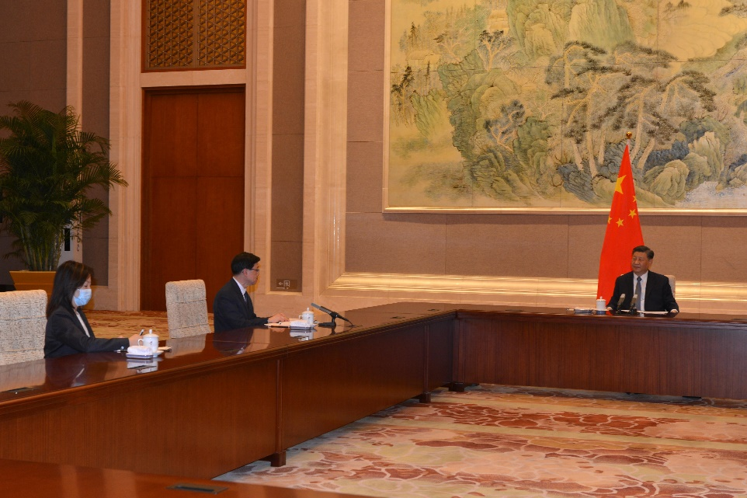
The Central People’s Government appoints the Chief Executive of the HKSAR
On 30 May 2022, the Chief Executive-elect, Mr John Lee, was received by President Xi Jinping and awarded the instrument of appointment as the sixth-term Chief Executive of the Hong Kong Special Administrative Region (SAR) of the People's Republic of China by Premier Li Keqiang in Beijing.
Source:
https://www.info.gov.hk/gia/general/202205/30/P2022053000570.htm?fontSize=1

Slide 14
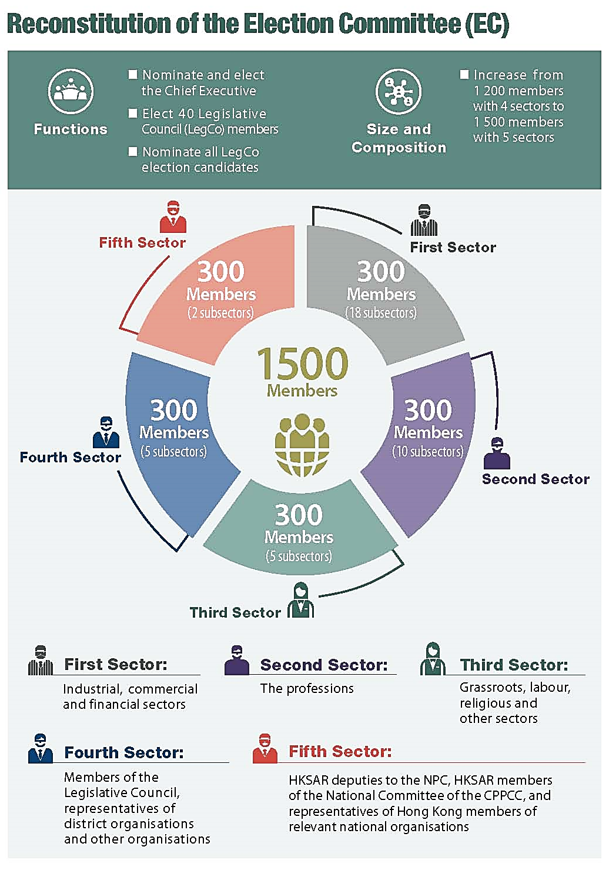
On 30 March 2021, the 27th Session of the Standing Committee of the 13th National People’s Congress adopted the amended Annex I to the Basic Law of the Hong Kong Special Administrative Region of the People’s Republic of China on Method for the Selection of the Chief Executive of the Hong Kong Special Administrative Region.
The Election Committee shall be composed of 1500 members from the following sectors:
The First Sector: Industrial, commercial and financial sectors - 300
The Second Sector: The professions - 300
The Third Sector: Grassroots, labour, religious and other sectors - 300
The Fourth Sector: Members of the Legislative Council, representatives of district organisations and other organisations - 300
The Fifth Sector: HKSAR deputies to the National People’s Congress, HKSAR members of the National Committee of the Chinese People’s Political Consultative Conference, and representatives of Hong Kong members of relevant national organisations - 300
Members of the Election Committee must be permanent residents of the HKSAR.
The term of office of the Election Committee shall be five years.
Source: https://www.cmab.gov.hk/improvement/filemanager/content/pdf/en/resource-centre/Electoral-Leaflet.pdf

Slide 15
Dual head and dual responsibility
“Dual head”
The Chief Executive is the head of the HKSAR, representing the SAR; he or she is also the head of the Government of the HKSAR.
The Chief Executive shall be accountable to the Central People’s Government, and shall report to the Central People’s Government. The Chief Executive shall also be accountable to the HKSAR.
“Dual responsibility”
Among all the officials in the HKSAR, only the Chief Executive has the legal status of “dual head and dual responsibility”, which manifests the core position of the Chief Executive.

Slide 16
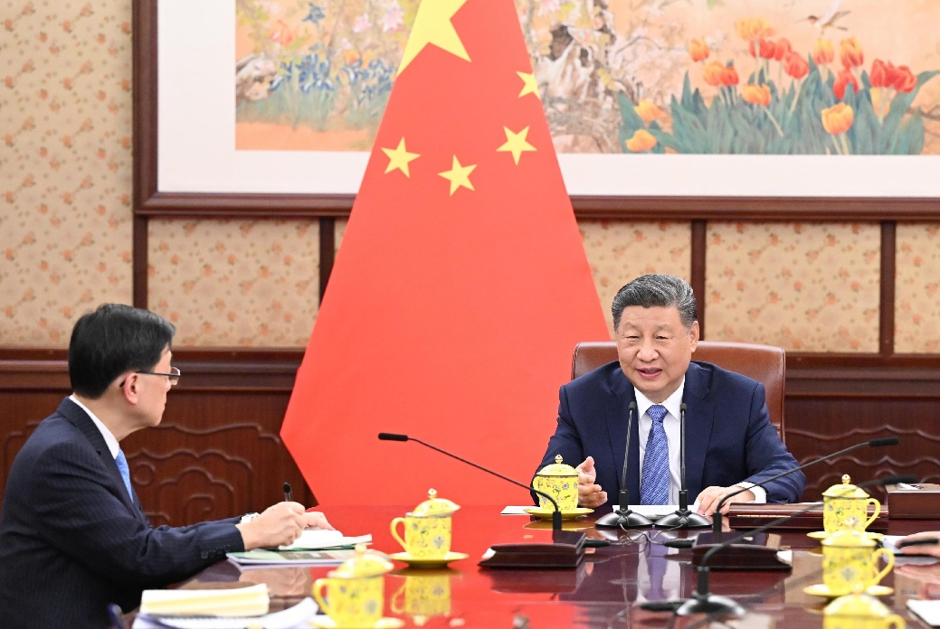
The Chief Executive of the Hong Kong Special Administrative Region shall be accountable to the Central People’s Government and the HKSAR in accordance with the provisions of the Basic Law.
The Chief Executive reported to President Xi Jinping.
Source:
https://www.info.gov.hk/gia/general/202412/13/P2024121300742.htm

Slide 17
The powers and functions of the Chief Executive
Duties relating to implementation of the Basic Law and other laws, which apply in the HKSAR
Duties relating to law-making
Duties relating to the management of administrative affairs of the government
Duties relating to the appointment and removal of officials
Duties relating to the implementation of the directives issued by the Central People's Government, and to conduct affairs authorized by the Central Authorities
Other important duties

Slide 18
Article 48 of the Basic Law
The Chief Executive of the Hong Kong Special Administrative Region shall exercise the following powers and functions:
(1) To lead the government of the Region;
(2) To be responsible for the implementation of this Law and other laws which, in accordance with this Law, apply in the Hong Kong Special Administrative Region;
(3) To sign bills passed by the Legislative Council and to promulgate laws;
To sign budgets passed by the Legislative Council and report the budgets and final accounts to the Central People's Government for the record;
(4) To decide on government policies and to issue executive orders;
(5) To nominate and to report to the Central People’s Government for appointment the following principal officials: Secretaries and Deputy Secretaries of Departments, Directors of Bureaux, Commissioner Against Corruption, Director of Audit, Commissioner of Police, Director of Immigration and Commissioner of Customs and Excise; and to recommend to the Central People's Government the removal of the above-mentioned officials;

Slide 19
(6) To appoint or remove judges of the courts at all levels in accordance with legal procedures;
(7) To appoint or remove holders of public office in accordance with legal procedures;
(8) To implement the directives issued by the Central People’s Government in respect of the relevant matters provided for in this Law;
(9) To conduct, on behalf of the Government of the Hong Kong Special Administrative Region, external affairs and other affairs as authorised by the Central Authorities;
(10) To approve the introduction of motions regarding revenues or expenditure to the Legislative Council;
(11) To decide, in the light of security and vital public interests, whether government officials or other personnel in charge of government affairs should testify or give evidence before the Legislative Council or its committees;
(12) To pardon persons convicted of criminal offences or commute their penalties; and
(13) To handle petitions and complaints.

Slide 20
Executive Council
Composition of the Executive Council
The Executive Council of the HKSAR is an organ for assisting the Chief Executive in policy-making. Its president is the Chief Executive, and it comprises official members and non-official members.
Members of the Executive Council shall be Chinese citizens who are permanent residents of the HKSAR with no right of abode in any foreign country.
The Chief Executive may, as he or she deems necessary, invite other persons concerned to sit in on meetings of the Council.

Slide 21
Operation of the Executive Council (Article 56 of the Basic Law)
The Executive Council of the Hong Kong Special Administrative Region shall be presided over by the Chief Executive.
Except for the appointment, removal and disciplining of officials and the adoption of measures in emergencies, the Chief Executive shall consult the Executive Council before making important policy decisions, introducing bills to the Legislative Council, making subordinate legislation, or dissolving the Legislative Council.
If the Chief Executive does not accept a majority opinion of the Executive Council, he or she shall put the specific reasons on record.

Slide 22
Body of power, district organisations, and public servants of Hong Kong
The Executive Authorities
The Government of the Hong Kong Special Administration Region shall be the executive authorities of the Region.
A Department of Administration, a Department of Finance, a Department of Justice, and various bureaux, divisions and commissions shall be established in the Government of the Hong Kong Special Administrative Region.
(refer to the Articles 59 and 60 of the Basic Law)
Article 61 of the Basic Law stipulates: The principal officials of the Hong Kong Special Administrative Region shall be Chinese citizens who are permanent residents of the Region with no right of abode in any foreign country and have ordinarily resided in Hong Kong for a continuous period of not less than 15 years.
Principal officials: below the Chief Executive are the three secretaries of departments, namely, Chief Secretary for Administration, Financial Secretary, Secretary for Justice; below them are directors of bureaux, Commissioner of Police, Commissioner of the Independent Commission Against Corruption, Director of Audit, Commissioner of Customs and Excise, and Director of Immigration.
* Source: https://www.gov.hk/en/about/govdirectory/po/

Slide 23
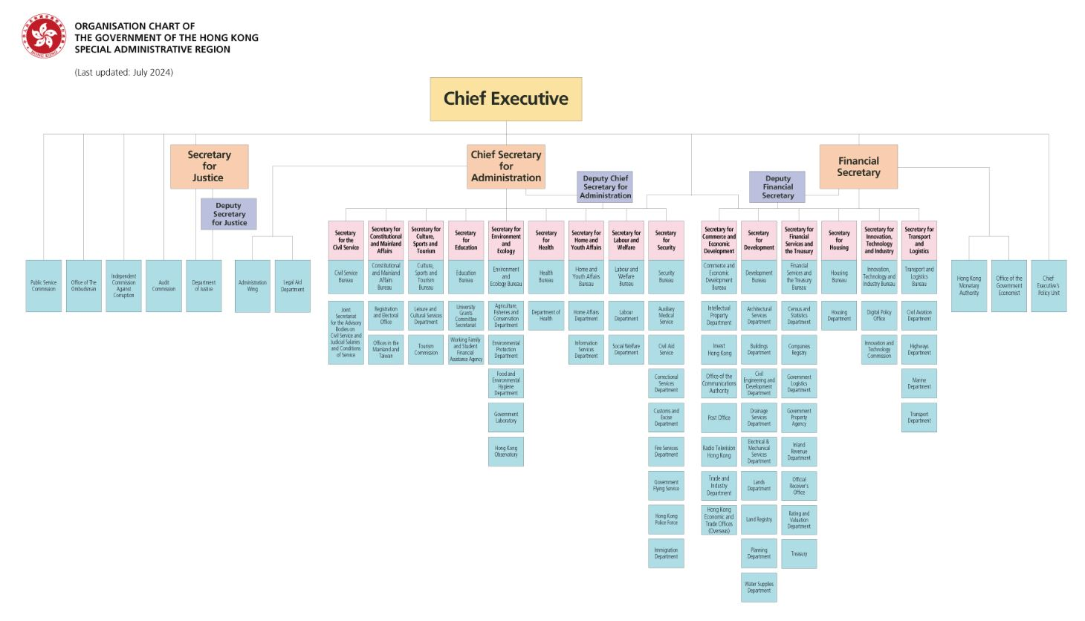
Full chart: https://www.gov.hk/en/about/govdirectory/govchart/index.htm

Slide 24
The Executive Authorities
According to Article 62 of the Basic Law, the Government of the Hong Kong Special Administration Region shall exercise the following powers and functions:
1. To formulate and implement policies;
2. To conduct administrative affairs;
3. To conduct external affairs as authorised by the Central People’s Government under this Law;
4. To draw up and introduce budgets and final accounts;
5. To draft and introduce bills, motions and subordinate legislation; and
6. To designate officials to sit in on the meetings of the Legislative Council and to speak on behalf of the government.

Slide 25
The Executive Authorities
Chief Secretary for Administration, Financial Secretary, Secretary for Justice
Secretaries of the three departments, i.e. Chief Secretary for Administration, Financial Secretary, Secretary for Justice, perform their different powers and functions.
The Chief Secretary for Administration is the leading principal official of the HKSAR Government, who plays a key role in ensuring harmonisation in policy formulation and implementation. This is particularly important in areas which cut across policy bureaux.
The primary responsibility of the Financial Secretary is to oversee policy formulation and implementation of financial, monetary, economic, trade, development matters, etc.
The Secretary for Justice is the head of the Department of Justice. Article 63 of the Basic Law stipulates that “The Department of Justice of the Hong Kong Special Administrative Region shall control criminal prosecutions, free from any interference.”
Source:
https://www.cso.gov.hk/eng/home/home.htm
https://www.fso.gov.hk/eng/
https://www.doj.gov.hk/en/community_engagement/press/20200229_pr1.html

Slide 26
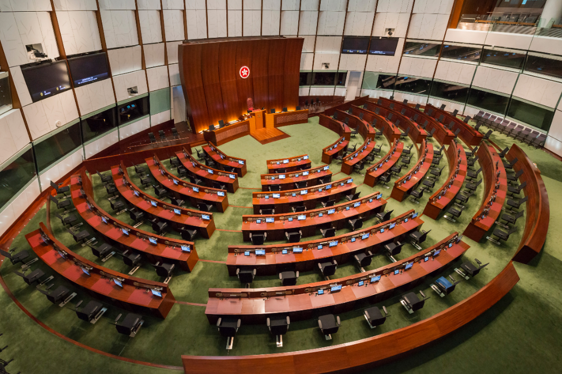
The Legislature
The Legislative Council is the legislature of the HKSAR.
Method for the formation of the Legislative Council of the HKSAR and its voting procedures are stipulated in Annex II to the Basic Law.
On 30 March 2021, Annex II to the Basic Law – Method for the Formation of the Legislative Council of the Hong Kong Special Administrative Region and Its Voting Procedures was amended and adopted at the 27th Session of the Standing Committee of the 13th National People’s Congress, and came into effect on 31 March 2021.
Chamber of the Legislative Council of the HKSAR

Slide 27
Powers and functions of the Legislative Council
Pursuant to Article 73 of the Basic Law, the Legislative Council of the Hong Kong Special Administrative Region shall exercise the following powers and functions:
(1) To enact, amend or repeal laws in accordance with the provisions of this Law and legal procedures;
(2) To examine and approve budgets introduced by the government;
(3) To approve taxation and public expenditure;
(4) To receive and debate the policy addresses of the Chief Executive;
(5) To raise questions on the work of the government;
(6) To debate any issue concerning public interests;
Legislation
Approval
Supervision
Impeachment
Others

Slide 28
Powers and functions of the Legislative Council
(7) To endorse the appointment and removal of the judges of the Court of Final Appeal and the Chief Judge of the High Court;
(8) To receive and handle complaints from Hong Kong residents;
(9) If a motion initiated jointly by one-fourth of all the members of the Legislative Council charges the Chief Executive with serious breach of law or dereliction of duty and if he or she refuses to resign, the Council may, after passing a motion for investigation, give a mandate to the Chief Justice of the Court of Final Appeal to form and chair an independent investigation committee. The committee shall be responsible for carrying out the investigation and reporting its findings to the Council. If the committee considers the evidence sufficient to substantiate such charges, the Council may pass a motion of impeachment by a two-thirds majority of all its members and report it to the Central People's Government for decision; and
(10) To summon, as required when exercising the above-mentioned powers and functions, persons concerned to testify or give evidence.
Legislation
Approval
Supervision
Impeachment
Others
Provisions of the Basic Law on impeachment (Article 73): https://www.basiclaw.gov.hk/en/basiclaw/chapter4.html

Slide 29
The legislative process of improving the electoral system
The National People’s Congress passed the Decision of the National People’s Congress on Improving the Electoral System of the Hong Kong Special Administrative Region on 11 March 2021.
The Standing Committee of the National People’s Congress passed the amended Annex I and Annex II to the Basic Law on 30 March 2021.
The Hong Kong Special Administrative Region Government take forward the amendment exercise of local electoral legislation in accordance with the amended Annex I and Annex II to the Basic Law. The Improving Electoral System (Consolidated Amendments) Ordinance 2021 was published in the Gazette and came into effect on 31 May 2021.
Click the image
to learn more about Improving the Electoral System
Source:
https://www.cmab.gov.hk/improvement/tc/npc-decision/index.html
29

Slide 30
Fundamental principles of improving the electoral system
The NPC passed the Decision of the National People’s Congress on Improving the Electoral System of the Hong Kong Special Administrative Region and authorised the Standing Committee of the National People’s Congress to amend Annex I and Annex II to the Basic Law in accordance with the following fundamental principles, so as to implement an improved electoral system that accords with the actual situation of Hong Kong.
Upholding and implementing the principles of “one country, two systems”, “Hong Kong people administering Hong Kong” and a high degree of autonomy
Firmly safeguarding the constitutional order of the HKSAR as enshrined under the Constitution and the Basic Law
Ensuring “patriots administering Hong Kong”
Effectively enhancing the governance capability of the HKSAR
Upholding HKSAR permanent residents’ right to vote and the right to stand for election in accordance with law
Questions: How does improving the electoral system embody and implement the principle of “patriots administering Hong Kong”?
Source: https://www.cmab.gov.hk/improvement/tc/npc-decision/index.html
30

Slide 31
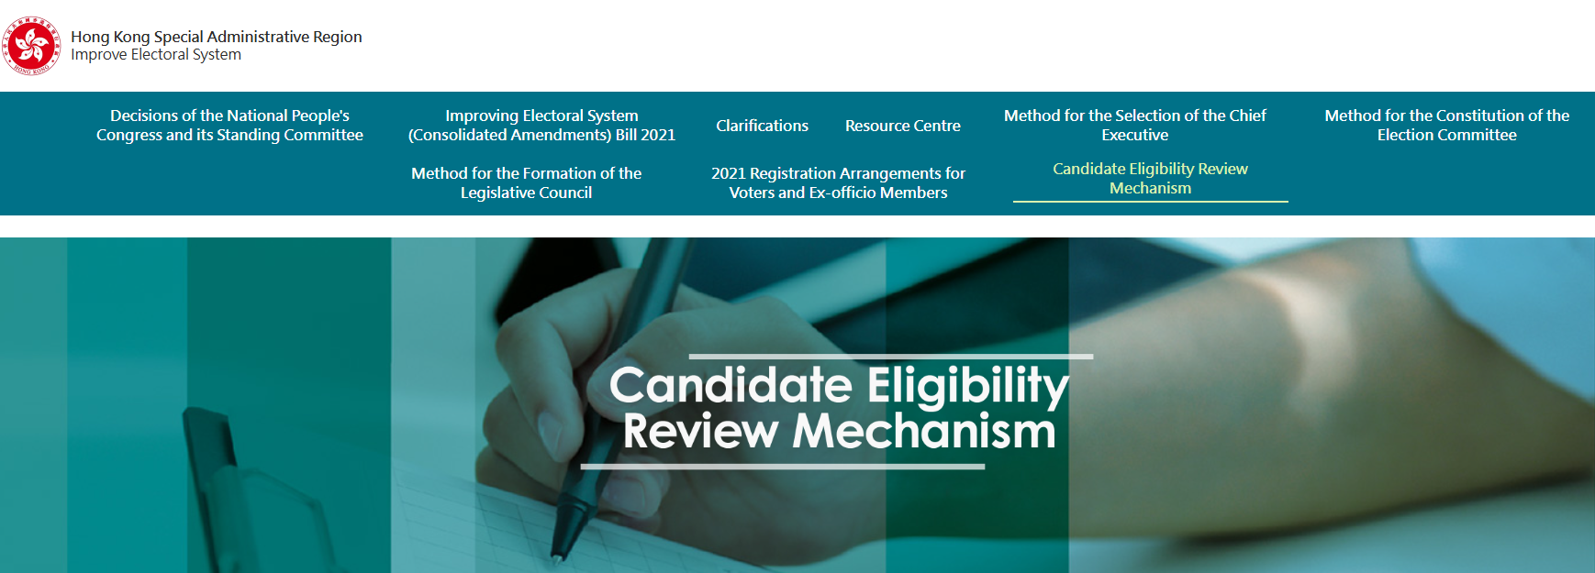
Improving the electoral system reflects the principle of “patriots administering Hong Kong”
A candidate eligibility review committee of the HKSAR shall be established. The committee shall be responsible for assessing and validating the eligibility of candidates for the Election Committee Members, the Chief Executive, and the LegCo Members.
The HKSAR shall improve the system and mechanisms related to qualification review, to ensure that the qualifications of candidates are in conformity with the Basic Law, the Law on Safeguarding National Security in the HKSAR, the NPC Standing Committee's interpretation of Article 104 of the Basic Law, the NPC Standing Committee's decision on the qualification of HKSAR LegCo Members, and provisions of relevant local laws of the HKSAR.
Source: https://www.cmab.gov.hk/improvement/en/qualification-review/index.html
Reference：
Chief Executive appoints Candidate Eligibility Review Committee member
https://www.info.gov.hk/gia/general/202209/19/P2022091600433.htm
Browse the website for more information
31

Slide 32
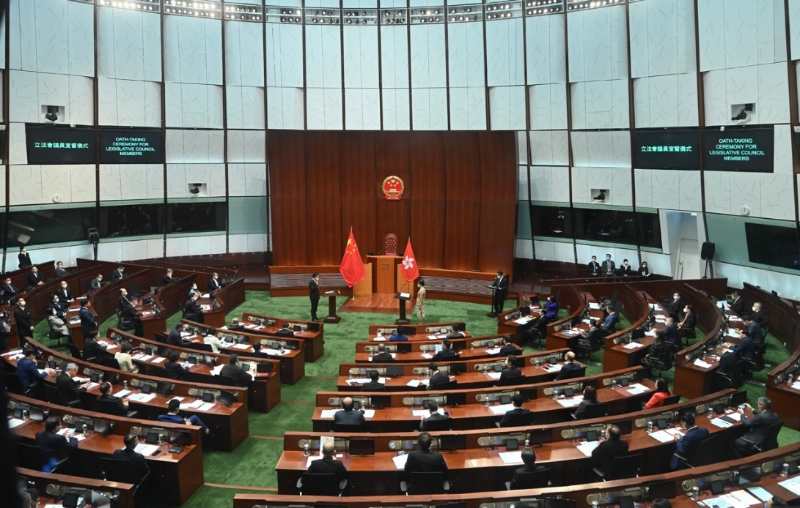
The oath-taking of Legislative Council members embodies the principle of “patriots administering Hong Kong”
Article 104 of the Basic Law:
When assuming office, the Chief Executive, principal officials, members of the Executive Council and of the Legislative Council, judges of the courts at all levels and other members of the judiciary in the Hong Kong Special Administrative Region must, in accordance with law, swear to uphold the Basic Law of the Hong Kong Special Administrative Region of the People's Republic of China and swear allegiance to the Hong Kong Special Administrative Region of the People's Republic of China.
The oath taking of the members of the LegCo must be administered by the Chief Executive or a person authorised by the Chief Executive.
The Chief Executive administered the LegCo oath of the members of the seventh-term Legislative Council at the Chamber of the Legislative Council Complex.
Reference: Interpretation of Article 104 of the Basic Law of the Hong Kong Special Administrative Region of the People’s Republic of China by the Standing Committee
of the National People’s Congress https://www.basiclaw.gov.hk/filemanager/content/en/files/basiclawtext/basiclawtext_doc27.pdf
Source:
https://www.info.gov.hk/gia/general/202201/03/P2022010300518.htm

Slide 33
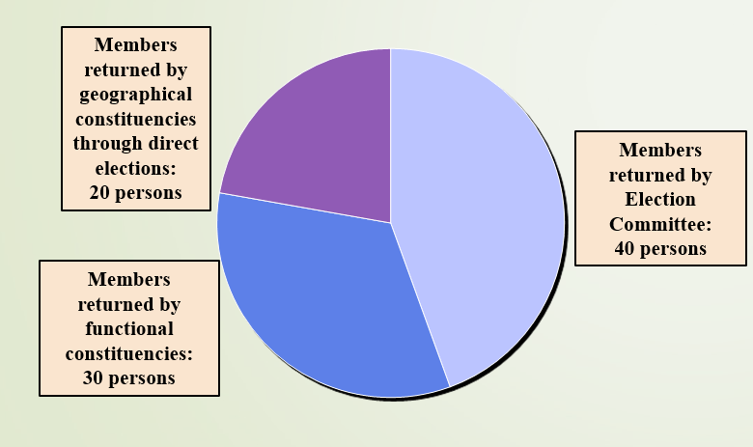
Composition of Legislative Council after improvement of the electoral system
With effect from 31 March 2021, the Legislative Council of the Hong Kong Special Administrative Region shall be composed of 90 members for each term. The composition should be as follows:
There are three methods for the election of Legislative Council members: direct elections from geographical constituencies, functional constituency elections, and members elected from the Election Committee sector.
The specific methods for the formation of the Legislative Council and the voting procedures for bills and motions are governed by Annex II, Methods for the Formation of the Legislative Council of the Hong Kong Special Administrative Region and Its Voting Procedures.

Slide 34
Outcomes of the seventh-term Legislative (Examples)
Reference
Following the improvement of the electoral system and implementation of the “patriots administering Hong Kong” principle, the seventh-term Legislative Council has enacted numerous bills of critical importance to Hong Kong's long-term development and livelihood improvement.
The seventh-term Legislative Council reviewed and passed approximately 130 bills, an increase of over 60% compared to the 81 bills passed during the same period in the previous Legislative Council. The Finance Committee of the Legislative Council approved 261 projects, including an allocation of about HK$520 billion to support 124 engineering projects, thereby fostering the development of Hong Kong.
Reference:
行政長官出席「行政立法同心治港創未來」研討會致辭
https://www.info.gov.hk/gia/general/202510/16/P2025101600321.htm
立法會主席年結記者會發言全文
https://www.info.gov.hk/gia/general/202510/22/P2025102200560.htm
Safeguarding National Security Ordinance
https://www.sb.gov.hk/eng/bl23/consultation.html

Slide 35

2025 Legislative Council General Election
Reference
Improving the electoral system and fully implementing the principle of “patriots administering Hong Kong” are crucial for ensuring the steadfast and successful implementation of the “one country, two systems” policy and the enduring stability and security of the region.
The 2025 Legislative Council General Election, which will form the eighth-term Legislative Council, is another significant election held by the Hong Kong Special Administrative Region after improving the electoral system and implementing the principle of “patriots administering Hong Kong”. It has received high attention from all sectors of society.
Reference:
行政長官出席「行政立法同心治港創未來」研討會致辭
https://www.info.gov.hk/gia/general/202510/16/P2025101600321.htm
香港第八屆立法會選舉有序展開 再次彰顯新選制優勢
http://www.news.cn/gangao/20251029/cc2bef23cea94344b30a77dd608a6456/c.html
Promotional poster of the 2025 Legislative Council General Election
35

Slide 36


Know more about 2025 Legislative Council General Election
Reference
Hints for learning and teaching:
Teachers arrange students to browse the website of Information Services Department and watch the promotional videos about the election to deepen their understanding of the importance of the 2025 LegCo General Election.
Reference: Information Services Department
https://www.isd.gov.hk/eng/tvapi.htm
Click the image to watch the promotional video of the election
Click the image to browse the website of 2025 LegCo General Election
Stay updated with relevant information about the election
36

Slide 37
Join the Election Together We Create the Future
The Legislative Council plays an important role in the development of Hong Kong. We should support the Legislative Council elections. By casting our votes, we can select visionary, responsible, competent, and dedicated individuals to join the Legislative Council, promote Hong Kong’s prosperity and development, and strive for the well-being of our community.
The Basic Law safeguards that permanent residents of the Hong Kong Special Administrative Region shall have the right to vote and the right to stand for election in accordance with the law. The new term of the Legislative Council is pivotal in shaping the future of our society. It is essential for citizens to embrace their civic responsibilities; voting is a powerful expression of their aspirations for the future of our community. Engaging in the electoral process not only influences the future of Hong Kong but also directly impacts the well-being of every individual in our society.
Reference:
選舉管理委員會主席出席2025年立法會換屆選舉啟動禮致辭
https://www.info.gov.hk/gia/general/202510/23/P2025102300477.htm
37

Slide 38
Caring About the 2025 Legislative Council General Election
Reference
Hong Kong residents can cast their votes on 7 December. We, as students, can also engage with the election in various ways. For example :
Stay updated with relevant information about the election
Explain to family members the meaning of this election and encourage them to participate and vote in the upcoming 2025 Legislative Council General Election
Organise activities in schools to raise students’ awareness of the 2025 Legislative Council General Election to help students understand the significance of this election in ensuring the implementation of “one country, two systems” and promoting Hong Kong's long-term development.
38

Slide 39
Suggested learning and teaching activities
Reference
Teachers can guide students in designing posters and videos to introduce the 2025 Legislative Council General Election. These materials should promote the improving of the electoral system, the principle of “patriots administering Hong Kong,” the significance of the Legislative Council elections to our community, and encourage family members to vote actively. This will consolidate students’ learning and help develop proper values.
Hints for learning and teaching:
Teachers should encourage students to utilize the reference materials provided in this resource, along with other official information, to enhance their conceptual understanding. This practice ensures that students’ works align closely with the key learning objectives, facilitating effective teaching outcomes.
To foster a supportive campus environment, teachers may select outstanding student works for display and promotion across the campus. This provides an opportunity for them to apply their learning and, around their caring for the Legislative Council elections.
39

Slide 40
Regulation and coordination between the Executive Authorities and the Legislature
Mutual Regulation
Under the executive-led system, it does not mean that there is no regulation between the executive authorities and the legislature; instead, the Basic Law stipulates the checks and balances between the two.
Regulations of the executive authorities on the legislature:
  The executive authorities draft bills and motions, and the power to propose bills by Legislative Council members is limited;
  The bills passed by the Legislative Council have to be signed and promulgated by the Chief Executive before coming into effect;
  Under certain specified circumstances, the Chief Executive may dissolve the Legislative Council.

Slide 41
Learn more
The power to propose bills by Legislative Council members
In accordance with Article 74 of the Basic Law, members of the Legislative Council of the Hong Kong Special Administrative Region may introduce bills in accordance with the provisions of this Law and legal procedures. Bills which do not relate to public expenditure or political structure or the operation of the government may be introduced individually or jointly by members of the Council. The written consent of the Chief Executive shall be required before bills relating to government policies are introduced.

Slide 42
Regulations of the Legislature on the Executive Authorities
The Executive Authorities must be accountable to the Legislative Council: it shall implement laws passed by the Council and already in force; it shall present regular policy addresses to the Council; it shall answer questions raised by members of the Council; and it shall obtain approval from the Council for taxation and public expenditure.
The Chief Executive must resign under any of the following circumstances: When, after the Legislative Council is dissolved because he or she twice refuses to sign a bill passed by it, the new Legislative Council again passes by a two-thirds majority of all the members the original bill in dispute, but he or she still refuses to sign it; or when, after the Legislative Council is dissolved because it refuses to pass a budget or any other important bill, the new legislative Council still refuses to pass the original bill in dispute.
Under certain specified circumstances, the Legislative Council can impeach the Chief Executive in accordance with the procedures as stipulated in the Basic Law.

Slide 43
Complement each other
The Executive Authorities shall draw up and introduce budgets, which shall be approved by the Legislative Council to ensure the smooth operation of public services and social facilities.
The Executive Authorities shall draft and introduce bills and motions, which shall be reviewed and passed by the Legislative Council, which are effective regulatory documents generally observed by society.
The Executive Council shall be an organ for assisting the Chief Executive in policy-making, and its members shall include members of the legislature to ensure effective communication with the Legislative Council in decision-making.
，
The Government shall designate officials to sit in on the meetings of the Legislative Council and to speak on behalf of the government to facilitate mutual understanding.
In the elections after 2021, the Election Committee shall elect the Chief Executive and part of Legislative Council members, further strengthening the interaction between the Chief Executive and the Legislative Council.

Slide 44
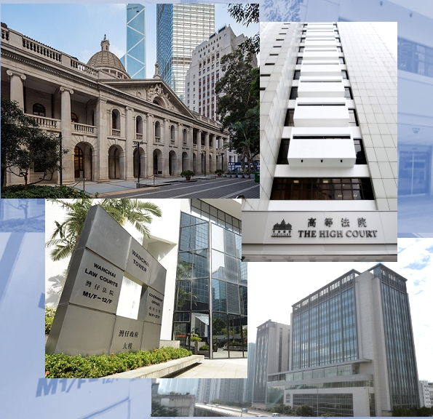
The Judiciary
The courts of the Hong Kong Special Administrative Region at all levels shall be the judiciary of the Region, exercising the judicial power of the Region.
The courts of the Hong Kong Special Administrative Region shall exercise judicial power independently, free from any interference. Members of the judiciary shall be immune from legal action in the performance of their judicial functions.
The Judiciary of Hong Kong

Slide 45
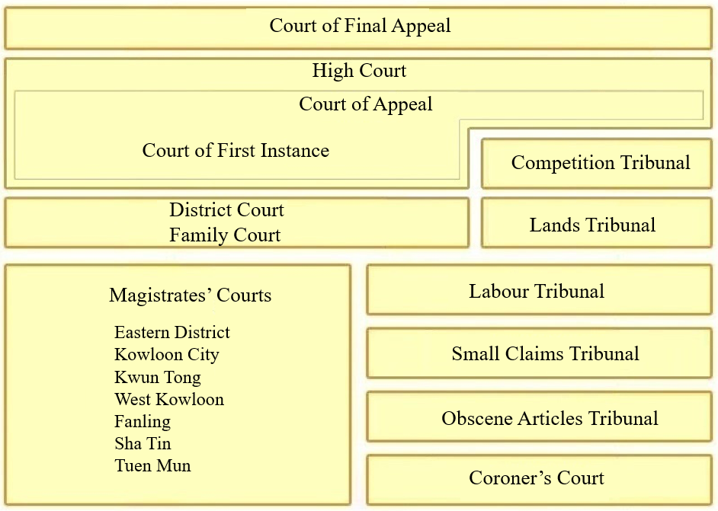
Structure of the Judiciary

Slide 46

Court of Final Appeal
The Court of Final Appeal exercises the power of final adjudication of the HKSAR.
The Court of Final Appeal exercises its power in accordance with Hong Kong Court of Final Appeal Ordinance (Cap.484) and other laws, handling appeals and related matters on civil and criminal judgements of the High Court (Court of Appeal and Court of First Instance).
Reference: Website of the Court of Final Appeal
https://www.hkcfa.hk/en/about/cfa_building/CFAB_PhotoGallery/index.html

Slide 47
High Court
The High Court is made up of the Court of Appeal and the Court of First Instance. It has both appellate and original jurisdiction, i.e. it can both hear appeals sent to it and try cases first taken to it.
The right of appeal is an important part of Hong Kong’s legal system, for it allows a higher court to review the judgement of a lower court. The appeal system seeks to ensure that any failures or mistakes claimed to have been made in or in relation to a court hearing, or indeed during an investigation, can be corrected by way of appeal to a higher court.

Slide 48
Chief Justice of the Judiciary
Judges of the courts of the Hong Kong Special Administrative Region shall be appointed by the Chief Executive on the recommendation of an independent commission of local judges, persons from the legal profession and eminent persons from other sectors.
In accordance with Article 90 of the Basic Law, the Chief Justice of the Court of Final Appeal and the Chief Judge of the High Court of the Hong Kong Special Administrative Region shall be Chinese citizens who are permanent residents of the Region with no right of abode in any foreign country.
In the case of the appointment or removal of judges of the Court of Final Appeal and the Chief Judge of the High Court of the Hong Kong Special Administrative Region, the Chief Executive shall obtain the endorsement of the Legislative Council and report such appointment or removal to the Standing Committee of the National People’s Congress for the record.
Reference: https://www.basiclaw.gov.hk/en/basiclaw/chapter4.html

Slide 49
Appointment of judicial officers
The Chief Executive appoints judges and other judicial officers based on the recommendation of the Judicial Officers Recommendation Commission, which is an independent statutory body composed of judges, persons from the legal profession and eminent persons from other sectors.
Judges and other members of the judiciary of the HKSAR shall be chosen on the basis of their judicial and professional qualities and may be recruited from other common law jurisdictions.
According to the Basic Law, the courts of the HKSAR shall be vested with independent judicial power, including that of final adjudication.
The judiciary of the HKSAR is independent from the executive authorities and the legislature, free from any interference. Members of the judiciary shall be immune from legal action in the performance of their judicial functions.
The judicial independence does not mean that the judiciary can perform its functions without limits. The Chief Executive has the right to appoint or remove judges.
The judiciary shall observe the interpretation of the Basic Law made by the Standing Committee of the National People’s Congress.

Slide 50
District organisations
Article 97 of the Basic Law stipulates that district organisations which are not organs of political power may be established in the Hong Kong Special Administrative Region, to be consulted by the government of the Region on district administration and other affairs, or to be responsible for providing services in such fields as culture, recreation and environmental sanitation.
District Councils are district organisations which are not organs of political power.

Slide 51
The District Councils (Amendment) Ordinance 2023 (the Ordinance) has been published and comes into effect
Reference
The District Councils (Amendment) Ordinance 2023 (the Ordinance) was formally gazetted and came into effect on 10 July 2023. The Ordinance restructures the District Councils and strengthens the district governance framework to improve governance efficacy.
Reforming the District Councils is an integral part of improving district governance. With the commencement of the Ordinance, the principle of “patriots administering Hong Kong” is fully implemented institutionally. The District Councils will return to their original positioning under the Basic Law and perform their services and advisory functions, and support the Government in district work. The efficacy of district governance would be enhanced, thereby achieving good governance and enhancing citizens' sense of happiness and satisfaction.
After the Ordinance came into effect, the new term of District Councils was formed on January 1, 2024. For information regarding the functions of the District Councils and details about the recent District Council election, please refer to the following websites:
References:
  Constitutional and Mainland Affairs Bureau：https://www.cmab.gov.hk/tc/issues/improve_district.htm
  The District Councils (Amendment) Ordinance 2023 : https://www.elegislation.gov.hk/hk/2023/19!zh-hant-hk
51

Slide 52
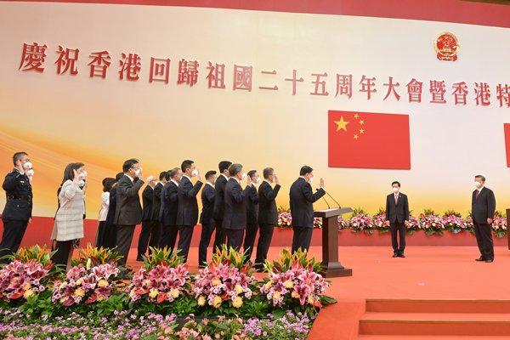
Public servants
Public servants serving in all government departments of the Hong Kong Special Administrative Region must be permanent residents of the Region. They must be dedicated to their duties and be responsible to the Government of the Hong Kong Special Administrative Region.
⧫ Oath-taking by public servants
Reference: https://www.news.gov.hk/eng/2022/07/20220701/20220701_122112_073.html

Slide 53
The Principle of “patriots administering Hong Kong” permeates through the Basic Law
港人治港有個界綫和標準，就是必須由以愛國者為主體的港人來治理香港。甚麽叫愛國者？愛國者的標準是，尊重自己民族，誠心誠意擁護祖國恢復行使對香港的主權，不損害香港的繁榮和穩定。
來源:選自《鄧小平論香港》，第二版，
三聯書店（香港）有限公司，第8頁
Chinese version only

Slide 54
According to the Basic Law, the Chief Executive, members of the Executive Council, the President of the Legislative Council, principal officials, and the Chief Justice of the Court of Final Appeal and the Chief Judge of the High Court of the Hong Kong Special Administrative Region shall be Chinese citizens who are permanent residents of the Region with no right of abode in any foreign country.
According to the Basic Law, when assuming office, the Chief Executive, principal officials, members of the Executive Council and of the Legislative Council, judges of the courts at all levels and other members of the judiciary in the Hong Kong Special Administrative Region must, in accordance with law, swear to uphold the Basic Law of the Hong Kong Special Administrative Region of the People’s Republic of China and swear allegiance to the Hong Kong Special Administrative Region of the People’s Republic of China.

Slide 55
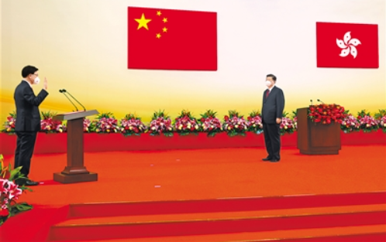
⧫ The Chief Executive taking the oath
Reference: http://cpc.people.com.cn/BIG5/n1/2022/0702/c64094-32463932.html

Slide 56
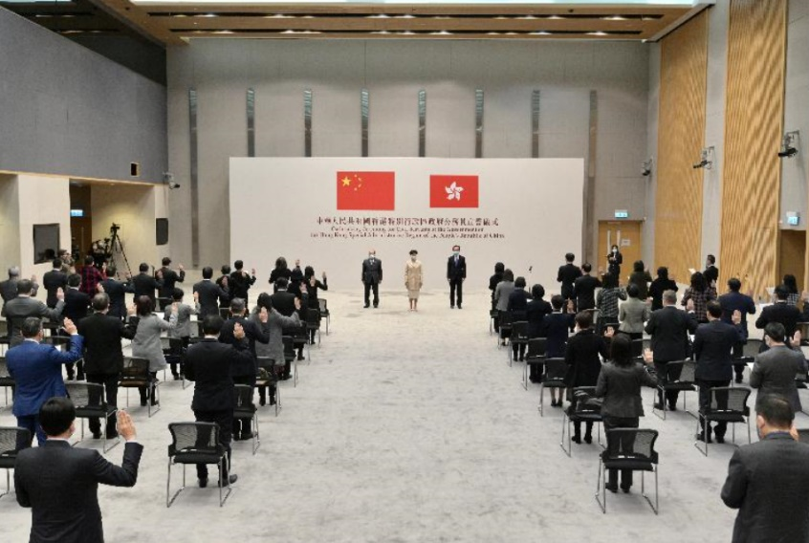
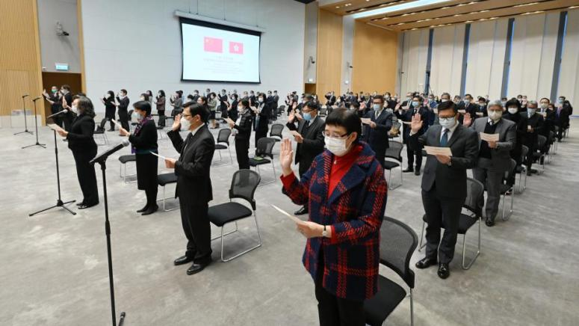
Learn More
Content of the Oath/Declaration
I declare that, as a civil servant of the Government of the Hong Kong Special Administrative Region of the People’s Republic of China, I will uphold the Basic Law of the Hong Kong Special Administrative Region of the People’s Republic of China, bear allegiance to the Hong Kong Special Administrative Region of the People’s Republic of China, be dedicated to my duties and be responsible to the Government of the Hong Kong Special Administrative Region.
Oath-taking by senior civil servants in 2020 
https://www.info.gov.hk/gia/general/202012/18/P2020121800236.htm
Oath-taking by civil servants
Reference: https://www.csb.gov.hk/english/admin/oathserving/2769.html

Slide 57
Question
Why are public servants of the HKSAR required to take an oath to swear allegiance to the HKSAR of the PRC?

Slide 58
Suggested answers:
According to the Basic Law, public servants of the Hong Kong Special Administrative Region must be dedicated to their duties and be responsible to the Government of the Hong Kong Special Administrative Region. It is a statutory requirement.
They swear to uphold the Basic Law and bear allegiance to the Hong Kong Special Administrative Region, making a solemn promise to society and manifesting their loyalty and commitment to the Basic Law and the Hong Kong Special Administrative Region, and thus enhance the public confidence in public servants.

Slide 59
香港由亂及治的重大轉折，再次昭示了一個深刻道理，那就是要確保「一國兩制」實踐行穩致遠，必須始終堅持「愛國者治港」。這是事關國家主權、安全、發展利益，事關香港長期繁榮穩定的根本原則。只有做到「愛國者治港」，中央對特別行政區的全面管治權才能得到有效落實，憲法和基本法確立的憲制秩序才能得到有效維護，各種深層次問題才能得到有效解決，香港才能實現長治久安，並為實現中華民族偉大復興作出應有的貢獻。
——節錄自習近平在聽取林鄭月娥2020年度述職報告時的講話
Chinese version only

Slide 60
Provisions on “Patriots administering Hong Kong” in The Law of the People’s Republic of China on Safeguarding National Security in the Hong Kong Special Administrative Region
shall be disqualified from standing as a candidate in the elections of the Legislative Council and District Councils of the HKSAR.
shall be disqualified from holding any public office in the Region, or serving as a member of the Election Committee for electing the Chief Executive.
who is convicted of an offence endangering national security by a court
Any person
Member of the Legislative Council
Government official and a public servant
Member of the Executive Council
Judge or a judicial officer; or
Member of the District Councils
who is convicted of an offence endangering national security by a court
shall be removed from his or her office upon conviction.
shall be disqualified from standing for the aforementioned elections or from holding any of the aforementioned posts.

Slide 61
Article 35 of The Law of the People’s Republic of China on Safeguarding National Security in the Hong Kong Special Administrative Region:
A person who is convicted of an offence endangering national security by a court shall be disqualified from standing as a candidate in the elections of the Legislative Council and district councils of the Hong Kong Special Administrative Region, holding any public office in the Region, or serving as a member of the Election Committee for electing the Chief Executive. If a person so convicted is a member of the Legislative Council, a government official, a public servant, a member of the Executive Council, a judge or a judicial officer, or a member of the district councils, who has taken an oath or made a declaration to uphold the Basic Law of the Hong Kong Special Administrative Region of the People’s Republic of China and swear allegiance to the Hong Kong Special Administrative Region of the People’s Republic of China, he or she shall be removed from his or her office upon conviction, and shall be disqualified from standing for the aforementioned elections or from holding any of the aforementioned posts.

Slide 62





Relevant reference materials
Full text and relevant documents of The Basic Law of the Hong Kong Special Administrative Region of the People's Republic of China
https://www.basiclaw.gov.hk/en/basiclaw/index.html
Basic Law
  https://www.basiclaw.gov.hk/en/index/index.html
RTHK.HK---憲法傳萬家:
http://www.rthk.hk/tv/dtt31/programme/rootorigintheconstitution
http://www.rthk.hk/tv/dtt31/programme/rootorigintheconstitution2
The China Current: 「一國兩制」下的香港
http://chinacurrent.com/education/category/%E3%80%8C%E4%B8%80%E5%9C%8B%E5%85%A9%E5 %88%B6%E3%80%8D%E4%B8%8B%E7%9A%84%E9%A6%99%E6%B8%AF
2025 Legislative Council General Election
https://www.elections.gov.hk/legco2025/eng/index.html
Constitutional and Mainland Affairs Bureau Topical Issues: Electoral Matters
https://www.cmab.gov.hk/en/issues/electoral.htm
Registration and Electoral Office Press Releases
https://www.reo.gov.hk/en/whats-new/press-releases.html#2025
行政長官出席「行政立法同心治港創未來」研討會致辭全文（只有中文）
http://www.info.gov.hk/gia/general/202510/16/P2025101600321.htm
62

Slide 63
Learning and Teaching Resources of Constitution and Basic Law developed by EDB
Teaching Resources on the Constitution of the People’s Republic of China
【Junior Secondary Curriculum of the PSHE KLA】
Constitution and Basic Law Education Wall-chart Resources
Constitution and Basic Law Online Course for Secondary School Students’ Self-directed Learning
Learning and Teaching Resources for “Constitution and the Basic Law”
Reference:
https://www.edb.gov.hk/en/curriculum-development/kla/pshe/basic-law-education.html
63

Slide 64
User guide
The primary users of this resource are teachers. It aims to provide teachers with content knowledge relevant to the topic to enable teachers to have a deeper understanding of teaching content when preparing for their lessons.
All data, videos, photos, pictures, questions and suggested answers can be used for multiple purposes, such as teachers’ teaching materials, references for curriculum planning and learning and teaching, and student assignments, etc. To align with Citizenship and Social Development Curriculum and Assessment Guide (Secondary 4-6) (2021) (C&A Guide), this resource should be adapted to cater for students’ learning diversity and the needs of classroom teaching, etc.
Teachers may provide appropriate supplementary notes/ explanations to enrich this resource in order to enhance students’ understanding of the topic and information provided.
In accordance with the curriculum rationale and aims, teachers may select other learning and teaching resources which are correct, reliable, objective and impartial to help students build up a solid knowledge base, develop positive values and attitudes as well as enhance critical thinking and problem solving skills, and various generic skills.
If some information cannot be provided in this resource due to copyright issue, teachers may visit relevant websites provided.
Some information may have been updated when being used by teachers, teachers may visit the corresponding websites to obtain the up-to-date information.
Please also refer to the C&A Guide to understand the requirements and arrangements of the learning and teaching of the curriculum. Teachers are welcome to point out the areas need improvement, and welcome to provide updated information to enrich the content for all teachers’ reference.

Slide 65
Notice and Disclaimer
Some sources were not translated into English as the official English version is not available.
In case of any discrepancy between the Chinese and English versions, the Chinese version shall prevail.
65

