Slide 1
Citizenship and Social Development
Theme 1: Hong Kong under “One Country, Two Systems”
Topic: The meaning and implementation of “one country, two systems”
Learning focus:
Significance of safeguarding national security (i.e. a holistic approach to national security); the National Security Law and promoting long-term development of Hong Kong; and
striking the balance between the rule of law and human rights
Translated version
April 2024

Slide 2
Learning Objectives
Knowledge
To understand the notion of national security, the holistic approach to national security, and different aspects of national security
To understand the significance and importance of safeguarding national security
To understand the relationship between the National Security Law and promoting the long-term development of Hong Kong
To understand the balance between the rule of law and human rights
Skills
To acquire generic skills, such as communication, collaboration, critical thinking, and generalisation and analytical skills
Values
To nurture the self-awareness of safeguarding national security
To raise the awareness of observing the National Security Law

Slide 3
Legislation for national security is an international convention
There are 20 laws on national security in the United States, such as the National Security Act in 1947, the Foreign Investment and National Security Act in 2007, etc. The scope of regulations includes treason, subversion of state power, terrorist acts, disclosure of national defence information or confidential information to foreign governments, and establishment of supervision and intelligence agencies.
The United Kingdom has promulgated several laws such as the Treason Felony Act 1848, the Official Secrets Act 1911, the Official Secrets Act 1920, the Security Service Act 1989, the Terrorism Act 2000, and the Counter-Terrorism and Security Act 2015, etc. The scope of regulations includes treason, terrorist acts, espionage, and illegal disclosure of official confidential information.
In addition to the United Kingdom and the United States, which countries have also enacted laws for national security?

Slide 4
Chinese version only:
- Slides 5-9,
- Slides14-36
- Slides 46

Slide 5

甚麼是國家安全?
《中華人民共和國國家安全法》第二條規定
國家安全，是指國家政權、主權、統一和領土完整、人民福祉、經濟社會可持續發展和國家其他重大利益相對處於沒有危險和不受內外威脅的狀態，以及保障持續安全狀態的能力。
可從四方面理解：
維護國家核心利益和重大利益的安全，涵蓋國家政權、主權、統一和領土完整、人民福祉、經濟社會可持續發展；
國家安全是一種狀態，沒有外部的威脅和侵害，亦沒有內在的動亂和失序的狀態；
國家安全的因素是相對和動態的，現實世界沒有絕對的國家安全，風險因素常在，必須時刻保持警惕；及
國家安全包括保障持續安全狀態的能力，不斷加強維護國家安全的能力建設，防範和化解風險因素和實質危害。
參考資料：https://www.nsed.gov.hk/national_security/index.php?l=en

Slide 6
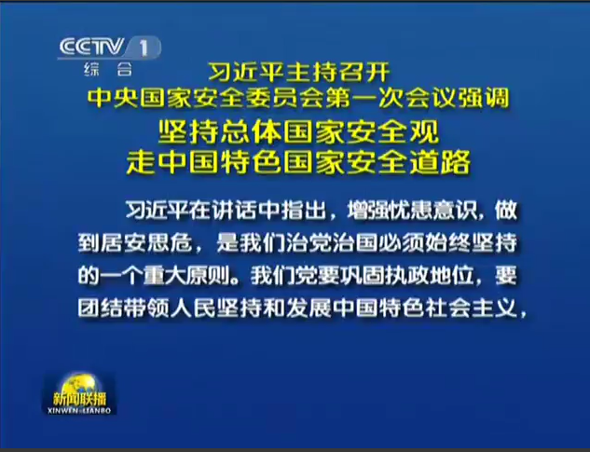
視頻：
〈習近平：堅持總體國家安全觀 走中國特色國家安全道路〉
視頻網址：http://tv.people.com.cn/n/2014/0415/c141029-24900133.html

Slide 7
總體國家安全觀的基本認識—發展歷程
2011年9月國務院新聞辦發表《中國的和平發展》白皮書界定中國的核心利益包括國家主權、國家安全、領土完整，國家統一，《中國憲法》確立的國家政治制度和社會大局穩定，經濟社會可持續發展的基本保障。
2014年4月15日國家主席習近平提出「總體國家安全觀」強調以人民安全為宗旨，以政治安全為根本，以經濟安全為基礎，以軍事、文化、社會安全為保障，以促進國際安全為依託，走出一條中國特色國家安全道路。
2015年1月中共中央政治局審議通過以「總體國家安全觀」為指導的《國家安全戰略網要》。
2015年7月1日全國人大常委會通過《中華人民共和國國家安全法》以法律形式確立了「總體國家安全觀」的指導地位。
2020年9月28日國家教育部制定了《大中小學國家安全教育指導綱要》以配合「將國家安全教育納入國民教育體系」的要求。
參考自: 王振民、黃風、畢雁英等《香港特別行政區維護國家安全法讀本》(香港: 三聯書店，2021年)頁7-9。
7

Slide 8
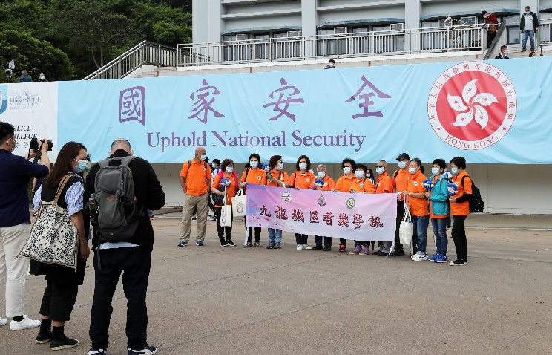
全民國家安全教育日
《中華人民共和國國家安全法》第十四條規定，每年4月15日為全民國家安全教育日。
2021年4月15日，「全民國家安全教育日2021」開幕典禮在香港會議展覽中心舉行

Slide 9
根據不同時期面臨的國家安全威脅和挑戰的變化，各國對國家安全所涉及的領域和範圍不斷進行調整，各國對國家安全概念會有不同的詮釋。
國家安全概念往往和國家利益聯繫在一起，各國關於國家利益的具體範圍界定也不一致，但也存在共同性:
  其一: 國家的核心利益或根本利益，是永久存在的利益, 當中包括領土完整、政治制度的延續、文化的認同、國家的安全等;
  其二: 由環境變化決定的利益，是國家依環境變化而不斷更新內容的利益。
  來源:王振民、黃風、畢雁英等《香港特別行政區維護國家安全法讀本》，三聯書店（香港），2021年，第6-7頁。
領土
完整
政治制度的延續
文化的認同
國家的安全
國家的核心利益

Slide 10
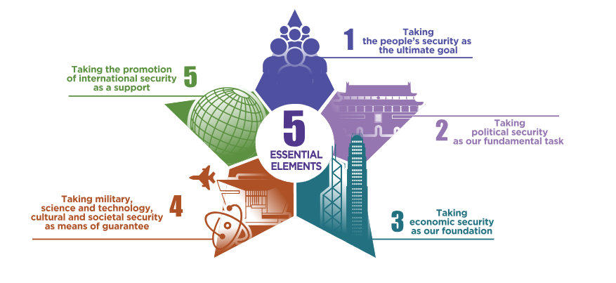


Five Essential Elements of A Holistic Approach to National Security
A Holistic Approach to National Security
Source: The China Current
https://chinacurrent.com/education/article/2022/09/24018.html
Source: www.nsed.gov.hk/national_security/index.php?l=en&a=national_security_overview

Slide 11
Five pairs of relationship of A Holistic Approach to National Security
Attaching equal importance to development and security
External security and internal security
Homeland security and the people’s security
Traditional security and non-traditional security
Our own security and common security
Source：https://www.nsed.gov.hk/booklet.php?b=greatwall_online_leaflet_tc.pdf

Slide 12
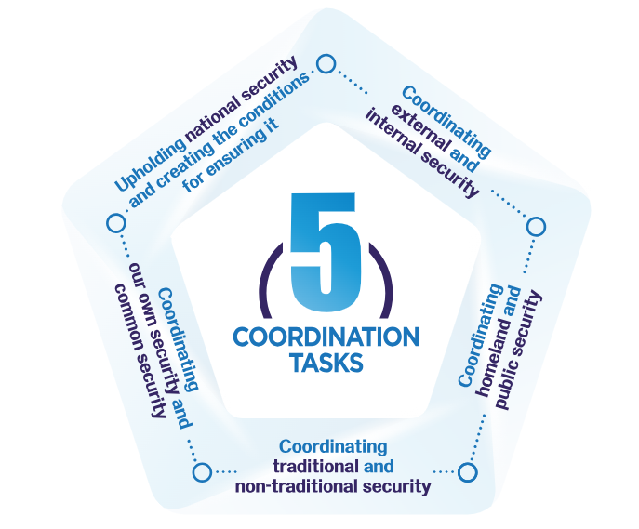
Five Coordination Tasks of A Holistic Approach to National Security
Source: https://www.nsed.gov.hk/national_security/index.php?l=en&a=national_security_plan

Slide 13
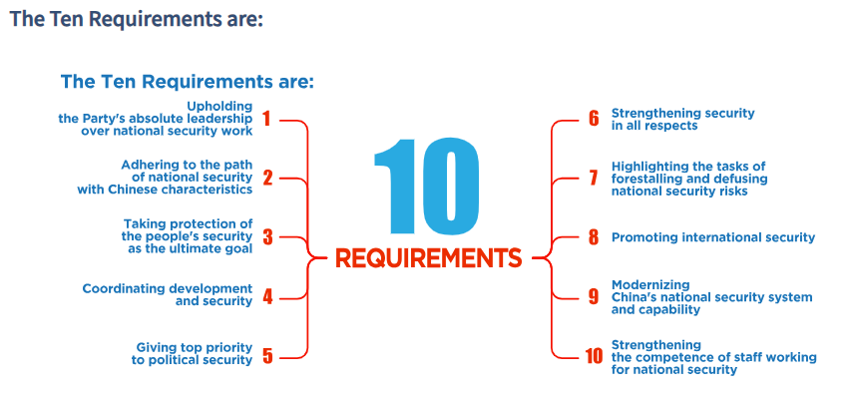
Ten Requirements of A Holistic Approach to National Security
On December 11, 2020, General Secretary Xi Jinping introduced Ten Requirements for the implementation of the holistic approach to national security at the 26th collective study session of the Political Bureau of the Communist Party of China Central Committee.
Source: https://www.nsed.gov.hk/national_security/index.php?l=en&a=national_security_10_persistence

Slide 14
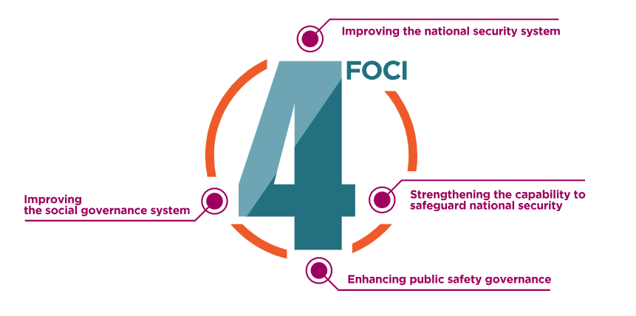
Four Foci of A Holistic Approach to National Security
In 2022, the 20th National Congress report of the Communist Party of China pointed to the strategic deployment of four tasks to modernize our country's national security system and capability, in order to implement the new requirement of safeguarding the new development pattern by a new security configuration. The new national security configuration which will advance the national security system and modernize our capability comprises Four Foci as follows:
Source: https://www.nsed.gov.hk/national_security/index.php?l=en&a=4_force_point

Slide 15

Holistic Approach to National Security
A holistic approach to national security stresses the need to construe and put into practice national security from a macro perspective holistically. The highlight is the concept of "holistic security" and it encompasses twenty major interconnected fields.
Traditional fields:
Political Security, Military Security, Homeland Security.
Non-traditional fields:
Economic Security, Financial Security, Cultural Security, Societal Security, Science and Technology Security, Cyber Security, Food Security, Ecological Security, Resource Security, Nuclear Security, Overseas Interests Security, Outer Space Security, Deep Sea Security, Polar Security, Biosecurity, Artificial Intelligence Security, Data Security.
Source: https://www.nsed.gov.hk/national_security/index.php?l=en&a=safety

Slide 16
（1）政治安全
政治安全包括政權安全、制度安全、意識形態安全等方面，是國家安全的根本。
政治安全防範、制止和依法懲治任何叛國、分裂國家、煽動叛亂、顛覆或者煽動顛覆人民民主專政政權的行為;防範、制止和依法懲治竊取、泄露國家秘密等危害國家安全的行為; 防範、制止和依法懲治境外勢力的滲透、破壞、顛覆、分裂活動。

Slide 17
（2）國土安全
國土安全包括領土以及自然資源、基礎設施安全等方面，核心是指領土完整、國家統一，邊疆邊境、領空、海洋權益等不受侵犯或免於威脅的狀態，是國家生存和發展的基本條件。
17

Slide 18
（3）軍事安全
軍事安全包括軍事力量、軍事戰略和領導體制等方面，是國家安全的重要保障和保底手段。
軍事安全指國家不受外部軍事入侵和戰爭威脅的狀態。
18

Slide 19
（4）經濟安全
經濟安全包括經濟制度安全、經濟秩序安全、經濟主權安全、經濟發展安全等方面，是國家安全與發展的基礎。
隨著經濟全球化迅速擴展，經濟互動日益增多，經濟競爭成為大國競爭的主要戰場，頻頻出現的經濟領域危機，摩擦和制裁成為世界各國面對的突出問題。國家間的矛盾、衝突和鬥爭在很大程度也圍繞經濟利益而展開。
金融是國家重要的核心競爭力。金融安全是國家安全的重要組成部分。

Slide 20
（5）金融安全
金融安全是經濟平穩健康發展的重要基礎，是國家重要的核心競爭力。金融制度是經濟社會發展中重要的基礎性制度。金融活，經濟活;金融穩，經濟穩。維護金融安全是關乎國家經濟社會發展全局的一件有戰略性、根本性的大事。維護金融安全，是治國理政的一件大事，必須堅守底線。

Slide 21
（6）文化安全
文化是民族的血脈，是人民的精神家園。文化安全是指一個文化相對處於沒有危險和不受內外威脅的狀態，以及保障持續安全狀態的能力。它關乎國家穩固、民族團結、精神傳承，是國家安全的重要保障。
21

Slide 22
（7）社會安全
社會安全包括社會治安、社會輿情、公共衛生等方面，是社會和諧穩定的基礎。
社會安全是指防範、消除、控制直接威脅社會公共秩序和人民群眾生命財產安全的治安、刑事、暴力恐怖事件以及規模較大的群體性事件等，涉及打擊犯罪、維護穩定、社會治理、公共服務等各個方面，與人民群眾切身利益息息相關。
22

Slide 23
（8）科技安全
科技安全包括科技自身安全和科技相關領域的安全，涵蓋科技人才、設施設備、科技活動、科技成果、成果應用等支撐國家安全的重要力量和技術基礎。

Slide 24
（9）網絡安全
網絡安全包括網絡基礎設施、網絡運行、網絡服務、資訊安全等方面，是保障和促進資訊社會健康發展的基礎。

Slide 25
（10）糧食安全
糧食安全包括確保生產足夠數量的糧食，最大限度地穩定糧食供應，確保所有需要糧食的人都能獲得糧食。糧食既是關係國計民生和國家經濟安全的重要戰略物資，也是人民最基本的生活物資，保障國家糧食是實現經濟發展、社會穩定、國家安全的重要基礎。

Slide 26
（11）生態安全
生態安全是指一個國家賴以生存和發展的生態環境處於不受或少受破壞和威脅的狀態，並致力完善生態環境保護制度體系，加大生態建設和環境保護力度，劃定生態保護紅線，強化生態風險的預警和防控，妥善處置土壤等自然環境和條件不受威脅和破壞，促進人與自然和諧發展。

Slide 27
（12）資源安全
資源安全包括可再生資源安全、不可再生資源安全等，與國家戰略和國家的發展息息相關。
資源安全的核心是保證各種重要資源充足、穩定、可持續供應，在此基礎上，追求以合理價值獲取資源，以集約節、環境友好的方式利用資源，保証資源供給的協調和可持續。
27

Slide 28
（13）核安全
核安全包括和平利用核能和核技術，加強國際合作，防止核擴散，完善防擴散機制，加強對核設施、核材料、核活動和核廢料處置的安全管理、監管和保護，加強核事故應急體系和應急能力建設，防止、控制和消除核事故對公民生命健康和生態環境的危害，不斷增強有效應對和防範核威脅、核攻擊的能力。
28

Slide 29
（14）海外利益安全
海外利益安全包括保護海外中國公民、機構、企業安全和正當權益，海外戰略性利益安全等方面不受威脅和侵害。
=

Slide 30
（15）太空安全
太空、深海、極地安全屬於新型領域安全。太空安全面臨的風險與挑戰包括:一些國家正大力發展太空力量和手段，太空武器化為全球太空安全治理帶來新的嚴峻挑戰;國際太空活動迅速增加，太空軌道資源緊絀加劇;太空碎片數量呈指數級增長，對人類太空活動與系統帶來威脅。

Slide 31
（16）深海安全
太空、深海、極地安全屬於新型領域安全。
國家管轄海域範圍包括領海、專屬經濟區和大陸架。深海蘊藏著豐富的金屬、能源和生物資源，包括鎳、鈷、錳等金屬、油氣資源、可燃冰等，潛在經濟和社會效益巨大。

Slide 32
（17）極地安全
太空、深海、極地安全屬於新型領域安全。極地包括北極和南極地區，資源豐富，深藏著關乎地球氣候與環境變遷的自然密碼，維繫著全球能量循環、水循環和物質輸送，是全球環境變化和地球系統科學研究的前沿陣地，同時也是全球治理以及國際合作的重要領域。

Slide 33
（18）生物安全
生物安全是指國家有效防範和應對危險生物因子及相關因素威脅，生物技術能夠穩定健康發展，人民生命健康和生態系統相對處於沒有危險和不受威脅的狀態，生物領域具備維護國家安全和持續發展的能力。

Slide 34
（19）人工智能安全
人工智能安全是惡意應用、私隱數據洩露、算法模型缺陷、輸出信息內容的安全風險、取代工人職位並降低就業率、敵對軍事應用。維護人工智能安全，必須確保人工智能可靠、可控、安全。

Slide 35
（20）數據安全
數據安全是網絡空間的基礎，是國家安全的重要組成部分。數據是指任何以電子或者其他方式對信息的記錄。數據安全是指通過採取必要措施，確保數據處於有效保護和合法利用的狀態，以及具備保障持續安全狀態的能力。

Slide 36
維護中國國家安全的意義
國家安全是國泰民安的重要基石，是國家生存發展的基本前提。維護國家安全是全國各族人民根本利益所在。
當前，國家面臨的風險是多方面的，既包括國內的經濟、政治、意識形態、社會風險以及來自自然界的風險，也包括國際經濟、政治、軍事風險等。各種風險相互交織、相互作用，威脅國家安全。
「發展」和「安全」需同步推進。維護國家安全，既要運用發展成果鞏固國家安全基礎，又要塑造有利於經濟社會發展的安全環境，以發展促安全，以安全保發展。

Slide 37
國家安全對於國家的生存和發展具有重要意義。每個國家都重視國家安全。
總體國家安全觀強調以宏觀的、整體的角度，全盤理解、實踐和推動國家的整體安全。總體國家安全涵蓋二十個重點領域。
樹立總體國家安全觀，自覺維護國家安全，是每個中國公民的義務。

Slide 38
香港維護國家安全有甚麼現實意義？
國家安全是一個不可分割的體系，每一個要素都相互關聯、相互影響。國家是一個整體，國家安全亦是一個整體，密不可分。認識總體國家安全觀，有助我們進一步認識祖國，認識國家安全的意義和重要性，以及如何為維護國家安全作出貢獻。有國才有家，中國是我的祖國，香港是我的家園。國家安全、護我家園！維護國家安全，也就維護了我的家園。
參考：全民國家安全教育日 https://www.nsed.gov.hk/

Slide 39
Legislation Process of the Law of the People’s Republic of China on Safeguarding National Security in the Hong Kong Special Administrative Region
Background of Legislation
Since Hong Kong’s return to China, it has been difficult for the HKSAR Government to commence the relevant work of local legislation for Article 23 of The Basic Law of the HKSAR of the PRC (The Basic Law). As a result, Hong Kong has long been “defenceless” in terms of safeguarding national security and hence facing considerable risks.
In recent years, the opposition forces and organisations advocating “Hong Kong independence” and “self-determination” have blatantly challenged the authority of the Central Authorities and the HKSAR Government, pleaded for interference in Hong Kong’s affairs by external forces and even begged for sanctions against Hong Kong and thus disregarding the interests of Hong Kong people and our country. Meanwhile, external forces have intensified their interference in Hong Kong’s internal affairs, passed laws relating to Hong Kong’s human rights, democracy or autonomy, and flagrantly glorified the illegal acts of radicals, all of which seriously jeopardise our nation’s sovereignty, security and development interests.
Reference:
Pamphlet of the Law of the People’s Republic of China on Safeguarding National Security in the Hong Kong Special Administrative Region, by the Government of Hong Kong Special Administrative Region. https://www.isd.gov.hk/nationalsecurity/eng/pdf/NSL_QnA_Book.pdf

Slide 40
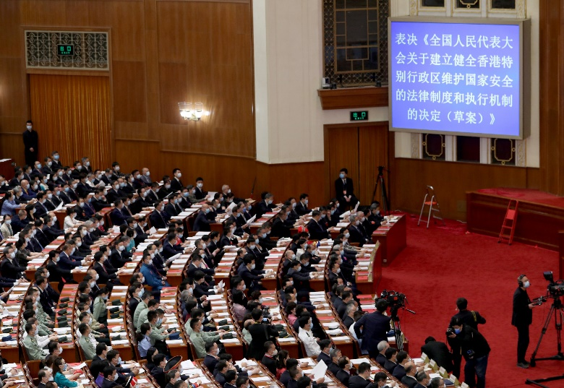
Enactment of the Law of the People’s Republic of China on Safeguarding National Security in the Hong Kong Special Administrative Region
The National People’s Congress adopted the Decision on Establishing and Improving the Legal System and Enforcement Mechanisms for the Hong Kong Special Administrative Region to Safeguard National Security
On 28 May 2020, the Third Session of the 13th National People’s Congress adopted the Decision on Establishing and Improving the Legal System and Enforcement Mechanisms for the Hong Kong Special Administrative Region to Safeguard National Security
The Standing Committee of National People’s Congress has been authorised to enact the relevant laws for establishing and improving the legal system and enforcement mechanisms in Hong Kong to safeguard national security, in order to effectively prevent, suppress, and impose punishment for any acts and activities of secession, subverting state power, organising and carrying out terrorist activities that seriously endanger national security, as well as activities of foreign and external forces to interfere in the affairs of the HKSAR.

Slide 41
Legislation Process of the Law of the People’s Republic of China on Safeguarding National Security in the Hong Kong Special Administrative Region
The National People’s Congress adopted the Decision on Establishing and Improving the Legal System and Enforcement Mechanisms for the Hong Kong Special Administrative Region to Safeguard National Security
On 30 June 2020, the Standing Committee of National People’s Congress enacted the Law of the People’s Republic of China on Safeguarding National Security in the Hong Kong Special Administrative Region, and the law took effect on the same day.
The Standing Committee of National People’s Congress added the Law of the People’s Republic of China on Safeguarding National Security in the Hong Kong Special Administrative Region in Annex III to the Basic Law.

Slide 42

Legislation Process of the Law of the People’s Republic of China on Safeguarding National Security in the Hong Kong Special Administrative Region
The Law of the People’s Republic of China on Safeguarding National Security in the Hong Kong Special Administrative Region took effect upon gazettal
The Law of the People’s Republic of China on Safeguarding National Security in the Hong Kong Special Administrative Region was gazetted by the Government of Hong Kong Special Administrative Region and took effect on 30 June 2020 in the Hong Kong Special Administrative Region.
Source: Website of the Government of Hong Kong Special Administrative Region on Safeguarding National Security in Hong Kong
https://www.isd.gov.hk/nationalsecurity/eng/pamphlets.html

Slide 43

Main Contents of the Law of the People’s Republic of China on Safeguarding National Security in the Hong Kong Special Administrative Region
The Central People’s Government has an overarching responsibility for national security affairs. It was the constitutional responsibility of the HKSAR to safeguard national security.
Click on the image to learn more about the main contents of the law
Source:
香港電片《國安法•話你知》
Principles that the HKSAR shall uphold in safeguarding national security
01
02
The duties and government bodies of the HKSAR for safeguarding national security
03
To prevent, curb and punish four types of crimes that seriously endangering national security
04
05
Jurisdiction of cases, application of laws and procedures
06
Setting up of the Office for Safeguarding National Security of the Central People’s Government in the HKSAR and its mandates
Source: https://www.gld.gov.hk/egazette/pdf/20202448e/egn2020244872.pdf

Slide 44
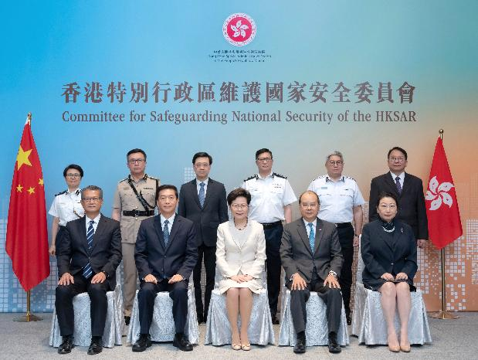
Key Content:
The Committee for Safeguarding National Security of the HKSAR
Article 12 of the Law of the People’s Republic of China on Safeguarding National Security in the Hong Kong Special Administrative Region stipulates
“The Hong Kong Special Administrative Region shall establish the Committee for Safeguarding National Security. The Committee shall be responsible for affairs relating to and assume primary responsibility for safeguarding national security in the Region. It shall be under the supervision of and accountable to the Central People’s Government.”
The Committee convened its first meeting on 6 July 2020 which was attended by all its members. The National Security Adviser appointed by the Central People's Government also sat in on the meeting.
https://baijiahao.baidu.com/s?id=1671537203952996119&wfr=spider&for=pc

Slide 45

Key Content:
The Office for Safeguarding National Security of the Central People’s Government in the Hong Kong Special Administrative Region
Article 48 of the Law of the People’s Republic of China on Safeguarding National Security in the Hong Kong Special Administrative Region stipulates
The Central People’s Government shall establish in the Hong Kong Special Administrative Region an office for safeguarding national security. The Office for Safeguarding National Security of the Central People’s Government in the Hong Kong Special Administrative Region shall perform its mandate for safeguarding national security and exercise relevant powers in accordance with the law.
The staff of the Office shall be jointly dispatched by relevant national security authorities under the Central People’s Government.
The Office for Safeguarding National Security of the Central People’s Government in the Hong Kong Special Administrative Region was inaugurated in Hong Kong on the morning of 8 July 2020.

Slide 46
Key Content:
National Security Education
Article 9 of the Law of the People’s Republic of China on Safeguarding National Security in the Hong Kong Special Administrative Region stipulates
Article 10 of the Law of the People’s Republic of China on Safeguarding National Security in the Hong Kong Special Administrative Region stipulates
“The Hong Kong Special Administrative Region shall strengthen its work on safeguarding national security and prevention of terrorist activities. The Government of the Hong Kong Special Administrative Region shall take necessary measures to strengthen public communication, guidance, supervision and regulation over matters concerning national security, including those relating to schools, universities, social organisations, the media, and the internet.”
“The Hong Kong Special Administrative Region shall promote national security education in schools and universities and through social organisations, the media, the internet and other means to raise the awareness of Hong Kong residents of national security and of the obligation to abide by the law.”

Slide 47
Key Content:
Penalties for the Four Types of Offences
The Chapter III “Offences and Penalties” in the Law of the People’s Republic of China on Safeguarding National Security in the Hong Kong Special Administrative Region clearly stipulates the offences and penalties of four types of offences, namely secession, subversion, terrorist activities and collusion with a foreign country or with external elements to endanger national security, as well as other provisions of penalties and scope of application.
Secession
Chapter III “Offences and Penalties” in the Law of the People’s Republic of China on Safeguarding National Security in the Hong Kong Special Administrative Region
Subversion
Terrorist Activities
Collusion with a foreign country or with external elements to endanger national security

Slide 48
香港維護國家安全立法的性質
《香港國安法》是對「一國兩制」制度體系的完善發展:
為香港特別行政區制定《香港國安法》， 而不是把《國家安全法》、《國家情報法》、《反間諜法》、《反恐怖主義法》等全國性法律列入基本法附件三在香港特別行政區實施, 本身就是堅持「一國兩制」原則的體現。
從國家層面建立健全香港特別行政區維護國家安全的法律制度和執行機制，貫徹保障人權自由原則、法治原則、法律面前人人平等、無罪推定和罪刑法定原則，充分保障被告人的辯護權和其他合法權益。
實施《香港國安法》有利於香港的長遠發展
來源: 王振民、黃風、畢雁英等《香港特別行政區維護國家安全法讀本》(香港: 三聯書店，2021年) 頁54-55。
48

Slide 49
Establishment of enforcement agencies shows full respect to the principle of “one country, two systems”
In the provision of working mechanisms for safeguarding national security, respect for the high degree of autonomy of Hong Kong is shown in the Law of the People’s Republic of China on Safeguarding National Security in the Hong Kong Special Administrative Region with delegation of enforcement power to the local authority to the greatest extent. The vast majority of cases will be within the jurisdiction of Hong Kong.
The Office for Safeguarding National Security of the Central People’s Government in the Hong Kong Special Administrative Region shall only exercise the jurisdiction over very few cases of offence endangering national security under certain circumstances.
Reference: 王振民、黃風、畢雁英等《香港特別行政區維護國家安全法讀本》(香港: 三聯書店，2021年) 頁150-151.
The implementation of the Law of the People’s Republic of China on Safeguarding National Security in the Hong Kong Special Administrative Region is conducive to the long-term development of Hong Kong
49

Slide 50
The Law of the People’s Republic of China on Safeguarding National Security in the Hong Kong Special Administrative Region further improves the legal system of Hong Kong for safeguarding national security
The implementation of the Law of the People’s Republic of China on Safeguarding National Security in the Hong Kong Special Administrative Region further improves the legal system for safeguarding national security. Currently, this legal system consists of three respects.
1. Relevant provisions of the Basic Law and legislation for Article 23
2. Relevant provisions on safeguarding national security in the existing laws of Hong Kong
3. Legislation for national security at the national level
Reference: 王振民、黃風、畢雁英等《香港特別行政區維護國家安全法讀本》(香港: 三聯書店，2021年) 頁18-21.

Slide 51
The Law of the People’s Republic of China on Safeguarding National Security in the Hong Kong Special Administrative Region plugs the national security loopholes
Enactment of the Law of the People’s Republic of China on Safeguarding National Security in the Hong Kong Special Administrative Region guarantees the system for safeguarding national security and plugs the loopholes of Hong Kong’s legal system and enforcement mechanisms for safeguarding national security.
National security has always been a matter that falls under the purview of the Central Authorities. The Law of the People’s Republic of China on Safeguarding National Security in the Hong Kong Special Administrative Region clearly stipulates that the Central People’s Government takes a leading, guiding, and dominant role in national security affairs.

Slide 52
Relationship between the rule of law and human rights
The rule of law is a prerequisite for safeguarding human rights. Without the rule of law, basic human rights such as democracy, equality and freedom cannot be fully respected and guaranteed. Trampling on the rule of law is bound to infringe human rights.
Safeguarding human rights is the purpose of enacting laws. The continuous progress in safeguarding human rights will also promote the continuous improvement in the rule of law.
Upholding the rule of law and safeguarding human rights are not contradictory. Instead, they are complementary to each other. The enactment and enforcement of the Law of the People’s Republic of China on Safeguarding National Security in the Hong Kong Special Administrative Region not only improves the rule of law, but also promotes the protection of human rights in Hong Kong.
Article 4 of the Law of the People’s Republic of China on Safeguarding National Security in the Hong Kong Special Administrative Region stipulates
Human rights shall be respected and protected in safeguarding national security in the Hong Kong Special Administrative Region. The rights and freedoms, including the freedoms of speech, of the press, of publication, of association, of assembly, of procession and of demonstration, which the residents of the Region enjoy under the Basic Law of the Hong Kong Special Administrative Region, the provisions of the International Covenant on Civil and Political Rights and the International Covenant on Economic, Social and Cultural Rights as applied to Hong Kong, shall be protected in accordance with the law.

Slide 53

The Law of the People’s Republic of China on Safeguarding National Security in the Hong Kong Special Administrative Region will not impair the basic rights and freedoms enjoyed by Hong Kong residents
The purpose of legislation for the Law of the People’s Republic of China on Safeguarding National Security in the Hong Kong Special Administrative Region is to effectively prevent, suppress and punish an extremely small minority of the acts and activities that endanger national security.
By combating illegal and criminal acts that endanger national security, the Law of the People’s Republic of China on Safeguarding National Security in the Hong Kong Special Administrative Region can effectively protect the core interests of the country and citizens and maintain social order of the HKSAR.
The enactment and enforcement of the Law of the People’s Republic of China on Safeguarding National Security in the Hong Kong Special Administrative Region with effect from 30 June 2020 has effectively stopped violence and curbed disorder and restored social stability, as well as timely protected the basic rights and freedoms of Hong Kong citizens.
Click on the image to learn more about related content.
\Source:香港電片《國安法•話你知》

Slide 54

The Law of the People’s Republic of China on Safeguarding National Security in the Hong Kong Special Administrative Region will not affect activities in regard to academic exchanges outside Hong Kong, religious contacts, cultural interchanges, trade and investment, etc.
The rights and freedom of Hong Kong residents, including freedom to enter or leave the HKSAR, freedom of conscience, freedom to engage in academic research, literary and artistic creation and other cultural activities, are clearly protected by the Basic Law.
The national security offence of colluding with foreign or external forces as stipulated under the Law of the People’s Republic of China on Safeguarding National Security in the Hong Kong Special Administrative Region only refers to specific acts, which have been clearly defined under the law. It will not affect the normal exchange activities between individuals, organisations or corporations and their foreign or external counterparts.
Source: 《關於涉港國家安全立法你需要了解的6個事實》，外交部網站: https://www.fmprc.gov.cn/web/zyxw/t1787597.shtml
Click on the image to learn more about related content.
Source:香港電片《國安法•話你知》

Slide 55

Basic Law Article 23 Legislation: Safeguarding National Security Ordinance
Constitutional duty of the HKSAR to safeguard national security
The Constitution of the People’s Republic of China (“the Constitution”) and the Basic Law together form the constitutional basis of the HKSAR. The Constitution clearly stipulates the duty to safeguard national security, including the obligation to safeguard national unity and the solidarity of all the country’s ethnic groups, the obligation to keep state secrets, the obligation to safeguard the security, honour and interests of the country, as well as the obligation to defend the country and resist aggression.
Article 1 and Article 12 of the Basic Law stipulate that the HKSAR is an inalienable part of the People’s Republic of China and a local administrative region of the People’s Republic of China, which shall enjoy a high degree of autonomy and come directly under the Central People’s Government(“CPG”). It goes without saying that the HKSAR has the constitutional duty to safeguard national security.
Article 23 of the Basic Law clearly stipulates that the HKSAR shall enact laws on its own to prohibit any act of treason, secession, sedition, subversion against the CPG, or theft of state secrets, to prohibit foreign political organizations or bodies from conducting political activities in the HKSAR, and to prohibit political organizations or bodies of the HKSAR from establishing ties with foreign political organizations or bodies.
Source: https://www.sb.gov.hk/eng/bl23/consultation.html

Slide 56
Basic Law Article 23 Legislation: Safeguarding National Security Ordinance
Constitutional duty of the HKSAR to safeguard national security
Although the Central Authorities have enacted the HKNSL on a national level, the HKSAR must still perform its constitutional duty to enact local legislation under Article 23 of the Basic Law. Both Article 3 of the 5.28 Decision and Article 7 of the HKNSL require the HKSAR to complete, as early as possible, legislation for safeguarding national security as stipulated in the Basic Law and refine relevant laws.
Even though the enactment and implementation of the HKNSL has enabled, the national security threats remain. Therefore, the HKSAR has the constitutional duty as well as a practical need to enact local legislation to safeguard national security.
Source: https://www.sb.gov.hk/eng/bl23/consultation.html

Slide 57
Basic Law Article 23 Legislation: Safeguarding National Security Ordinance
The Safeguarding National Security Ordinance (the Ordinance) was passed by the Legislative Council on 19 March 2024. The Ordinance was published in the gazette and came into effect on 23 March 2024.
The Ordinance fully implements the requirements set out in Article 23 of the Basic Law, the Decision of the National People's Congress on Establishing and Improving the Legal System and Enforcement Mechanisms for the HKSAR to Safeguard National Security (5.28 Decision), and the Hong Kong National Security Law for improving the legal system and enforcement mechanisms for the HKSAR to safeguard national security, ensuring the comprehensiveness and effectiveness of the protection of national security.
Sources:
https://www.sb.gov.hk/eng/bl23/consultation.html
https://www.info.gov.hk/gia/general/202403/22/P2024032200642.htm?fontSize=1

Slide 58
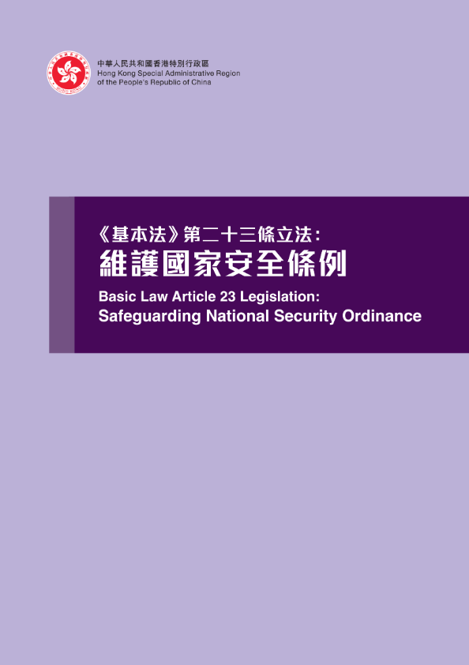
Basic Law Article 23 Legislation: Purpose of the Safeguarding National Security Ordinance
To resolutely, fully and faithfully implement the policy of “one country, two systems” under which the people of Hong Kong administer Hong Kong with a high degree of autonomy.
To establish and improve the legal system and enforcement mechanisms for the HKSAR to safeguard national security.
To prevent, suppress and punish acts and activities endangering national security in accordance with the law, to protect the lawful rights and interests of the residents of the HKSAR and other people in the HKSAR, to ensure the property and investment in the HKSAR are protected by the law, to maintain prosperity and stability of the HKSAR.
Click on the image to learn more about the Ordinance
Source: https://www.sb.gov.hk/eng/bl23/consultation.html

Slide 59
References
王振民 、黃風、畢雁英等 《 香港特別行政區維護國家安全法
讀本 》 (香港 : 三聯書店， 2021 年)
《 國家安全知識百問 》 (北京 : 人民出版社， 2020 年)
中華人民共和國教育部《大中小學國家安全教育指導綱要》(2020)
59

Slide 60
Suggested Readings
Website on Safeguarding National Security in Hong Kong (https://www.isd.gov.hk/nationalsecurity/eng/law.html)
National Security Education Day (https://www.nsed.gov.hk/index.php?l=en)
Safeguarding National Security Ordinance and other relevant documents https://www.sb.gov.hk/eng/bl23/consultation.html
Basic Law Online Course for Secondary Students’ Self-directed Learning (https://www.edb.gov.hk/en/curriculum-development/kla/pshe/basic-law-education/student-onlinecourse/index.html)
Website of the Basic Law of the HKSAR of the PRC (https://www.basiclaw.gov.hk/en/index/index.html)
Learning and Teaching Resources on the Constitution and the Basic Law (https://www.edb.gov.hk/pshe/constitution-basiclaw) [Chinese version is currently available]
Teaching Resources on the Constitution of the People’s Republic of China [Junior Secondary Curriculum of the PSHE KLA] (https://www.edb.gov.hk/tc/curriculum-development/kla/pshe/basic-law-education/constitution_chi/index.html) [Chinese version is currently available]
The Constitution and the Basic Law Education Wall-chart Resources (https://www.edb.gov.hk/tc/curriculum-development/kla/pshe/basic-law-education/cble_wallcharts/index.html) [Chinese version is currently available]
Full text of the Basic Law of the HKSAR of the PRC and related documents (https://www.basiclaw.gov.hk/en/basiclaw/index.html)
60

Slide 61
The End
61

Slide 62
User guide
The primary users of this resource are teachers. It aims to provide teachers with content knowledge relevant to the topic to enable teachers to have a deeper understanding of teaching content when preparing for their lessons.
All data, videos, photos, pictures, questions and suggested answers can be used for multiple purposes, such as teachers’ teaching materials, references for curriculum planning and learning and teaching, and student assignments, etc. To align with Citizenship and Social Development Curriculum and Assessment Guide (Secondary 4-6) (2021) (C&A Guide), this resource should be adapted to cater for students’ learning diversity and the needs of classroom teaching, etc.
Teachers may provide appropriate supplementary notes/ explanations to enrich this resource in order to enhance students' understanding of the topic and the information provided.
In In accordance with the curriculum rationale and aims, teachers may select other learning and teaching resources which are correct, reliable, objective and impartial to help students build up a solid knowledge base, develop positive values and attitudes as well as enhance critical thinking and problem solving skills, and various generic skills.
If some information cannot be provided in this resource due to copyright issue, teachers may visit relevant websites provided.
Some information may have been updated when being used by teachers, teachers may visit the corresponding websites to obtain the up-to-date information.
Please also refer to the C&A Guide to understand the requirements and arrangements of the learning and teaching of the Curriculum.
62

Slide 63
Notice and Disclaimer
Some sources were not translated into English as the official English version is not available.
In case of any discrepancy between the Chinese and English versions, the Chinese version shall prevail.
63

