Slide 1
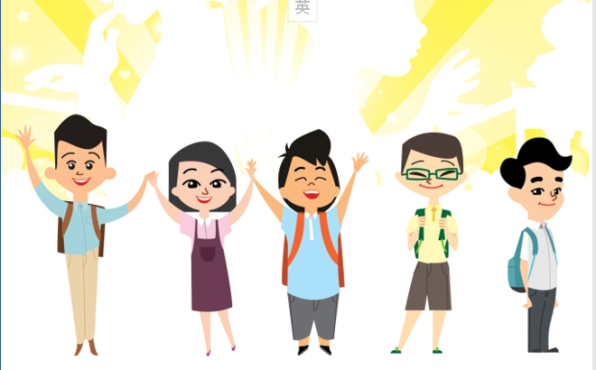
Coronavirus Disease 2019 (COVID-19)﹕ “How could we identify authentic/false information ?”
Liberal Studies X Information Literacy ﹕
For Teachers

Slide 2
Information overloaded about the outbreak of epidemic
〈網上充斥真假資訊 梁卓偉指港爆「資訊疫症」〉 (頭條日報，2020-02-07)
〈過度憂慮影響心理健康 穩住情緒擺脫疫情恐慌〉 (明報，2020-02-03)
“Government condemns rumour monger” (Press Release, the Government of the HKSAR，2020-02-05)

Slide 3
Teachers’ thoughts
In view of the overwhelming amount of information circulated in the public, how can I guide students to find out the truth?
What important values and attitudes should my students uphold when facing the serious threat of the epidemic?
How could I provide more reliable and accurate information and sources for students?
What could I do to protect students from the disturbance of rumours, enhance their critical thinking skills and enable them to develop multiple perspectives?

Slide 4
Brief introduction﹕
Teaching objectives | Guide students to understand the importance of information literacy, think critically in face of the outbreak of epidemic, and not to be disturbed by rumours. Remind students to distinguish the sources and reliability of different types of messages cautiously. Encourage students to find out reliable facts by paying attention to the information delivered by the Government and people with high credibility.
Values / Attitudes | respect for evidence, respect for others, sense of responsibility, care, integrity, solidarity, cooperation, information literacy

Slide 5
Information Literacy

Slide 6
Information Literacy for Hong Kong Students(EDB)
The Information Literacy for Hong Kong Students is developed to help schools understand how to develop students’ knowledge, skills and attitude to use information and information technology at different key stages.
identify the need for information;
locate, evaluate, extract, organise and present information;
create new ideas;
cope with the dynamic in our information world; and
refrain from unethical use of information such as cyber-bullying and infringing intellectual property rights.
Source: Information Literacy for Hong Kong Students(EDB) https://www.edb.gov.hk/en/edu-system/primary-secondary/applicable-to-primary-secondary/it-in-edu/information-literacy/il-document.html

Slide 7
What areas does the Information Literacy for HK Students encompass?
1. Use, provide and communicate information
ethically and responsibly
2. Identify and define a need for information
3. Locate and access relevant information
6. Be able to apply IT skills in order to process
information and produce user-generated content
4. Evaluate information and information providers,
in terms of authority, credibility and current purpose
7. Recognise the roles and functions of information
providers (e.g. libraries, museums, internet) in the society
5. Extract and organise information and create new ideas
8. Recognise the conditions under which reliable
information could be obtained
Source: Information Literacy for Hong Kong Students(EDB) https://www.edb.gov.hk/en/edu-system/primary-secondary/applicable-to-primary-secondary/it-in-edu/information-literacy/il-document.html

Slide 8
Suggested Learning & Teaching Activity

Slide 9
Suggested Learning & Teaching Activity﹕
“Should I forward this message?”
Ask students to select 1 message about COVID-19 recently received from the online chat groups/ online platforms
Make reference to the suggested checklist, reflect upon the content and source of message, and verify the authenticity of the content so as not to blindly forward inaccurate information.
Refer to the suggested teachers’ feedback to guide students to think critically about the message

Slide 10
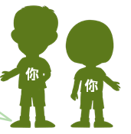
Please read the following “sample message” carefully
< 1 Happy Family Group
Forwarded on 3.2.2020
(Breaking news!!! Please spread!!!)There is a global outbreak of Coronavirus Disease 2019 (COVID-19)! A large-scale infection has occurred in Hong Kong. The HKSAR Government is about to impose a ban on the import from the Mainland. This will seriously affect the supply of goods. Everyone should go to the supermarket to buy daily necessities and food as soon as possible! In addition, don’t forget to buy and hoard a large quantity of masks and alcohol disinfectant at home for emergency use!!!

Slide 11
Suggested Questions for Reflection
Who created the message?
Who forwarded the message to me?
What should I do after receiving the message?
What are the contents of the message, and how can I verify them?
What will happen if I forward unverified messages?

Slide 12
Suggested feedback
Who created the message?
During a severe epidemic, it is difficult to find the author of the message, but if it is not from credible agencies or Government official information, we should always stay alert.
Who forwarded the message to me?
The person who forwarded the message may be your family, friends, or even seniors. They may forward the message out of love and care, but this does not mean that the message forwarded must be correct.
Instead, we must verify the content of the message and inform the sender to correct the message in a timely manner. To be a responsible person, we should not forward any doubtful and incorrect message.

Slide 13
What should I do after receiving the message?
Guide students on how to respond to any forwarded message received. Students should first “stop and think”, instead of rushing to forward the messages received. They should find out the key points of the message, analyse and verify it detailedly, point out any unreasonable and illogical contents, respect for evidence and think critically.
What are the contents of the message, and how can I verify them?
Prompt students to analyse the contents of the message carefully and try to identify any parts unreasonable. For example, there are two main points mentioned in the “sample message”:
First: Hong Kong has a large-scale infection
Second: The HKSAR Government is about to impose a ban on the import from the Mainland.
Since this message involves officially published information, students should check the relevant information from the Government website. (see next page)

Slide 14
What’re the contents of the message, and how can I verify them?
The message was received on February 3, 2020. According to the Centre for Health Protection of the Department of Health, no new confirmed cases of the Coronavirus Disease 2019 infection were recorded as of 8 pm on February 3, and the number of confirmed cases in Hong Kong remain to this day was 15 (Source: ﹕ https://www.info.gov.hk/gia/general/202002/03/P2020020300736.htm )。Therefore, the “large-scale infection" mentioned in the message is incorrect.
The official website of the HKSAR Government mentioned about the measures for further reducing cross-border passenger flow, but did not mention about cross-border arrangement for goods. (Source: ﹕https://www.info.gov.hk/gia/general/202002/03/P2020020300759.htm )。
Teachers should guide students to think critically and verify the data source when rumours occur.

Slide 15
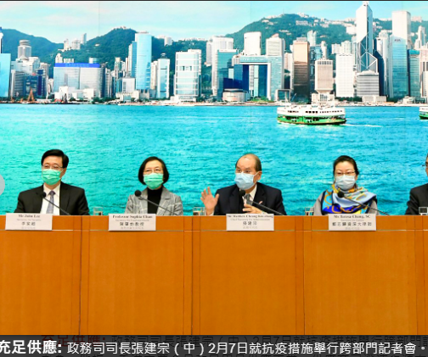
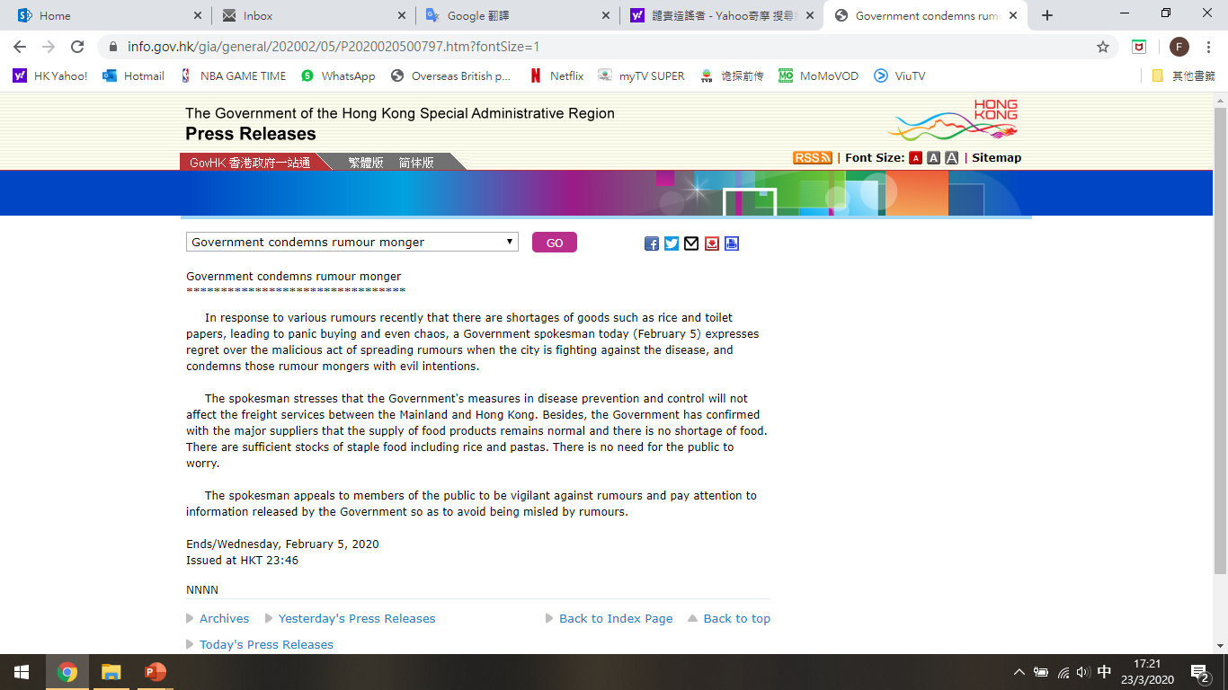
Make reference to Government official websites ﹕ The HKSAR Government has clarified that the epidemic prevention measures will not affect freight transportation between Hong Kong and the Mainland and the food supplies are adequate.
Source of pictures and information: Press Release of the Government of the Hong Kong Special Administrative Region https://www.info.gov.hk/gia/general/202002/05/P2020020500797.htm

Slide 16
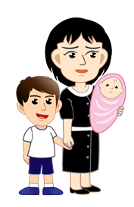
What will happen if I forward unverified messages?
If the unverified message is forwarded, the negative consequences may not appear immediately, but in an age of conformity, some people will eventually hoard the goods, resulting in insufficient supply, and those who are really in need may not be able to obtain the resources in time.

Slide 17
Reference
Census and Statistics Department of The Government of the Hong Kong Special Administrative Region https://www.censtatd.gov.hk/home/index.jsp
Centre for Health Protection, Department of Health of The Government of the Hong Kong Special Administrative Region https://www.chp.gov.hk/en/index.html
National Bureau of Statistics http://www.stats.gov.cn/
GovHK http://www.gov.hk/en/residents/
Press Releases of The Government of the Hong Kong Special Administrative Region https://www.info.gov.hk/gia/ISD_public_Calendar_en.html?fontSize=1

Slide 18
Summary: Together! We fight the virus!
During a severe epidemic, teachers can:
Encourage students to act positively and apply and practise information literacy.
Guide students to select information carefully and do not forward unverified messages.
Share proven and reliable information to get students together to fight the virus
Image source: Centre for Health Protection, Department of Health
https://www.chp.gov.hk/tc/healthtopics/content/24/102466.html

